Slide 1
That is his ruler.
Unit 2
Lesson Two - Grammar

Slide 2
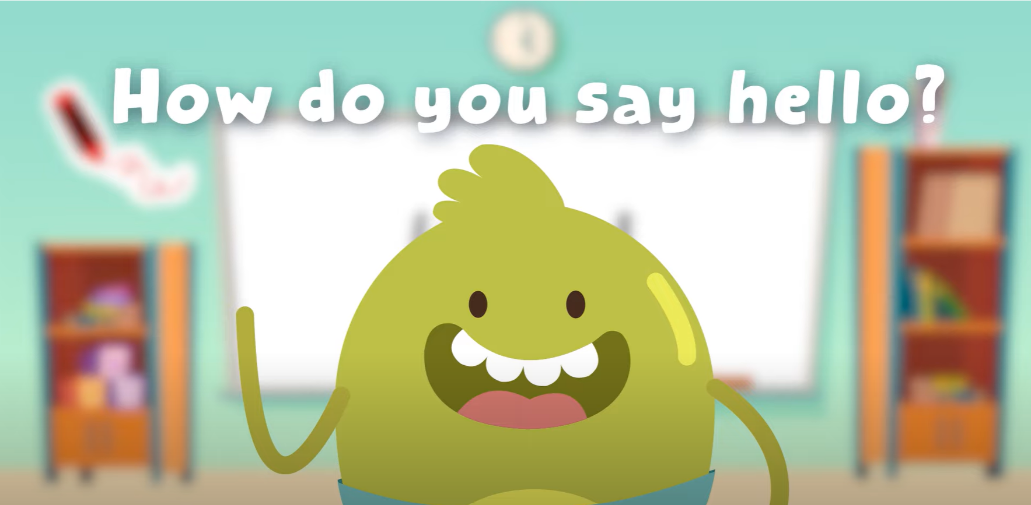
Hello song

Slide 3
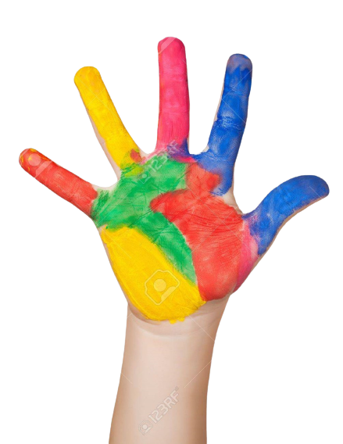
Give Me Five

Slide 4
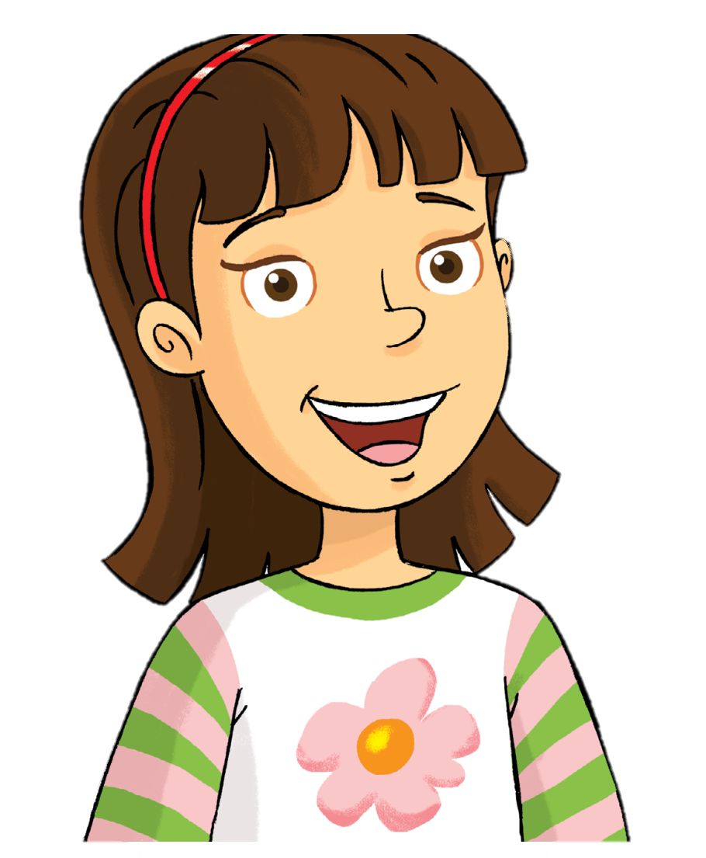
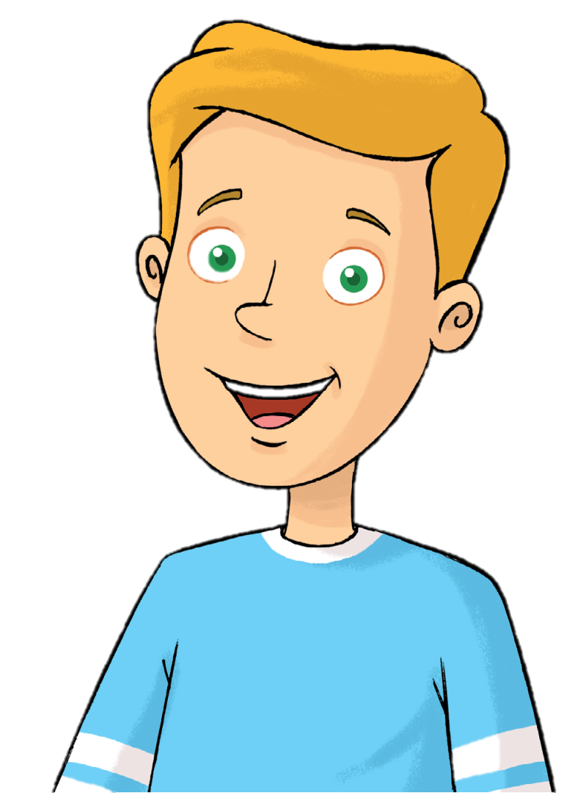
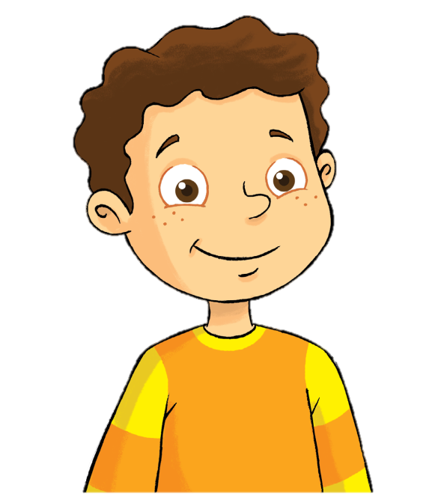
Remember
Rosy
Tim
Billy

Slide 5
Watch and Say

Slide 6
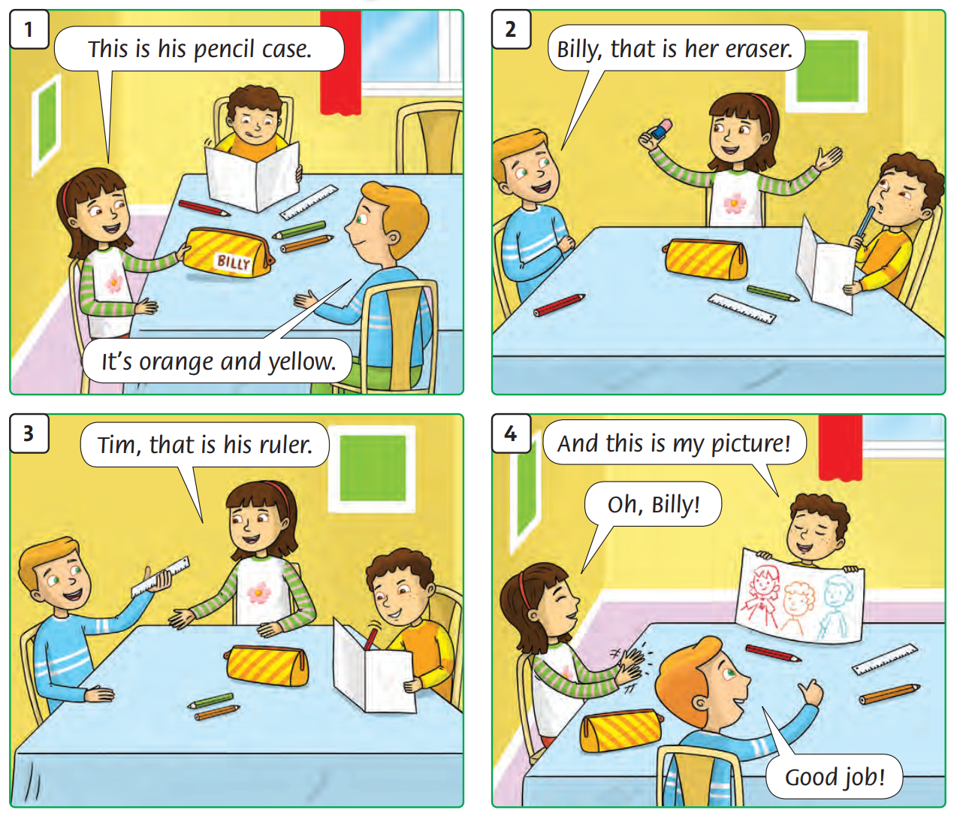
Listen and repeat

Slide 7
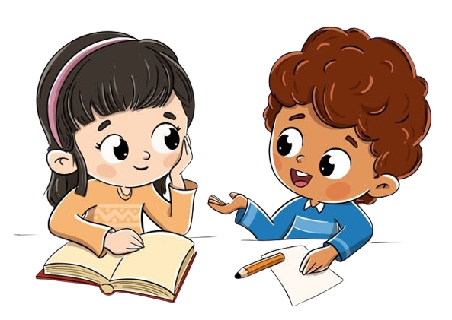
Work in groups

Slide 8
Listen and repeat

Slide 9
Work in pairs

Slide 10
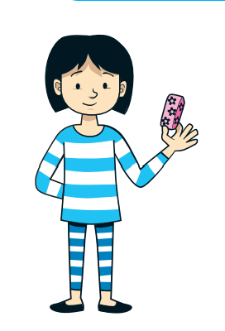
Look and Say
That is her eraser.

Slide 11
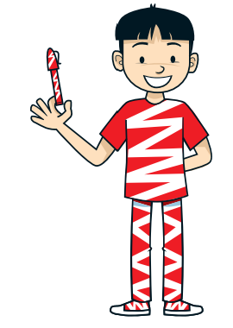
Look and Say
That is his pen.

Slide 12
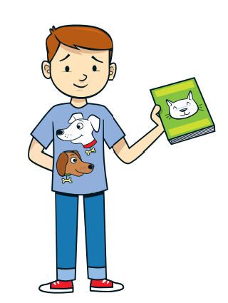
Look and Say
That is his book.

Slide 13
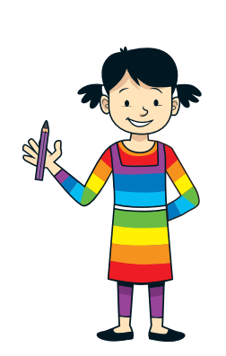
Look and Say
That is her pencil.

Slide 14
Work in pairs

Slide 15
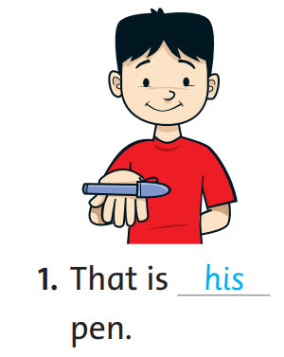
Let’s write
his - her
his

Slide 16
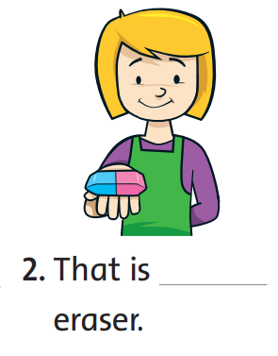
Let’s write
his - her
her

Slide 17
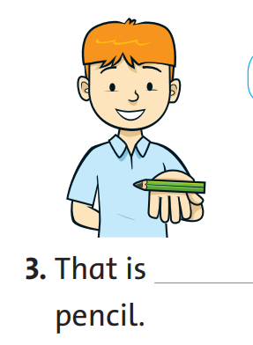
Let’s write
his - her
his

Slide 18
Work in pairs

Slide 19
Good job!

Slide 20
Game:

Slide 21
Good job!

Slide 22
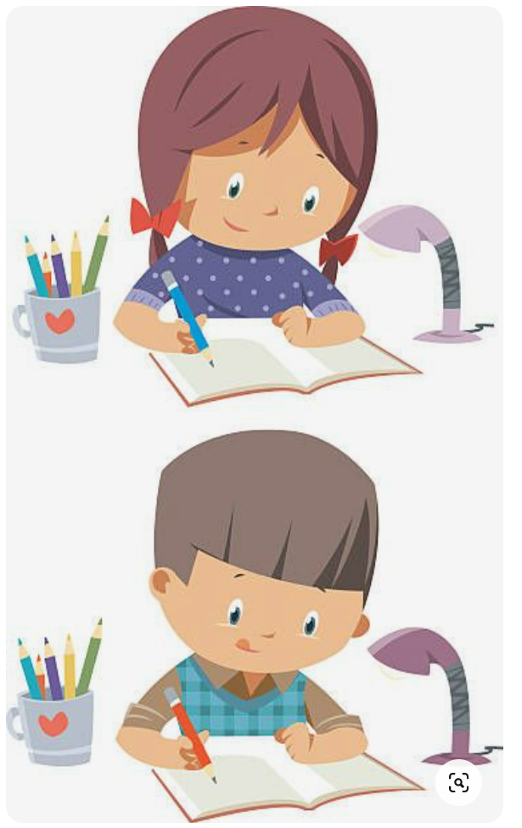
Homework

Slide 23
Goodbye! See you later!
Notes:
Click to the picture of a smiley face to play the Goodbye song.

