Slide 1
Unit Starter
Lesson 6
Classroom Language

Slide 2
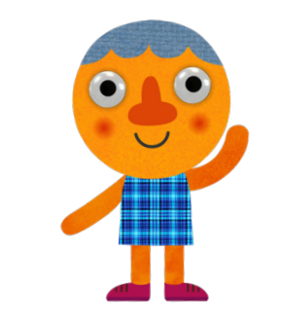
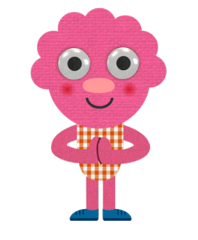
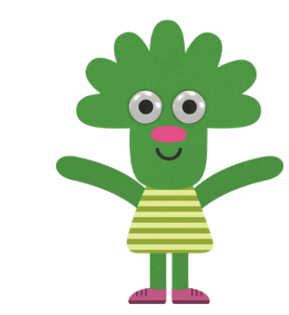
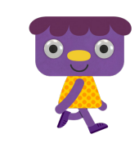
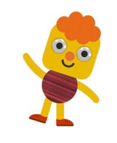
Let’s watch and sing together

Slide 3
Give me Five
Notes:
Class Rules

Slide 4
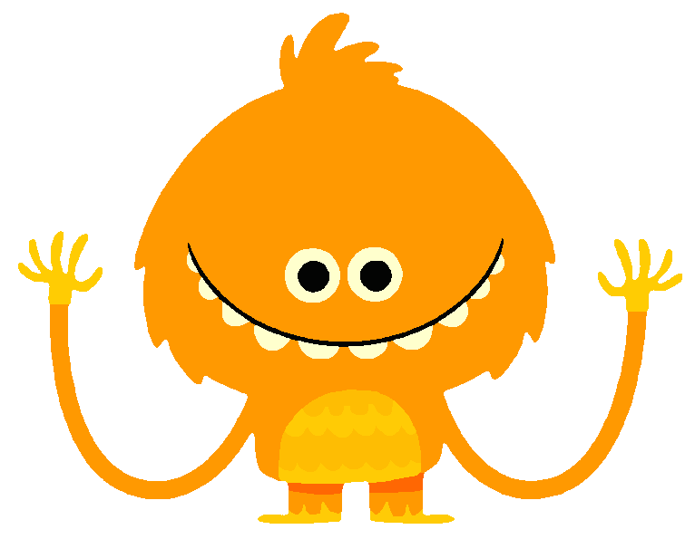
Listen and Point.
This can be the part of the presentation where you introduce yourself, write your email...
Notes:
- Click Boy the hear the song.

Slide 5
Listen, Point and Repeat.
This can be the part of the presentation where you introduce yourself, write your email...
Notes:
- Click Boy the hear the song.

Slide 6
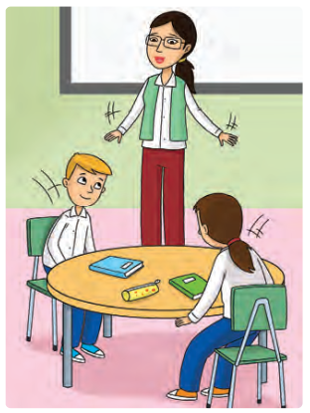
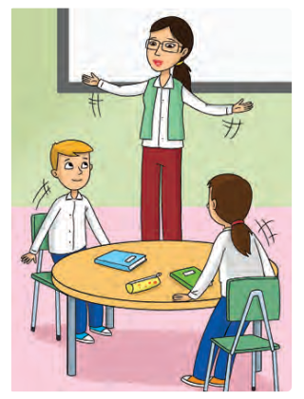
Look and Say.
1
2
3
4
Sit down, please!
Stand up, please!

Slide 7
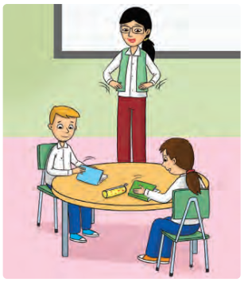
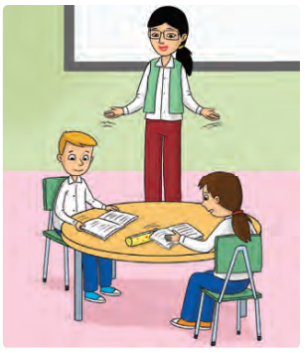
Look and Say.
1
2
3
4
Open your book, please!
Close your book, please!

Slide 8
Look and Say.
1
2
3
4
Don’t talk, please!

Slide 9
Work in Pairs!!!

Slide 10
Listen and Do.
1
2
3
4

Slide 11
Listen and Do.
1
2
3
4
Notes:
Click to play the recording again for students to do the actions without stopping.

Slide 12
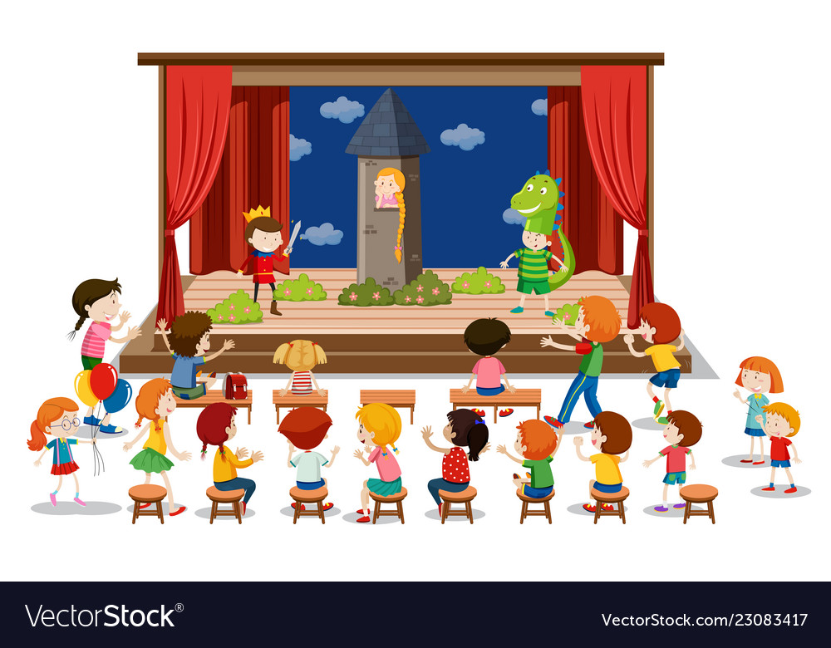
Welcome on stage!!!

Slide 13
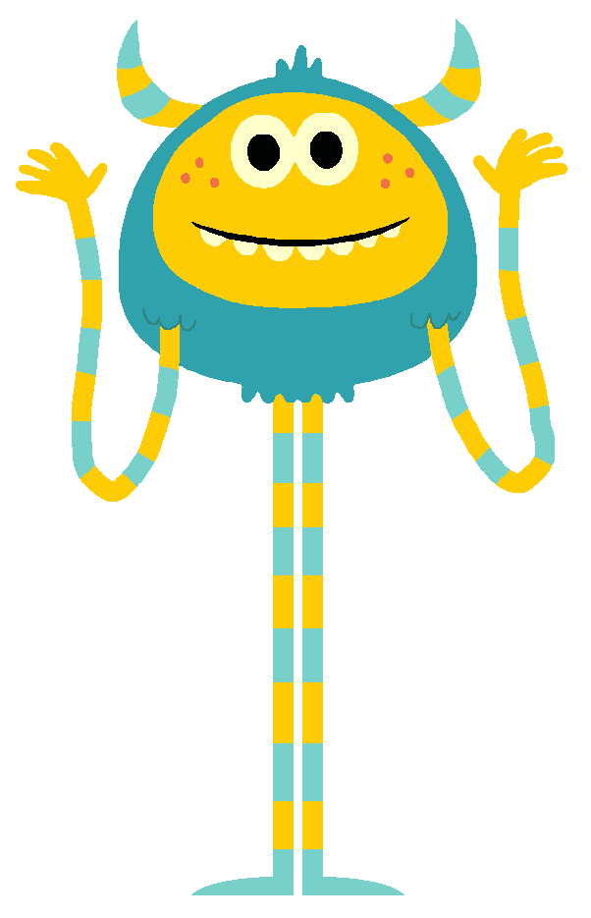
Rock, Scissors, Paper?
Notes:
- The student who says the number first is the winner.

Slide 14
Goodbye!!!

