Slide 1
Unit Starter
Lesson 4
The Alphabet

Slide 2
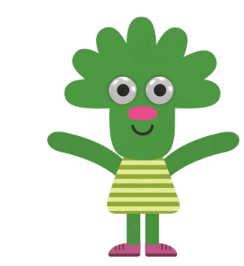
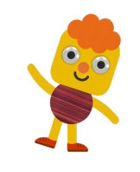
Let’s watch and sing together

Slide 3
Give me Five
Notes:
Class Rules

Slide 4
Let’s play a game!!!

Slide 5
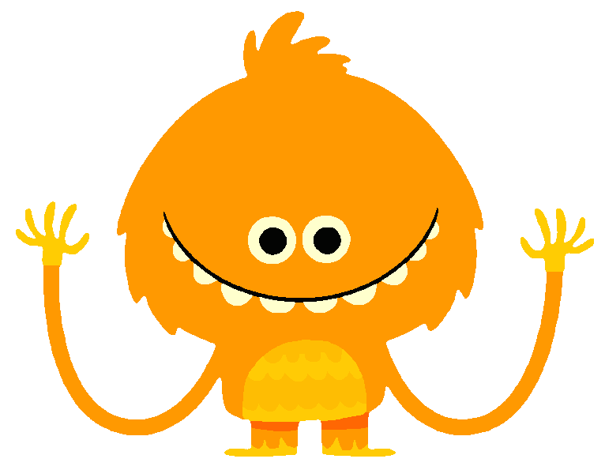
Missing Numbers!!!
2
4
Round 1

Slide 6
Missing Numbers!!!
2
4
Round 2

Slide 7
Missing Numbers!!!
2
4
Round 3

Slide 8
Missing Numbers!!!
2
4
Round 4

Slide 9
The Alphabet

Slide 10
Notes:
Click chuot theo audio

Slide 11
Notes:
Click chuot theo audio

Slide 12
Listen and Sing!!!
Page 7

Slide 13
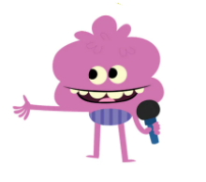
1
2
3
4
Notes:
- click audio theo song

Slide 14
Let’s sing in groups!!!

Slide 15
1
2
3
4
Notes:
- click audio theo song

Slide 16
Notes:
- Click Letter to show the hidden picture.

Slide 17
Hidden Letter!!!
1
2
4

Slide 18
Hidden Letter!!!
1
2
4

Slide 19
Hidden Letter!!!
1
2
4

Slide 20
Hidden Letter!!!
1
2
4

Slide 21
Hidden Letter!!!
1
2
4

Slide 22
Goodbye!!!
Notes:
- Click the picture to play the Goodbye song on YouTube.

