Slide 1
WELCOME TO OUR CLASS
3/2

Slide 2
Sing and do

Slide 3
Hello song

Slide 4
Lucky number
1
2
3
4
5
6

Slide 5
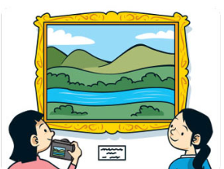
Say the word

Slide 6
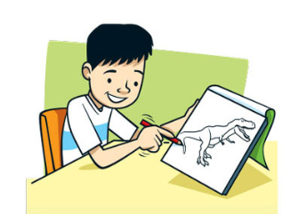
Ask and answer “May I .......?”

Slide 7
+ 1 point

Slide 8
Reorder the words
can/ He/soccer./ play
---> He can play soccer.

Slide 9
Fill in the word
It can _____.
fly

Slide 10
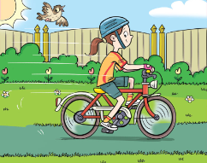
She can ________.
ride a bike

Slide 11
Good job!

Slide 12
Tuesday, April 2nd ,2024
Unit 11
There is a doll on the rug.
Lesson 1: Words

Slide 13
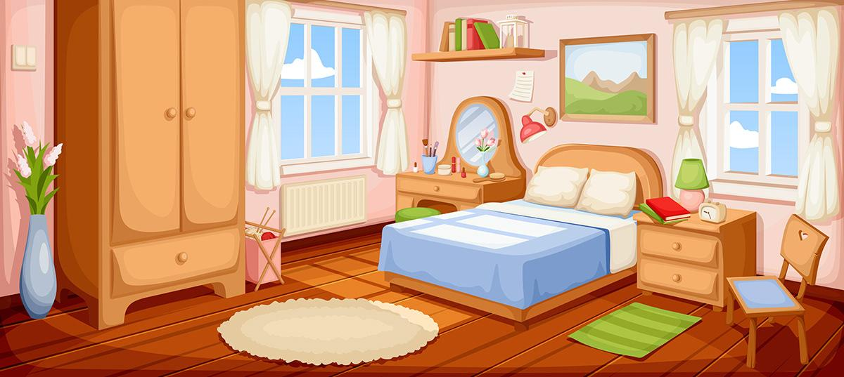

Slide 14
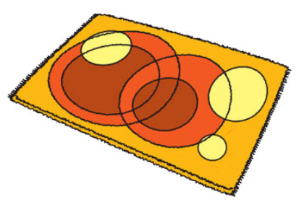
Look and Say
rug
Notes:
Use the Prepositions of place flashcards and the Directions flashcards to elicit the vocabulary. Hold up the flashcards one at a time and elicit the words. Model any words that the children don’t know.

Slide 15
Look and Say
cabinet
Notes:
Use the Prepositions of place flashcards and the Directions flashcards to elicit the vocabulary. Hold up the flashcards one at a time and elicit the words. Model any words that the children don’t know.

Slide 16
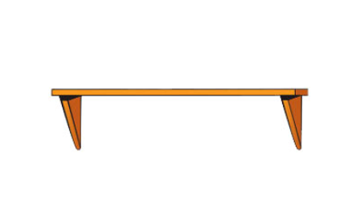
Look and Say
shelf
Notes:
Use the Prepositions of place flashcards and the Directions flashcards to elicit the vocabulary. Hold up the flashcards one at a time and elicit the words. Model any words that the children don’t know.

Slide 17
Look and Say
pillow
Notes:
Use the Prepositions of place flashcards and the Directions flashcards to elicit the vocabulary. Hold up the flashcards one at a time and elicit the words. Model any words that the children don’t know.

Slide 18
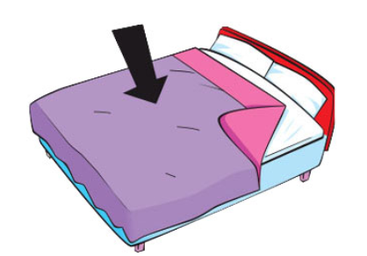
Look and Say
blanket
Notes:
Use the Prepositions of place flashcards and the Directions flashcards to elicit the vocabulary. Hold up the flashcards one at a time and elicit the words. Model any words that the children don’t know.

Slide 19
Listen and Point. Repeat

Slide 20
Listen and Chant

Slide 21
Play a game
“ What’s missing?”

Slide 29
Good job!

Slide 30
PRACTICE
Listening skill

Slide 31
Listen and circle
1.Where's the .......? It's on the bed
A. blanket B. pillow C. book
2. Where's the book? It's on the .......
A. shelf B. cabinet C. bed
3. Where's the ......? It's on the bed.
A. pillow B. blanket C. rug
4. Where's the pen? It's on the ......
A. cabinet B. pillow C. shelf
5. Where's the T-shirt? It's in the ......
A. cabinet B. shelf C. bed

Slide 32
Listen and circle
1.Where's the .......? It's on the bed
A. blanket B. pillow C. book
2. Where's the book? It's on the .......
A. shelf B. cabinet C. bed
3. Where's the ......? It's on the bed.
A. pillow B. blanket C. rug
4. Where's the pen? It's on the ......
A. cabinet B. pillow C. shelf
5. Where's the T-shirt? It's in the ......
A. cabinet B. shelf C. bed

Slide 33
Good job!

Slide 34
QUIZ TIME
Let's Put Your Knowledge to The Test!

Slide 35
QUESTION
What’s this?
It’s a .
table
shelf
cabinet
blanket

Slide 36
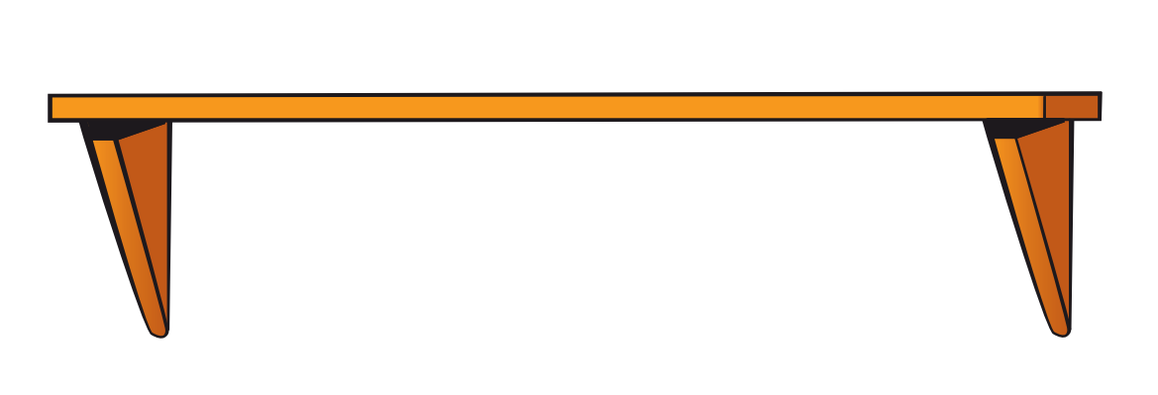
QUESTION
What’s this?
It’s a .
blanket
shelf
cabinet
table

Slide 37
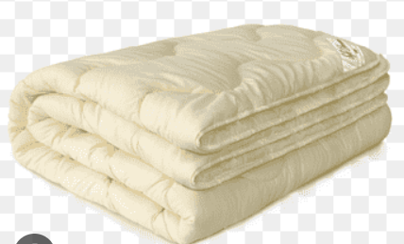
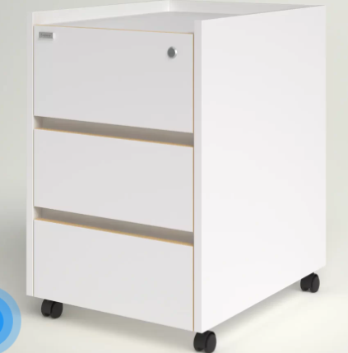
Listen to the sound and choose the picture.
A B C D

Slide 38
Look at the pictures and write the missing letters
b l_ _ k_t
a n e

Slide 39
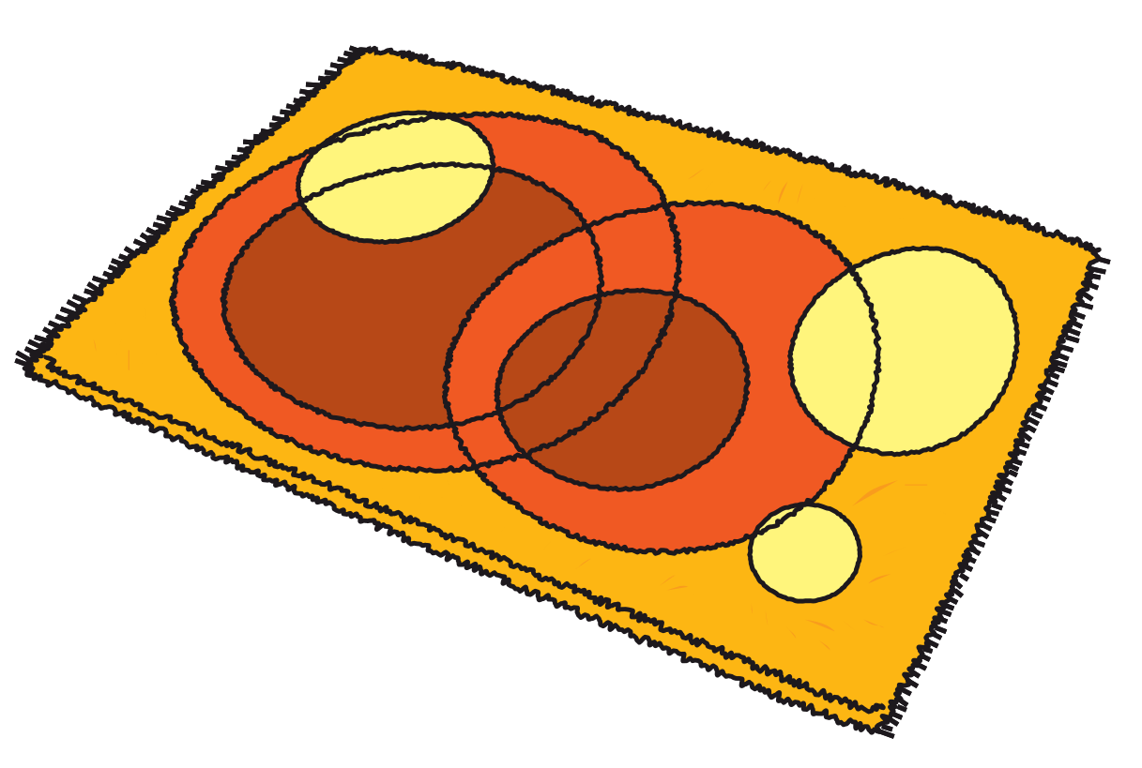
Look at the picture and write the word.
rug

Slide 40
Good job!

Slide 41
GOOD BYE!

