Slide 1
WELCOME TO OUR CLASS
4/1

Slide 2
Sing and do

Slide 3
HELLO SONG
Notes:
https://www.youtube.com/watch?v=pqDEwPi7vxg

Slide 4
Play a game
“Pass the balls”

Slide 6
Ask and answer ?
Does she like _____________?
reading comics
Yes, she does.

Slide 8
Ask and answer ?
Do they _____________?
playing chess
Yes, they do.

Slide 10
Say about YOU (I like/ I don’t like....)

Slide 12
Ask your friend (Do you like .....?)

Slide 13
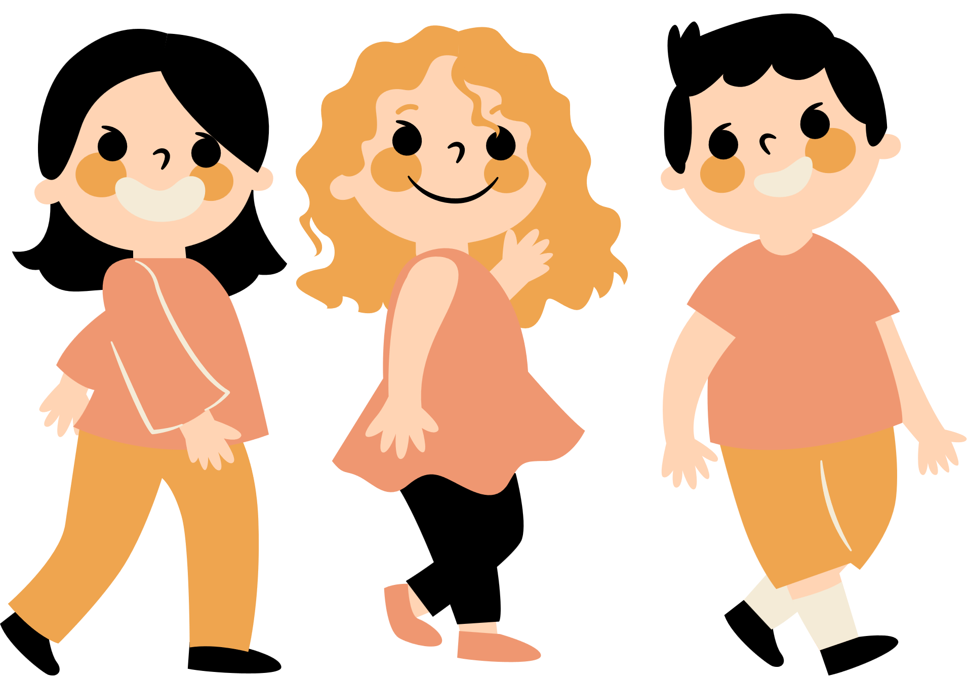
Good job!

Slide 14
Watch a video

Slide 15
Tuesday, April 2nd ,2024
Unit 11
How do we get to
the hospital?
Lesson 1 - Words

Slide 16
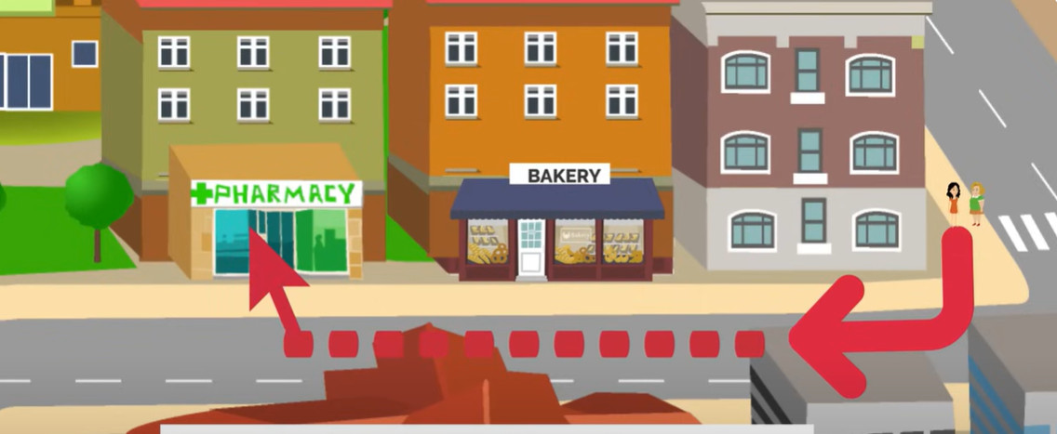
bookshop

Slide 17
Look and Say
next to
Notes:
Use the Prepositions of place flashcards and the Directions flashcards to elicit the vocabulary. Hold up the flashcards one at a time and elicit the words. Model any words that the children don’t know.

Slide 18
Look and Say
opposite
Notes:
Use the Prepositions of place flashcards and the Directions flashcards to elicit the vocabulary. Hold up the flashcards one at a time and elicit the words. Model any words that the children don’t know.

Slide 19
Look and Say
between
Notes:
Use the Prepositions of place flashcards and the Directions flashcards to elicit the vocabulary. Hold up the flashcards one at a time and elicit the words. Model any words that the children don’t know.

Slide 20
Look and Say
turn left
Notes:
Use the Prepositions of place flashcards and the Directions flashcards to elicit the vocabulary. Hold up the flashcards one at a time and elicit the words. Model any words that the children don’t know.

Slide 21
Look and Say
turn right
Notes:
Use the Prepositions of place flashcards and the Directions flashcards to elicit the vocabulary. Hold up the flashcards one at a time and elicit the words. Model any words that the children don’t know.

Slide 22
Look and Say
go straight
Notes:
Use the Prepositions of place flashcards and the Directions flashcards to elicit the vocabulary. Hold up the flashcards one at a time and elicit the words. Model any words that the children don’t know.

Slide 23
Listen and Point.
82
Notes:
Say all the words for children to repeat.

Slide 24
Listen and Repeat.
82
next to
opposite
between
turn left
turn right
go straight
Notes:
Play the second part of the recording for children to repeat the words in chorus.
Ask individual children to say the words for the class.

Slide 25
Listen and Chant.
82
next to
opposite
between
turn left
turn right
go straight
Notes:
*Listen and chant. Track 131
Play the recording and teach the chant.
Play the recording a second time for children to repeat the phrases in the chant.
Children say the chant as a class, without the recording.

Slide 26
Play a game
“ Who is faster?”

Slide 27
Notes:
Say all the words for children to repeat.

Slide 28
“ What’s missing?”
Notes:
Say all the words for children to repeat.

Slide 29
“ What’s missing?”
Notes:
Say all the words for children to repeat.

Slide 30
“ What’s missing?”
Notes:
Say all the words for children to repeat.

Slide 31
“ What’s missing?”
Notes:
Say all the words for children to repeat.

Slide 32
“ What’s missing?”
Notes:
Say all the words for children to repeat.

Slide 33
“ What’s missing?”
Notes:
Say all the words for children to repeat.

Slide 34
Good job!

Slide 35
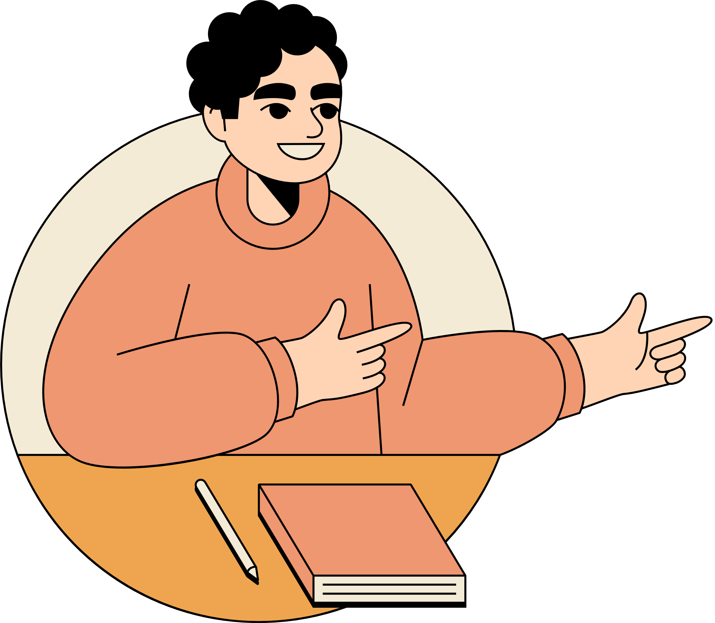
PRACTICE
Listening skill

Slide 36
Listen and circle
1.How do we get to the hospital?
I think it’s near a ………..
A.bookstore B. library C. school
2.No, it’s ……. the library. It isn’t near a bookstore.
A.opposite B. next to C. between
3.….….. It’s opposite the school. It’s between the traffic lights and the library.
A.Turn left B. Turn right C. Go straight
4.It’s …….. the bookstore and the library.
A.near B. turn left C. between

Slide 37
Listen and circle
1.How do we get to the hospital?
I think it’s near a ………..
A.bookstore B. library C. school
2.No, it’s ……. the library. It isn’t near a bookstore.
A.opposite B. next to C. between
3.….….. It’s opposite the school. It’s between the traffic lights and the library.
A.Turn left B. Turn right C. Go straight
4.It’s …….. the bookstore and the library.
A.near B. turn left C. between

Slide 38
Good job!

Slide 39
Consolidation

Slide 40
Listen to the sound and choose the words.
A. turn right
B. turn left
C. next to
D. between

Slide 41
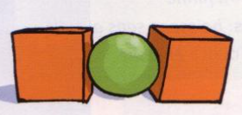
Listen to the sound and choose the picture.
A B C D

Slide 42
Look at the picture and choose the word.
A. turn left B. turn right C. next to D. opposite

Slide 43
Look at the picture and choose the word.
A. turn left B. turn right C. next to D. opposite

Slide 44
Look at the pictures and write the missing letters
bet _ _ _n
w e e

Slide 45
Look at the picture and write the word.
next to

Slide 46
Good job!

Slide 47
AT HOME
- Learn by heart the words
- Write the directions to your school.
- Next time, share with your
friends.

Slide 48
Thank You!

