Slide 1
WELCOME TO OUR CLASS
4/1

Slide 2
Wednesday, January 24th , 2024
Unit 8 Let’s buy presents!

Slide 3
Warm up
Sing a song “ Hello”

Slide 5
Play a game
“ Matching game”

Slide 7
Week 21
Wednesday, January 24th , 2024
Unit 8 Let’s buy presents!
Lesson 1

Slide 8
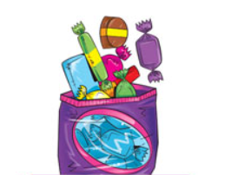
candy

Slide 9
balloon

Slide 10
present

Slide 11
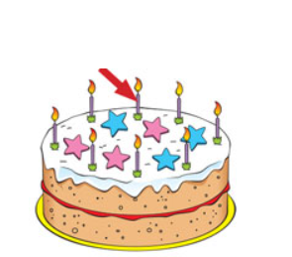
candle

Slide 22
Consolidation

Slide 23
1. Look at the pictures and write the missing letters
p_ _sent
r e

Slide 24
2. Look at the pictures and write the words
candy

Slide 25
3. Listen to the sound and choose the words.
A. candy
B. balloon
C. cake
D. candle

Slide 26
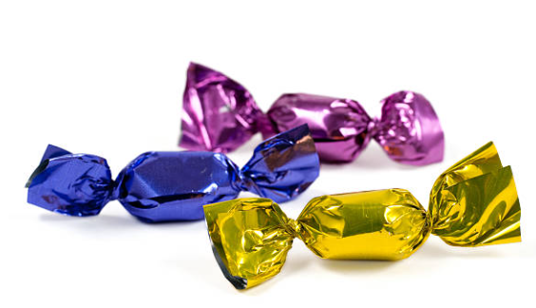
4. Listen to the sound and choose the picture.
A B C D

Slide 27
Goodbye
Thank you!

