Slide 1
That is his ruler.
Unit 2
Lesson One - Words

Slide 2
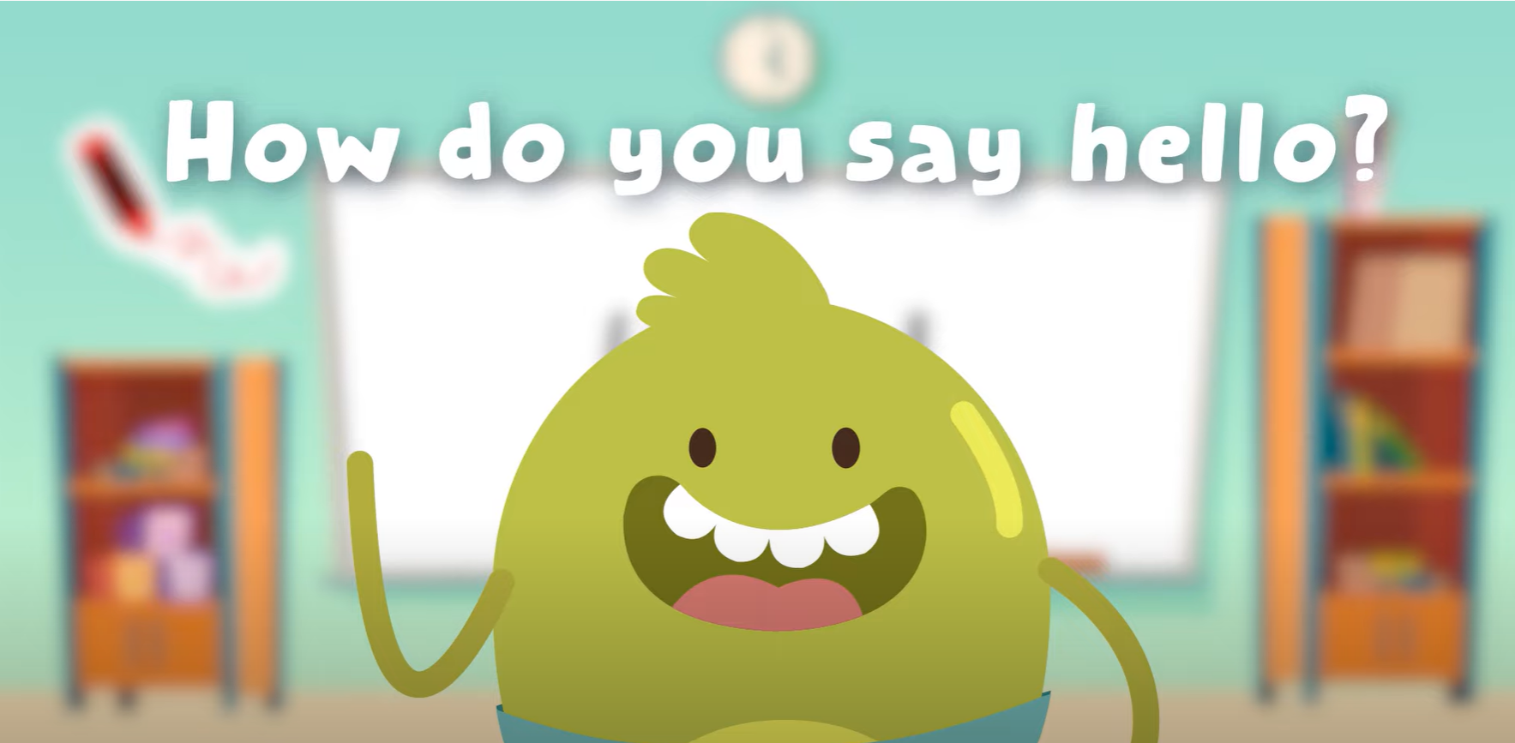
Hello song

Slide 3
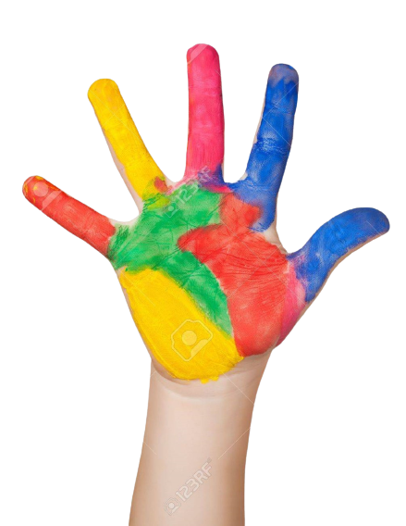
Give Me Five

Slide 4
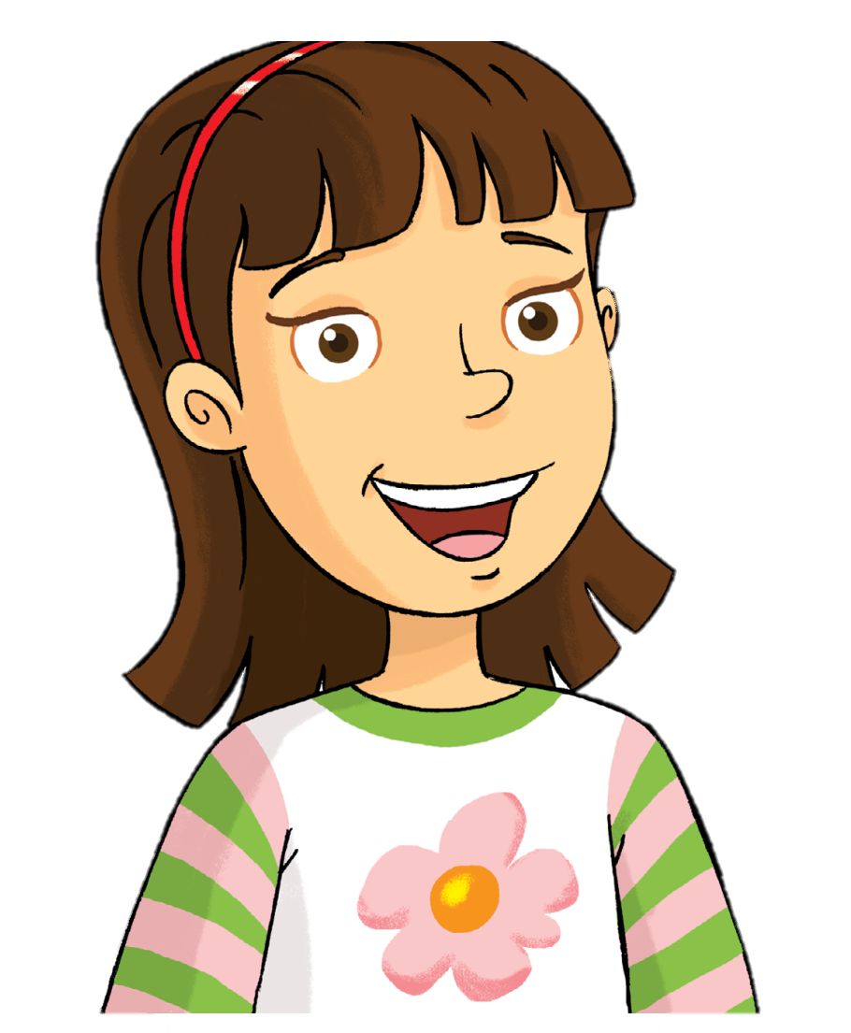
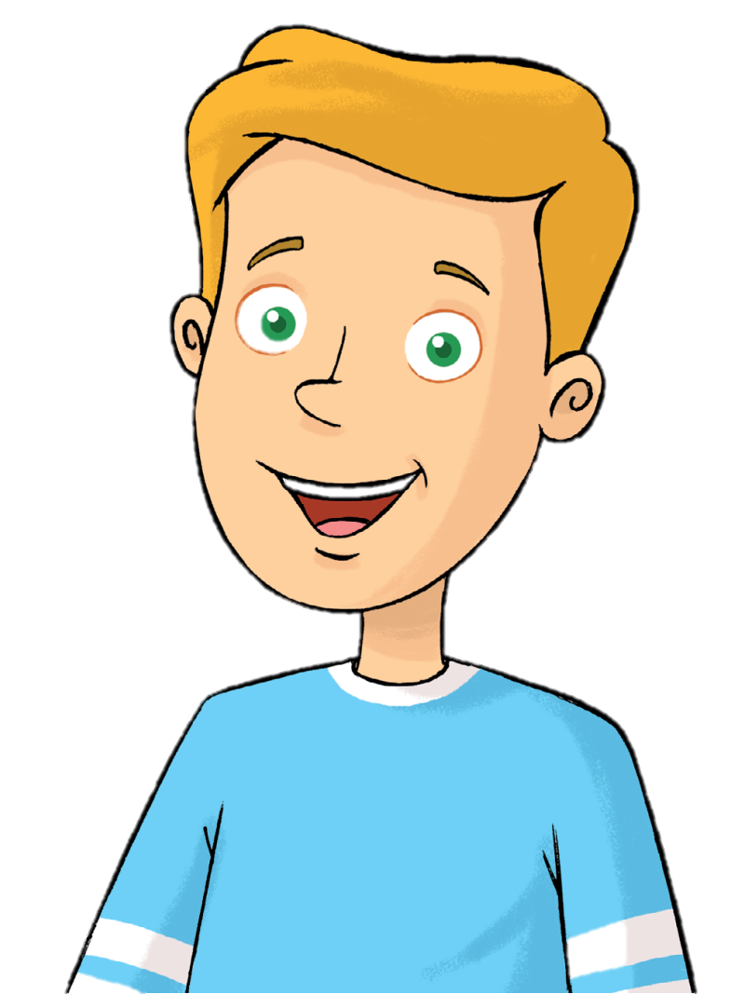
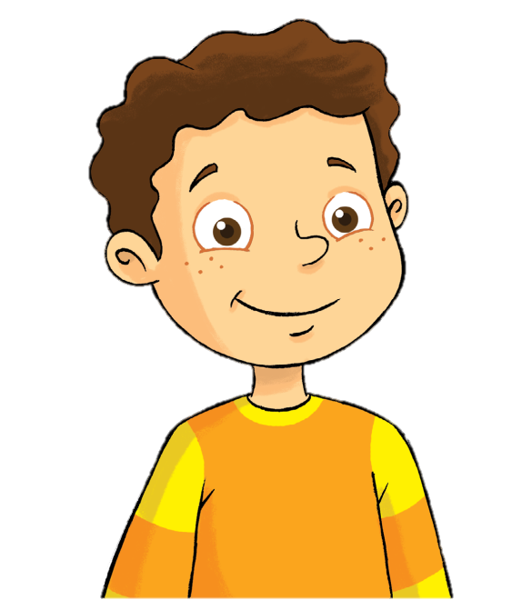
Look and Say
Rosy
Tim
Billy

Slide 5
Watch and Answer

Slide 6
Listen and point

Slide 7
Listen and repeat

Slide 8
Listen and chant

Slide 9
Who’s this?
Rosy
Tim
Billy

Slide 10
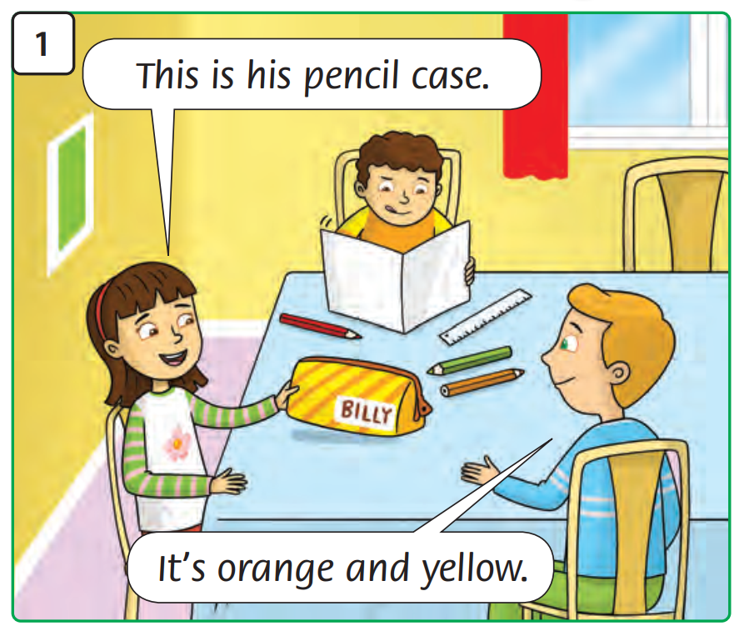
What’s happening?

Slide 11
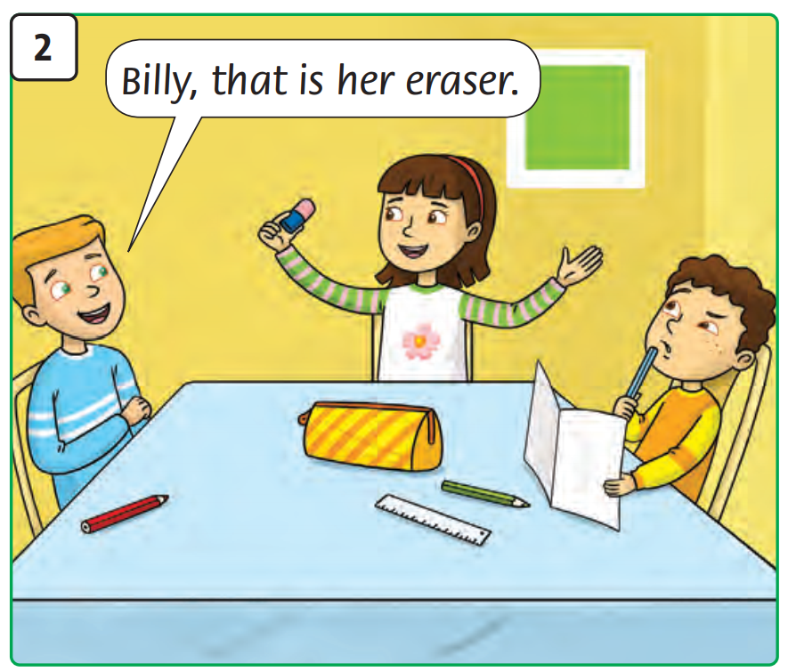
What’s happening?

Slide 12
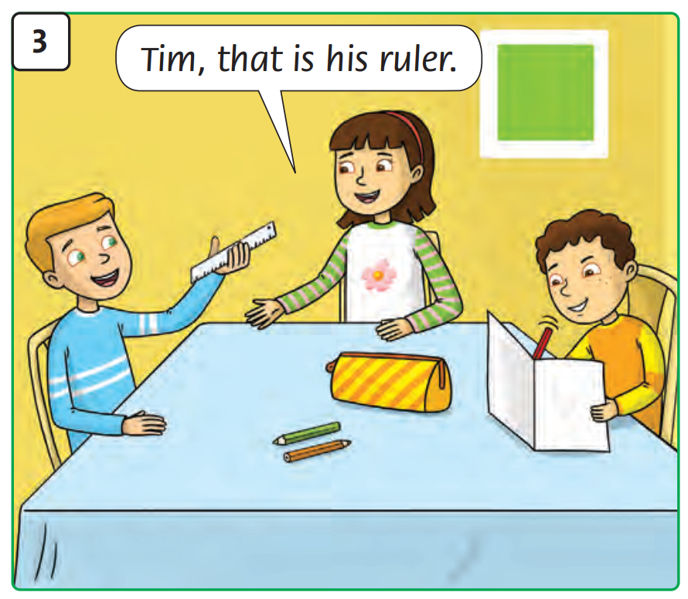
What’s happening?

Slide 13
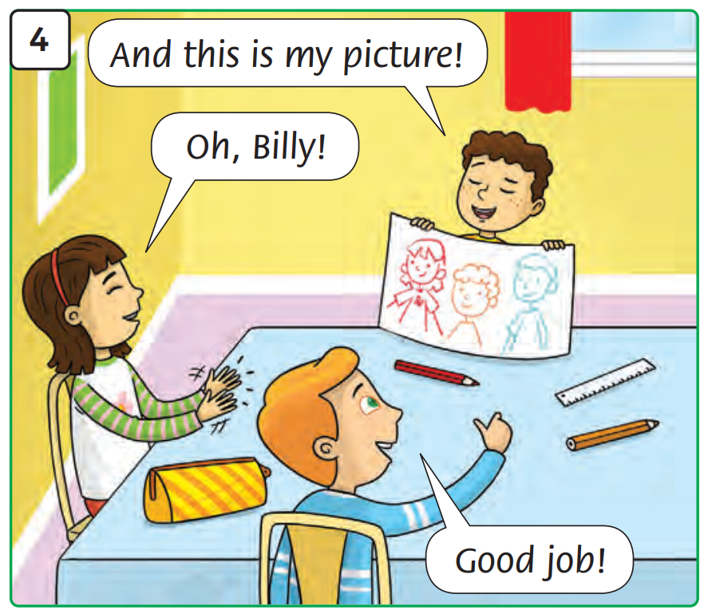
What’s happening?

Slide 14
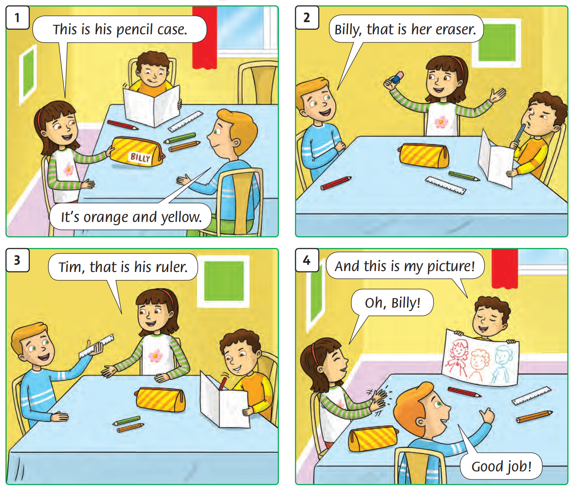
Listen and point

Slide 15
Listen and repeat

Slide 16
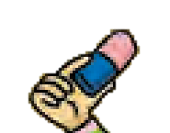
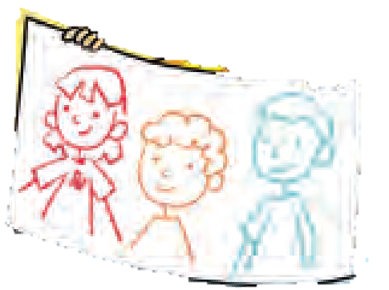
Answer

Slide 17
Listen and point

Slide 18
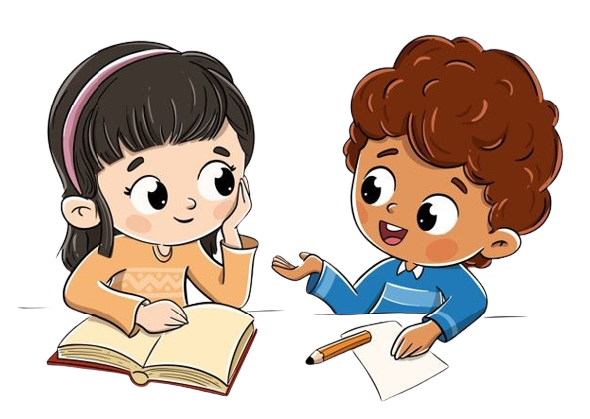
Work in pairs

Slide 19
Good job!

Slide 20
Presentation
Some pairs come to the front and do role-play.

Slide 21
Good job!

Slide 22
Homework

Slide 23
Goodbye! See you later!
Notes:
Click to the picture of a smiley face to play the Goodbye song.

