Slide 1

Unit 6
DESCRIBING PEOPLE
LESSON 2. 2 - PAGE 82

Slide 2
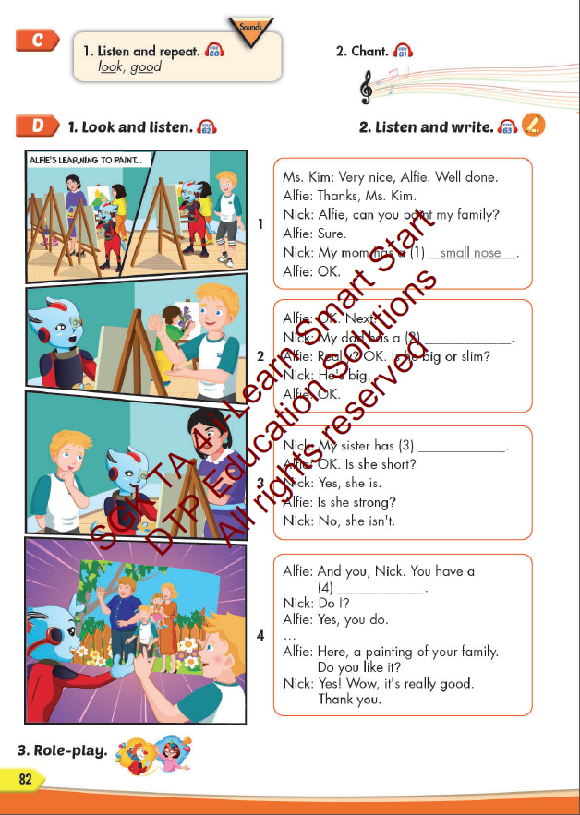
Lesson Outline
Warm-up
Listening
Consolidation
Wrap-up

Slide 3
Objectives
By the end of this lesson, students will be able to identify the /ʊ/ sound and practice the conversations.
Vocabulary: look, good
Phonics: /ʊ/

Slide 4

WARM UP

Slide 5



LISTEN AND CHOOSE
LET’S PLAY!

Slide 6

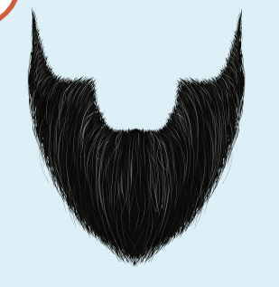


Slide 7

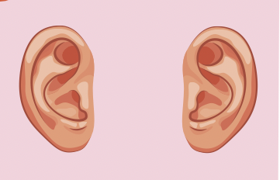

Slide 8
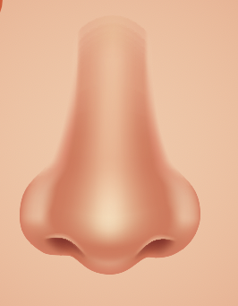


Slide 10

It’s time to learn …

Slide 11

Phonics /ʊ/

Slide 12

Presentation

Slide 13


Click the icon to hear the sound.
look
good
/lʊk/
/ɡʊd/

Slide 14

Practice

Slide 15



Slide 16
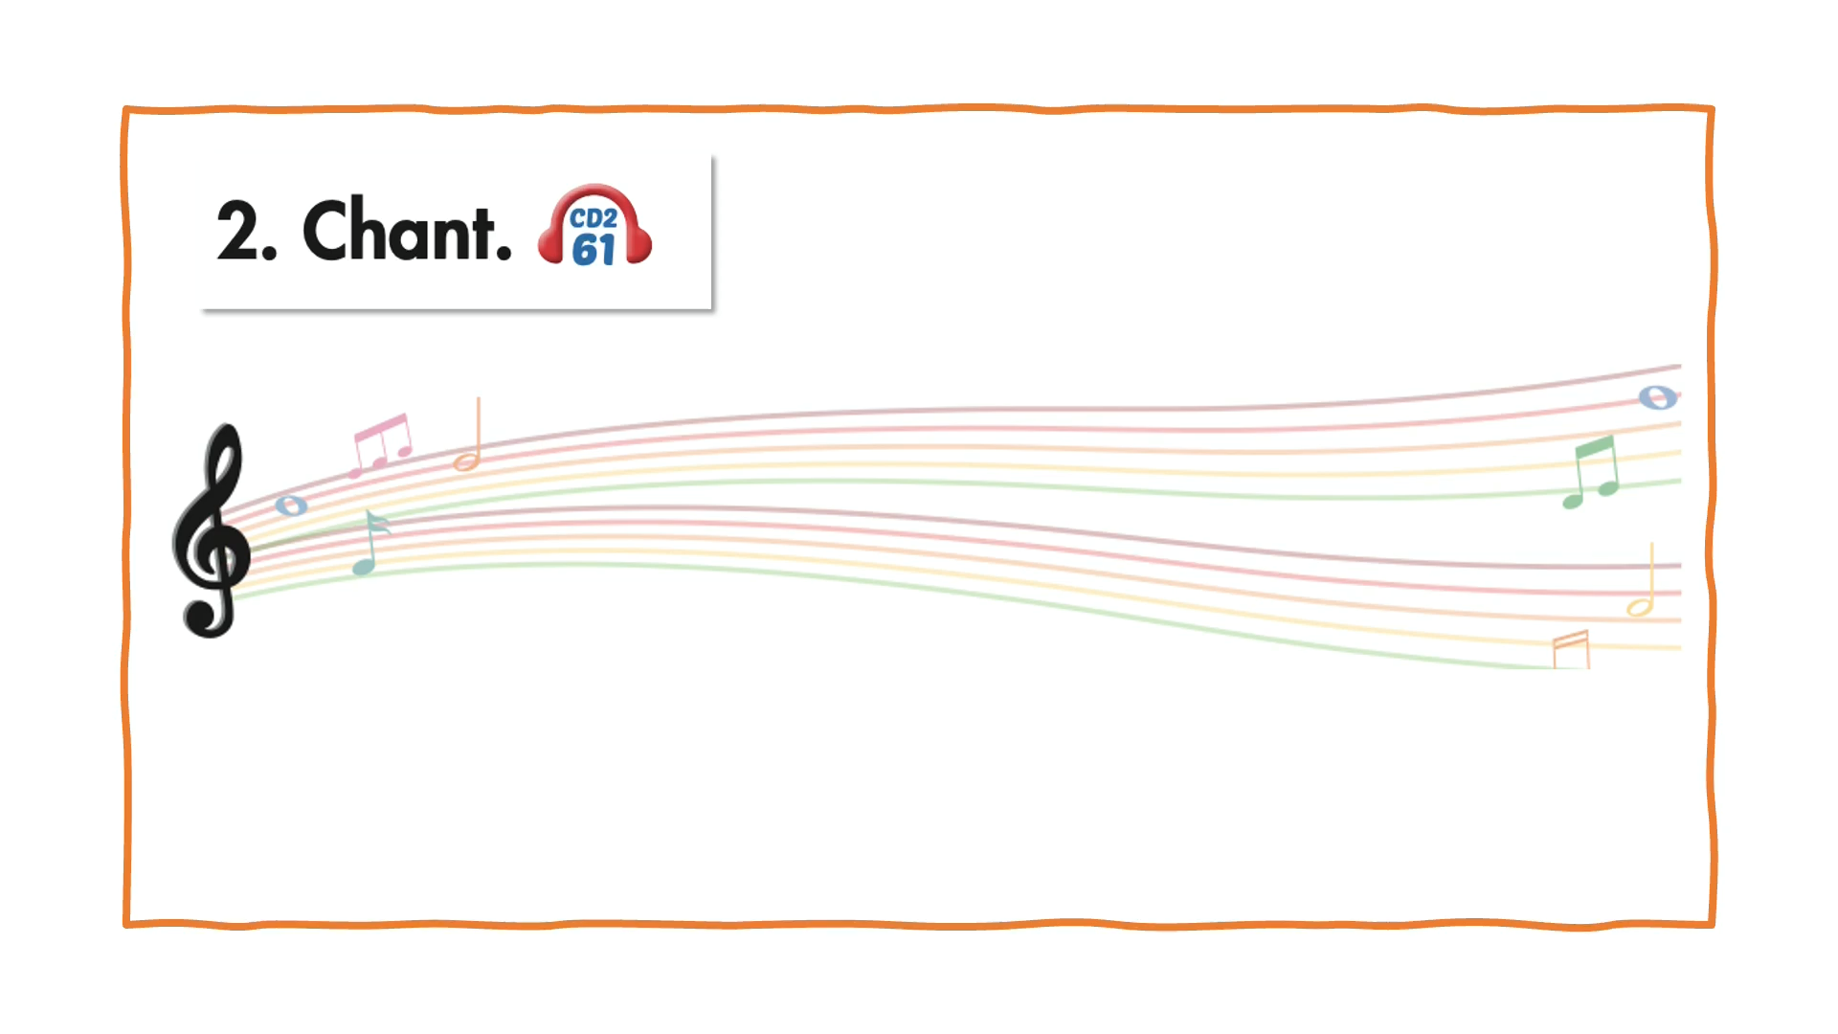

Slide 17

Speaking

Slide 18
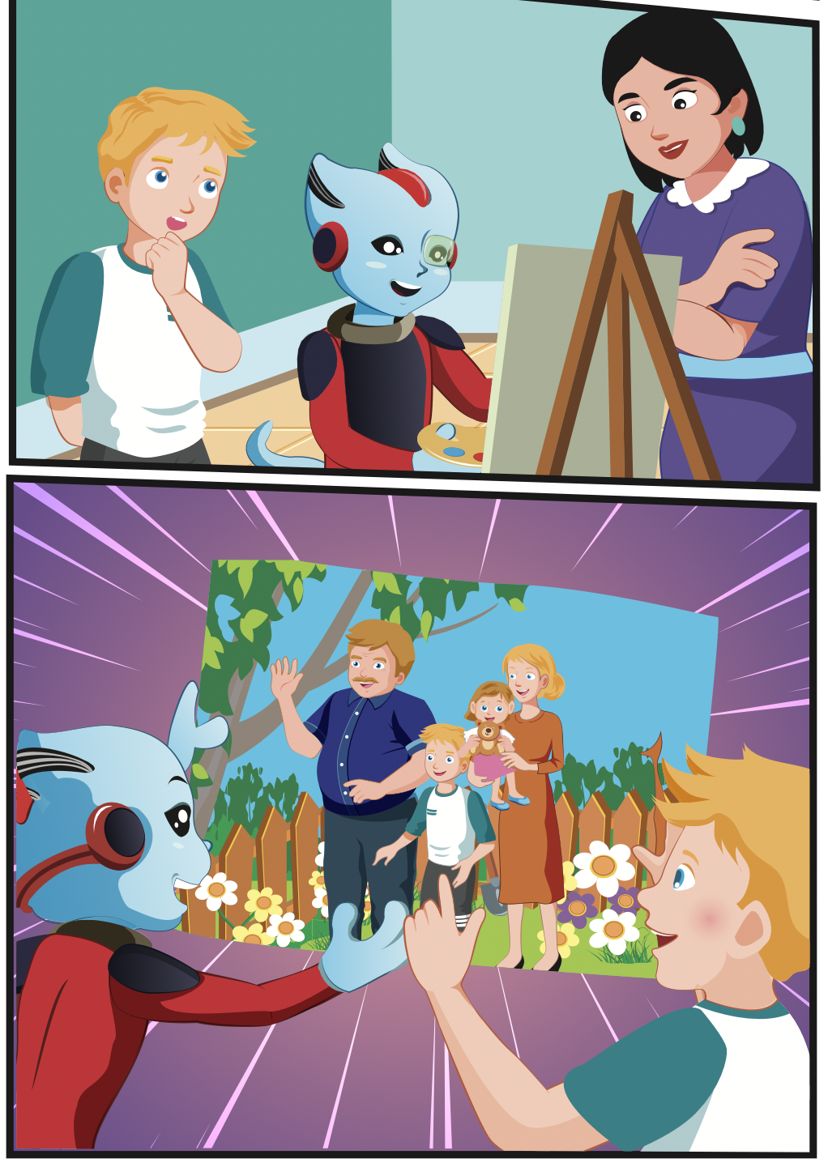
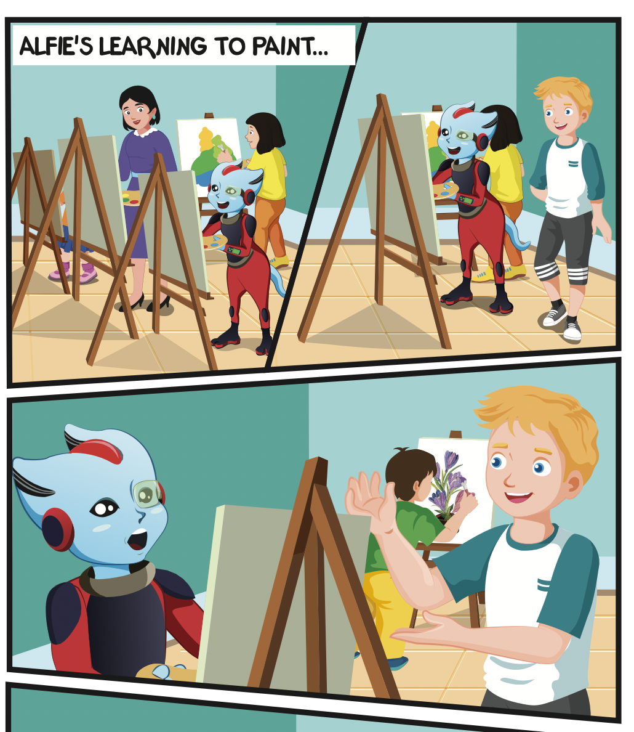
Where are they?
Who can you see?
What are they doing?

Slide 19

Listening

Slide 20


Slide 21

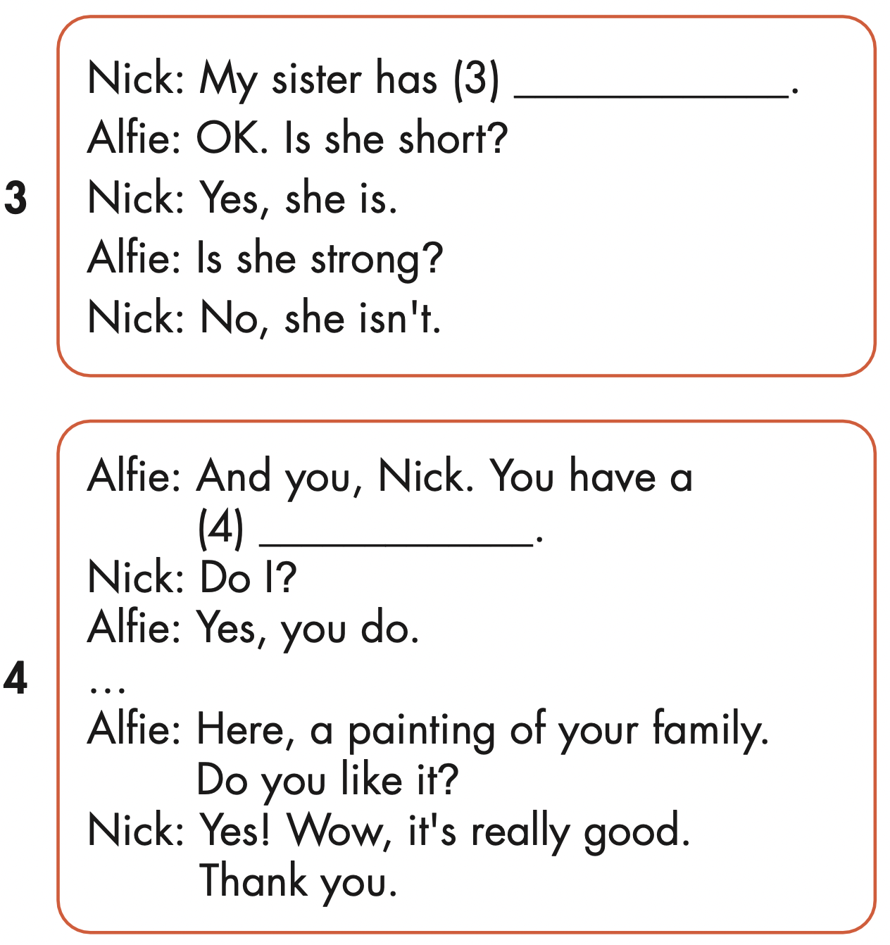
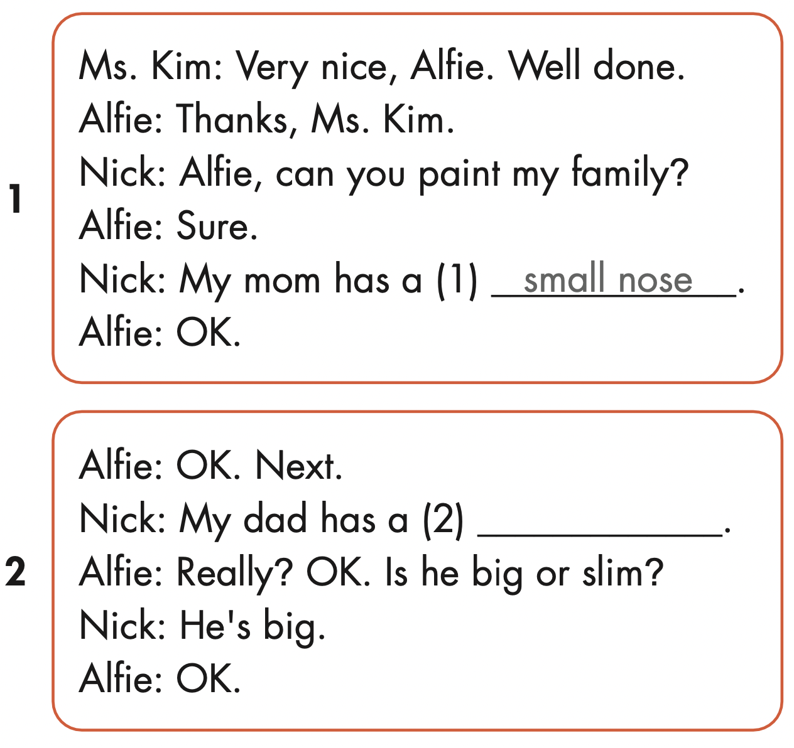
big ears
small mouth
mustache

Slide 22

Speaking

Slide 23



Slide 24

Writing

Slide 25
Make their own stories.

Slide 26

CONSOLIDATION

Slide 27

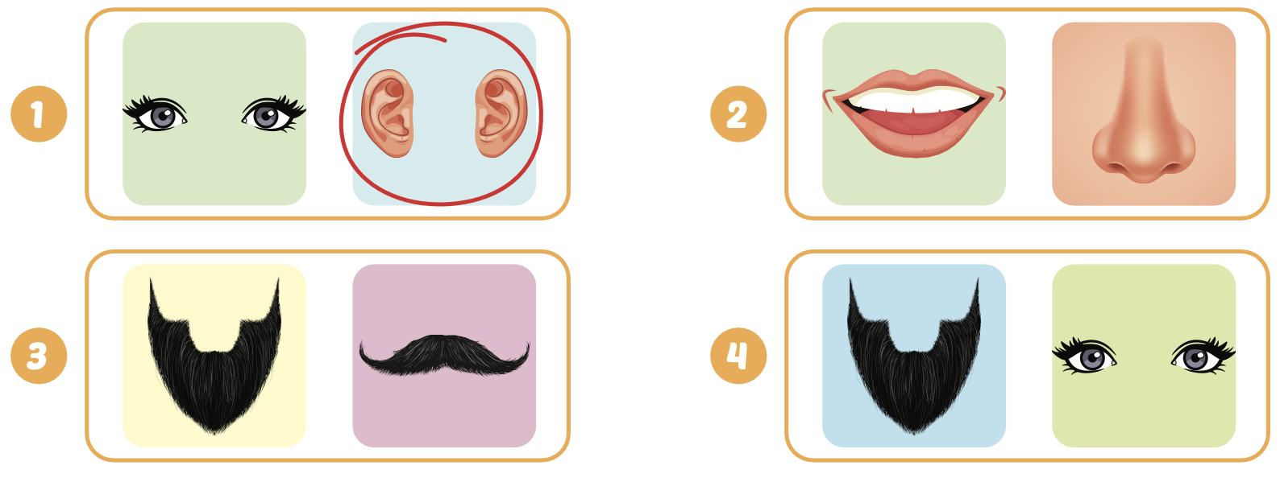

Extra Practice
WB, page 15

Slide 28

WRAP-UP

Slide 29
Today’s lesson
Phonics
/ʊ /
Structures/ Sentence patterns
My dad has big eyes.
My sister doesn't have a big nose.

Slide 30
Homework
Practice the vocabularies and structure; and make sentences using them.
Do the exercises in Tiếng Anh 4 i-Learn Smart Start WB (page 55).
Do the exercises in Tiếng Anh 4 i-Learn Smart Start Notebook (page 35).
Prepare the next lesson (page 83 SB).
Play the consolidation games in Tiếng Anh 4 i-Learn Smart Start DHA App on www.eduhome.com.vn

Slide 31

Enjoy your day!

