Slide 1

Unit 6
DESCRIBING PEOPLE
LESSON 2.3 - PAGE 83

Slide 2
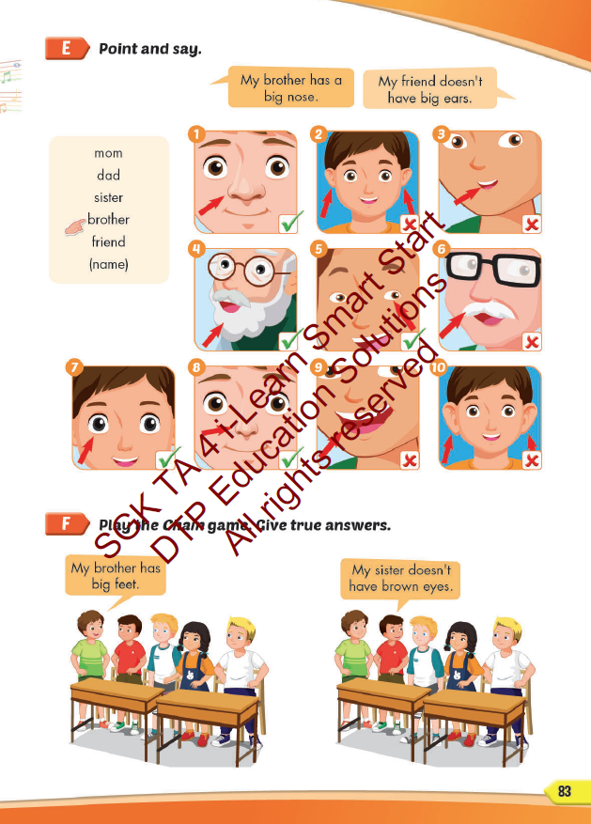
Lesson Outline
Warm-up
Practice
Speaking
Consolidation
Wrap-up

Slide 3
Objectives
By the end of this lesson, students will be able to describe people.
Vocabulary: eyes, ears, mouth, nose, mustache, beard.
Structure: My dad has big eyes.
My sister doesn't have a big nose.

Slide 4

WARM UP

Slide 5



Slide 6
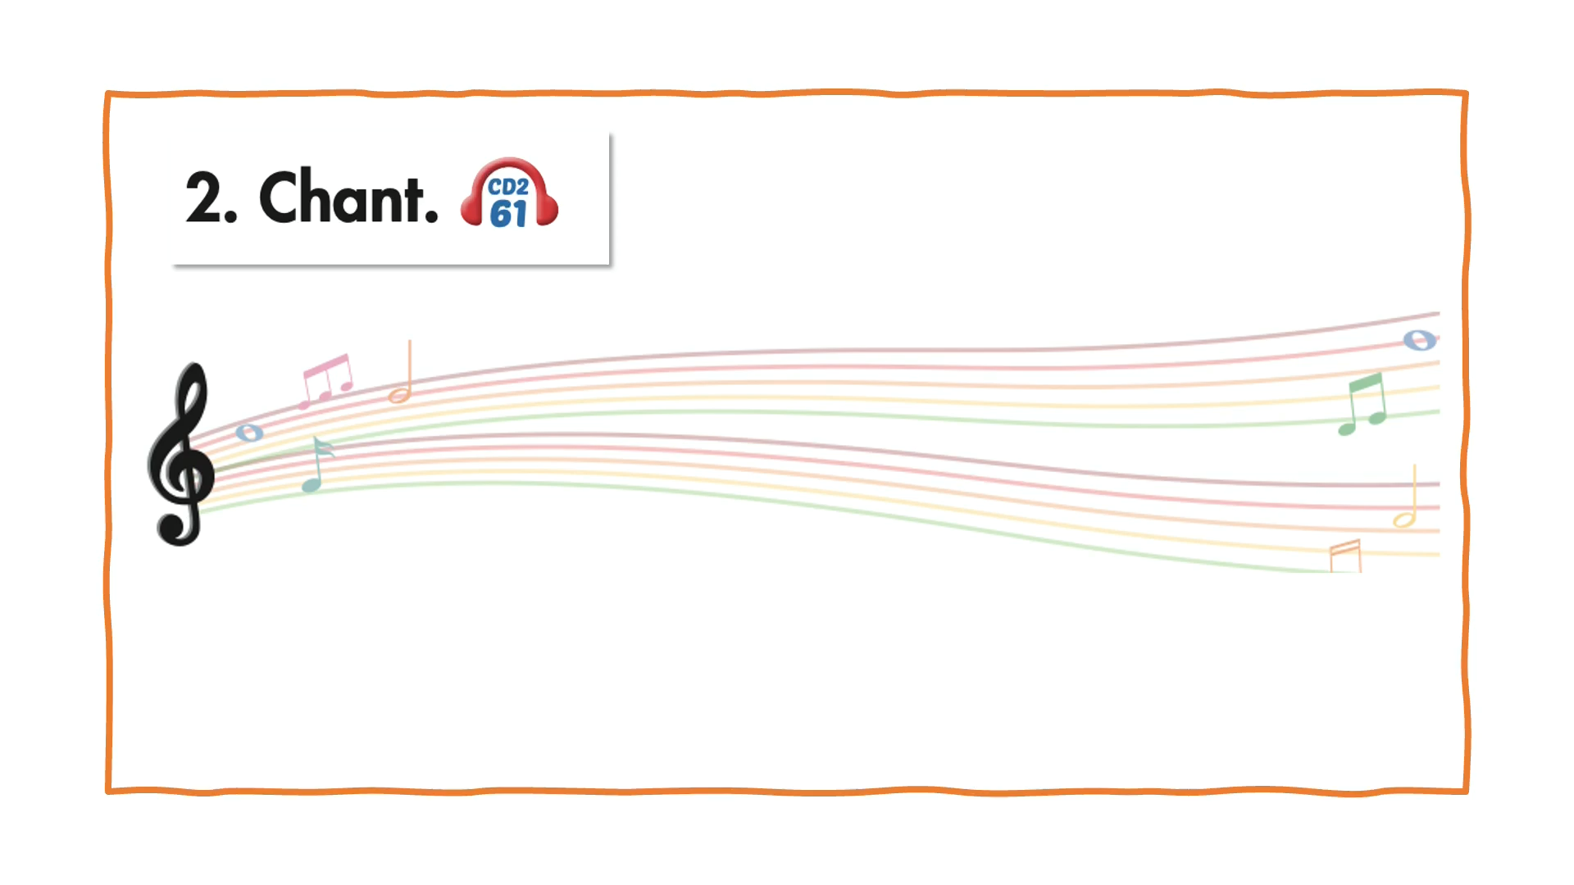

Slide 7

It’s time to learn …

Slide 8

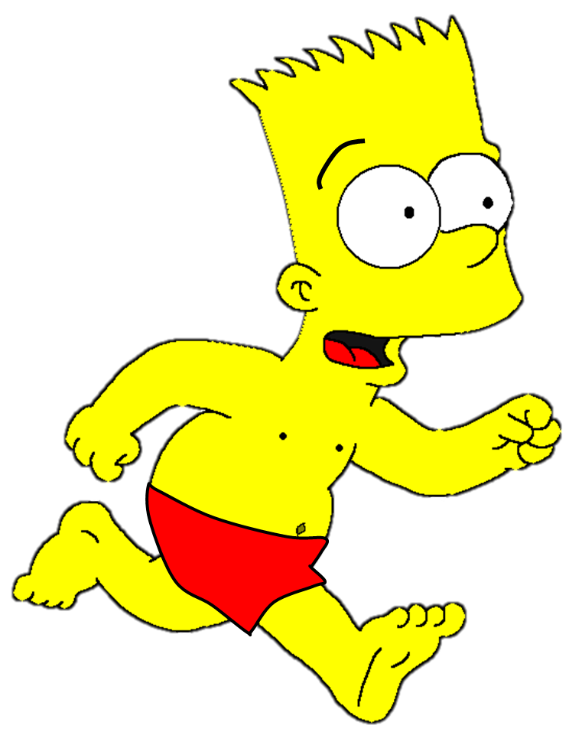
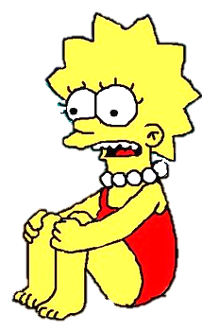




Slide 9



nose
tongue
mouth

Slide 10
mouth
nose
ear

Slide 11
eye
mouth
ear

Slide 12
eyebrow
elbow
eye

Slide 13




leg
mustache
beard

Slide 14
mouth
mustache
beard

Slide 15

Speaking

Slide 16


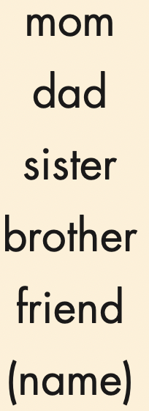
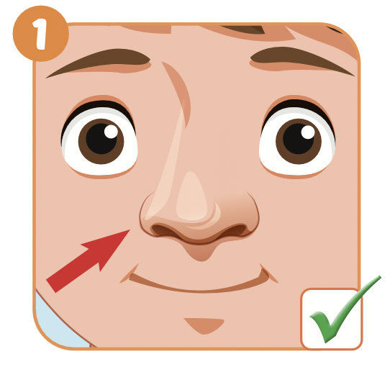


Slide 17
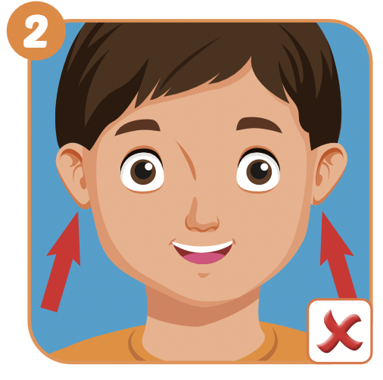

Slide 18
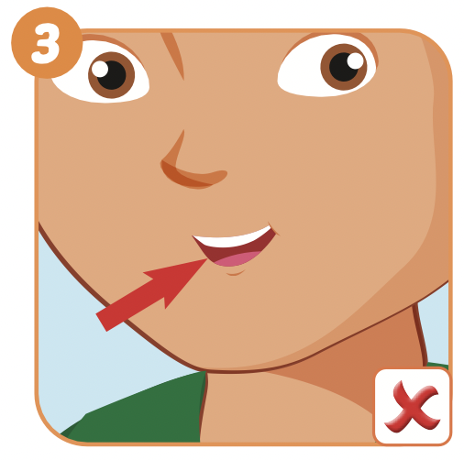
My sister doesn’t have a small mouth.

Slide 19
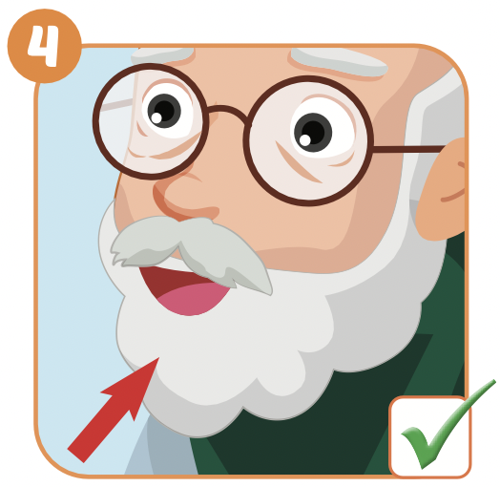
My dad has a beard.

Slide 20
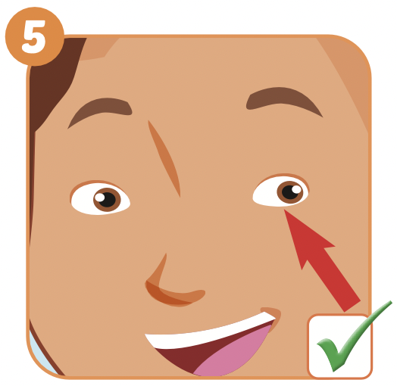
My mom has small eyes.

Slide 21
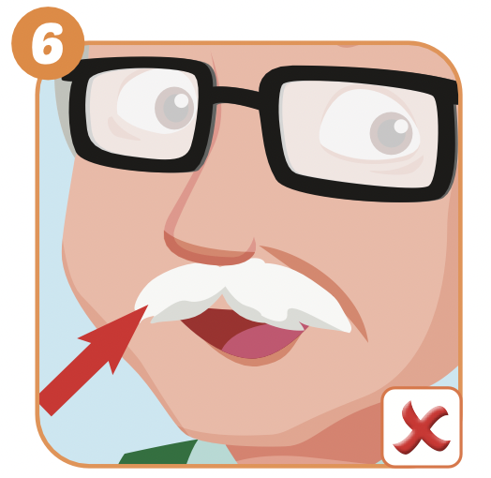
My dad doesn’t have a mustache.

Slide 22
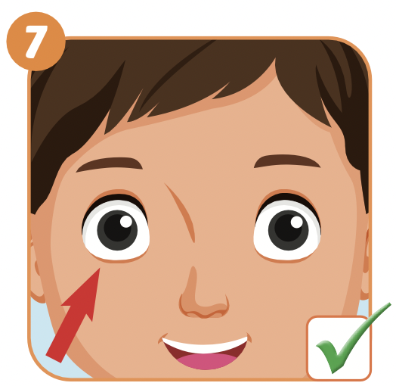
Nick has big eyes.
Nick

Slide 23
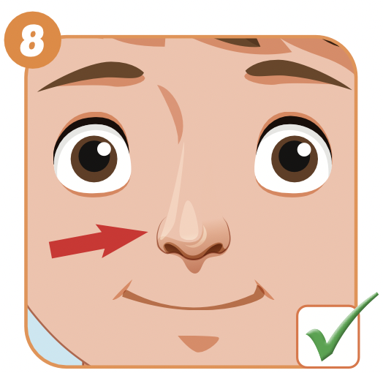
My brother has a small nose.

Slide 24
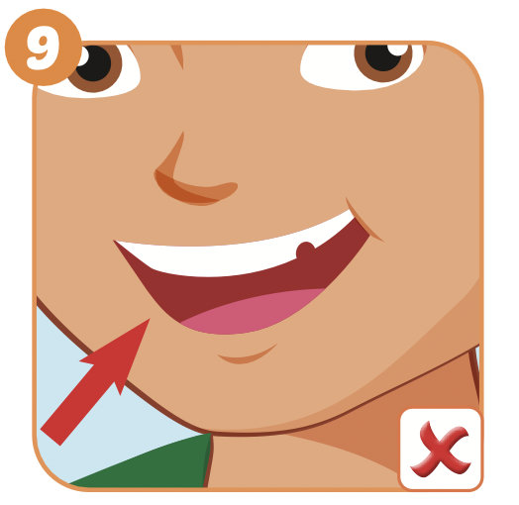
My sister doesn’t have a big mouth.

Slide 25
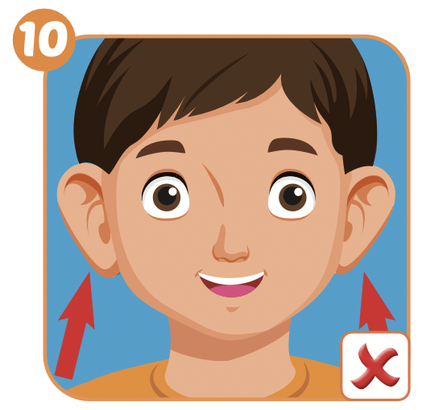
Ben doesn’t have big ears.
Ben

Slide 26
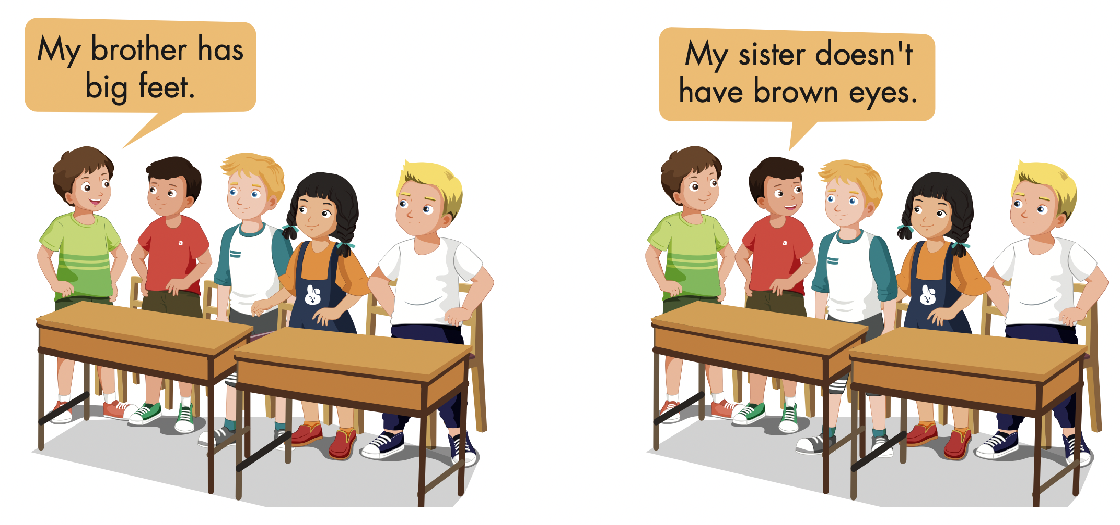

Slide 27

Production

Slide 28

have or has
GAME

Slide 29
Great
She________ a small nose.
have
has

Slide 30
Great
I _______ big eyes .
have
has

Slide 31
Great
My father_______ a mustache.
have
has

Slide 32
Great
He doesn’t_______ big ears.
have
has

Slide 33

Writing

Slide 34

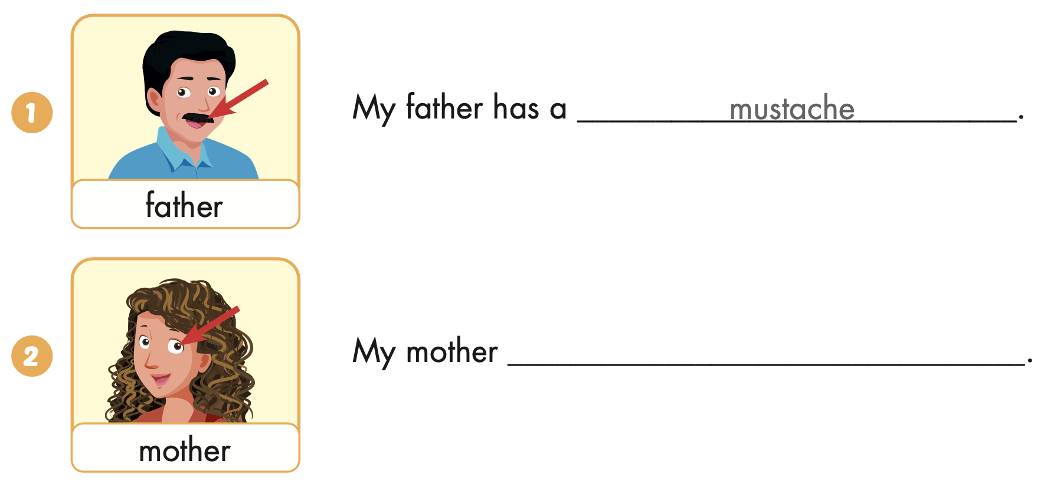
Extra Practice
WB, page 55
has big eyes

Slide 35
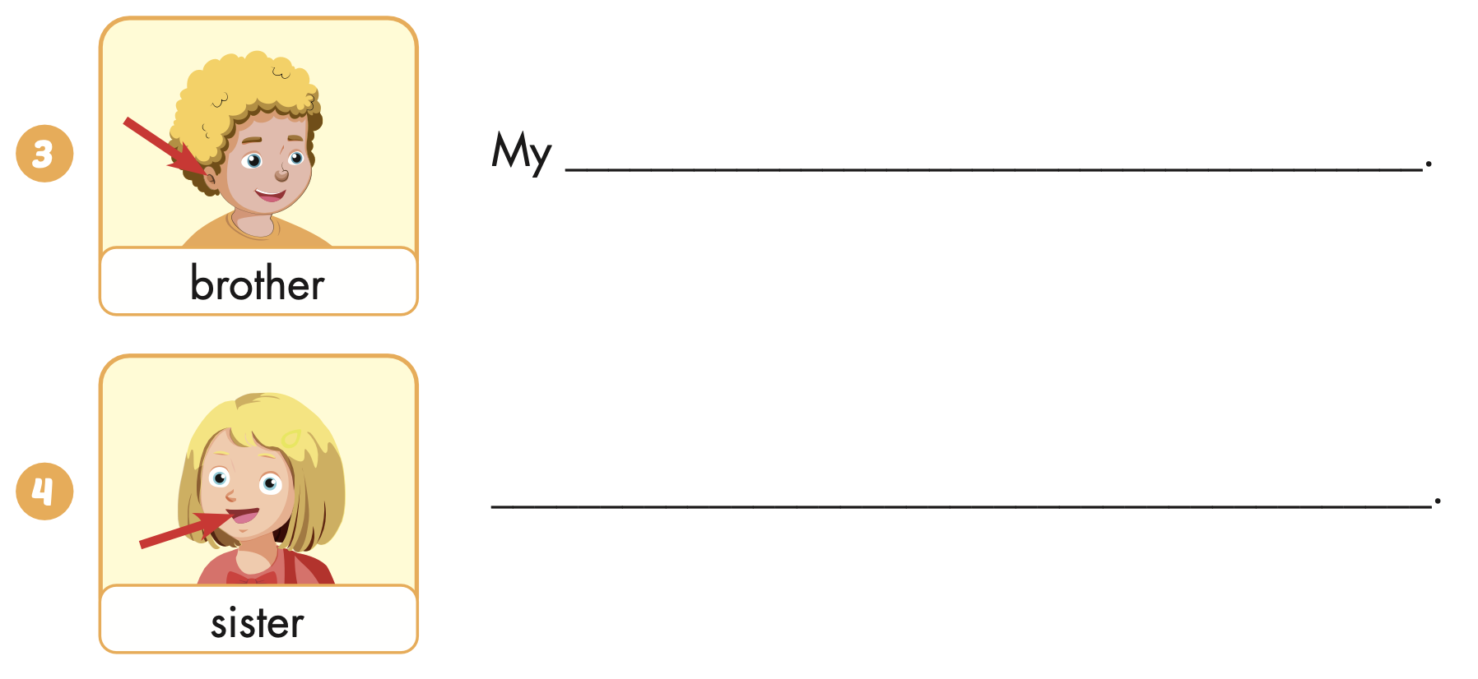
Extra Practice
WB, page 15
brother has small ears
My sister has a big mouth

Slide 36

CONSOLIDATION

Slide 37

WRAP-UP

Slide 38
Today’s lesson
Structures/ Sentence patterns
My dad has big eyes.
My sister doesn't have a big nose.
Vocabularies
eyes,
ears,
mouth,
nose,
mustache,
beard.

Slide 39
Homework
Practice the vocabularies and structure, and make sentences using them.
Do the exercises in Tiếng Anh 4 i-Learn Smart Start WB (page 55).
Prepare the next lesson (page 84 SB).
Play the consolidation games in Tiếng Anh 4 i-Learn Smart Start DHA App on www.eduhome.com.vn

Slide 40
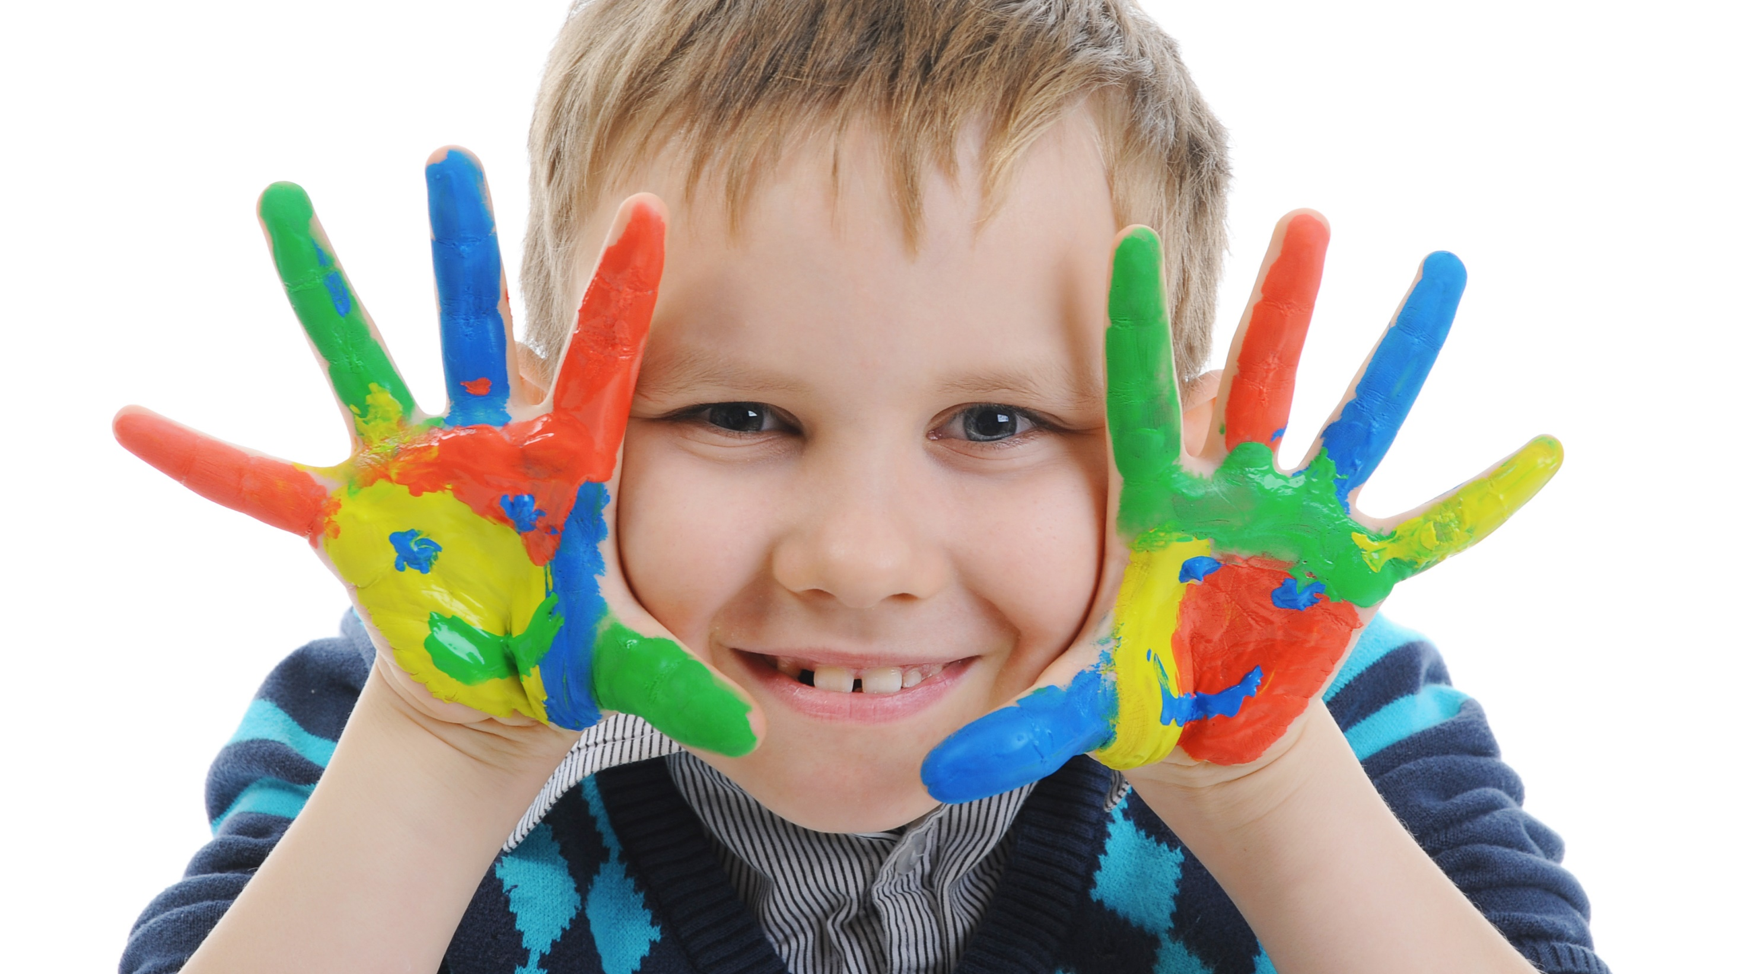
Enjoy your day!

