Slide 1

Unit 6: FOOD AND DRINKS
Lesson 2.1
Page 81

Slide 2
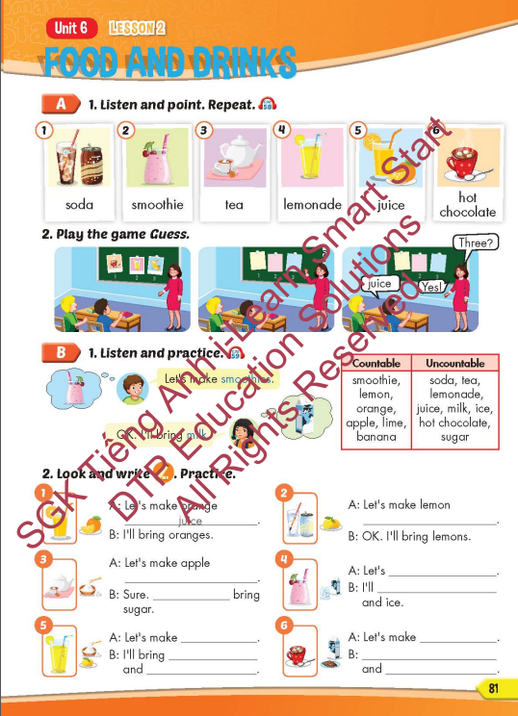
Lesson Outline
Warm-up
Vocabulary
Structure
Consolidation
Wrap-up

Slide 3
Objectives
By the end of this lesson, students will be able to recognize the vocabulary to say what drink they want to make and
what they will bring to make it.
Vocabulary: soda, smoothie, tea, lemonade, juice, hot chocolate
Structure: Let's make smoothies.
OK.
I'll bring milk.

Slide 4

WARM-UP

Slide 5

Guess the Food and Drinks

Slide 6

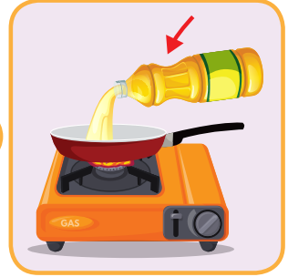
a smooth thick liquid produced from plants or animals that is used in cooking.
OIL

Slide 7
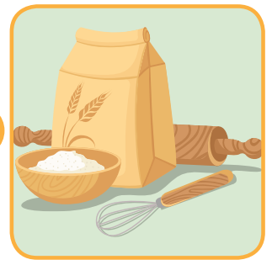
powder made from grain, esp. wheat, used for making bread, cakes, pasta, pastry,….
FLOUR

Slide 8
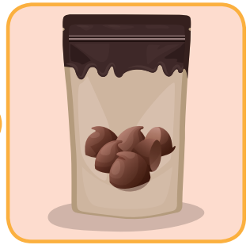
a small piece of solid chocolate.
CHOCOLATE CHIPS

Slide 9

a pale yellow, fatty solid made from cream that is spread on bread or used in cooking.
BUTTER

Slide 10
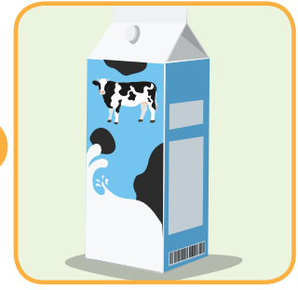
the white liquid produced by cows, goats, and sheep and used by humans as a drink or for making butter, cheese,….
MILK

Slide 11
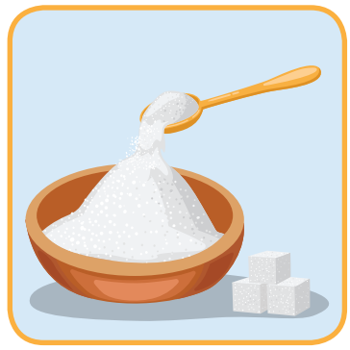
a sweet substance especially from the plants sugar cane and sugar beet, used to make food and drinks sweet
SUGAR

Slide 12

It’s time to learn …

Slide 13

New words
soda, smoothie, tea, lemonade, juice, hot chocolate.

Slide 14

Presentation

Slide 15


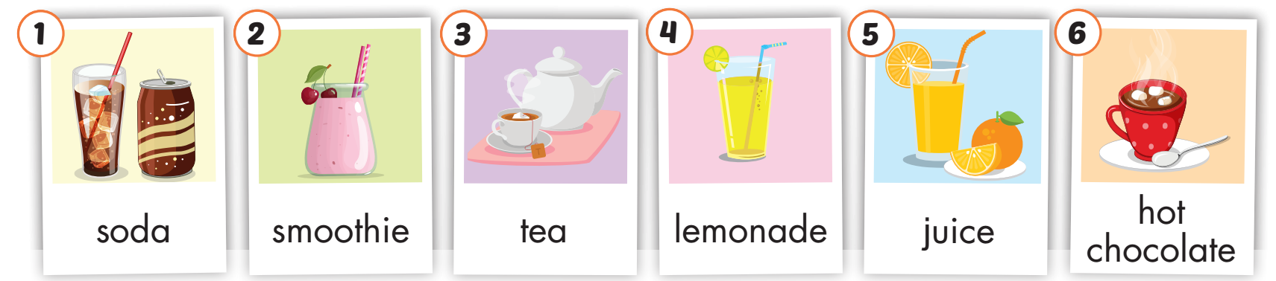
Click on A to hear the sound.
/ˈsoʊ.də/
nước ngọt có gas
/ˈsmuː.ði/
sinh tố
/tiː/
trà
/ˌlem.əˈneɪd/
nước chanh
/dʒuːs/
nước cam
/ˌhɑːt ˈtʃɑːk.lət/
socola nóng
Notes:
Click vào hình A. 1. Listen and point. Repeat để cho cả audio full chạy

Slide 16
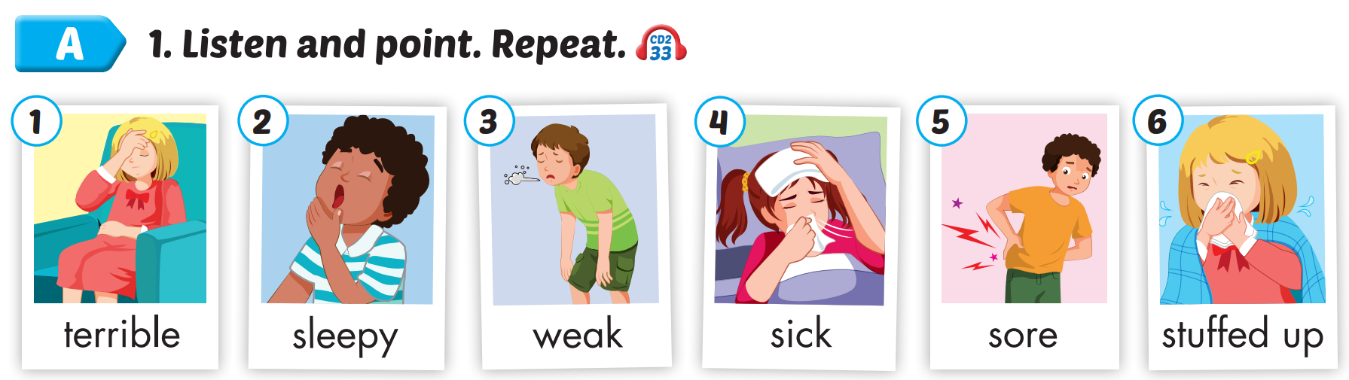
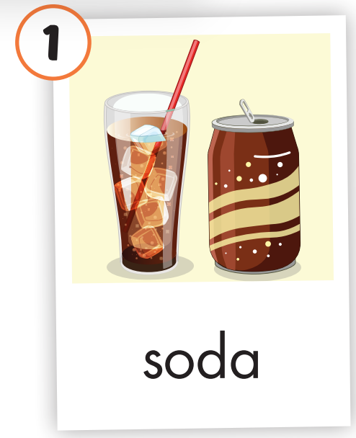
Click on the picture to hear the sound.
soda
/ˈsoʊ.də/
nước ngọt có gas

Slide 17
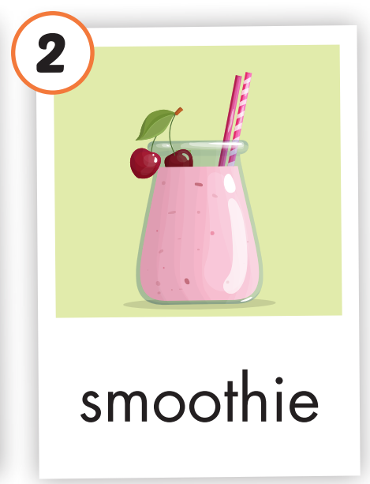
Click on the picture to hear the sound.
smoothie
/ˈsmuː.ði/
sinh tố

Slide 18
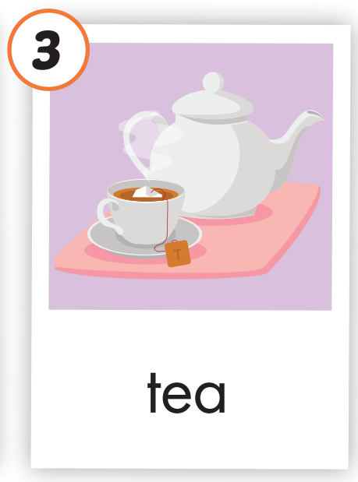
Click on the picture to hear the sound.
tea
/tiː/
trà

Slide 19
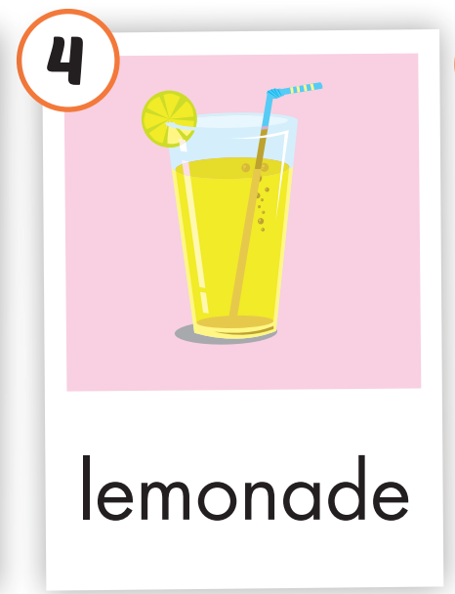
Click on the picture to hear the sound.
lemonade
/ˌlem.əˈneɪd/
nước chanh

Slide 20
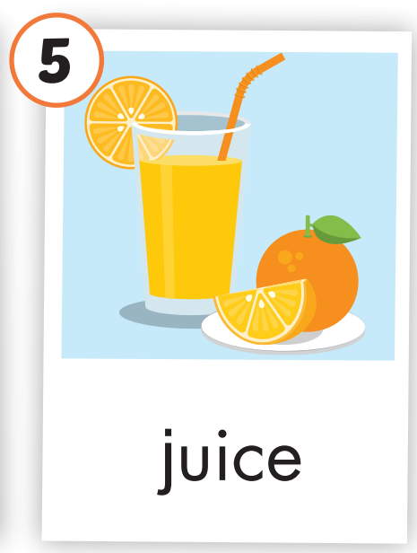
Click on the picture to hear the sound.
juice
/dʒuːs/
nước cam

Slide 21

Click on the picture to hear the sound.
hot chocolate
/ˌhɑːt ˈtʃɑːk.lət/
socola nóng

Slide 22
Practice

Slide 23
Listen and choose. Then say.

Slide 24




Listen and choose
A
B
C
lemonade

Slide 25
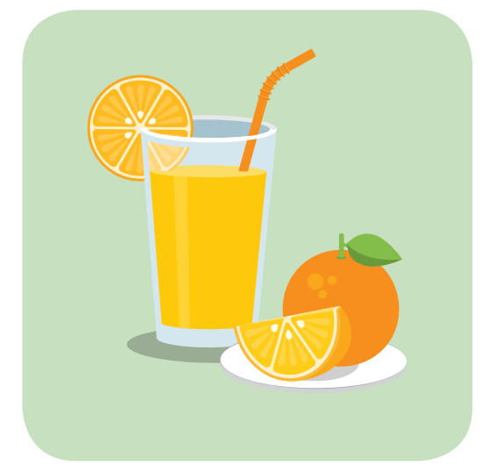
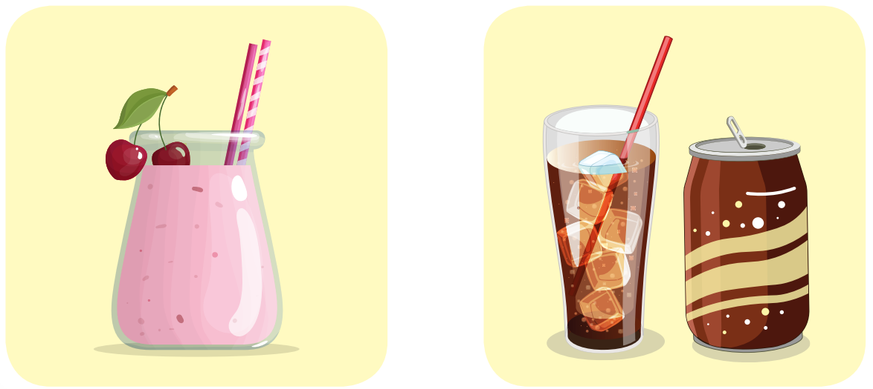
Listen and choose
A
B
C
soda

Slide 26

Listen and choose
A
B
C
Hot chocolate

Slide 27
Listen and choose
A
B
C
tea

Slide 28
Listen and choose
A
B
C
juice

Slide 29

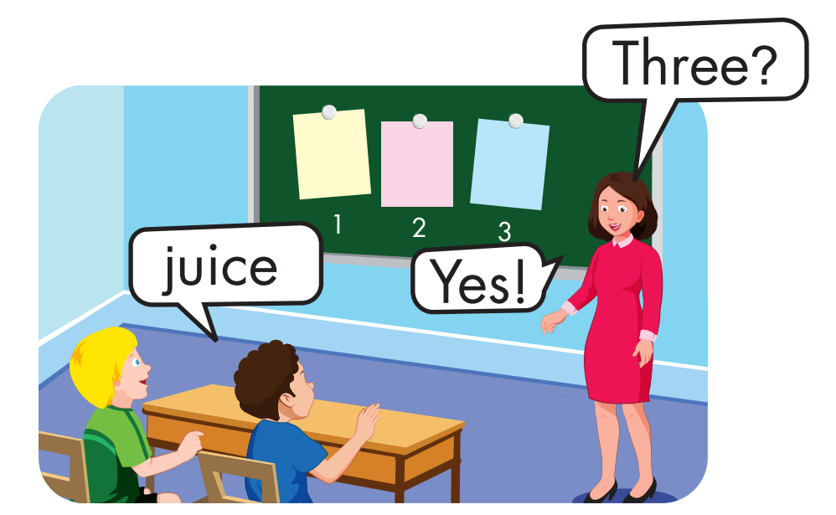
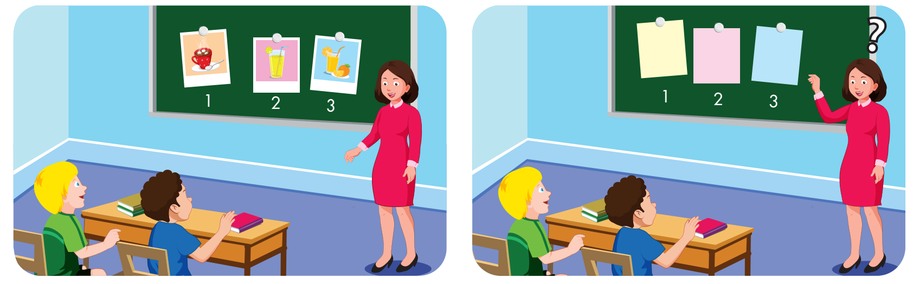

Slide 30
Structure
Let's make smoothies.
OK.
I'll bring milk.

Slide 31
Presentation

Slide 32
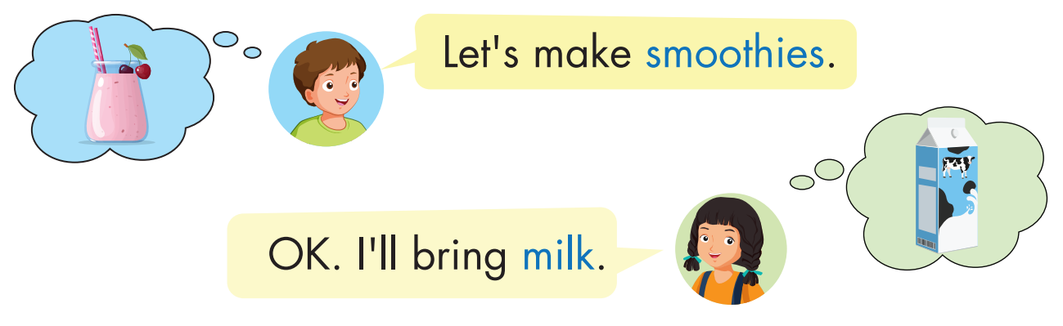
Structure

Slide 33

Practice

Slide 34
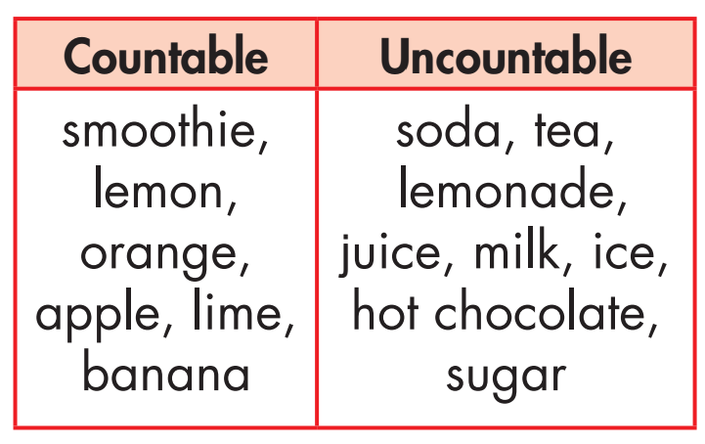
Grammar

Slide 35
Grammar
Singular | Plural
a smoothie a lemon an orange an apple a lime a banana | smoothies lemons oranges apples limes bananas

Slide 36

Grammar
milks
juices
sugars
sodas
teas
ices
hot chocolates

Slide 37
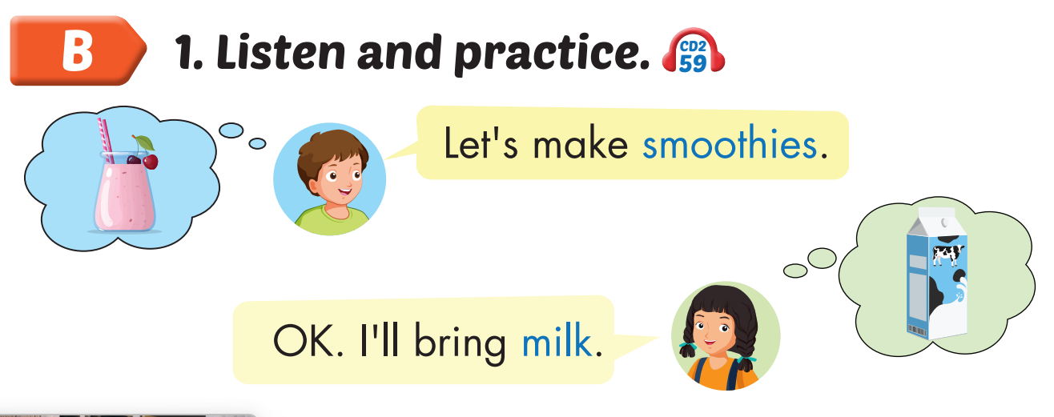
Click on B to hear the sound.

Slide 38
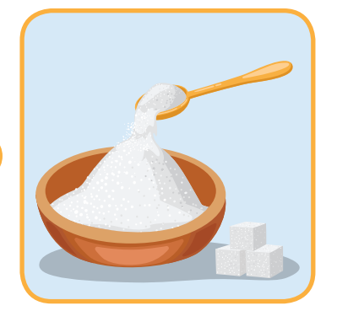
Let’s make __________.
Ok. I will bring ________.
smoothies
sugar

Slide 39

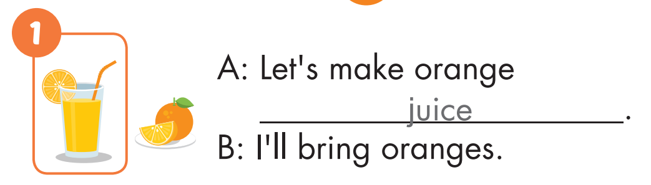

Slide 40
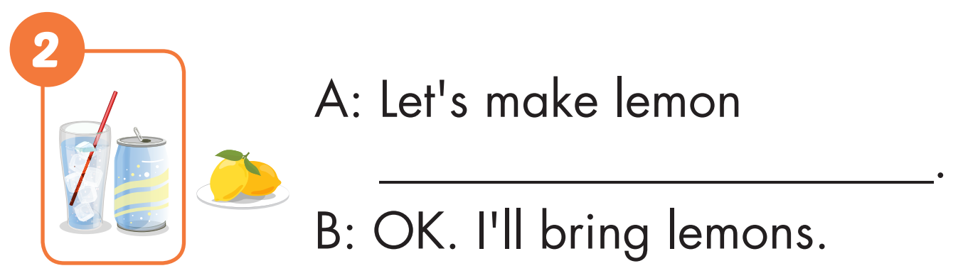

soda

Slide 41
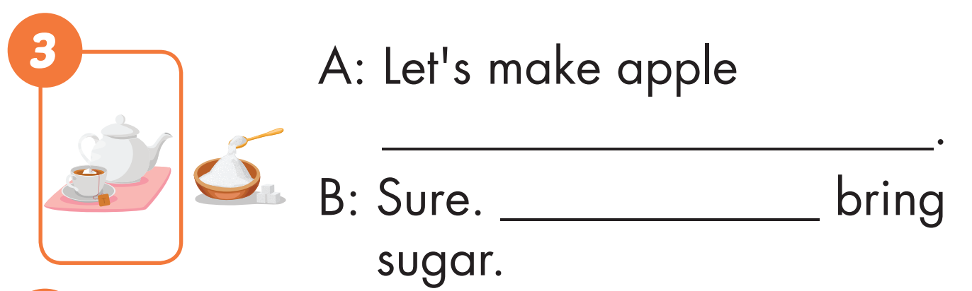
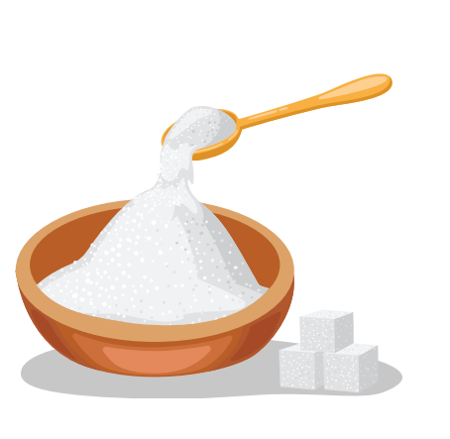
tea
I’ll

Slide 42
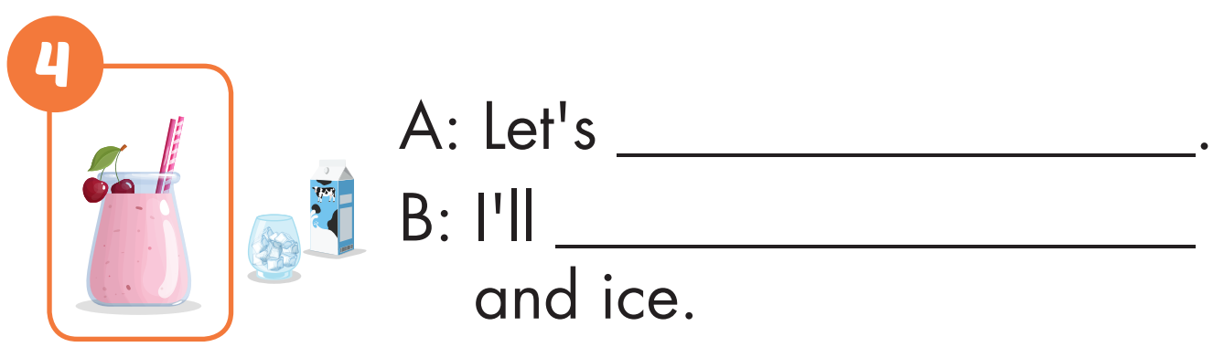
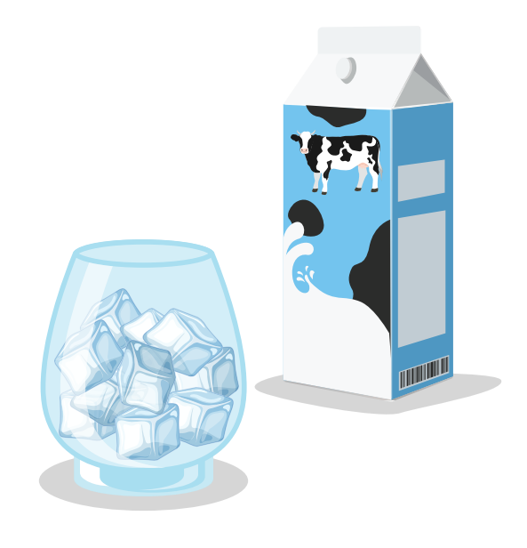
make smoothies
bring milk

Slide 43
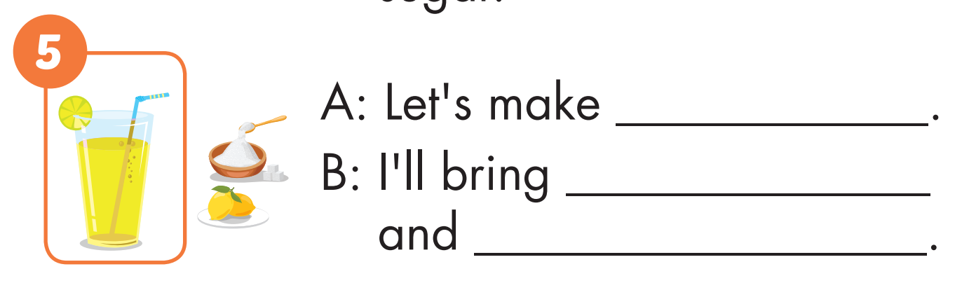
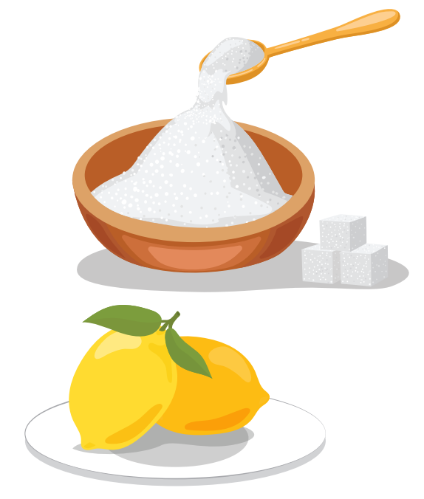
lemonade
lemons
sugar

Slide 44
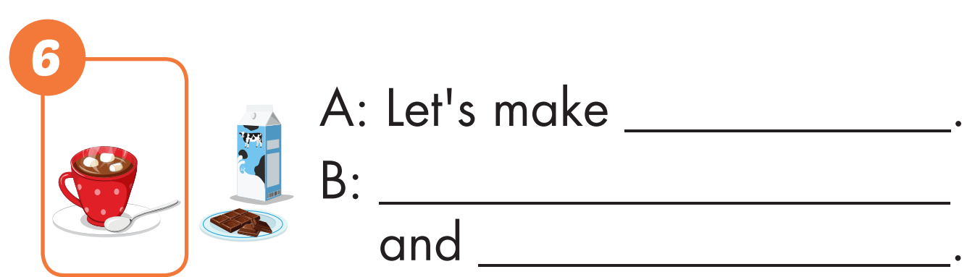
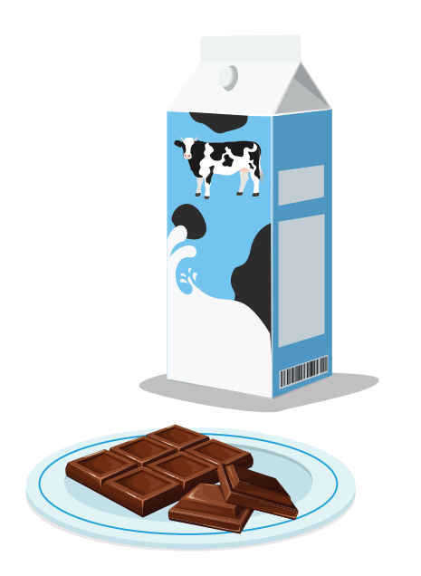
hot chocolate
Ok. I’ll bring milk
chocolate chips

Slide 45

Production

Slide 46


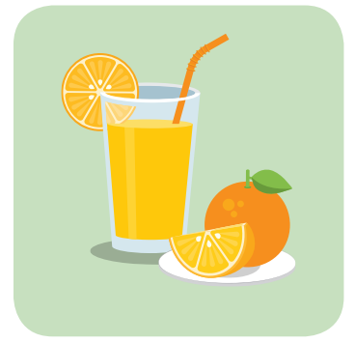

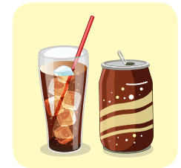
soda |  | smoothie
 | hot chocolate
juice |  | tea
 | lemonade
1
2
3
4
5
6
7
8
9
10
11
12

Slide 47

CONSOLIDATION

Slide 48
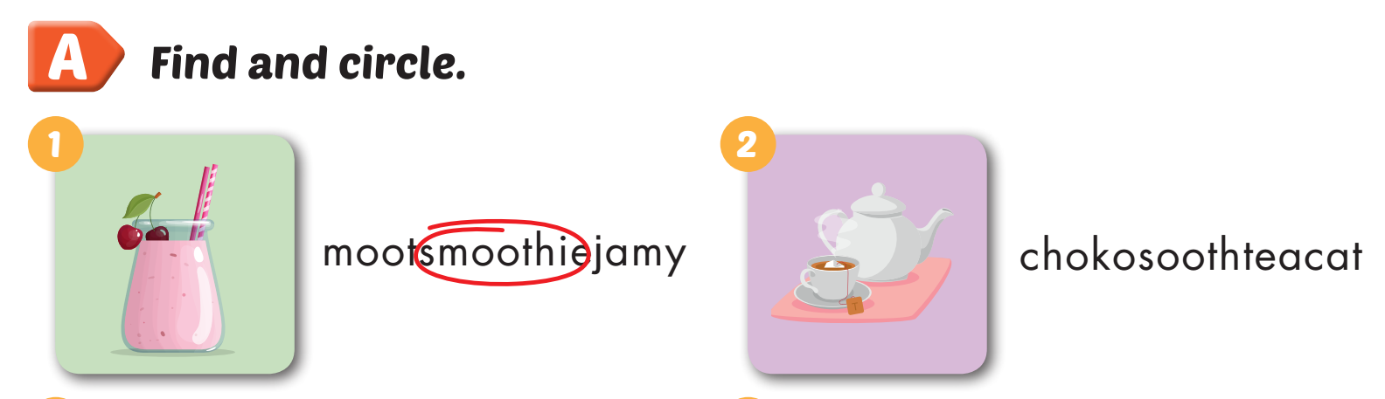
Extra Practice
WB, page 54

Slide 49
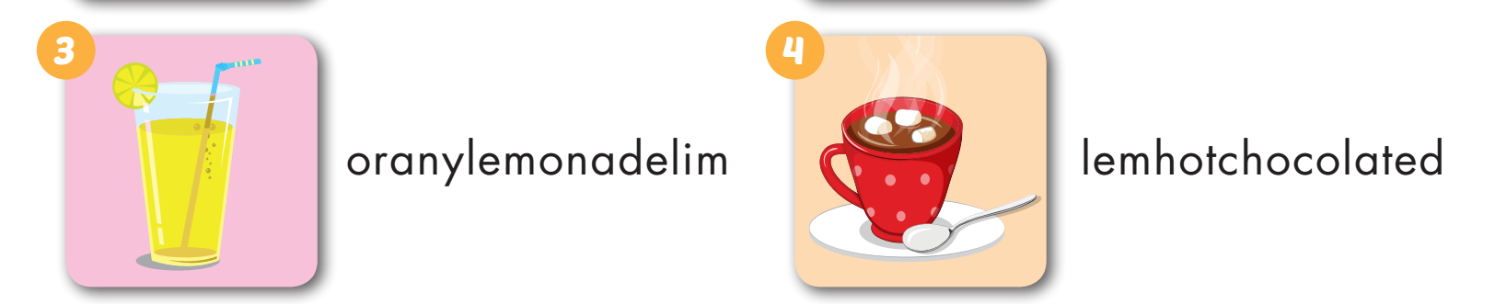
Extra Practice
WB, page 54

Slide 50

Extra Practice
WB, page 54

Slide 51

WRAP-UP

Slide 52
Today’s lesson
Vocabularies
soda, smoothie, tea, lemonade, juice, hot chocolate.
Structures/ Sentence patterns
Let's make smoothies.
OK.
I'll bring milk.

Slide 53
Homework
Practice the vocabularies and structure, and make sentences using them.
Do the exercises in Tiếng Anh 5 i-Learn Smart Start WB (page 54).
Do the exercises in Tiếng Anh 5 i-Learn Smart Start Notebook.
Prepare the next lesson (page 82 SB).
Play the consolidation games in Tiếng Anh 5 i-Learn Smart Start DHA App on www.eduhome.com.vn

Slide 54

Enjoy your day!

Slide 55

Lesson 3
Stay positive and have a nice day!

