Slide 1

Unit 6
DESCRIBING PEOPLE
LESSON 1. 3 - PAGE 80

Slide 2
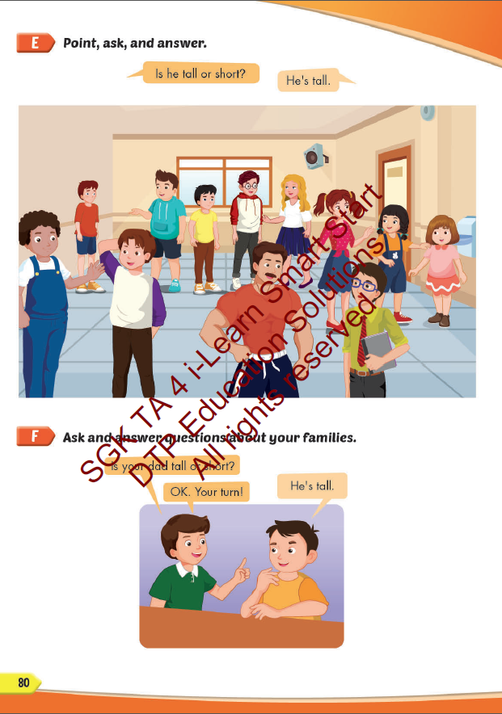
Lesson Outline
Warm-up
Practice
Speaking
Consolidation
Wrap-up

Slide 3
Objectives
By the end of this lesson, students will be able to describe people correctly
Vocabulary: tall, short, big, slim, strong, weak.
Structure: Is your father big or slim? / He's slim. / Is your sister tall or short? / She's tall.

Slide 4

WARM UP

Slide 5



Slide 6


Slide 7

It’s time to learn …

Slide 8

Speaking

Slide 9
Ask and answer

Slide 10
father/big/ slim/
Is your father big or slim?
He’s slim.

Slide 11
mother/ short/ tall
Is your mother short or tall?
She’s short.

Slide 12
brother /big / slim/
Is your brother big or slim?
He’s big.

Slide 13
Grandma /strong / weak/
Is your grandma strong or weak?
She’s weak.

Slide 14


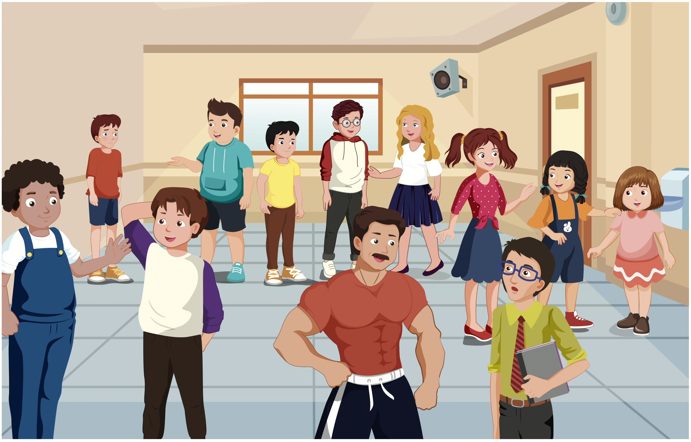

Slide 19

Production

Slide 20
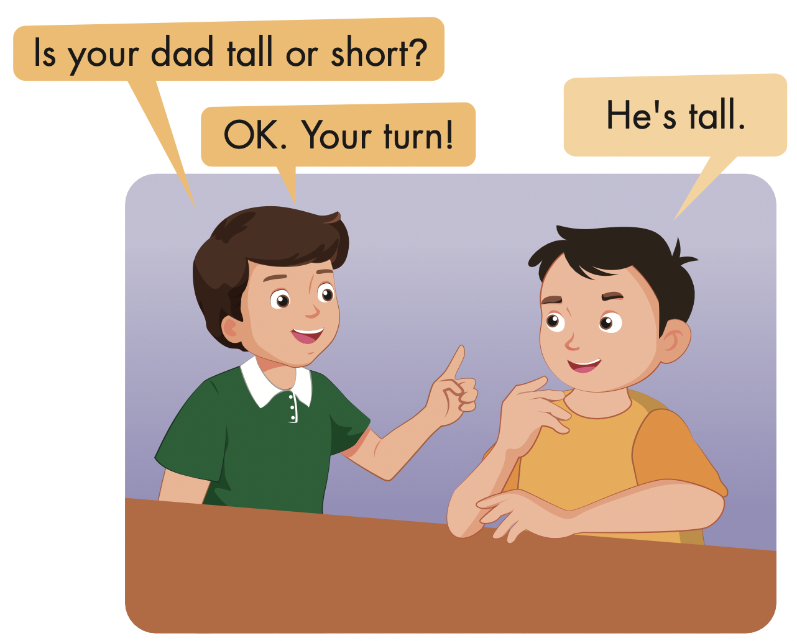

Slide 21

Look and answer

Slide 22
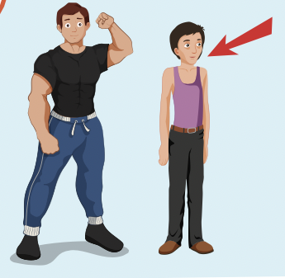
Next
CHECK
Is your aunt strong or weak?
weak
She’s………………….

Slide 23
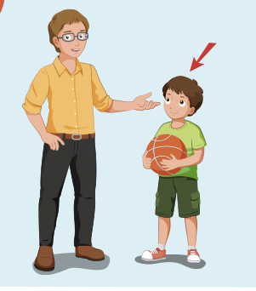
Next
CHECK
Is your brother tall or short?
short
He’s ………………..

Slide 24
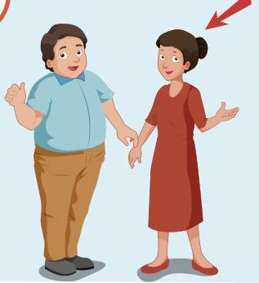
Next
CHECK
Is your mother big or slim?
slim
She’s…………….

Slide 25
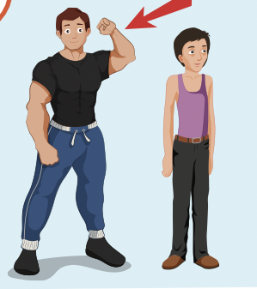
Next
CHECK
Is your uncle strong or weak?
strong
He’s …………………..

Slide 26
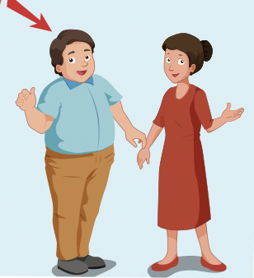
Next
CHECK
Is your father big or slim?
big
He’s………………..

Slide 27

CONSOLIDATION

Slide 28

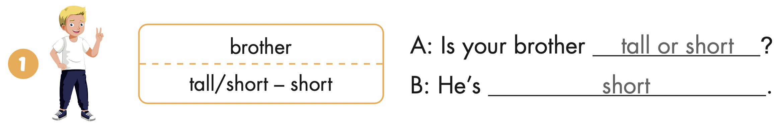
Extra Practice
WB, page 53

Slide 29
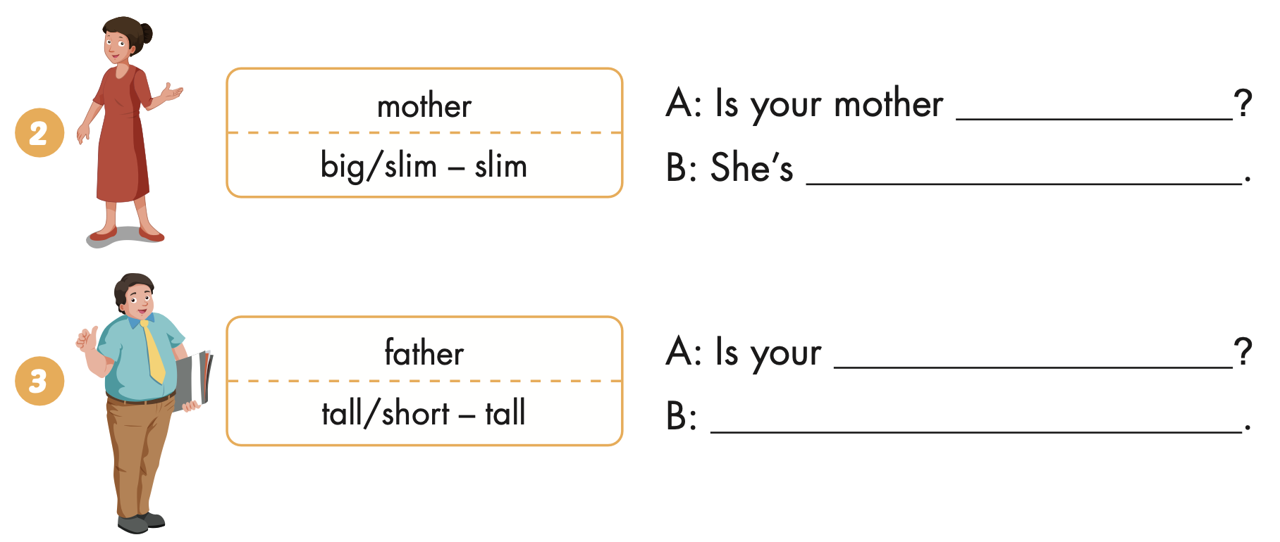
Extra Practice
WB, page 53
big or slim
slim
father tall or short
He’s tall

Slide 30
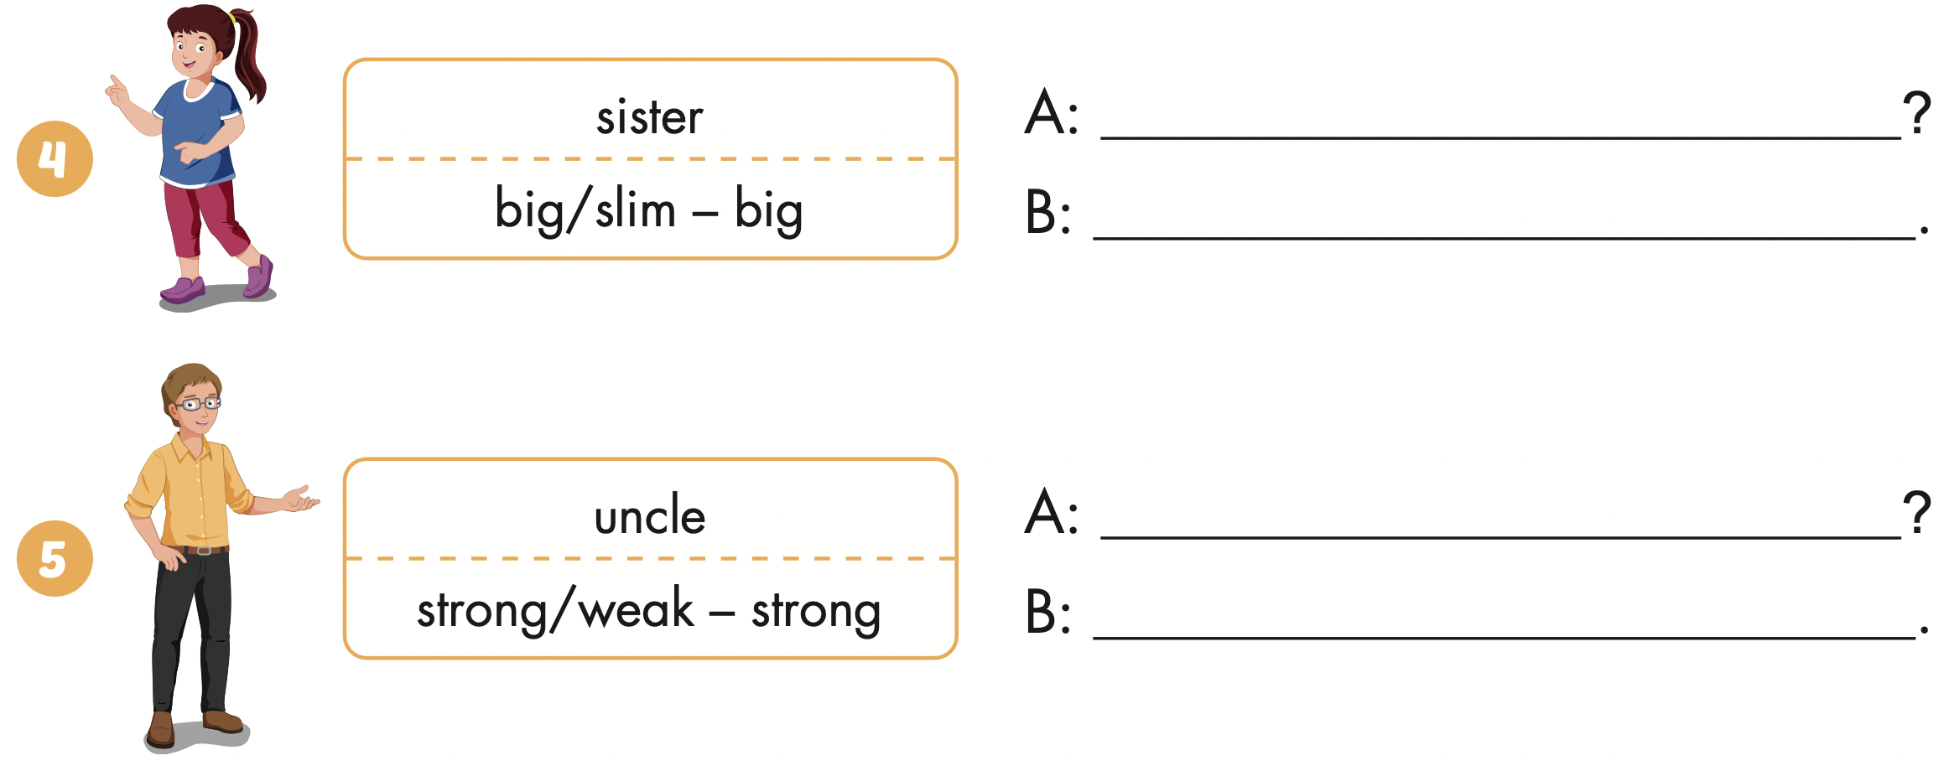
Extra Practice
WB, page 53
Is your sister big or slim
She’s big
Is your uncle strong or weak
He’s strong

Slide 31

WRAP-UP

Slide 32
Today’s lesson
Vocabularies
tall, short, big, slim, strong, weak.
Structures/ Sentence patterns
Is your father big or slim? / He's slim. / Is your sister tall or short? / She's tall.

Slide 33
Homework
Practice the vocabularies and structure; and make sentences using them.
Do the exercises in Tiếng Anh 4 i-Learn Smart Start WB (page 53).
Prepare the next lesson (page 81 SB).
Play the consolidation games in Tiếng Anh 4 i-Learn Smart Start DHA App on www.eduhome.com.vn

Slide 34

Enjoy your day!

