Slide 1

Unit 6
DESCRIBING PEOPLE
LESSON 2. 1 - PAGE 81

Slide 2
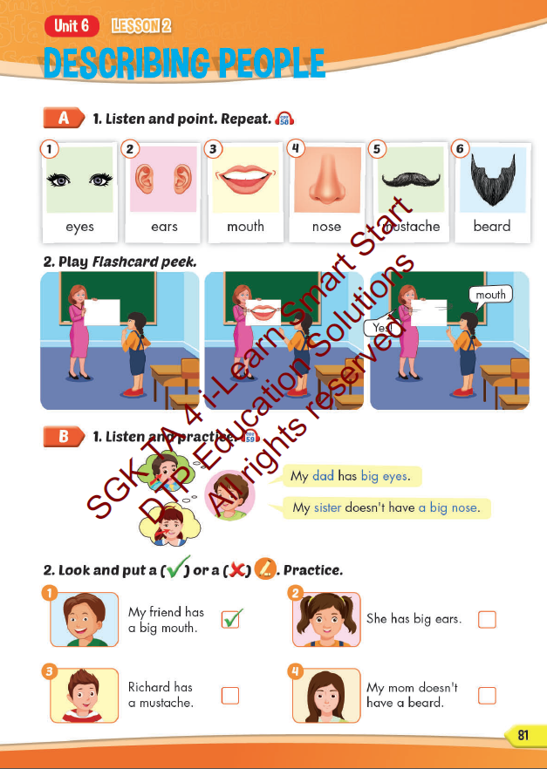
Lesson Outline
Warm-up
Vocabulary
Structure
Consolidation
Wrap-up

Slide 3
Objectives
By the end of this lesson, students will be able to describe people.
Vocabulary: eyes, ears, mouth, nose, mustache, beard.
Structure: My dad has big eyes.
My sister doesn't have a big nose.

Slide 4

WARM UP

Slide 5

Look and answer

Slide 6
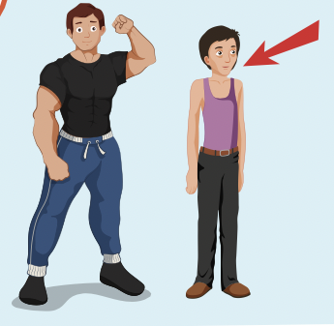
Next
CHECK
Is your aunt strong or weak?
weak
She’s………………….

Slide 7
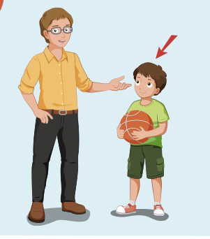
Next
CHECK
Is your brother tall or short?
short
He’s ………………..

Slide 8
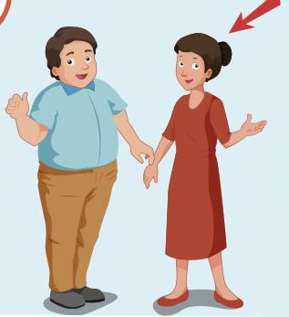
Next
CHECK
Is your mother big or slim?
slim
She’s…………….

Slide 9
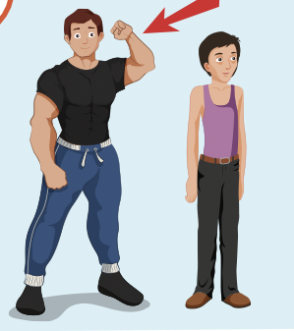
Next
CHECK
Is your uncle strong or weak?
strong
He’s …………………..

Slide 10
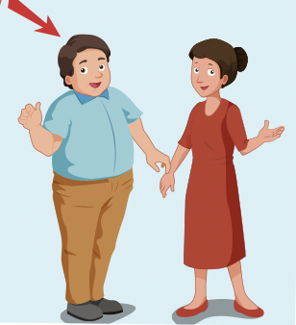
Next
CHECK
Is your father big or slim?
big
He’s………………..

Slide 11

It’s time to learn …

Slide 12

New words
eyes,
ears,
mouth,
nose,
mustache,
beard.

Slide 13

Presentation

Slide 14

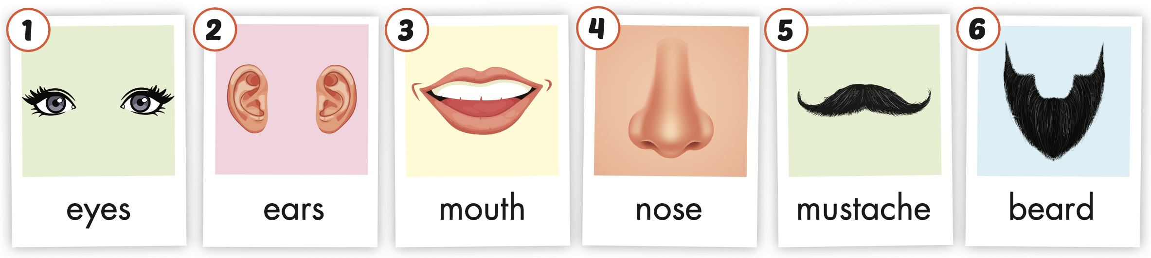
Click the icon to hear the sound.

Slide 15
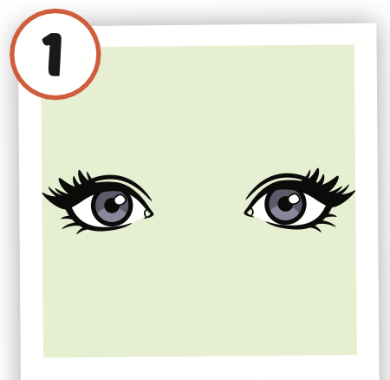
Click the picture to hear the sound.
eyes
/aɪz/
đôi mắt

Slide 16
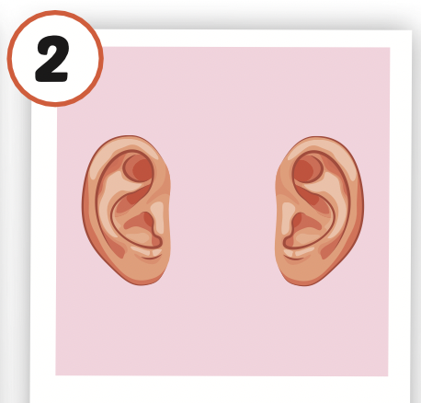
Click the picture to hear the sound.
ears
/ɪrz/
đôi tai

Slide 17
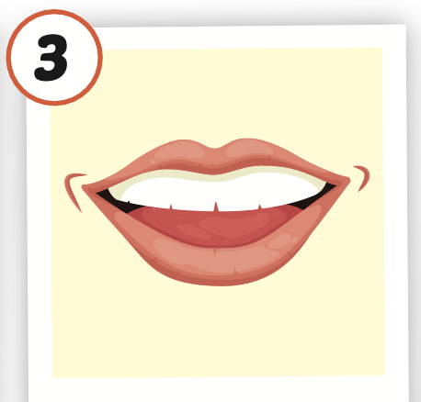
Click the picture to hear the sound.
mouth
/maʊθ/
miệng

Slide 18
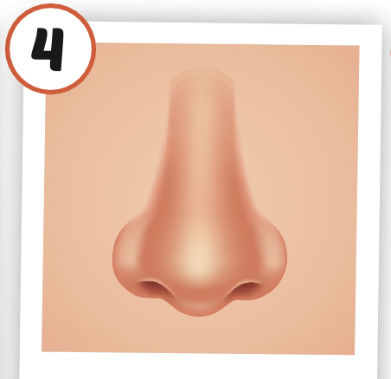
Click the picture to hear the sound.
nose
/noʊz/
mũi

Slide 19
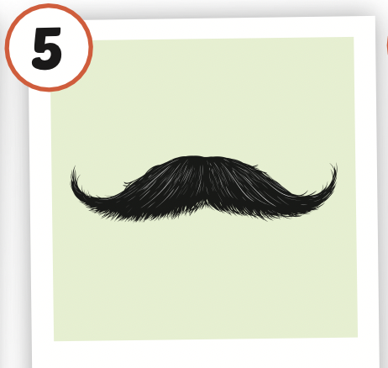
Click the picture to hear the sound.
mustache
/ˈmʌstæʃ/
ria mép

Slide 20
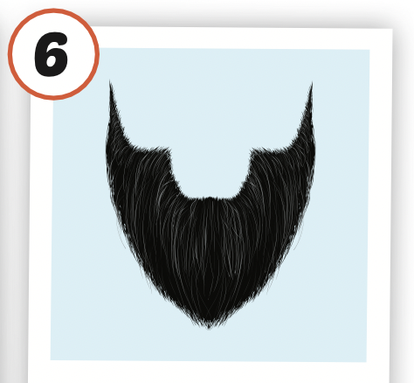
Click the picture to hear the sound.
beard
/bɪrd/
râu

Slide 21

Practice

Slide 22



LISTEN AND CHOOSE
LET’S PLAY!

Slide 26

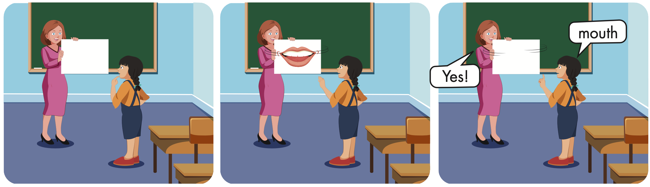

Slide 27
Structures
My dad has big eyes.
My sister doesn't have a big nose.

Slide 28
Presentation

Slide 29

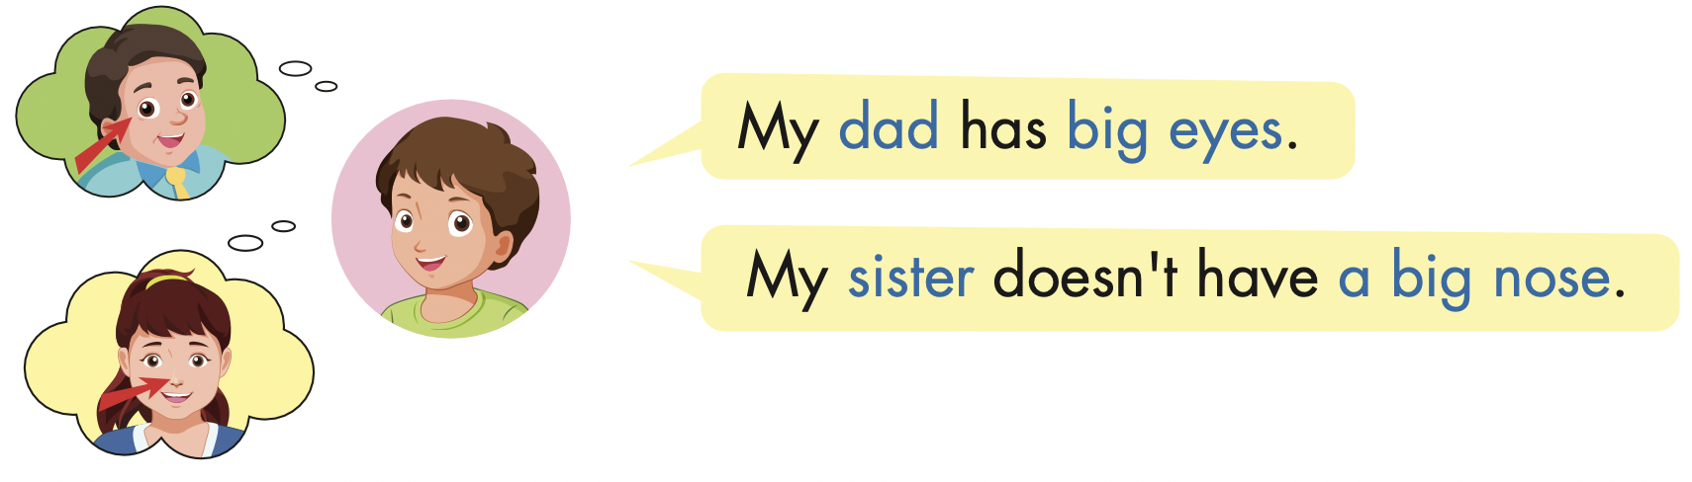

Slide 30
Practice

Slide 31

My mother has big eyes
my mother

Slide 32

Charlie doesn’t have big ears.
Charlie

Slide 33
My grandfather doesn’t have a beard.
My grandfather

Slide 34
My father has a mustache.
My father

Slide 35

Writing

Slide 36
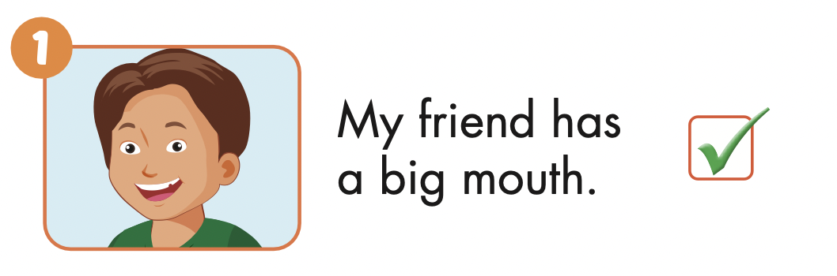

Slide 37
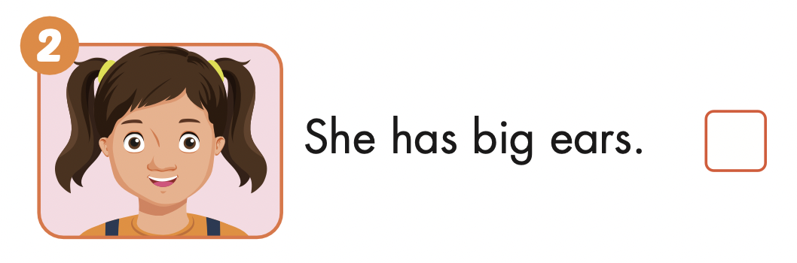

Slide 38
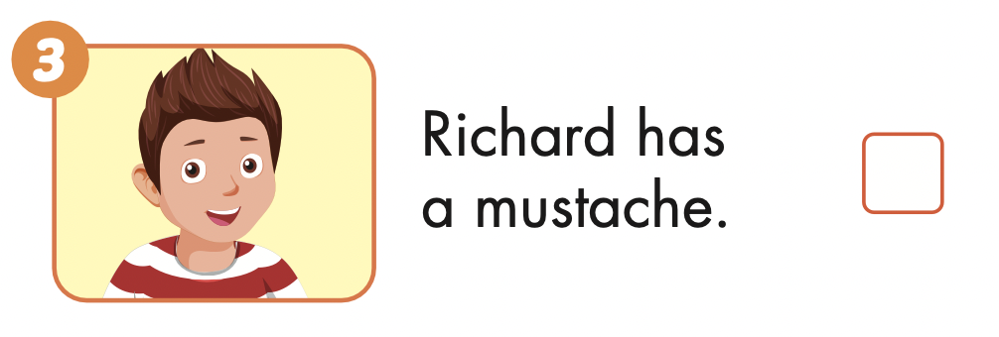

Slide 39
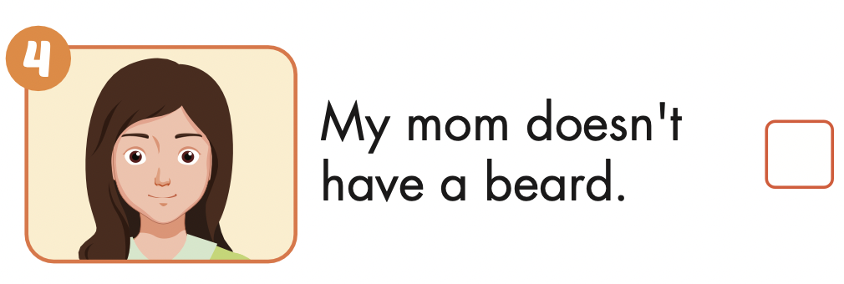

Slide 40

Production

Slide 41


Extra Practice
WB, page 14

Slide 42

Extra Practice
WB, page 14

Slide 43

Extra Practice
WB, page 14

Slide 44

CONSOLIDATION

Slide 45

WRAP-UP

Slide 46
Today’s lesson
Structures/ Sentence patterns
My dad has big eyes.
My sister doesn't have a big nose.
Vocabularies
eyes,
ears,
mouth,
nose,
mustache,
beard.

Slide 47
Homework
Practice the vocabularies and structure, and make sentences using them.
Do the exercises in Tiếng Anh 4 i-Learn Smart Start WB (page 54).
Do the exercises in Tiếng Anh 4 i-Learn Smart Start Notebook (page 35).
Prepare the next lesson (page 82 SB).
Play the consolidation games in Tiếng Anh 4 i-Learn Smart Start DHA App on www.eduhome.com.vn

Slide 48

Enjoy your day!

