Slide 1

Unit 6: Clothes
Lesson 3.1
Page 88

Slide 2

WARM UP

Slide 3
Let’s play!

Slide 4
Guess the clothes
behind the numbers.

Slide 5

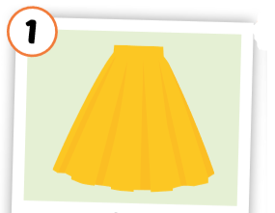
1
2

Slide 6
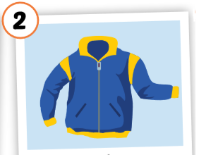
2
1
3

Slide 7
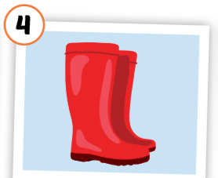
1
4
3
2

Slide 8
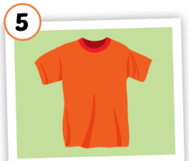
3
1
2
5
4

Slide 9
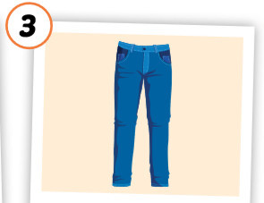
2
1
3

Slide 10
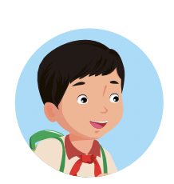
Good job!

Slide 11

It’s time to learn …

Slide 12

New words
belt,
scarf,
sweater,
pajamas,
skiing.

Slide 13

Presentation

Slide 14


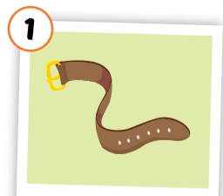
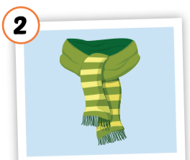
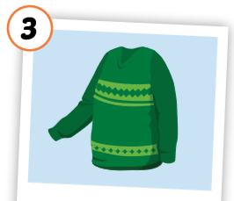
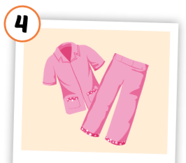
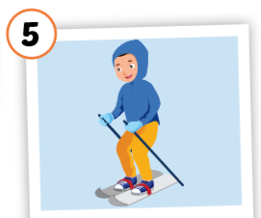
Click each English word to hear the sound.
belt
scarf
sweater
pajamas
skiing
/belt/
thắt lưng
/ skɑːrf / khăn choàng
/ ˈswetər /
áo len
/ pəˈdʒæməz / quần áo ngủ
/skiːɪŋ/
trượt tuyết
Notes:
GV giới thiệu từ vựng, CCQ

Slide 15
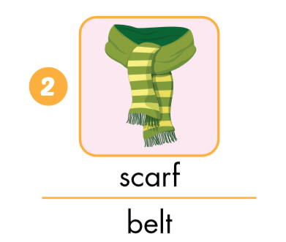
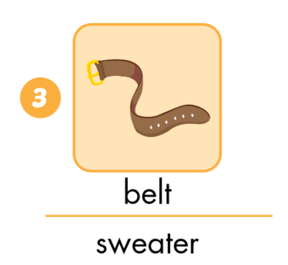
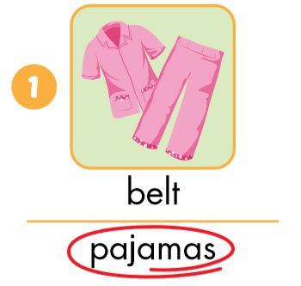
Look and circle.

Slide 16
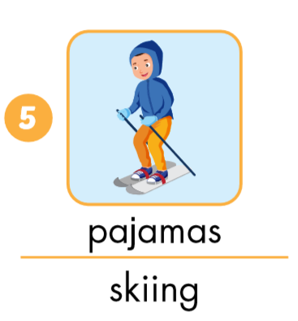
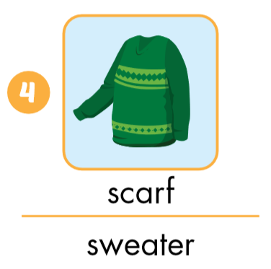
Look and circle.

Slide 17
LOOK AND WRITE
t
Swea_er
g
Skiin_
t
bel_
s
_carf
Pa_amas
j

Slide 18

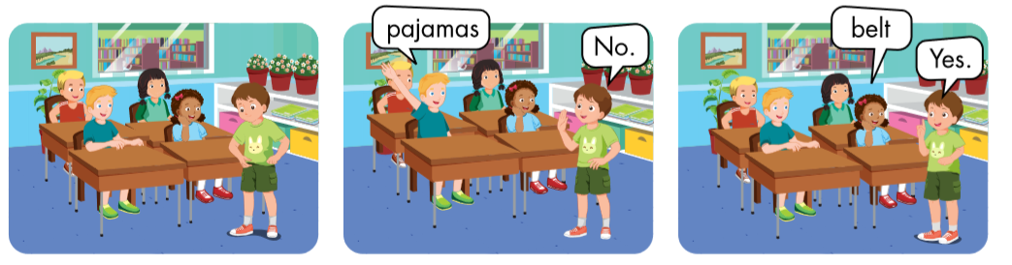

Slide 19

Practice

Slide 20

Put the pictures in the right group.
◆
❖
is
are

Slide 21

Structures
Is that your belt? Yes, it is./No, it isn’t
Are those your pajamas?
Yes, they are./
No, they aren’t.

Slide 22




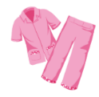
Click on the earphone to hear the sound.
Is that your belt?
Yes, it is. /No, it isn’t.
Are those your pajamas?
Yes, they are./No, they aren’t.

Slide 23

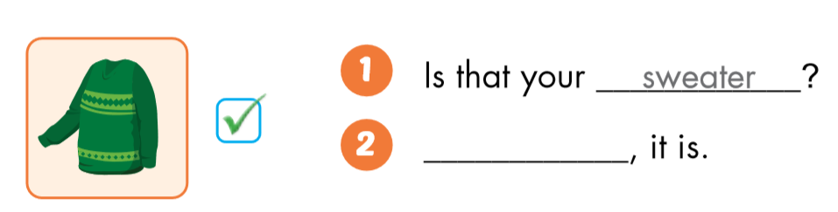
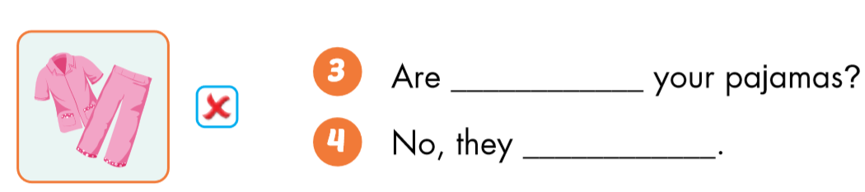
sweater
Yes
those
aren’t

Slide 24

Production

Slide 25

Notes:
134722862

Slide 26

Notes:
134722862

Slide 27
Notes:
134722862

Slide 28
Notes:
134722862

Slide 29

CONSOLIDATION

Slide 30
Game: Slap the board.
Notes:
134722862

Slide 31
Homework
Practice the vocabularies and structure; and make sentences using them.
Do the exercises in Tiếng Anh 3 i-Learn Smart Start Workbook (page 62).
Prepare the next lesson (page 89 SB).
Play the consolidation games in Tiếng Anh 3 i-Learn Smart Start DHA App on www.eduhome.com.vn

Slide 32

Enjoy your day!

