Slide 1

Unit 6: Clothes
Lesson 2.3
Page 87

Slide 2
Lesson Outline
Warm-up
Practice
Speaking
Consolidation
Wrap-up

Slide 3
Objectives
By the end of this lesson, students will be able to ask what people are wearing.
Vocabulary:
Revision (skirt, jacket, jeans, boots, T-shirt).
Structure: What are you wearing?
I’m wearing blue jeans/ I’m wearing a red jacket.

Slide 4

WARM UP

Slide 5
Let’s play!
Pictionary

Slide 6
How to play
Pictionary
Put the words in a bag.
Divide the class into 2 teams and draw a line down the middle of the board.
Ask one member from each team to choose a word from the bag.
Tell the students to draw the word as a picture on the board and encourage their team to guess the word.
The first team to shout the correct answer gets a point.

Slide 7
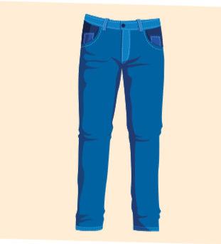
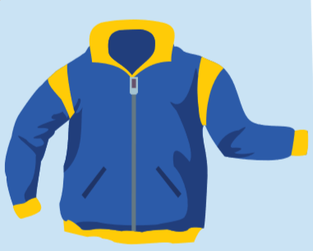
What are you wearing?
What are you wearing?
I’m wearing a blue jacket.
I’m wearing blue jeans.

Slide 8

Practice

Slide 9

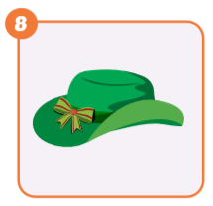
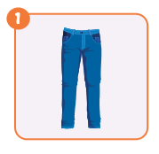
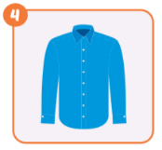
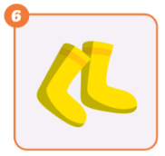
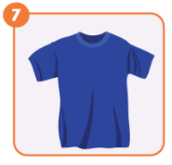
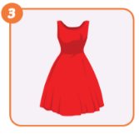
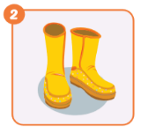
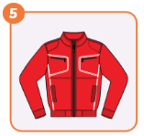
What are you wearing?
I'm wearing a green hat.

Slide 10
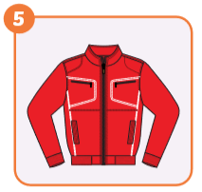

What are you wearing?
I'm wearing a red jacket.

Slide 11
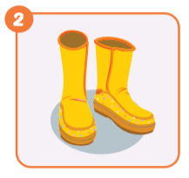
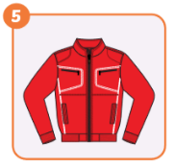
What are you wearing?
I'm wearing yellow boots.

Slide 12
What are you wearing?
I'm wearing blue jeans.

Slide 13


What are you wearing?
I'm wearing a red drees.

Slide 14

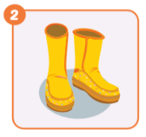
What are you wearing?
I'm wearing yellow socks.

Slide 15

What are you wearing?
I'm wearing a blue T-shirt.

Slide 16


What are you wearing?
I'm wearing a blue shirt.

Slide 17

Speaking

Slide 18

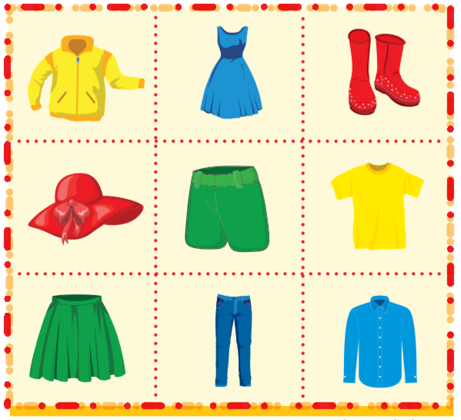
What are you wearing?
I'm wearing a yellow jacket.
OK, our turn.

Slide 19
What are you wearing?
I'm wearing a blue dress.
OK, our turn.

Slide 20
What are you wearing?
I'm wearing red boots.
OK, our turn.

Slide 21
What are you wearing?
I'm wearing a red hat.
OK, our turn.

Slide 22
What are you wearing?
I'm wearing green shorts.
OK, our turn.

Slide 23
What are you wearing?
I'm wearing a yellow T-shirt.
OK, our turn.

Slide 24
What are you wearing?
I'm wearing a green skirt.
OK, our turn.

Slide 25
What are you wearing?
I'm wearing blue pants.
OK, our turn.

Slide 26
What are you wearing?
I'm wearing blue shirt.
OK, our turn.

Slide 27

CONSOLIDATION

Slide 28

Spelling Game
Divide the class into two teams.
Have one member from each team come up to the whiteboard.
Say a day (dress) and the first student to spell it correctly gets a point for their team.

Slide 29
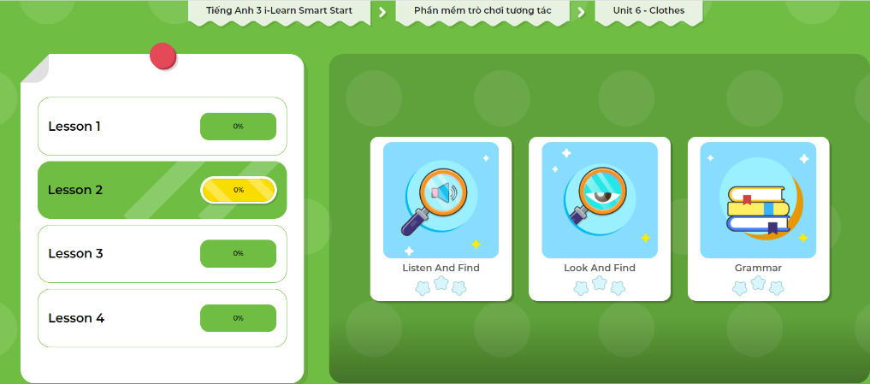
Extra Practice
DHA App
Let’s play!
Click here to play the game

Slide 30

WRAP-UP

Slide 31
Today’s lesson
Structures/ Sentence patterns
- What are you wearing?
- I’m wearing blue jeans/ I’m wearing a red jacket.

Slide 32
Homework
Practice the vocabularies and structure; and make sentences using them.
Do the exercises in Tiếng Anh 3 i-Learn Smart Start Workbook (page 61).
Prepare the next lesson (page 88 SB).
Play the consolidation games in Tiếng Anh 3 i-Learn Smart Start DHA App on www.eduhome.com.vn
Do the exercise in Tiếng Anh 3 i-Learn Smart Start Notebook (page 41).

Slide 33
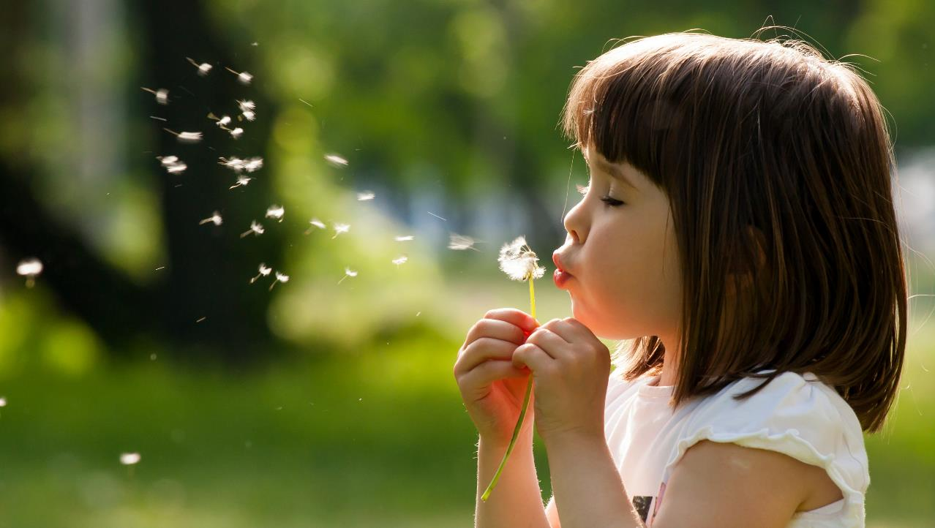
Enjoy your day!

