Slide 1

Unit 5: Getting Around
Lesson 2.1
Page 67

Slide 2
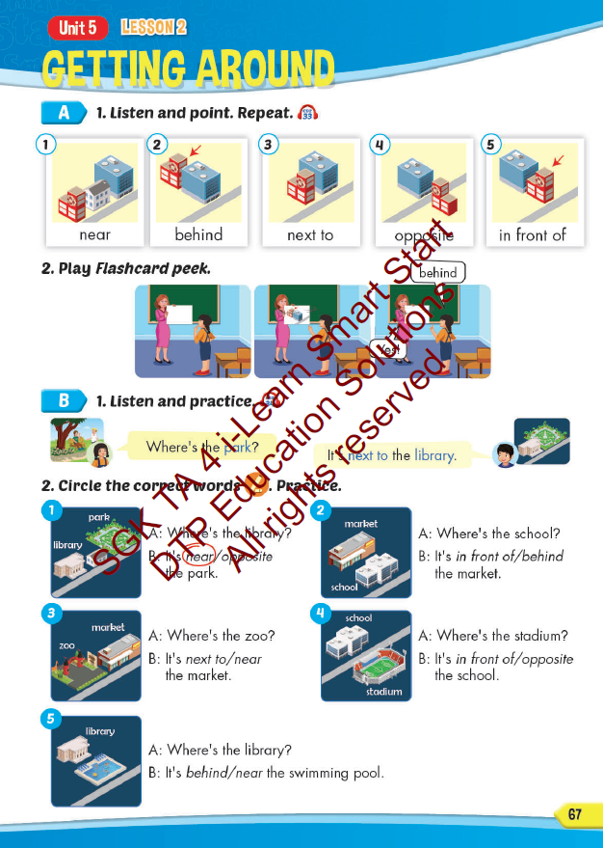
Lesson Outline
Warm-up
Vocabulary
Structure
Consolidation
Wrap-up

Slide 3
Objectives
By the end of this lesson, students will be able to…
Vocabulary: Pronounce and use the words related to the topic properly: near, behind, next to, opposite, in front of.
Structure: Where's the park? - It's next to the library.

Slide 4

WARM UP

Slide 5
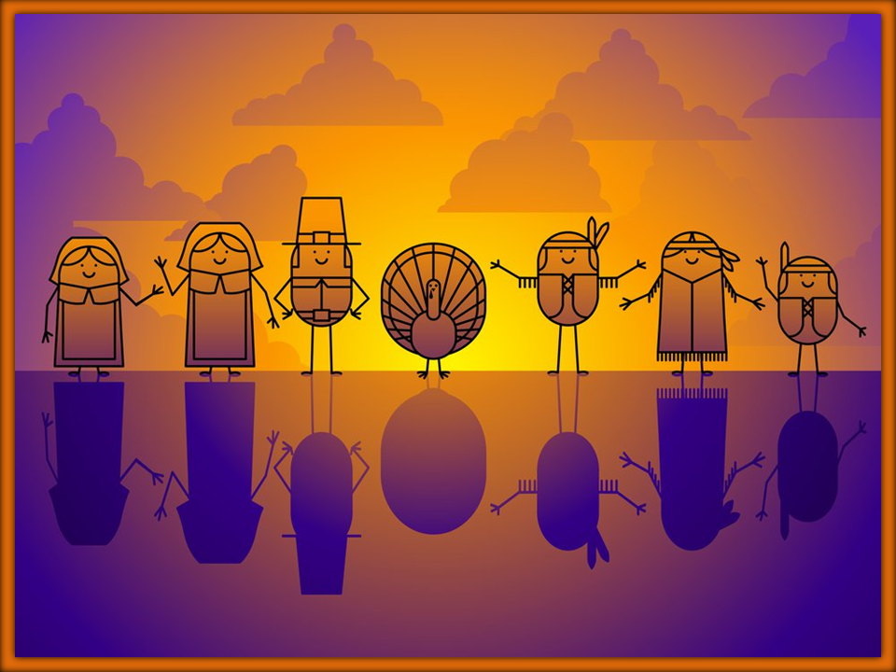




stop
Click on the right picture
NEXT

Slide 6




do not enter
Click on the right picture
NEXT

Slide 7



turn left
Click on the right picture
NEXT

Slide 8



turn right
Click on the right picture
NEXT

Slide 9



no parking
Click on the right picture
NEXT

Slide 10

It’s time to learn …

Slide 11
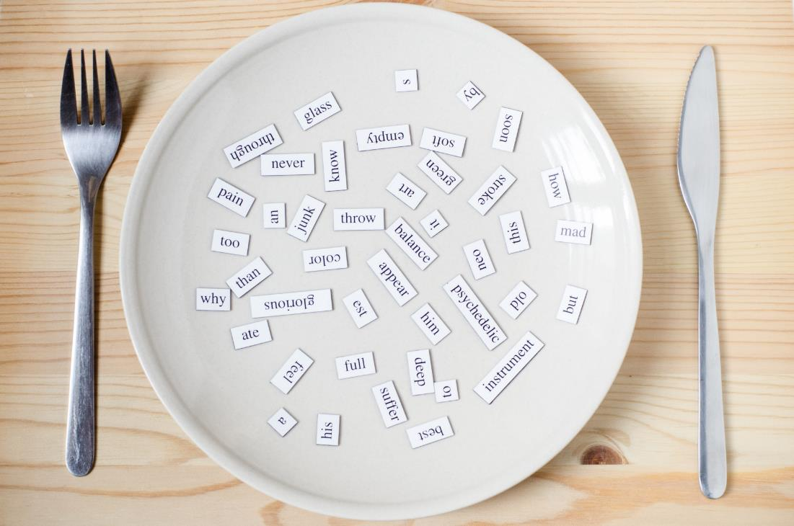
New words
near, behind, next to,
opposite, in front of

Slide 12

Presentation

Slide 13

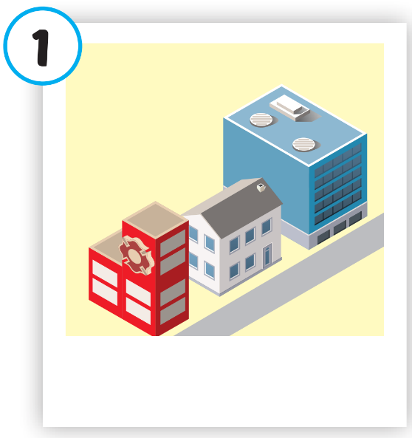
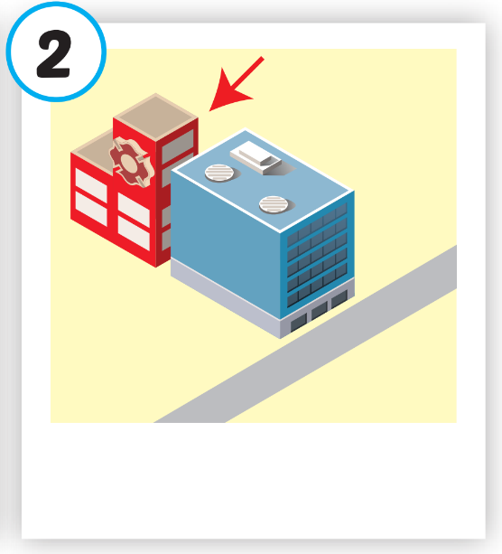
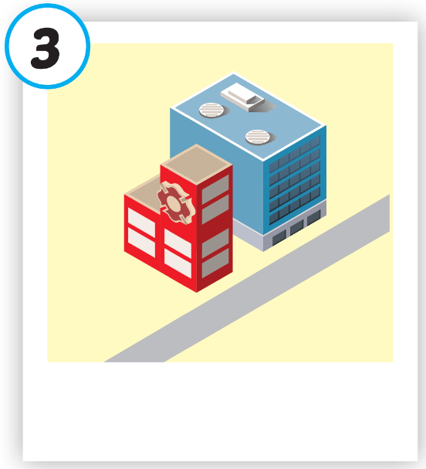
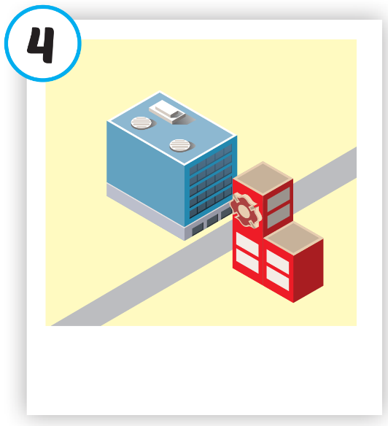
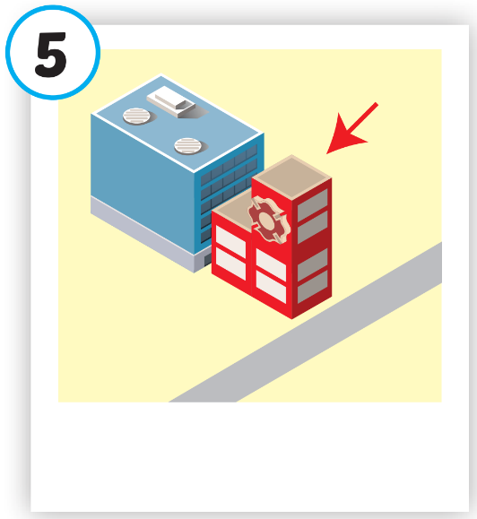





Click on each picture to hear the sound.
/nɪr/
gần
/bɪˈhaɪnd/
đằng sau
/nekst tə/
bên cạnh
/ˈɑːpəzɪt/
đối diện
/ɪn ˈfrʌnt əv/
phía trước
Notes:
Click vào hình A. 1. Listen and point. Repeat để cho cả audio full chạy

Slide 14
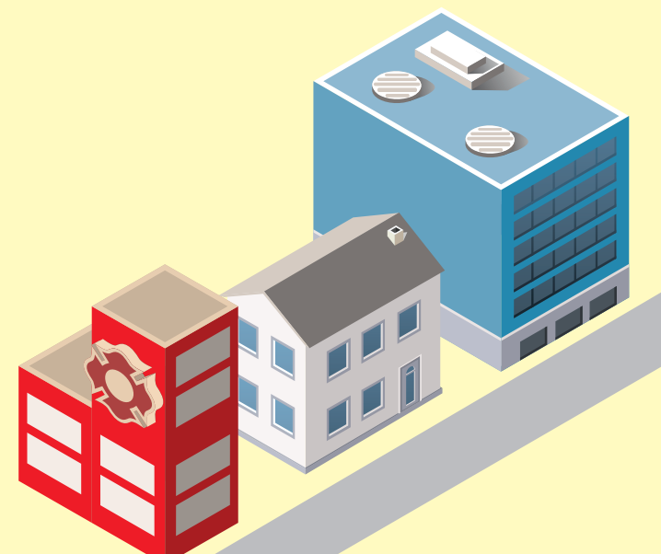
Click on each picture to hear the sound.
/nɪr/
gần

Slide 15
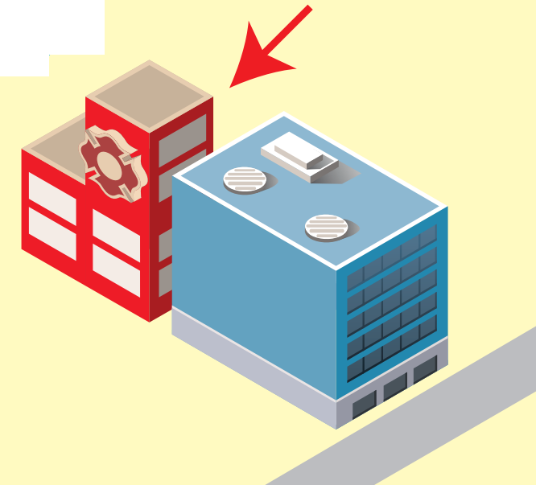
Click on each picture to hear the sound.
/bɪˈhaɪnd/
đằng sau
Notes:
Click vào hình A. 1. Listen and point. Repeat để cho cả audio full chạy

Slide 16

Click on each picture to hear the sound.
/nekst tə/
bên cạnh

Slide 17
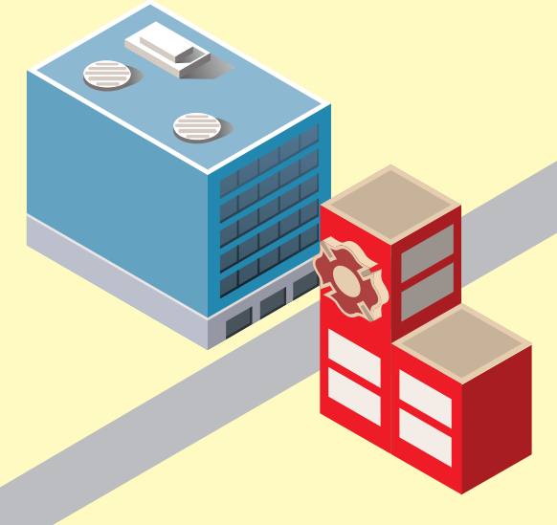
Click on each picture to hear the sound.
/ˈɑːpəzɪt/
đối diện

Slide 18
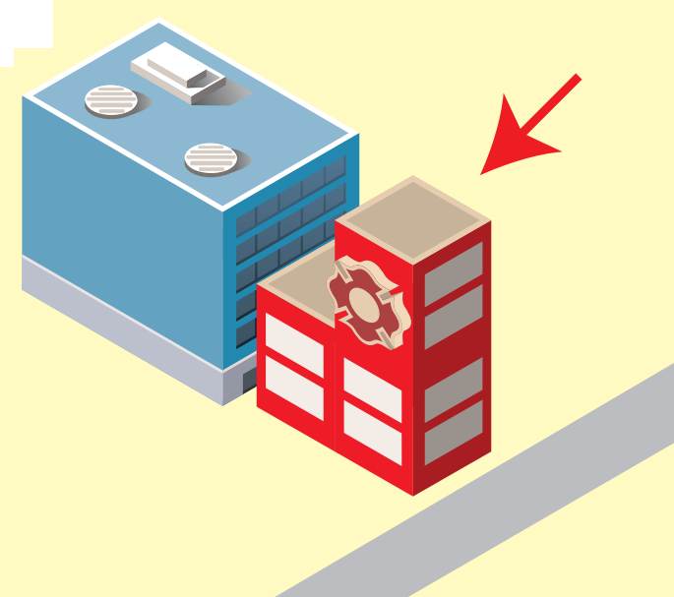
Click on each picture to hear the sound.
/ɪn ˈfrʌnt əv/
phía trước

Slide 19
Practice

Slide 20
Check your memory

Slide 21






PLAY

Slide 22


Click on the SPIN button and guess the word.

Slide 23




near
Which word is it?
NEXT
r
ar
fast
d
fa
ne
r
e
a
a
m
ak
fa
br
Check

Slide 24
opposite
Which word is it?
NEXT
site
ar
fast
h
fa
po
p
si
te
p
op
h
n
fa
br
Check

Slide 25
behind
Which word is it?
NEXT
nd
ar
fast
d
fa
hi
r
br
e
a
be
m
ak
fa
br
Check

Slide 26
in front of
Which word is it?
NEXT
in
ar
fast
d
fa
of
r
br
e
a
front
m
ak
fa
br
Check

Slide 27
next to
Which word is it?
NEXT
to
ar
fast
d
fa
xt
r
br
e
a
ne
m
ak
fa
br
Check

Slide 28

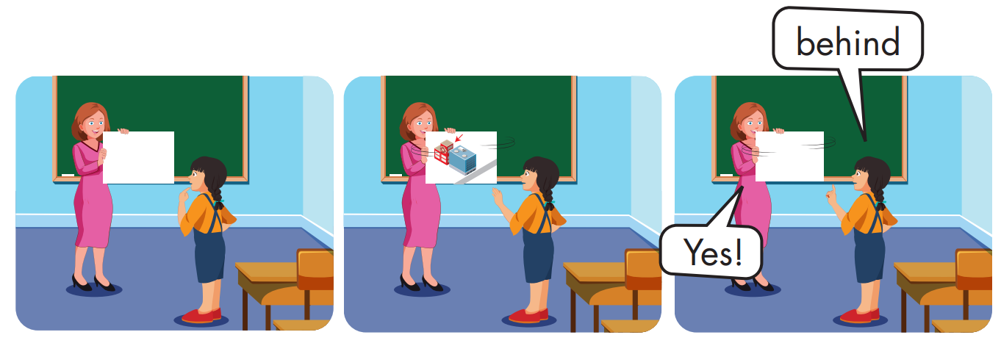

Slide 29
Structure
Where's the park?
It's next to the library.

Slide 30
Presentation

Slide 31
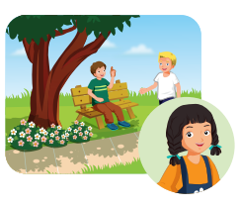
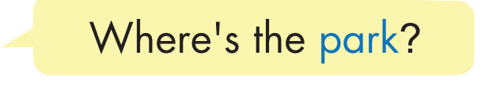
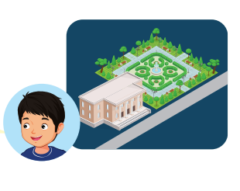
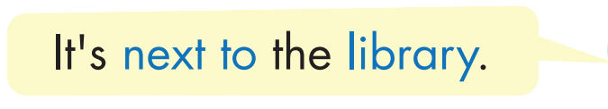
Structure

Slide 32

Practice

Slide 33


Slide 34
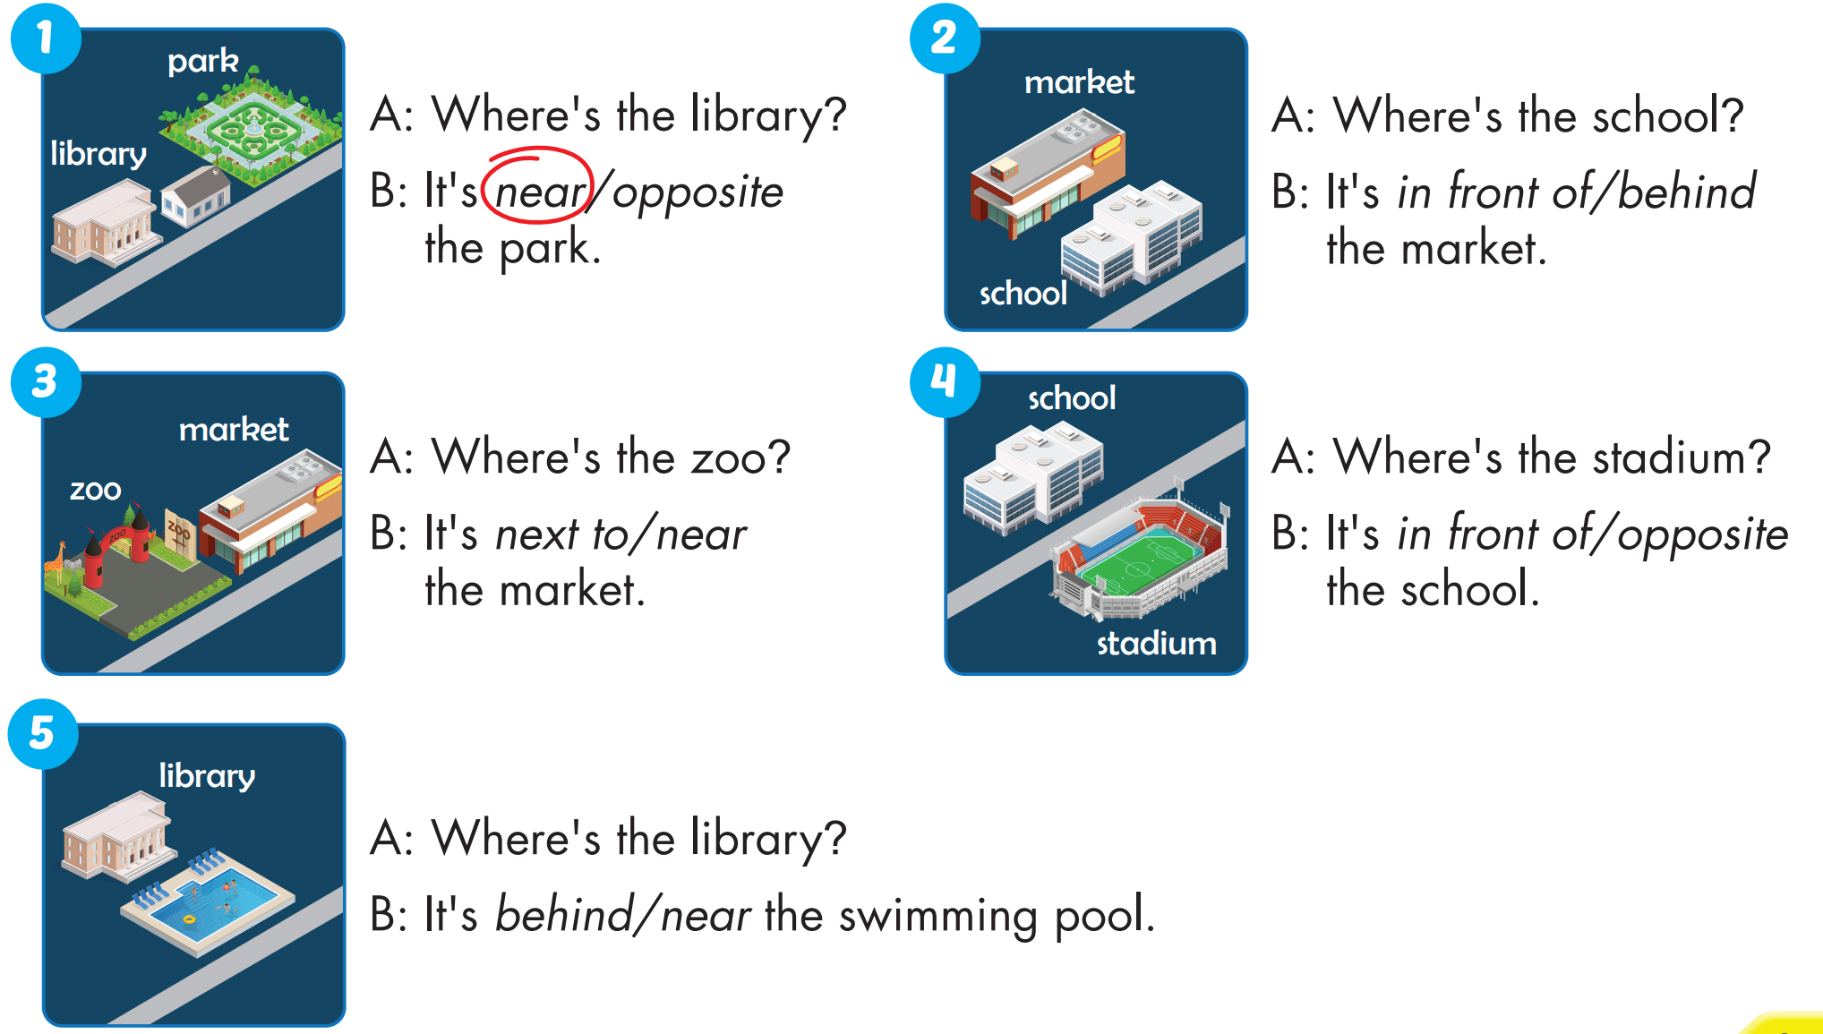


Slide 35

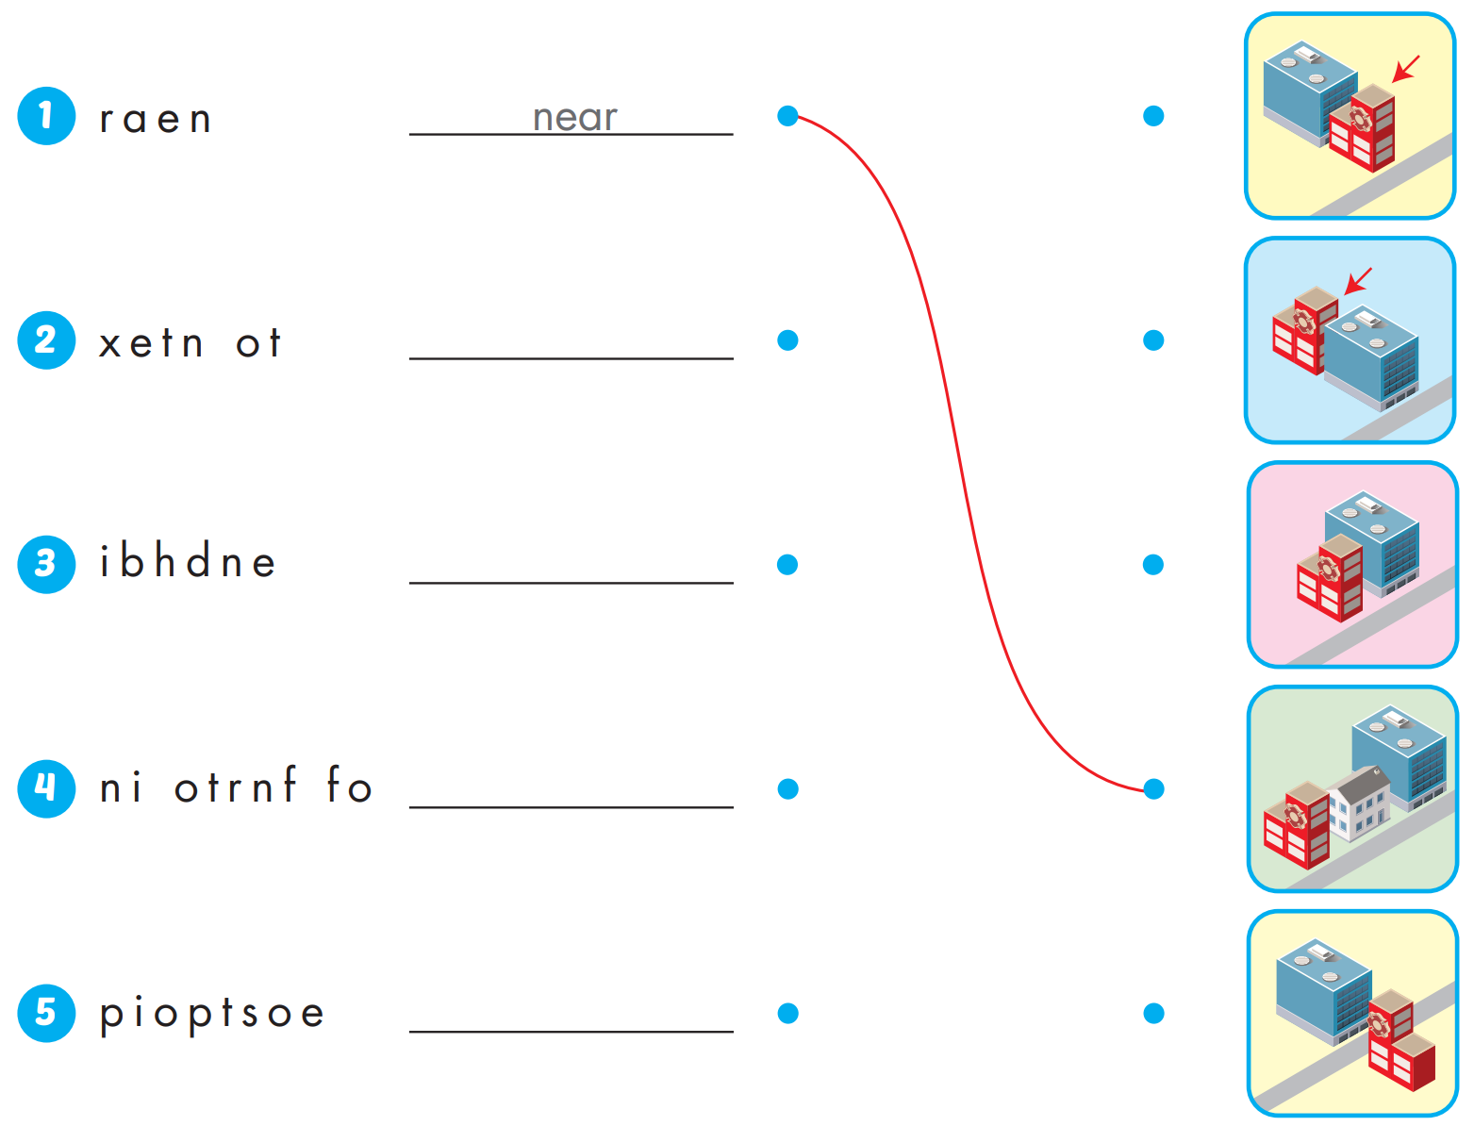
Extra Practice
WB, page 44
next to
behind
in front of
opposite

Slide 36

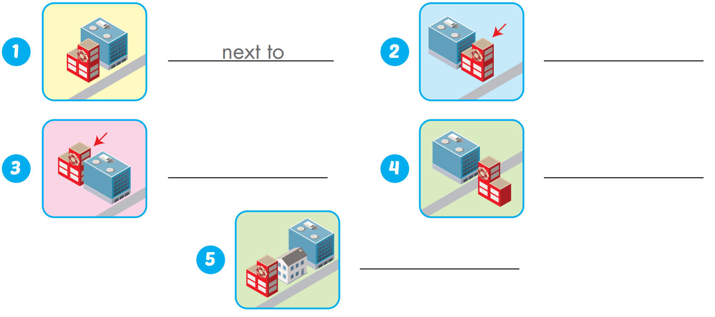
Extra Practice
WB, page 44
in front of
behind
opposite
near

Slide 37

WRAP-UP

Slide 38
Today’s lesson
Vocabularies
near, behind, next to, opposite, in front of.
Structures/ Sentence patterns
Where's the park?
- It's next to the library.

Slide 39
Homework
Practice the vocabularies and structure; and make sentences using them.
Do the exercises in Tiếng Anh 4 i-Learn Smart Start WB (page 44).
Do the exercises in Tiếng Anh 4 i-Learn Smart Start Notebook (page 29).
Prepare the next lesson (page 68 SB).
Play the consolidation games in Tiếng Anh 4 i-Learn Smart Start DHA App on www.eduhome.com.vn

Slide 40

Enjoy your day!

