Slide 1

Unit 4: HOME
Review and practice
Page 64

Slide 2

WARM UP

Slide 3

Hidden
Pictures
Guessing
Game

Slide 4
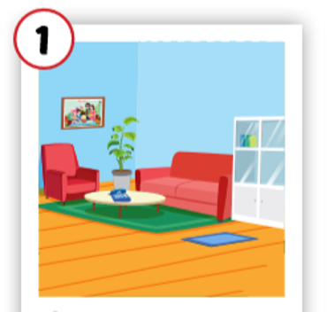
Living room

Slide 5
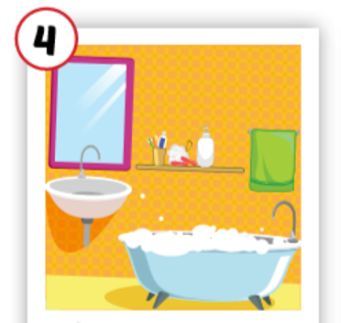
bathroom

Slide 6
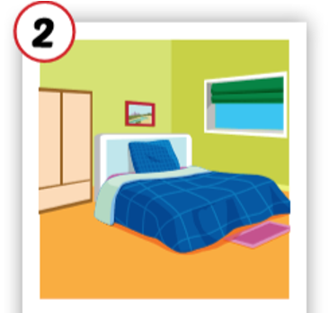
bedroom

Slide 7
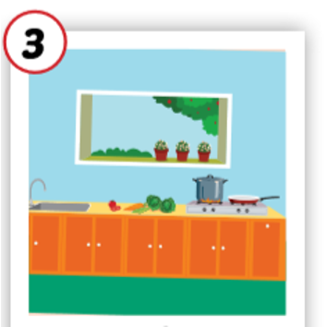
kitchen

Slide 8
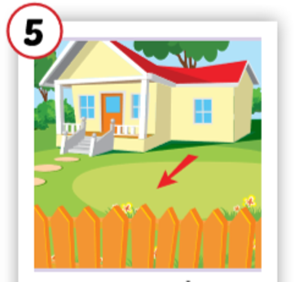
yard

Slide 9
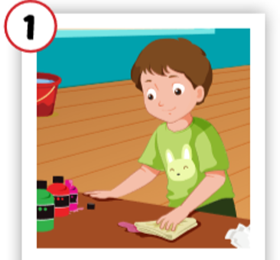
cleaning

Slide 10
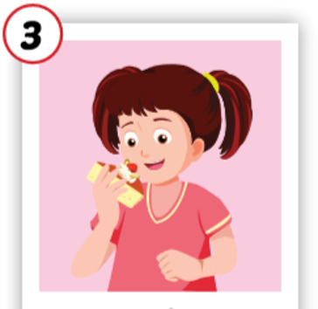
eating

Slide 11

It’s time to learn …

Slide 12

Listening

Slide 13

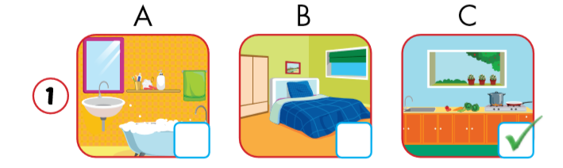

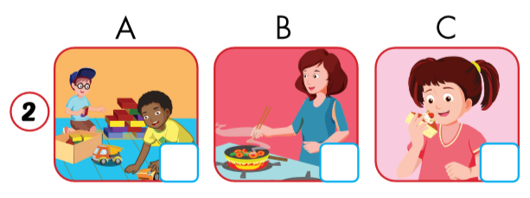

Click on the earphone to hear the sound.
Notes:
2 A

Slide 14
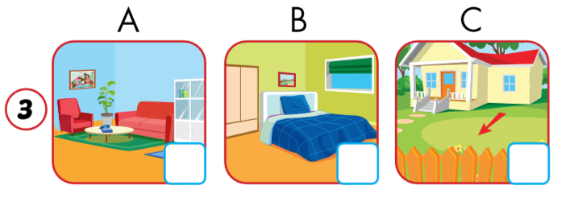
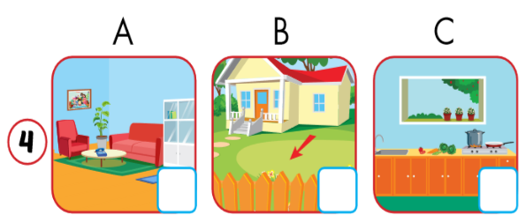
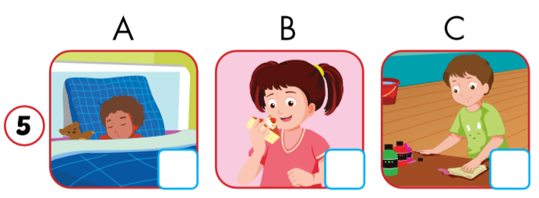
Click on the earphone to hear the sound.
Notes:
3 - B 4 - C 5 C

Slide 15
Make up sentences.
Jame _______.
Jame is playing.
My bedroom has______.
My bedroom has a picture (in it).
Notes:
Teacher can make use of these pictures to say the sentences (e.g. : 3. Ben is in the yard) and students give their answer C. Then ask students to work in pairs to do the same.

Slide 16
Make up sentences.
My kitchen _______.
My kitchen is blue./
My kitchen has a picture.
Ben _______.
He is cleaning.
Notes:
3 - B 4 - C 5 C

Slide 17

Reading

Slide 18

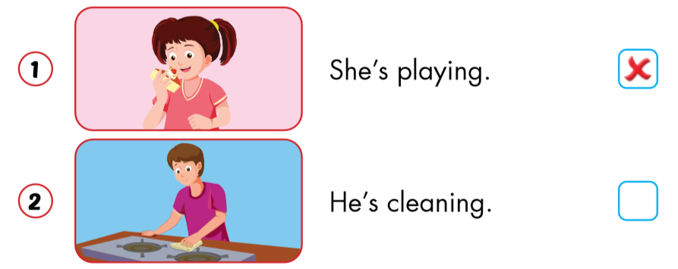

Slide 19
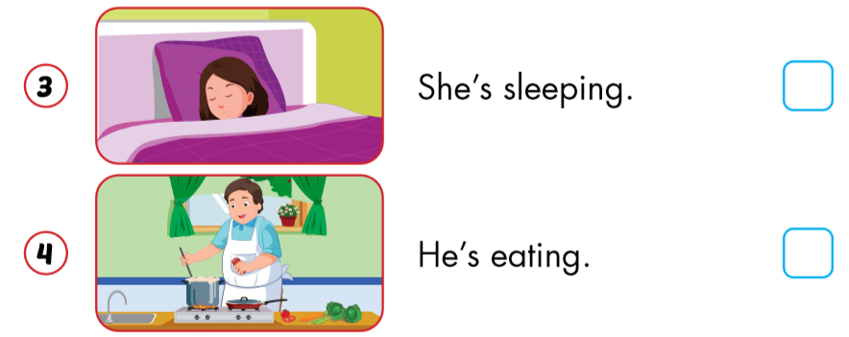


Slide 20
PRODUCTION

Slide 21
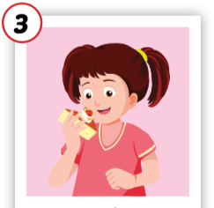
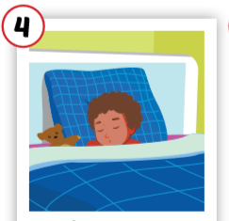
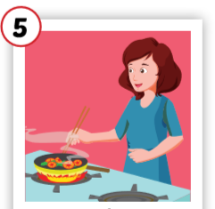

LOOK, ASK AND ANSWER

Slide 22

CONSOLIDATION

Slide 23
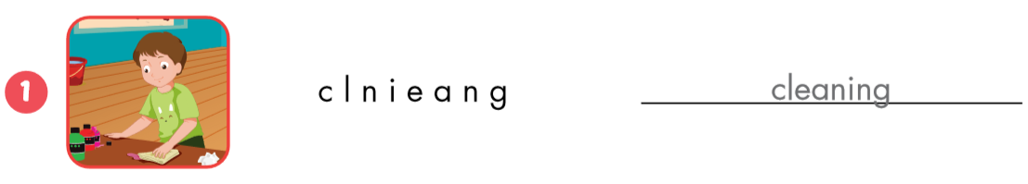
ORDER THE LETTERS
cleaning

Slide 24
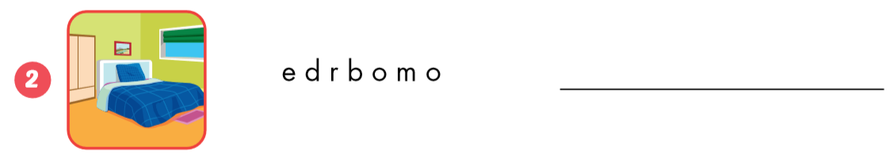
bedroom

Slide 25
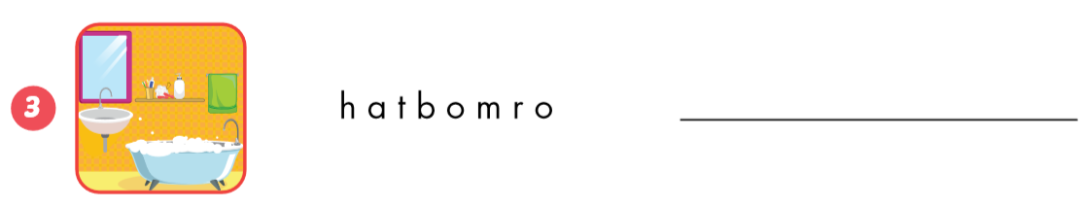
bathroom

Slide 26
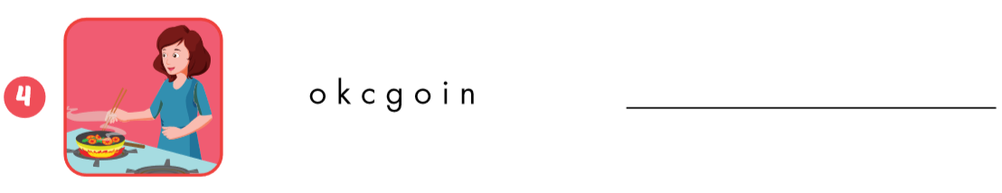
cooking

Slide 27
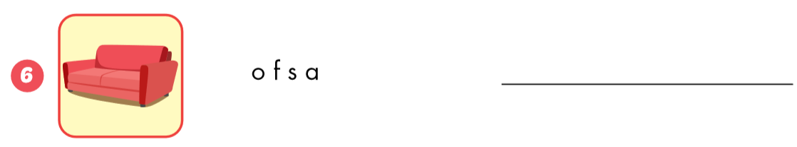
sofa

Slide 28
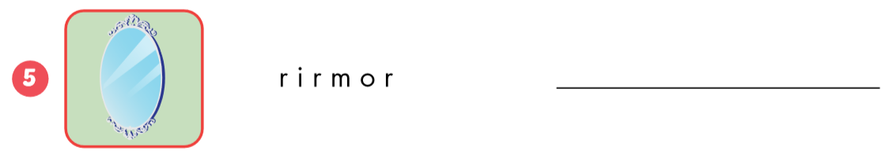
mirror

Slide 29
Homework
Review the vocabularies and sentence patterns. Make sentences using them.
Do the exercises on page 46 (WB)
Prepare the next lesson (page 65 SB)
Play the consolidation games in Tiếng Anh 3 i-Learn Smart Start DHA App on www.eduhome.com.vn
Do the exercises in Tiếng Anh 3 i-Learn Smart Start Notebook on page 32.

Slide 30

Have a nice day!

