Slide 1

Unit 4: ACTIVITIES
Lesson 3
Page 56

Slide 2
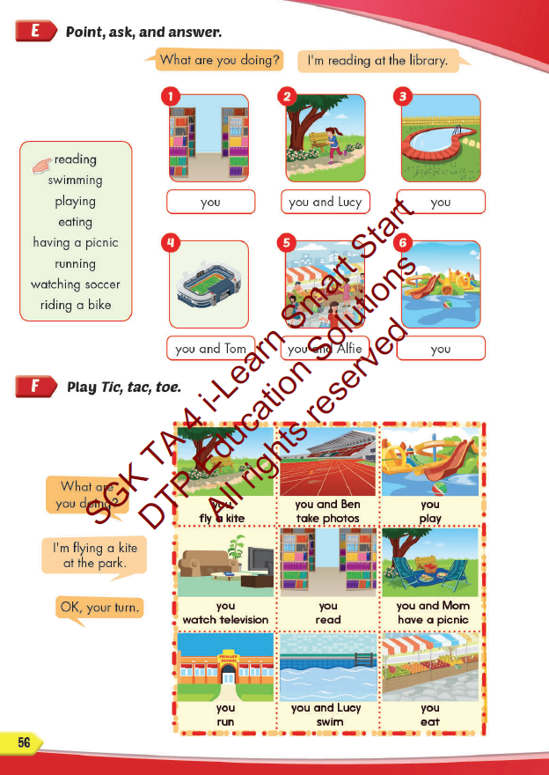
Lesson Outline
Warm-up
Practice
Speaking
Consolidation
Wrap-up

Slide 3
Objectives
By the end of this lesson, students will be able to ask and answer what they are doing at some different places.
Vocabulary: library, stadium, park, water park, market, swimming pool.
Structure:
What are you doing?
I’m swimming at the pool.
What are you doing?
We are reading at the library.

Slide 4

WARM UP

Slide 5

LET’S PLAY!
What’s missing?
Notes:
Put three or four FLASHCARDS (clothes) on the board and tell your child to look at them. Ask them to close their eyes and take one card away. When your child opens their eyes, ask them to guess what is missing.

Slide 6

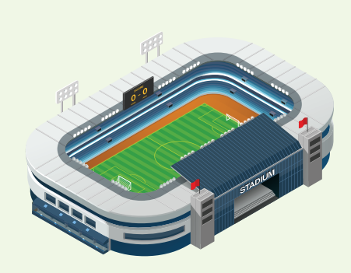
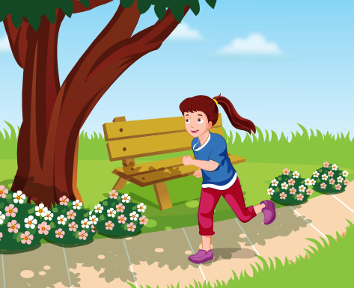
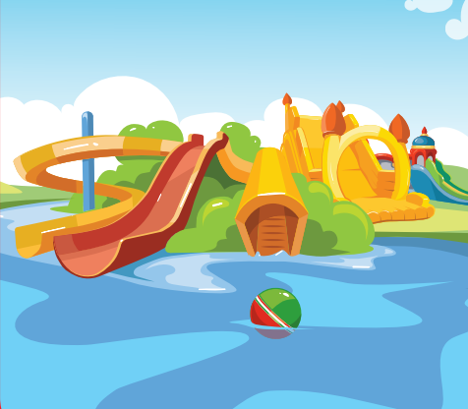
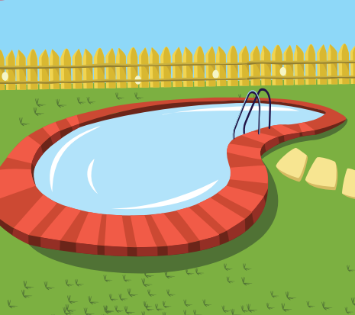


Slide 12
REVIEW 2
library
stadium
park
water park
swimming pool
market

Slide 13

It’s time to learn …

Slide 14

Practice

Slide 15

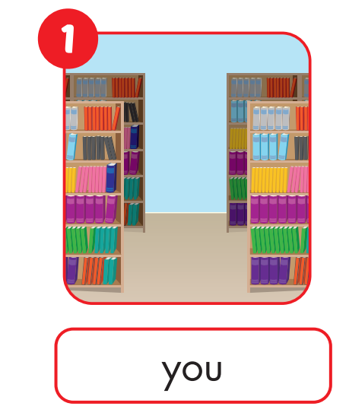

What are you doing?
I’m reading at the library.

Slide 16
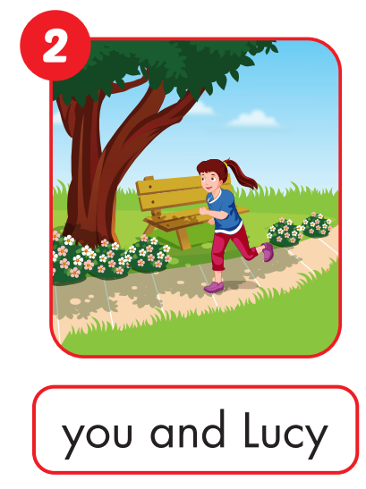

What are you and Lucy doing?
We’re running at the park.

Slide 17
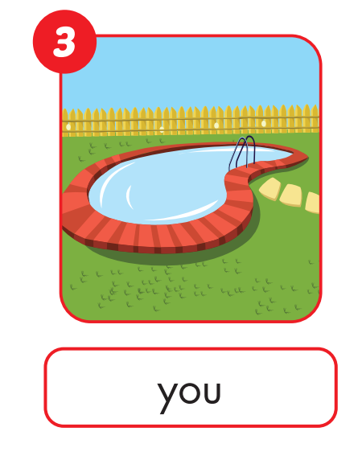

What are you doing?
I’m swimming at the pool.

Slide 18
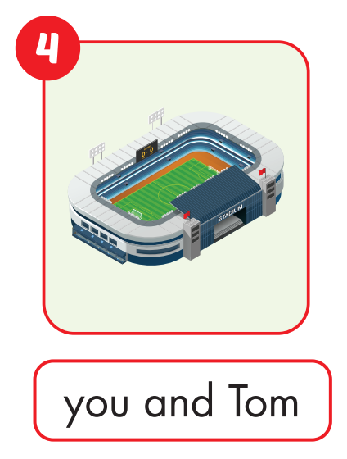

What are you doing?
I’m watching soccer at the stadium.

Slide 19


What are you and Alfie doing?
We’re eating at the market.

Slide 20
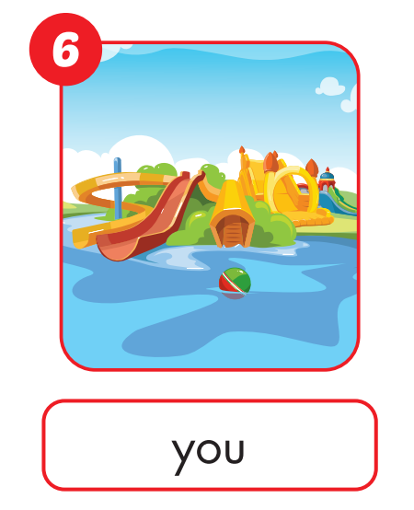

What are you doing?
I’m playing at the water park.

Slide 21

Speaking

Slide 22



Slide 23
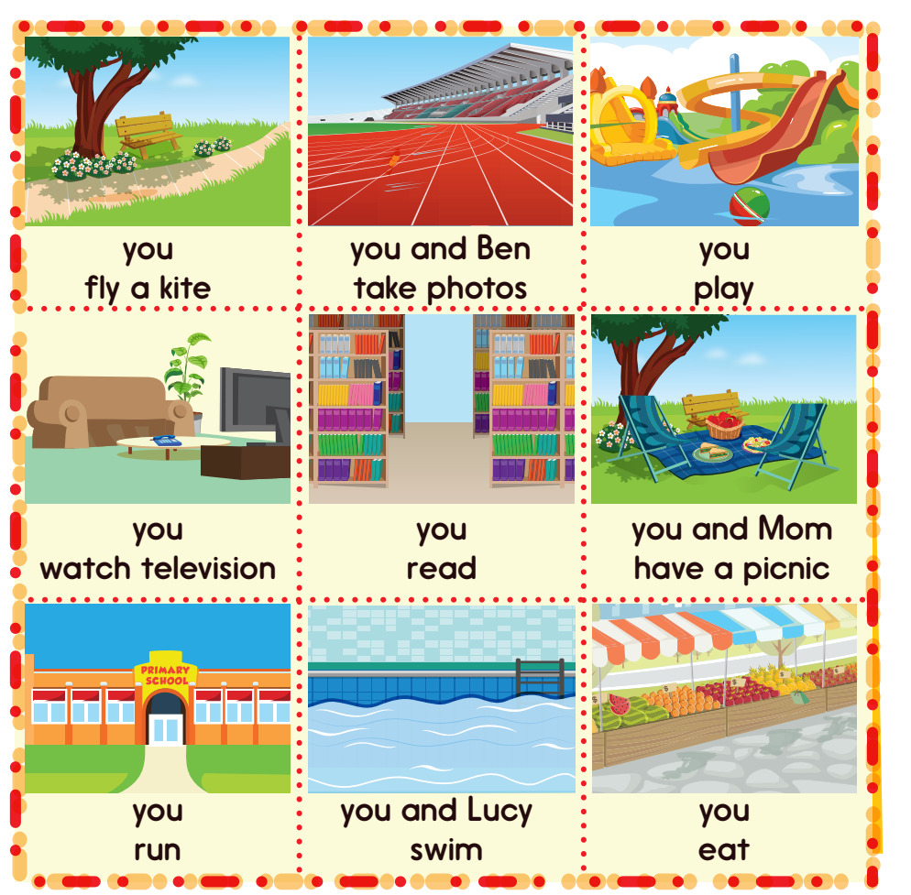
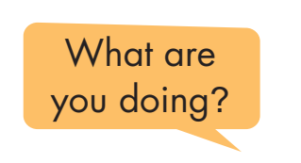
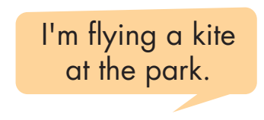
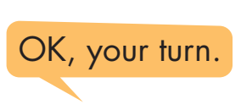

Slide 24

CONSOLIDATION

Slide 25



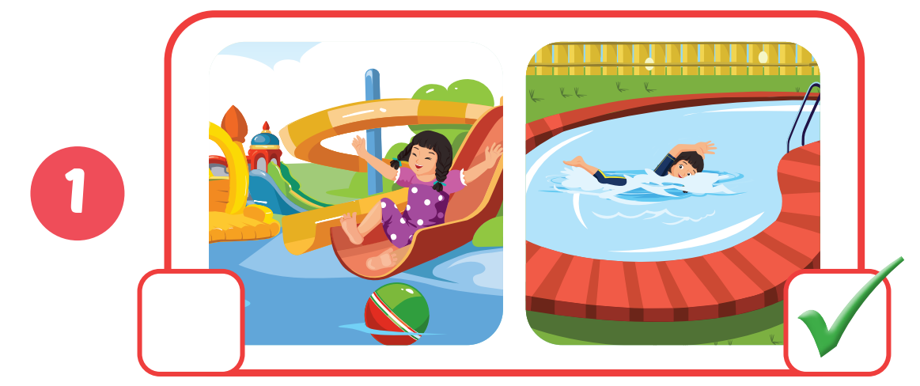

Slide 26
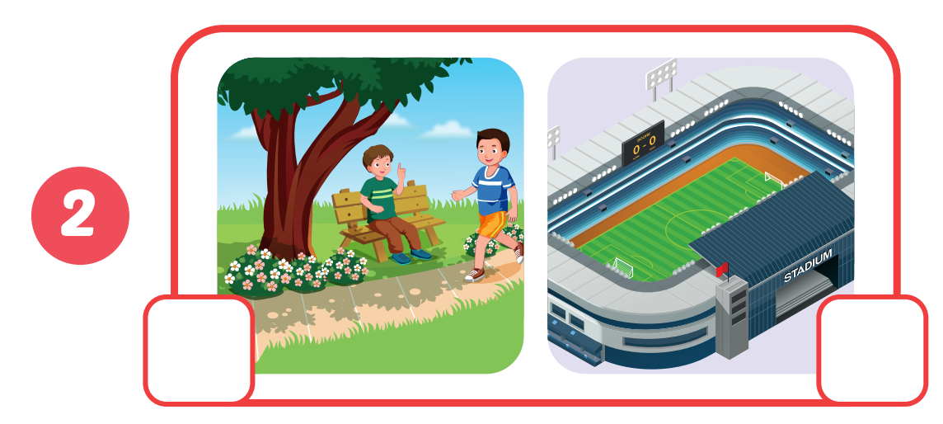

Click on the headphone icon to hear the sound.

Slide 27

Click on the headphone icon to hear the sound.

Slide 28
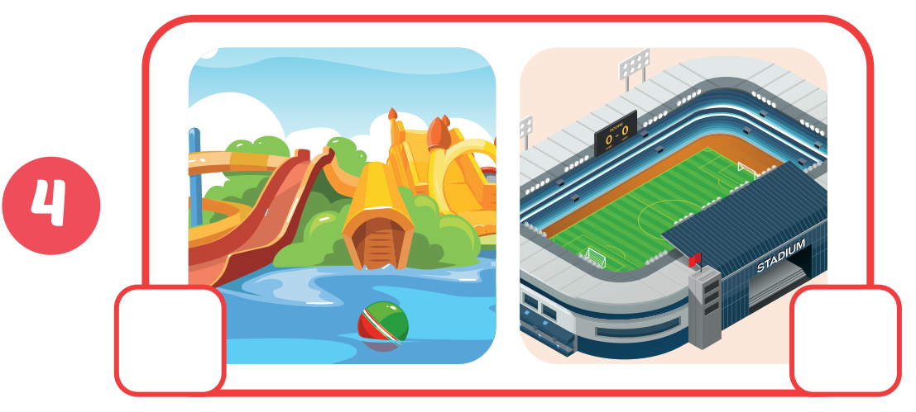
Click on the headphone icon to hear the sound.

Slide 29
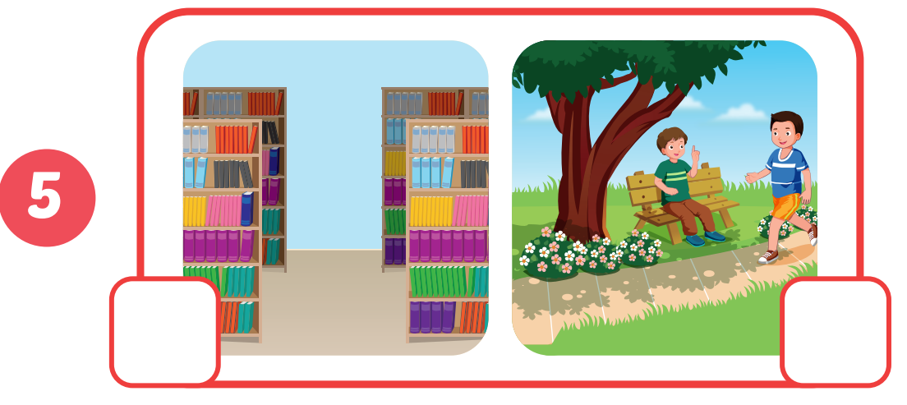
Click on the headphone icon to hear the sound.

Slide 30

WRAP-UP

Slide 31
Today’s lesson
Vocabularies
library, stadium, park, water park, market, swimming pool.
Structures/ Sentence patterns
What are you doing?
I’m swimming at the pool.
What are you doing?
We are reading at the library.

Slide 32
Homework
Practice the vocabulary and structure; and make sentences using them.
Do the exercises in Tiếng Anh 4 i-Learn Smart Start WB (page 37)
Do the exercises in Tiếng Anh 4 i-Learn Smart Start Notebook (page 24).
Prepare the next lesson (page 57 SB)
Play the consolidation games in Tiếng Anh 4 i-Learn Smart Start DHA App on www.eduhome.com.vn

Slide 33

Enjoy your day!

