Slide 1

Unit 4: ACTIVITIES
Review and Practice
Page 60

Slide 2
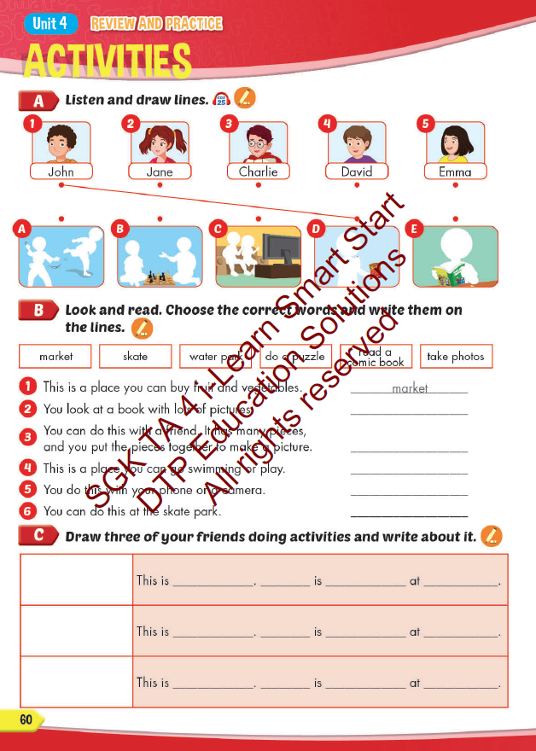
Lesson Outline
Warm-up
Reading
Listening
Consolidation
Wrap-up

Slide 3
Objectives
By the end of this lesson, students will be able to review the target language in the unit.
Vocabulary:
Activities: listen to music, watch television, play table tennis, do martial arts, skate, play chess, play a board game, do a puzzle, read a comic book, eat snacks, take photos, play video games.
Places: library, stadium, park, water park, market, swimming pool. studio, soccer field, arcade, skate park, coffee shop.
Structure:
What are you doing? What are they doing?
I’m swimming at the pool. They’re swimming at the pool.
What is he/she doing?
He/she swimming at the pool.

Slide 4

WARM UP

Slide 5

LET’S PLAY!
What’s missing?
Notes:
Put three or four FLASHCARDS (clothes) on the board and tell your child to look at them. Ask them to close their eyes and take one card away. When your child opens their eyes, ask them to guess what is missing.

Slide 6

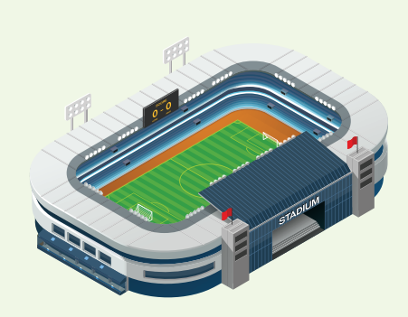
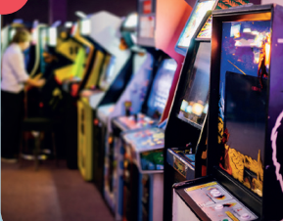
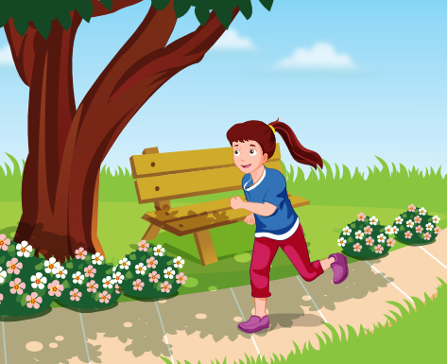
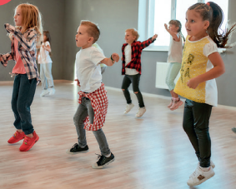
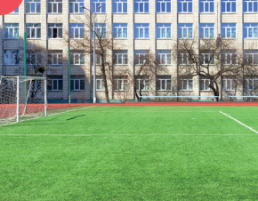
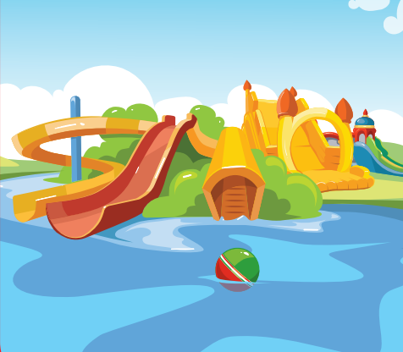

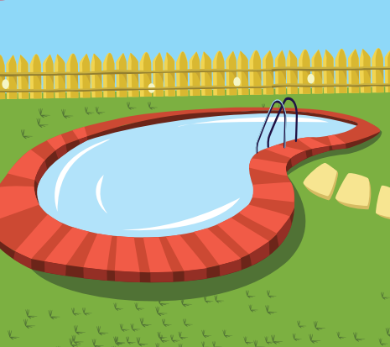


Slide 14
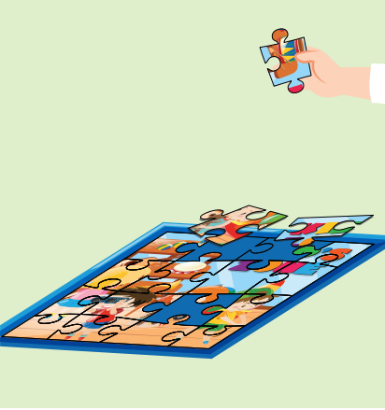

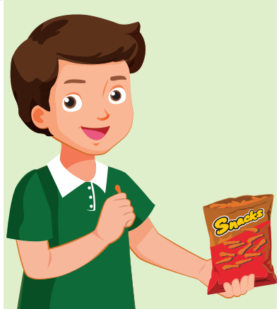

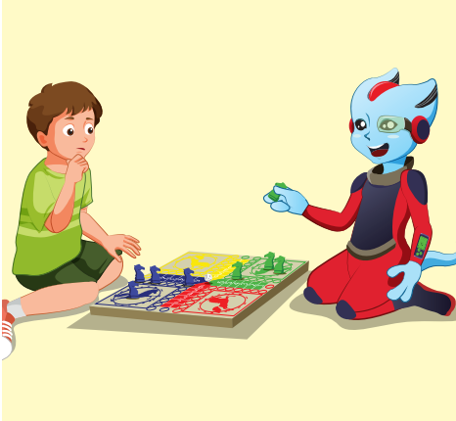
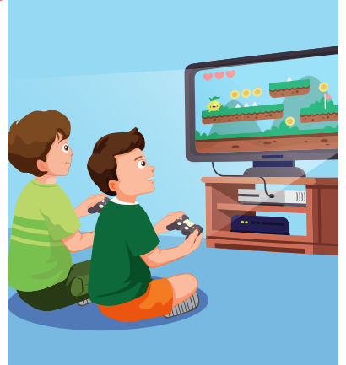
REVIEW 2
do puzzle
read a comic book
eat snack
take photo
play board game
play video game

Slide 15


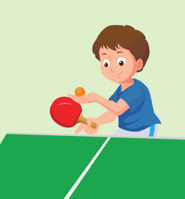
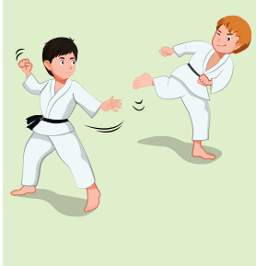
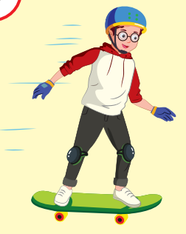
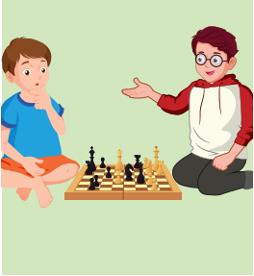
REVIEW 2
listen to music
watch TV
play table tennis
do martial arts
skate
play chess

Slide 16

It’s time to learn …

Slide 17

Listening

Slide 18


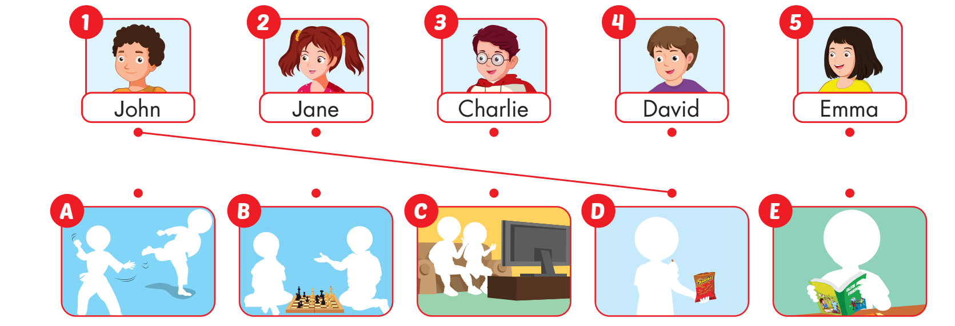

Slide 19

Reading

Slide 20







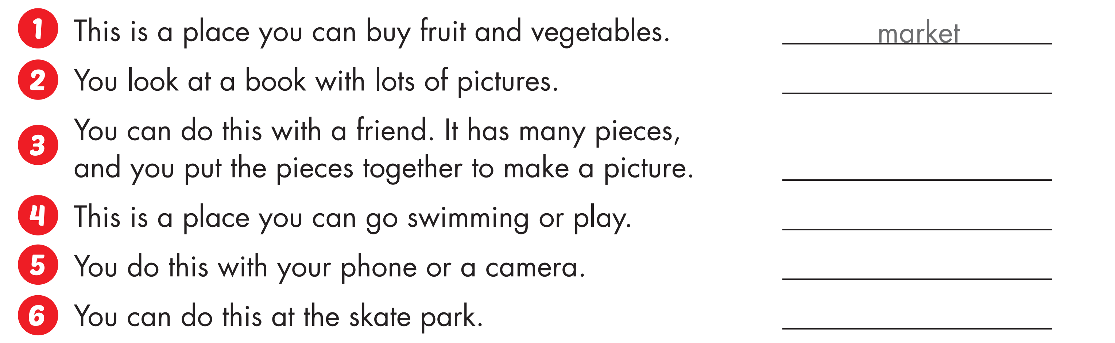
read a comic book
do a puzzle
water park
take photos
skate

Slide 21
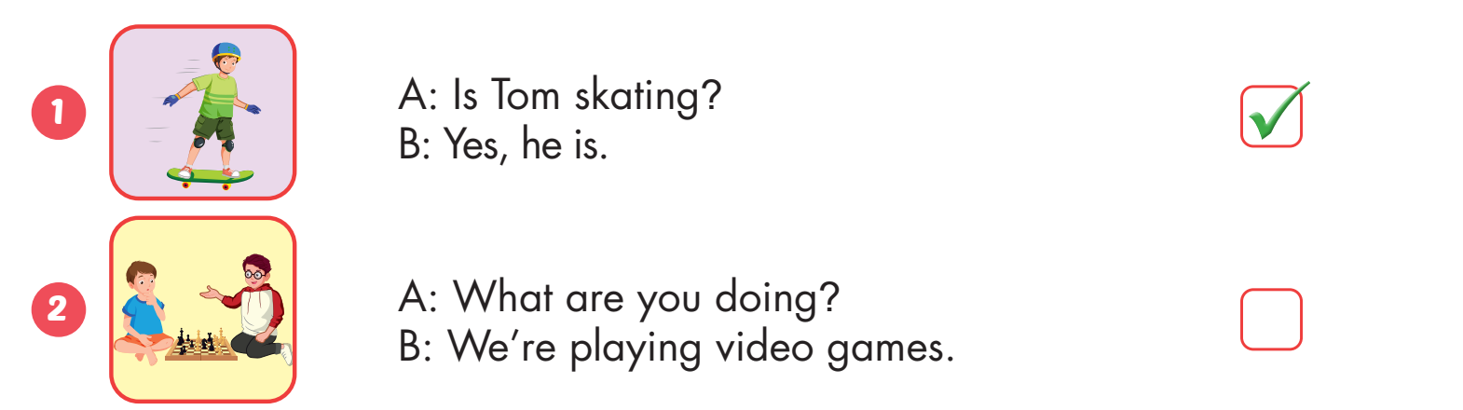


Slide 22
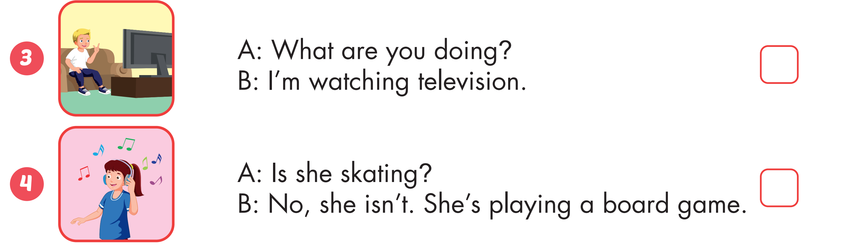



Slide 23
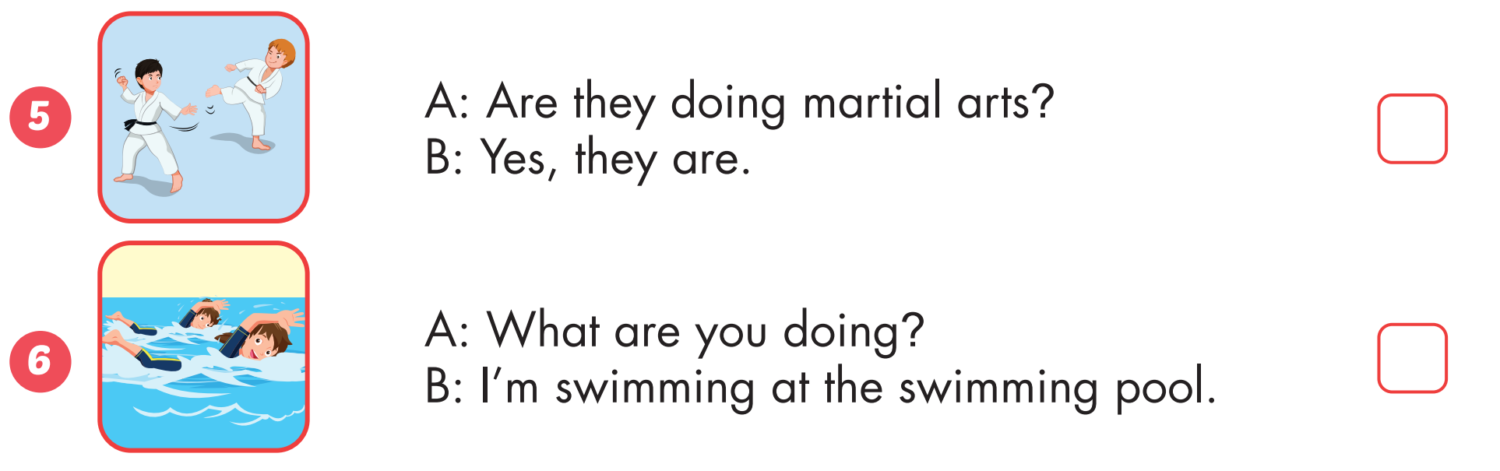

Slide 24
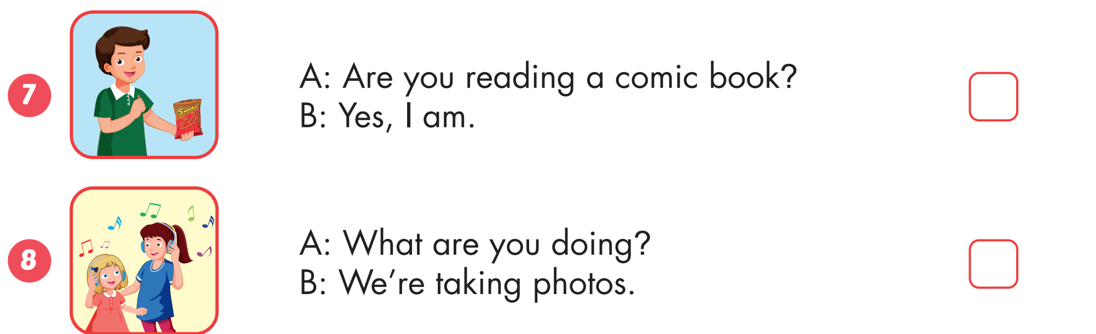

Slide 25
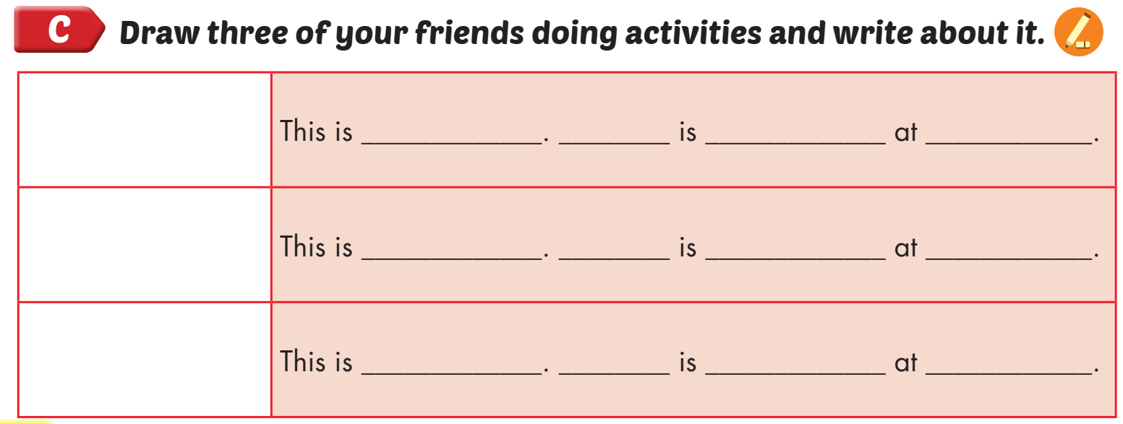

Nick
He
reading a comic book
home

Slide 26

Speaking

Slide 27



Slide 28
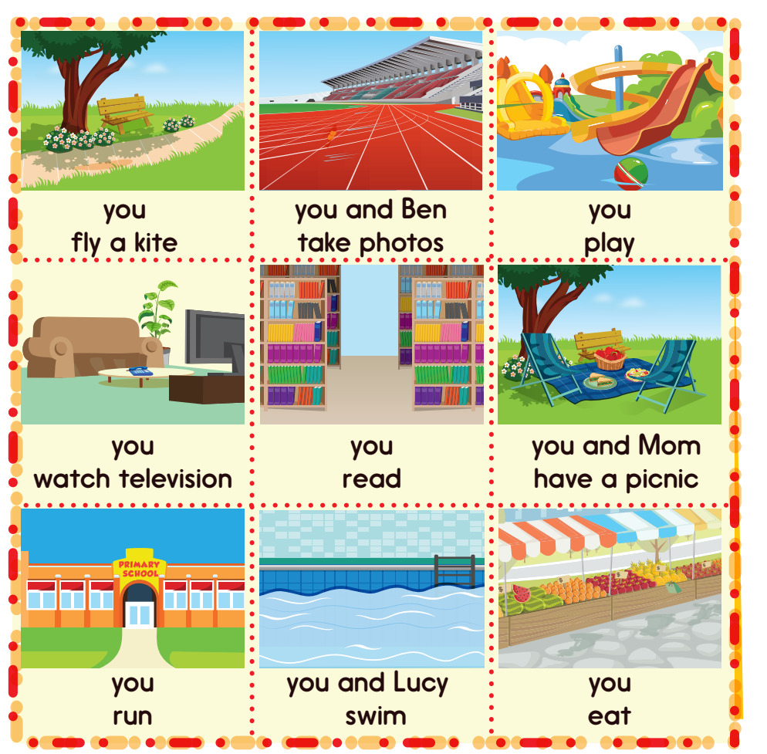
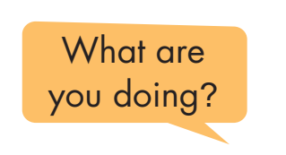
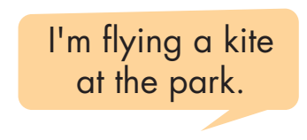
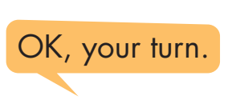

Slide 29

CONSOLIDATION

Slide 30

game
Word Jumble Race

Slide 31
How to play
Word Jumble Race
Write out 3 sentences, using different colors for each sentence.
Cut up the sentences so you have a handful of words.
Put each sentence into hats, cups or bags, keeping each separate.
Split your class into teams of 4.
Teams must now put their sentences in the correct order.
The winning team is the first team to have all sentences correctly ordered.

Slide 32
Answers
Word Jumble Race
What are you doing?
He’s skating at the skate park.
Are they reading a comic book at home?

Slide 33

WRAP-UP

Slide 34
Today’s lesson
Vocabularies
Activities: listen to music, watch television, play table tennis, do martial arts, skate, play chess, play a board game, do a puzzle, read a comic book, eat snacks, take photos, play video games.
Places: library, stadium, park, water park, market, swimming pool. studio, soccer field, arcade, skate park, coffee shop.
Structures/ Sentence patterns
What are you doing?
I’m swimming at the pool.
What are they doing?
They’re swimming at the pool.
What is he/she doing?
He/she swimming at the pool.

Slide 35
Homework
Practice the vocabularies and structure; and make sentences using them.
Do the exercises in Tiếng Anh 4 i-Learn Smart Start WB (page 40)
Do the exercises in Tiếng Anh 4 i-Learn Smart Start Notebook (page 26).
Prepare the next lesson (page 61 SB)
Play the consolidation games in Tiếng Anh 4 i-Learn Smart Start DHA App on www.eduhome.com.vn

Slide 36
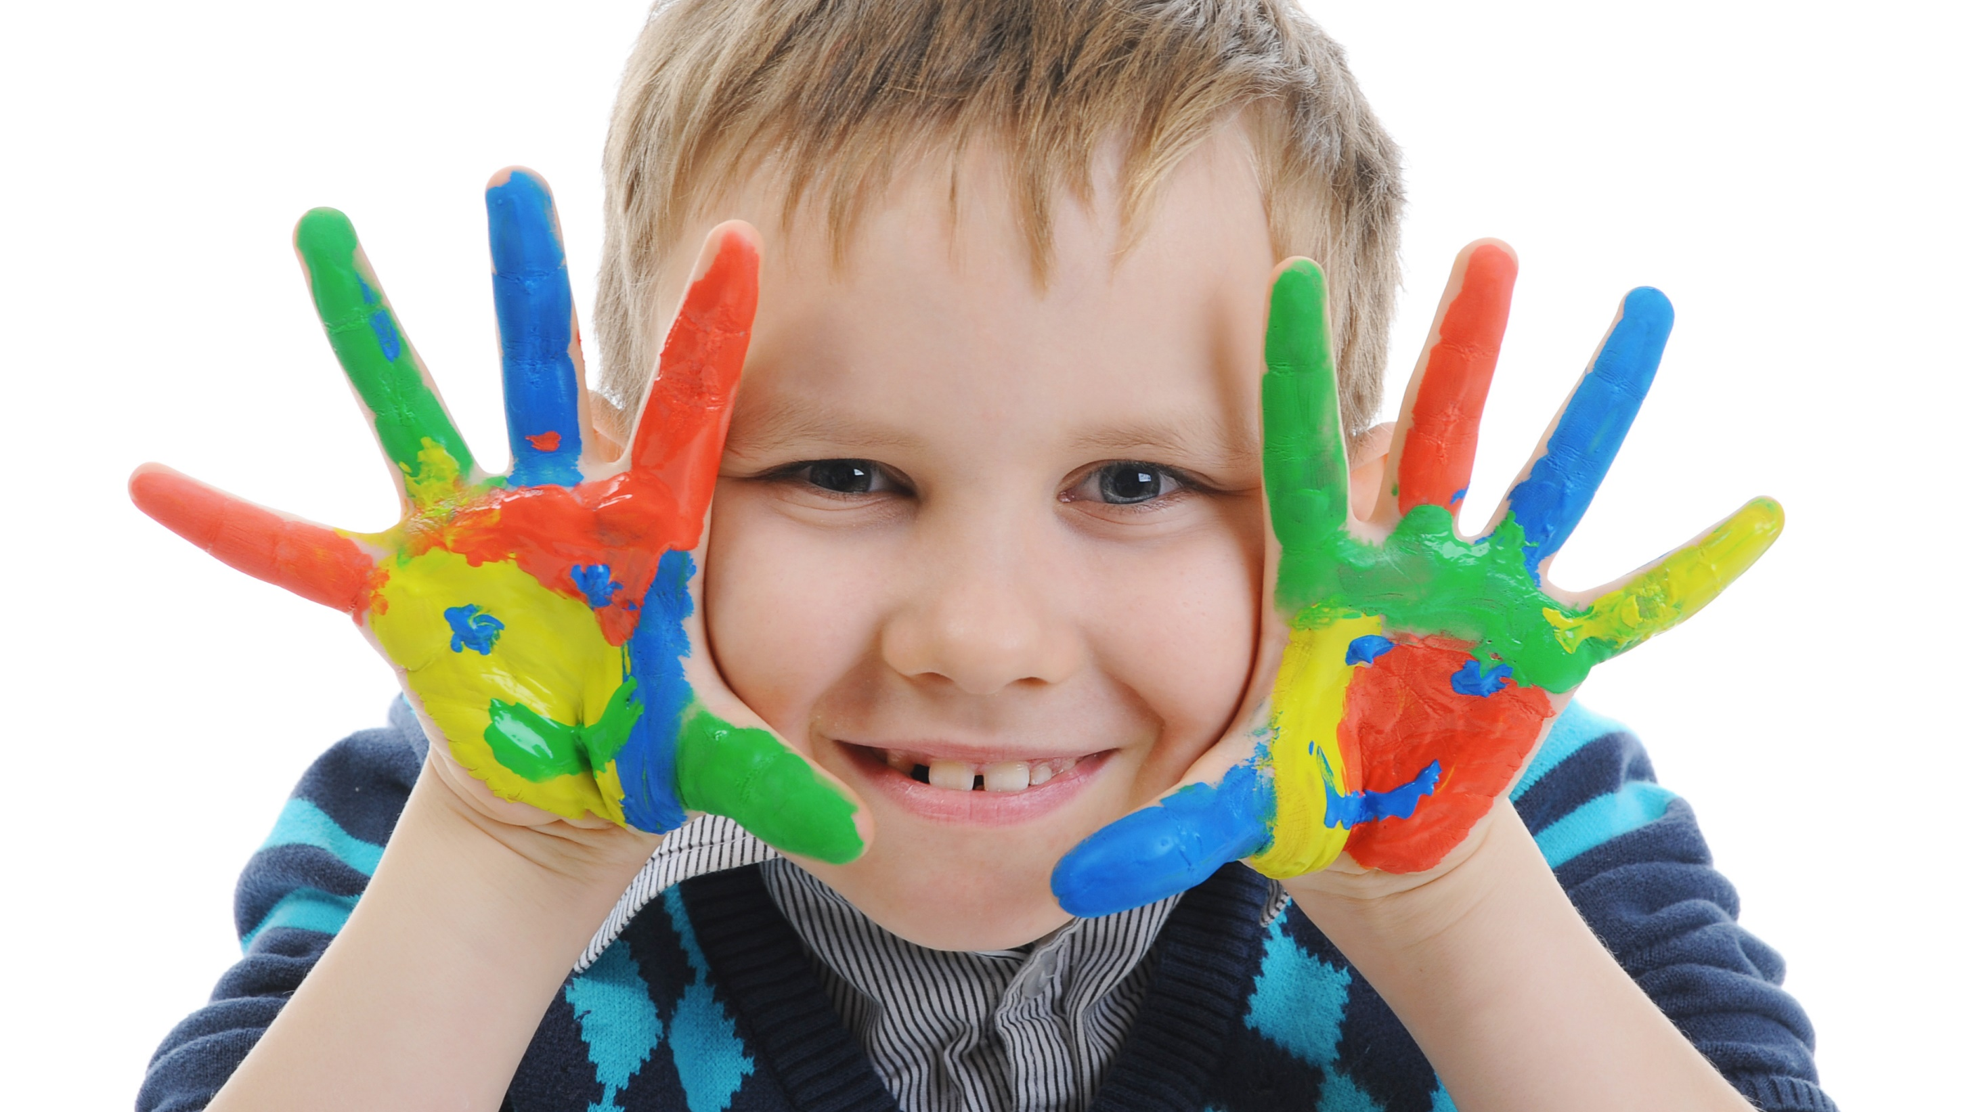
Enjoy your day!

