Slide 1

Unit 4: ACTIVITIES
Lesson 3
Page 55

Slide 2
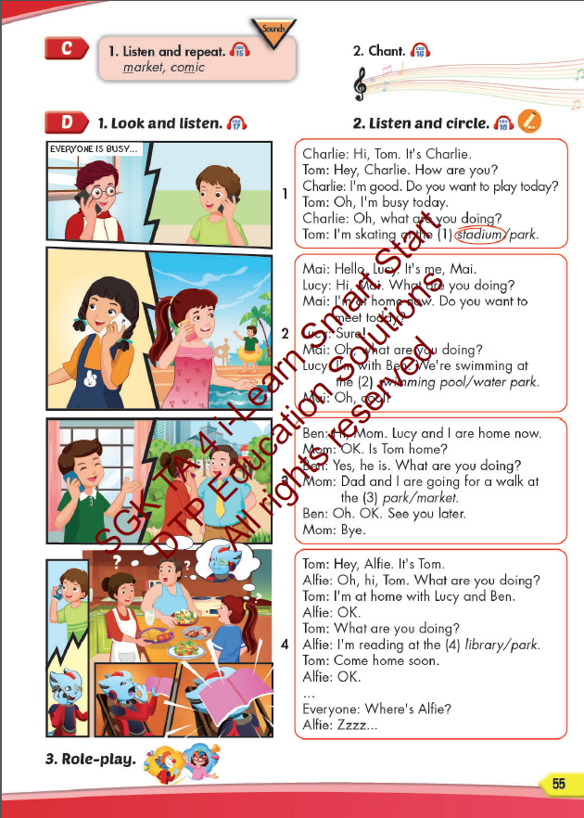
Lesson Outline
Warm-up
Listening
Consolidation
Wrap-up

Slide 3
Objectives
By the end of this lesson, students will be able to pronounce the sound /m/; and practice asking and answering what they are doing at some different places.
Vocabulary: library, stadium, park, water park, market, swimming pool.
Structure:
What are you doing?
I’m swimming at the pool.
What are you doing?
We are reading at the library.
Phonics: /m/, market, comic.

Slide 4

WARM UP

Slide 5
1
4
6
1
SPIN
2
5
2
5
4
3
3
6
Next Part

Slide 6
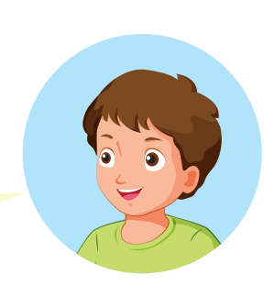


I’m reading books at the
____________________
library.
Go back

Slide 7
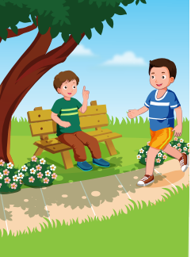
I’m running at the
____________________
park.
Go back

Slide 8
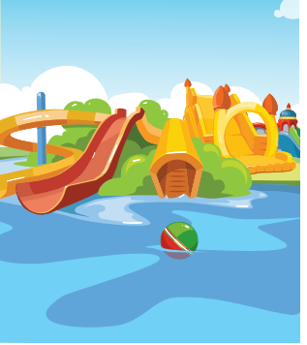
I’m playing at the
____________________
water park.
Go back

Slide 9
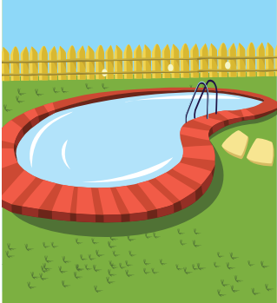
I’m swimming at the
____________________
pool.
Go back

Slide 10
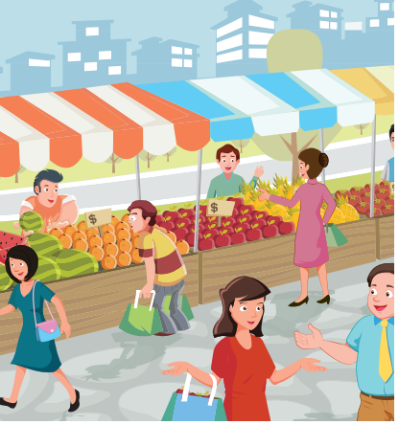
I’m eating at the
____________________
market.
Go back

Slide 11

I’m doing martial arts at
the _________________
school.
Go back

Slide 12

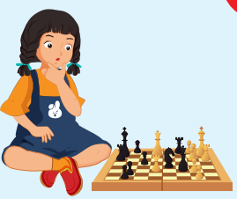
REVIEW 2
Look and say.
What are you doing?
I’m playing chess at home.

Slide 13
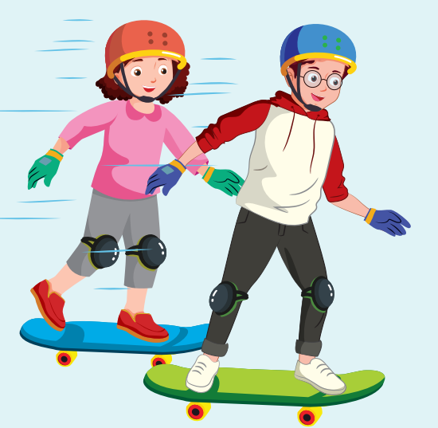
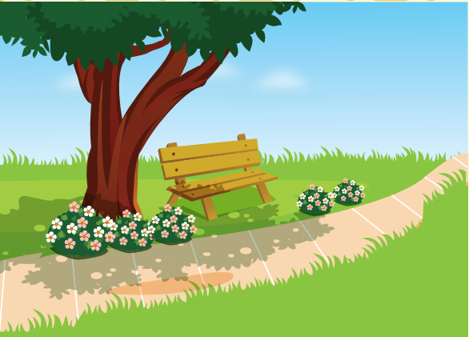
REVIEW 2
Look and say.
What are you doing?
We’re skating at the park.

Slide 14
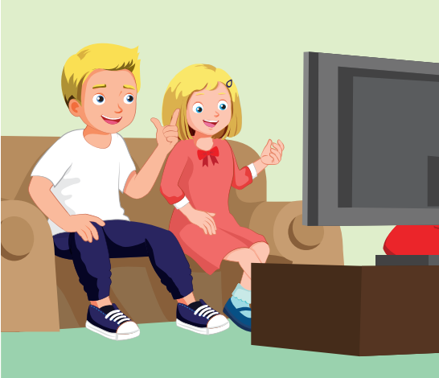
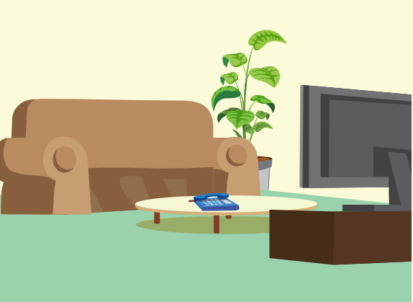
REVIEW 2
Look and say.
What are you doing?
We’re watching TV at home.

Slide 15
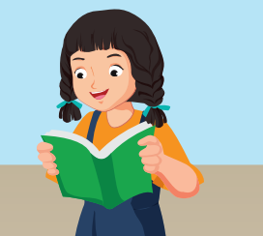

REVIEW 2
Look and say.
What are you doing?
We’re reading at the library.

Slide 16
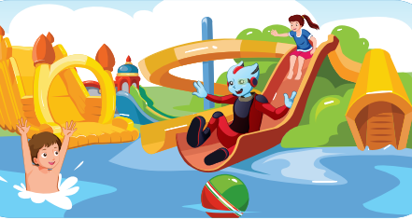
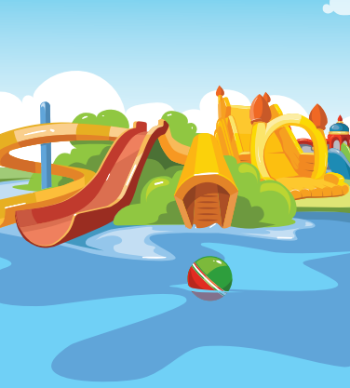
REVIEW 2
Look and say.
What are you doing?
We’re playing at the water park.

Slide 17
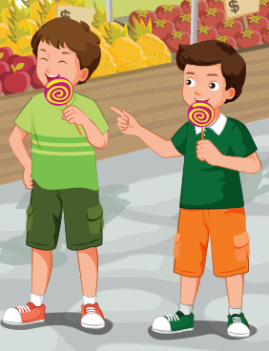
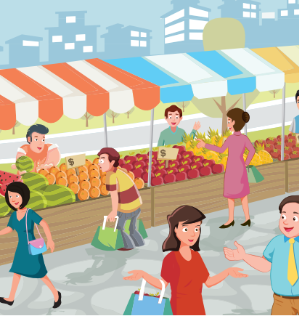
REVIEW 2
Look and say.
What are you doing?
We’re eating at the market.

Slide 18
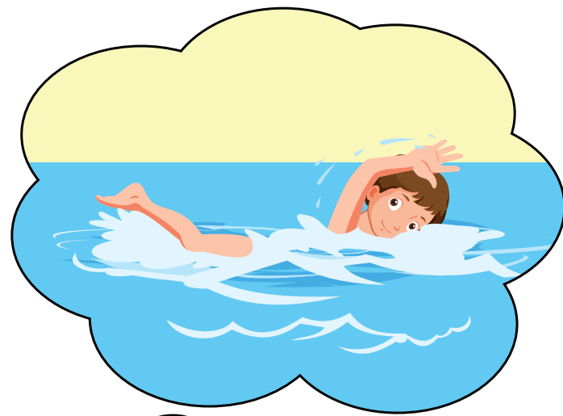
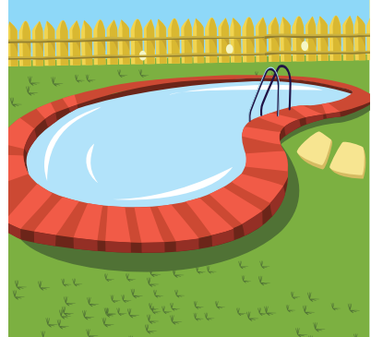
REVIEW 2
Look and say.
What are you doing?
We’re swimming at the pool.

Slide 19

It’s time to learn …

Slide 20

Phonics
/m/

Slide 21
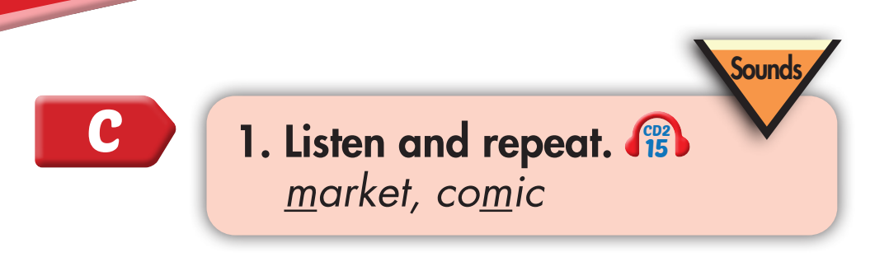
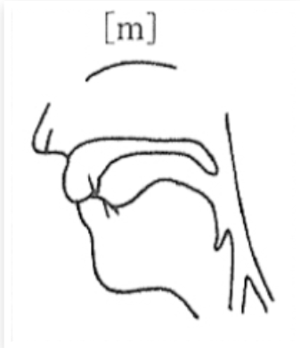

m, m, market
m, m, comic

Slide 22
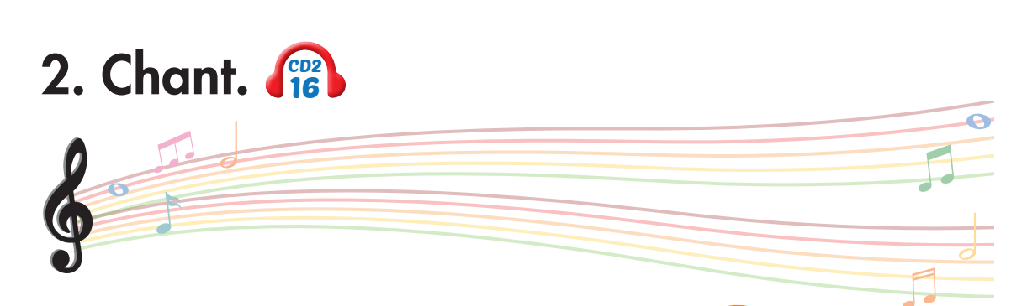
I’m reading a comic book at home
What are you doing, Lucy?
I’m reading a comic book at home.
What are you doing, Tom?
I’m swimming the swimming pool.
What are you doing, Mom and Dad?
We’re walking at the market.
Notes:
1. Listen.
2. Listen and chant.

Slide 23
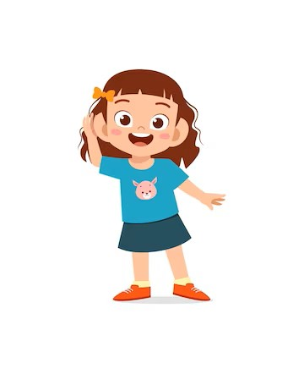
Listen. Hop and repeat when you hear /m/ sound.
Notes:
T says
Chess
Market
Comic
Library
Park
Swimming pool
Stadium
music

Slide 24

Listening

Slide 25
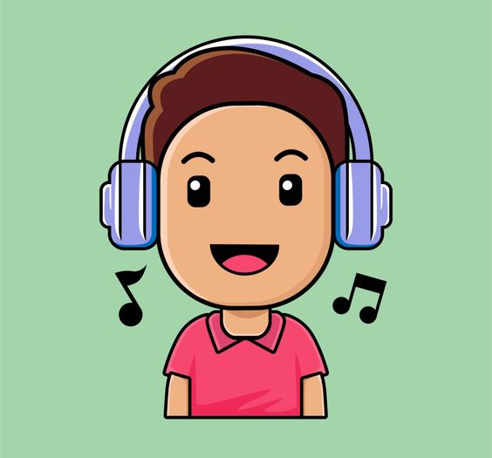
BEFORE YOU LISTEN

Slide 26
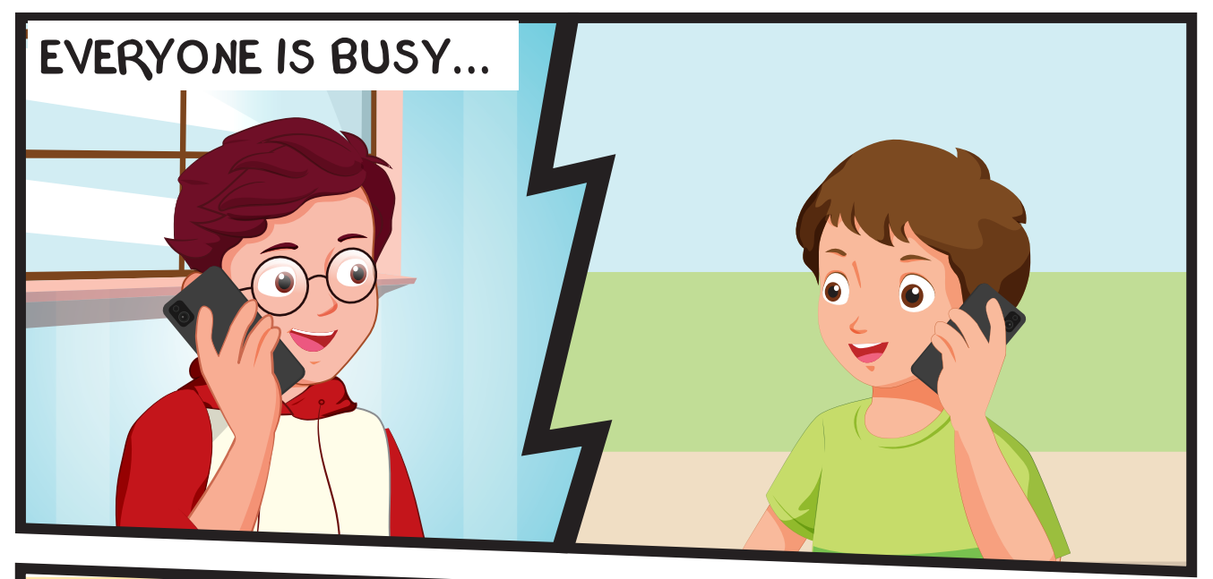
Where’s Tom?
What is Tom doing?
Notes:
Encourage Ss to guess

Slide 27
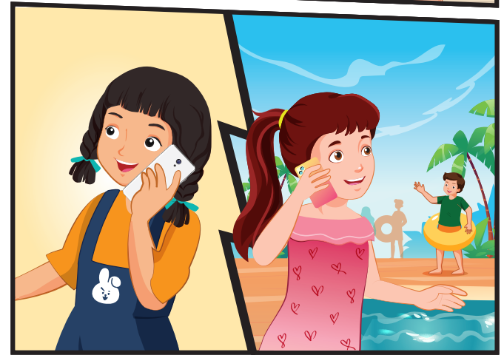
Where are Lucy and Ben?
What are Lucy and Ben doing?

Slide 28
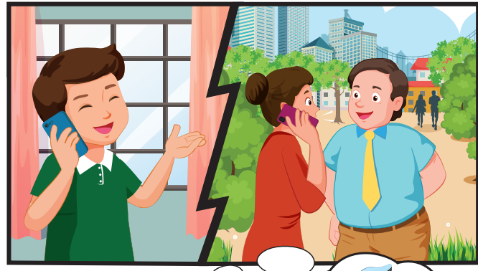
Where are Mom and Dad?
What are Mom and Dad doing?

Slide 29
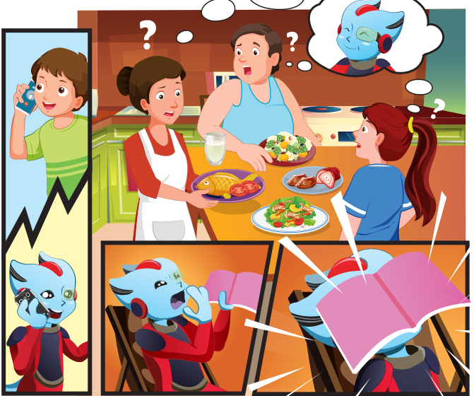
Where is Alfie?
What is Alfie doing?

Slide 30


Slide 34
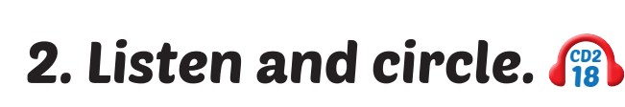
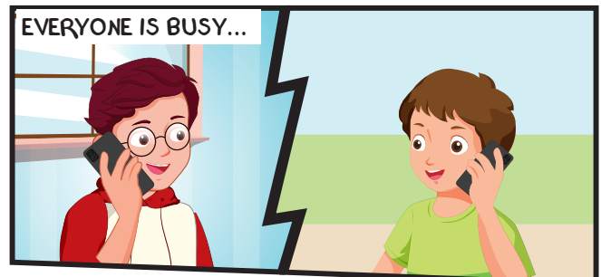
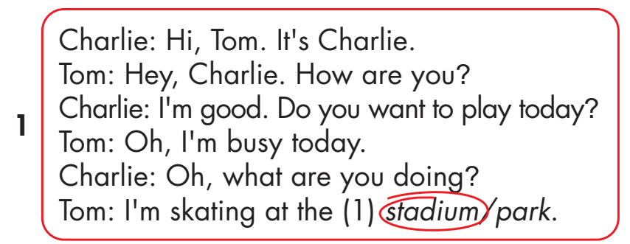
Click on the headphone icon to hear the sound.
Click on number 1
to show the answer.

Slide 35
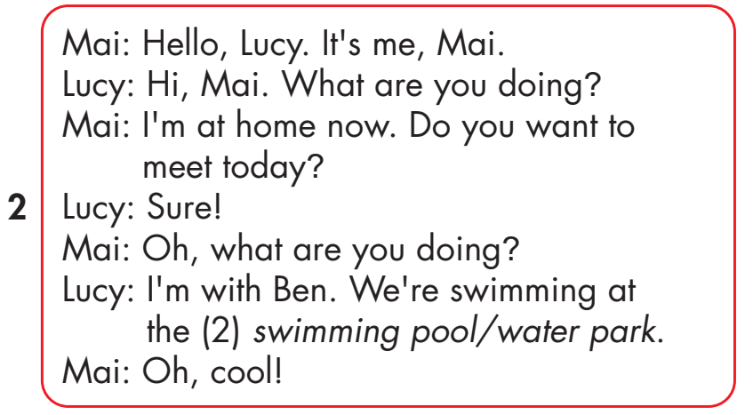
Click on the headphone icon to hear the sound.
Click on number 2
to show the answer.

Slide 36
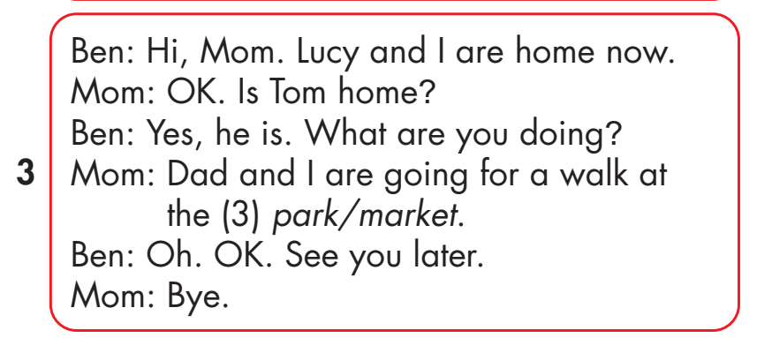
Click on the headphone icon to hear the sound.
Click on number 3
to show the answer.

Slide 37
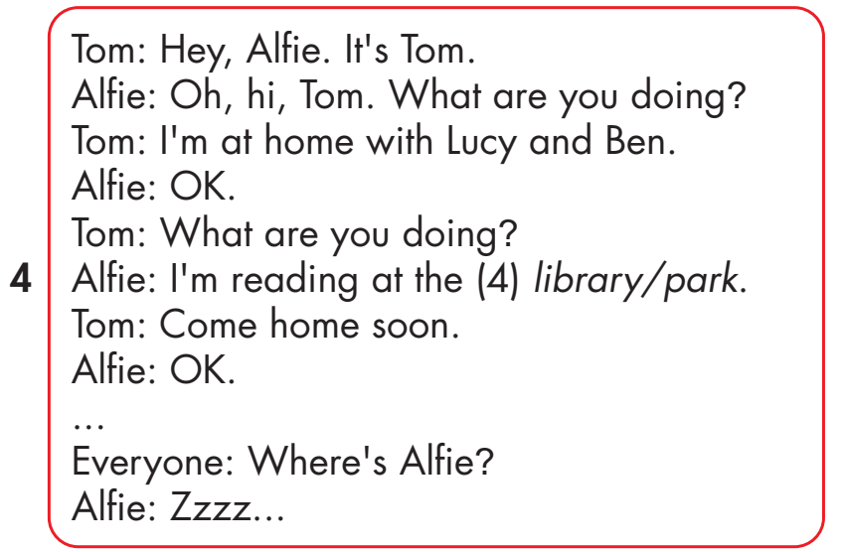
Click on the headphone icon to hear the sound.
Click on number 4
to show the answer.

Slide 38

Practice

Slide 39
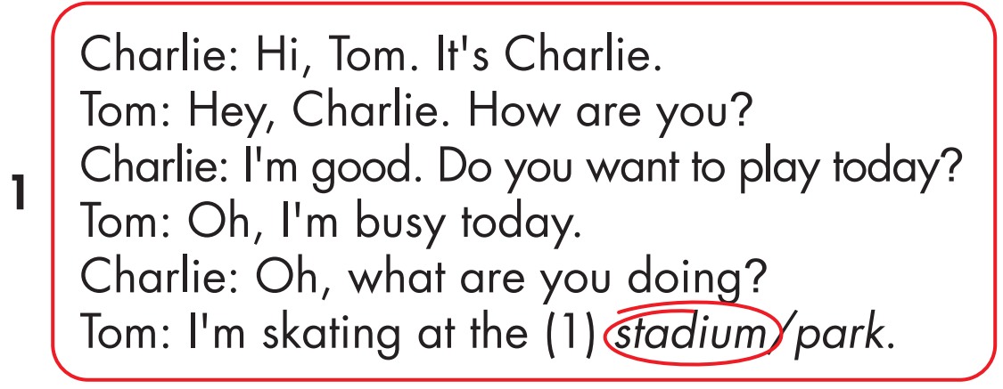

Slide 43
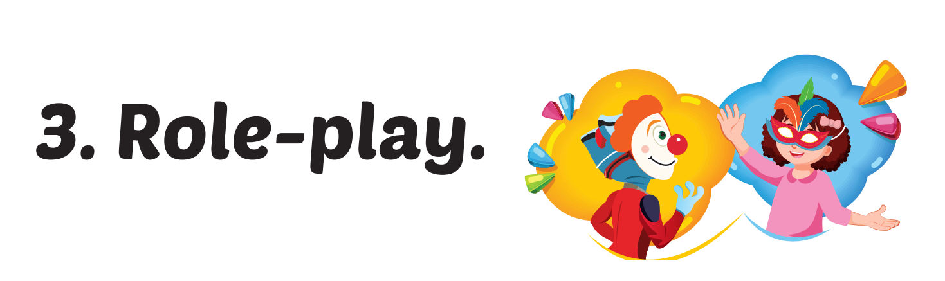

Slide 44

CONSOLIDATION

Slide 45

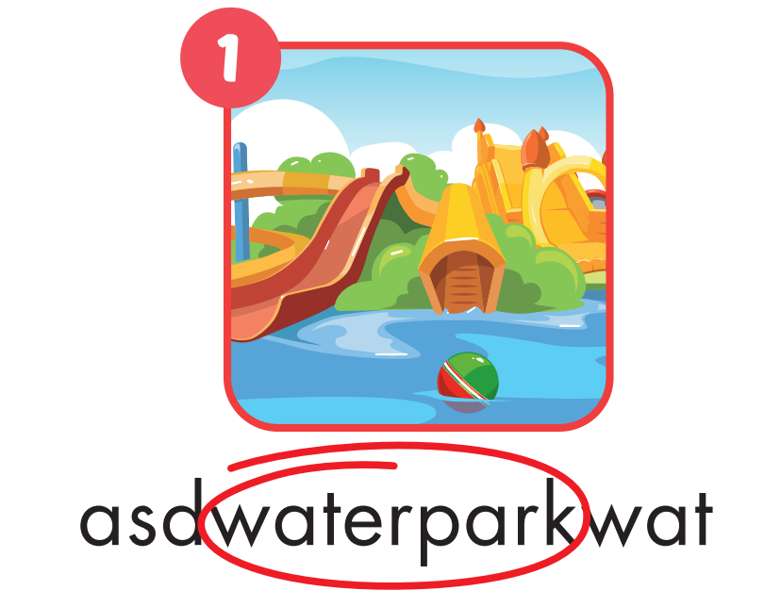
Notes:
WB page 32

Slide 46
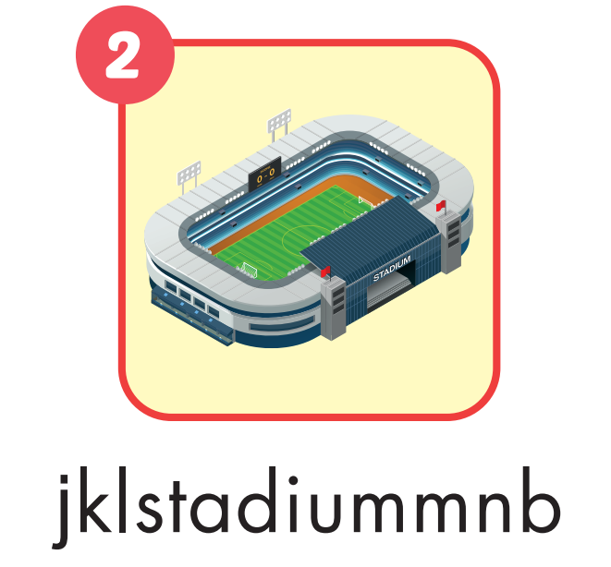
Notes:
WB page 32

Slide 47

Notes:
WB page 32

Slide 48

Notes:
WB page 32

Slide 49
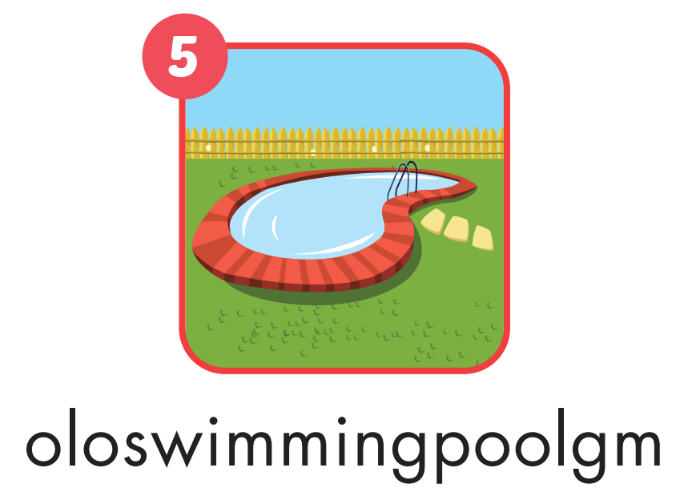
Notes:
WB page 32

Slide 50

Notes:
WB page 32

Slide 51

WRAP-UP

Slide 52
Today’s lesson
Vocabularies
library, stadium, park, water park, market, swimming pool.
Structures/ Sentence patterns
What are you doing?
I’m swimming at the pool.
What are you doing?
We are reading at the library.

Slide 53
Homework
Practice the vocabularies and structure, and make sentences using them.
Do the exercises in Tiếng Anh 4 i-Learn Smart Start WB (page 37)
Do the exercises in Tiếng Anh 4 i-Learn Smart Start Notebook (page 24).
Prepare the next lesson (page 56 SB)
Play the consolidation games in Tiếng Anh 4 i-Learn Smart Start DHA App on www.eduhome.com.vn

Slide 54

Lesson 3
Stay positive and have a nice day!

