Slide 1

Unit 4: ACTIVITIES
Lesson 4
Page 58

Slide 2
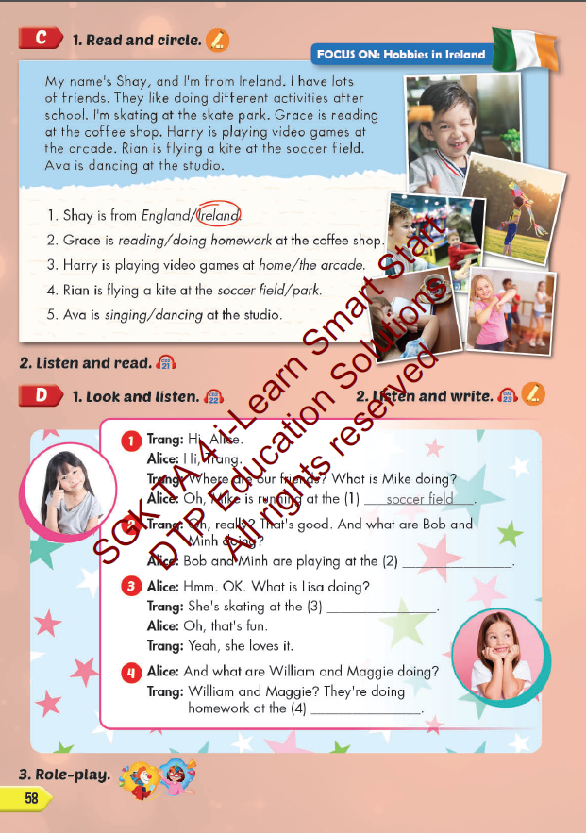
Lesson Outline
Warm-up
Reading
Listening
Consolidation
Wrap-up

Slide 3
Objectives
By the end of this lesson, students will be able to read and listen about where people do some different activities that are popular in their culture.
Vocabulary: studio, soccer field, arcade, skate park, coffee shop.
Structure:
What's she doing?
She's dancing at the studio.
What are they doing?
They're playing soccer at the soccer field.

Slide 4

WARM UP

Slide 5














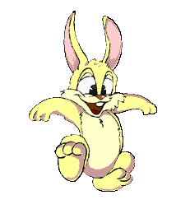




5
CONGRATULATIONS TIGER TEAM
5
CONGRATULATIONS RABBIT TEAM
4
4
3
3
2
2
overtop
1
1
Notes:
T divides Ss into 2 teams.
Each team has a leader.
Team leaders have to play Rock, Scissors, Paper for each question.
The winner will get a turn to answer the question.
Ss can step once for a correct answer.

Slide 6

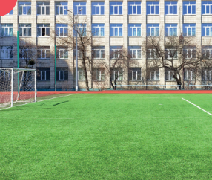

Click on each sentence to check the correct answer.
What are they doing?
1
play soccer
A
They playing soccer at the soccer field.
B
They’re playing soccer at the soccer field.
C
They’re play soccer at the soccer field.

Slide 7

Click on each sentence to check the correct answer.
What are they doing?
2
chat
A
They’re chatting at the coffee shop.
B
They’re chatting the coffee shop.
C
They’re chat at the coffee shop

Slide 8
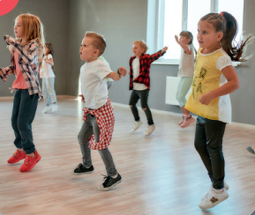
Click on each sentence to check the correct answer.
What are they doing?
3
dance
A
They’s dancing at the studio.
B
They dance at the studio.
C
They’re dancing at the studio.

Slide 9

Click on each sentence to check the correct answer.
What is he doing?
4
playing
A
He’s play at the arcade.
B
He’s playings at the arcade.
C
He’s playing at the arcade.

Slide 10
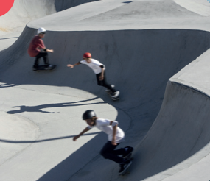
Click on each sentence to check the correct answer.
What are the doing?
5
A
They’re skating at the skate park.
B
They are skate at the skate park.
C
They skating at the skate park.

Slide 11

It’s time to learn …

Slide 12

Reading

Slide 13
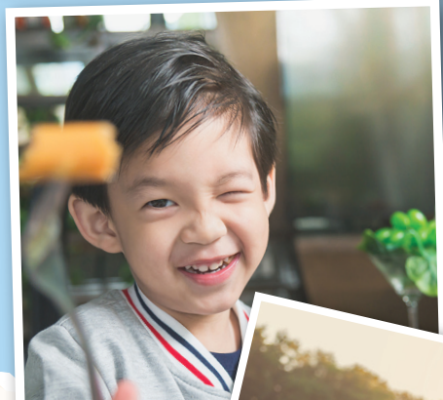


Underline key words in each statement.
Read the text carefully and find information.

Slide 14
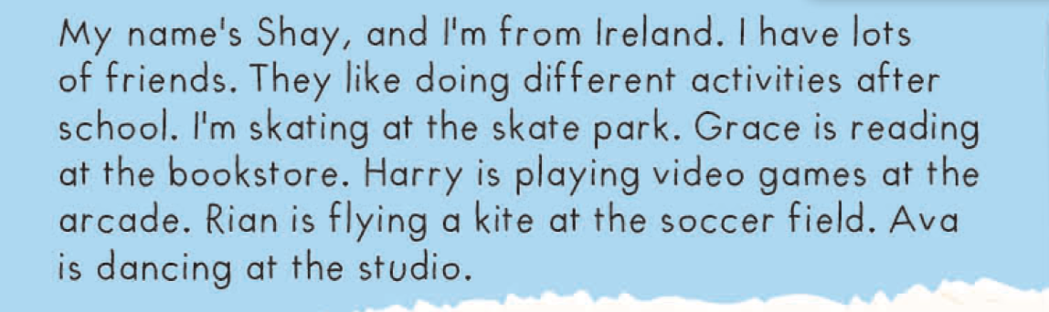
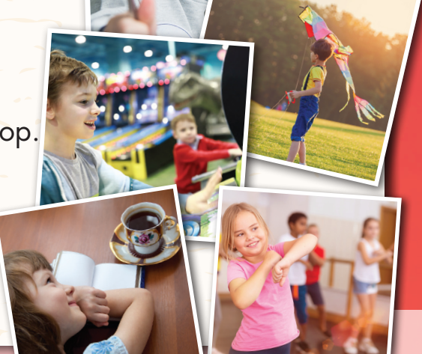
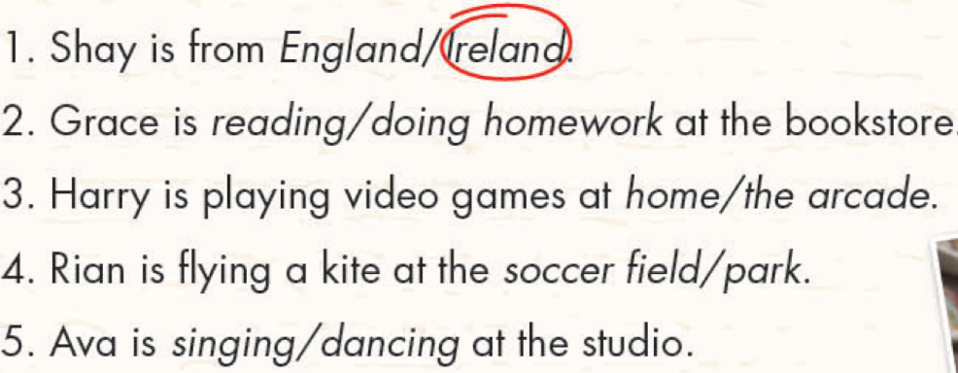

Slide 15
1. Shay is from England/ Ireland.
2. Grace is reading/doing homework at the bookstore.
3. Harry is playing video games at home/the arcade.
4. Rian is playing a kite at the soccer field/park.
5. Ava is singing/dancing at the studio.

Slide 16
1. Shay is from England/ Ireland.
2. Grace is reading/doing homework at the coffee shop.
3. Harry is playing video games at home/the arcade.
4. Rian is playing a kite at the soccer field/park.
5. Ava is singing/dancing at the studio.

Slide 17


Slide 18
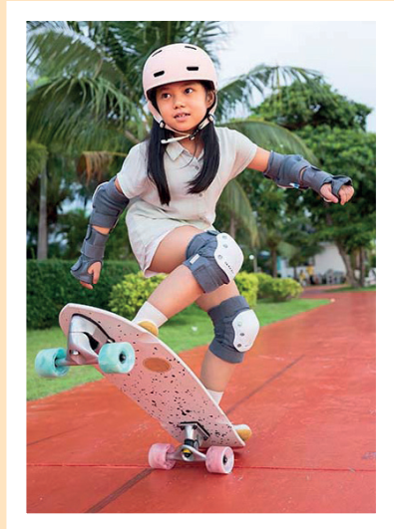
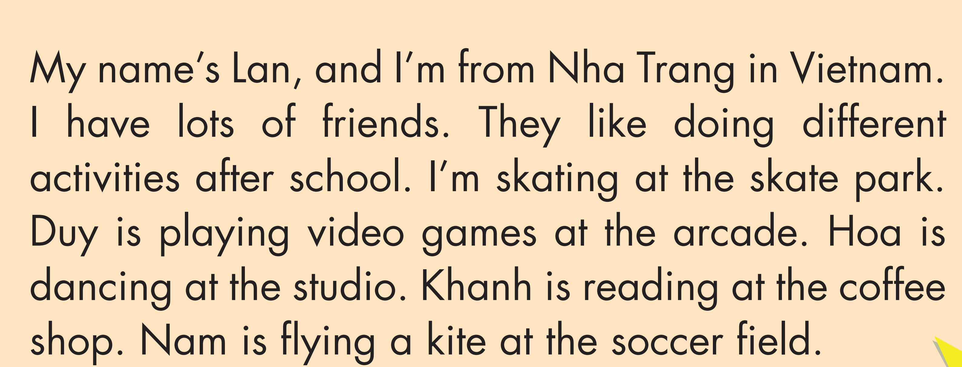
3. Read and complete.
skating
arcade
dancing
soccer field
skating
arcade
dancing
soccer field

Slide 19

Listening

Slide 20

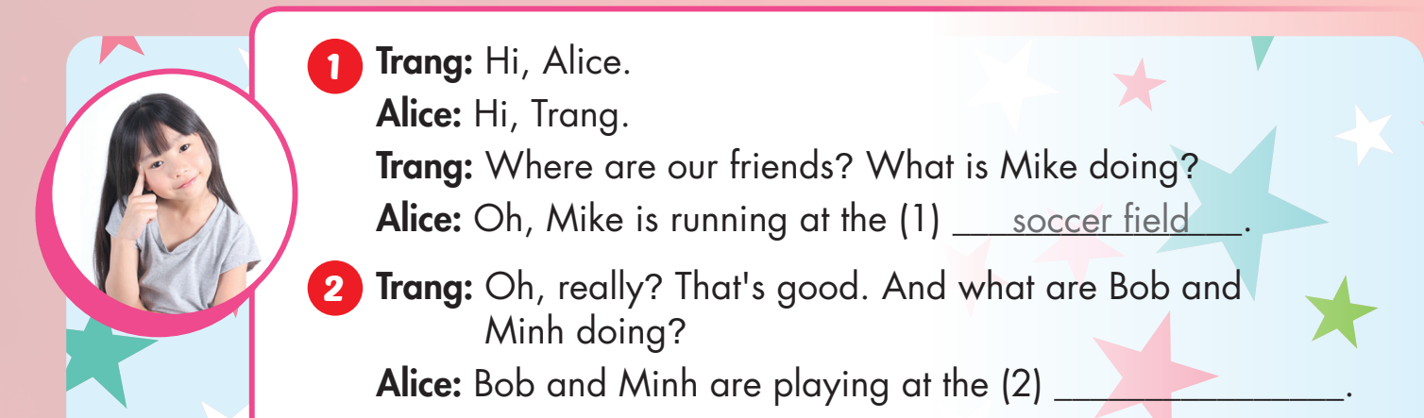

Slide 21
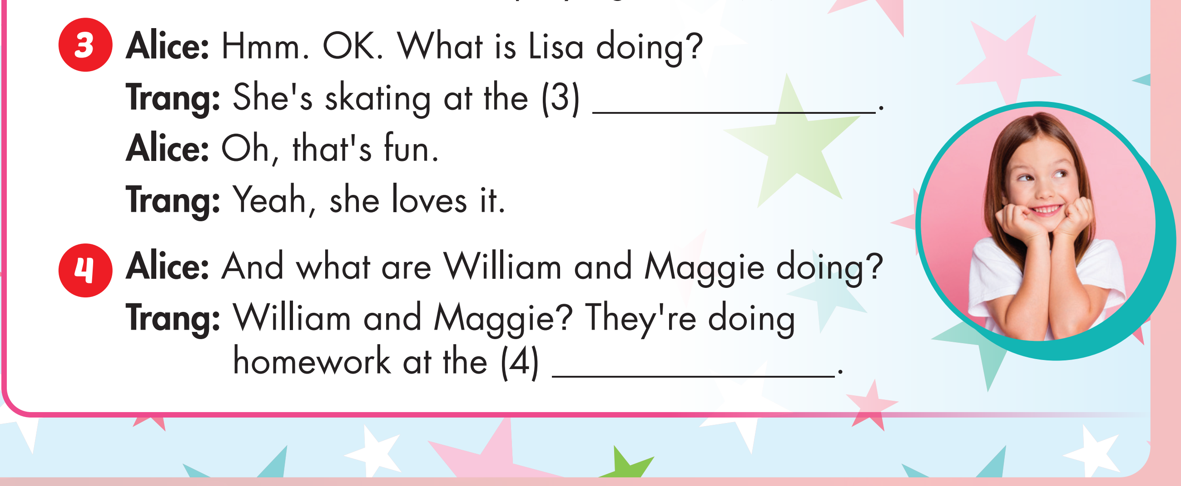

Slide 22
arcade

Slide 23
arcade
arcade

Slide 24

Production

Slide 25
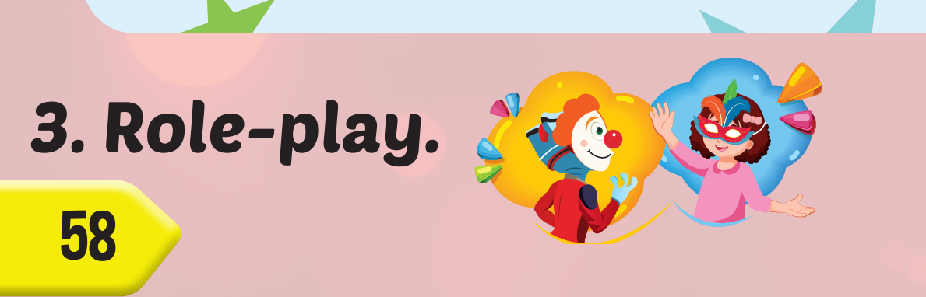

Slide 26

CONSOLIDATION

Slide 27
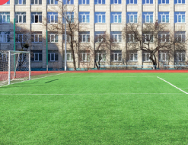

What are they doing?
They’re playing soccer at the soccer field.

Slide 28
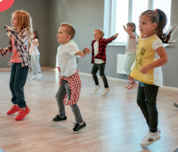
What are they doing?
They’re dancing at the studio.

Slide 29
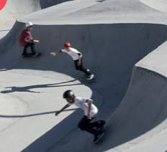
What are they doing?
They’re playing skating at the skate park.

Slide 30

What is he doing?
He’s playing games at the arcade.

Slide 31

What are they doing?
They’re chatting at the coffee shop.

Slide 32

WRAP-UP

Slide 33
Today’s lesson
Vocabularies
studio, soccer field, arcade, skate park, coffee shop.
Structures/ Sentence patterns
What is she doing?
She’s dancing at the studio.
What are they doing?
They are playing soccer at the soccer field.

Slide 34
Homework
Practice the vocabularies and structure; and make sentences using them.
Do the exercises in Tiếng Anh 4 i-Learn Smart Start WB (page 39)
Do the exercises in Tiếng Anh 4 i-Learn Smart Start Notebook (page 25).
Prepare the next lesson (page 51 SB)
Play the consolidation games in Tiếng Anh 4 i-Learn Smart Start DHA App on www.eduhome.com.vn

Slide 35
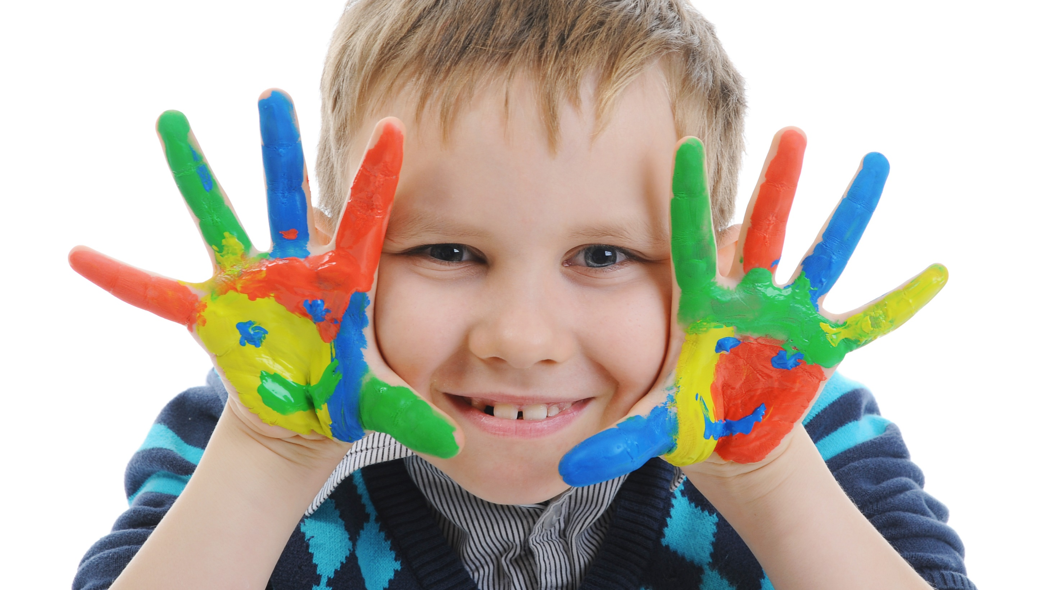
Enjoy your day!

