Slide 1

Unit 5: HEALTH
Review 2
Page 77

Slide 2
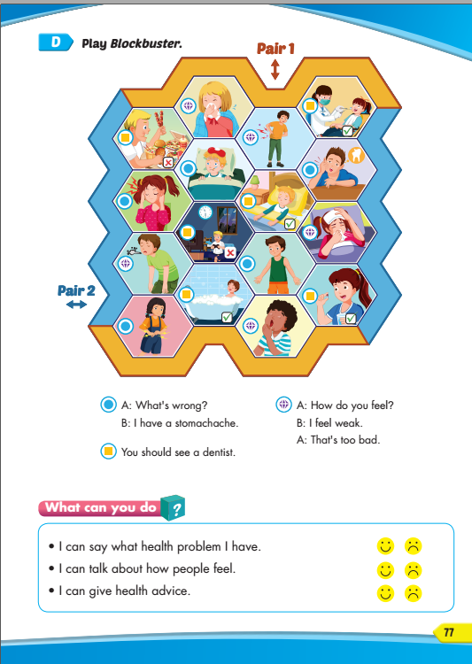
Lesson Outline
Warm-up
Speaking
Listening
Writing
Wrap-up

Slide 3
Objectives
By the end of this lesson, students will be able to review and practice the target language and skills in unit 5.
Vocabulary: unit 5
Structure: unit 5

Slide 4

WARM UP

Slide 5
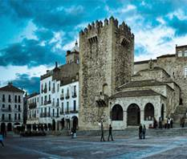
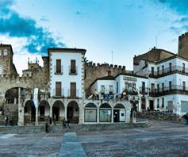
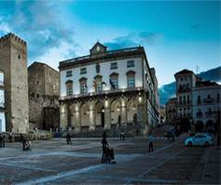

WHAT IS THIS PICTURE?
PHOTO PUZZLE

Slide 6

WHAT IS IT?
Turn around as many colored boxes as you can within the time limit (5 seconds) and say what it is in the picture.

Slide 7
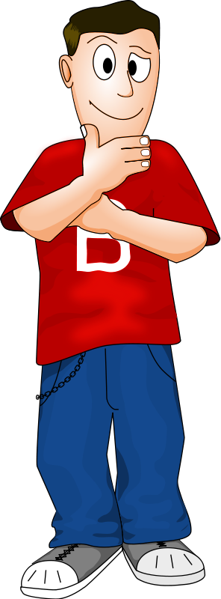
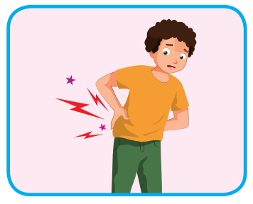
I feel sore.
T
I
M
E
I
S
U
P
CHECK
NEXT
Click on the colored boxes to turn them around

Slide 8
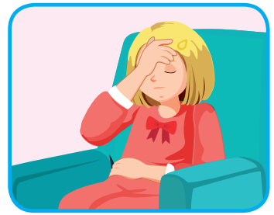
I feel stuffed up.
T
I
M
E
I
S
U
P
CHECK
NEXT
Click on the coloured boxes to turn them around

Slide 9
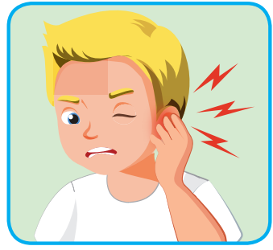
He has an earache.
T
I
M
E
I
S
U
P
CHECK
NEXT
Click on the colored boxes to turn them around

Slide 10
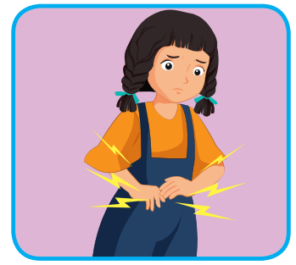
She has a stomachache.
T
I
M
E
I
S
U
P
CHECK
NEXT
Click on the colored boxes to turn them around

Slide 11
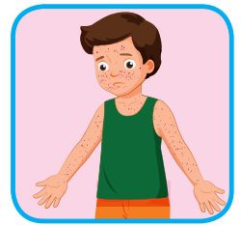
He has chickenpox.
T
I
M
E
I
S
U
P
CHECK
NEXT
Click on the colored boxes to turn them around

Slide 12
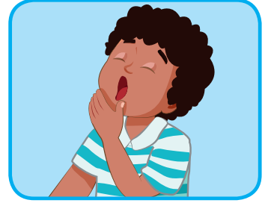
I feel sleepy.
T
I
M
E
I
S
U
P
CHECK
END
Click on the colored boxes to turn them around

Slide 13
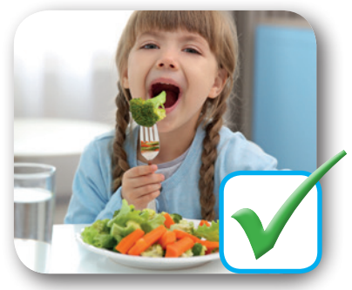
You should eat vegetables.
T
I
M
E
I
S
U
P
CHECK
END
Click on the colored boxes to turn them around

Slide 14

It’s time to learn …

Slide 15

Review

Slide 16


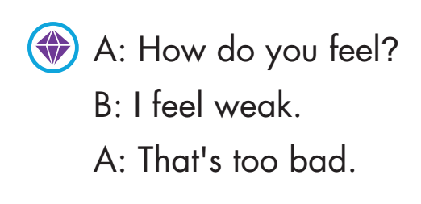
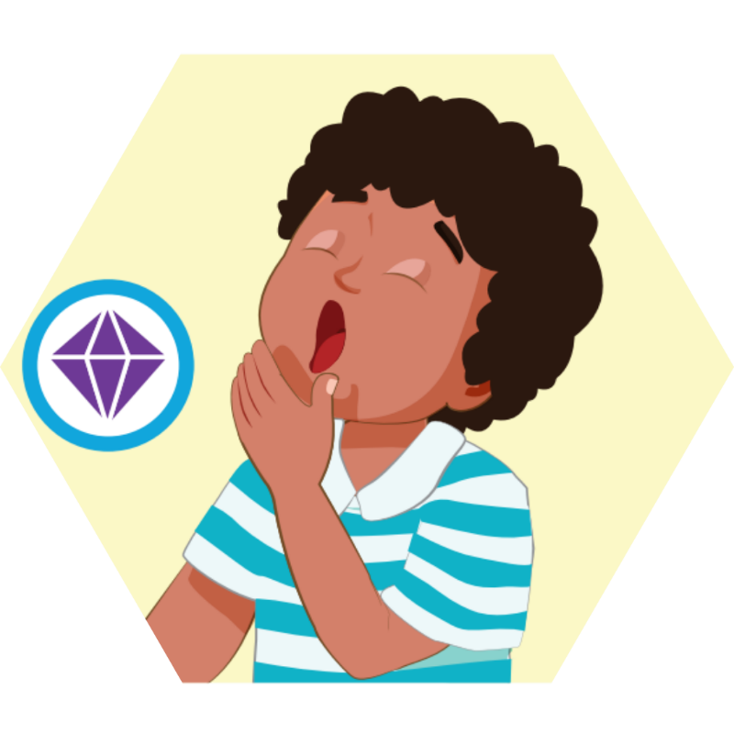
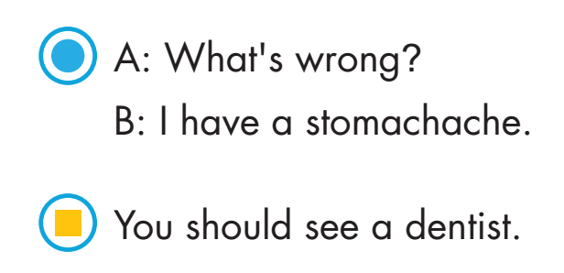
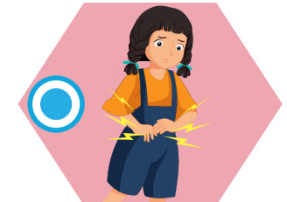

Slide 17
Practice

Slide 18
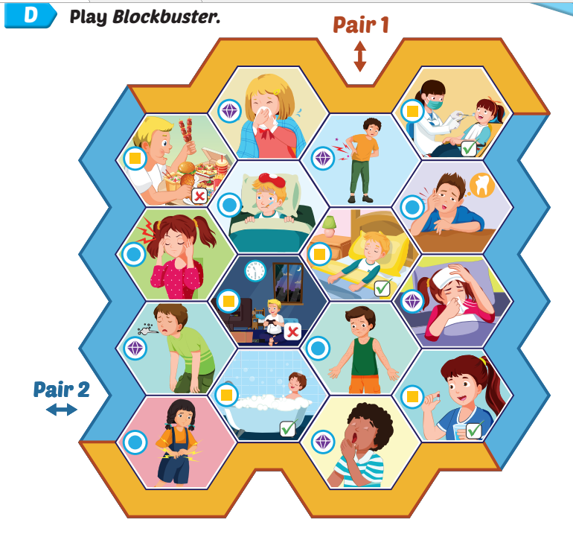
Work in pairs and play the game.

Slide 20
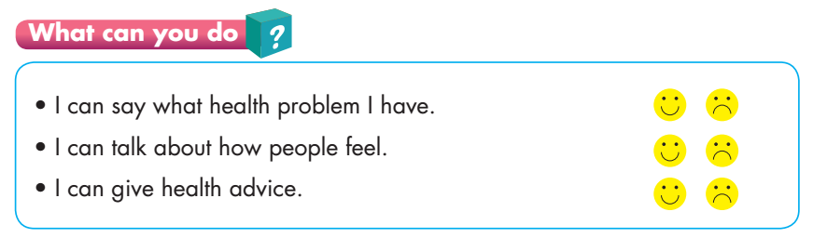

Slide 21

Production

Slide 22

Writing

Slide 23
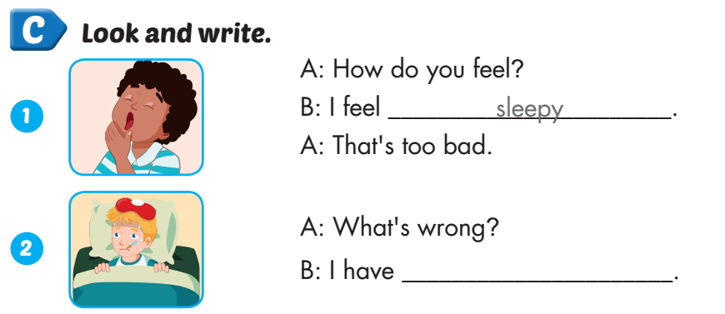
Extra Practice
WB, page 51
the flu

Slide 24
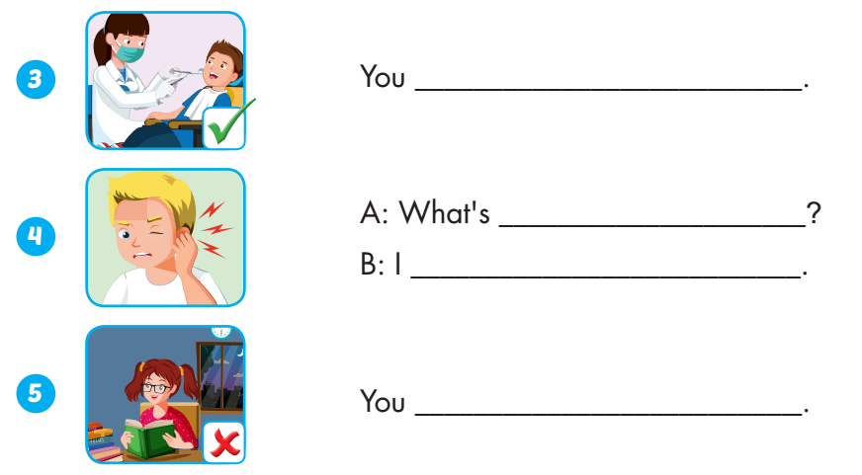
Extra Practice
WB, page 51
should see a dentist
wrong
have an earache
Shouldn’t stay up late

Slide 25

CONSOLIDATION

Slide 26

Let’s play!
Let’s Dance Game

Slide 27
How To Play
Students must take turns make sentence use “should” or “shouldn’t” then, read the words in order.
Each time a student can choose to say the words in 1 square, 2 squares or a maximum of 3 squares.
The student who says the last word must dance!

Slide 28

stay up late
eat fast food
wake up early
do exercise
drink water
smoke
see a doctor
drink medicine
get some rest
play outside
wash your hands
sleep early
DANCE!!
eat too much
take a bath
Skip breakfast
see a dentist
eat vegetables
play sport
eat fruit
drink water
eat fast food
stay up late
take a bath
Wash your hands
eat too much
skip breakfast
play sport
see a dentist
get some rest
drink water

Slide 29

WRAP-UP

Slide 30
Today’s lesson
Vocabularies
Unit 5
Structures/ Sentence patterns
Unit 5

Slide 31
Homework
Practice the vocabularies and structure, and make sentences using them.
Do the exercises in Tiếng Anh 5 i-Learn Smart Start WB (page 51).
Do the exercises in Tiếng Anh 5 i-Learn Smart Start Notebook.
Prepare the next lesson (page 78 SB).
Play the consolidation games in Tiếng Anh 5 i-Learn Smart Start DHA App on www.eduhome.com.vn

Slide 32

Enjoy your day!

Slide 33

Lesson 3
Stay positive and have a nice day!

