Slide 1

Unit 5: HEALTH
CLIL - Lesson 3
Page 75

Slide 2
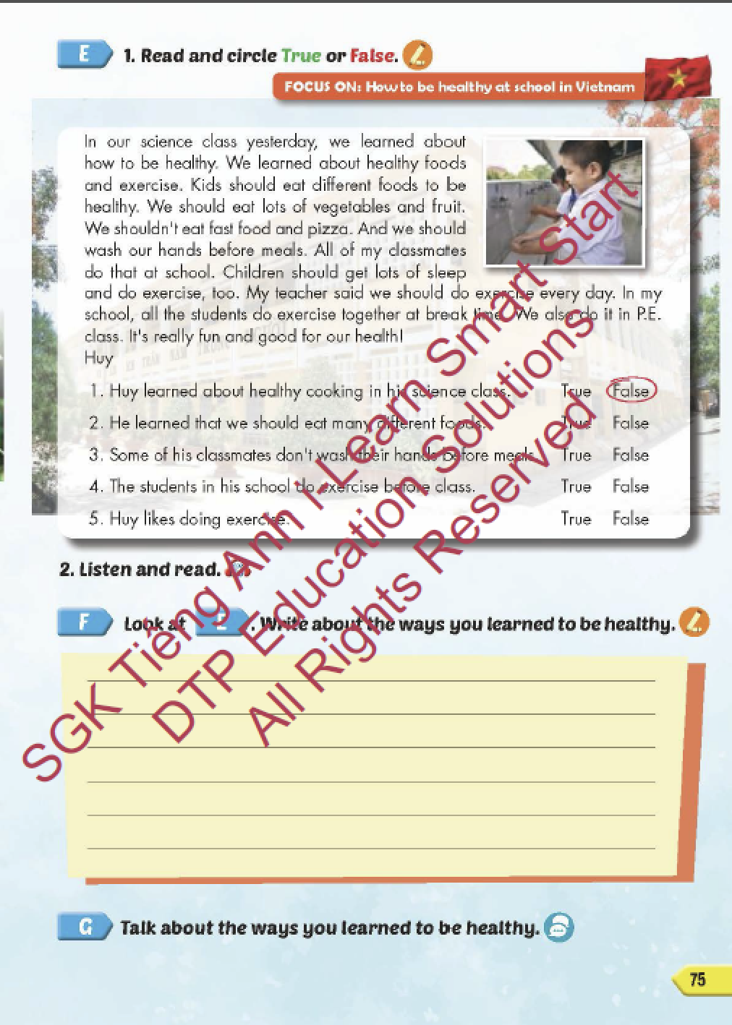
Lesson Outline
Warm-up
Reading
Writing
Speaking
Consolidation
Wrap-up

Slide 3
Objectives
By the end of this lesson, students will be able review the target language and familiarize themselves with aspect how to be healthy at school in Vietnam and practice reading comprehension.
Vocabulary: do exercise, eat fast food, eat vegetables, wash your hands, play outside, eat too much.
Structure: What should I do to be healthy?
You should do exercise.
You shouldn't eat fast food.

Slide 4

WARM UP

Slide 5
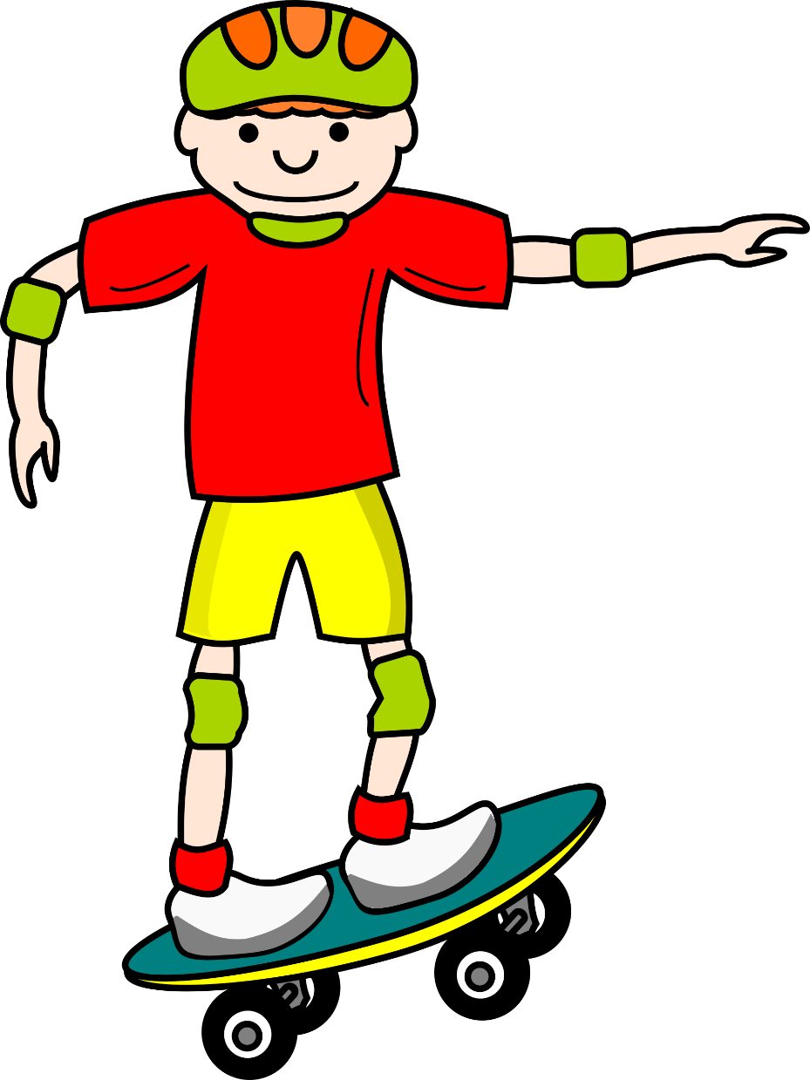
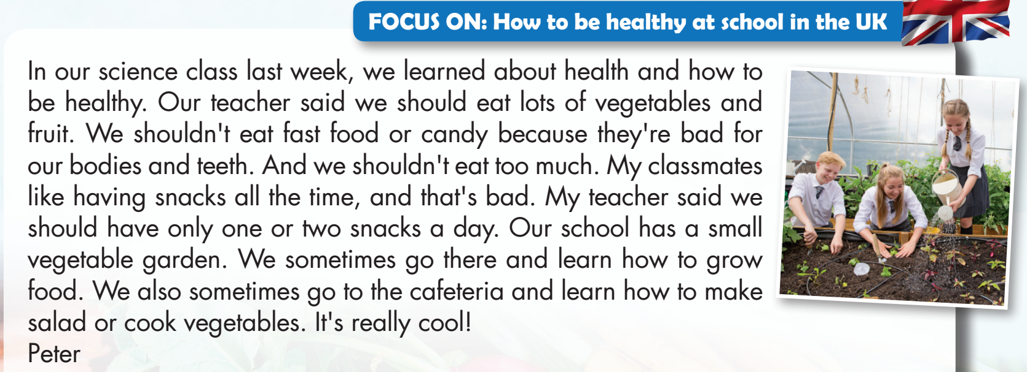
WHERE IS MY SKATEBOARD?
START

Slide 6


Peter learned about health and how to be healthy in his science class.
TRUE
FALSE

Slide 7
WHERE IS MY SKATEBOARD?
START

Slide 8
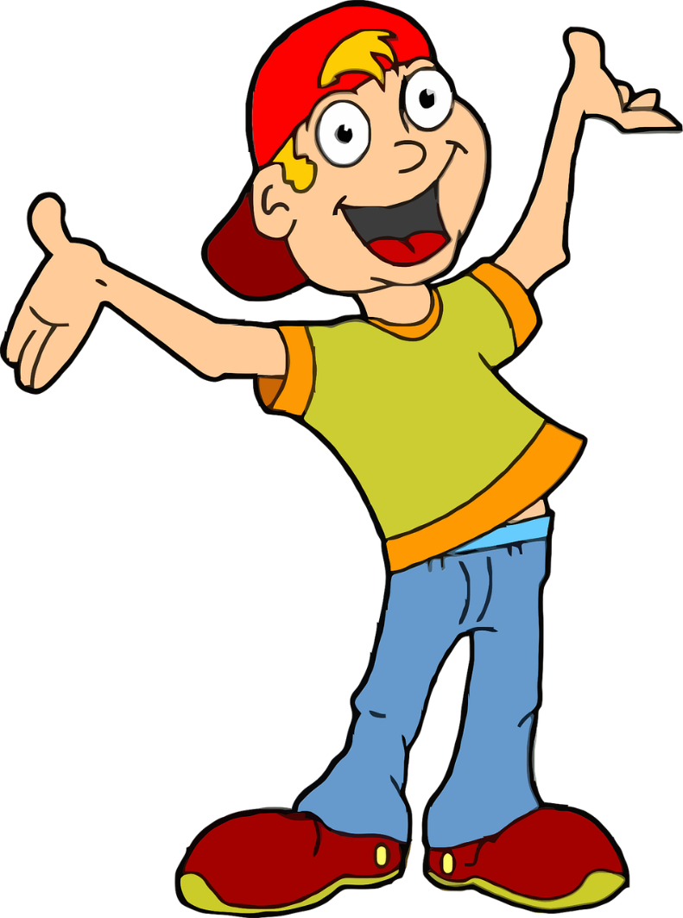
His teacher said we should eat lots of snacks.
TRUE
FALSE

Slide 9
WHERE IS MY SKATEBOARD?
START

Slide 10
We shouldn't eat fast food or candy.
TRUE
FALSE

Slide 11
WHERE IS MY SKATEBOARD?
START

Slide 12
Peter's classmates like having fast food all the time.
TRUE
FALSE

Slide 13
WHERE IS MY SKATEBOARD?
START

Slide 14
Peter sometimes goes to his school’s garden and learns how to grow food.
TRUE
FALSE

Slide 15
WHERE IS MY SKATEBOARD?
START

Slide 16

It’s time to learn …

Slide 17

Lead-in

Slide 18

WHAT COUNTRY IS IT?

Slide 19
LIST 5 THINGS ABOUT VIETNAM!
It’s a beautiful country in Asia.
Hanoi is the capital city.
Ho Chi Minh is in the south.
…………………..
…………………..

Slide 20
Practice

Slide 21

Reading

Slide 22

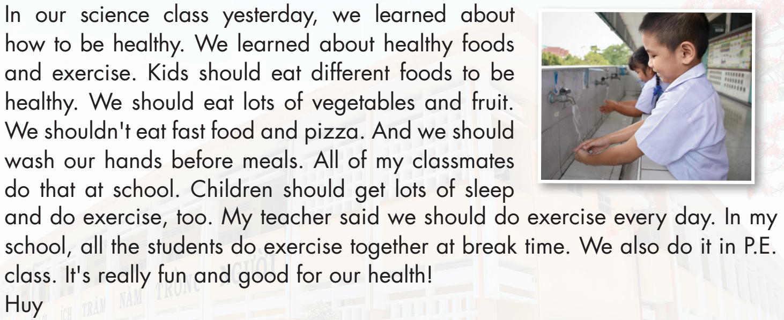

Slide 23
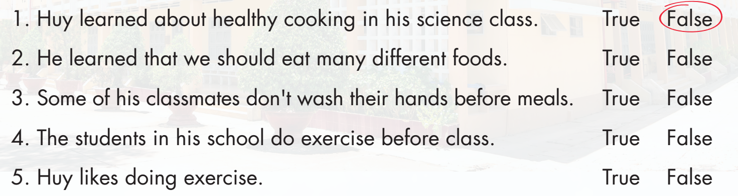
English
geography
P.E.

Slide 24
English
geography
P.E.

Slide 26
English
geography
P.E.

Slide 28
English
geography
P.E.

Slide 30
English
geography
P.E.

Slide 32
English
geography
P.E.

Slide 34

Listening

Slide 35



Slide 36
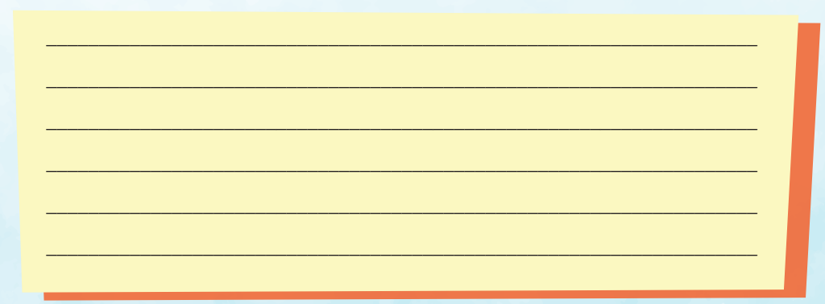
Examples: Last week, we learned about how to be healthy in science class. Our teacher said that we should eat lots of vegetables and fruit to be healthy. We should do exercise and play outside. We shouldn't eat fast food, and we should wash our hands before meals. We also need to brush our teeth twice a day and sleep early.

Slide 37

Production

Slide 38

Speaking

Slide 40
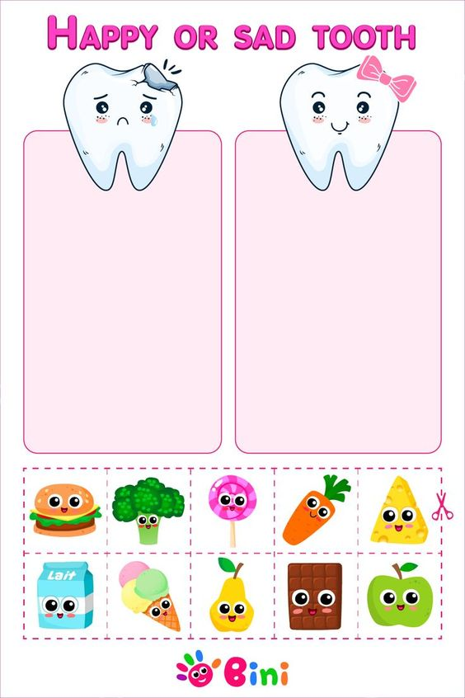
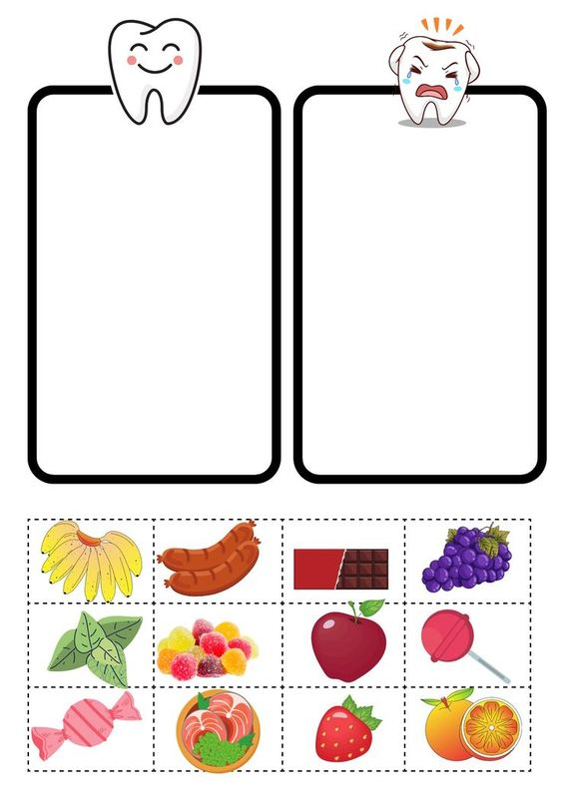

Slide 42

CONSOLIDATION

Slide 43

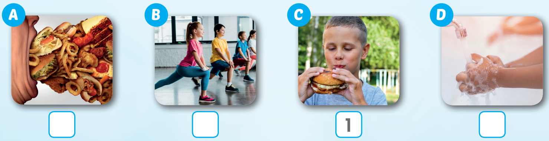
Extra Practice
WB, page 49
Click on C to hear the sound
3
2
4

Slide 44

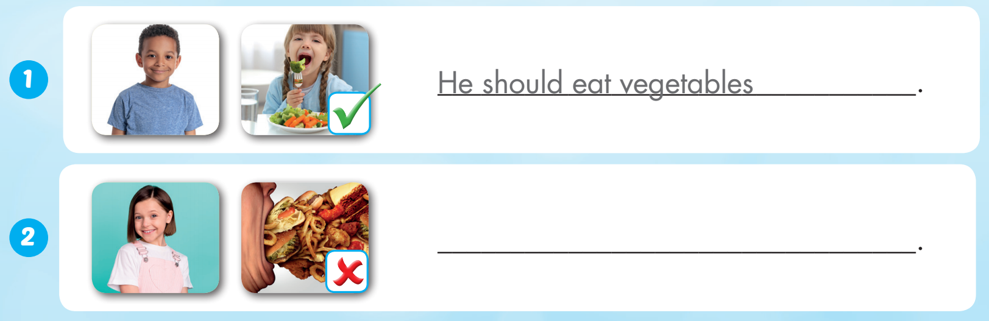
Extra Practice
WB, page 49
Example:
She shouldn’t eat too much

Slide 45
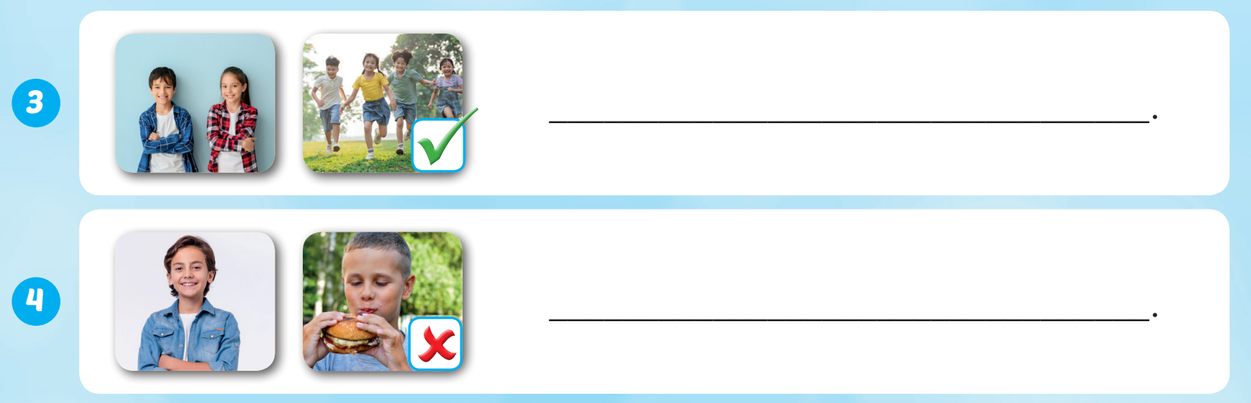
Extra Practice
WB, page 49
Example:
They should play outside
He shouldn’t eat fastfood

Slide 46

WRAP-UP

Slide 47
Today’s lesson
Vocabularies
do exercise, eat fast food, eat vegetables, wash your hands, play outside, eat too much
Structures/ Sentence patterns
What should I do to be healthy?
You should do exercise.
You shouldn't eat fast food.

Slide 48
Homework
Practice the vocabularies and structure, and make sentences using them.
Do the exercises in Tiếng Anh 5 i-Learn Smart Start WB (page 49).
Do the exercises in Tiếng Anh 5 i-Learn Smart Start Notebook.
Prepare the next lesson (page 76 SB).
Play the consolidation games in Tiếng Anh 5 i-Learn Smart Start DHA App on www.eduhome.com.vn

Slide 49

Enjoy your day!

Slide 50

Lesson 3
Stay positive and have a nice day!

