Slide 1

Unit 3: School
Review 2
Page 51

Slide 2
Lesson Outline
Warm-up
Speaking
Consolidation
Wrap-up

Slide 3
Objectives
By the end of this lesson, students will be able to review asking who owns different school supplies, asking what subjects people like, and talking about their school timetables.

Slide 4

WARM UP

Slide 5

Let’s play!
Hot seat

Slide 6

Hot seat
How to play:
Divide the class into 4 teams.
Elect one person from each team to sit in the Hot Seat,
facing the classroom with the board behind them.
Write a word on the board (days, school things, subjects).
One of the team members of the student in the hot seat
must help the student guess the word by describing it (but he/she cannot say, spell or draw the word).

Slide 7

LET’S CHANT!

Slide 8


Slide 9

It’s time to learn …

Slide 10

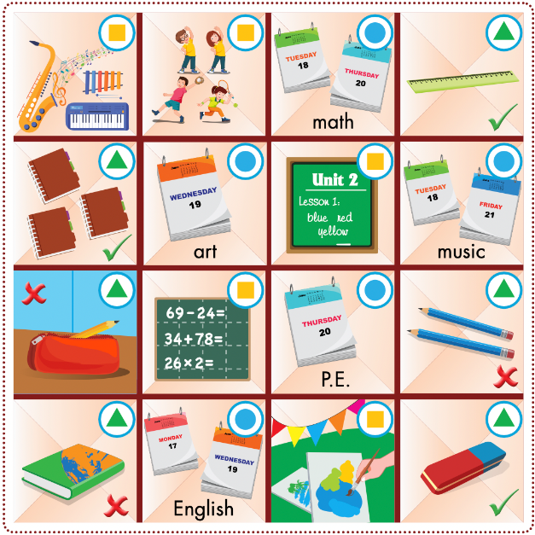

Slide 11
How to play
Divide the class into groups of four with two pairs in each group.
Have pairs play rock, paper, scissors to see which pair goes first.
Have the winning pair choose a space, match the symbol to the useful language, then ask and answer.
Have the pair mark that space as theirs if they use the useful language correctly.
The pair that gets three spaces in a horizontal, vertical, or diagonal line wins the game.

Slide 12

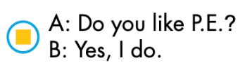

Example:

Slide 13


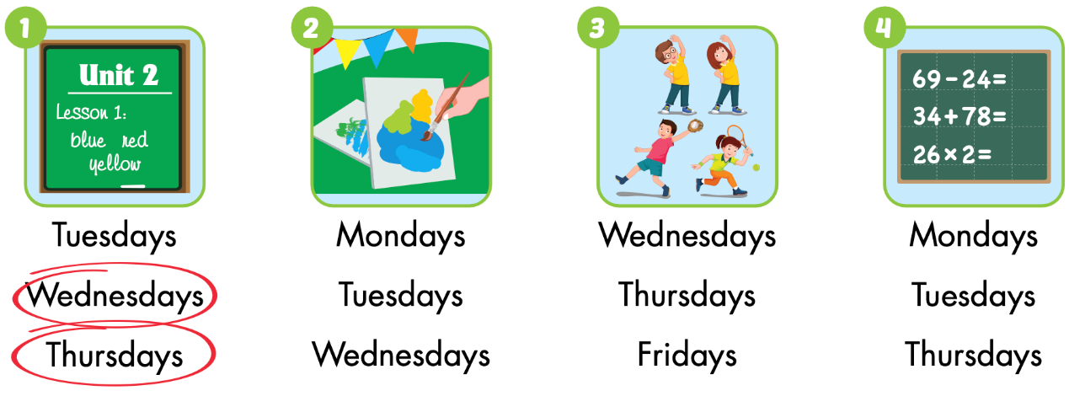
Extra Practice
WB p. 37

Slide 14
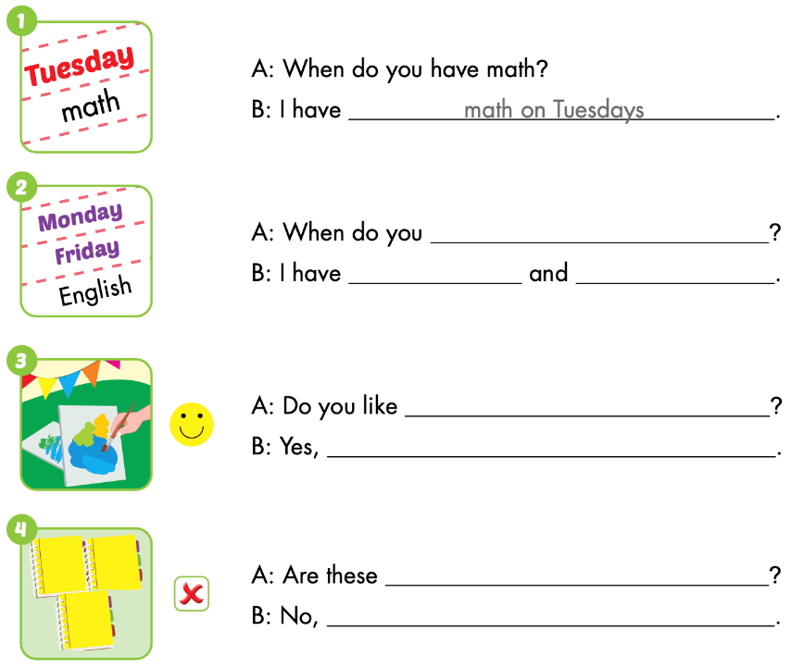


Slide 15

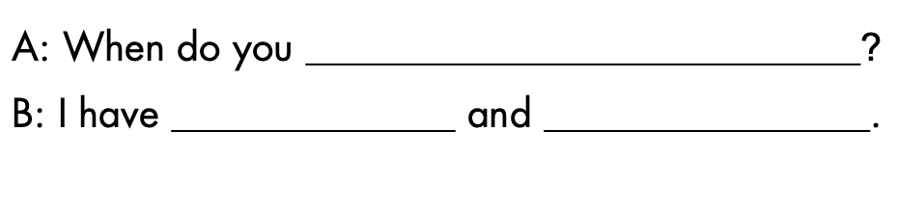
Let’s check!
have English
English on Monday
Friday

Slide 16
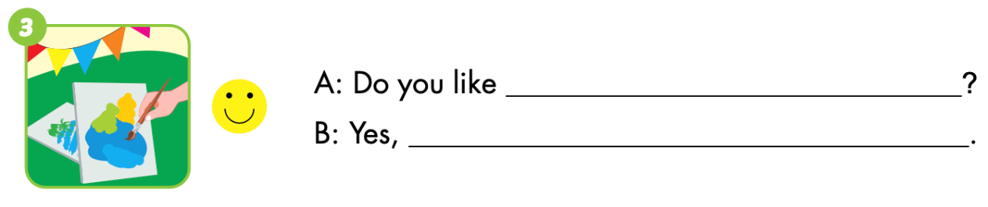
Let’s check!
art
I do

Slide 17
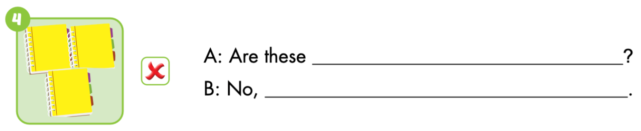
Let’s check!
your notebooks
they aren’t

Slide 18
Let’s play!

Slide 19
Top
5
QUIZ

Slide 20
HOW TO PLAY
Ask students to read the questions.
They write down ONE answer.
Students get points if their answer in “top 5”.

Slide 21
# 1

Slide 22
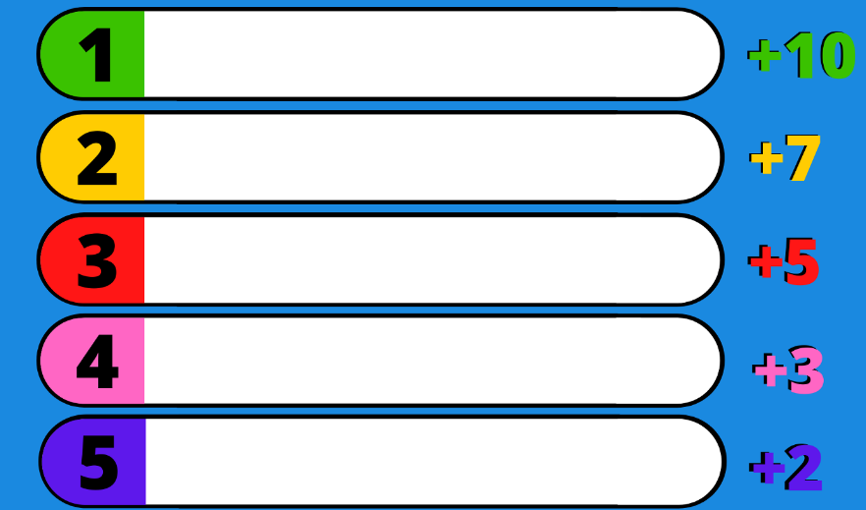
Name a school thing.
eraser
notebook
ruler
pencil case
book

Slide 23
# 2

Slide 24
Name a color.
green
orange
red
pink
purple

Slide 25
# 3

Slide 26
Name a day.
Sunday
Tuesday
Friday
Thursday
Monday

Slide 27
# 4

Slide 28
Name a school subject.
Math
English
music
art
P.E.

Slide 29

CONSOLIDATION

Slide 30
Let’s play!

Slide 31

game
Word Jumble Race

Slide 32
How to play
Word Jumble Race
Write out 3 sentences, using different colors for each sentence.
Cut up the sentences so you have a handful of words.
Put each sentence into hats, cups or bags, keeping each separate.
Split your class into teams of 4.
Teams must now put their sentences in the correct order.
The winning team is the first team to have all sentences correctly ordered.

Slide 33
Answers
Word Jumble Race
When do you have math?
Do you like math?
Are these your pencils?

Slide 34



Read the statements and give an example for each.
In pairs, have students give a few more examples of each aim,
then briefly practice.
Ask students to circle the happy or sad face to show if they can
perform the tasks.
= Yes, I can.
= No, I can't.

Slide 35


Slide 36

WRAP-UP

Slide 37
Lesson 3
Today’s lesson
Vocabularies:
Monday, Tuesday, Wednesday, Thursday, Friday, Saturday, Sunday
math, art, English, music, P.E.
pencil, ruler, notebook, eraser
Structures/ Sentence patterns
When do you have math?
I have math on Monday.

Slide 38
Lesson 3
Homework
Review all vocabularies and structures. Make sentences using them.
Do the exercises on page 37 WB
Play the consolidation games in Tiếng Anh 3 i-Learn Smart Start Notebook on www.eduhome.com.vn
Prepare the next lesson (page 52 SB)

Slide 39
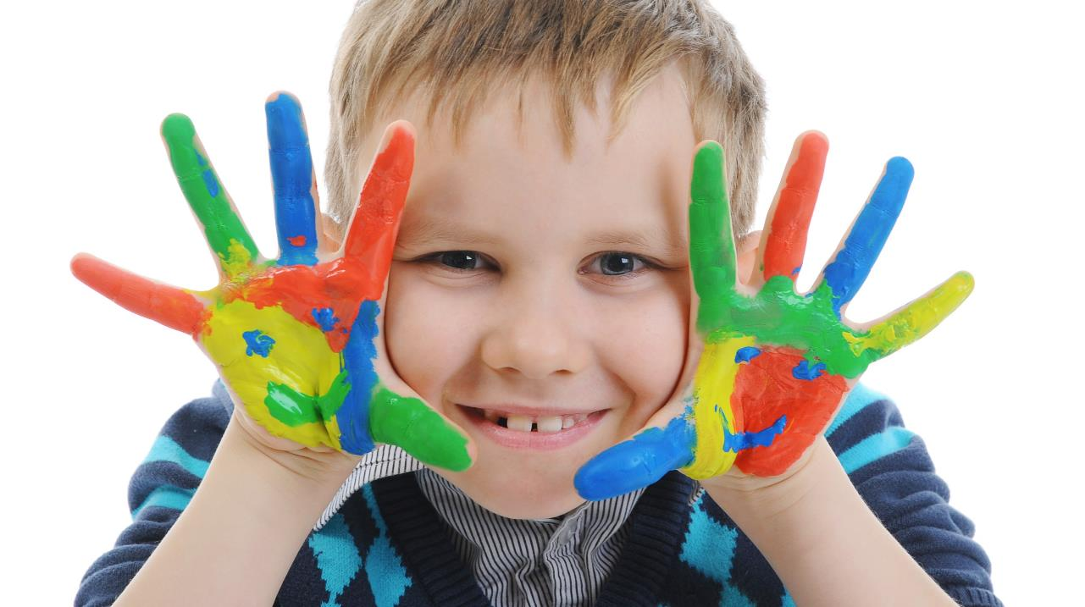
Enjoy your day!

Slide 40

Enjoy your day!

Slide 41

Lesson 3
Stay positive and have a nice day!

