Slide 1

Unit 3: MY FRIENDS AND I
Review 1
Page 46

Slide 2
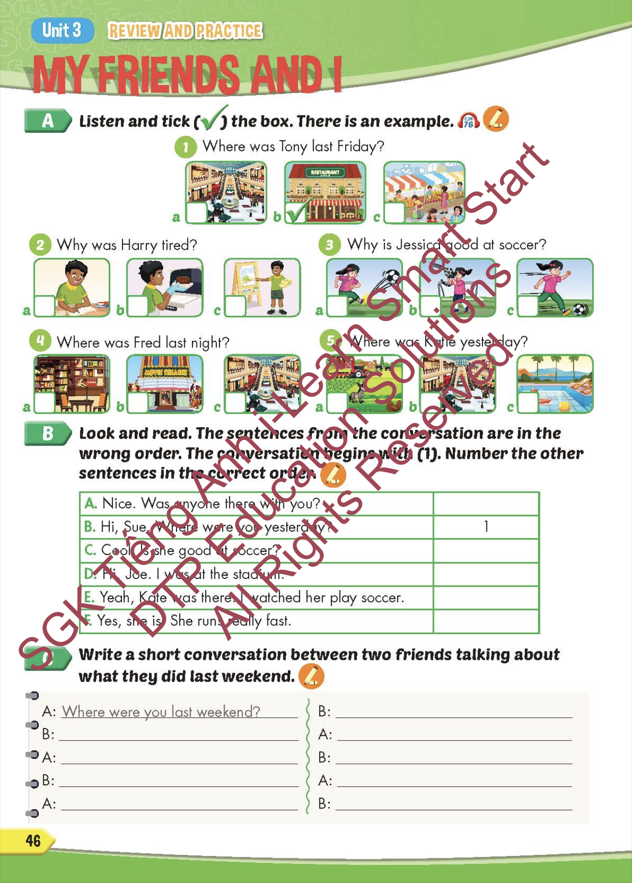
Lesson Outline
Warm-up
Listening
Reading
Writing
Wrap-up

Slide 3
Objectives
By the end of this lesson, students will be able to review the target language presented in unit 3 and practice Listening, Reading and Writing.
Vocabulary: unit 3
Structure: unit 3

Slide 4

WARM-UP

Slide 5



PLACES AROUND TOWN

Slide 6
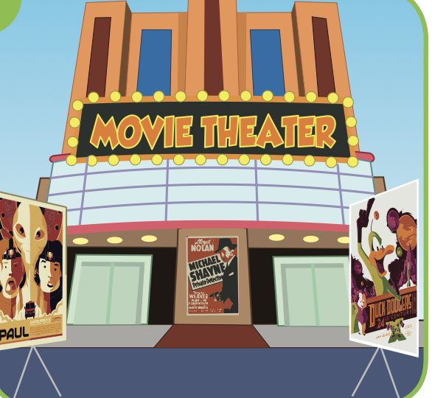


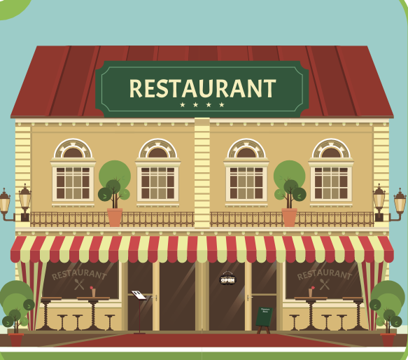


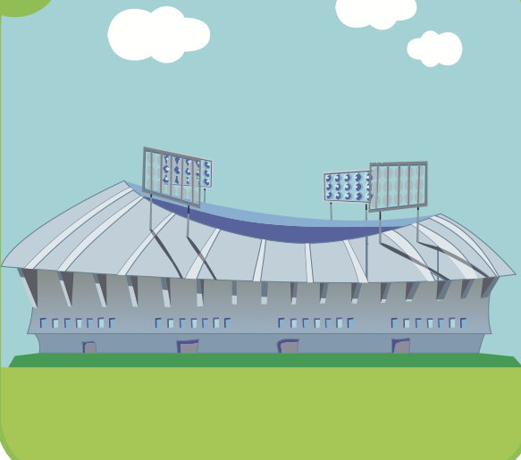

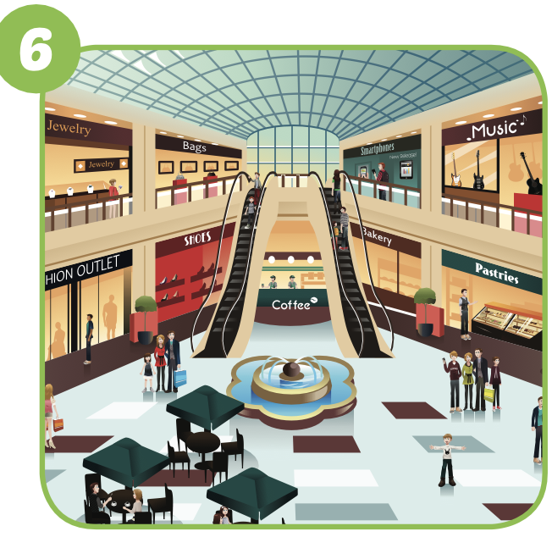
I was at the mall.
TIM
SUE
ANN
MALL
NEXT
Click on the right kid
TOM

Slide 7

I was at the stadium.
TIM
SUE
stadium
ANN
NEXT
Click on the right kid
TOM

Slide 8
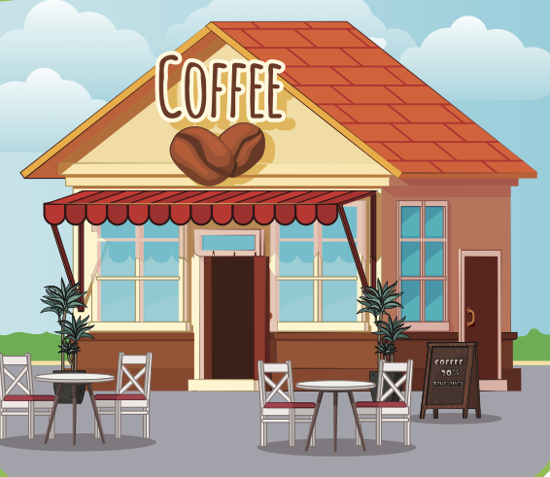
I was at the restaurant.
TIM
RESTAURANT
SUE
ANN
NEXT
TOM
Click on the right kid

Slide 9
I was at the movie theater.
MOVIE THEATER
TIM
SUE
ANN
END
Click on the right kid
TOM

Slide 10

It’s time to learn …

Slide 11

Practice

Slide 12
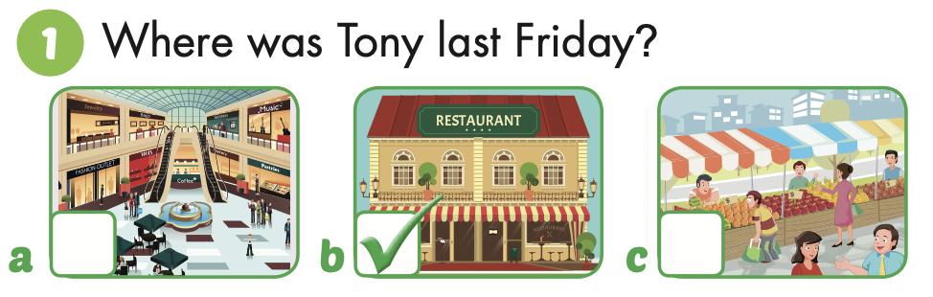
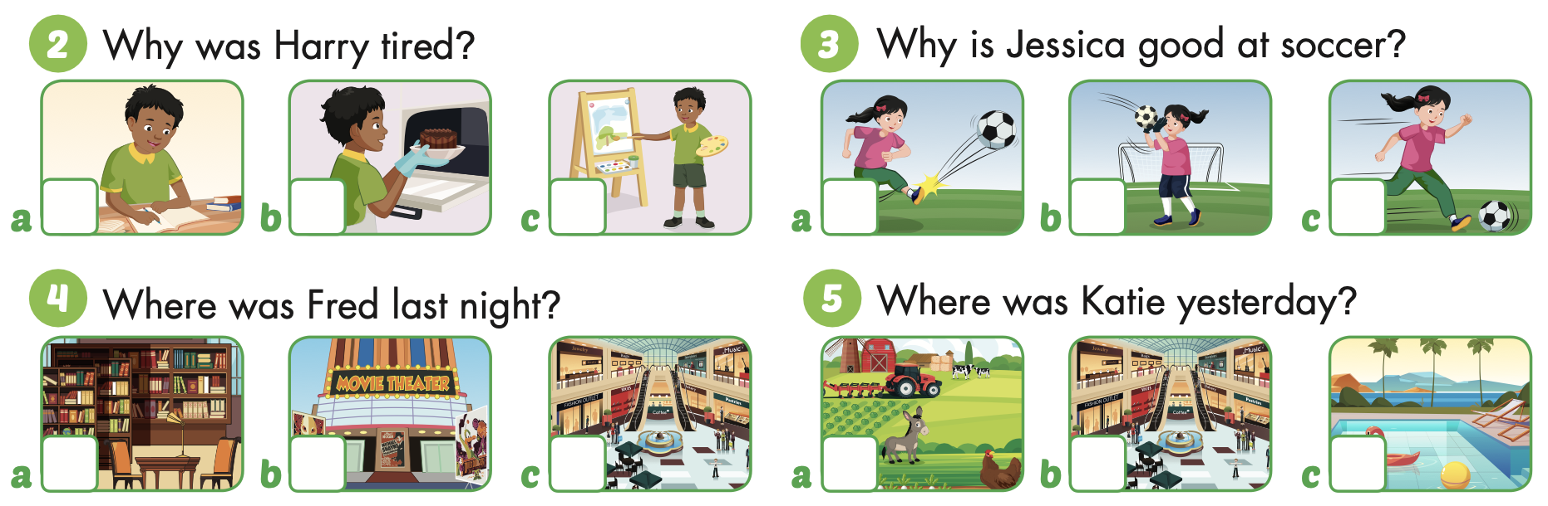
Point and say.

Slide 13

Listening

Slide 14


Slide 15


Slide 16

Reading

Slide 17
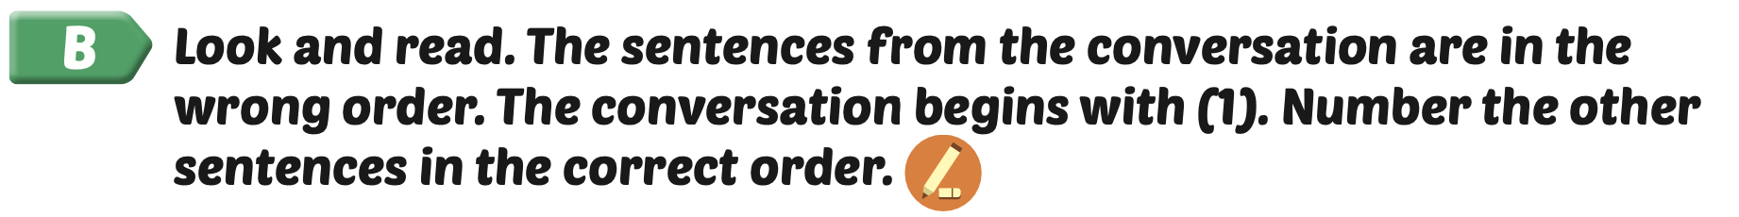
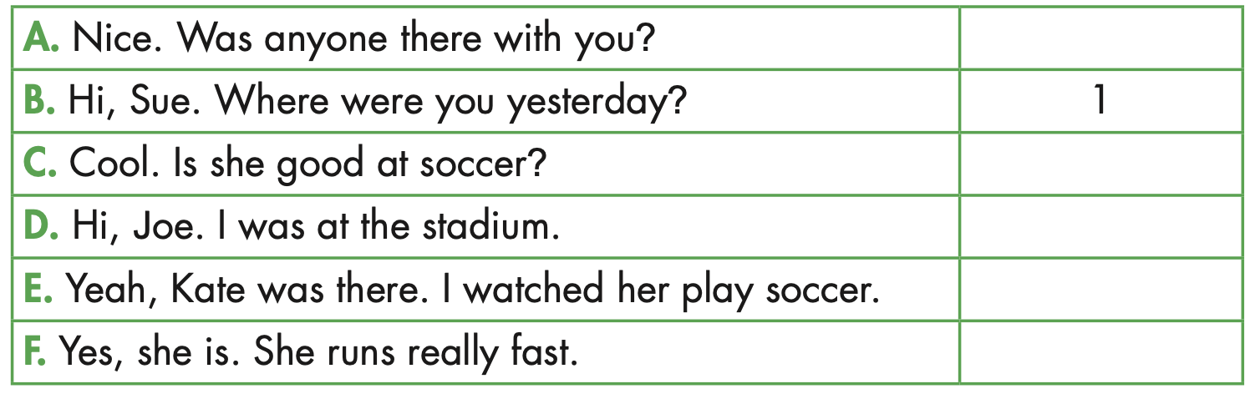
3
5
2
4
6

Slide 18



Slide 19
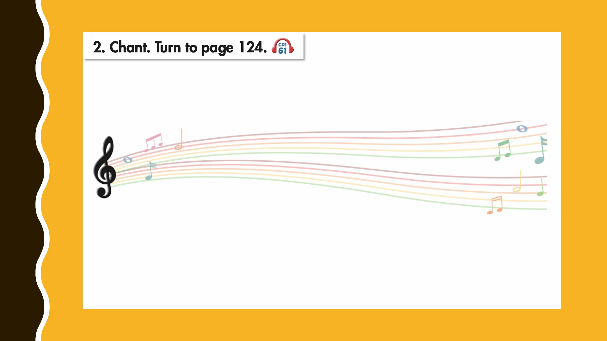

Slide 20

Writing

Slide 21
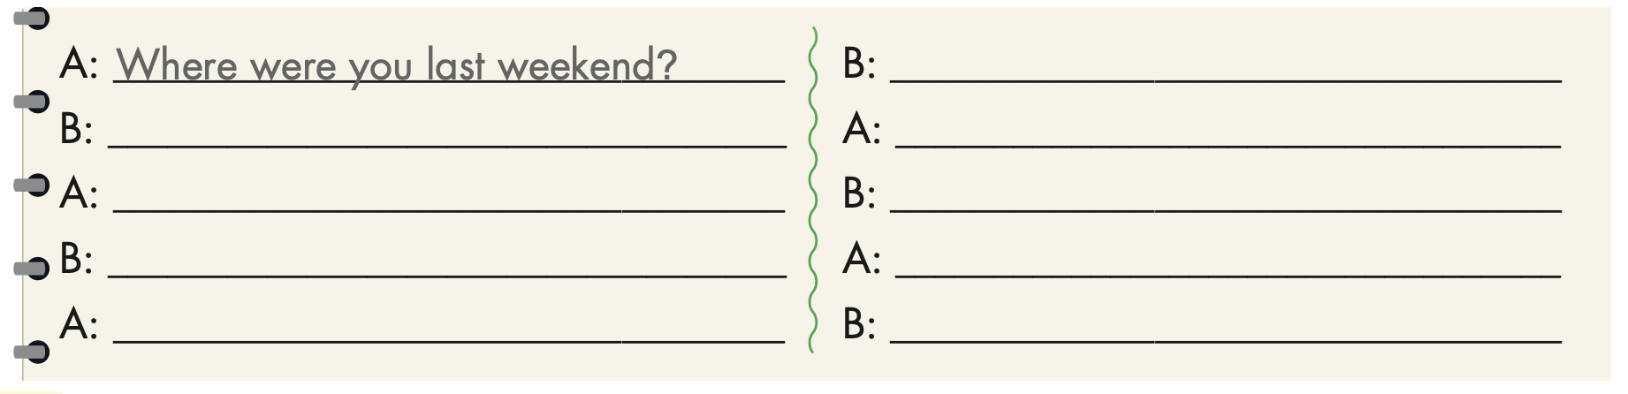
Examples:
Where were you last week?
I was at the mall.
I stayed home.
How was it?
What did you do?
It was fun, but it was busy.
I read a comic book.
Oh.
That’s nice.

Slide 22

Production

Slide 23
Talk about what you did last weekend.

Slide 24

CONSOLIDATION

Slide 25

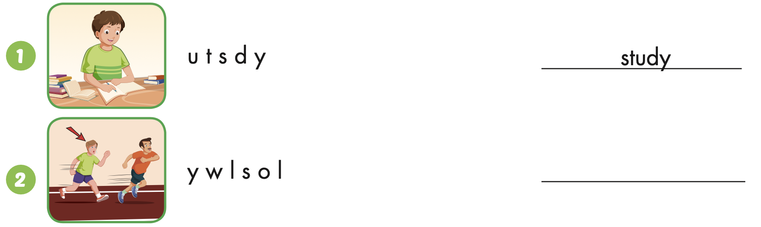
Extra Practice
WB, page 29
slowly

Slide 26
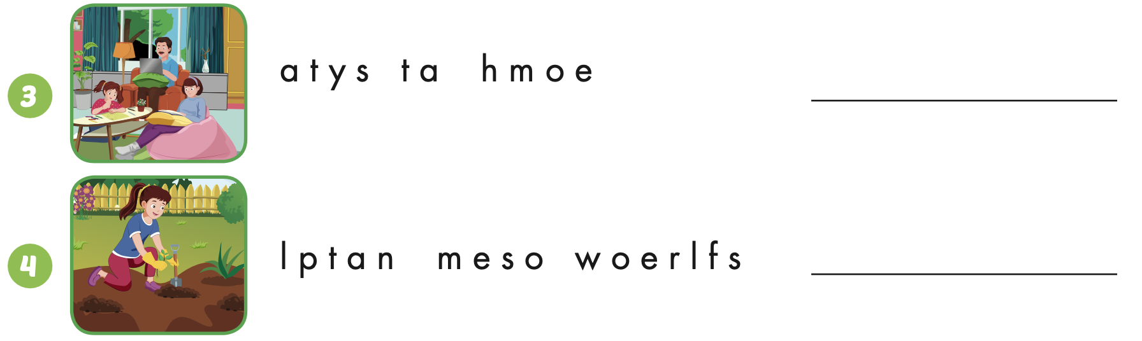
Extra Practice
WB, page 29
stay at home
plant some flowers

Slide 27
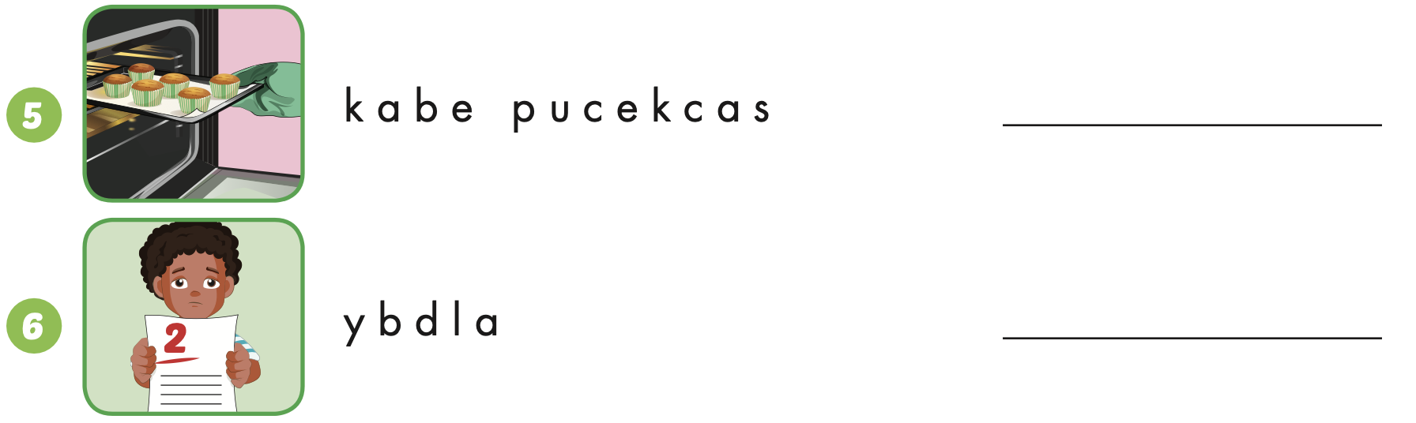
Extra Practice
WB, page 30
bake cupcakes
badly

Slide 28
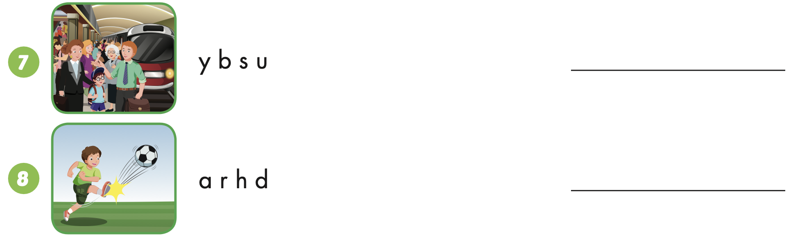
Extra Practice
WB, page 30
busy
hard

Slide 29

WRAP-UP

Slide 30
Today’s lesson
Vocabularies
Unit 3
Structures/ Sentence patterns
Unit 3

Slide 31
Homework
Practice the vocabularies and structure, and make sentences using them.
Do the exercises in Tiếng Anh 5 i-Learn Smart Start WB (page 30).
Do the exercises in Tiếng Anh 5 i-Learn Smart Start Notebook.
Prepare the next lesson (page 47 SB).
Play the consolidation games in Tiếng Anh 5 i-Learn Smart Start DHA App on www.eduhome.com.vn

Slide 32

Enjoy your day!

Slide 33

Lesson 3
Stay positive and have a nice day!

