Slide 1

Unit 3: MY FRIENDS AND I
Lesson 3.2
Page 41

Slide 2
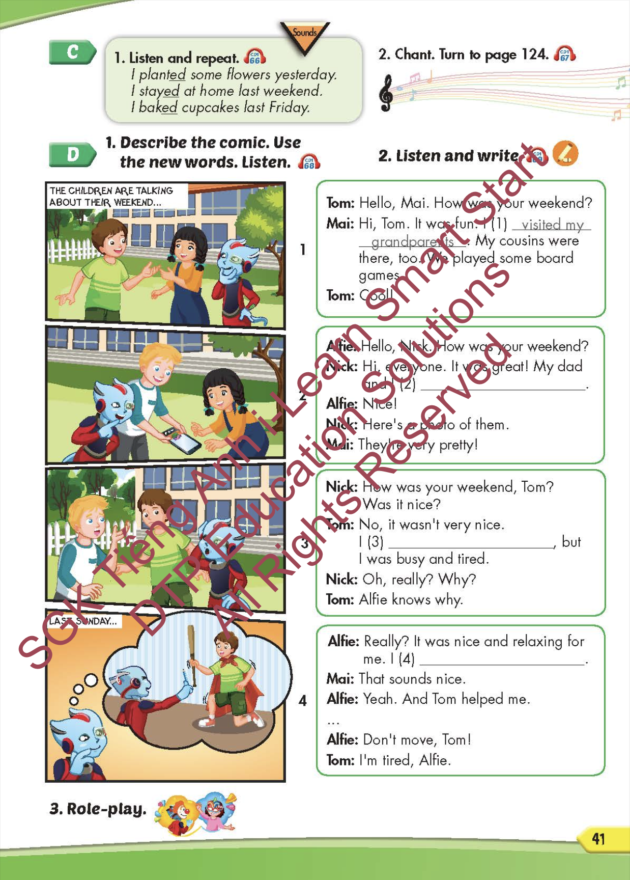
Lesson Outline
Warm-up
Listening
Speaking
Consolidation
Wrap-up

Slide 3
Objectives
By the end of this lesson, students will be able to recognize the /ɪd/, /d/, and /t/ sounds and conversations about what they and their friends did in the past.
Phonics: the /ɪd/, /d/, and /t/ sounds
Structure: I planted some flowers yesterday.

Slide 4

WARM-UP

Slide 5
Look, read and choose. Then say.

Slide 6

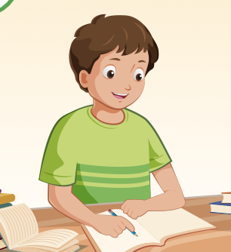
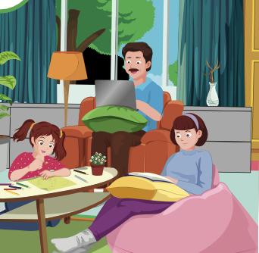
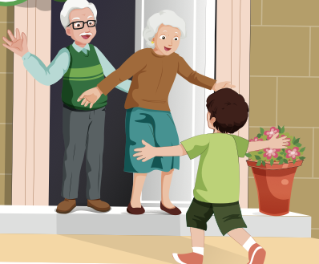
study
A
B
C

Slide 7
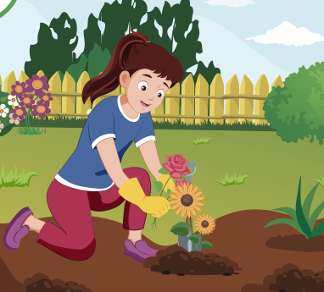
plant some flowers
A
B
C

Slide 8
visit my grandparents
A
B
C

Slide 9
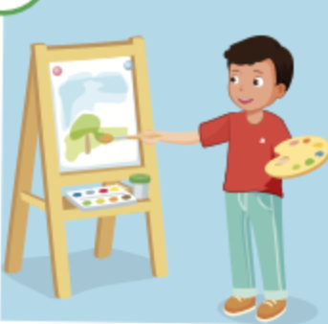
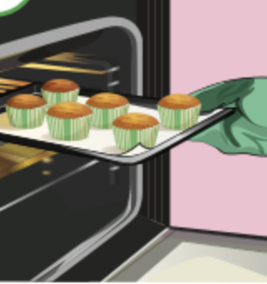
paint a picture
A
B
C

Slide 10

It’s time to learn …

Slide 11

Pronunciation
the /ɪd/, /d/, and /t/ sounds

Slide 12

Presentation

Slide 13

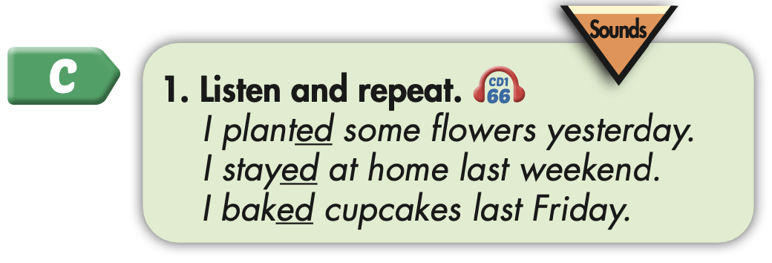

Slide 14
Practice

Slide 15



Slide 16
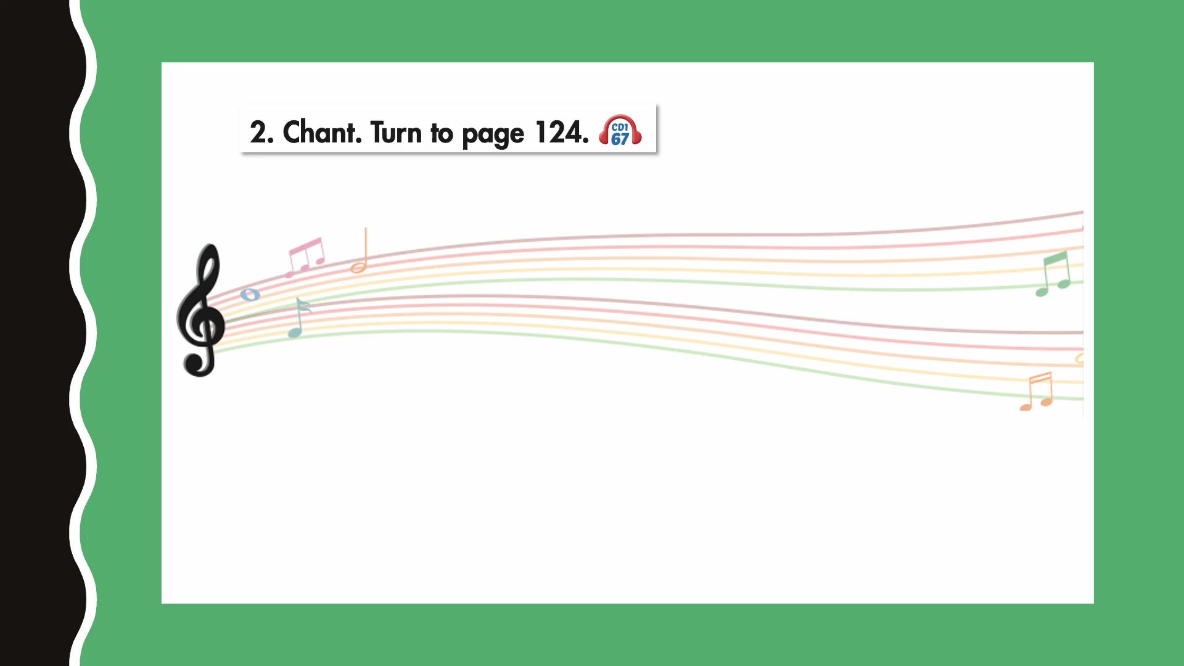

Slide 17

Structure
I planted some flowers yesterday.

Slide 18
Speaking

Slide 19
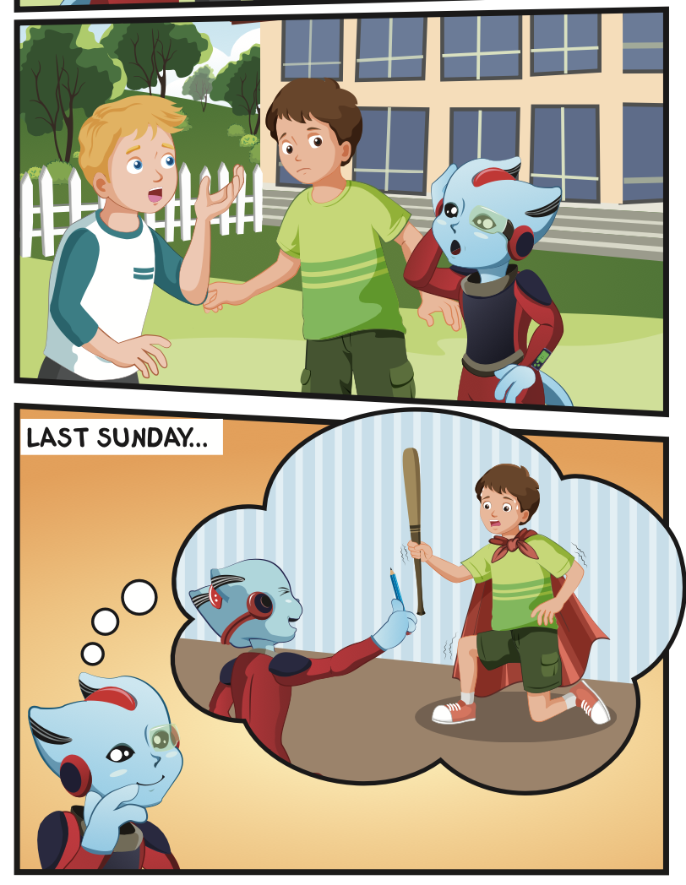
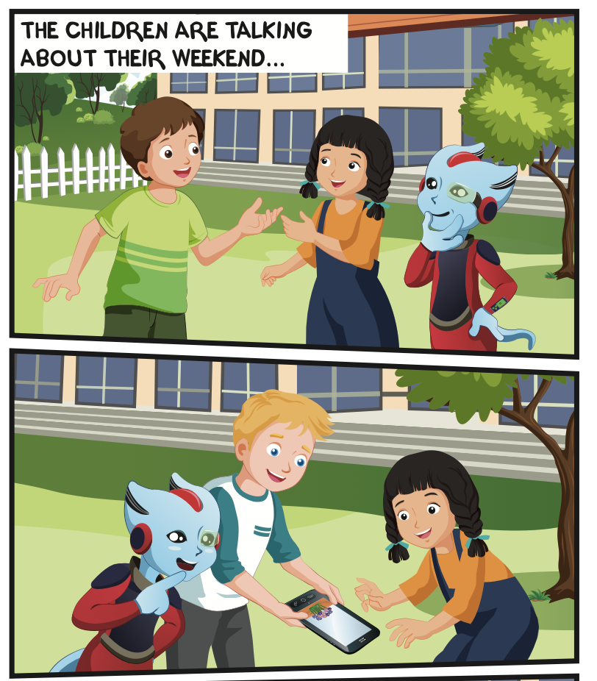
Who is talking?
Where are they?

Slide 20

Listening

Slide 21


Slide 22
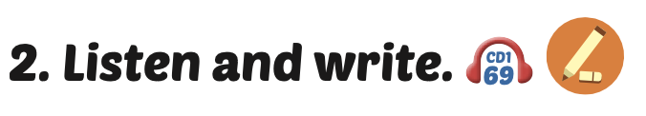
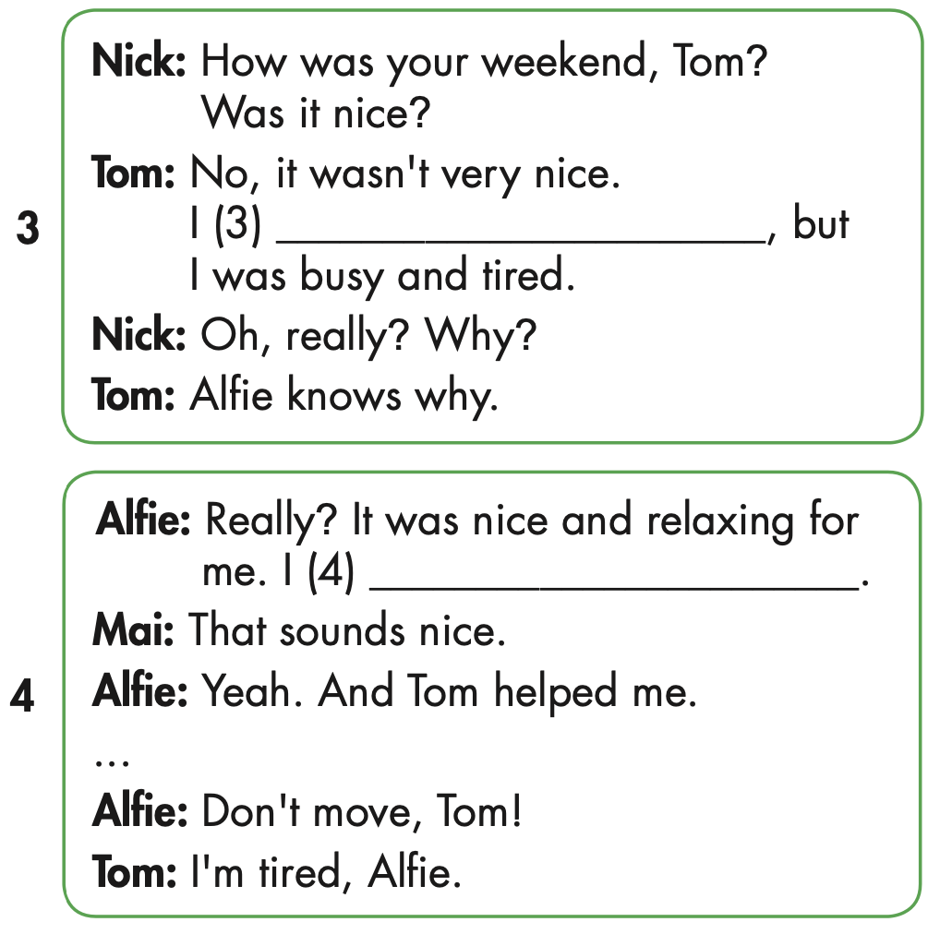
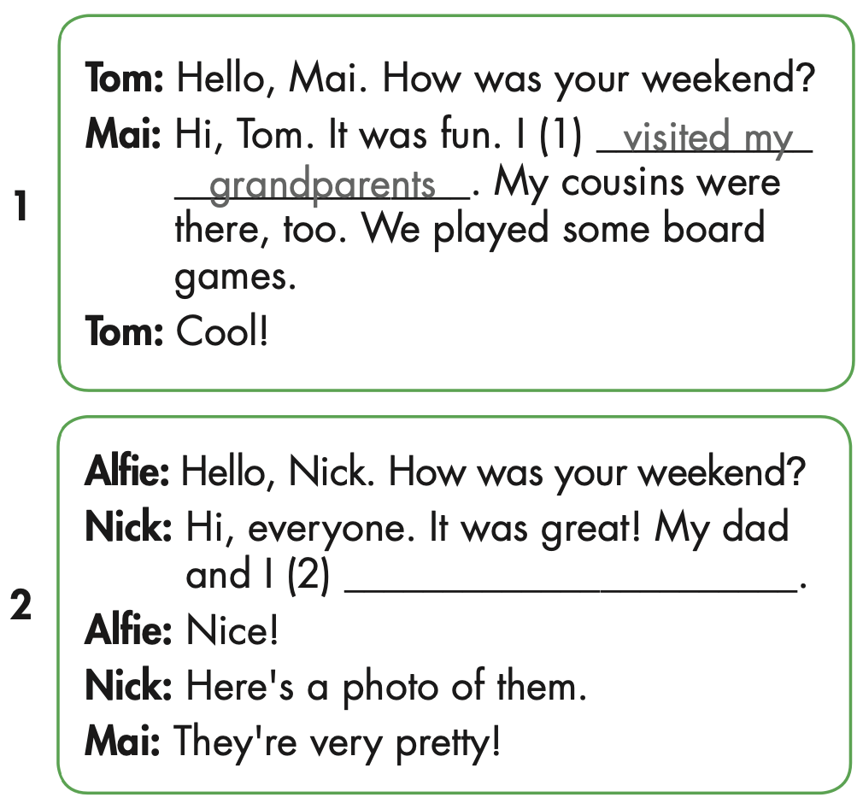

Slide 24
planted some flowers

Slide 25
stayed at home

Slide 26
painted a picture

Slide 27

Speaking

Slide 28

Role-play the conversation. Mind the sounds for verbs ending in ‘ed’.

Slide 29

Production

Slide 30

Writing

Slide 31
MAKE YOUR OWN STORY

Slide 32

CONSOLIDATION

Slide 33
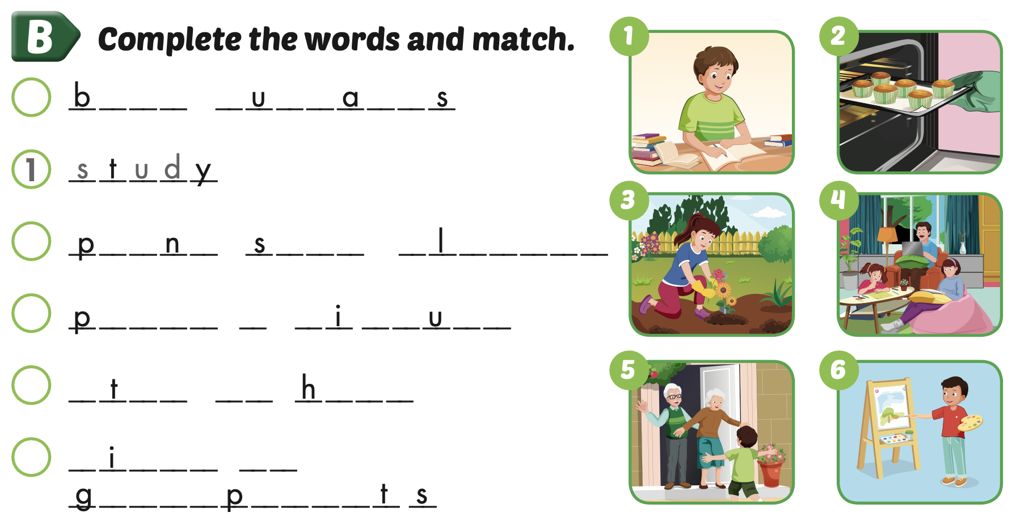
Extra Practice
WB, page 27
2
a k e
c p c k e
3
l a t
o m e
f o w e r s
5
a i n t
a
p c t r e
4
s a y
a t
o m e
6
v s i t
m y
r a n d
a r e n

Slide 34


Slide 35
Divide into 4 teams.
Students look, read and choose.
The first student answers the question correctly, wins 1 point.

Slide 36
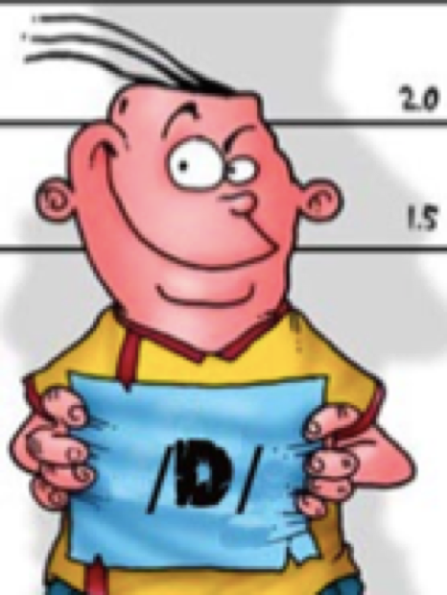
Which one belongs?
planted
painted
baked
stayed
visited
needed

Slide 37
stayed

Slide 38
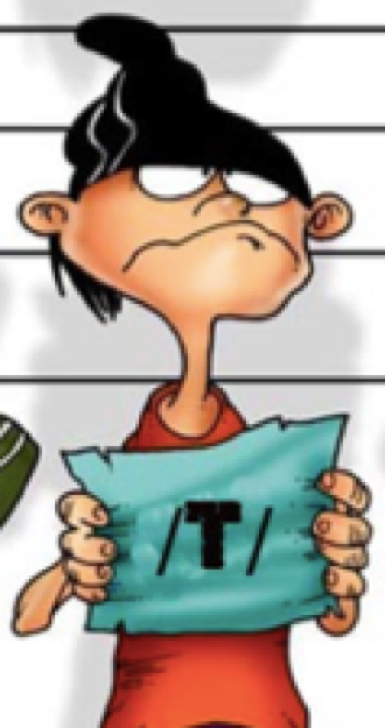
Which one doesn’t belong?
washed
looked
fixed
closed
baked
planted

Slide 39
planted

Slide 40
Which one is wrong?
decided
needed
ended
played
painted
visited
planted

Slide 41
played

Slide 42

WRAP-UP

Slide 43
Today’s lesson
Phonics
the /ɪd/, /d/, and /t/ sounds
Structures/ Sentence patterns
I planted some flowers yesterday.

Slide 44
Homework
Practice the vocabularies and structure, and make sentences using them.
Do the exercises in Tiếng Anh 5 i-Learn Smart Start WB (page 27).
Do the exercises in Tiếng Anh 5 i-Learn Smart Start Notebook.
Prepare the next lesson (page 42 SB).
Play the consolidation games in Tiếng Anh 5 i-Learn Smart Start DHA App on www.eduhome.com.vn

Slide 45

Enjoy your day!

Slide 46
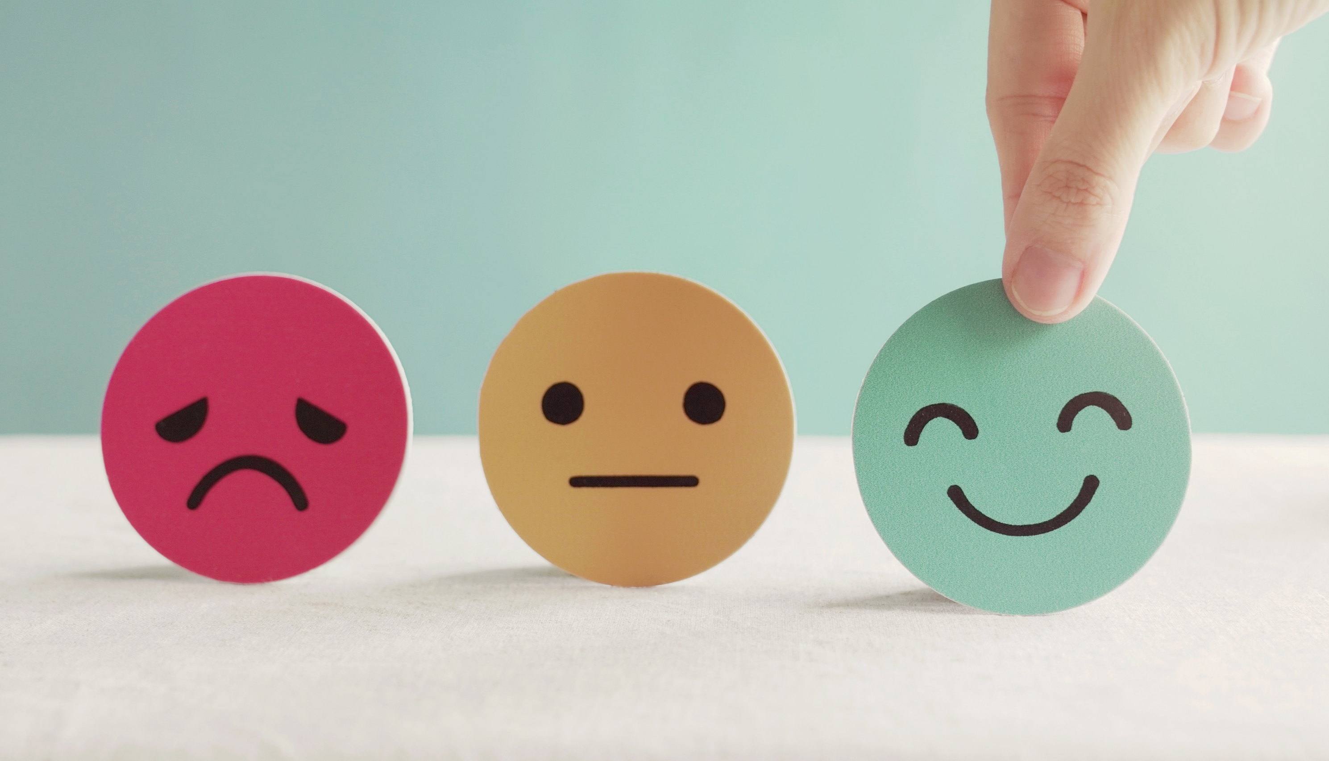
Lesson 3
Stay positive and have a nice day!

