Slide 1

Unit 3: MY FRIENDS AND I
Lesson 2.2
Page 38

Slide 2
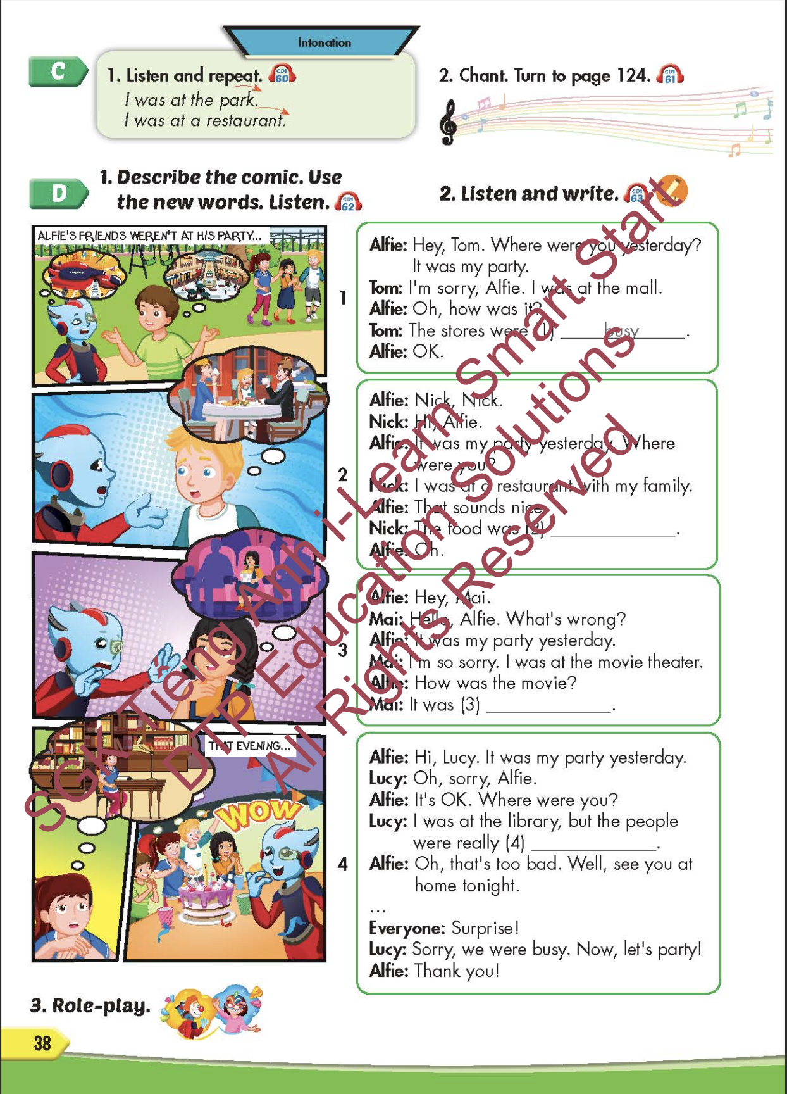
Lesson Outline
Warm-up
Pronunciation
Listening
Speaking
Consolidation
Wrap-up

Slide 3
Objectives
By the end of this lesson, students will be able to identify the intonation and practice the conversations.
Pronunciation: intonation for an affirmative sentence
Structure: Where were you last night?
I was at the movie theater. The movie was scary.

Slide 4

WARM-UP

Slide 5
Listen and choose. Then say.

Slide 6

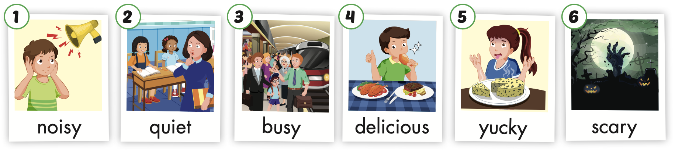


A
B
C
Listen and choose

Slide 7
A
B
C
Listen and choose

Slide 8
A
B
C
Listen and choose

Slide 9
C
A
B
Listen and choose

Slide 10

It’s time to learn …

Slide 11

Pronunciation
intonation for
an affirmative sentence

Slide 12

Presentation

Slide 13
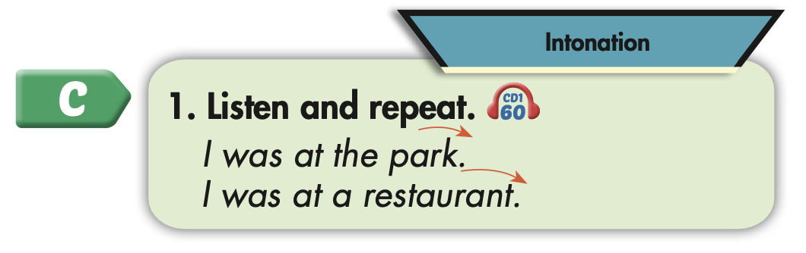

Slide 14
Practice

Slide 15



Slide 16
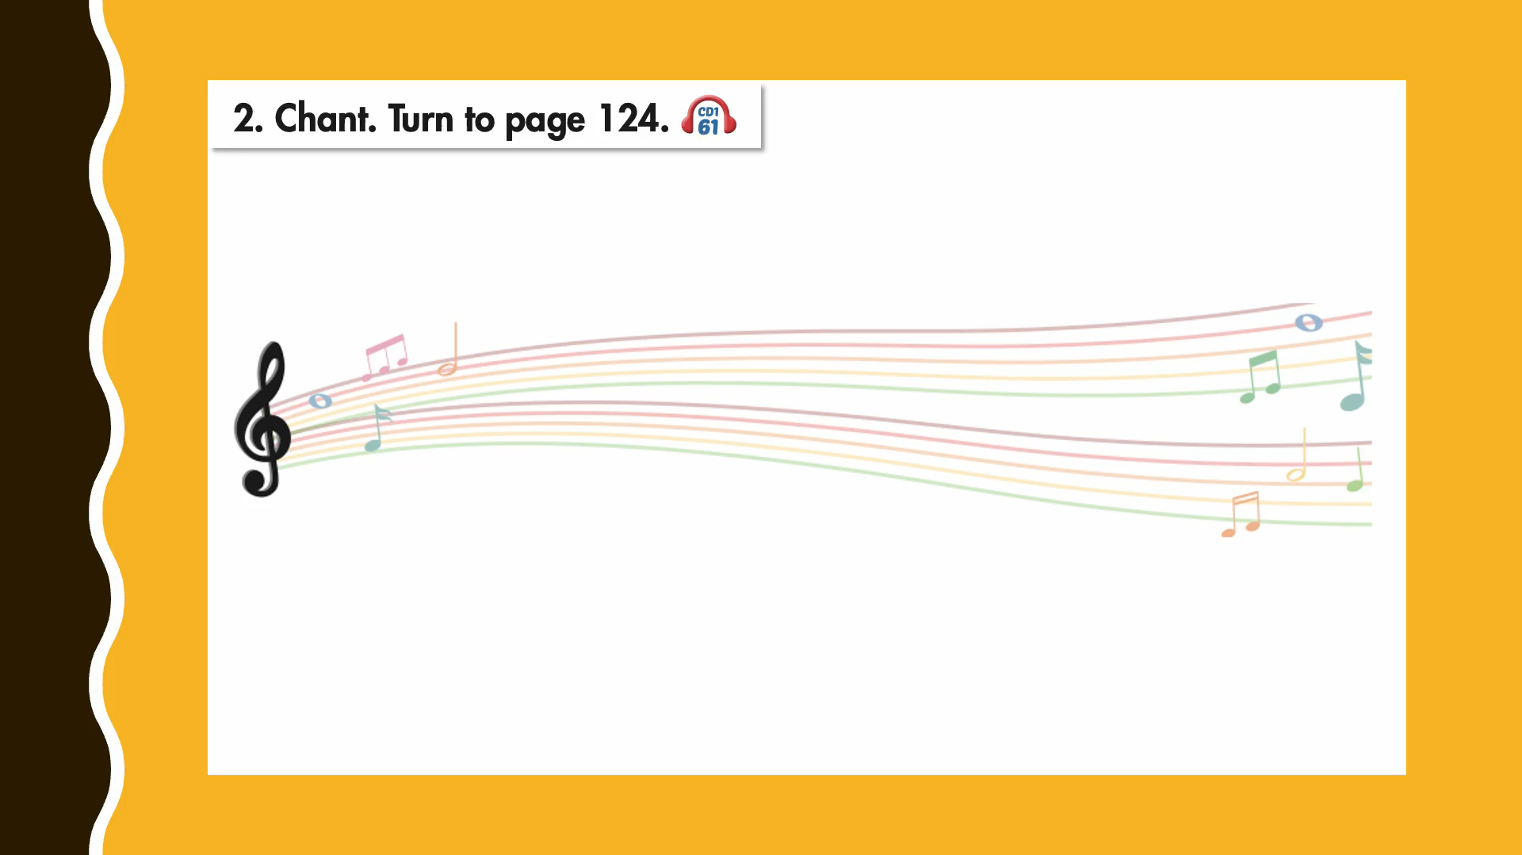

Slide 17

Structure
Where were you last night?
I was at the movie theater.
The movie was scary.

Slide 18

Speaking

Slide 19
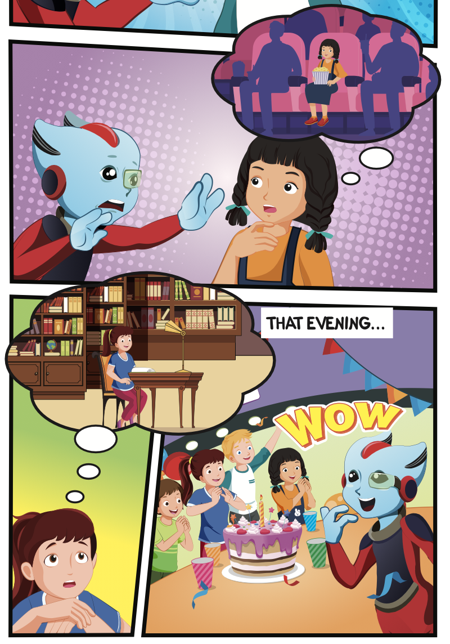
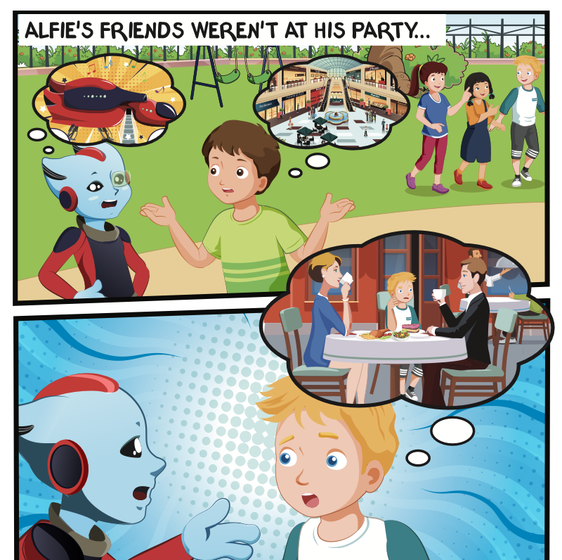
Who is talking?
Where are they?

Slide 20

Listening

Slide 21


Slide 22

Practice

Slide 23

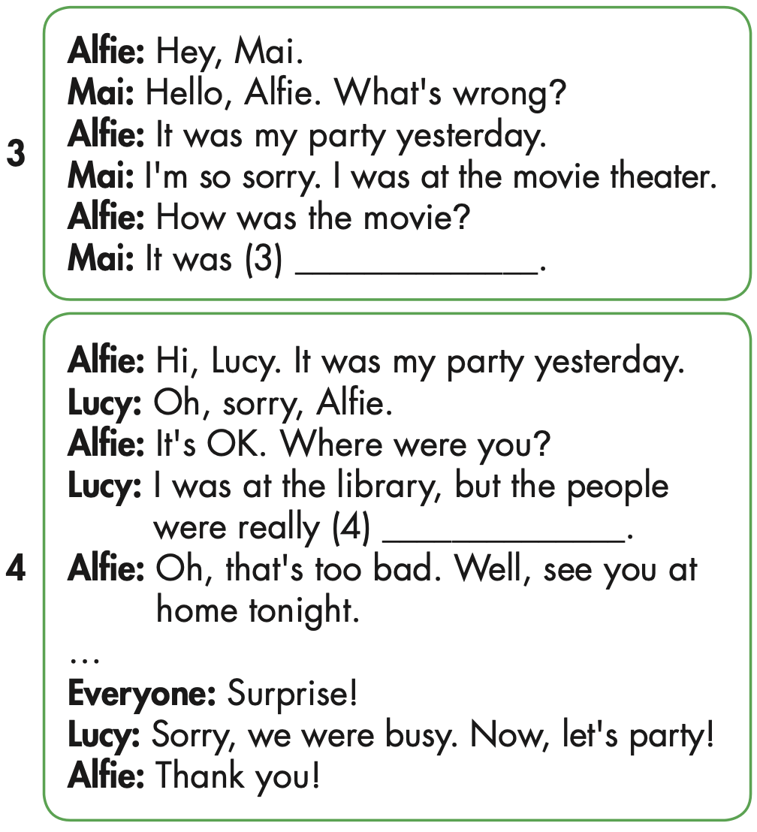
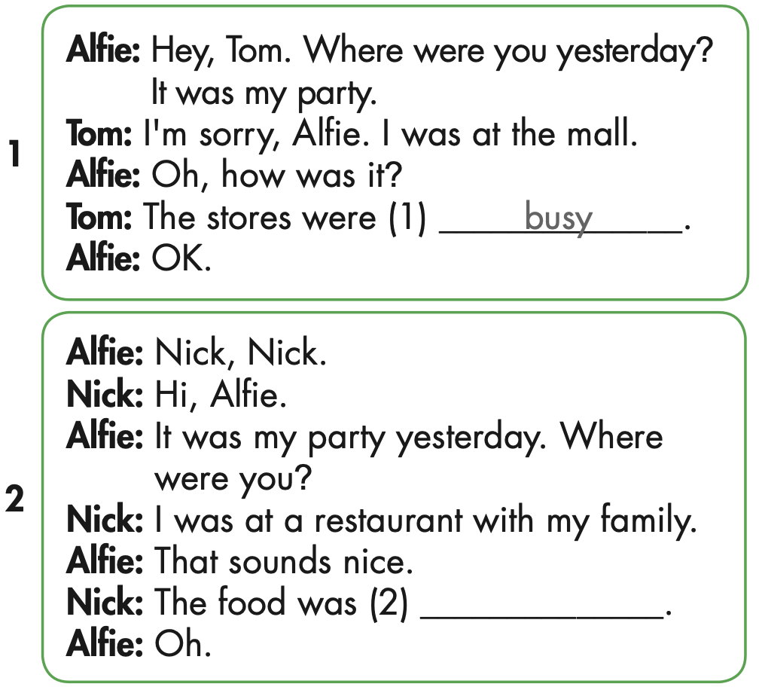

Slide 25
yucky

Slide 26
scary

Slide 27
noisy

Slide 28

Speaking

Slide 29

Role-play the conversations. Mind your intonation.

Slide 30

Production

Slide 31

Writing

Slide 32
MAKE YOUR OWN STORY

Slide 33

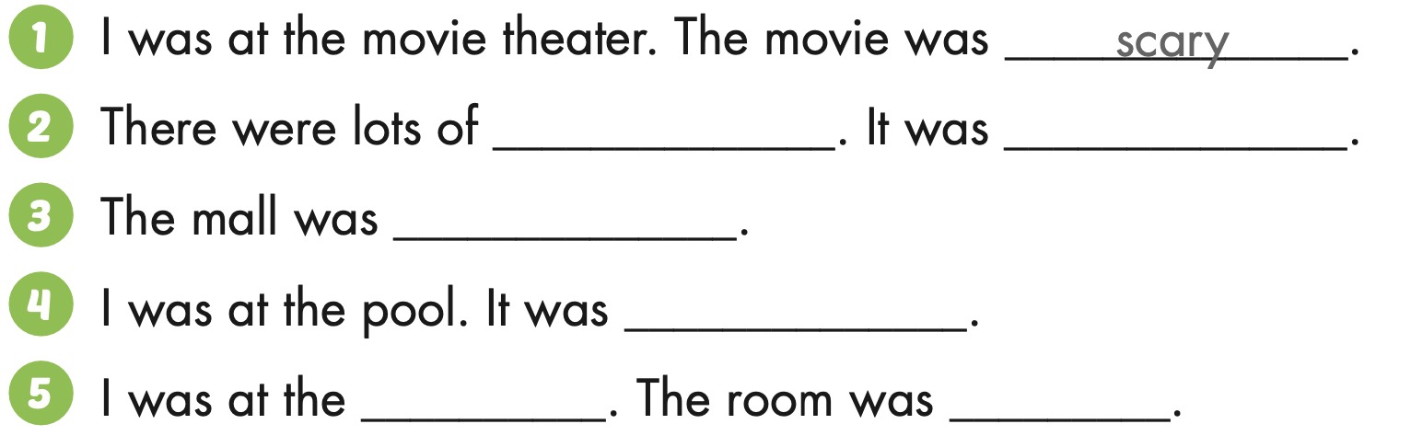
Extra Practice
WB, page 24
food
delicious
busy
noisy
library
quiet

Slide 34

CONSOLIDATION

Slide 35
LOOK, READ AND CHOOSE.

Slide 36
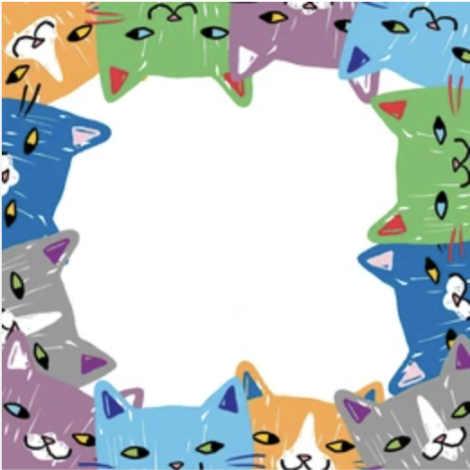

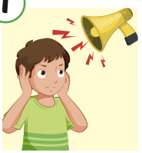
NOISY
QUIET
YUCKY
NOISY

Slide 37

SCARY
QUIET
YUCKY
QUIET

Slide 38
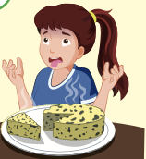
SCARY
DELICIOUS
YUCKY
THE FOOD WAS…..……..
YUCKY

Slide 39

WAS
WERE
THE PEOPLE …………. NOISY.
WERE

Slide 40
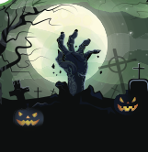
WAS
WERE
THE FILM …………. SCARY.
WAS

Slide 41

WRAP-UP

Slide 42
Today’s lesson
Pronunciation
intonation for an affirmative sentence
Structures/ Sentence patterns
Where were you last night?
I was at the movie theater. The movie was scary.

Slide 43
Homework
Practice the vocabularies and structure, and make sentences using them.
Do the exercises in Tiếng Anh 5 i-Learn Smart Start WB (page 24).
Do the exercises in Tiếng Anh 5 i-Learn Smart Start Notebook.
Prepare the next lesson (page 39 SB).
Play the consolidation games in Tiếng Anh 5 i-Learn Smart Start DHA App on www.eduhome.com.vn

Slide 44

Enjoy your day!

Slide 45
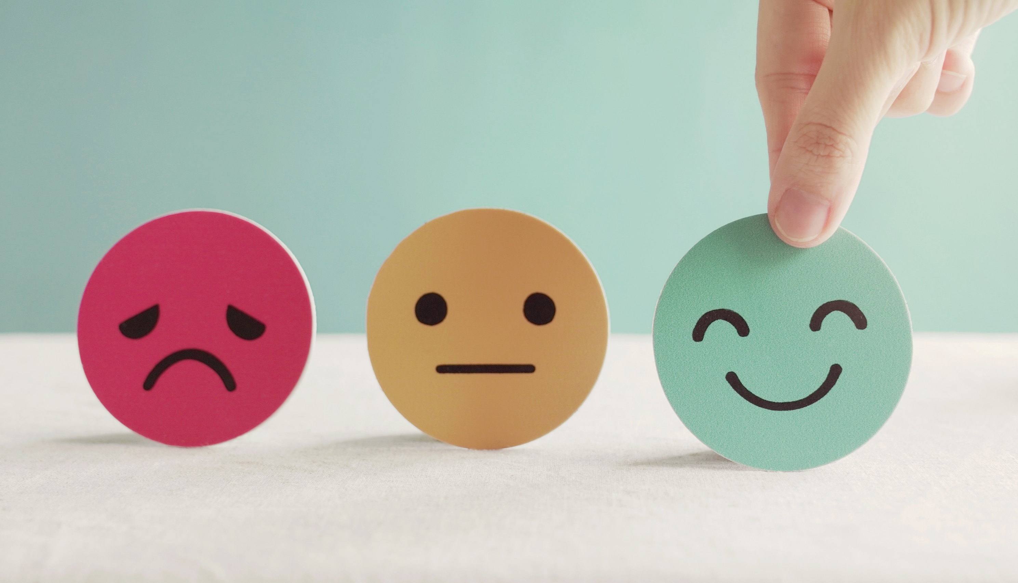
Lesson 3
Stay positive and have a nice day!

