Slide 1

Unit 3: WEATHER
REVIEW AND PRACTICE 2
Page 47

Slide 2
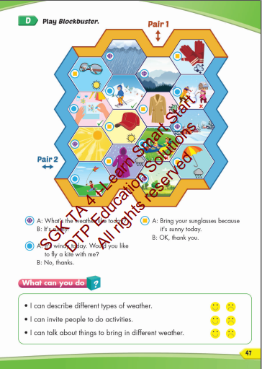
Lesson Outline
Warm-up
Practice
Consolidation
Wrap-up

Slide 3

WARM UP

Slide 4


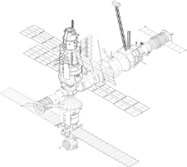










SPACE RACE
GO!
3
2
1
ROCKET SHIP WINS!
ALIEN SHIP
WINS!

Slide 5




SPACE RACE
1
2
3
4
5
6
7
8
9
10
11
12
13
14
15

Slide 6


What’s the weather like today?
It’s sunny.

Slide 7

What’s the weather like today?
It’s cloudy.

Slide 8
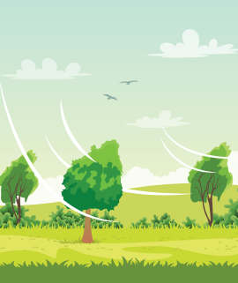
What’s the weather like today?
It’s windy.

Slide 9

What’s the weather like today?
It’s rainy.

Slide 10

What’s the weather like today?
It’s snowy.

Slide 11

What’s the weather like today?
It’s foggy.

Slide 12
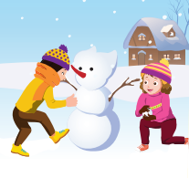
What are they doing?
They are making a snowman.

Slide 13
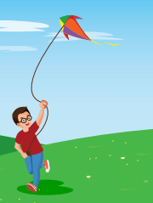
What is he doing?
He is flying a kite.

Slide 14

What are they doing?
They are having a picnic.

Slide 15
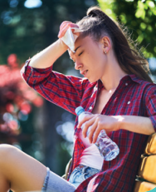
What is she feeling?
She’s feeling hot.

Slide 16
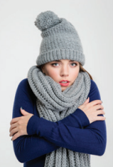
What is she feeling
She’s feeling cold.

Slide 17
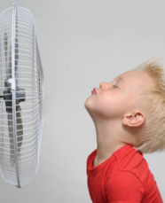
What is he feeling?
He’s feeling cool.

Slide 18
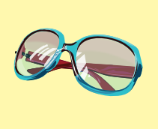
What’s this?
It’s a sunglasses.

Slide 19

What is this?
It’s a coat.

Slide 20
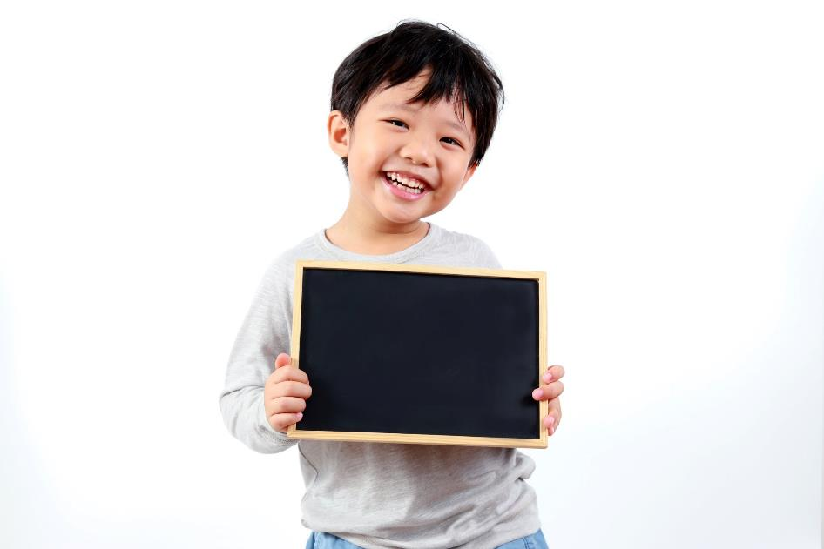
Practice

Slide 21

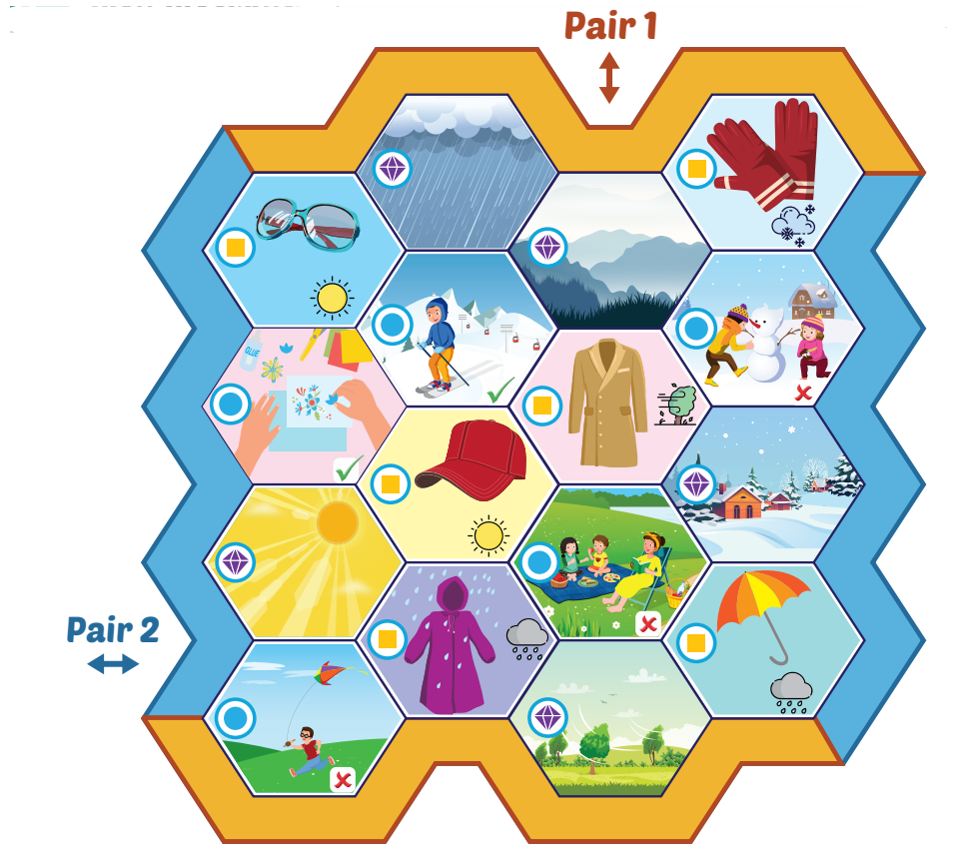

Slide 22
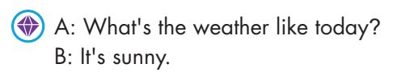
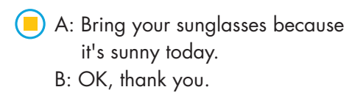
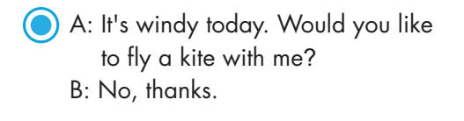

Slide 23



A: What’s the weather like today?
B: It’s rainy.
A: Bring your umbrella because it’s rainy today.
B: Ok, thank you.
A: It’s rainy today. Would you like to make arts and crafts with me?
B: Yes, I like.

Slide 24
A: What’s the weather like today?
B: It’s windy.
A: Bring your coat because it’s windy today.
B: Ok, thank you.
A: It’s windy today. Would you like to have a picnic with me?
B: No, thank you.

Slide 25
A: What’s the weather like today?
B: It’s snowy.
A: Bring your gloves because it’s snowy today.
B: Ok, thank you.
A: It’s snowy today. Would you like to make a snowman with me?
B: No, thank you.

Slide 26

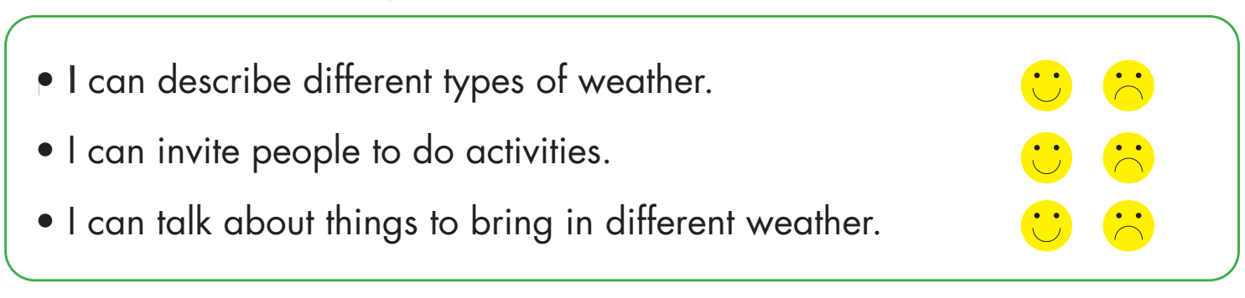

Slide 27

CONSOLIDATION

Slide 28

Workbook
p.31

Slide 29


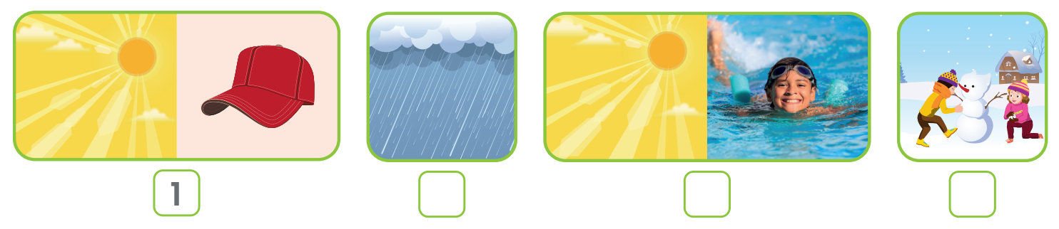
3
4
2

Slide 30

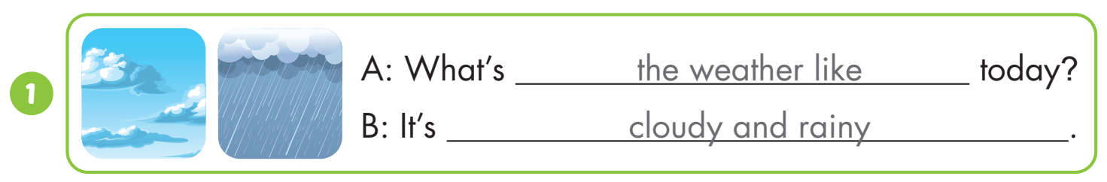
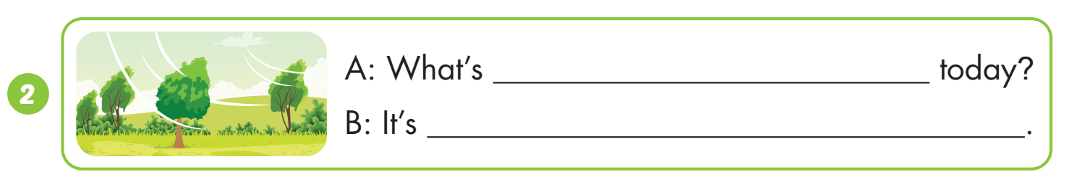
the weather like
windy

Slide 31
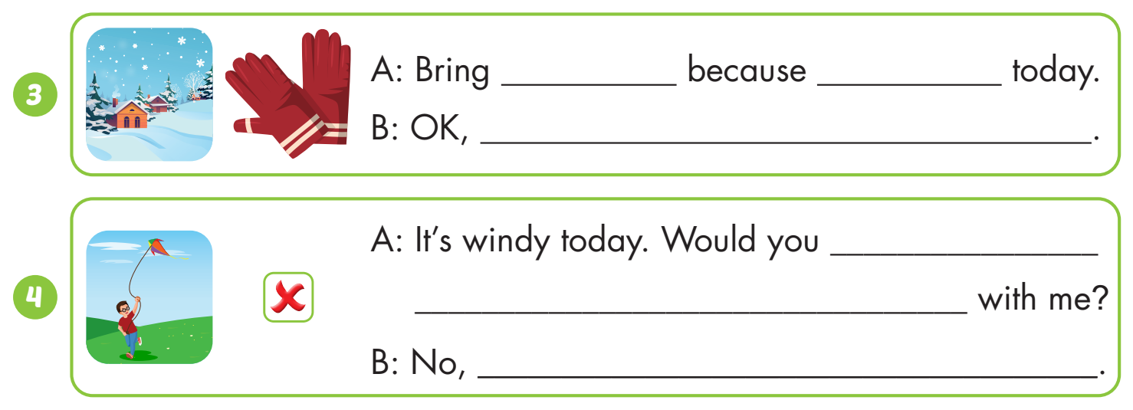
your gloves
it’s snowy
thank you.
like to fly a kite
thanks.

Slide 32
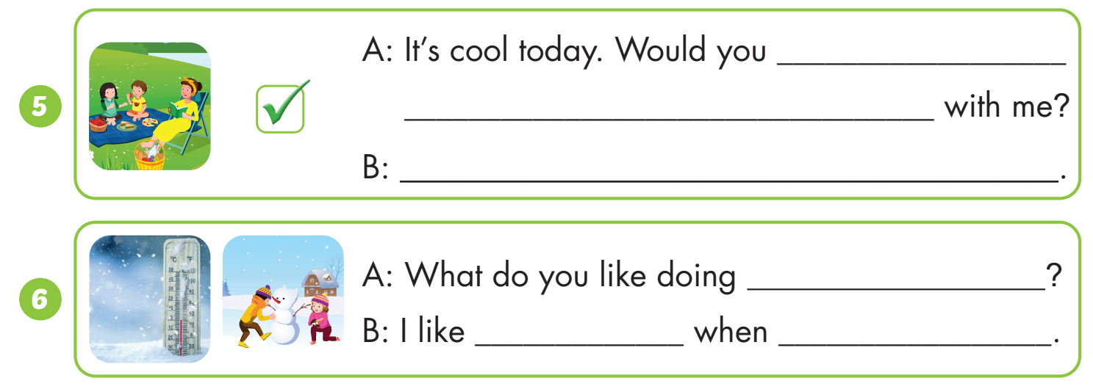
like to have a picnic
Yes, i’d love to.
when it’s snowy
making a snowman
it’s snowy

Slide 33

WRAP-UP

Slide 34
Today’s lesson
Vocabularies
sunny, rainy, snowy, cloudy, windy, foggy.
sunglasses, coat, cap, raincoat, umbrella, gloves.
do arts and crafts, fly a kite, make a snowman, go skiing, go for a walk, have a picnic.
Structures/ Sentence patterns
What's the weather like today?
It's sunny.
Bring your sunglasses because it's sunny today.
OK, thank you.
It's windy today.
Would you like to fly a kite with me?
Yes, I'd love to./ No, thanks.

Slide 35
Homework
Practice the vocabularies and structure; and make sentences using them.
Do the exercises in Tiếng Anh 4 i-Learn Smart Start WB (page 31).
Do the exercises in Tiếng Anh 4 i-Learn Smart Start Notebook (page 21).
Prepare the next lesson (page 48 SB).
Play the consolidation games in Tiếng Anh 4 i-Learn Smart Start DHA App on www.eduhome.com.vn

Slide 36
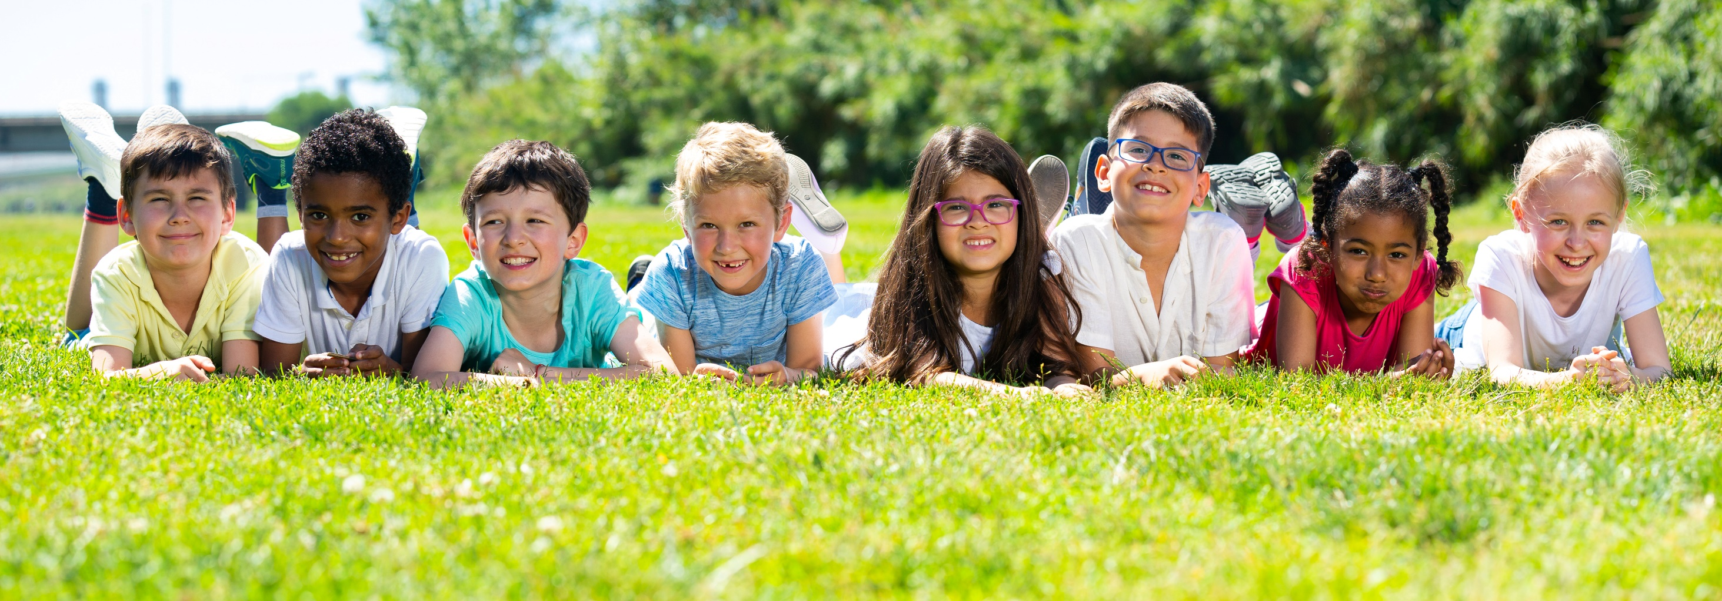
Have a nice day!

