Slide 1

Unit 3: WEATHER
Lesson 4.3
Page 45

Slide 2
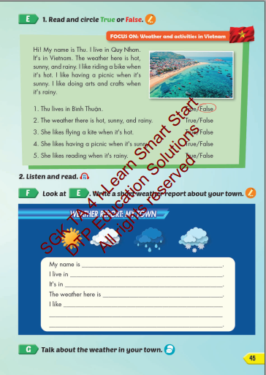
Lesson Outline
Warm-up
Vocabulary
Structure
Consolidation
Wrap-up

Slide 3
Objectives
By the end of this lesson, students will be able to the weather like today.
Vocabulary: Cold, Hot, Warm, Freezing, Cool, Stormy
Structure: What do you like doing when it's hot?
I like swimming.

Slide 4

WARM UP

Slide 5


Rule:
You are divided into 2 teams. You take turn to play.
You have to find out the word that is not the same type with others.
If you’re correct, your team will have 1 point/ 1 star
PLAY
VOCABULARY REVIEW

Slide 6

sad
happy
hot
Why?
great
Because it is not a shape.
CHECK
NEXT

Slide 7
freezing
cool
warm
hungry
Why?
Because it is not a shape.
CHECK
NEXT

Slide 8
stormy
hot
warm
water
Why?
Because it is not a shape.
CHECK
NEXT

Slide 9
watching
playing
freezing
Why?
swimming
Because it is not a shape
CHECK
NEXT

Slide 10
sad
funny
happy
stormy
Why?
Because it is not feeling.
CHECK
NEXT

Slide 11
cool
hot
cold
hope
Why?
Because it is not a shape.
CHECK
NEXT

Slide 12
car
warm
Why?
plane
bike
Because it is not a shape.
CHECK
NEXT

Slide 13
great
sad
square
Why?
happy
Because it is not feeling.
CHECK
NEXT

Slide 14
pencil
cool
Why?
erase
pen
Because it is not a shape.
CHECK
NEXT

Slide 15
scared
hungry
bored
stormy
Why?
Because it is not feeling.
CHECK
NEXT

Slide 16
stormy
thirsty
freezing
Why?
cold
Because it is not a shape.
CHECK
NEXT

Slide 17
12/15
work
play
cook
cold
Why?
Because it is not feeling.
CHECK
NEXT

Slide 18

It’s time to learn …
Vocabulary

Slide 19
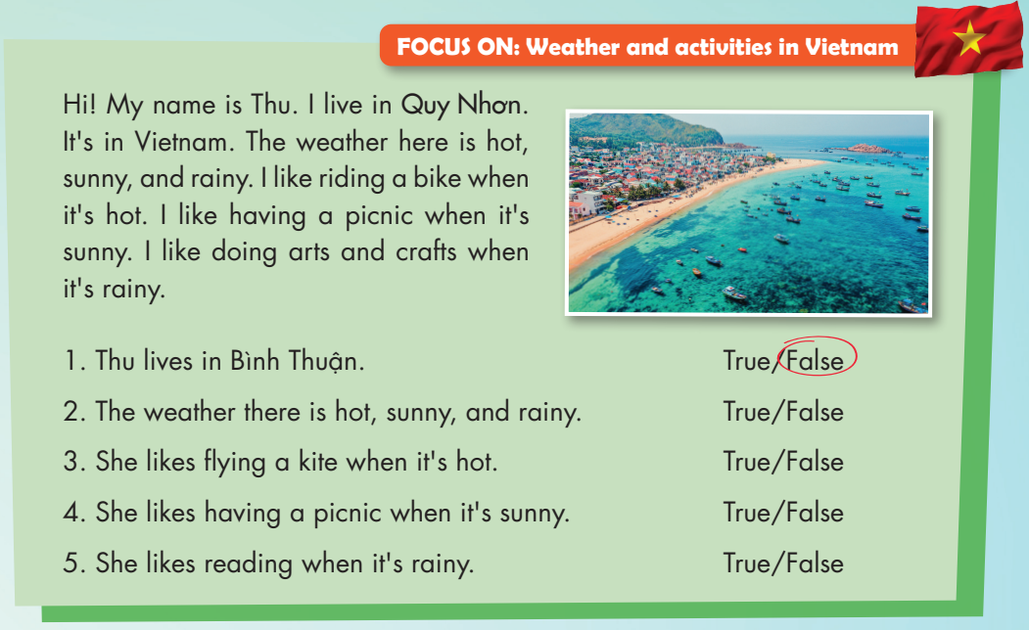

Slide 21


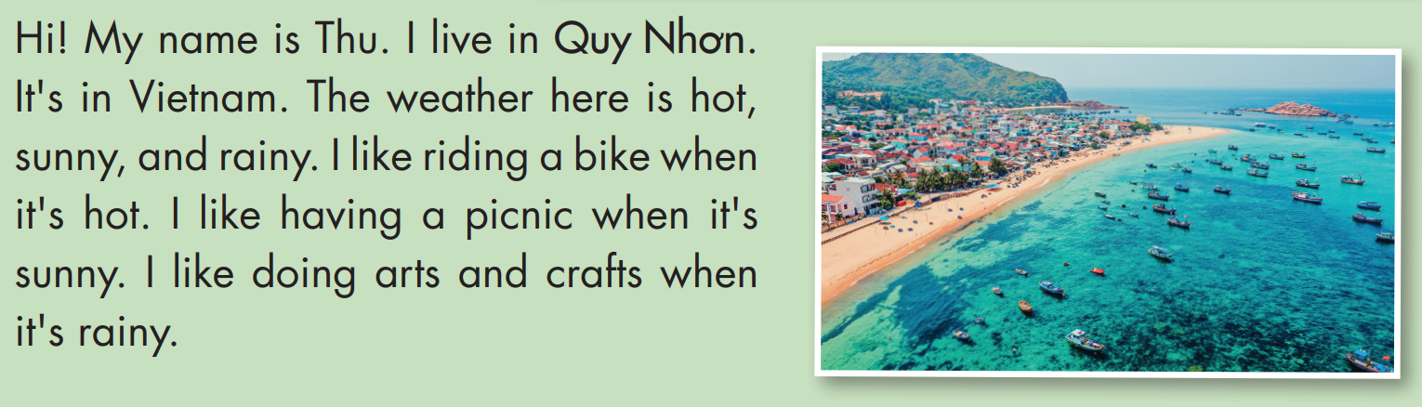

Slide 22
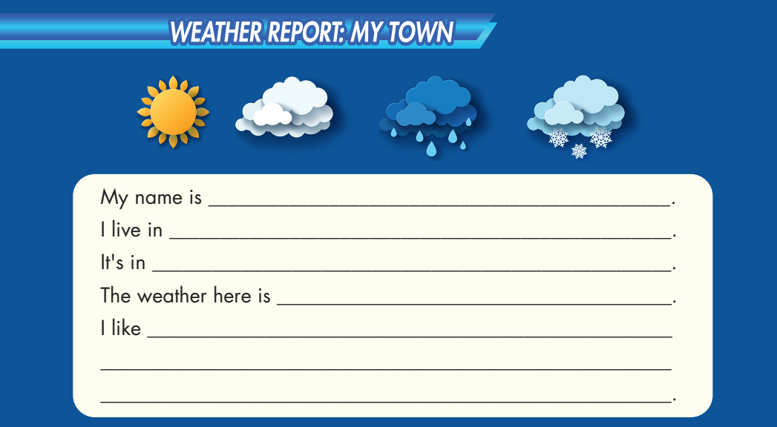

Slide 23

Practice

Slide 24

After write a short weather report about your town. Let speak about that!

Slide 25

CONSOLIDATION

Slide 26

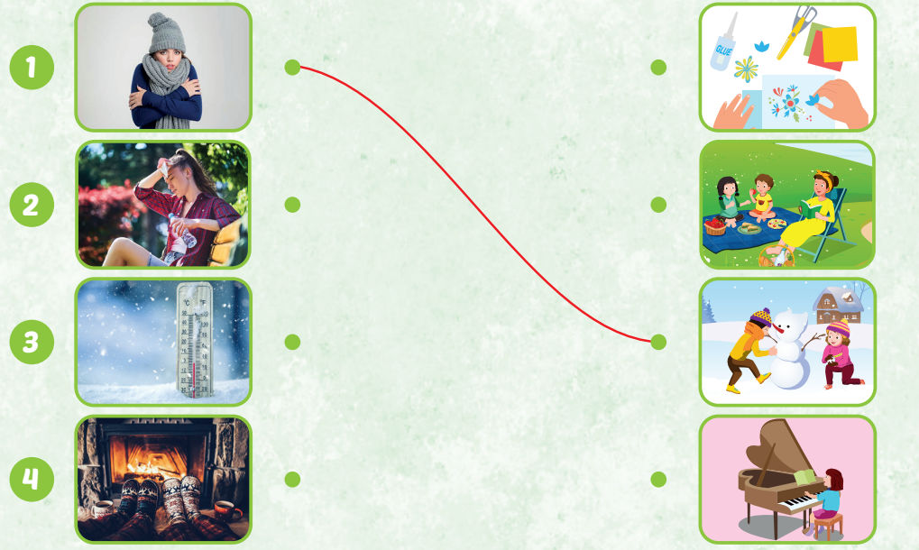

Slide 27

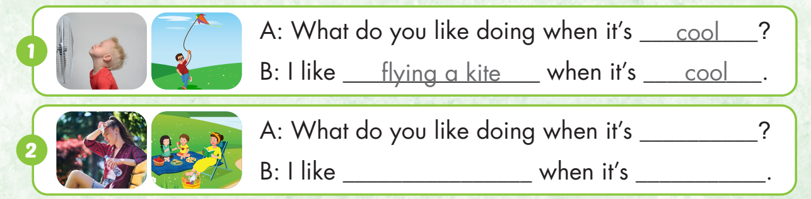
hot
having a pinic
hot

Slide 28
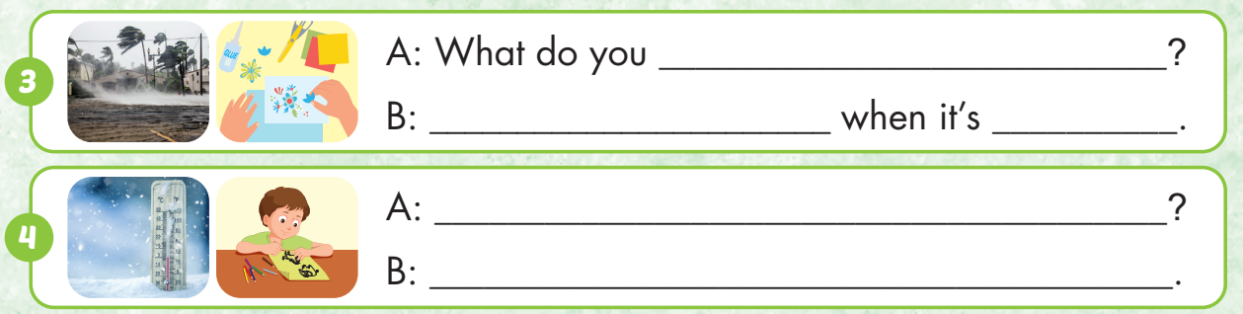
like doing when it’s stormy
I like doing arts and crafts
stormy
What do you like doing when it’s freezing
I like painting when it’s freezing

Slide 29

WRAP-UP

Slide 30
Today’s lesson
Vocabularies
Hot
Cold
Warm
Cool
Freezing
Stormy
Structures/ Sentence patterns
What do you like doing when it's hot?
I like swimming.

Slide 31
Homework
Practice the vocabularies and structure; and make sentences using them.
Do the exercises in Tiếng Anh 4 i-Learn Smart Start WB (page 29).
Do the exercises in Tiếng Anh 4 i-Learn Smart Start Notebook (page 19).
Prepare the next lesson (page 46 SB).
Play the consolidation games in Tiếng Anh 4 i-Learn Smart Start DHA App on www.eduhome.com.vn

Slide 32
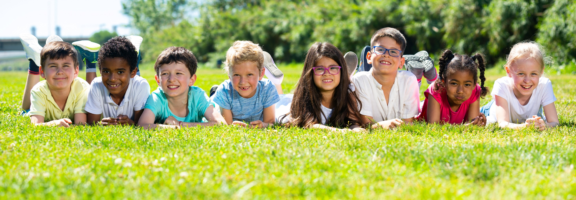
Have a nice day!

