Slide 1

Unit 3: WEATHER
Lesson 1.1
Page 34

Slide 2
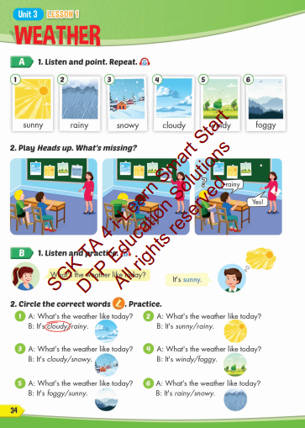
Lesson Outline
Warm-up
Vocabulary
Structure
Consolidation
Wrap-up

Slide 3
Objectives
By the end of this lesson, students will be able to pronounce the correct adjectives about types of weather; ask and answer about weather.
Vocabulary: sunny, rainy, snowy, cloudy, windy, foggy.
Structure: What's the weather like today?
It's sunny.

Slide 4

WARM UP

Slide 5
Talk about abilities
Pair work:
Students take turns to talk about their own / family member’s abilities.
Eg: I can play football.
My brother can play the piano.

Slide 6

It’s time to learn …

Slide 7

New words
sunny, rainy, snowy, cloudy, windy, foggy

Slide 8

Vocabulary

Slide 9

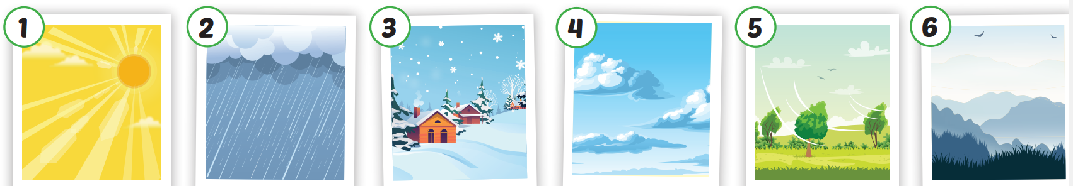

Slide 10
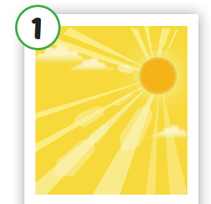
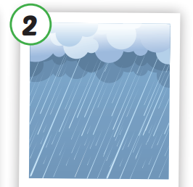
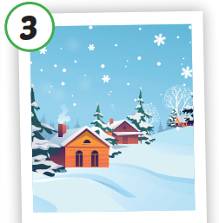
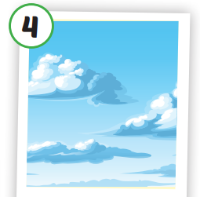
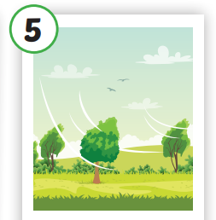

Click each English word to hear the sound.
sunny
rainy
snowy
cloudy
windy
foggy
/ˈsʌni/
có nắng
/ˈreɪni/
có mưa
/ˈsnoʊi/
có tuyết
/ˈklaʊdi/
có nhiều mây
/ˈwɪndi/
có gió
/ˈfɑːɡi/
có sương mù

Slide 11
Click each English word to hear the sound.
sunny
/ˈsʌni/
có nắng

Slide 12
Click each English word to hear the sound.
rainy
/ˈreɪni/
có mưa

Slide 13
Click each English word to hear the sound.
snowy
/ˈsnoʊi/
có tuyết

Slide 14
Click each English word to hear the sound.
cloudy
/ˈklaʊdi/
có nhiều mây

Slide 15
Click each English word to hear the sound.
windy
/ˈwɪndi/
có gió

Slide 16
Click each English word to hear the sound.
foggy
/ˈfɑːɡi/
có sương mù

Slide 17

Practice

Slide 18
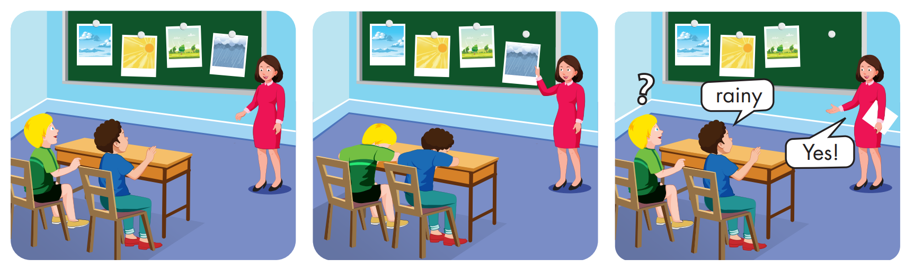

Slide 19
Structures
What's the weather like today?
It's sunny.

Slide 20


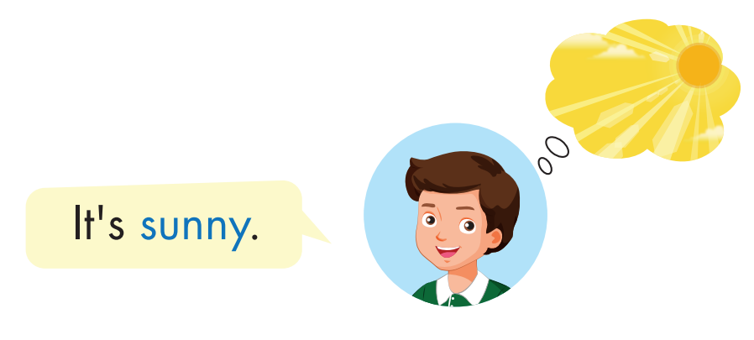
Click each English word to hear the sound.

Slide 21
Practice

Slide 22


What's the weather like today?
It's cloudy.

Slide 23
What's the weather like today?
It's snowy.

Slide 24
What's the weather like today?
It's rainy.

Slide 25
What's the weather like today?
It's foggy.

Slide 26
What's the weather like today?
It's windy.

Slide 27
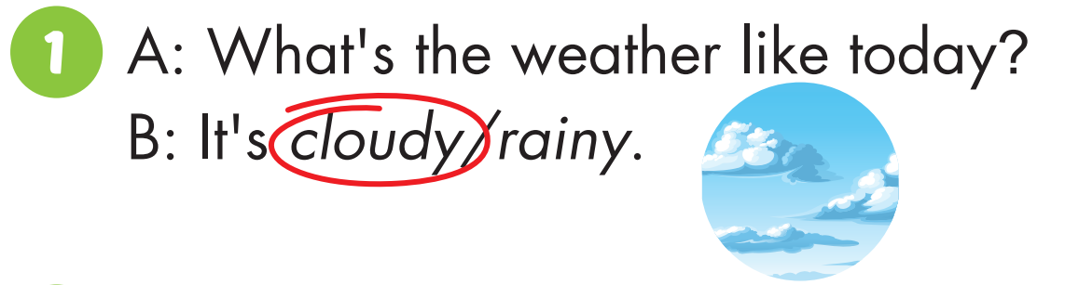
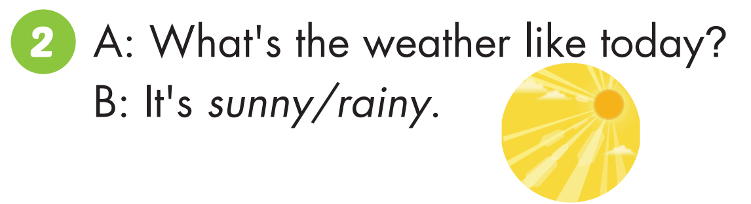


Slide 28
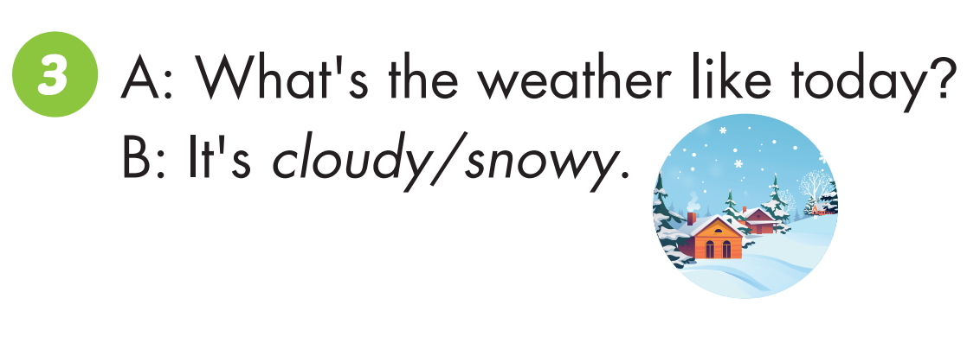
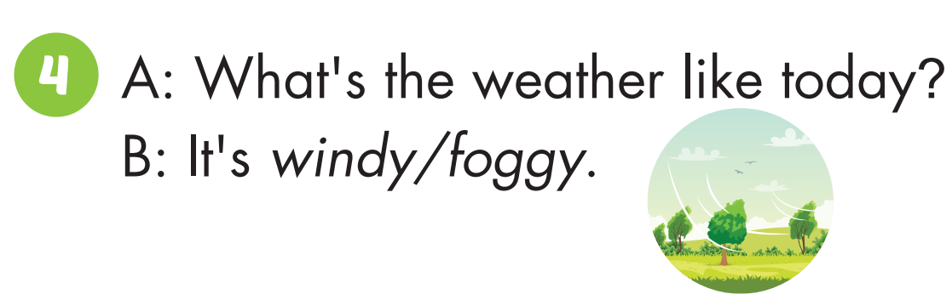

Slide 29
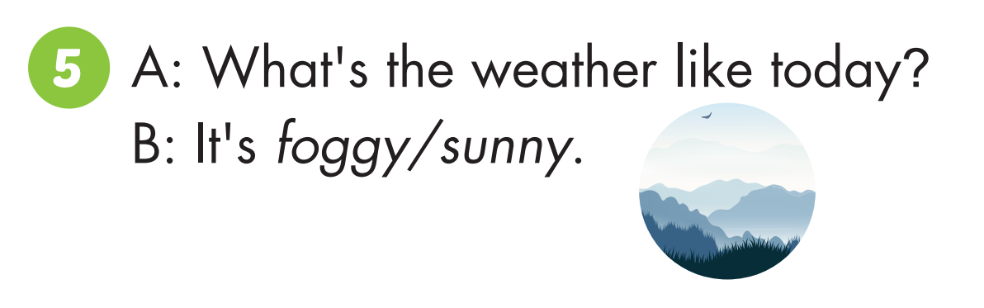
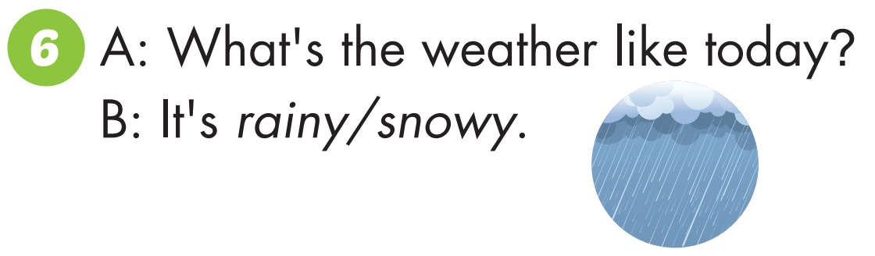

Slide 30
Practice

Slide 31

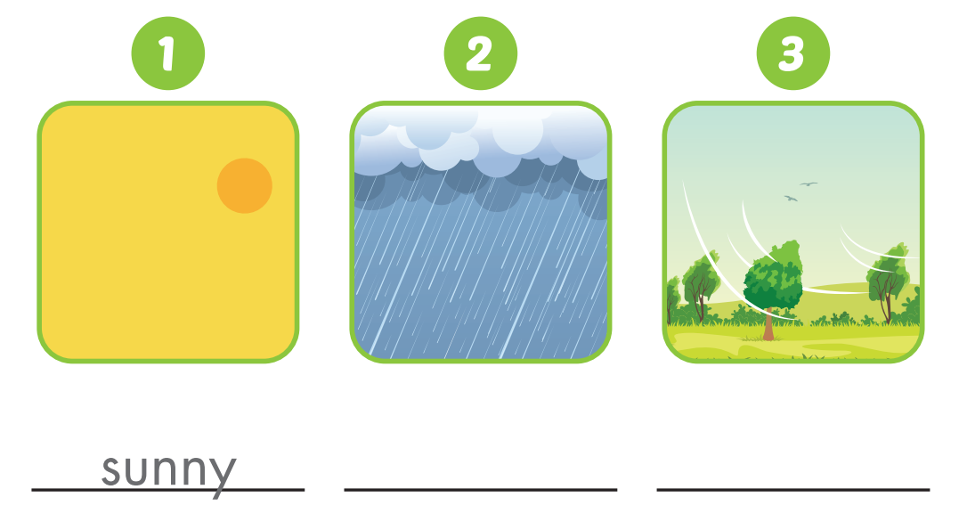
sunny
rainy
windy

Slide 32
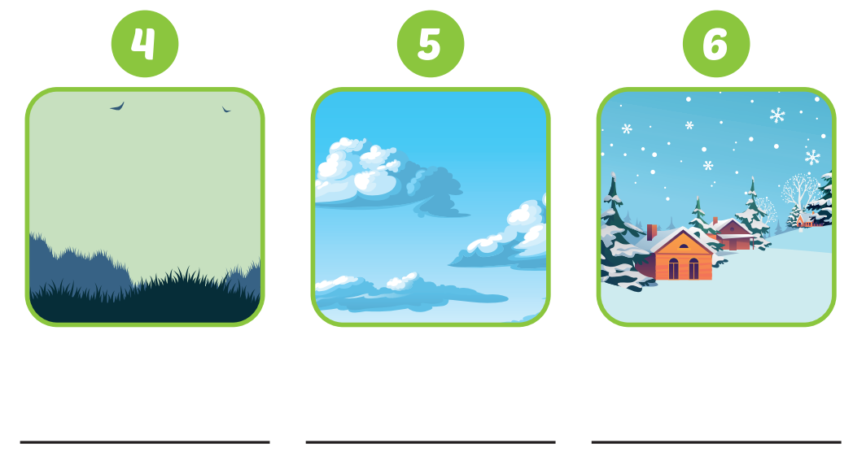
foggy
cloudy
snowy

Slide 33

CONSOLIDATION

Slide 34

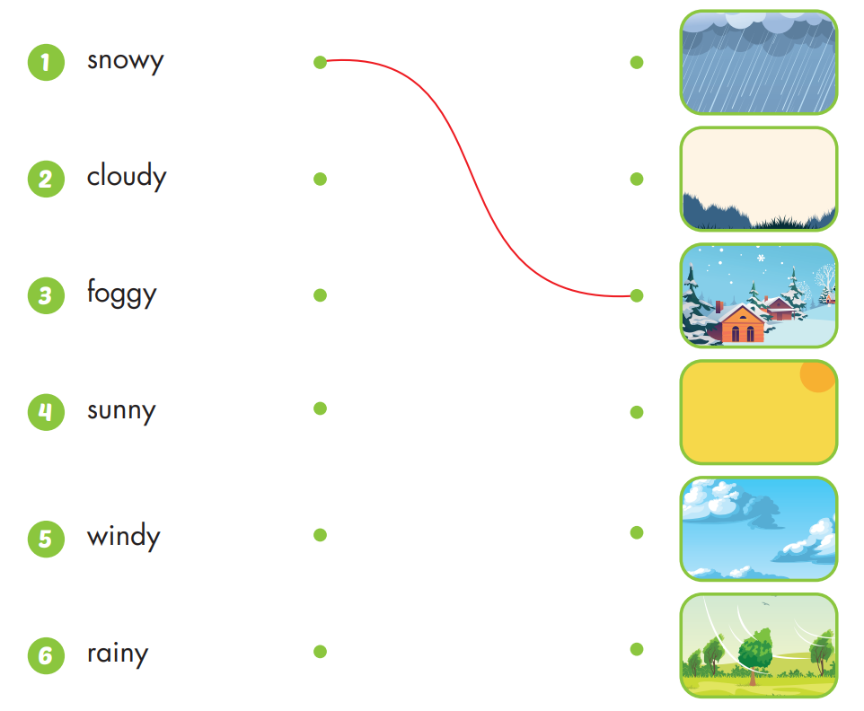

Slide 35

WRAP-UP

Slide 36
Today’s lesson
Vocabularies
sunny, rainy, snowy, cloudy, windy, foggy.
Structures/ Sentence patterns
What's the weather like today?
It's sunny.

Slide 37
Homework
Practice the vocabulary and structure; make sentences using the vocabulary learnt in the lesson.
Do the exercises in Tiếng Anh 4 i-Learn Smart Start WB (page 22)
Do the exercises in Tiếng Anh 4 i-Learn Smart Start Notebook (page 16)
Prepare the next lesson (page 35 SB)
Play the consolidation games in Tiếng Anh 4 i-Learn Smart Start DHA App on www.eduhome.com.vn

Slide 38

Have a nice day!

