Slide 1

Unit 2: Holidays
Lesson 4.2
Page 30

Slide 2
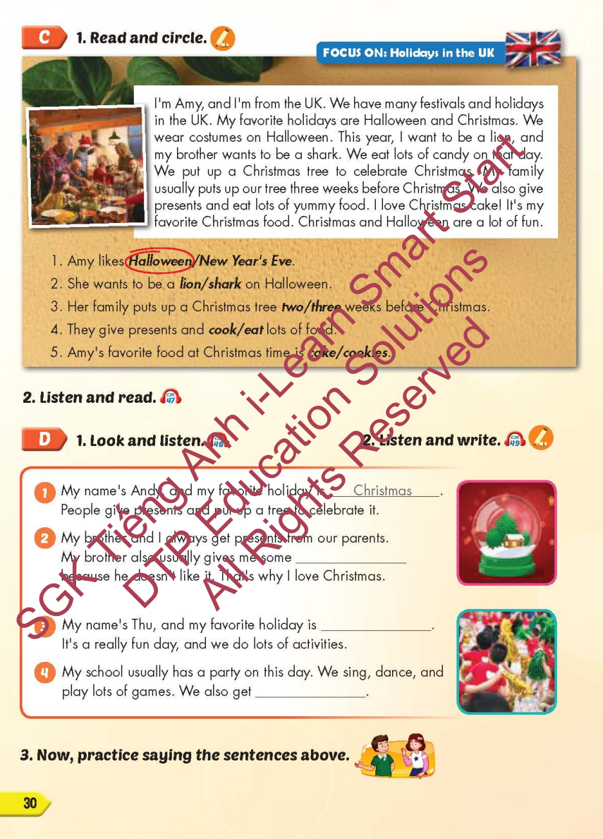
Lesson Outline
Warm-up
Reading
Listening
Consolidation
Wrap-up

Slide 3
Objectives
By the end of this lesson, students will be able to…
Skill: Read the text, listen to a conversation and practice saying the sentences.
Structure: What do people do to celebrate Christmas?
- They put up a Christmas tree.

Slide 4

WARM-UP

Slide 5
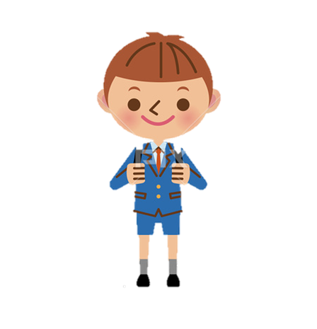
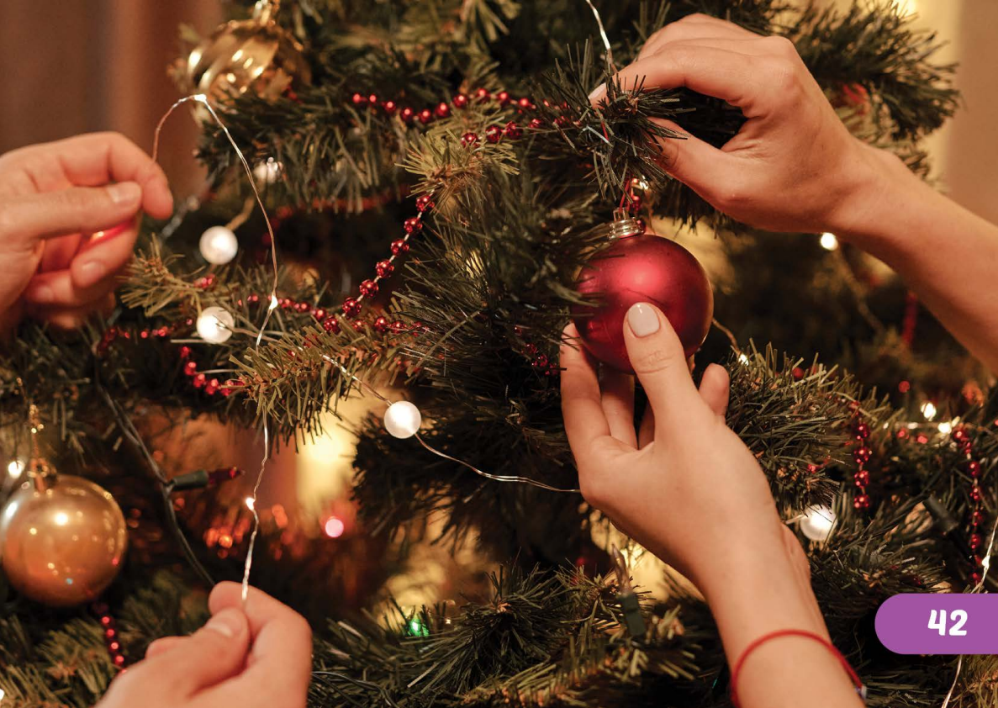

What do people do to celebrate Christmas?
What is in the picture?
- They put up a Christmas tree.
T
I
M
E
I
S
U
P
CHECK
NEXT
Click on the coloured boxes to turn them around

Slide 6
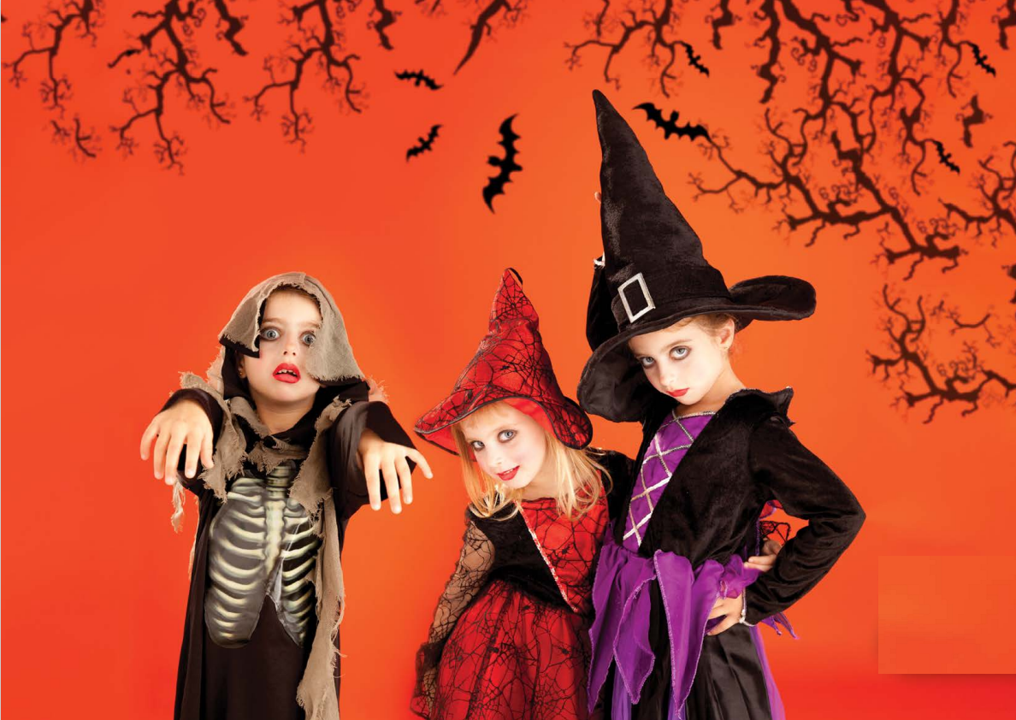
What do people do to celebrate Christmas?
What is in the picture?
- They wear costumes.
T
I
M
E
I
S
U
P
CHECK
NEXT
Click on the coloured boxes to turn them around

Slide 7

What do people do to celebrate Christmas?
What is in the picture?
- They watch fireworks.
T
I
M
E
I
S
U
P
CHECK
NEXT
Click on the coloured boxes to turn them around

Slide 8
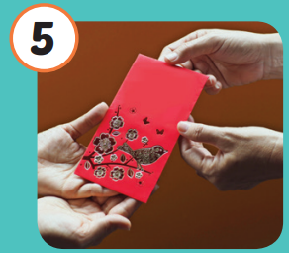
What do people do to celebrate Christmas?
What is in the picture?
- They give lucky money.
T
I
M
E
I
S
U
P
CHECK
NEXT
Click on the coloured boxes to turn them around

Slide 9
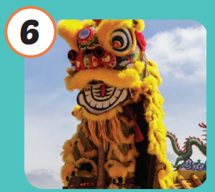
What do people do to celebrate Christmas?
What is in the picture?
- They watch the lion dance.
T
I
M
E
I
S
U
P
CHECK
NEXT
Click on the coloured boxes to turn them around

Slide 10

It’s time to learn …

Slide 11

Reading

Slide 12

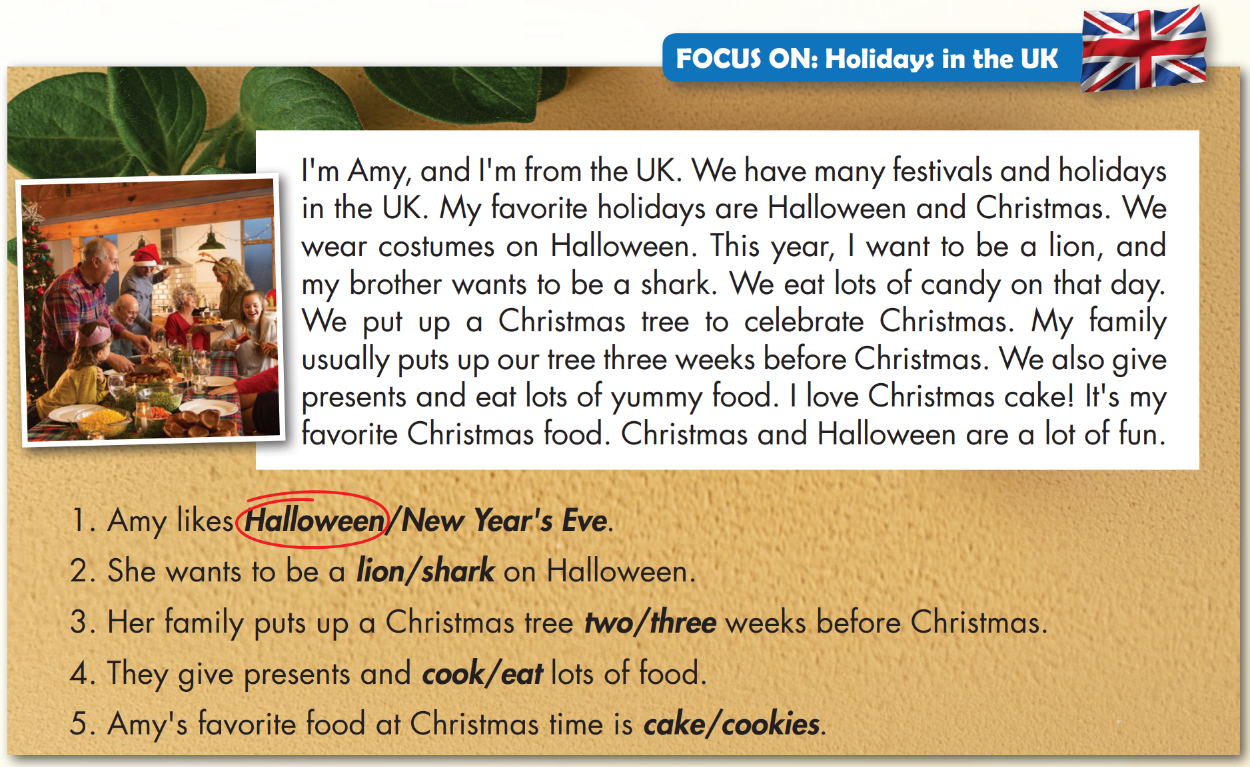


Slide 13
Listening

Slide 14



Slide 15

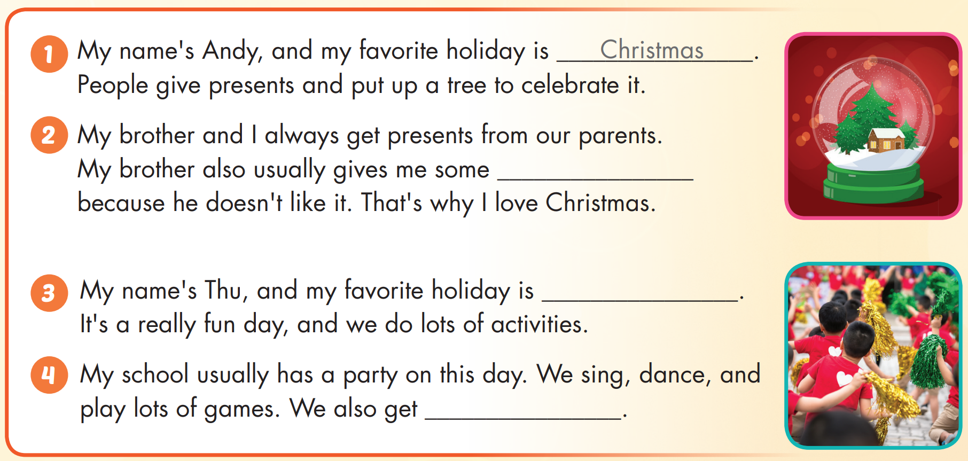

Slide 16

chocolate
Children's Day
presents

Slide 17
Practice

Slide 18
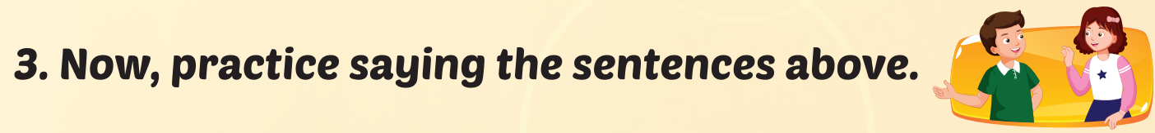
chocolate
Children's Day
presents

Slide 19

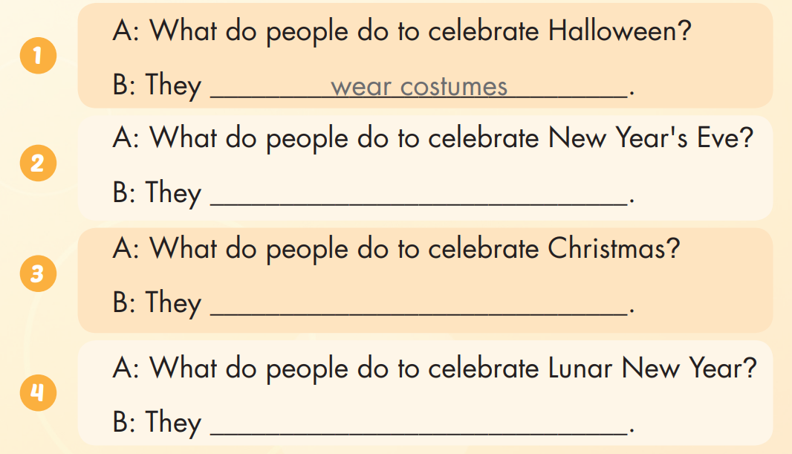
Extra Practice
WB, page 19
watch fireworks
give presents
watch the lion dance

Slide 20

CONSOLIDATION

Slide 21

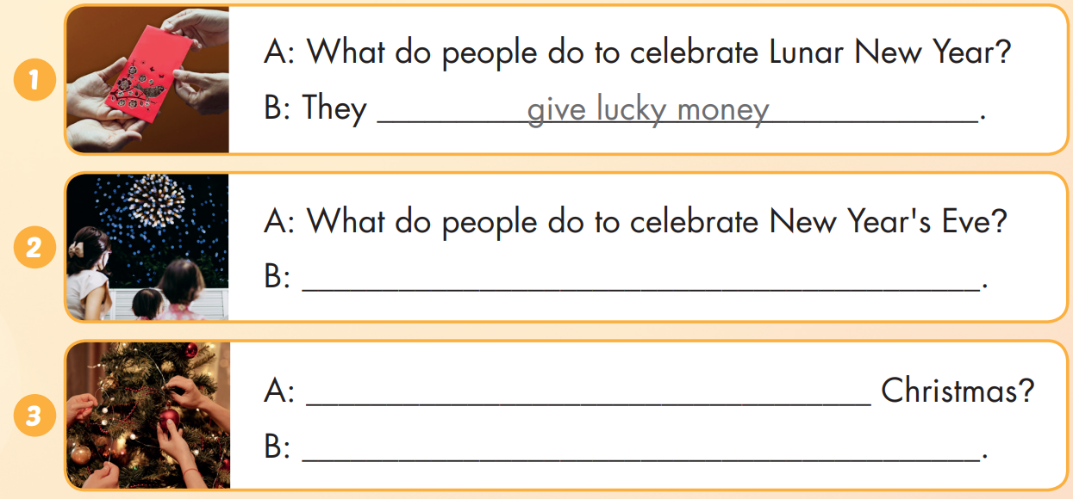
Extra Practice
WB, page 19
They watch fireworks.
What do people do to celebrate
They put up a Christmas tree.

Slide 22
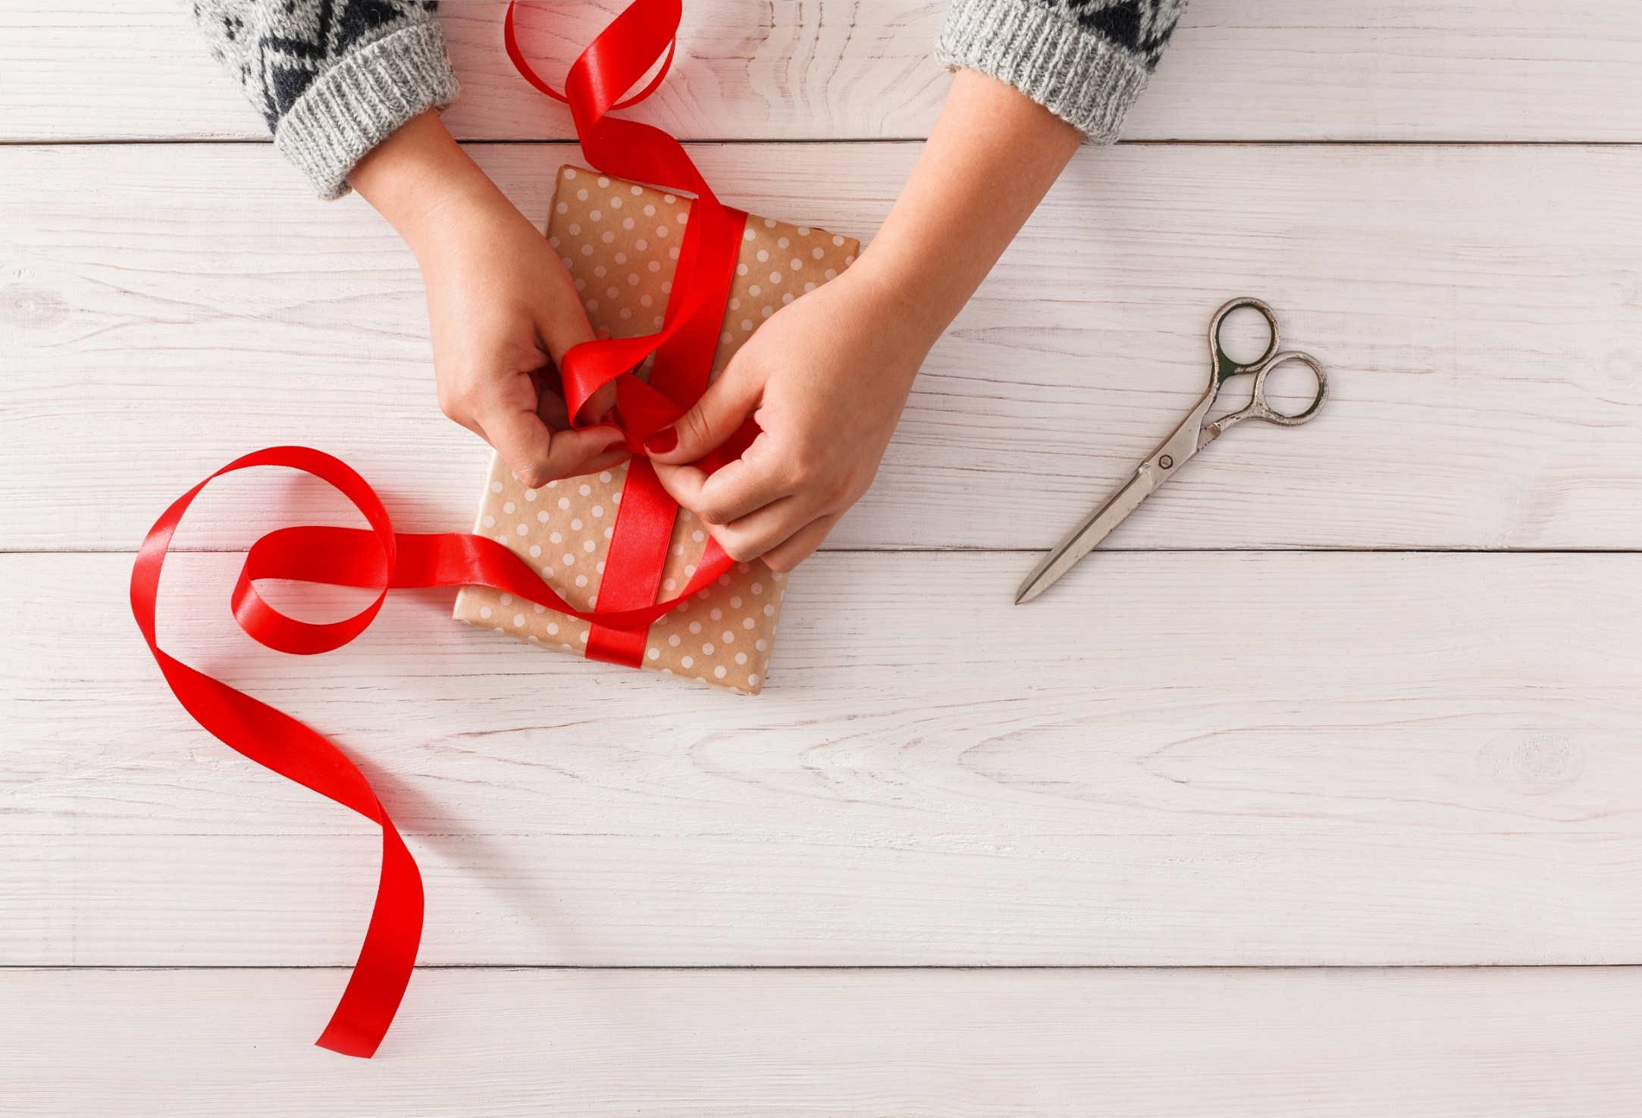
WRAP-UP

Slide 23
Today’s lesson
Skill:
Read the text, listen to a conversation and practice saying the sentences.
Structures/ Sentence patterns
What do people do to celebrate Christmas?
- They put up a Christmas tree.

Slide 24
Homework
Practice the vocabularies and structure, and make sentences using them.
Do the exercises in Tiếng Anh 5 i-Learn Smart Start WB (page 19)
Do the exercises in Tiếng Anh 5 i-Learn Smart Start Notebook (page 13)
Prepare the next lesson (page 31 SB)
Play the consolidation games in Tiếng Anh 5 i-Learn Smart Start DHA App on www.eduhome.com.vn

Slide 25

Enjoy your day!

Slide 26
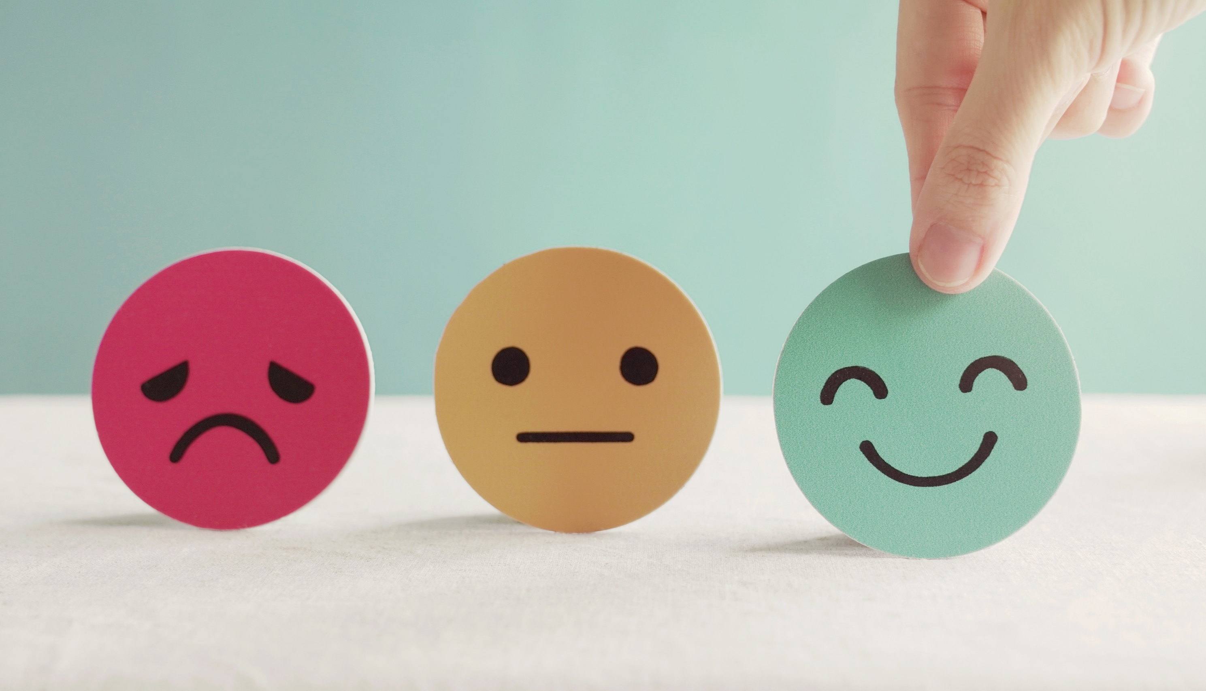
Lesson 3
Stay positive and have a nice day!

