Slide 1

Unit 2
Review and Practice
Page 37

Slide 2
Lesson Outline
Warm-up
Speaking
Consolidation
Wrap-up

Slide 3
Objectives
By the end of this lesson, students will be able to review introducing family members, asking who someone is, and following simple instructions.
Vocabulary:
friend, cousin, brother, sister, uncle, aunt, father, grandfather, grandmother
Structures:
What’s his name?/ Go to bed!/ This is my friend, Alfie.

Slide 4

WARM UP

Slide 5
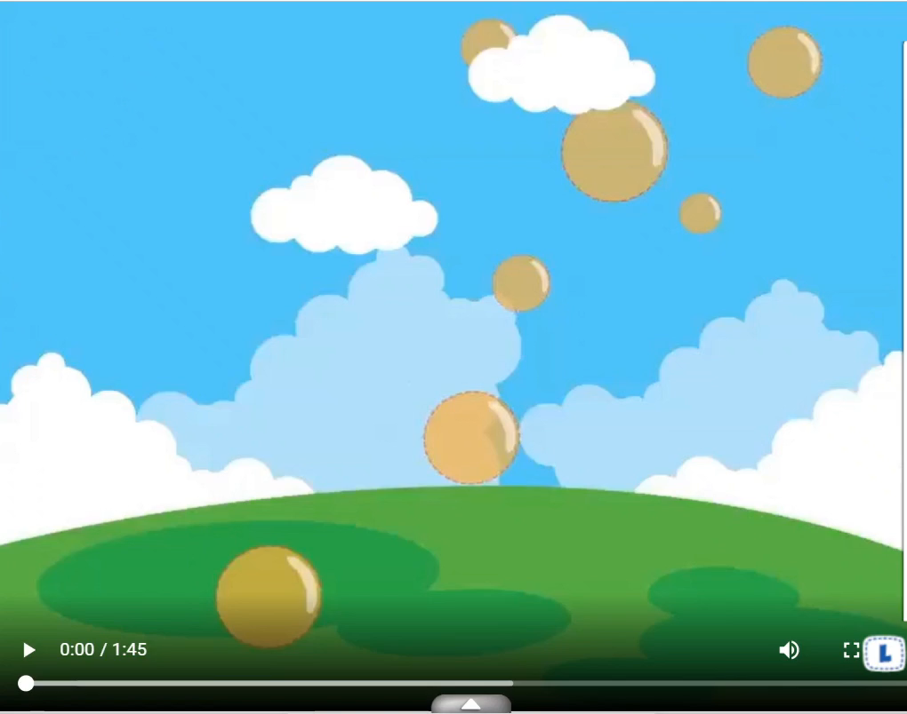

Slide 6



Listen and circle.
A
B
Keys

Slide 7

Listen and circle.
A
B
Keys

Slide 8
Listen and circle.
A
B
Keys

Slide 9

Listen and circle.
A
B
Keys

Slide 10






Memory Game
1
2
3
uncle
4
5
6
sister
grandfather
7
8
9
cousin
10
11
12
grandmother
aunt

Slide 11

It’s time to learn …

Slide 12

Speaking

Slide 13
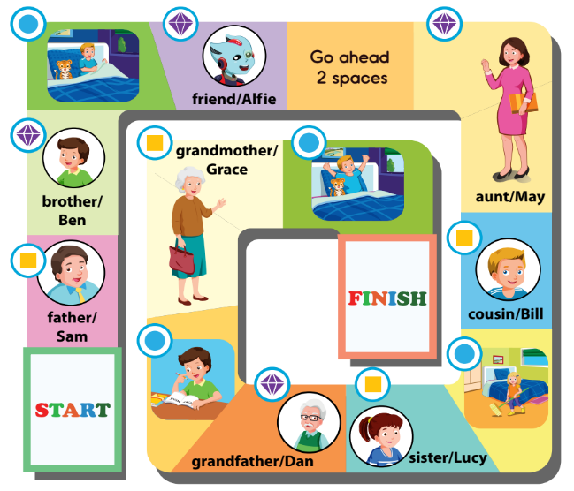
A
Play the board game.

Slide 14



A
Play the board game.
This is my friend, Alfie.
Hello, Alfie.
Go to bed!
Who’s he?
He’s my father.
What’s his name?
His name’s Sam.

Slide 15
What can you do
?
I can talk about my family.
I can ask who someone is.
I can follow instructions.

Slide 16

Extra Practice

Slide 17
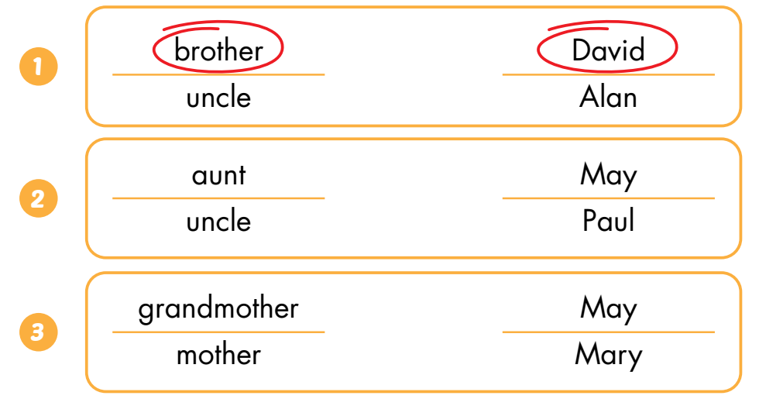
B
Listen and circle. (WB Track 16)
Keys

Slide 18
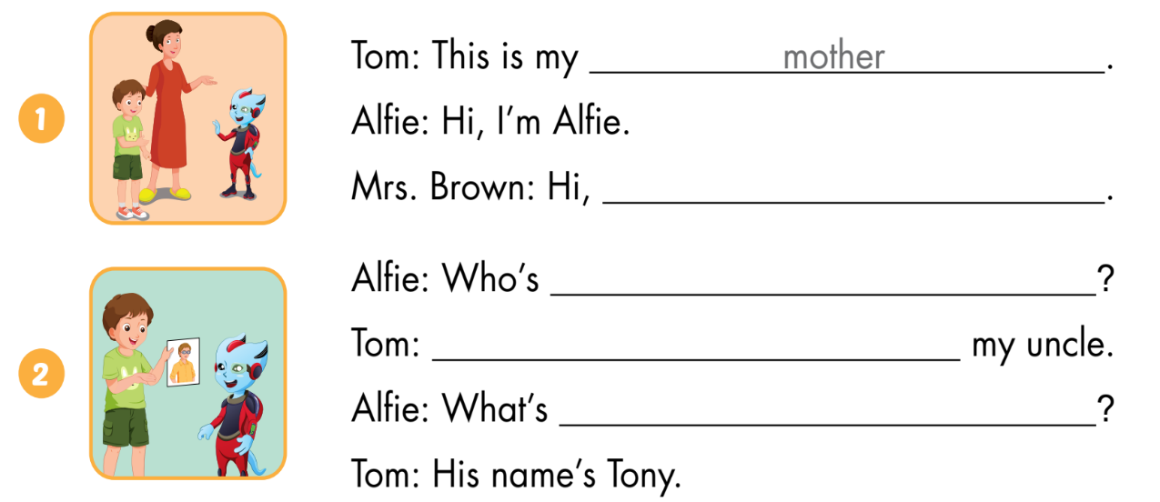
C
Look and write.
I’m Mrs. Brown
he
He’s
his name

Slide 19
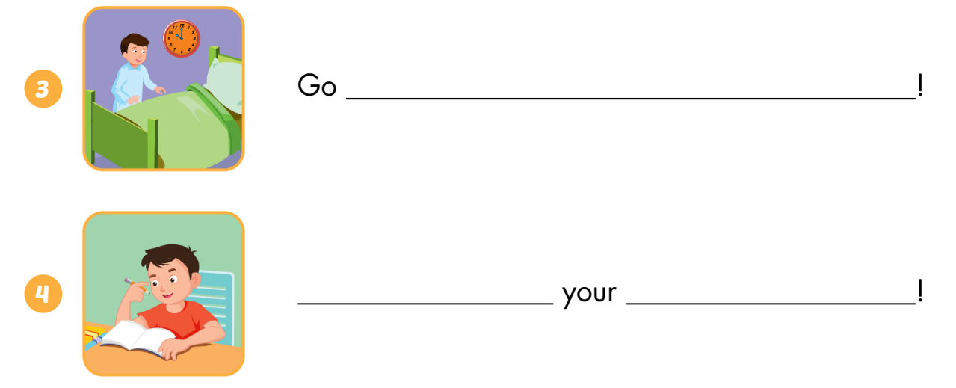
C
Look and write.
to bed
Do
homework

Slide 20

Consolidation

Slide 21
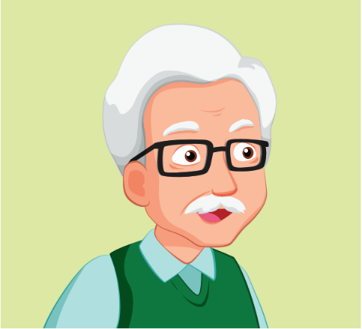
Who is he?

Slide 22
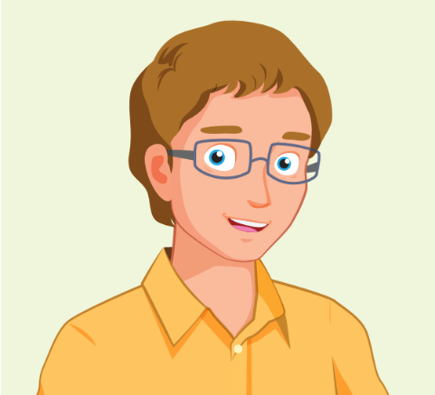
Who is he?

Slide 23
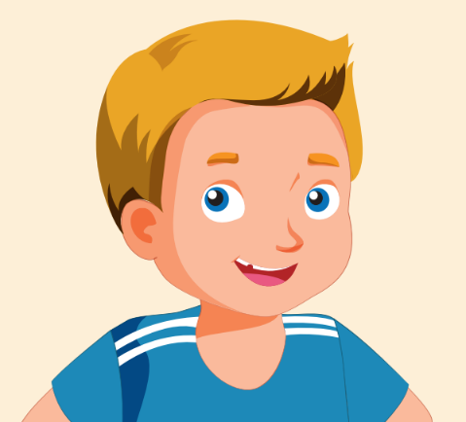
Who is he?

Slide 24

Who is she?

Slide 25

do ______ ______

Slide 26

clean ______ ______

Slide 27

go ______ ______

Slide 28

WRAP-UP

Slide 29
Today’s lesson
Vocabulary:
friend, cousin, uncle, grandfather, aunt, homework, clean, wake up
Structures:
Who’s he/she?/ This is my…/ What’s his/her name?/ Clean your room.

Slide 30
Homework
Practice vocabularies and structure. Make sentences using them.
Do the exercises in Tiếng Anh 3 i-Learn Smart Start Workbook (page 26).
Practice the vocabulary and structure in Tiếng Anh 3 i-Learn Smart Start Notebook (page 20).
Play the consolidation games in Tiếng Anh 3 i-Learn Smart Start DHA App on www.eduhome.com.vn
Prepare the next lesson (page 37).

Slide 31

Enjoy your day!

