Slide 1
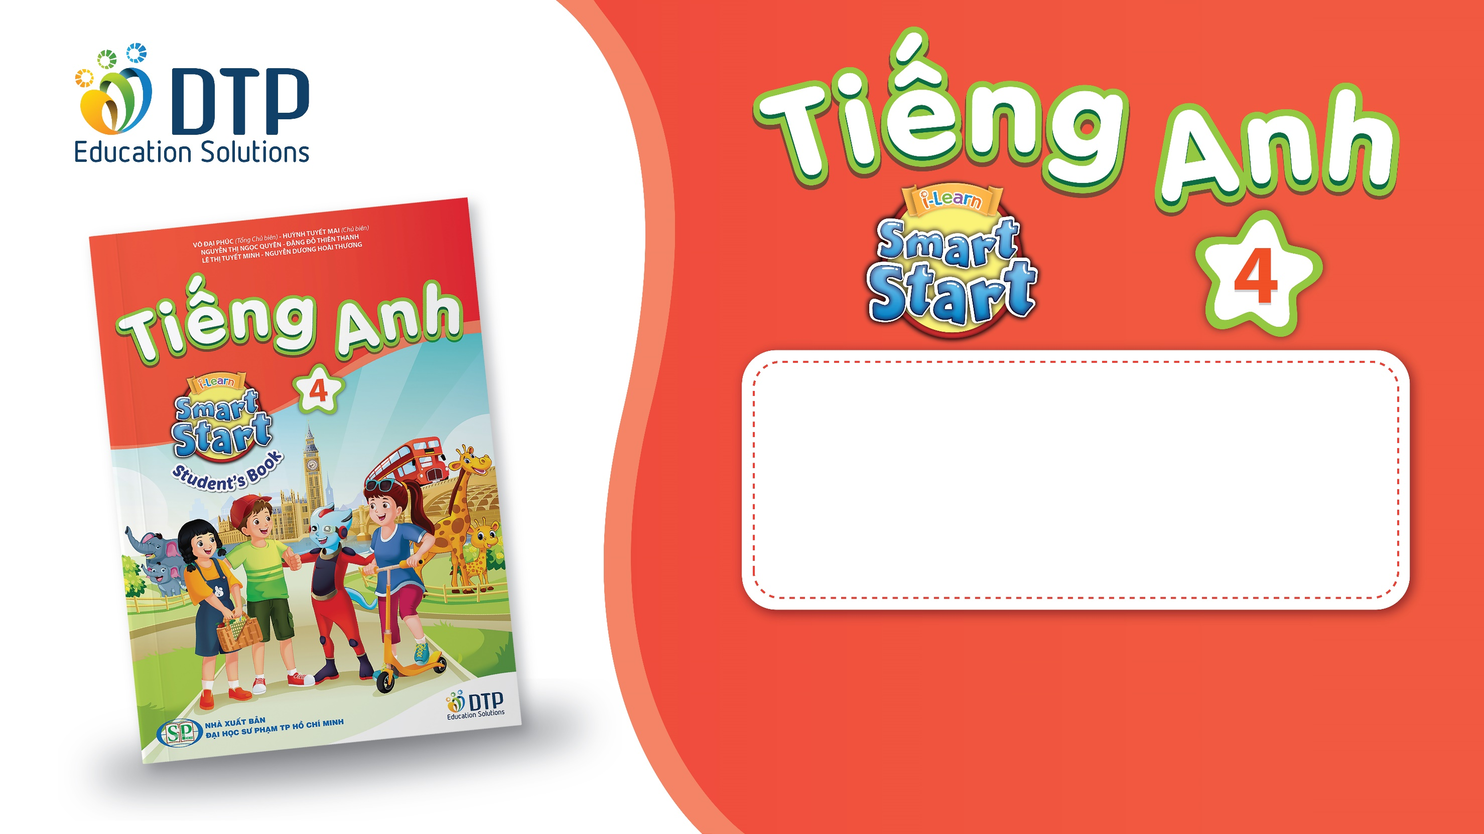
Unit 1: Animals
Lesson 2.1
Page 9

Slide 2
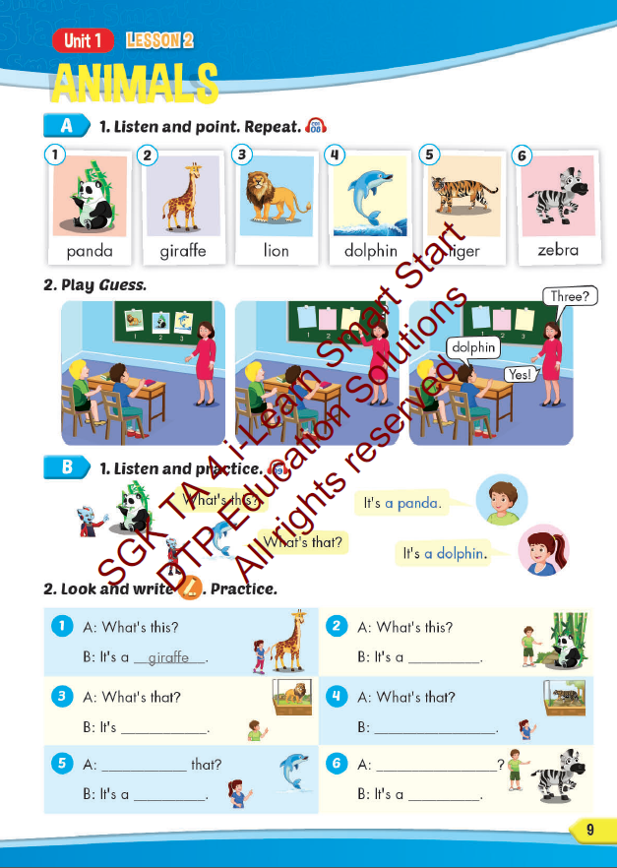
Lesson Outline
Warm-up
Vocabulary
Structure
Consolidation
Wrap-up

Slide 3
Objectives
By the end of this lesson, students will be able to…
Vocabulary: Pronounce and use the words related to the topic properly: panda, giraffe, lion, dolphin, tiger, zebra.
Structure: What's this? - It's a panda.
What's that? - It's a dolphin.

Slide 4

WARM UP

Slide 5
Look quickly and say aloud the word.
Who’s faster?

Slide 6
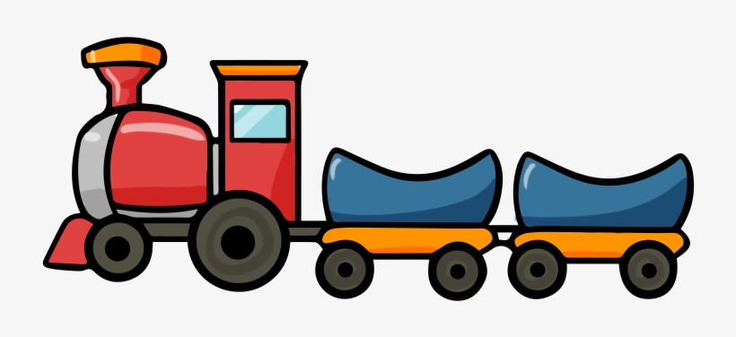
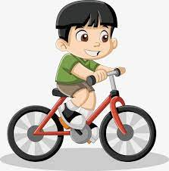
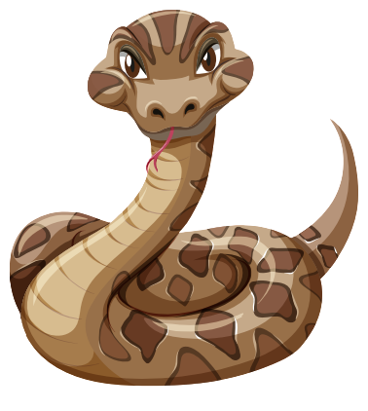

Slide 7

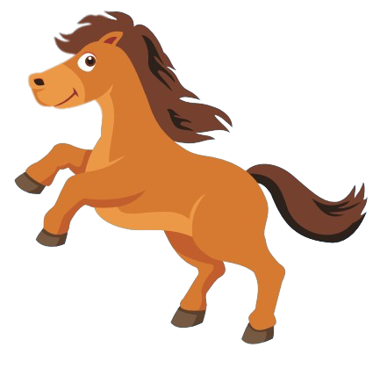

Slide 8

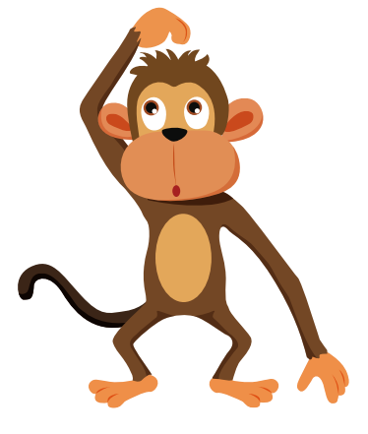

Slide 9
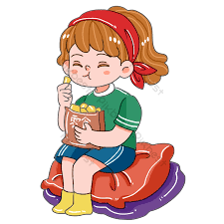
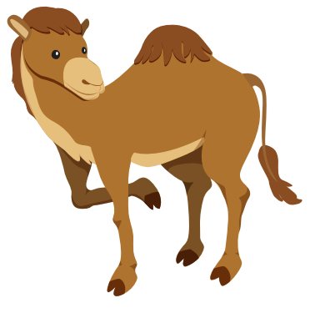

Slide 10
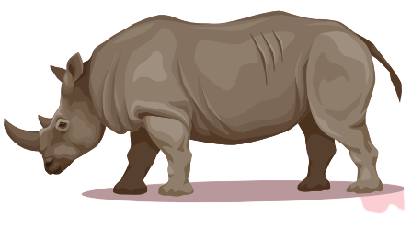

Slide 11


Slide 12

It’s time to learn …

Slide 13
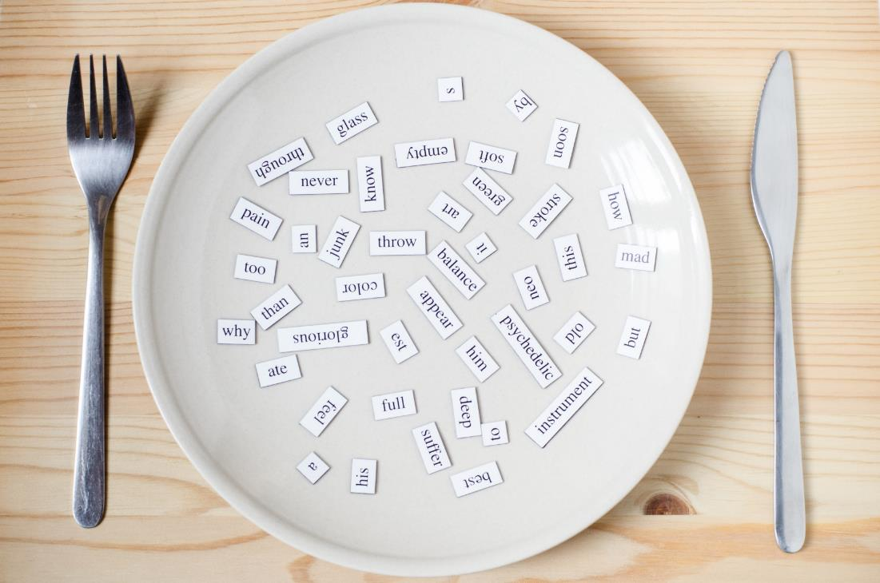
New words
panda, giraffe, lion,
dolphin, tiger, zebra

Slide 14

Presentation

Slide 15


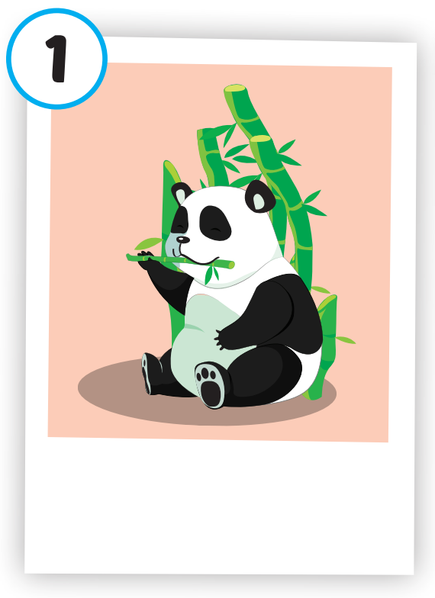
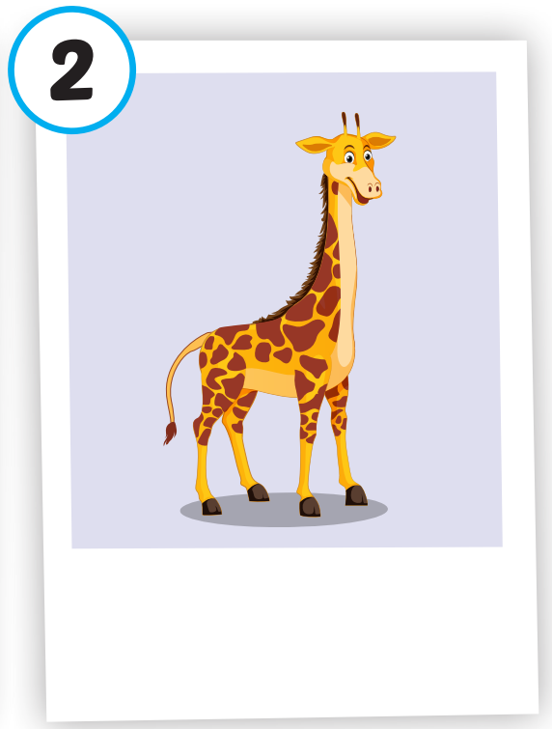
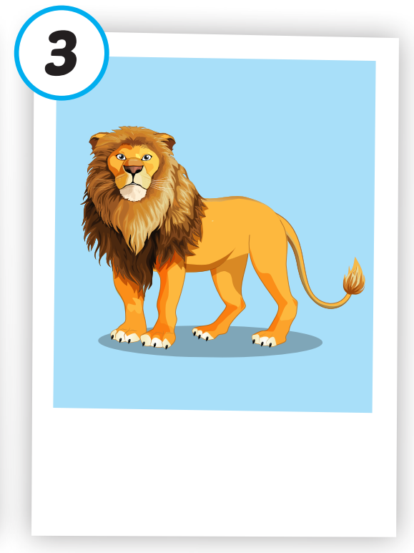
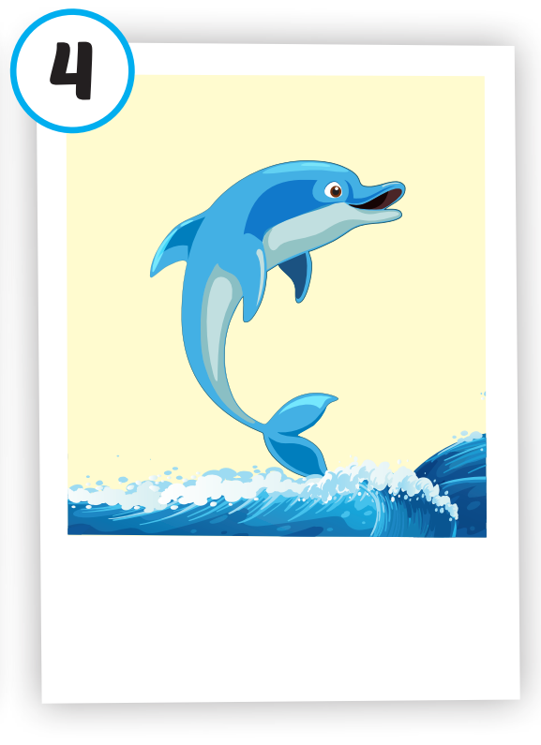
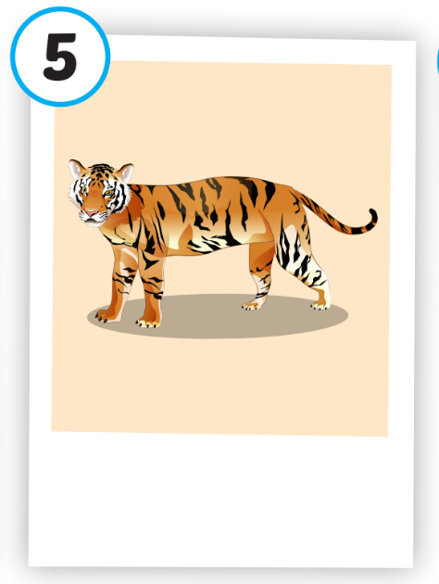
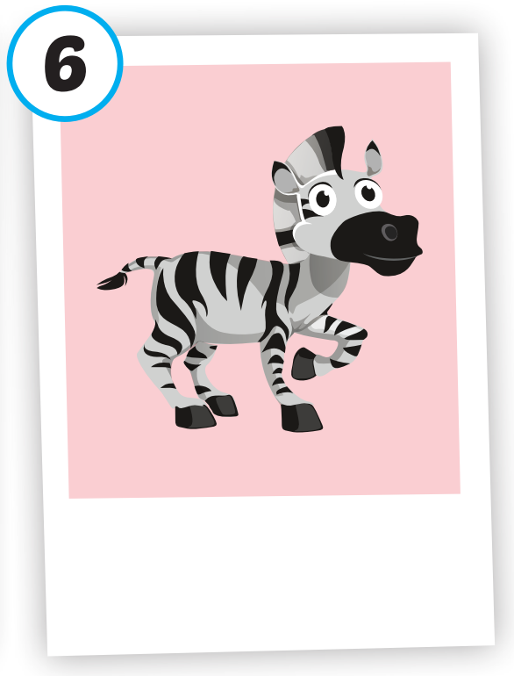






/ˈpændə/
con gấu trúc
/dʒɪˈræf/
con hươu cao cổ
/ˈlaɪən/
con sư tử
/ˈdɑːlfɪn/
cá heo
/ˈtaɪɡər/
con hổ
/ˈziːbrə/
con ngựa vằn
Click on each word to hear

Slide 16

Click on each picture to hear the sound.
/ˈpændə/
con gấu trúc
Notes:
Click vào hình A. 1. Listen and point. Repeat để cho cả audio full chạy

Slide 17
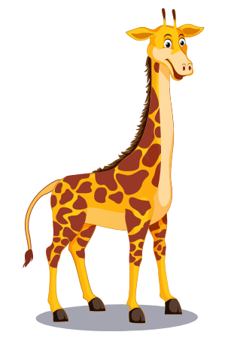
Click on each picture to hear the sound.
/dʒɪˈræf/
con hươu cao cổ
Notes:
Click vào hình A. 1. Listen and point. Repeat để cho cả audio full chạy

Slide 18
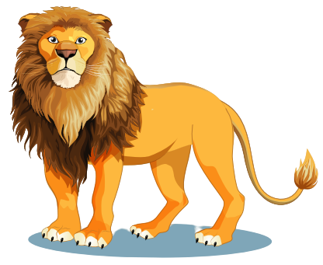
Click on each picture to hear the sound.
/ˈlaɪən/
con sư tử
Notes:
Click vào hình A. 1. Listen and point. Repeat để cho cả audio full chạy

Slide 19
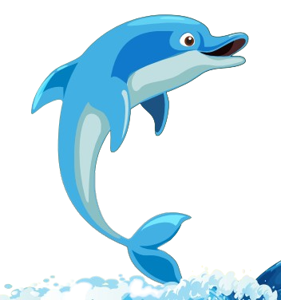
Click on each picture to hear the sound.
/ˈdɑːlfɪn/
cá heo
Notes:
Click vào hình A. 1. Listen and point. Repeat để cho cả audio full chạy

Slide 20
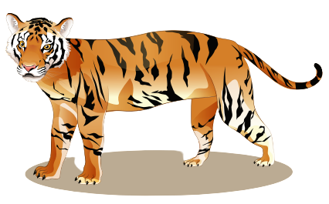
Click on each picture to hear the sound.
/ˈtaɪɡər/
con hổ
Notes:
Click vào hình A. 1. Listen and point. Repeat để cho cả audio full chạy

Slide 21
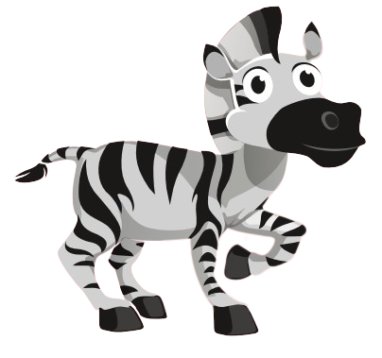
Click on each picture to hear the sound.
/ˈziːbrə/
con ngựa vằn
Notes:
Click vào hình A. 1. Listen and point. Repeat để cho cả audio full chạy

Slide 22
Practice

Slide 23
Check your memory

Slide 24



A. tiger
B. lion
C. panda

Slide 25
A. dolphin
B. giraffe
C. duck

Slide 26
A. monkey
B. lion
C. tiger

Slide 27
A. dolphin
B. tiger
C. lion

Slide 28
A. camel
B. tiger
C. giraffe

Slide 29
A. lion
B. tiger
C. zebra

Slide 30

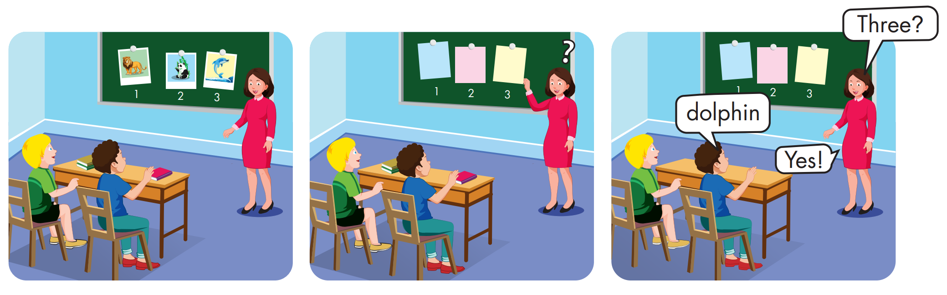

Slide 31
Structure
What's this? - It's a panda.
What's that? - It's a dolphin.

Slide 32
Presentation

Slide 33

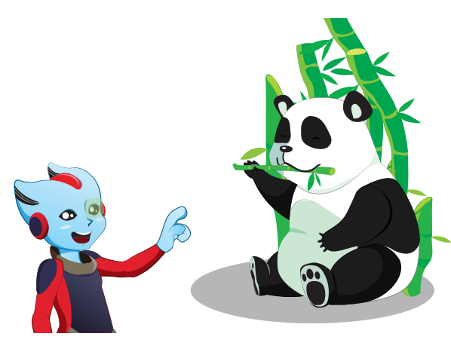


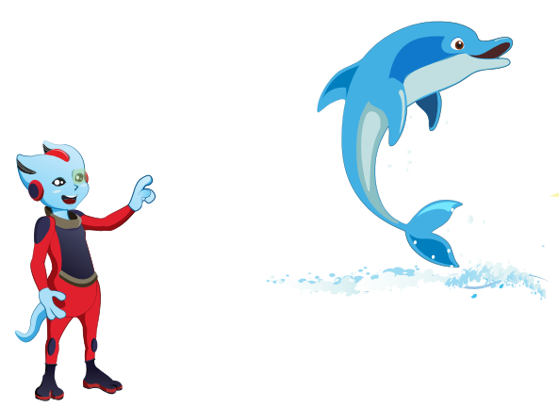


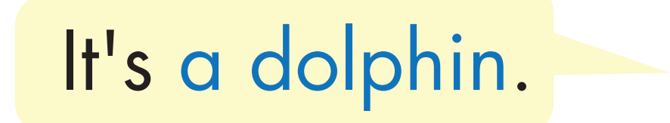
Structure
Click on the speaker or each sentence to hear the sound.

Slide 34

Practice

Slide 35

Click on each sentence to hear the sound.
Notes:
Bấm vào B để nghe full audio

Slide 36

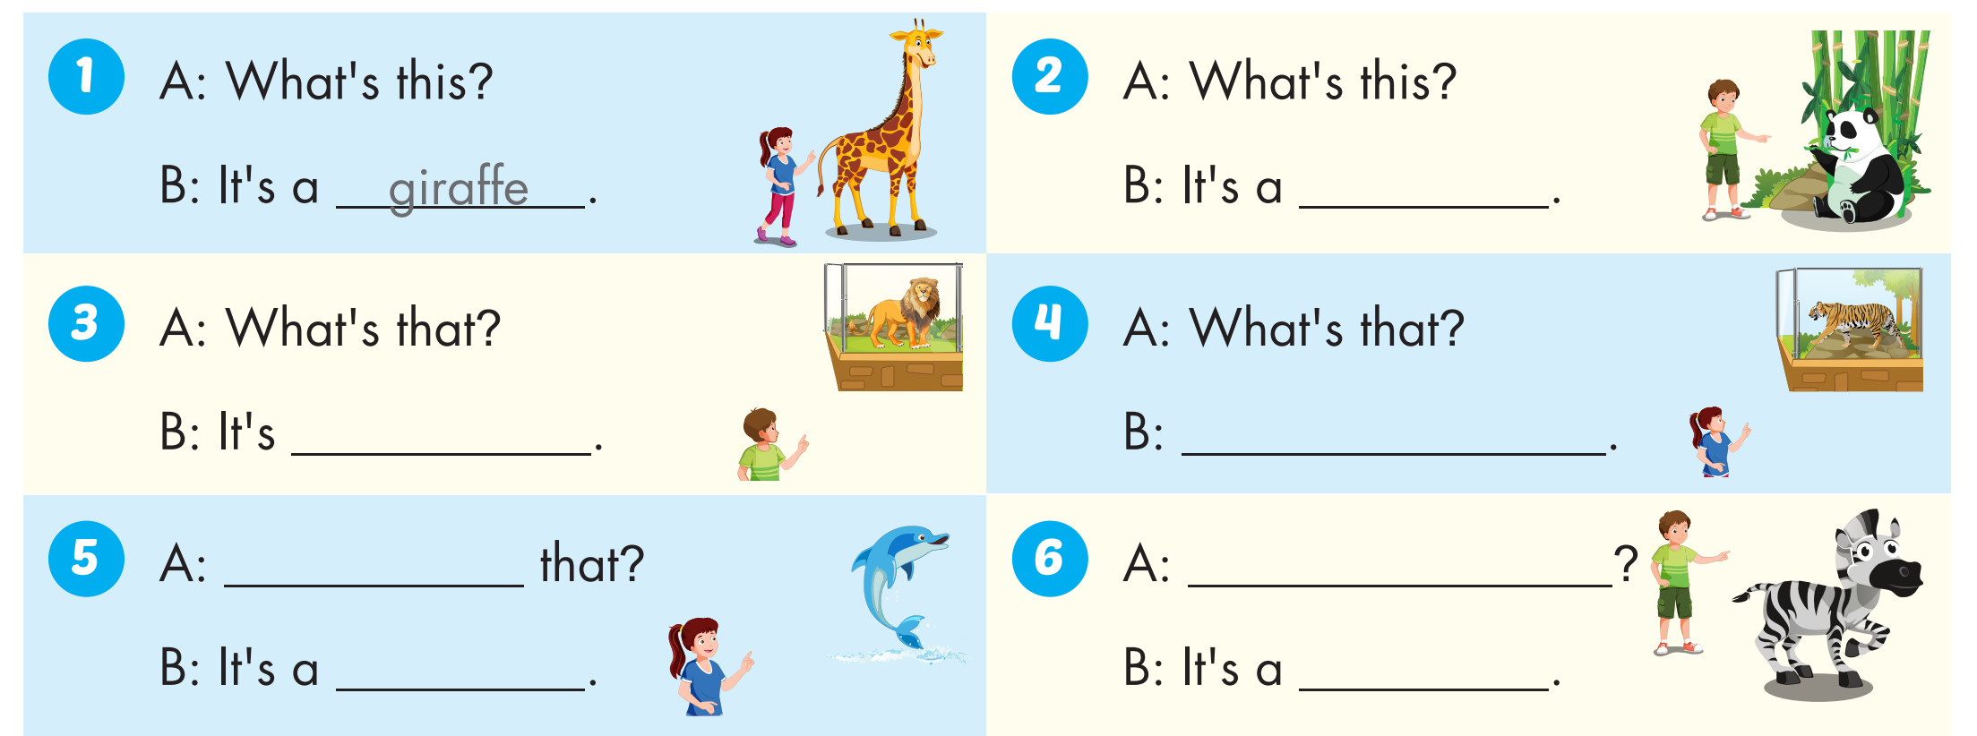
panda
a lion
It's a tiger
What's
What's this?
dolphin
zebra

Slide 37


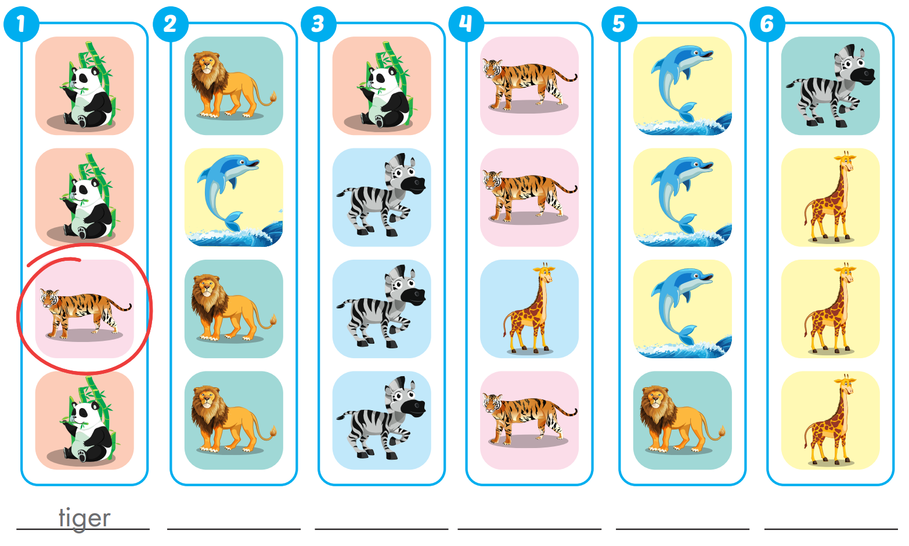
Extra Practice
WB, page 4
dolphin
panda
giraffe
lion
zebra

Slide 38

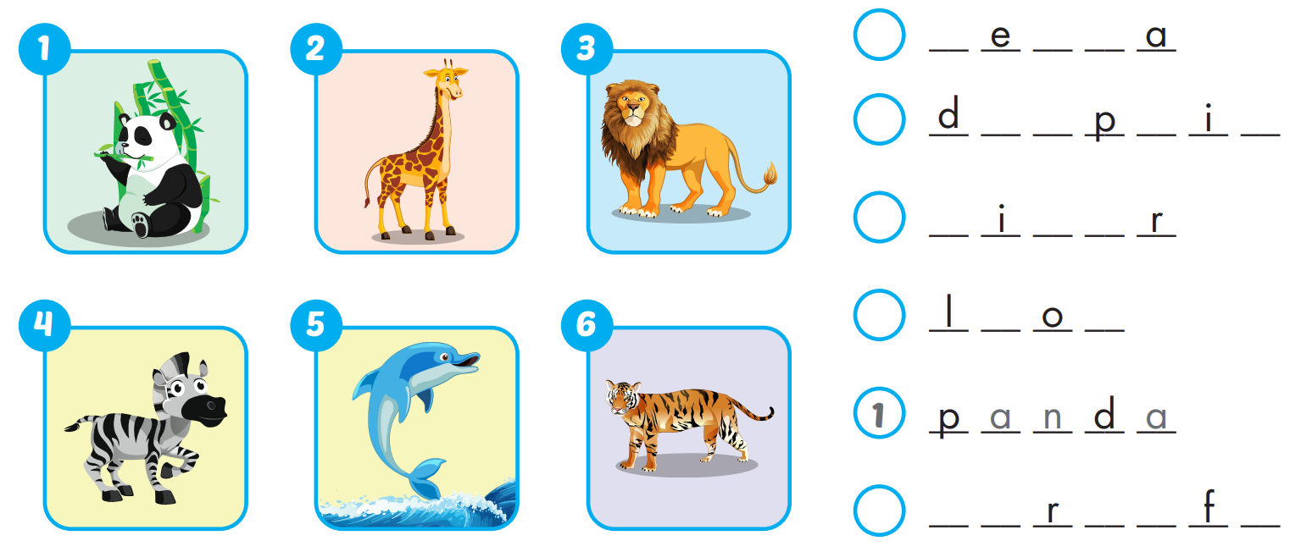
Extra Practice
WB, page 4
4
z b r
5
o l h n
6
t g e
3
i n
2
g i a f e

Slide 39

WRAP-UP

Slide 40
Today’s lesson
Vocabularies
panda, giraffe, lion, dolphin, tiger, zebra.
Structures/ Sentence patterns
What's this? - It's a panda. What's that? - It's a dolphin.

Slide 41
Homework
Practice the vocabularies and structure; and make sentences using them.
Do the exercises in Tiếng Anh 4 i-Learn Smart Start WB (page 4)
Do the exercises in Tiếng Anh 4 i-Learn Smart Start Notebook (page 7)
Prepare the next lesson (page 10 SB)
Play the consolidation games in Tiếng Anh 4 i-Learn Smart Start DHA App on www.eduhome.com.vn

Slide 42

Lesson 3
Stay positive and have a nice day!

