Slide 1

Unit 1: Animals
Lesson 1.3
Page 8

Slide 2
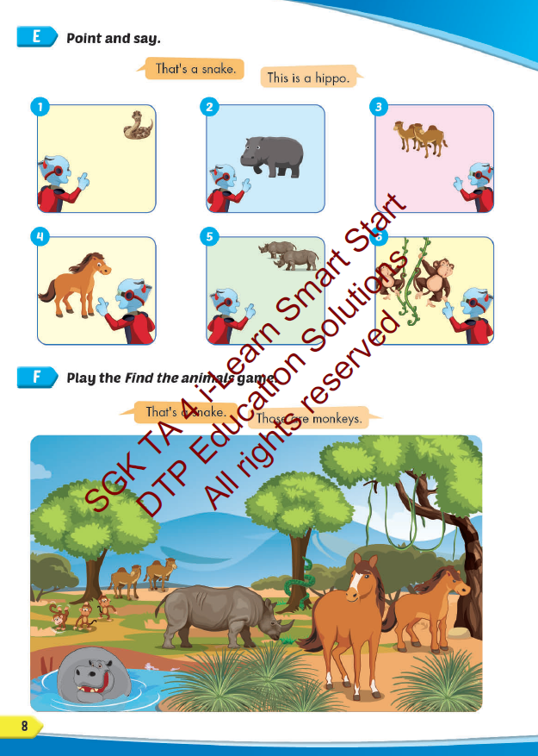
Lesson Outline
Warm-up
Practice
Speaking
Consolidation
Wrap-up

Slide 3
Objectives
By the end of this lesson, students will be able to…
Vocabulary: Pronounce and use the words related to the topic properly: snake, monkey, horse, camel, hippo, rhino.
Structure: This is a monkey. - These are monkeys.
That's a snake. - Those are snakes
Phonics: Identify the /h/ sound and practice the conversations.

Slide 4

WARM UP

Slide 5
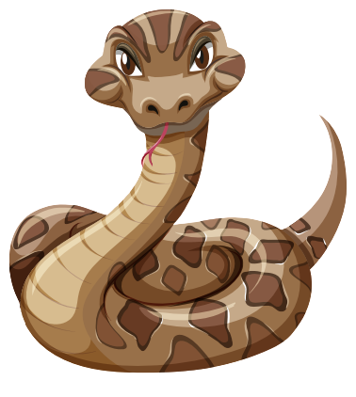

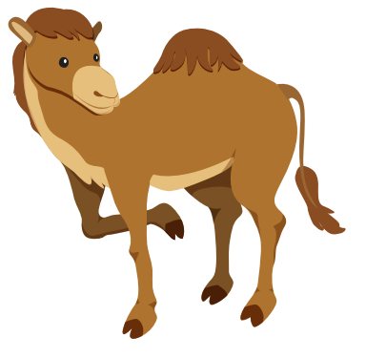
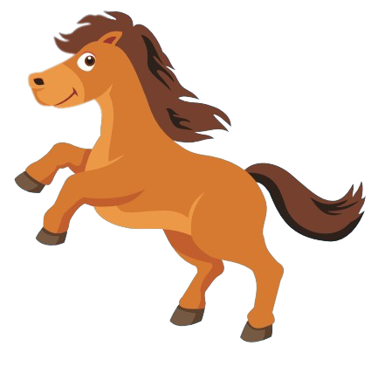

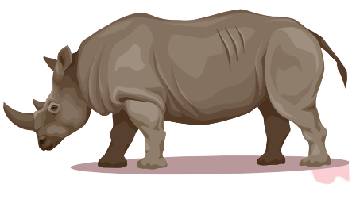
Look at the numbers and say the animals.
1
2
3
Well done!
6
1
4
3
5
4
1
3
2
4
2
6
5
2
6
5
4
6

Slide 6

It’s time to learn …

Slide 7

Speaking

Slide 8



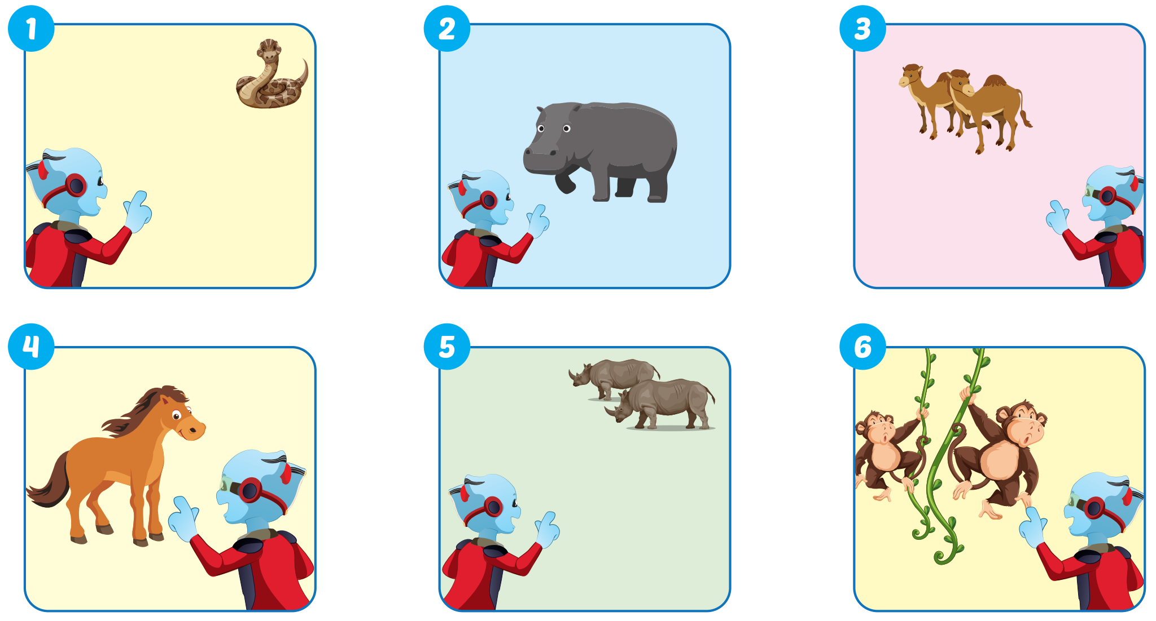

Slide 9
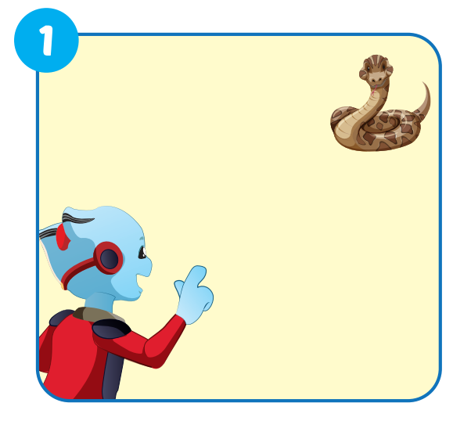

That's a snake.

Slide 10
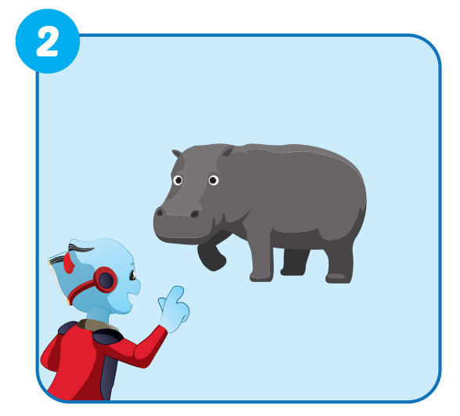
This is a hippo.

Slide 11
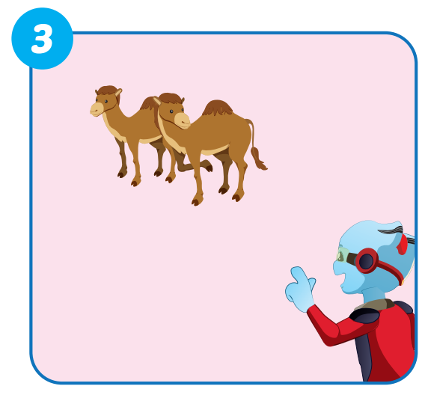
Those are camels.

Slide 12
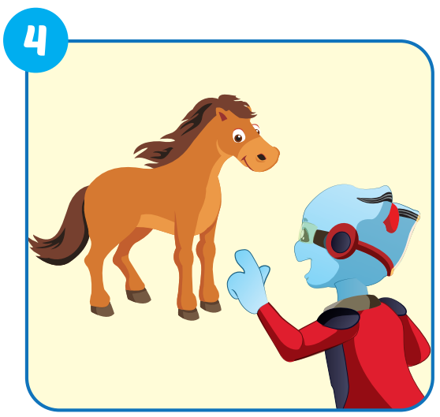
This is a horse.

Slide 13
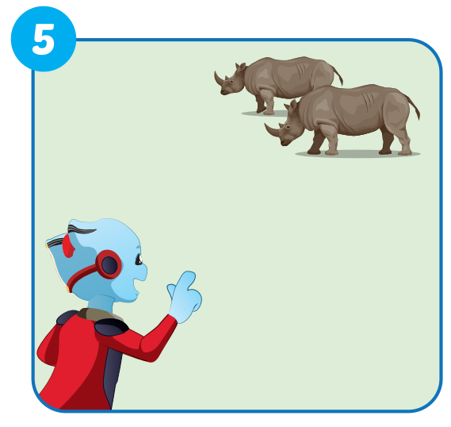
Those are rhinos.

Slide 14
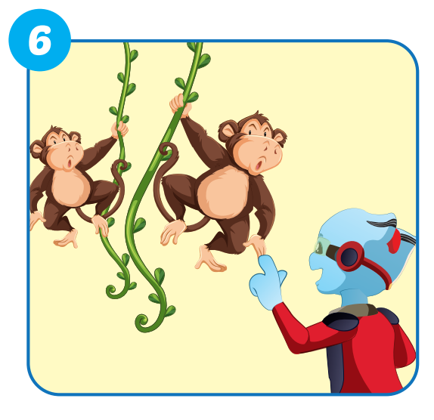
These are monkeys.

Slide 15

Production

Slide 16

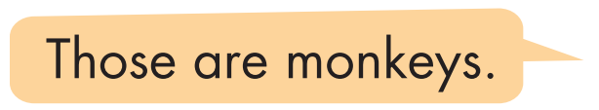
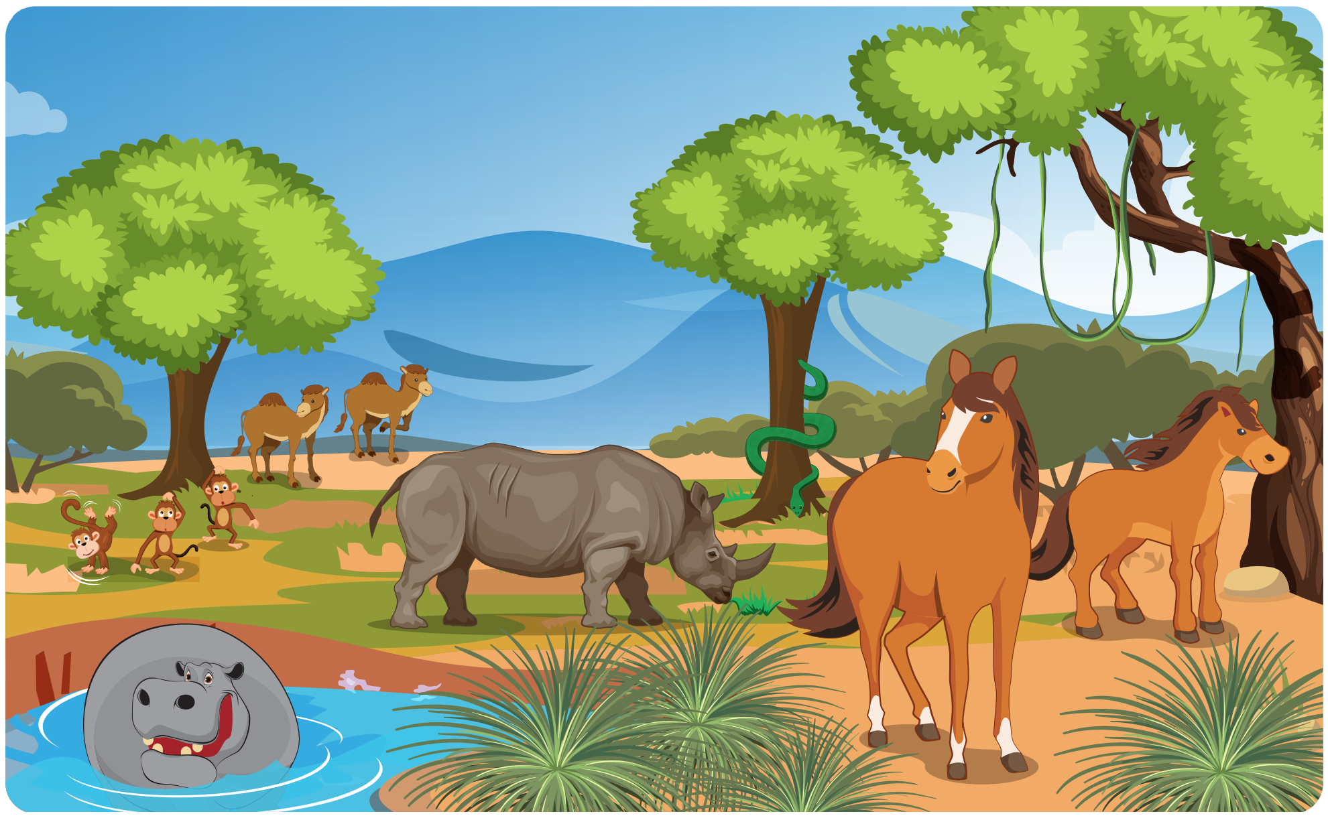

Slide 17
FINDING THE ANIMALS
GAME

Slide 18
Look and say. Which is missing?
START
CHECK

Slide 19
Look and say. Which is missing?
START
CHECK

Slide 20
Look and say. Which is missing?
START
CHECK

Slide 21
Look and say. Which is missing?
START
CHECK

Slide 22
Look and say. Which is missing?
START
CHECK

Slide 23
Look and say. Which is missing?
START
CHECK

Slide 24
Look and say. Which is missing?
START
CHECK

Slide 25

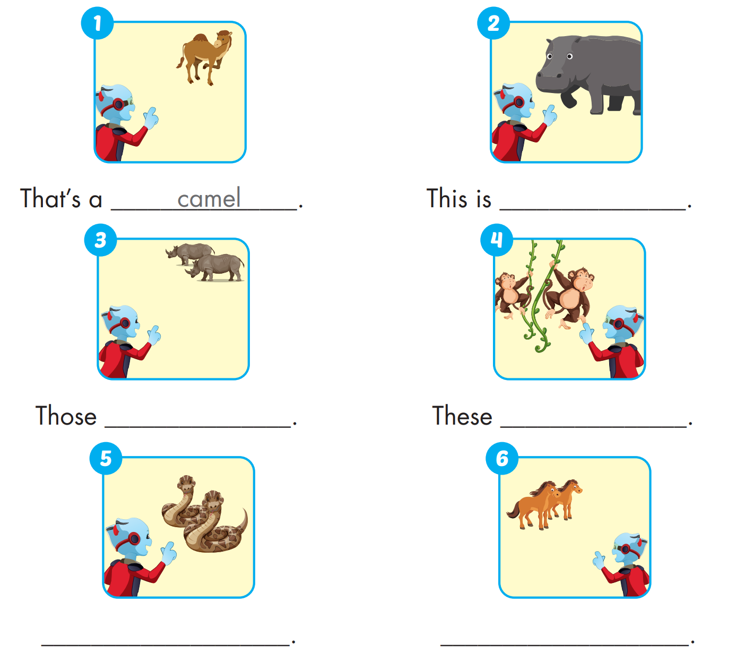
Extra Practice
WB, P. 3
a hippo
are rhinos
are monkeys
These are snakes
Those are horses

Slide 26

WRAP-UP

Slide 27
Today’s lesson
Structures/ Sentence patterns
This is a monkey.
These are monkeys.
That's a snake.
Those are snakes
Vocabularies
snake, monkey, horse, camel, hippo, rhino.
Phonics
Identify the /h/ sound and practice the conversations.

Slide 28
Homework
Practice the vocabularies and structure; and make sentences using them.
Do the exercises in Tiếng Anh 4 i-Learn Smart Start WB (page 3)
Prepare the next lesson (page 9 SB)
Play the consolidation games in Tiếng Anh 4 i-Learn Smart Start DHA App on www.eduhome.com.vn

Slide 29

Lesson 3
Stay positive and have a nice day!

