Slide 1
Unit 12
Those are our computers.
Lesson 6: Skills Time

Slide 2
Welcome, Students!

Slide 3
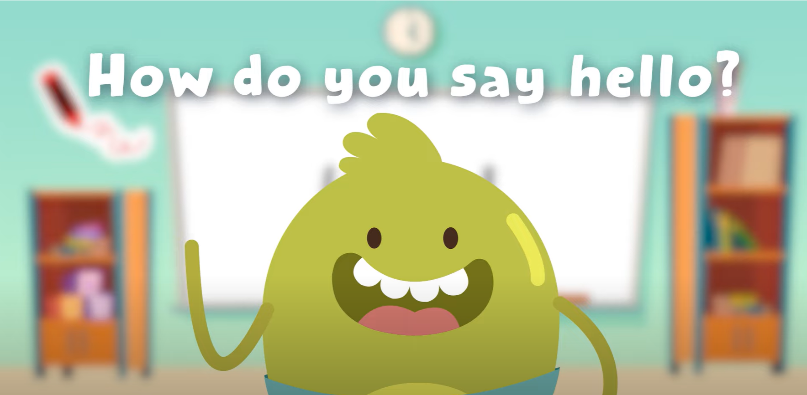
Hello song!

Slide 4
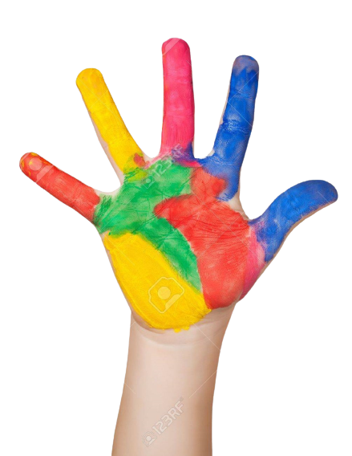
Give me Five

Slide 5
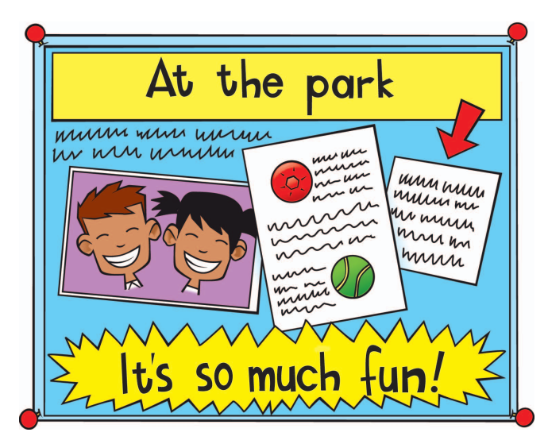
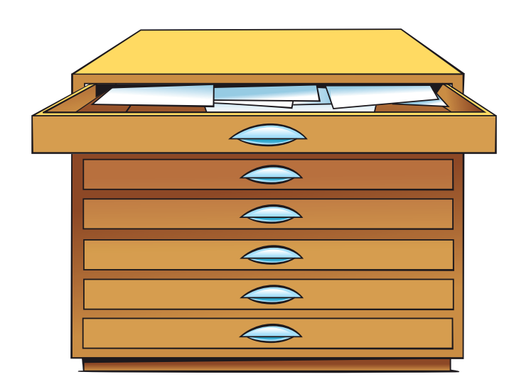
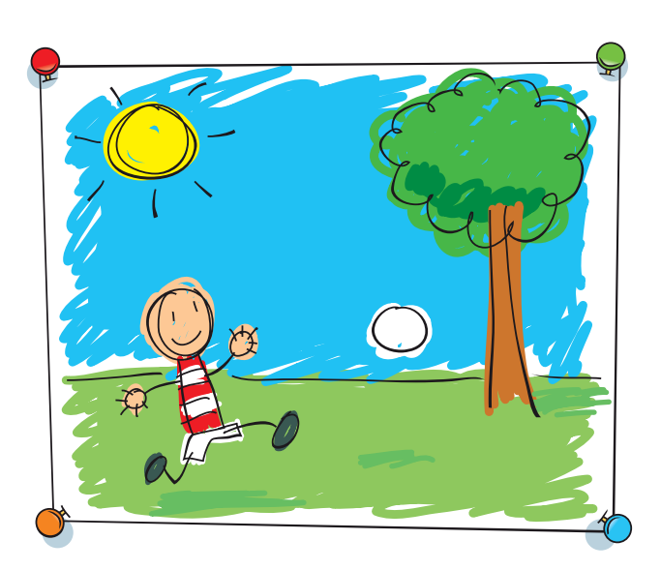
Concentration Game
1
2
A
B
poster
computer
3
4
C
D
drawers
board
5
6
E
F
chair
picture

Slide 6
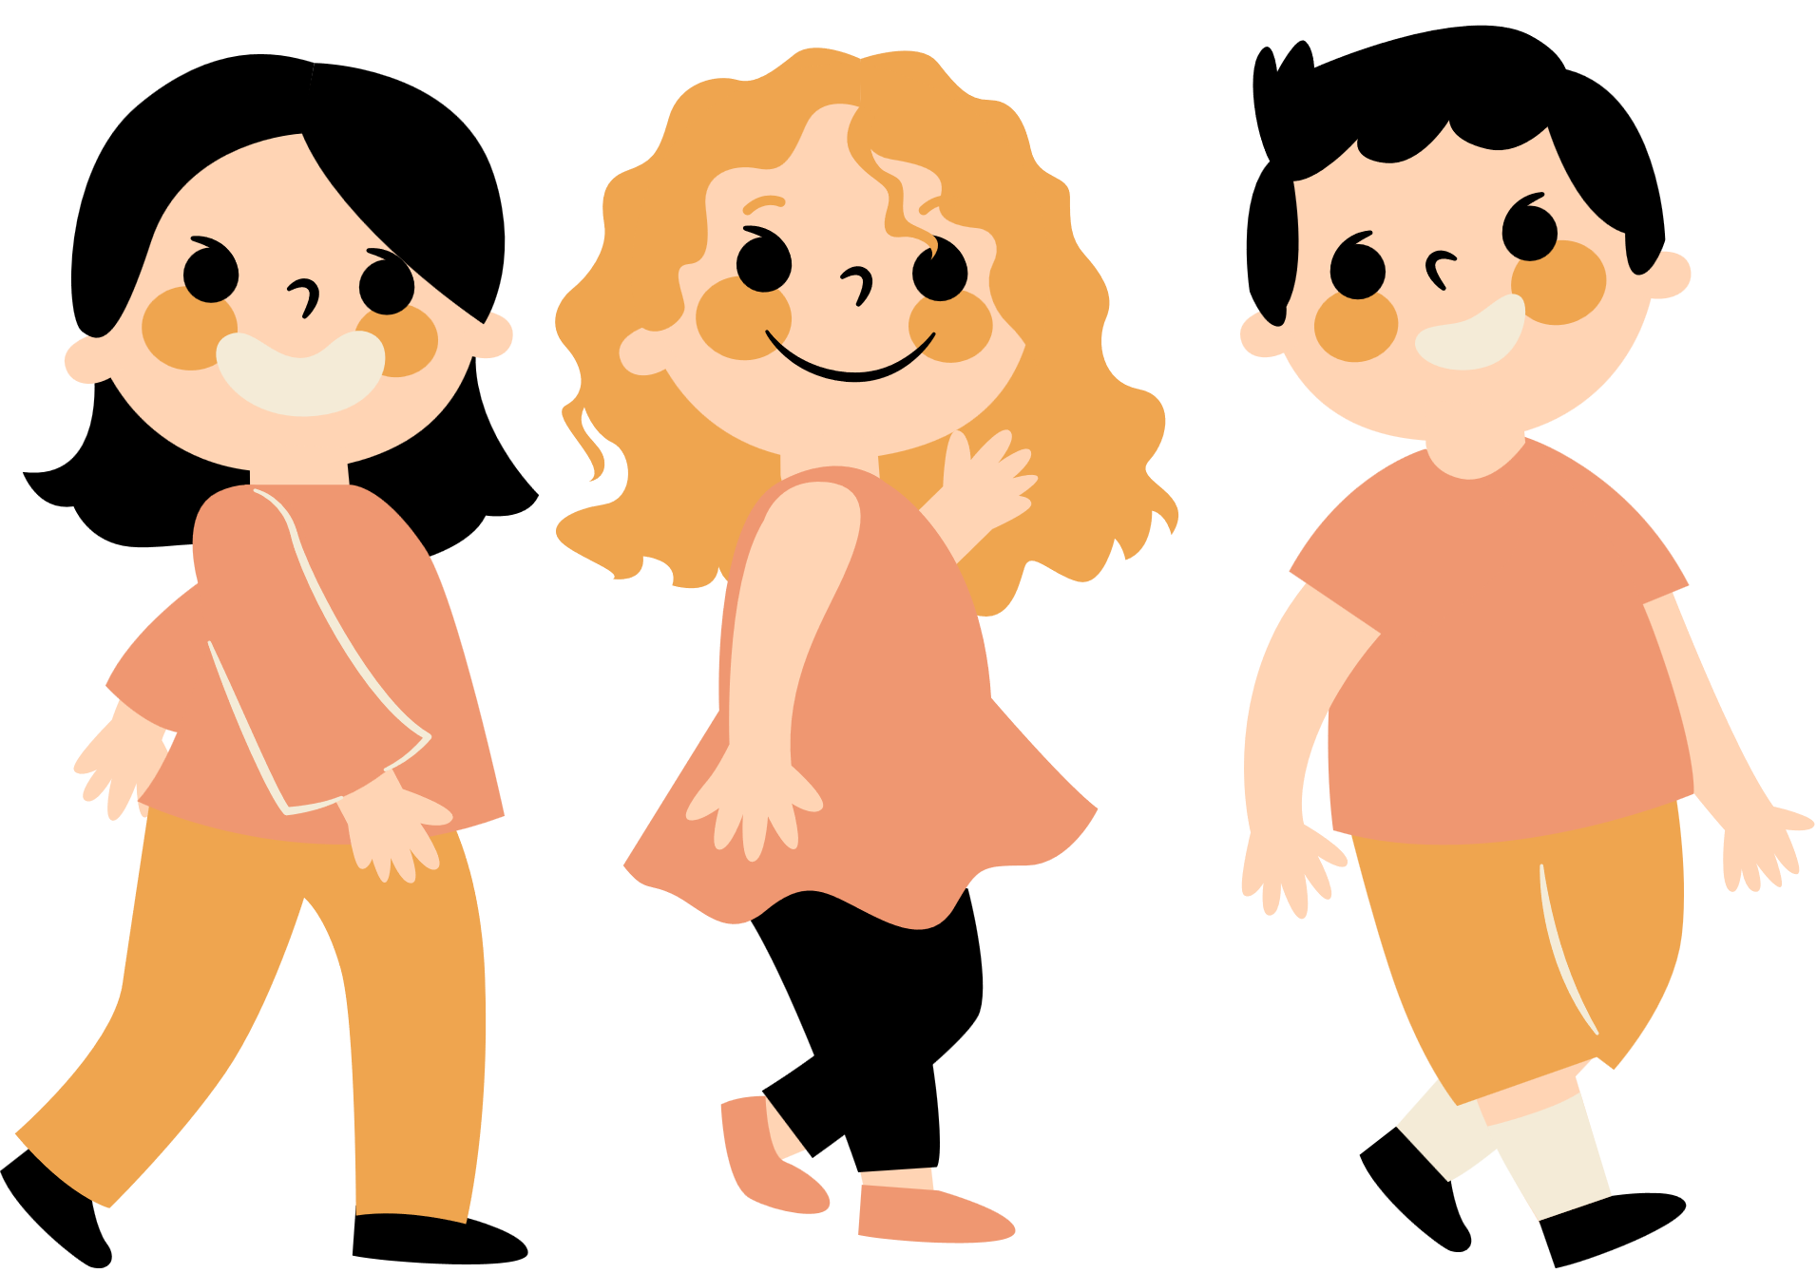
Good job!

Slide 7
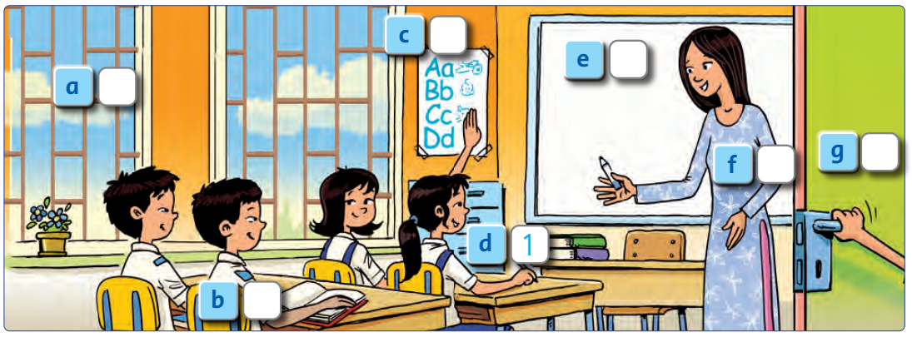
Look and Say

Slide 8
Listen and Number
1
Notes:
Do number 1 with the whole class as an example.

Slide 9
Listen and Number
1
Notes:
Students listen and do the task individually.

Slide 10
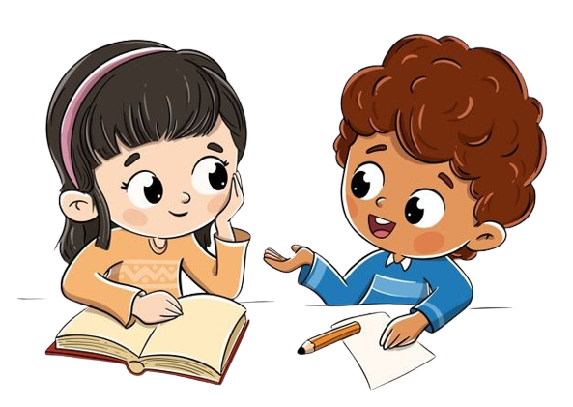
Work in Pairs.
Peer-check your answers.
Notes:
Listen again and check answers.
Check answer with sachso.edu.vn

Slide 11
Let’s check!
7
4
5
2
6
1
3
Notes:
Play the recording and invite students to tell the answers.

Slide 12
Good job!

Slide 13
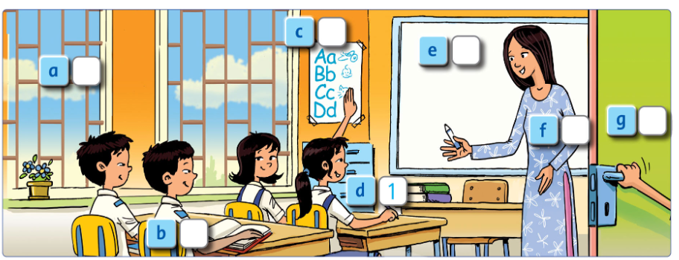
Point, ask and answer.
Notes:
How many girls are there in the classroom? There are two girls.

Slide 14
Good job!

Slide 15
Look and Write.

Slide 16
Work in groups
Notes:
Students read aloud their writing texts.

Slide 17
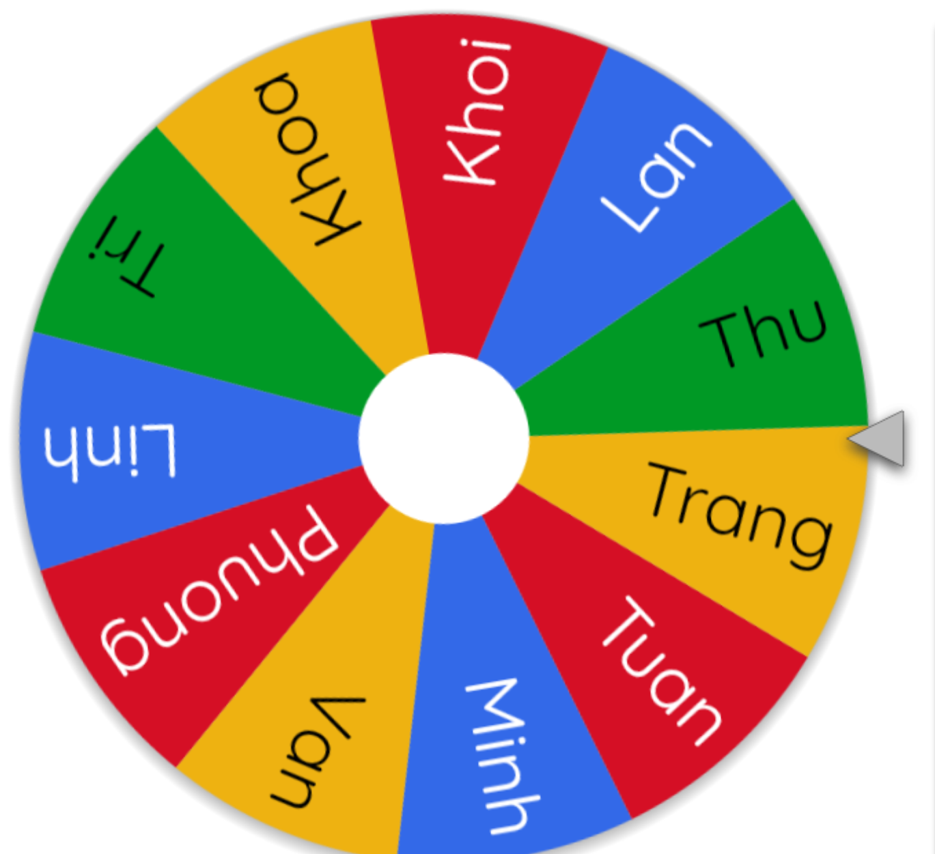
Read your text aloud.
Notes:
Invite a few students to the front of the class to rad aloud their text.
Use this link to choose students in random: https://wheelofnames.com/

Slide 18
Good job!

Slide 19
THANK YOU!

