Slide 2
REVIEW 4
Period 1

Slide 3
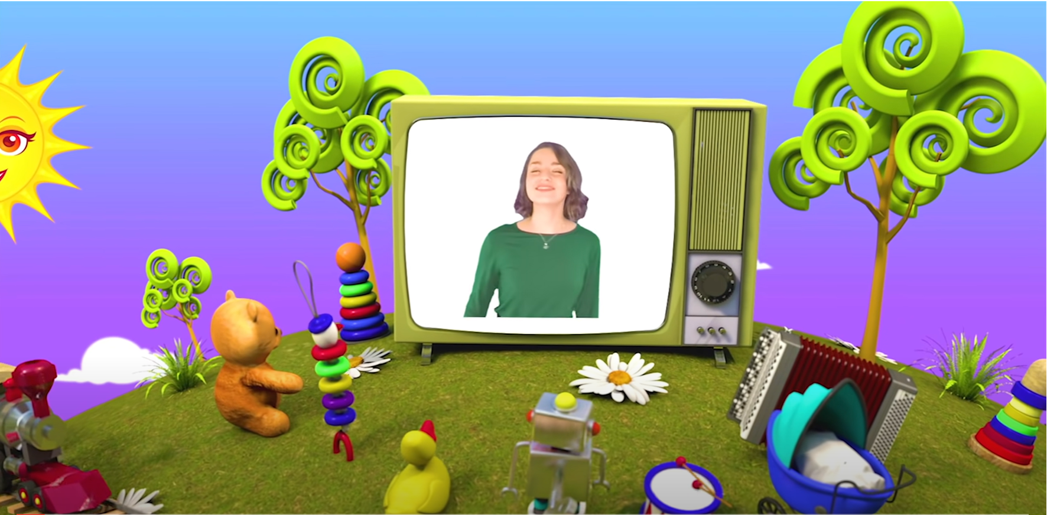
HELLO SONG
Notes:
https://www.youtube.com/watch?v=pqDEwPi7vxg

Slide 5
Game: VOCABULARY TENNIS!
 | TOTAL POINTS
Team A | ……. points
Team B | ……. points
Notes:
* Game: Vocabulary tennis
Divide the class into two teams. Tell the class the category.
The first team “serves” by saying the name of one word, and play passes to the second team, who has five seconds to name a word.
If they are successful, the player passes to the first team to name another word. The first team who repeats a word or cannot think of another word will lose. Repeat the game with different lexical sets such as directions, hobbies, adjectives.

Slide 6
Good job!

Slide 7
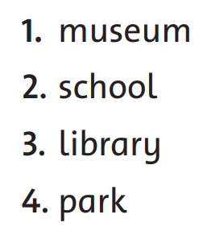
Listen and Match.
94
Places
Directions
Notes:
* Listen and match. Track 151
- Children identify places and instructions.
- Tell them that they need to listen to the instructions in the audio to find out how to get to the places on the left.
- Ask them to read out loud the names of the places. Then ask them to read out loud the directions. Tell them they need to match the places to the directions.
- Play the recording once.

Slide 8
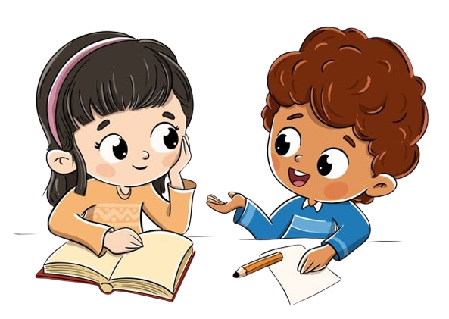
Work in Pairs
Notes:
Ask two students to work in pairs to peer-check their answers. One asks and the other gives directions.

Slide 9
Listen and Match.
94
Places
Directions
Notes:
- Play the recording again for the children to check their answers.
Answers
1 b 2 d 3 a 4 c

Slide 10
Look and Say.
1. They were old. They __________ young.
2. He was sad. He _________ happy.
3. I wasn’t a monkey in the play. I ______ a kangaroo.
4. There weren’t cakes, but there _______ balloons.
Notes:
* Write.
Show the sentences.
Children work in pairs to say the full sentences by guessing the missing words.
Do the first one as an example if necessary.
Answers
1 weren’t 2 wasn’t 3 was 4 were

Slide 11
Let’s write!
They were old.
They __________ young.
weren’t
Notes:
Do the first one as an example if necessary.
Answers
1 weren’t

Slide 12
Let’s write!
1. They were old. They __________ young.
weren’t
2. He was sad. He _________ happy.
3. I wasn’t a monkey in the play. I ______ a kangaroo.
4. There weren’t cakes, but there _______ balloons.
Notes:
Children do the task individually.

Slide 13
Let’s check!
2. He was sad.
He _________ happy.
wasn’t
Notes:
Answers
2 wasn’t 3 was 4 were

Slide 14
Let’s check!
3. I wasn’t a monkey in the play. I ______ a kangaroo.
was
Notes:
Answers
2 wasn’t 3 was 4 were

Slide 15
Let’s check!
4. There weren’t cakes, but there _______ balloons.
were
Notes:
Answers
2 wasn’t 3 was 4 were

Slide 16
Read the text and think.
94
Notes:
* Read the text and circle the correct words.
Show the text.
Ask different children to read the text once without noticing the gaps so they get an idea of what it is about.
Children work in pairs to guess the missing words without looking at the answer options.

Slide 17
Read and Circle.
94
old
1. old new small
Notes:
Show the example answer to demonstrate the activity.

Slide 18
Read and Circle.
94
1. old new small
2. is was were
3. handsome old cute
4. girl baby man
5. pretty cute handsome
6. aren’t wasn’t weren’t
7. was were are
Notes:
Show the example answer to demonstrate the activity.
Allow time for children to read the text and decide which word fits each gap. They circle the correct words.

Slide 19
Work in Pairs
Notes:
Ask two students to work in pairs to peer-check their answers.

Slide 20
Let’s check!
94
old
was
2. is was were
Notes:
Answers
2 was 3 cute 4 baby 5 pretty 6 weren’t 7 were

Slide 21
Let’s check!
94
old
was
cute
3. handsome old cute
Notes:
Answers
2 was 3 cute 4 baby 5 pretty 6 weren’t 7 were

Slide 22
Let’s check!
94
old
was
cute
baby
4. girl baby man
Notes:
Answers
2 was 3 cute 4 baby 5 pretty 6 weren’t 7 were

Slide 23
Let’s check!
94
old
was
cute
baby
pretty
5. pretty cute handsome
Notes:
Answers
2 was 3 cute 4 baby 5 pretty 6 weren’t 7 were

Slide 24
Let’s check!
94
old
was
cute
baby
pretty
weren’t
6. aren’t wasn’t weren’t
Notes:
Answers
2 was 3 cute 4 baby 5 pretty 6 weren’t 7 were

Slide 25
Let’s check!
94
old
was
cute
baby
pretty
weren’t
were
7. was were are
Notes:
Answers
2 was 3 cute 4 baby 5 pretty 6 weren’t 7 were

Slide 26
Good job!

Slide 27
Ring
the bell

Slide 28
Round 1

Slide 29
Question No. 1
How do we get to the school?
Start

Slide 30
Answer
Go straight. Turn right at the traffic light. It’s on the left.
Start

Slide 31
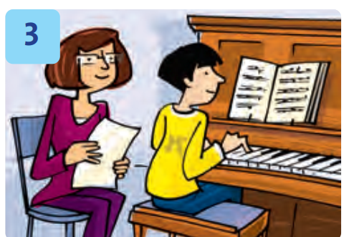
Question No. 2
Where was the boy yesterday?

Slide 32
Answer
He was at piano class.
Where was the boy yesterday?

Slide 33
Round 2

Slide 34
Question No. 1
How do we get to the bank?
Start

Slide 35
Answer
Go straight. Turn left at the traffic light. It’s on the right.
Start

Slide 36
Question No. 2
Where was the vet last night?

Slide 37
Answer
He was at the clinic.
Where was the vet last night?

Slide 38
Congratulations!

Slide 39
Our Winners!
Peter
Eric
Julie
Notes:
Replace photos and names with your students’ information.

Slide 40
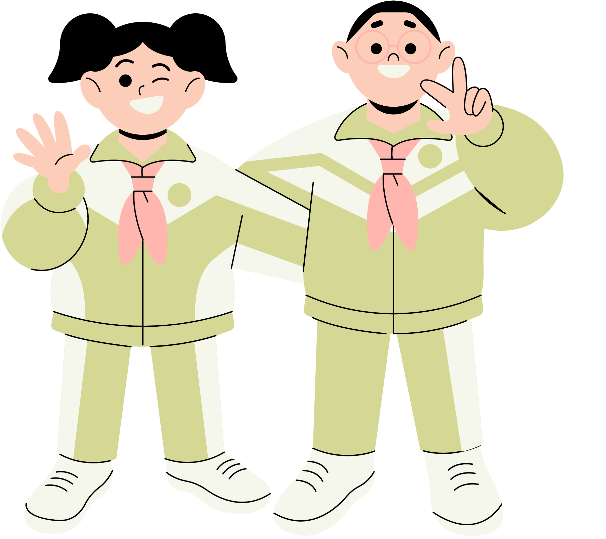
Thank You!
See You Next Time.
Notes:
https://www.youtube.com/watch?v=SRyFiVeNjWs

