Slide 2
REVIEW 4
Period 2

Slide 3
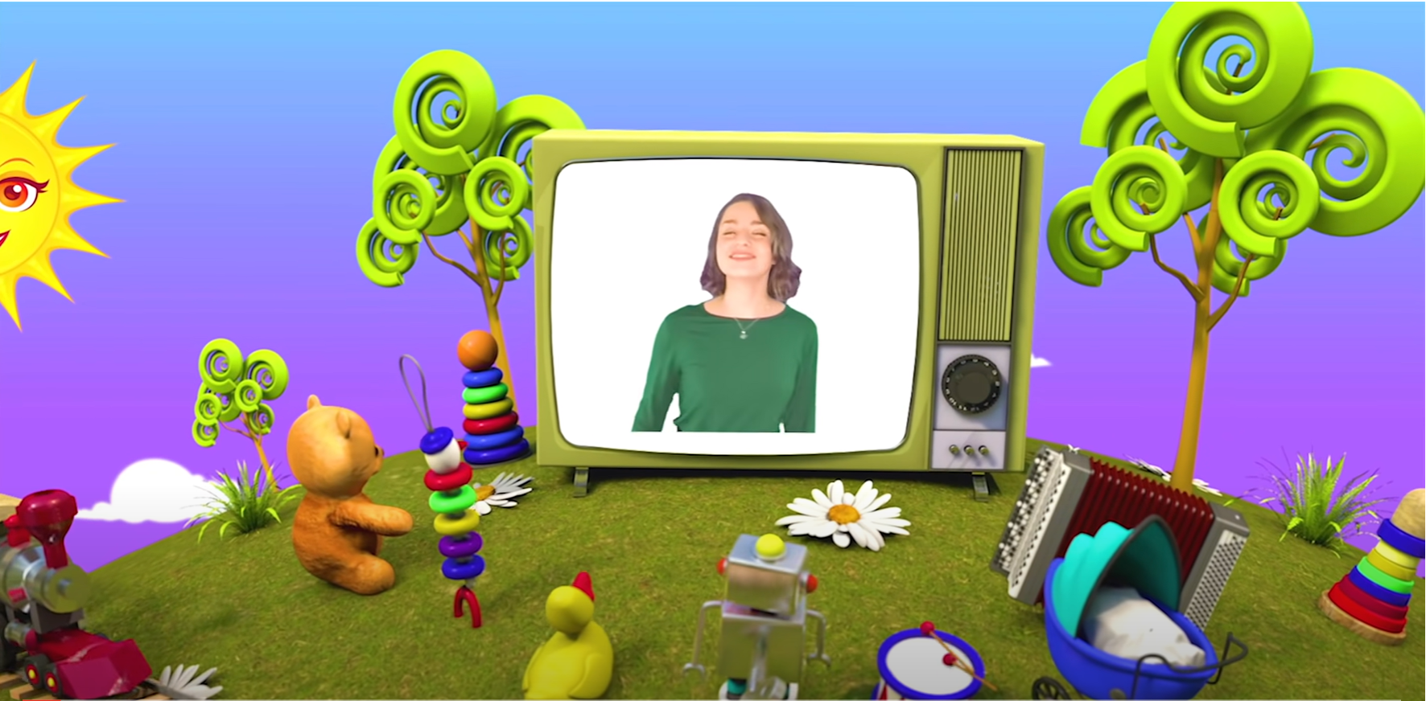
HELLO SONG
Notes:
https://www.youtube.com/watch?v=pqDEwPi7vxg

Slide 5
Game: BINGO
Notes:
* Game: Bingo!
Ask the children to draw a three-by-three grid. In each of the squares, they write a different word from the vocabulary they have studied in the unit.
Call out words from the vocabulary in any order. Keep a record of the words as you say them, so that you don’t say the same word twice. The children cross off the words in their grids as they hear them. The first child to complete a line of three, shouts Bingo!

Slide 6
Game: BINGO!
old
young
cute
pretty
handsome
long
short
clean
round
square
read books
play chess
fish
play
basketball
play
badminton
play
volleyball
Notes:
Write the words on the board.

Slide 7
Game: BINGO!
old
long
cute
play volleyball
handsome
young
short
play chess
round
square
clean
read books
fish
play badminton
play basketball
pretty
Notes:
Demonstrate how to fill in the grid with the words, writing them in random order.
Call out words from the board in any order. Keep a record of the words as you say them, so that you don’t say the same word twice. The children cross off the words in their grids as they hear them. The first child to complete a line of four, shouts Bingo!

Slide 8
Game: BINGO!
old
long
cute
play volleyball
handsome
young
short
play chess
round
square
clean
read books
fish
play badminton
play basketball
pretty
Notes:
Call out words from the board in any order. Keep a record of the words as you say them, so that you don’t say the same word twice. The children cross off the words in their grids as they hear them. The first child to complete a line of four, shouts Bingo!

Slide 9
Game: BINGO!
old
long
cute
play volleyball
handsome
young
short
play chess
round
square
clean
read books
fish
play badminton
play basketball
pretty
Notes:
Call out words from the board in any order. Keep a record of the words as you say them, so that you don’t say the same word twice. The children cross off the words in their grids as they hear them. The first child to complete a line of four, shouts Bingo!

Slide 10
Game: BINGO!
old
long
cute
play volleyball
handsome
young
short
play chess
round
square
clean
read books
fish
play badminton
play basketball
pretty
Notes:
Call out words from the board in any order. Keep a record of the words as you say them, so that you don’t say the same word twice. The children cross off the words in their grids as they hear them. The first child to complete a line of four, shouts Bingo!

Slide 11
Good job!
Notes:
Point and Say

Slide 12
Read the text.
95
The writer’s grandma
Notes:
* Read and write T (true) or F (false).
Ask the children to read the text once and say what it’s about (the writer’s grandma).

Slide 13
Read again and Write T (true) or F (false).
1. When Grandma was little, her hair was long and black.
T
F
Notes:
- Children read the sentences aloud in the front.

Slide 14
Read again and Write T (true) or F (false).
95
Notes:
Ask children to read the sentences silently.
Children do the exercise individually.

Slide 15
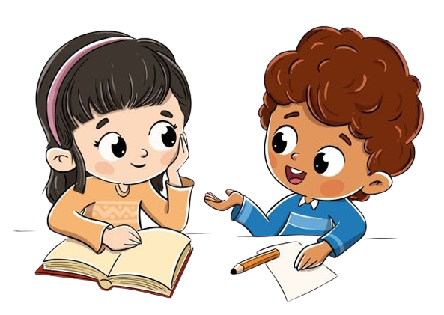
Work in Pairs
Notes:
Children work in pairs to peer-check their answers.

Slide 16
Let’s check!
2. Her face was square.
T
F
Notes:
Answers
1 T 2 F 3 F 4 F 5 T

Slide 17
Let’s check!
3. Her eyes were black and bright.
T
F
Notes:
Answers
1 T 2 F 3 F 4 F 5 T

Slide 18
Let’s check!
4. Now Grandma is seventy-five years old.
T
F
Notes:
Answers
1 T 2 F 3 F 4 F 5 T

Slide 19
Let’s check!
5. Grandma’s house is clean.
T
F
Notes:
Answers
1 T 2 F 3 F 4 F 5 T

Slide 20
Good job!

Slide 21
Try to remember!
94
handsome dad
young parents
old photos
pretty
mom
Mai’s text – Exercise 3
parents were students
handsome and happy brother
Notes:
* Read the text in exercise 3 again. Then write the correct sentences.
Ask the children to say what they remember about Mai’s text in Exercise 3. Elicit ideas and then have children read the text again to check.

Slide 22
Read again silently!
94
old
was
cute
baby
pretty
weren’t
were
Notes:
Children read the text again silently in 1 minute.

Slide 23
Read and write.
94
1. The photos are new.
The photos are old.
Notes:
Ask the children to look at the picture and say the word.

Slide 24
Read and write.
94
Notes:
Children do the task individually.

Slide 25
Work in Pairs
Notes:
Children work in pairs to peer-check their answers.

Slide 26
Let’s check!
94
2. Mai’s brother was handsome.
Mai’s brother was cute.
Notes:
Answers
1 The photos are old.
2 Mai’s brother was cute.
3 Mai’s parents were students.
4 Mai was shy.

Slide 27
Let’s check!
94
3. Mai’s parents were police officers.
Mai’s parents were students.
Notes:
Answers
1 The photos are old.
2 Mai’s brother was cute.
3 Mai’s parents were students.
4 Mai was shy.

Slide 28
Let’s check!
94
4. Mai wasn’t shy.
Mai was shy.
Notes:
Answers
1 The photos are old.
2 Mai’s brother was cute.
3 Mai’s parents were students.
4 Mai was shy.

Slide 29
Good job!

Slide 30
Game: MUSICAL CHAIRS!
What do you like doing with your friends?
Notes:
* Look and say.
Ask the children to think about what they like doing with their friends.

Slide 31
Think and Say.
Make a list of activities you talked in Exercise 6!
playing basketball
reading books
playing volleyball
riding a bike
playing soccer
watching TV
playing chess
doing a puzzle
Notes:
* What do you and your friends like doing? Write 20–30 words.
Ask the children to make a list of the activities they talked about in Exercise 6.
Play music for children talking to each other.
Show suggested ideas.

Slide 32
Let’s write!
WHAT DO YOU AND YOUR FRIENDS LIKE DOING?
Notes:
Ask children to write 3 sentences saying what they like doing with their friends.
Answers Children’s own answers

Slide 33
Work in Pairs
Notes:
Children work in pairs to read aloud their writing text.
Invite some volunteers to read their text in the front.

Slide 34
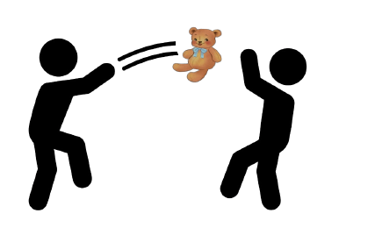
Game: PASS THE TEDDY BEAR!
Notes:
* Game: Pass the teddy bear
Explain how the game is played.
Give a teddy bear to one student.
Have students listen to music and pass the teddy bear.
Stop music suddenly.
Have the student with the teddy bear talk about their hobbies.
Continue the game until the time’s out.
Check students’ pronunciation. Praise students if they have done well.

Slide 35
Our Winners!
Peter
Eric
Julie
Notes:
Replace photos and names with your students’ information.

Slide 36
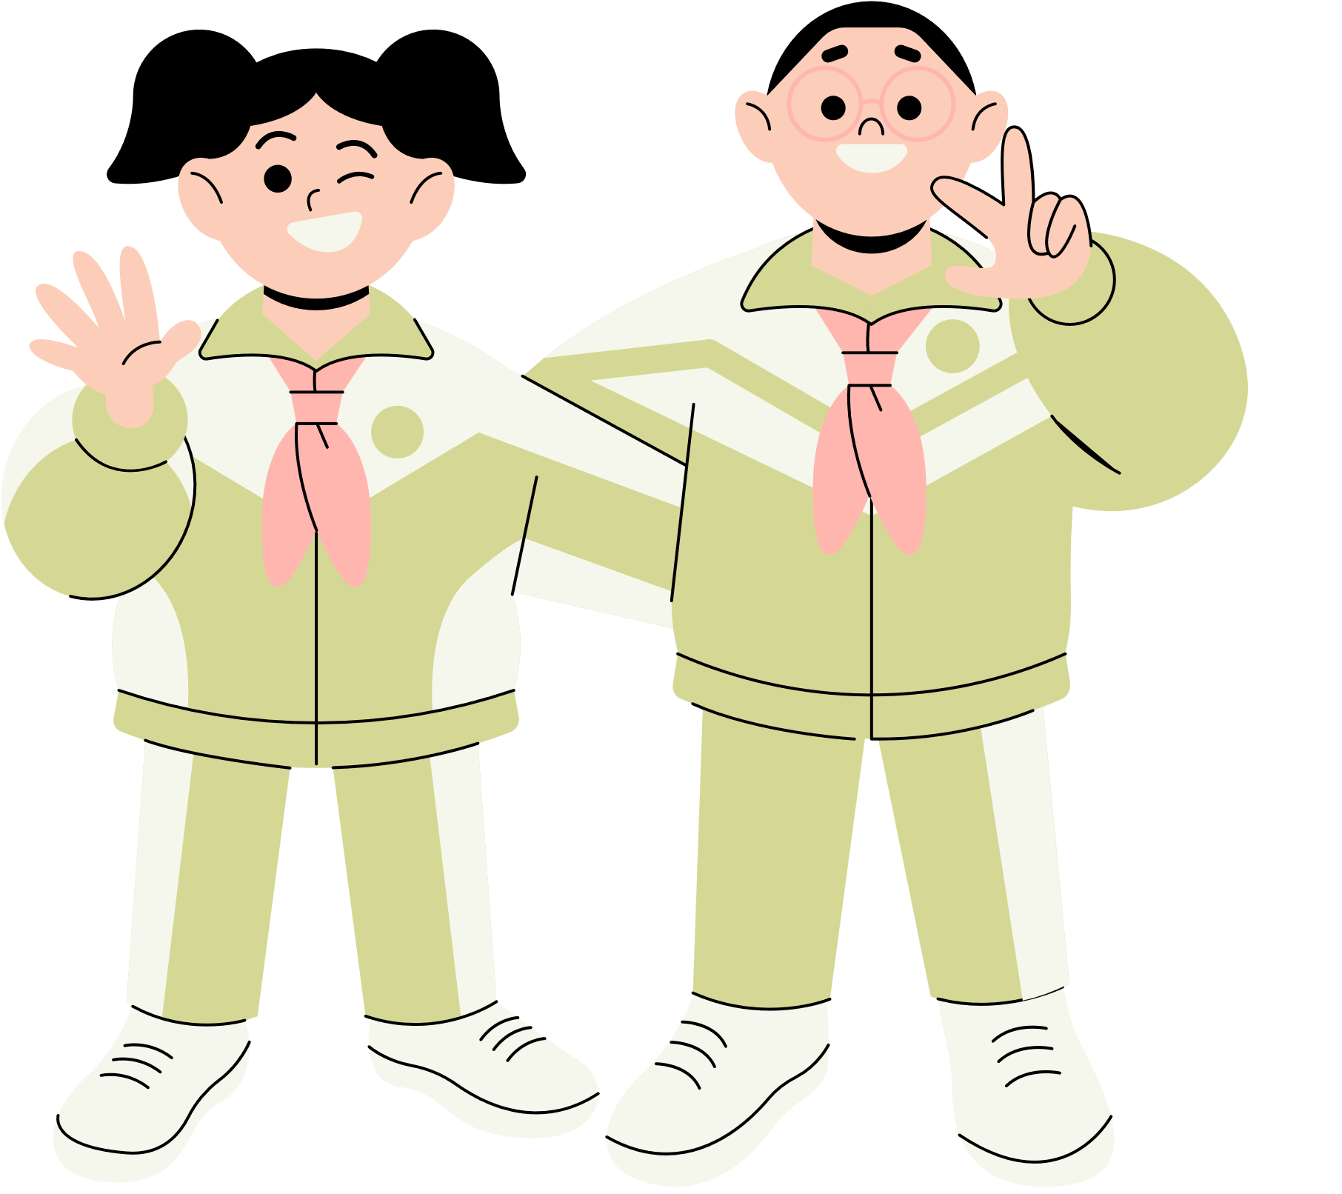
Thank You!
See You Next Time.
Notes:
https://www.youtube.com/watch?v=SRyFiVeNjWs

