Slide 2
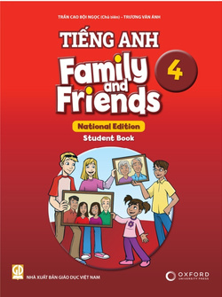
FLUENCY TIME 4
Lesson 2 - CLIL - GEOGRAPHY

Slide 3
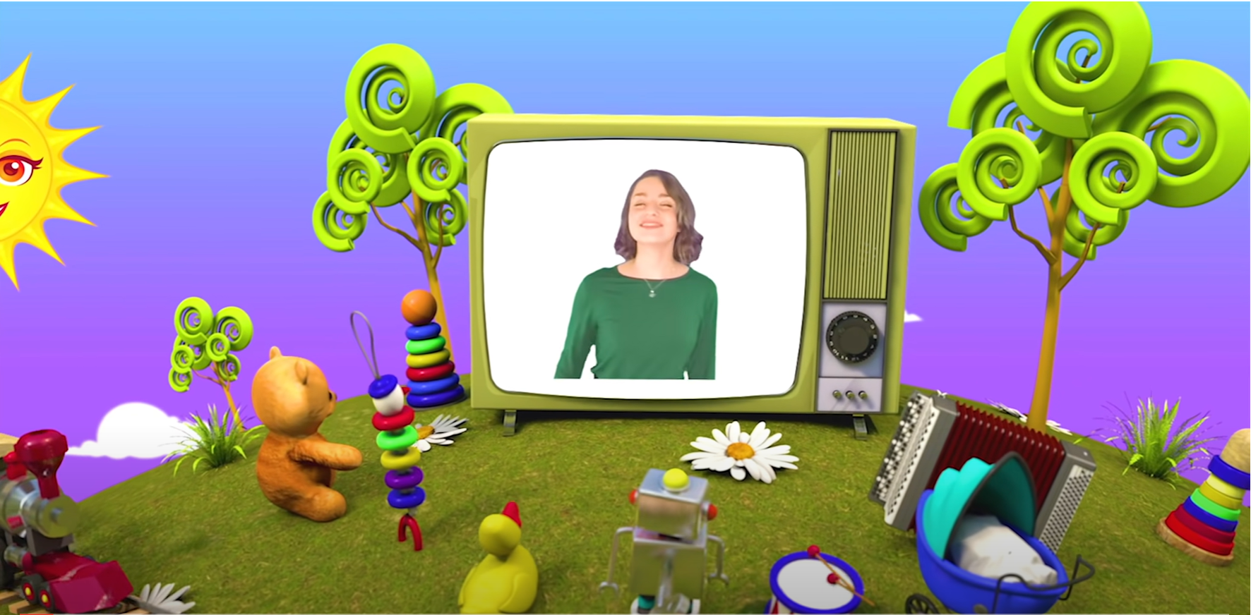
HELLO SONG
Notes:
https://www.youtube.com/watch?v=pqDEwPi7vxg

Slide 4
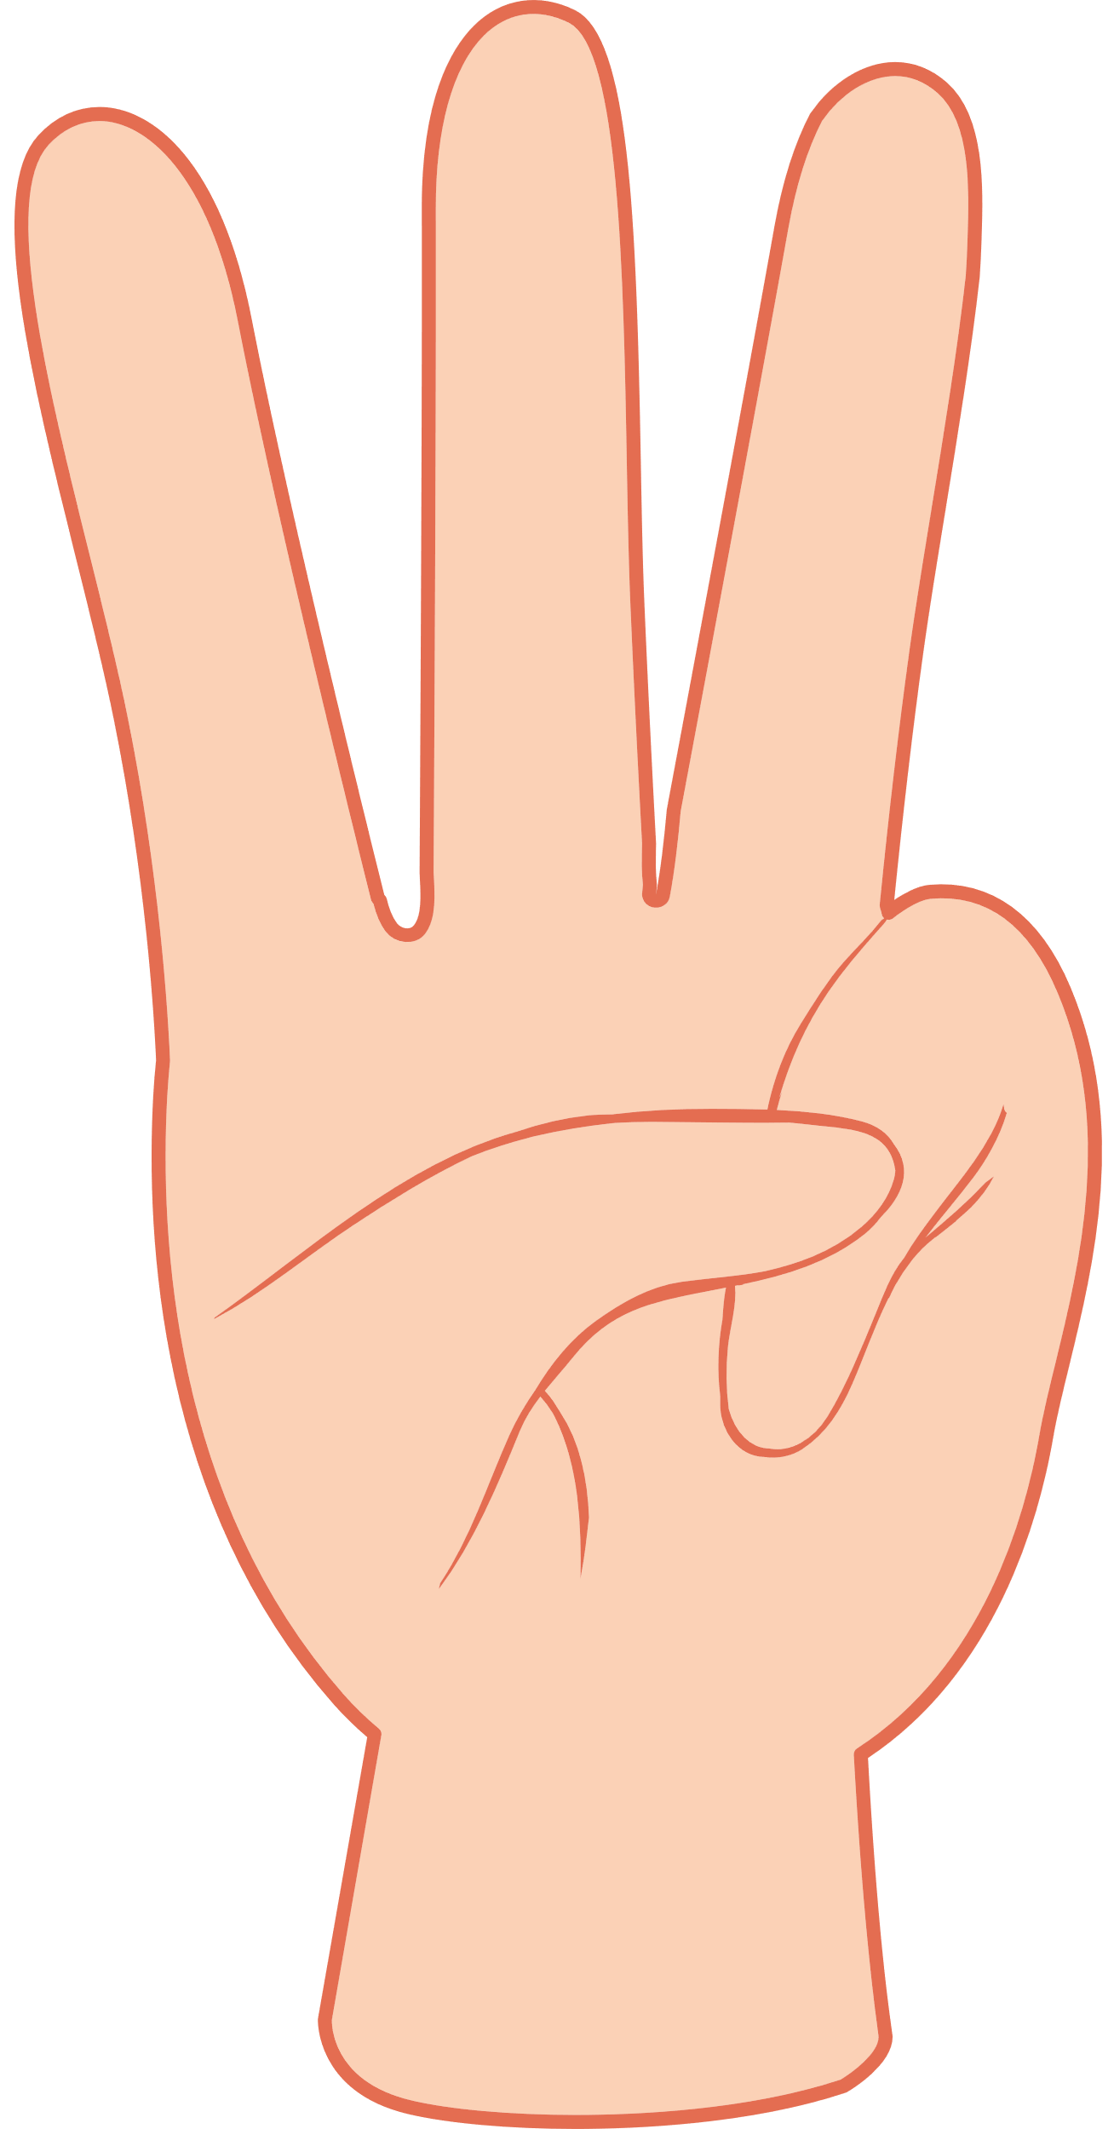

Slide 5
GUESSING GAME
What is it?
volcano
Notes:
* Warmer
Slowly draw a simple picture of a volcano (erupting) on the board.
Ask children to guess what you are drawing before you finish the picture. Encourage them to call out guesses (mountain, hill, etc.). Teach the word volcano.

Slide 6
Good job!

Slide 7
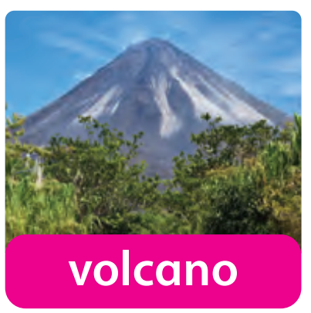
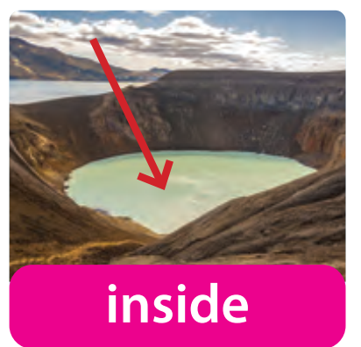
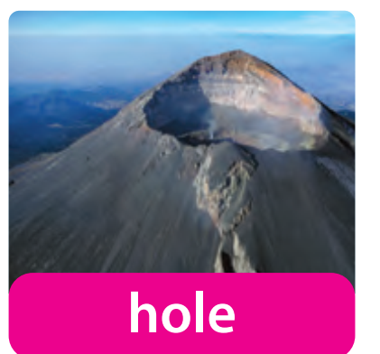
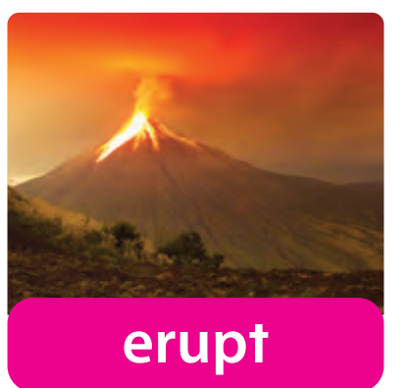
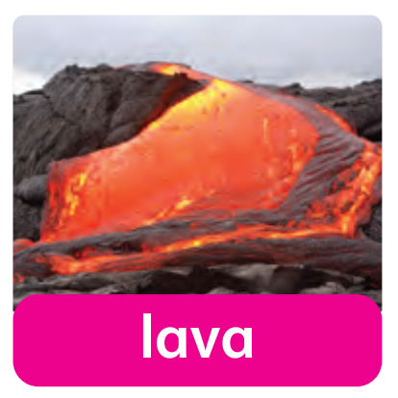
Listen and Repeat.
Notes:
*Lead-in:
Hold up the Geography flashcards and say the words for children to repeat.

Slide 8
Listen and Point.
97

Slide 9
Listen and Repeat.
97

Slide 10
Look and Say.
Notes:
Show the flashcards in random order and elicit the words.

Slide 11
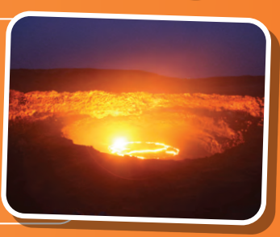
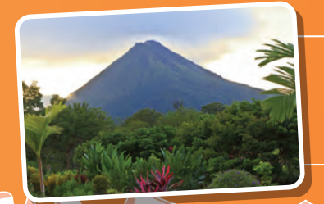
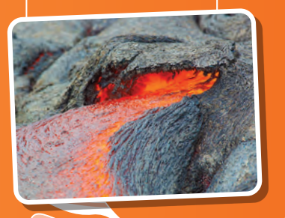
Look and Say.
Notes:
* Listen and read. Track 155
Focus on the pictures and ask what they can see.

Slide 12
Listen
and
Point.
97
Notes:
Play Track 155 for children to listen and follow the text.

Slide 13
Listen and Answer.
97
What is inside the hole in the volcano?
What color is lava?
Where is Mauna Loa?
Notes:
Play the recording again. Ask comprehension questions, e.g. What is inside the hole in the volcano? What color is lava? Where is Mauna Loa?

Slide 14
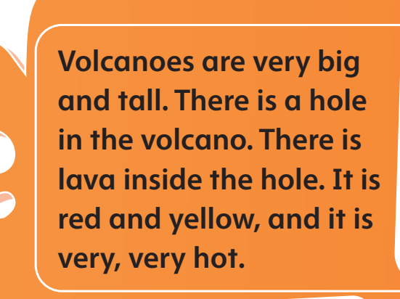
Read again and Write T (true) or F (false).
97
1. Lava is red and yellow.
T
F
Notes:
* Read again and write T (true) or F (false).
Put children into pairs. Explain that together they must decide if the sentences are true or false.
Write the first sentence on the board. Ask the children to find and point to the part of the text that talks about the color of lava. Ask Is the sentence true or false? Write T next to the sentence.

Slide 15
Read again and Write T (true) or F (false).
97
Notes:
Ask children to read the sentences silently.
Children do the exercise individually.

Slide 16
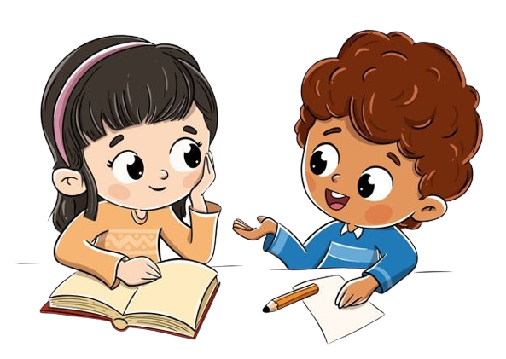
Work in Pairs
Notes:
Children work in pairs to peer-check their answers.

Slide 17
Read again and Write T (true) or F (false).
97
2. It is hot inside the volcano.
T
F
Notes:
Answer
1 T 2 T 3 F 4 F

Slide 18
Read again and Write T (true) or F (false).
97
3. Volcanoes can’t erupt.
T
F
Notes:
Answer
1 T 2 T 3 F 4 F

Slide 19
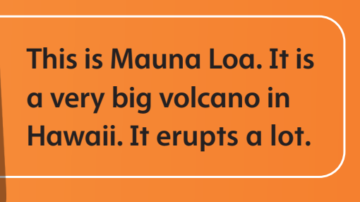
Read again and Write T (true) or F (false).
97
4. Mauna Loa is a little volcano.
T
F
Notes:
Answer
1 T 2 T 3 F 4 F

Slide 20
Good job!

Slide 21
Listen and Answer.
There is a hole in the volcano.
There is a lava inside the hole.
What happens
when the volcano erupts?
The lava is red and yellow. It is very hot.
The lava comes out and goes down the volcano.
Notes:
* What happens when a volcano erupts? Make a poster.
Ask the class the question and make notes on the board.
Make sure they use the new vocabulary in their answers.

Slide 22
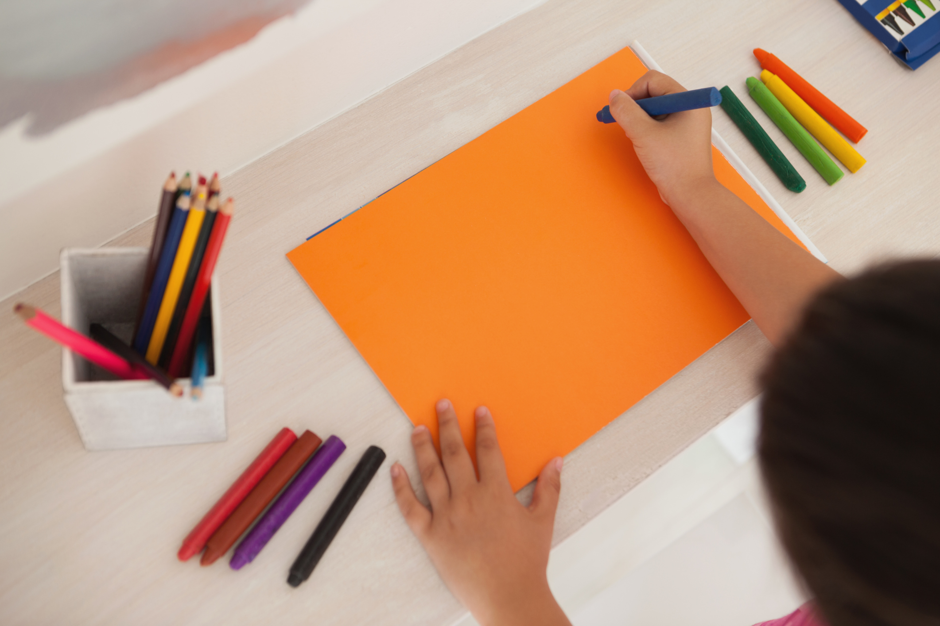
Make a Poster.
Notes:
Divide the class into pairs to draw a picture of a volcano erupting.
Ask the children to label the vocabulary on their poster.

Slide 23
LIVE ON THE STAGE
Notes:
* Talk about their posters.
- Ask the children to talk about their posters to illustrate what floats and sinks in groups and in the front.

Slide 24
Good job!

Slide 25
Look and Color.
Notes:
Children color their smiley faces depending on how well they feel and understand what they have learned in Units 4, 5, and 6, and Fluency Time 2.

Slide 26
Our Winners!
Peter
Eric
Julie
Notes:
Replace photos and names with your students’ information.

Slide 27
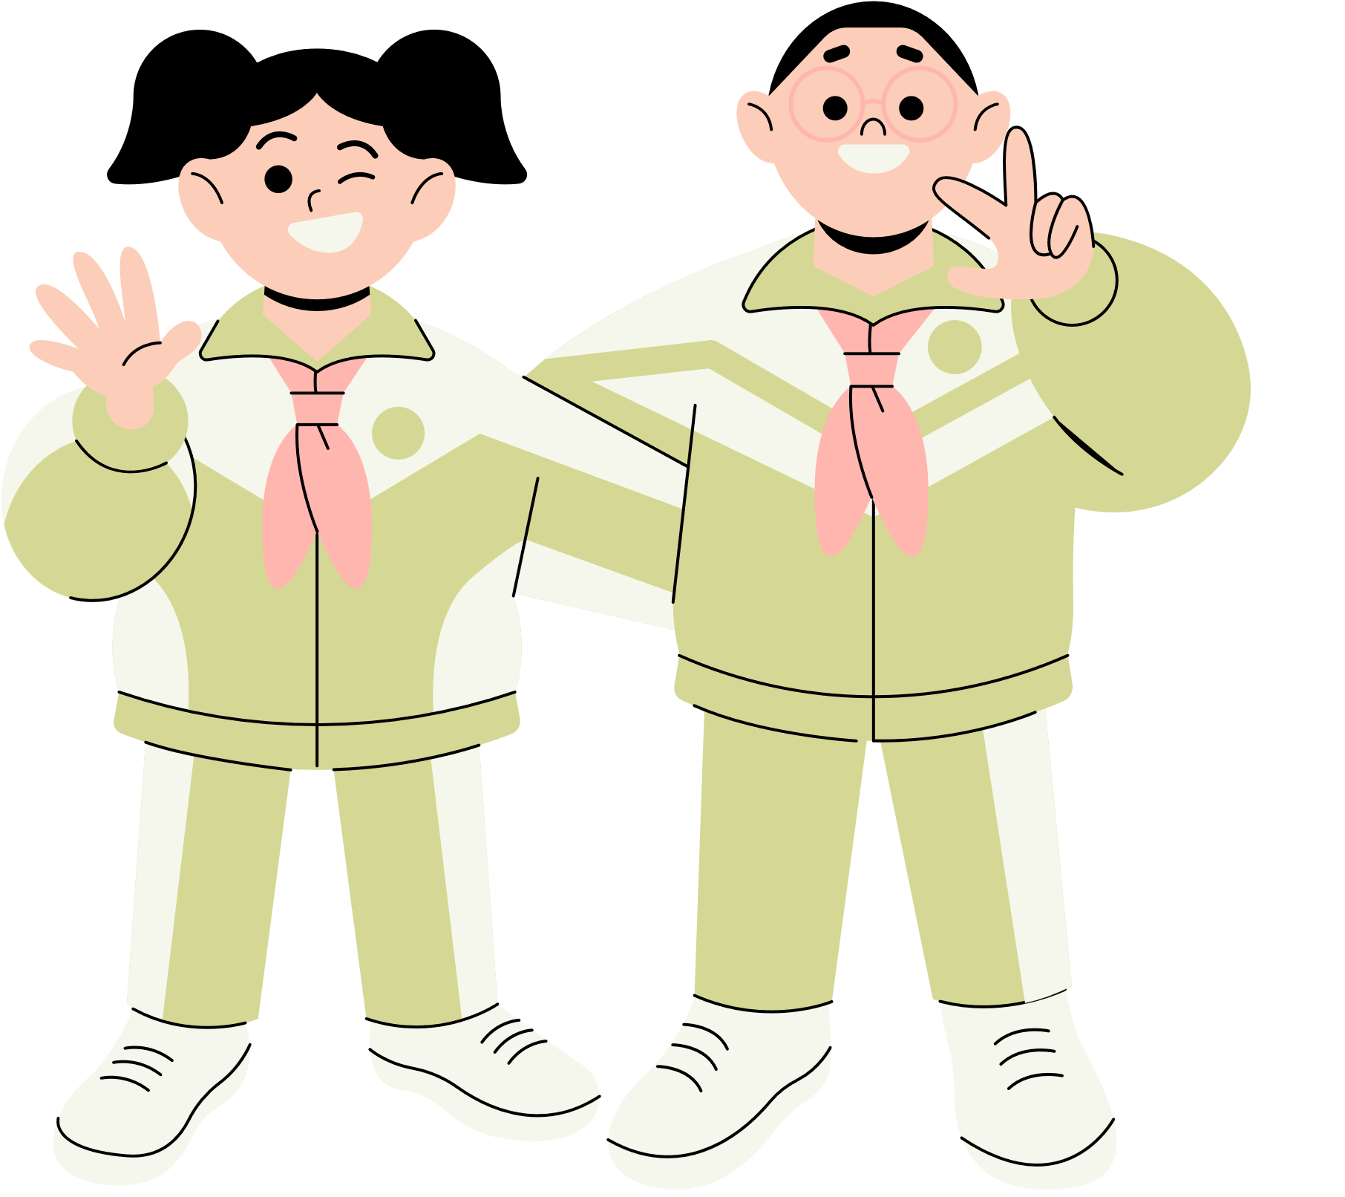
Thank You!
See You Next Time.
Notes:
https://www.youtube.com/watch?v=SRyFiVeNjWs

