Slide 2
Unit 12
A SMART BABY!
Lesson 6 – Skills Time! – Period 1

Slide 3
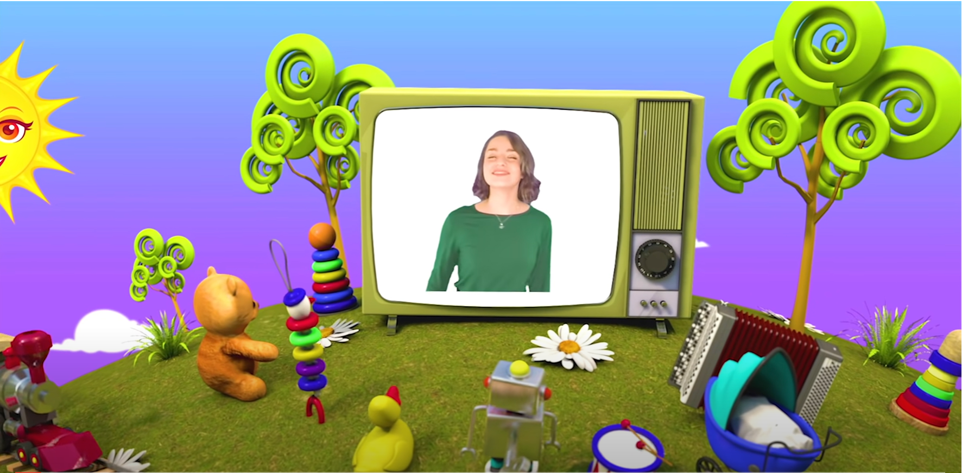
HELLO SONG
Notes:
https://www.youtube.com/watch?v=pqDEwPi7vxg

Slide 4
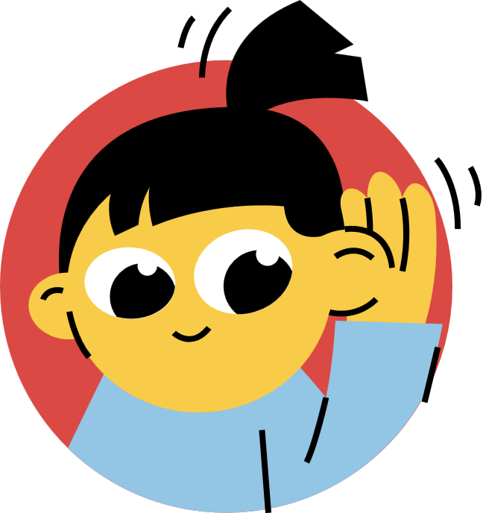

Slide 5
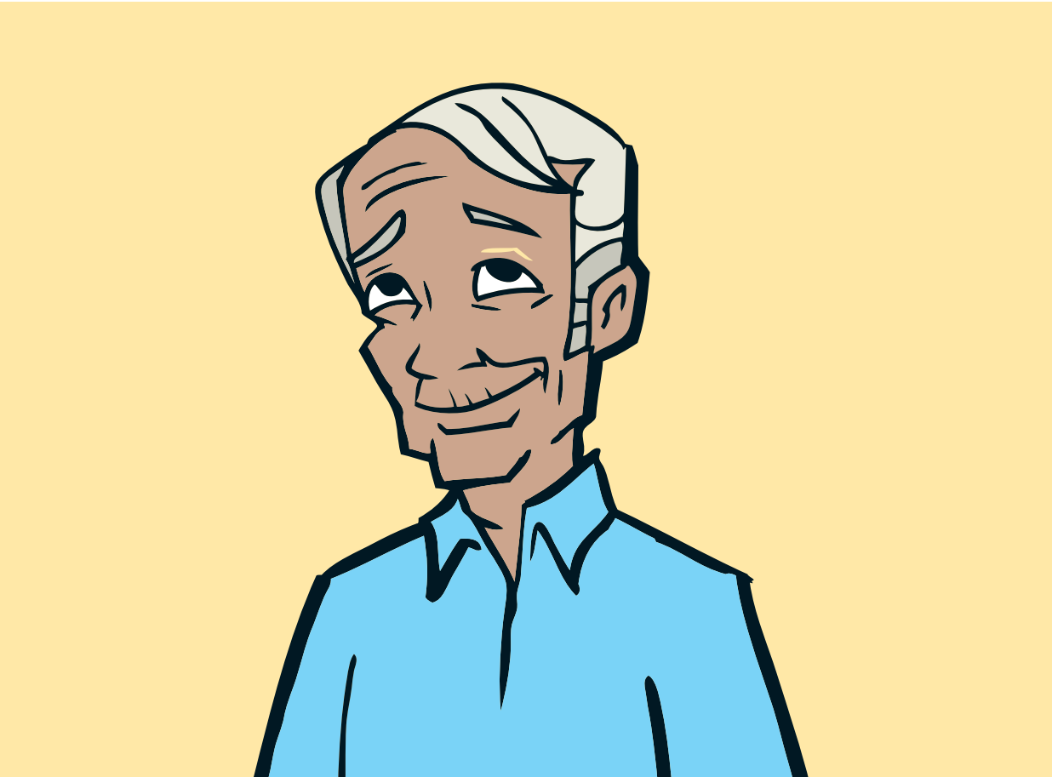
Game: SMILEY FACE!
Let’s guess the letters!
____ ____ ____
O
L
D
Notes:
* Game: Smiley face!
Think of a word from the unit and draw a short line for each letter on the board, one next to the other.
Ask the children to guess the letters that are in the secret word, one-by-one.
If a child guesses a letter correctly, write it on the line.
If a child guesses incorrectly, write the letter on the board with an X through it, and draw a large circle to represent a face. With each letter that is guessed incorrectly, add another feature to the face (two eyes, a nose, a smile, two ears, a neck, and hair).
The game continues until either the word or the face is complete. If the word is complete, the class has won; if the face is complete, the teacher has won.
Divide the class into groups of three or four to continue playing with any new words from the previous lessons.

Slide 6
Game: SMILEY FACE!
Let’s guess the letters!
__ __ __ __ __ __
P
R
E
T
T
Y
Notes:
* Game: Smiley face!
Think of a word from the unit and draw a short line for each letter on the board, one next to the other.
Ask the children to guess the letters that are in the secret word, one-by-one.
If a child guesses a letter correctly, write it on the line.
If a child guesses incorrectly, write the letter on the board with an X through it, and draw a large circle to represent a face. With each letter that is guessed incorrectly, add another feature to the face (two eyes, a nose, a smile, two ears, a neck, and hair).
The game continues until either the word or the face is complete. If the word is complete, the class has won; if the face is complete, the teacher has won.
Divide the class into groups of three or four to continue playing with any new words from the previous lessons.

Slide 7
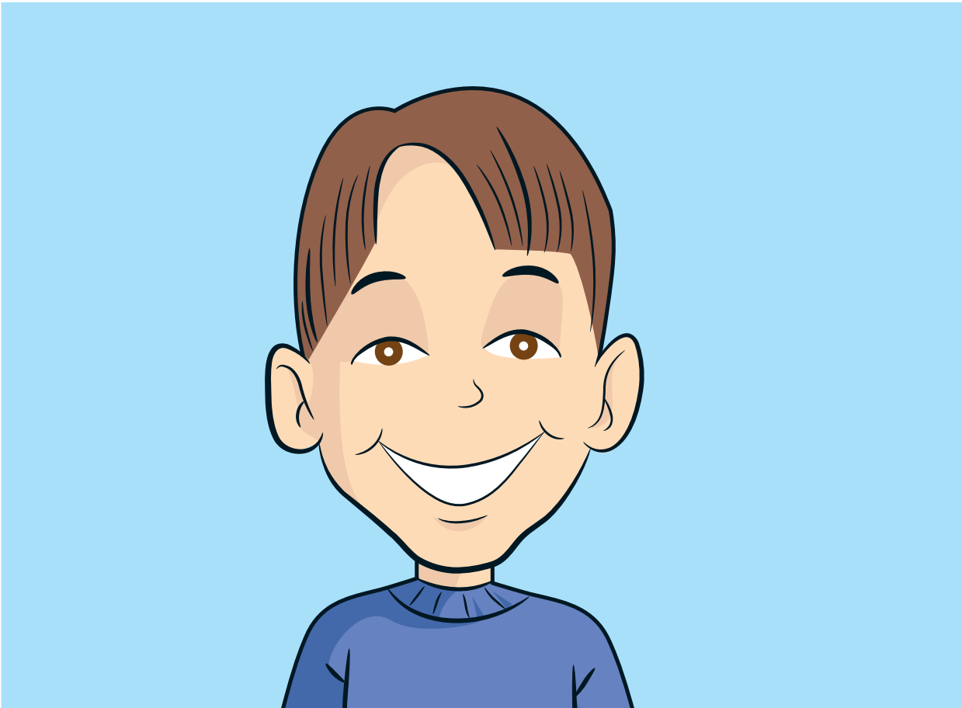
Game: SMILEY FACE!
Let’s guess the letters!
__ __ __ __ __
Y
O
U
N
G
Notes:
* Game: Smiley face!
Think of a word from the unit and draw a short line for each letter on the board, one next to the other.
Ask the children to guess the letters that are in the secret word, one-by-one.
If a child guesses a letter correctly, write it on the line.
If a child guesses incorrectly, write the letter on the board with an X through it, and draw a large circle to represent a face. With each letter that is guessed incorrectly, add another feature to the face (two eyes, a nose, a smile, two ears, a neck, and hair).
The game continues until either the word or the face is complete. If the word is complete, the class has won; if the face is complete, the teacher has won.
Divide the class into groups of three or four to continue playing with any new words from the previous lessons.

Slide 8
Game: SMILEY FACE!
Let’s guess the letters!
__ __ __ __ __ __ __ __
H
A
N
D
S
O
M
E
Notes:
* Game: Smiley face!
Think of a word from the unit and draw a short line for each letter on the board, one next to the other.
Ask the children to guess the letters that are in the secret word, one-by-one.
If a child guesses a letter correctly, write it on the line.
If a child guesses incorrectly, write the letter on the board with an X through it, and draw a large circle to represent a face. With each letter that is guessed incorrectly, add another feature to the face (two eyes, a nose, a smile, two ears, a neck, and hair).
The game continues until either the word or the face is complete. If the word is complete, the class has won; if the face is complete, the teacher has won.
Divide the class into groups of three or four to continue playing with any new words from the previous lessons.

Slide 9
Game: SMILEY FACE!
Let’s guess the letters!
__ __ __ __ __
M
E
S
S
Y
Notes:
* Game: Smiley face!
Think of a word from the unit and draw a short line for each letter on the board, one next to the other.
Ask the children to guess the letters that are in the secret word, one-by-one.
If a child guesses a letter correctly, write it on the line.
If a child guesses incorrectly, write the letter on the board with an X through it, and draw a large circle to represent a face. With each letter that is guessed incorrectly, add another feature to the face (two eyes, a nose, a smile, two ears, a neck, and hair).
The game continues until either the word or the face is complete. If the word is complete, the class has won; if the face is complete, the teacher has won.
Divide the class into groups of three or four to continue playing with any new words from the previous lessons.

Slide 10
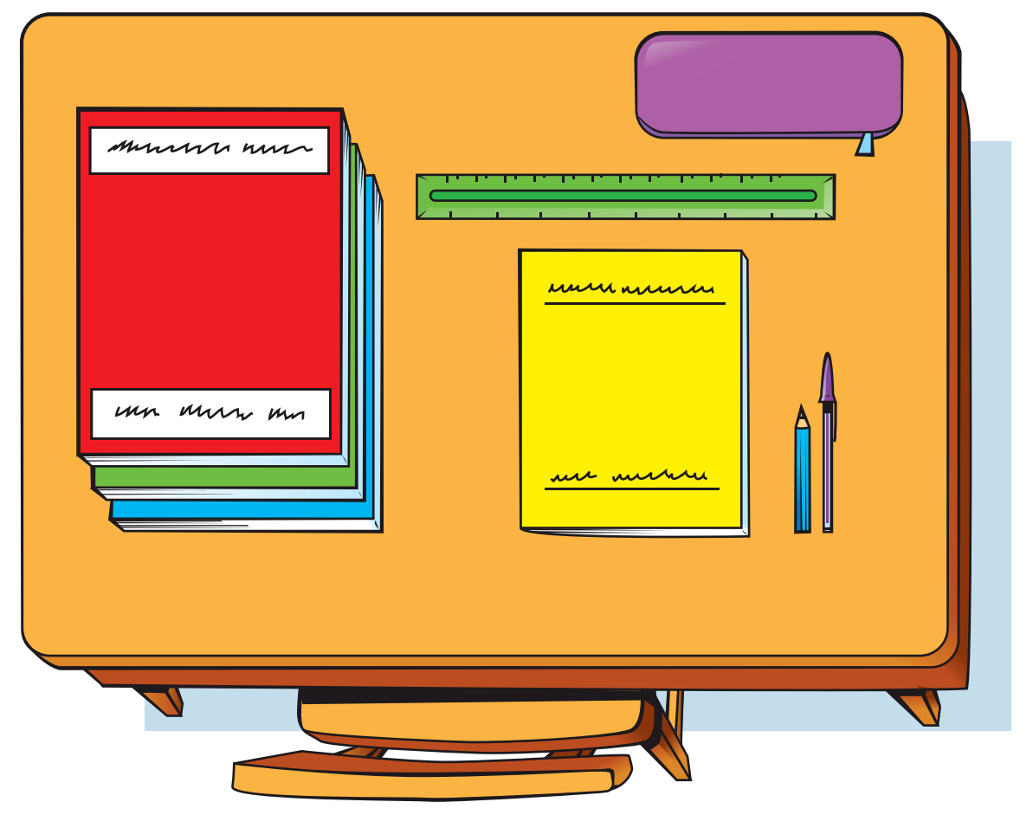
Game: SMILEY FACE!
Let’s guess the letters!
__ __ __ __
N
E
A
T
Notes:
* Game: Smiley face!
Think of a word from the unit and draw a short line for each letter on the board, one next to the other.
Ask the children to guess the letters that are in the secret word, one-by-one.
If a child guesses a letter correctly, write it on the line.
If a child guesses incorrectly, write the letter on the board with an X through it, and draw a large circle to represent a face. With each letter that is guessed incorrectly, add another feature to the face (two eyes, a nose, a smile, two ears, a neck, and hair).
The game continues until either the word or the face is complete. If the word is complete, the class has won; if the face is complete, the teacher has won.
Divide the class into groups of three or four to continue playing with any new words from the previous lessons.

Slide 11
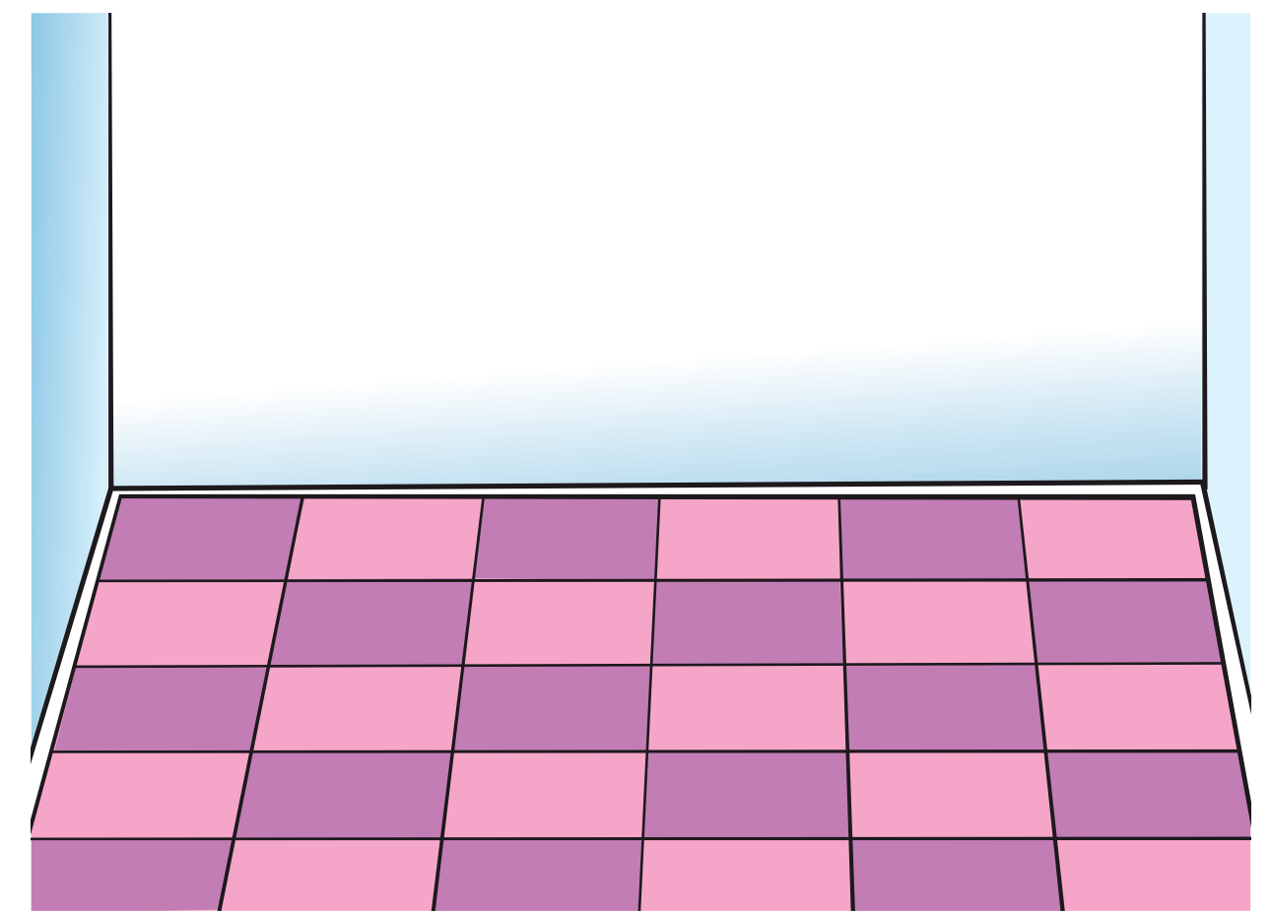
Game: SMILEY FACE!
Let’s guess the letters!
__ __ __ __ __
F
L
O
O
R
Notes:
* Game: Smiley face!
Think of a word from the unit and draw a short line for each letter on the board, one next to the other.
Ask the children to guess the letters that are in the secret word, one-by-one.
If a child guesses a letter correctly, write it on the line.
If a child guesses incorrectly, write the letter on the board with an X through it, and draw a large circle to represent a face. With each letter that is guessed incorrectly, add another feature to the face (two eyes, a nose, a smile, two ears, a neck, and hair).
The game continues until either the word or the face is complete. If the word is complete, the class has won; if the face is complete, the teacher has won.
Divide the class into groups of three or four to continue playing with any new words from the previous lessons.

Slide 12
Good job!

Slide 13
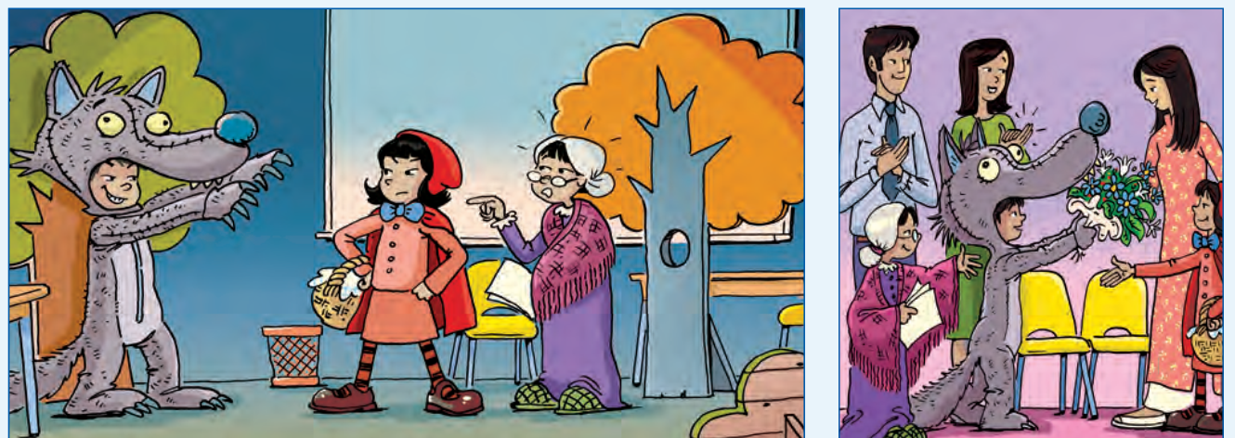
Listen and Answer.
92
Notes:
* Lead-in:
Ask children what they can remember about the text from the previous lesson. Ask What was the play? Who was in it? What were the costumes?
Allow children to check the text on page 92 to see how much they remembered correctly.

Slide 14
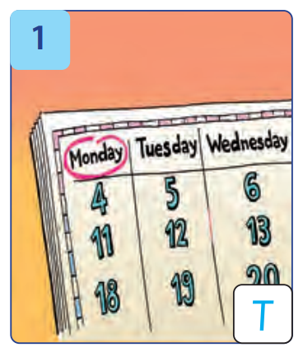
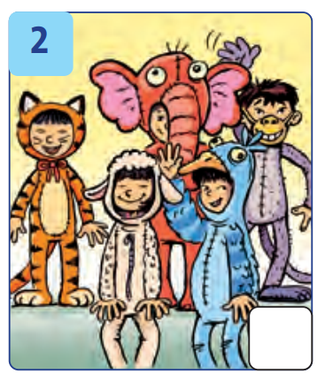
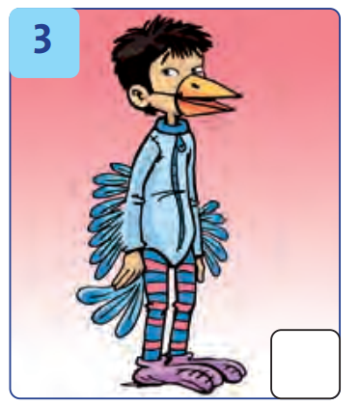
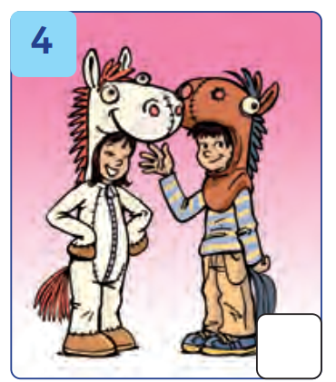
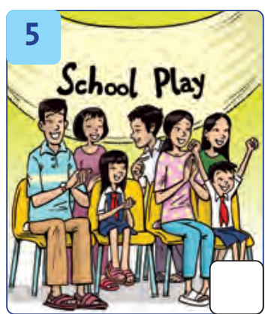
Listen and Answer.
93
A SCHOOL PLAY
Notes:
Ask them to look at the pictures on page 93 in Exercise 1 and tell you what they can see.
Ask them to predict what they will hear (a story about a school play).

Slide 15
Listen and Point.
93
Notes:
* Listen and write T (true) or F (false). Track 150
Tell the children they are going to listen to a recording of a girl talking about her school play. Explain that they need to listen and decide whether the pictures show the correct information.
Play Track 150 for children to listen and point to the pictures.

Slide 16
Listen and Write.
93
T
Notes:
Play the recording a second time for children to decide whether the pictures show the correct information. Stop the recording after the first sentence. Show children the first picture and ask Is this true or false? (True). Point out the letter T in the box.
Continue to play the recording for children to complete their answers.

Slide 17
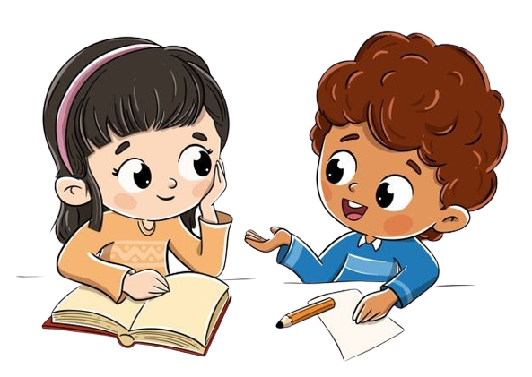
Work in Pairs
Notes:
Children work in pairs to peer-check their answers.

Slide 18
Let’s check!
93
T
F
F
T
T
Notes:
Answers 1 T 2 F 3 F 4 T 5 T

Slide 19
Look and Say.
Notes:
* Look and say.
Children look at the words and say them aloud.

Slide 20
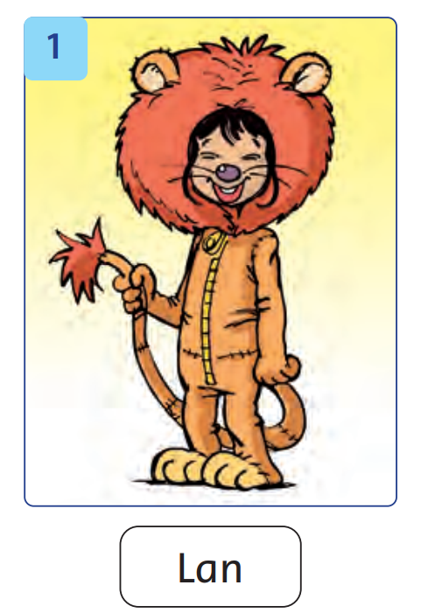
Look and Say.
Look at Lan.
She was a lion.
Her costume was orange.
Notes:
* Look and say.
Children look at the picture of Lan and talk about her costume.

Slide 21
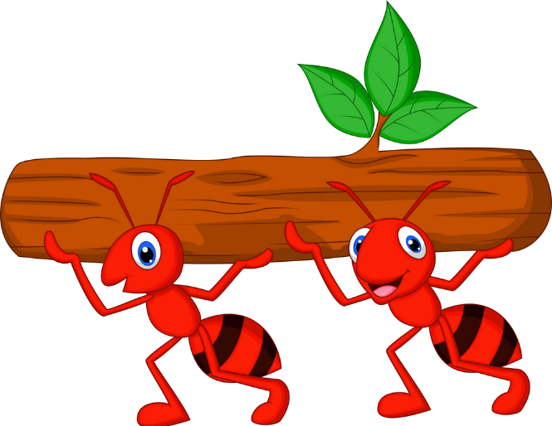
The Hard Ants
PLAY
Notes:
In pairs, children take turns pointing to the pictures and then make sentences about what the children were in the play and what color their costume was.

Slide 22
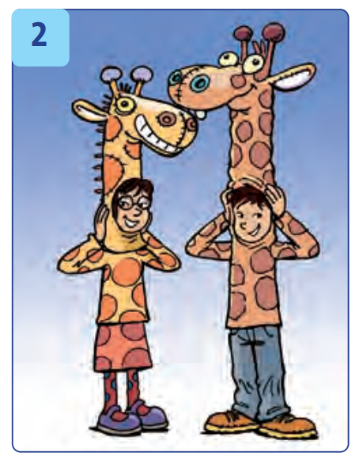
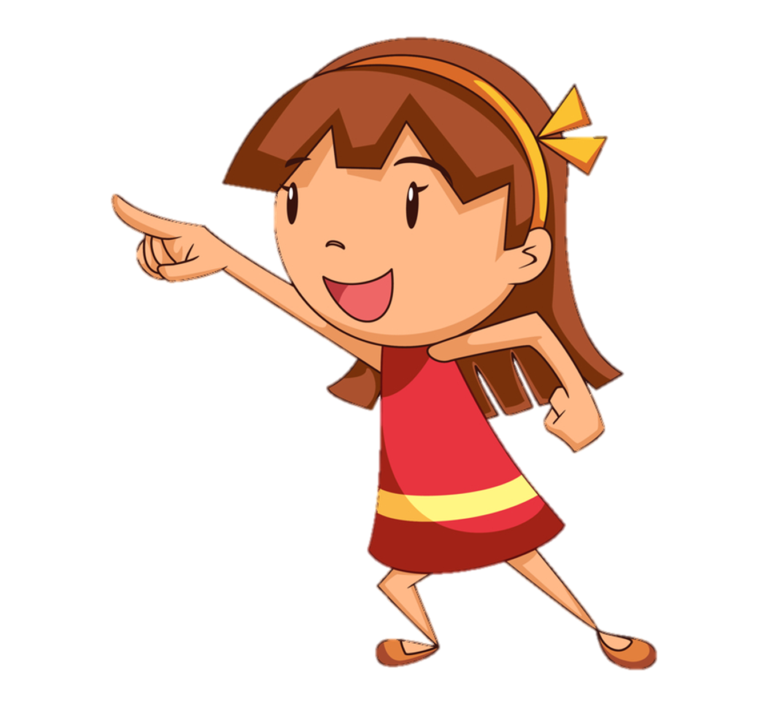
Look at Mai and Minh.
They were giraffes.
Their costumes were orange and brown.
Next
Notes:
In pairs, children take turns pointing to the pictures and then make sentences about what the children were in the play and what color their costume was.

Slide 23
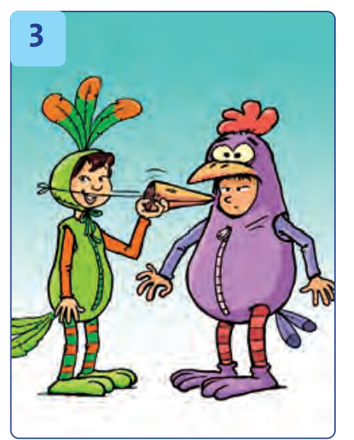
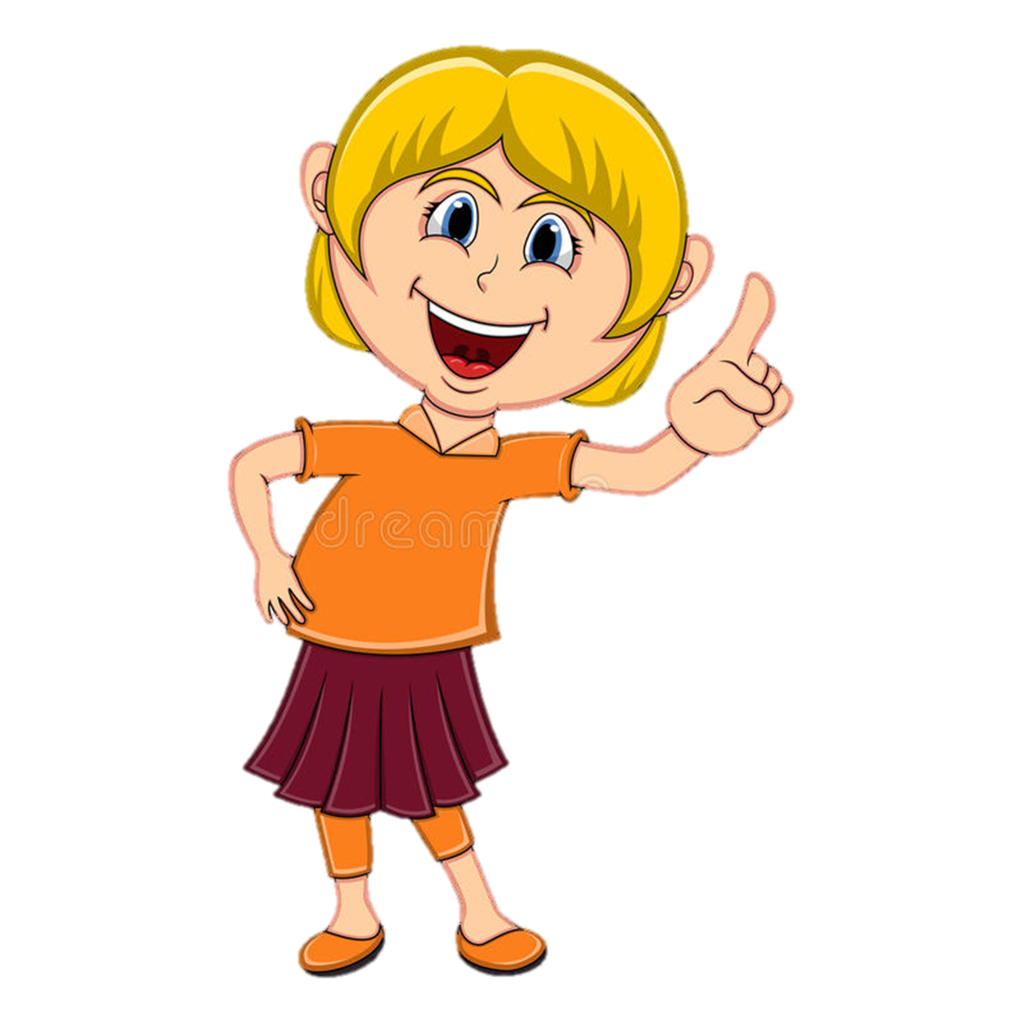
Look at Linh and Giang.
They were birds.
Their costumes were green and purple.
Next
Notes:
In pairs, children take turns pointing to the pictures and then make sentences about what the children were in the play and what color their costume was.

Slide 24
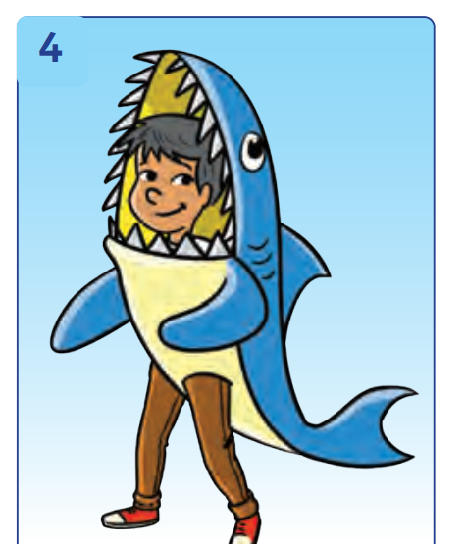
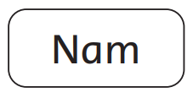
Look at Nam.
He was a fish.
His costume was blue.
Next
Notes:
In pairs, children take turns pointing to the pictures and then make sentences about what the children were in the play and what color their costume was.

Slide 25
WELL DONE!

Slide 26
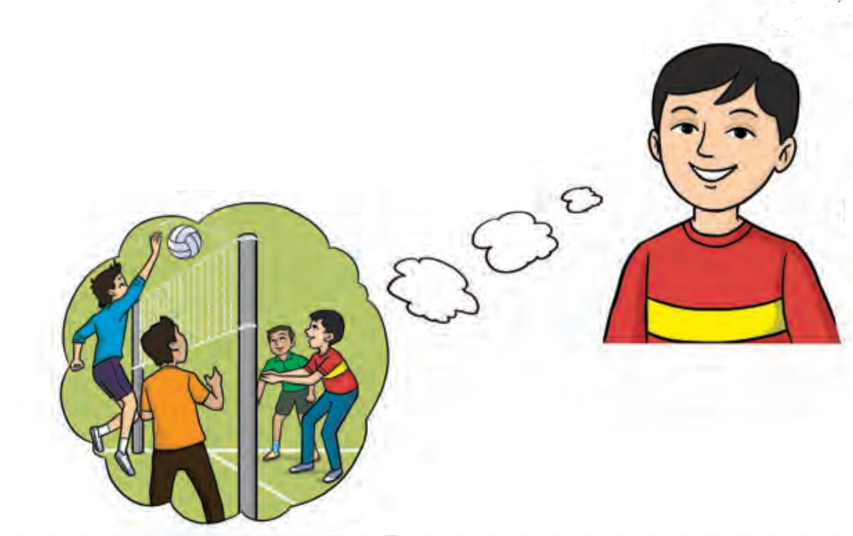
Game:
TALK ABOUT WHERE YOU WERE YESTERDAY!
Yesterday I was at school with my friends.
Notes:
* Talk about where you were yesterday.
Ask a child to read the speech bubble.
In pairs, children tell each other where they were yesterday, following the pattern in the speech bubble.

Slide 27
Our Winners!
Peter
Eric
Julie
Notes:
Replace photos and names with your students’ information.

Slide 28
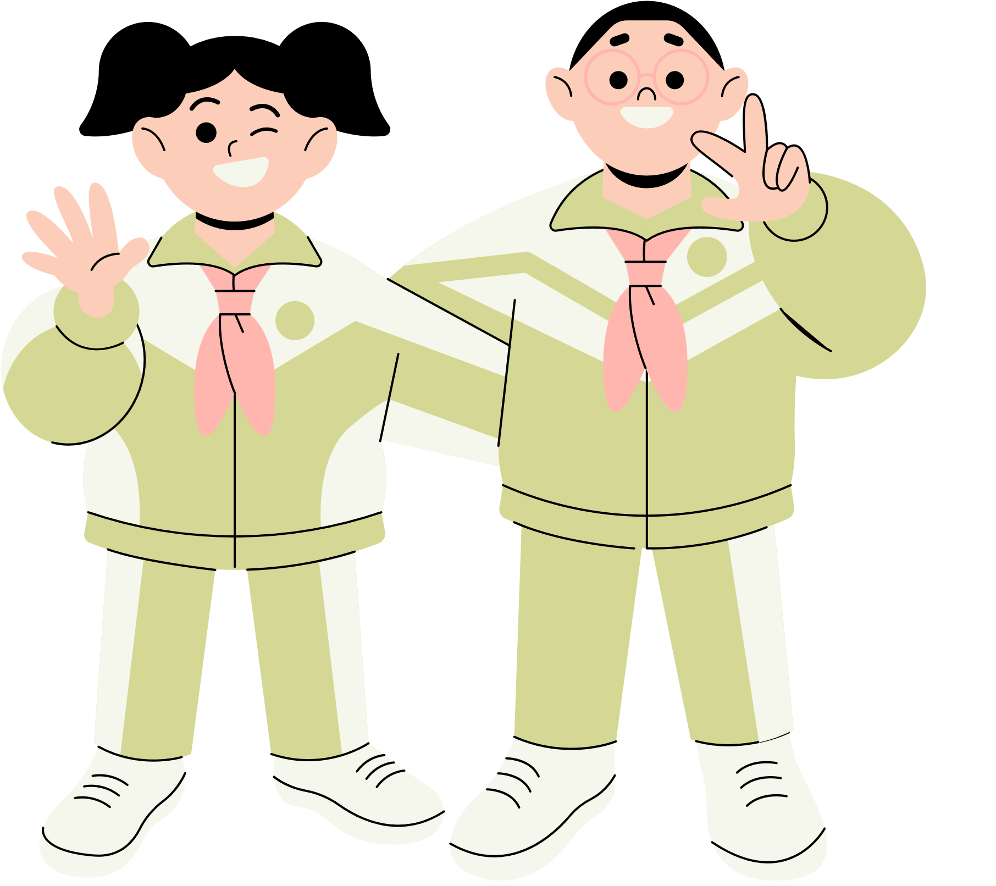
Thank You!
See You Next Time!
Notes:
https://www.youtube.com/watch?v=SRyFiVeNjWs

