Slide 2
Unit 10
Do they like fishing?
Lesson 4 – Phonics

Slide 3
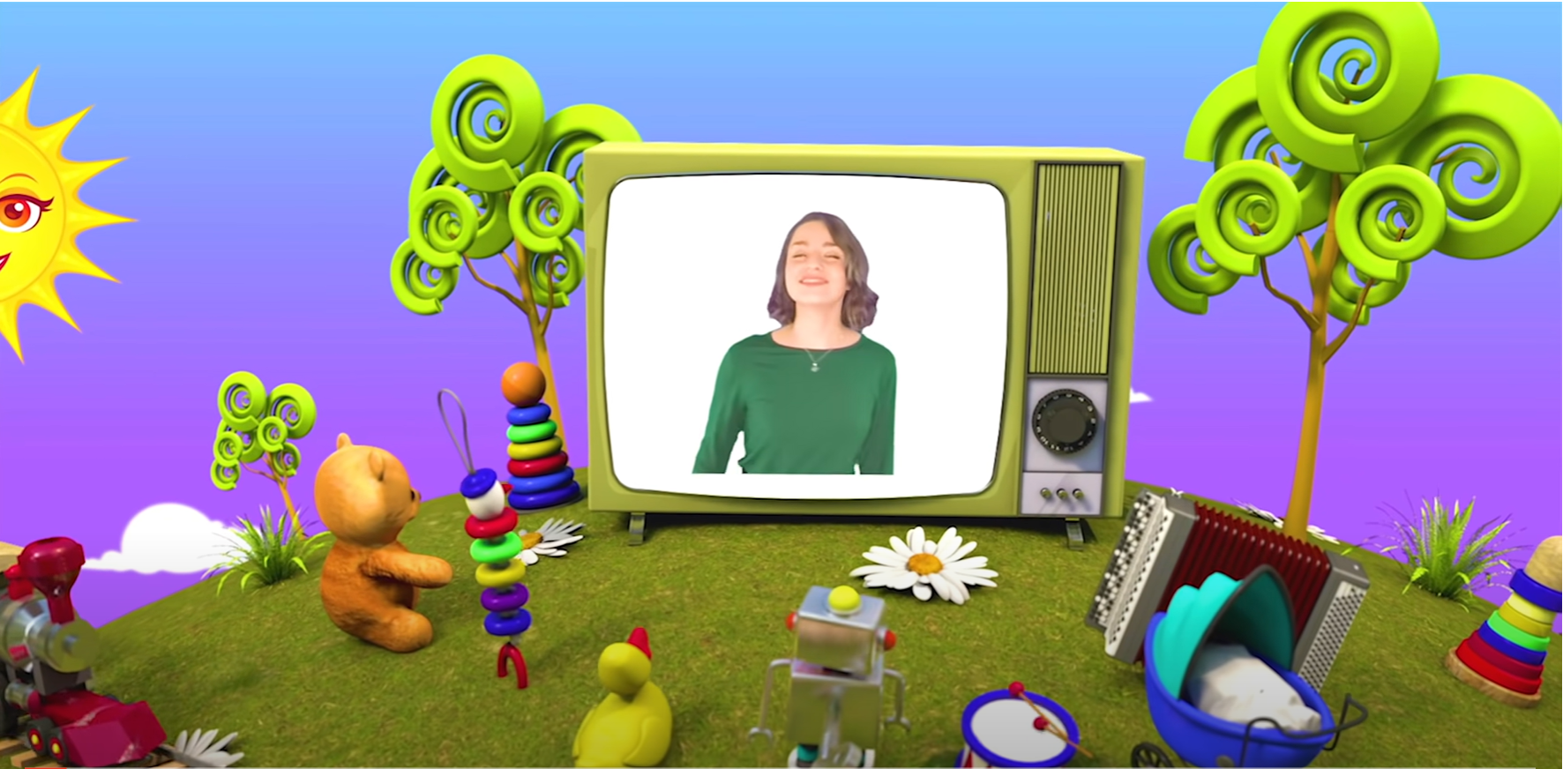
HELLO SONG

Slide 5
Think and Say
u_e
ou
oo
ew
cube
soup
look
few
tube
you
book
new
Notes:
* Warmer
Ask children if they can remember the sounds from the previous phonics lesson (/uː/, /ʊ/, and /juː/). Say the words flute, you, foot, new to help them remember.

Slide 6
Let’s chant and do the actions!
69
Notes:
Say the chant from page 69 to energize the class.

Slide 7
Good job!

Slide 8
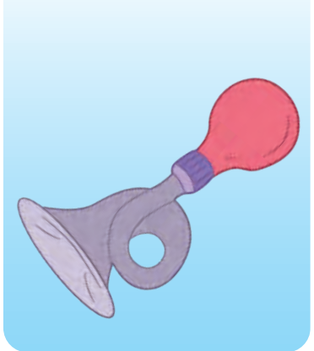
Listen and Repeat.
or
horn
Notes:
* Lead-in:
Teach the sounds for this lesson, using the phonics cards.
Hold up the phonics card for the sound /ɔː/ (horn, corn, storm) and say the words for the children to repeat.
Repeat with the phonics cards for the sound /ɑː/ (car, farm, star).

Slide 9
Listen and Repeat.
or
corn
Notes:
* Lead-in:
Teach the sounds for this lesson, using the phonics cards.
Hold up the phonics card for the sound /ɔː/ (horn, corn, storm) and say the words for the children to repeat.
Repeat with the phonics cards for the sound /ɑː/ (car, farm, star).

Slide 10
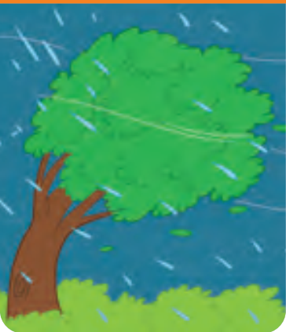
Listen and Repeat.
or
storm
Notes:
* Lead-in:
Teach the sounds for this lesson, using the phonics cards.
Hold up the phonics card for the sound /ɔː/ (horn, corn, storm) and say the words for the children to repeat.
Repeat with the phonics cards for the sound /ɑː/ (car, farm, star).

Slide 11
Listen and Repeat.
ar
car
Notes:
* Lead-in:
Teach the sounds for this lesson, using the phonics cards.
Hold up the phonics card for the sound /ɔː/ (horn, corn, storm) and say the words for the children to repeat.
Repeat with the phonics cards for the sound /ɑː/ (car, farm, star).

Slide 12
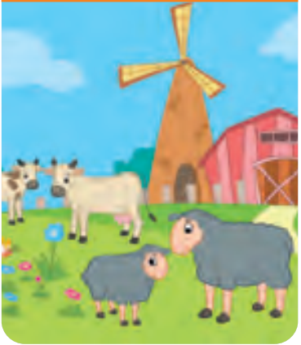
Listen and Repeat.
ar
farm
Notes:
* Lead-in:
Teach the sounds for this lesson, using the phonics cards.
Hold up the phonics card for the sound /ɔː/ (horn, corn, storm) and say the words for the children to repeat.
Repeat with the phonics cards for the sound /ɑː/ (car, farm, star).

Slide 13
Listen and Repeat.
ar
star
Notes:
* Lead-in:
Teach the sounds for this lesson, using the phonics cards.
Hold up the phonics card for the sound /ɔː/ (horn, corn, storm) and say the words for the children to repeat.
Repeat with the phonics cards for the sound /ɑː/ (car, farm, star).

Slide 14
Listen and Point.
79
Notes:
* Listen, point, and repeat. Track 125
Ask children to look at the pictures in their books.
Play the first part of Track 125 for children to listen and point to the pictures.

Slide 15
Listen and Repeat.
79
Notes:
Play the second part of the recording for children to repeat.

Slide 16
Listen and Repeat.
79
Notes:
Play the whole recording. Children point and then repeat.

Slide 17
Look and Answer.
What can you see?
79
Notes:
* Listen and chant. Track 112
Ask children to look at the picture. Ask What can you see? (a boy); What does he have? (a scarf, a toy shark); Where is the boy? (in the car).

Slide 18
Listen and Point.
79
Notes:
Play Track 126 for children to listen to the chant.
Play the chant again, pausing for children to repeat.

Slide 19
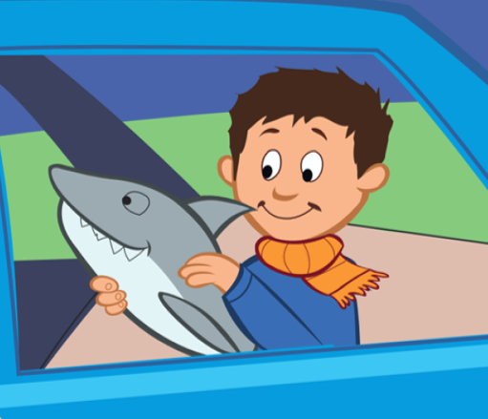
Listen and Repeat.
We’re in the car,
After playing in the park.
I have a short scarf.
I have a toy shark.
Here comes a storm.
It’s getting dark.
Notes:
Ask children to listen and repeat line by line.
Put the phonics cards around the room.
Play the recording for children to point to the cards.

Slide 20
Listen and Chant.
79
Notes:
Play the recording again and ask children to chant along with actions in groups and in the front.

Slide 21
Read and Say the words. Write.
or
ar
We’re in the car.
Notes:
* Read the chant again. Say the words with ar and or. Write.
Write the first line of the chant on the board. Ask a child to come and find an example of the sound /ɑː/. They find and circle car.

Slide 22
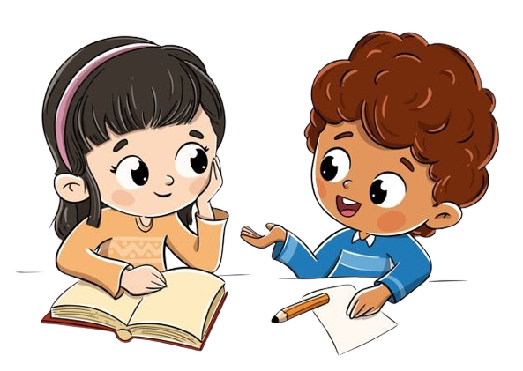
Work in Pairs
Notes:
Children read the chant silently and only say the words with ar and or out loud.
Children write the ar and or words in their notebooks.

Slide 23
Let’s check!
or
ar
After playing in the park.
Notes:
Answers
car park short scarf shark storm dark

Slide 24
Let’s check!
or
ar
I have a short scarf.
Notes:
Answers
car park short scarf shark storm dark

Slide 25
Let’s check!
or
ar
I have a toy shark.
Notes:
Answers
car park short scarf shark storm dark

Slide 26
Let’s check!
or
ar
Here comes a storm.
Notes:
Answers
car park short scarf shark storm dark

Slide 27
Let’s check!
or
ar
It’s getting dark.
Notes:
Answers
car park short scarf shark storm dark

Slide 28
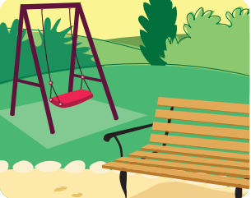
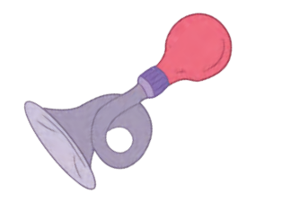
Look and Say.
Notes:
* Listen and write the missing letters. Match. Track 127.
Ask children to look at the pictures and say what they see.
Click each picture to hear the sound.

Slide 29
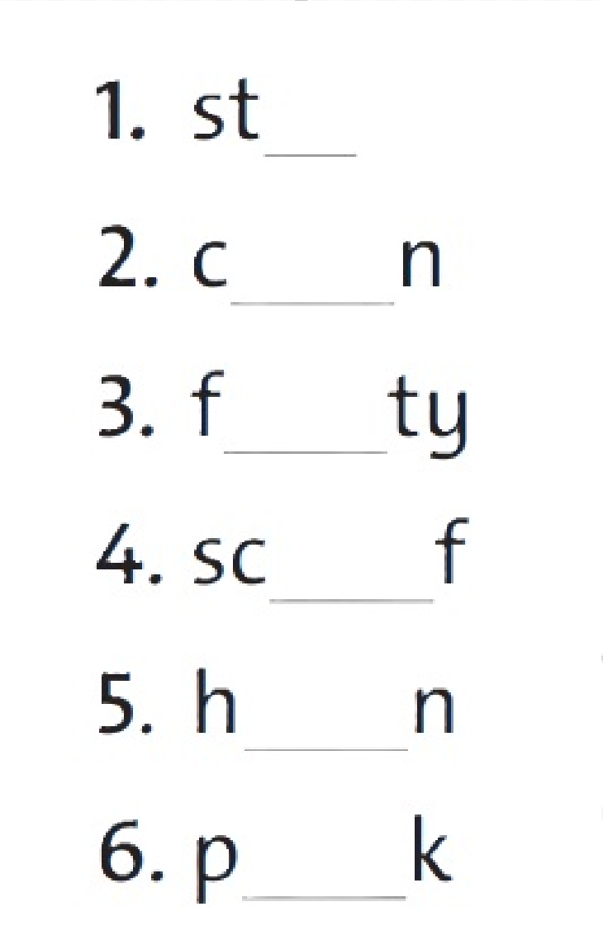
Listen, Write and Match.
ar
Notes:
Do number 1 as an example with the whole class.
Ask children to listen and write the missing letters for each word and match each word to the correct picture.

Slide 30
Work in Pairs
Notes:
Then work in pairs to peer-check their answers.

Slide 31
Let’s check!
ar
or
Notes:
Answers
1 star 2 corn 3 forty 4 scarf 5 horn 6 park

Slide 32
Let’s check!
ar
or
or
Notes:
Answers
1 star 2 corn 3 forty 4 scarf 5 horn 6 park

Slide 33
Let’s check!
ar
or
or
ar
Notes:
Answers
1 star 2 corn 3 forty 4 scarf 5 horn 6 park

Slide 34
Let’s check!
ar
or
or
ar
or
Notes:
Answers
1 star 2 corn 3 forty 4 scarf 5 horn 6 park

Slide 35
Let’s check!
ar
or
or
ar
or
ar
Notes:
Answers
1 star 2 corn 3 forty 4 scarf 5 horn 6 park

Slide 36
Let’s talk!
There are
lots of stars.
Notes:
* Let’s talk
Ask children to look at the picture and speech bubble. Say There are a lot of stars!
Ask a child to read the sentence.
In pairs, children take turns saying the sentence, using other vocabulary words on the page.

Slide 37
Sentence
Building

Slide 38
Choose a number,
say and write.

Slide 39
1
6
7
2
3
8
4
9
5
10

Slide 40
car

Slide 41
corn

Slide 42
storm

Slide 43
park

Slide 44
forty

Slide 45
horn

Slide 46
scarf

Slide 47
shark

Slide 48
short

Slide 49
farm

Slide 51
Our Winners!
Peter
Eric
Julie
Notes:
Replace photos and names with your students’ information.

Slide 52
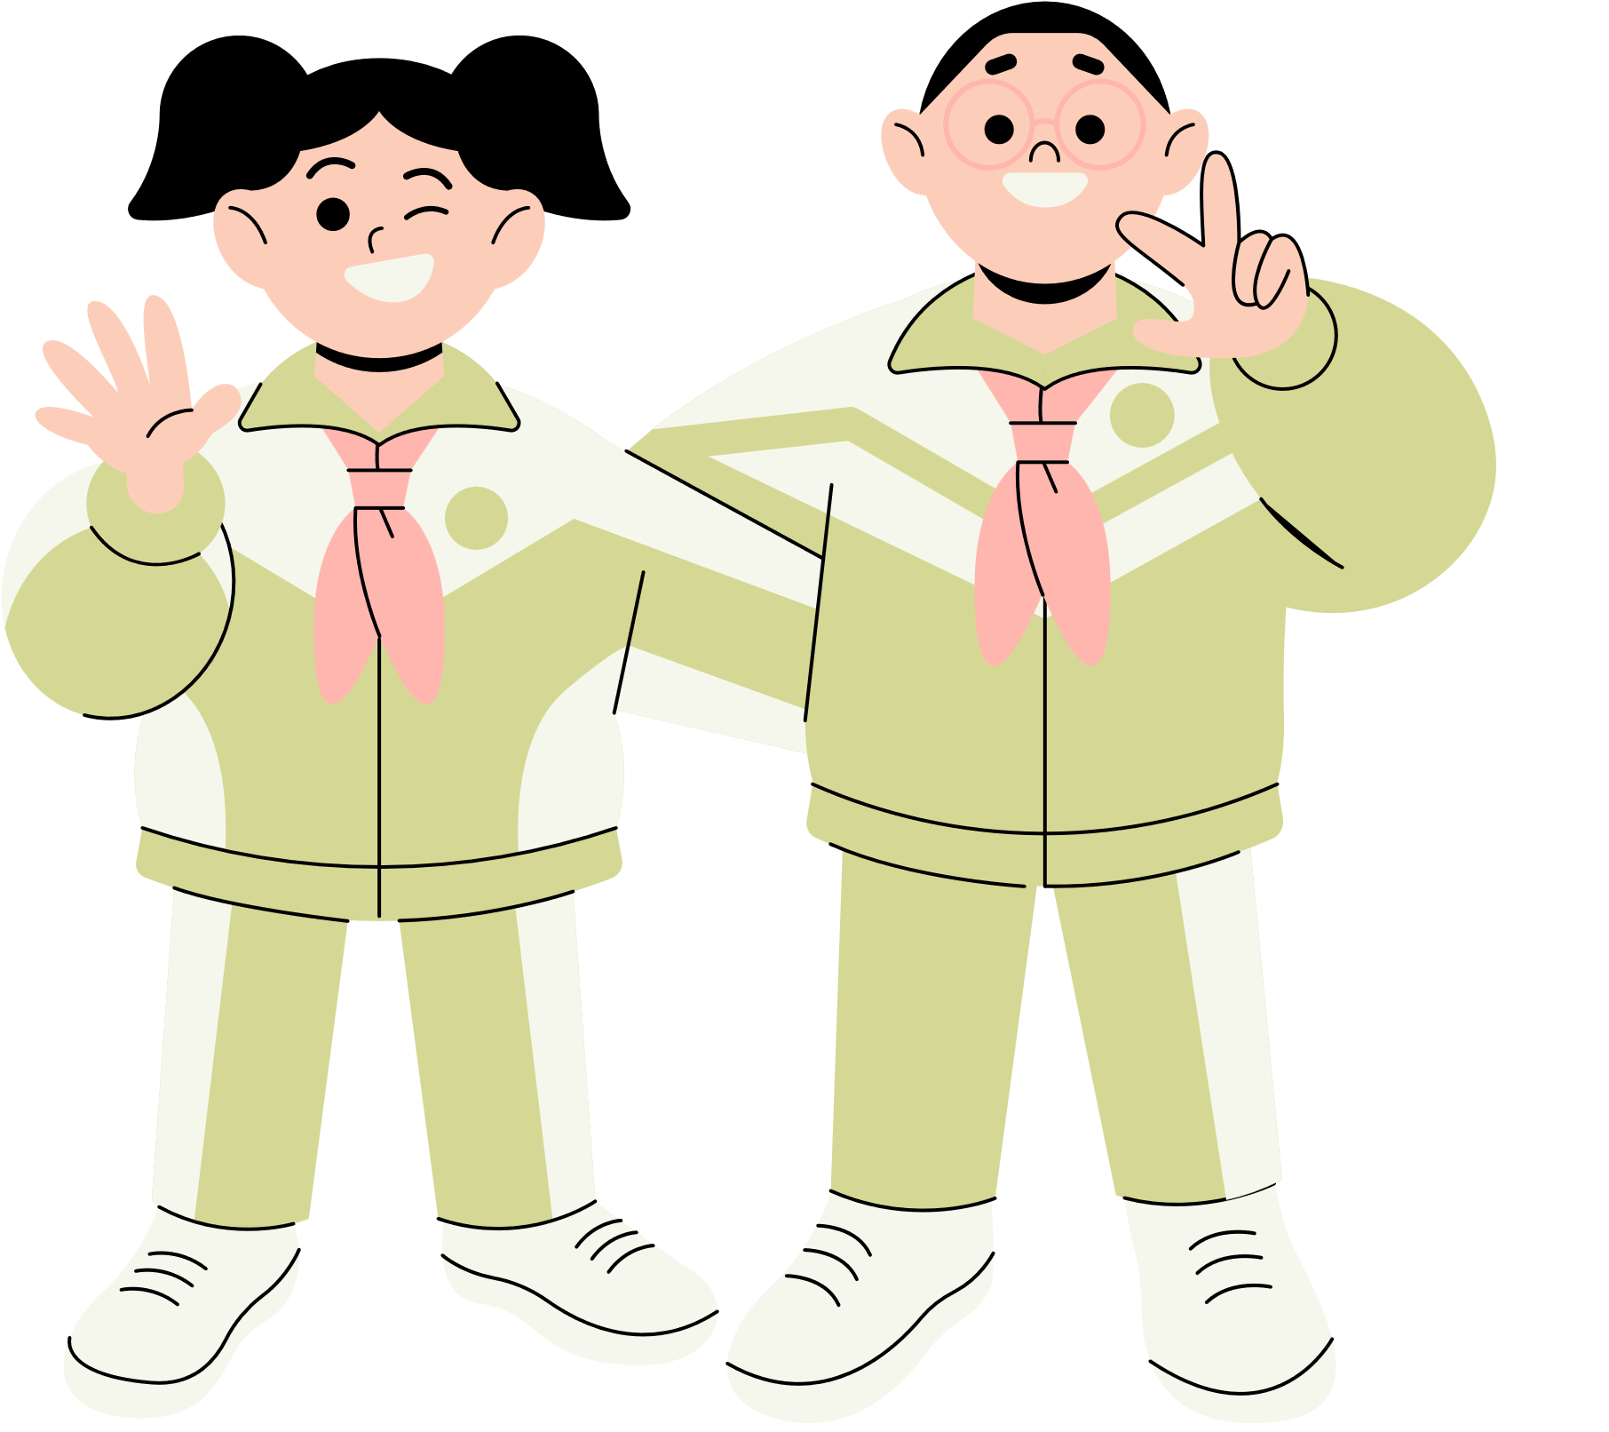
Thank You!
See You Next Time!
Notes:
https://www.youtube.com/watch?v=SRyFiVeNjWs

