Slide 2








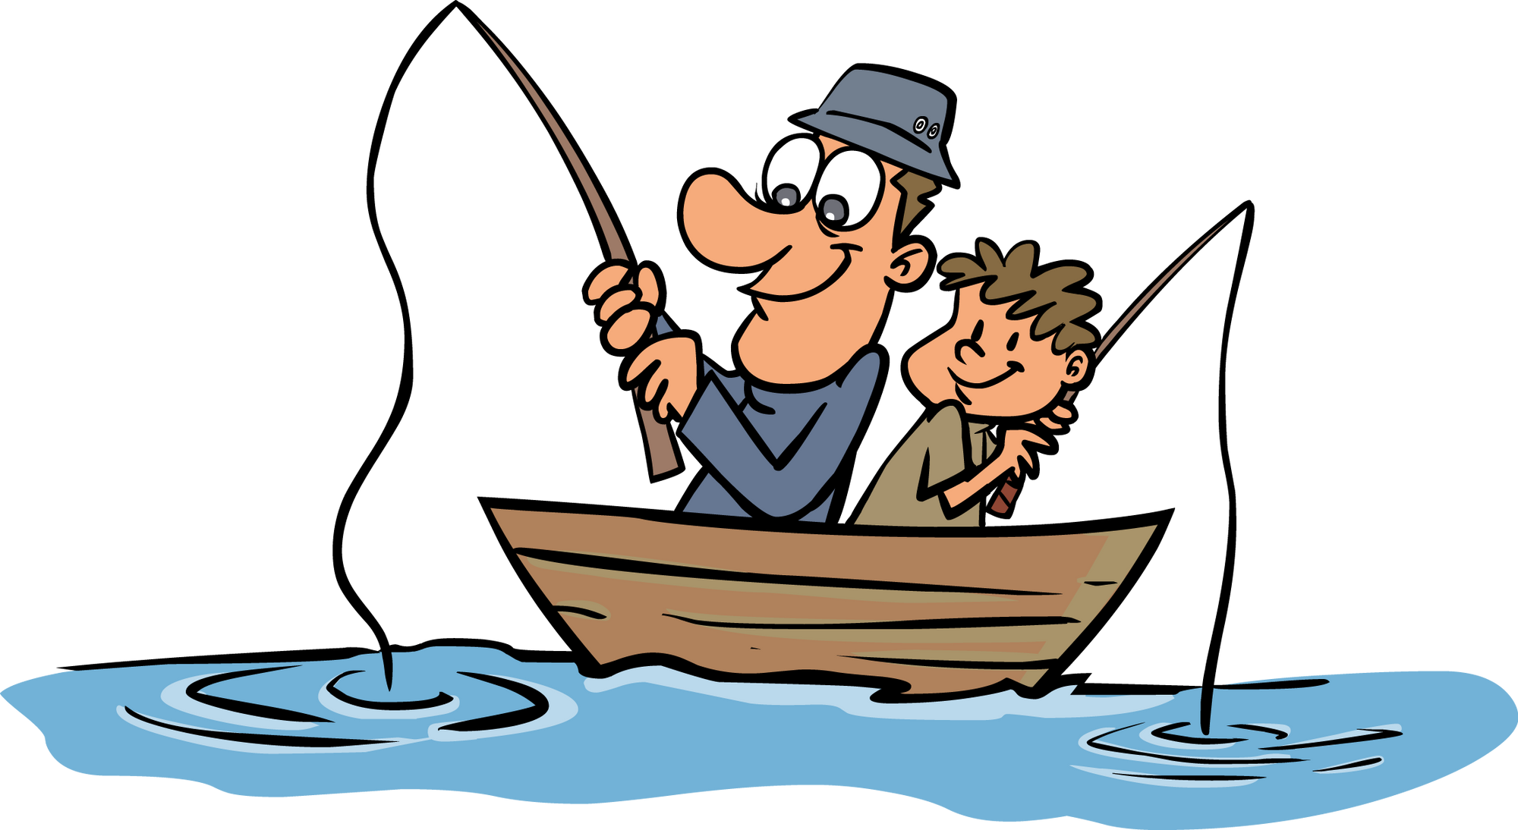

Unit 10
Do they like fishing?
Lesson 2 – Grammar – Period 2

Slide 3
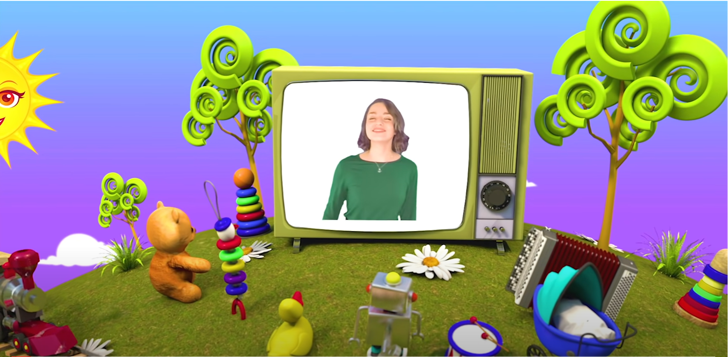
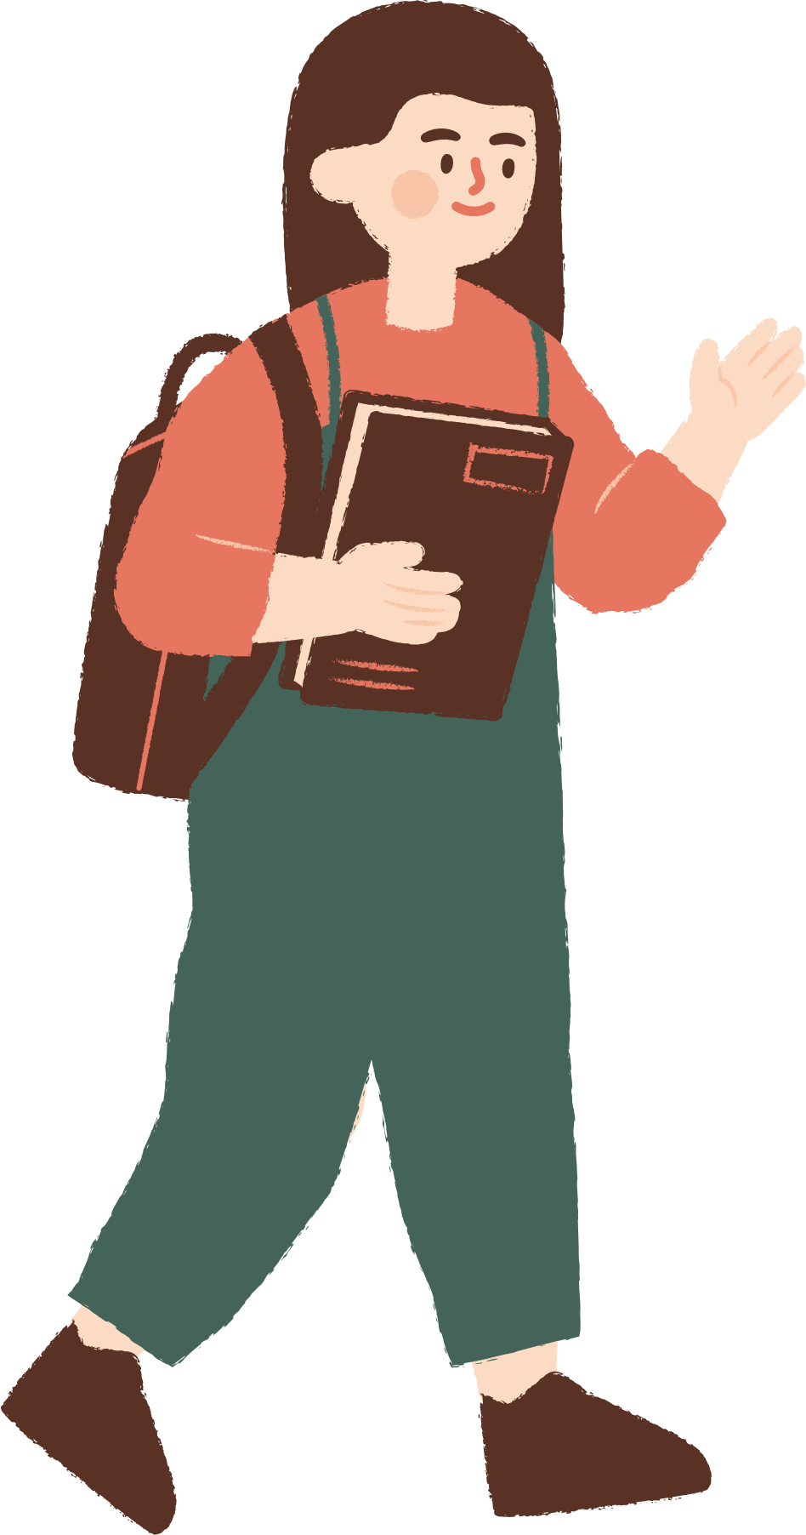

HELLO SONG

Slide 4
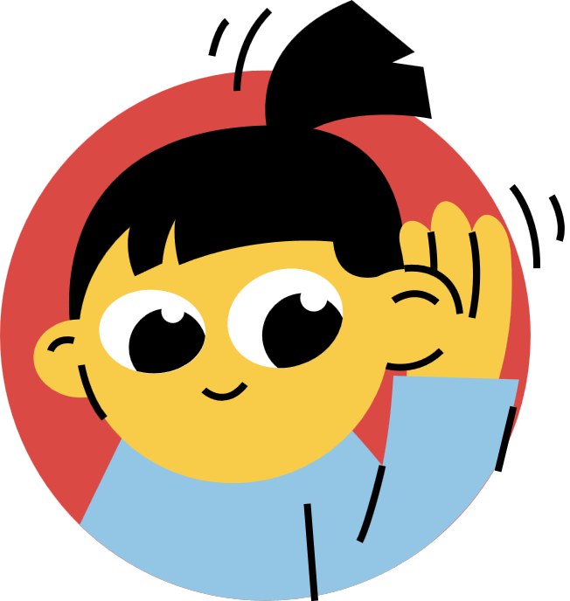


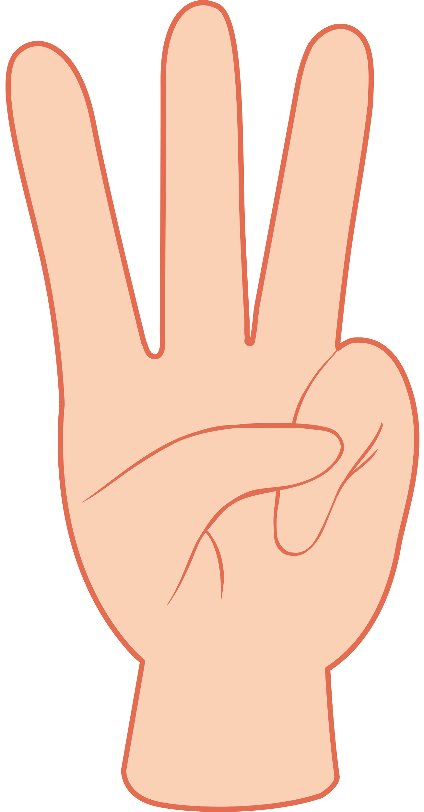



Slide 5


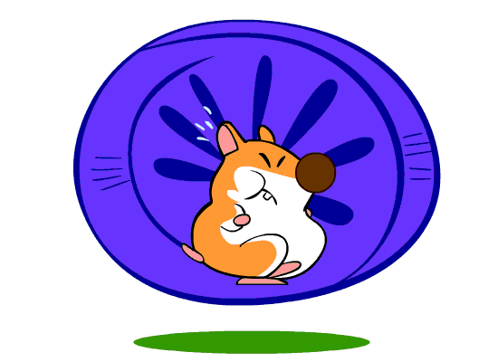


Game
HAMSTER
Look, Read and Choose the correct sentence.

Slide 6






1
8
2
1. They like reading comics.
2. They like talking.
7
3
3. They like fishing.
4. They don’t like reading comics.
6
4
5. They don’t like talking.
5
6. They like playing chess.
7. They like playing volleyball.
8. They like playing basketball.

Slide 7
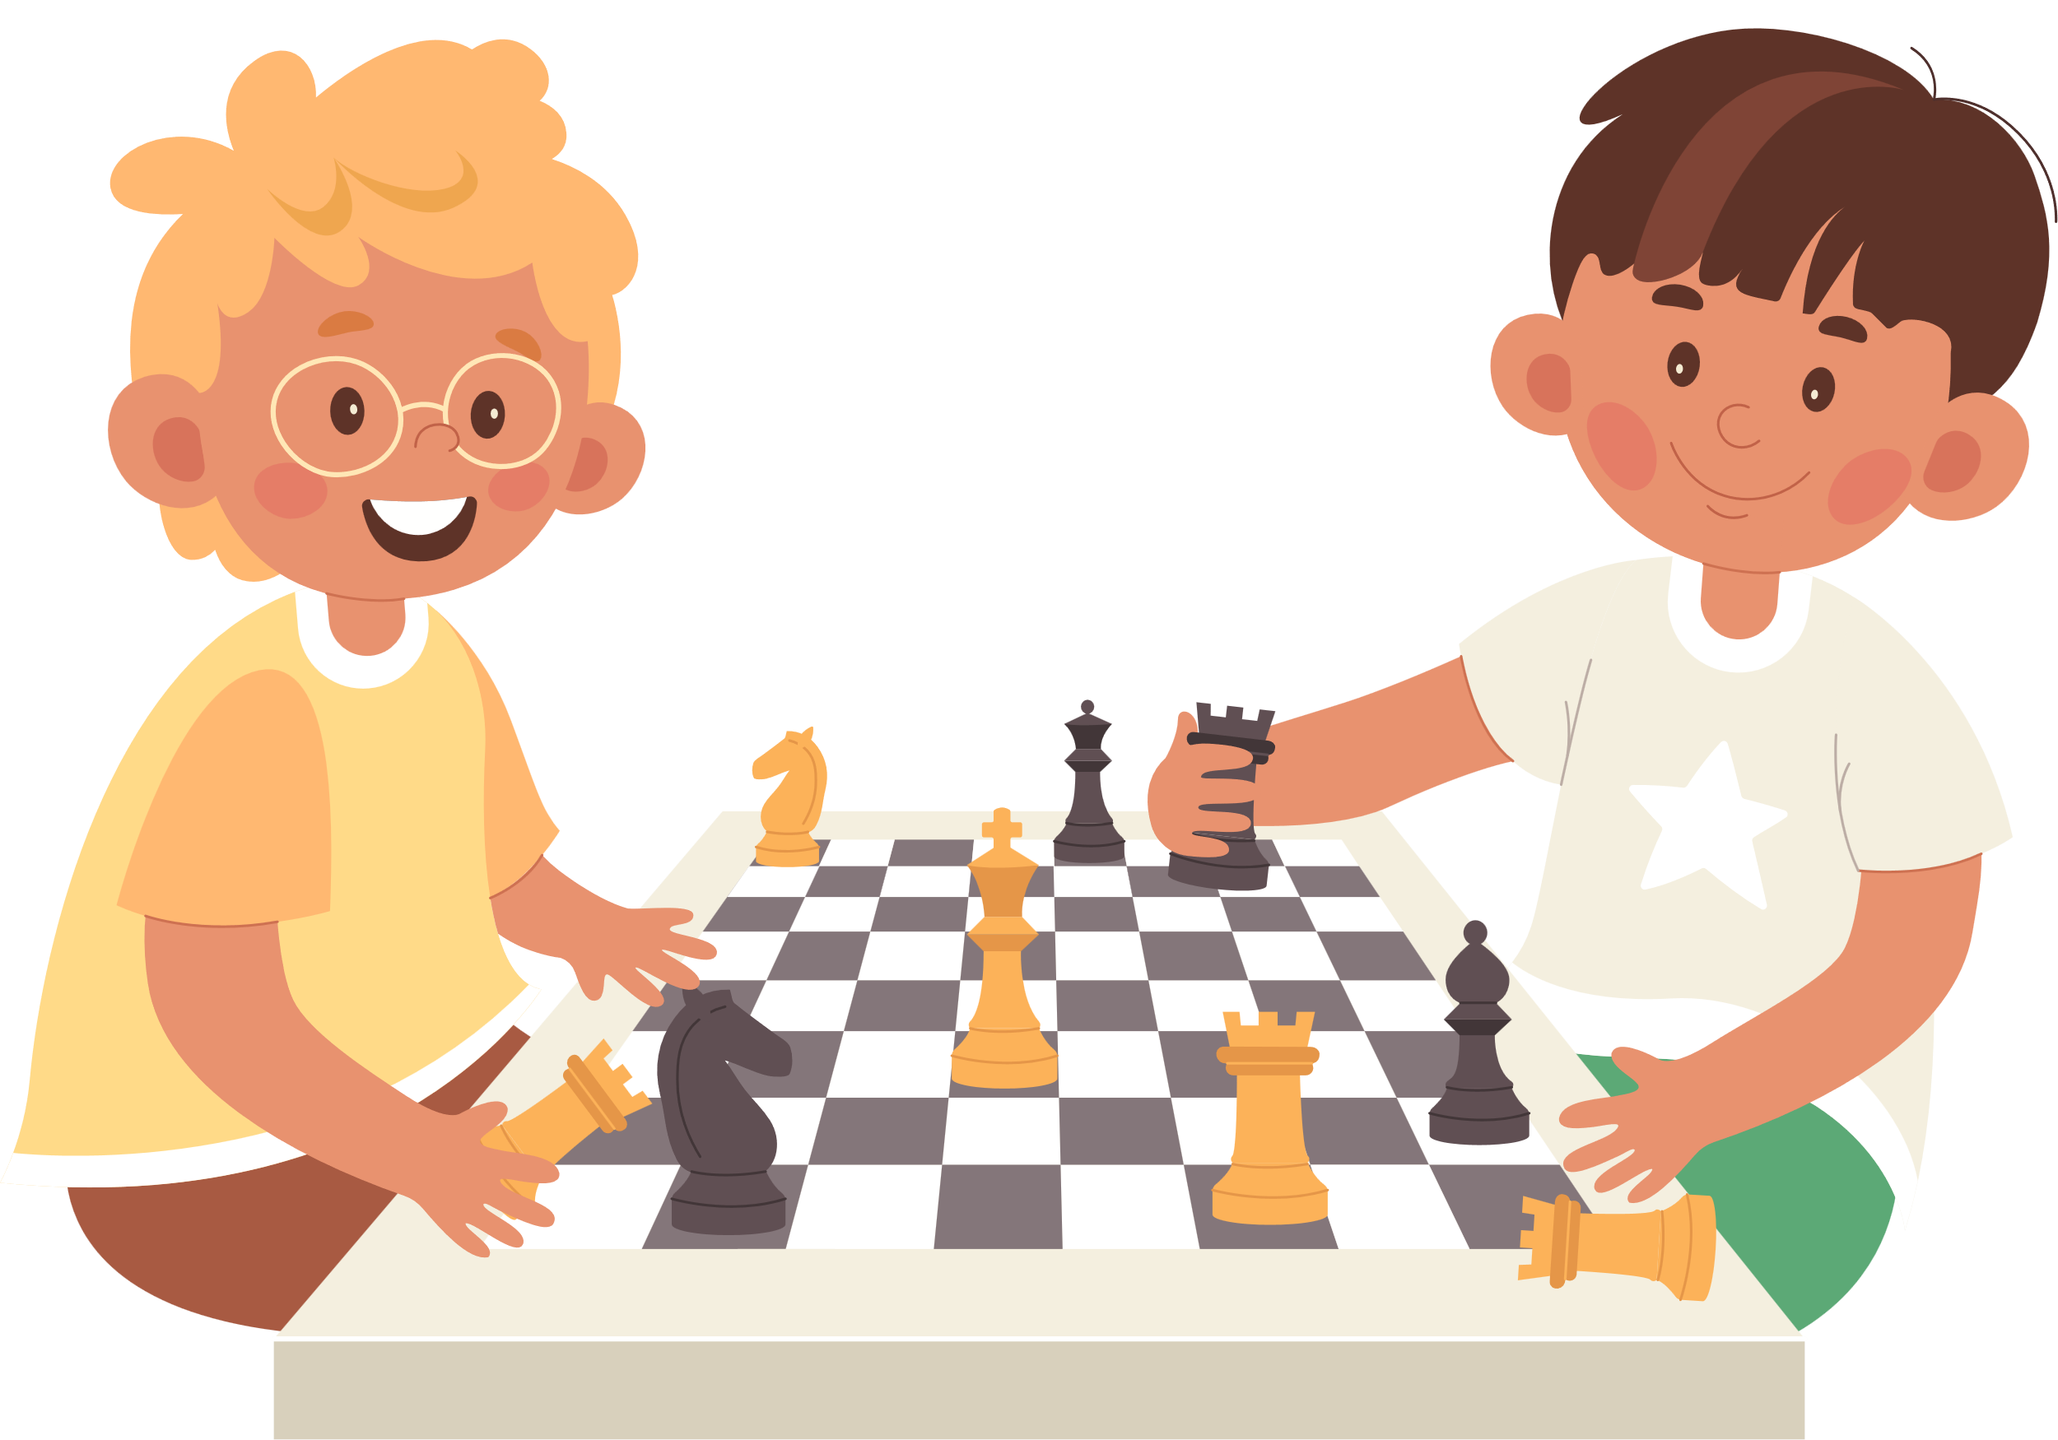

1
8
2
1. They like reading comics.
2. They like doing puzzles.
7
3
3. They don’t like playing chess.
4. They like playing hide and seek.
6
4
5. They like playing chess.
5
6. They don’t like drawing.
7. They don’t like coloring a picture.
8. They like talking.

Slide 8
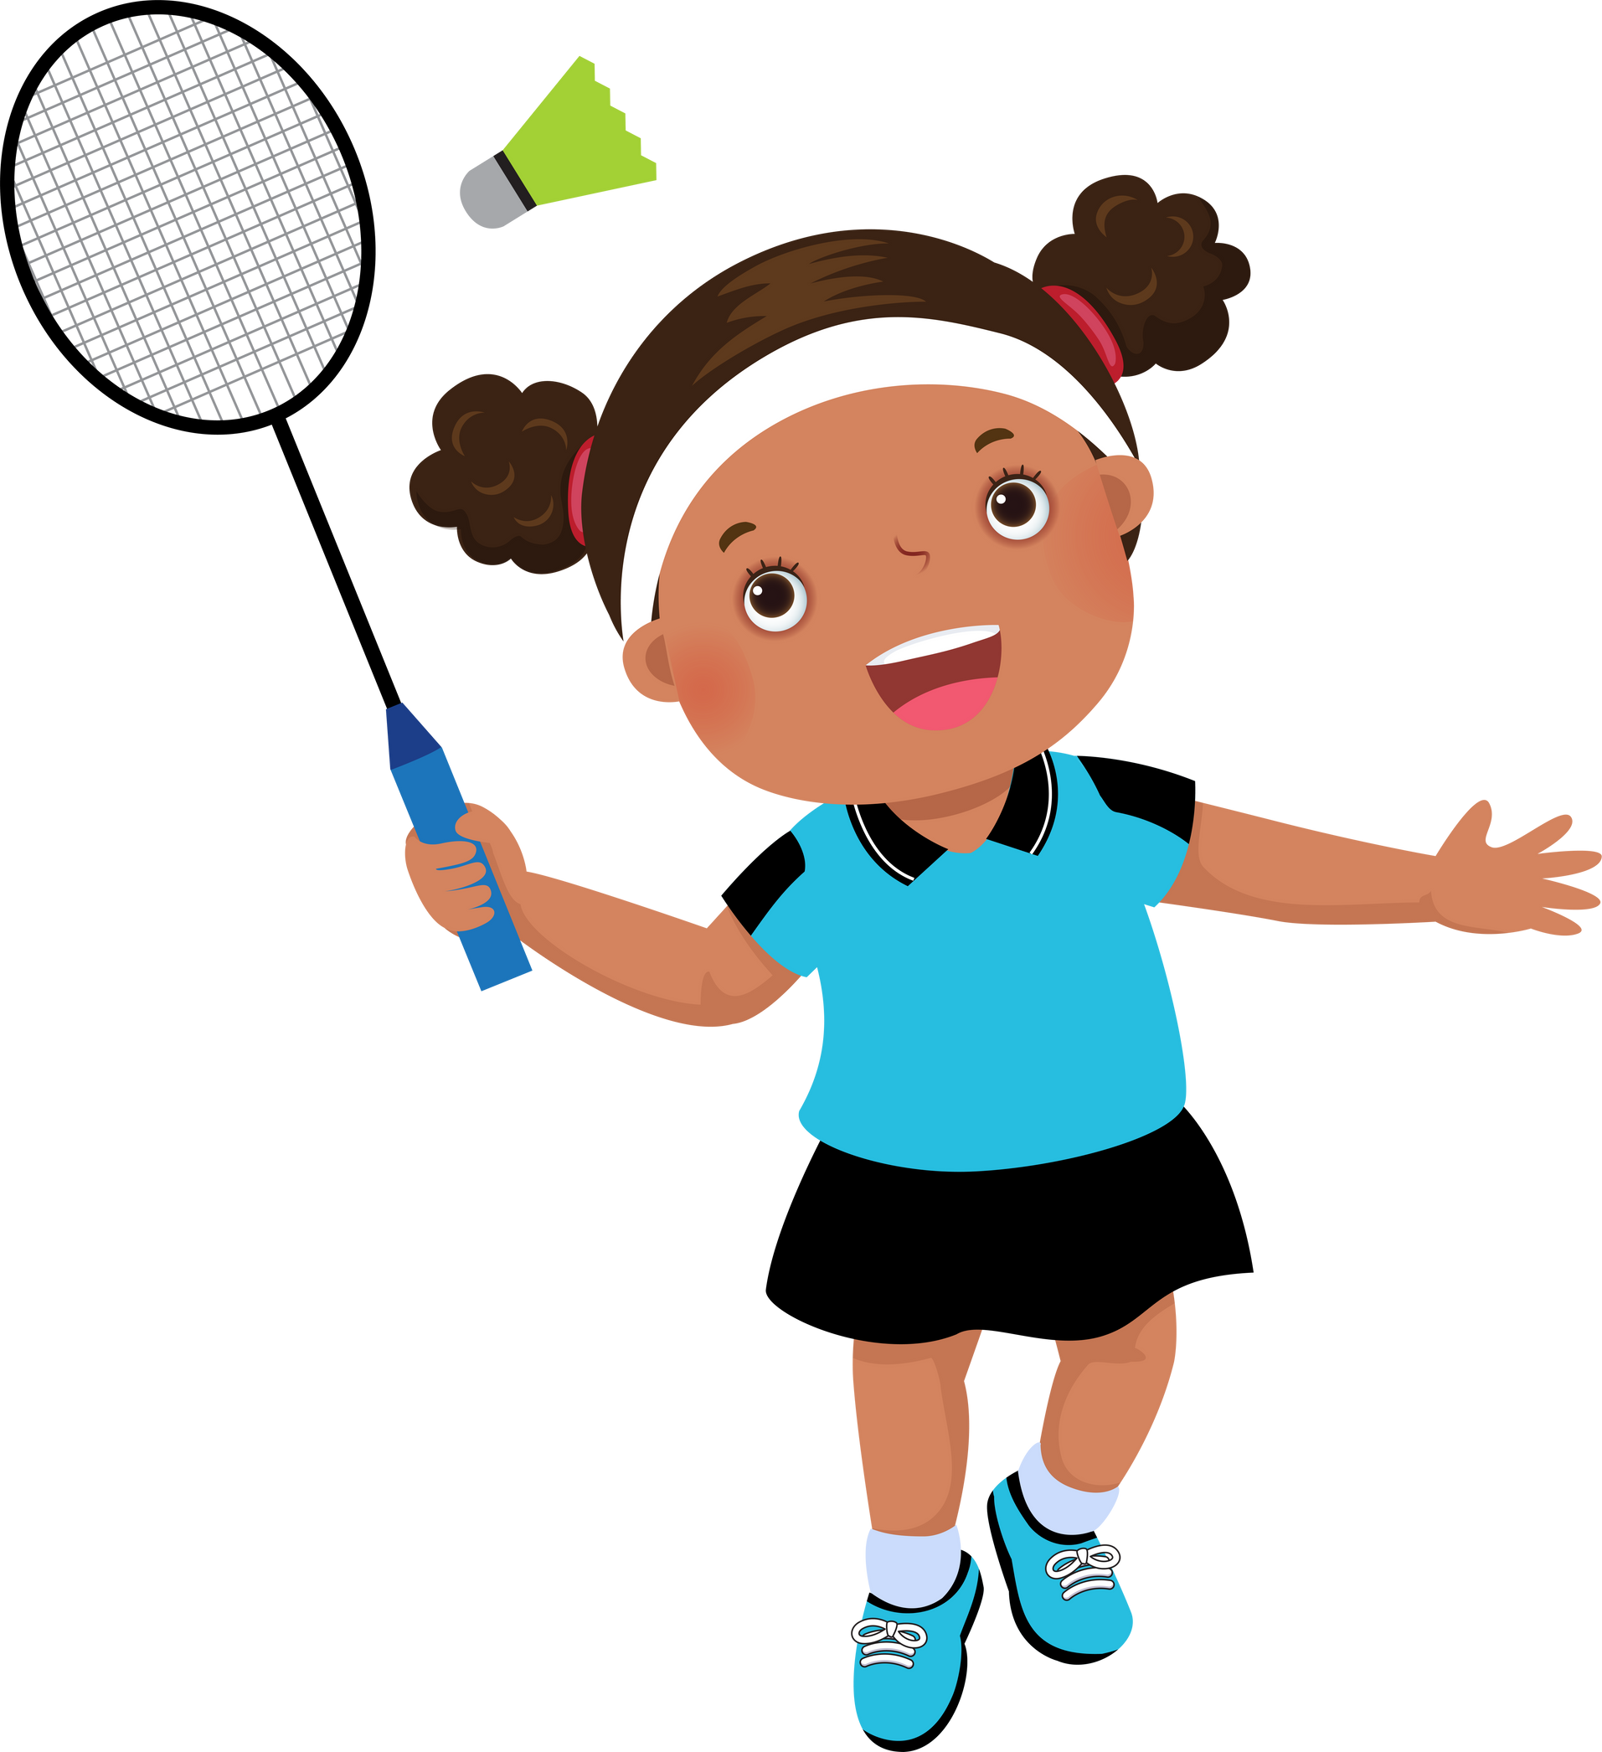
1
8
2
1. She likes playing volleyball.
2. She likes playing badminton.
7
3
3. She doesn’t like playing badminton.
4. She doesn’t like playing basketball.
6
4
5. She doesn’t like fishing.
5
6. She likes reading comics.
7. She likes jumping.
8. She likes singing a song.

Slide 9
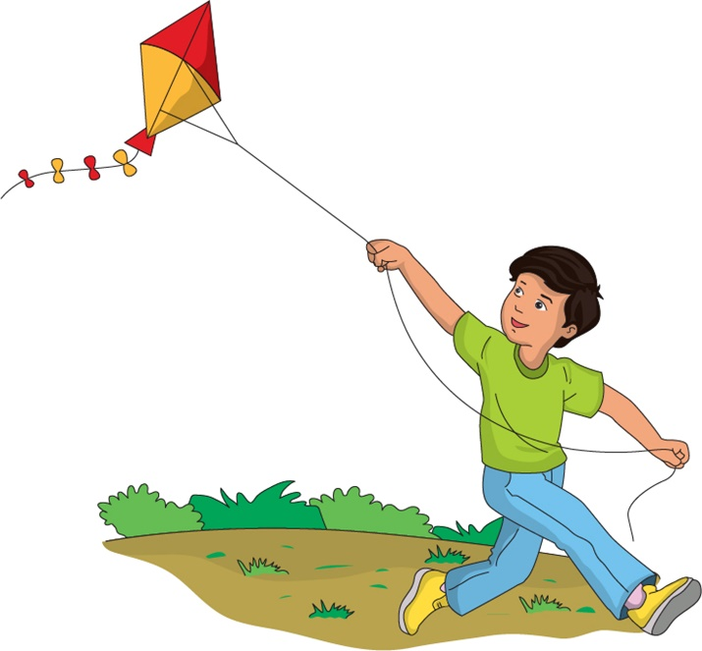
1
8
2
1. He likes swimming.
2. He likes surfing.
7
3
3. He likes playing with a ball.
4. He likes collecting shells.
6
4
5. He doesn’t like snorkeling.
5
6. He doesn’t like flying a kite.
7. He likes flying a kite.
8. He doesn’t like playing with friends.

Slide 10
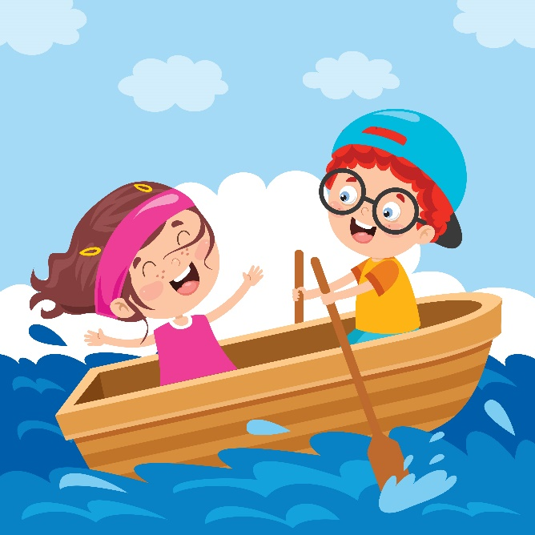
1
8
2
1. They like swimming.
2. They like surfing.
7
3
3. They like snorkeling.
4. They like reading comics.
6
4
5. They don’t like rowing a boat.
5
6. They don’t like swimming.
7. They don’t like playing with friends.
8. They like rowing a boat.

Slide 11
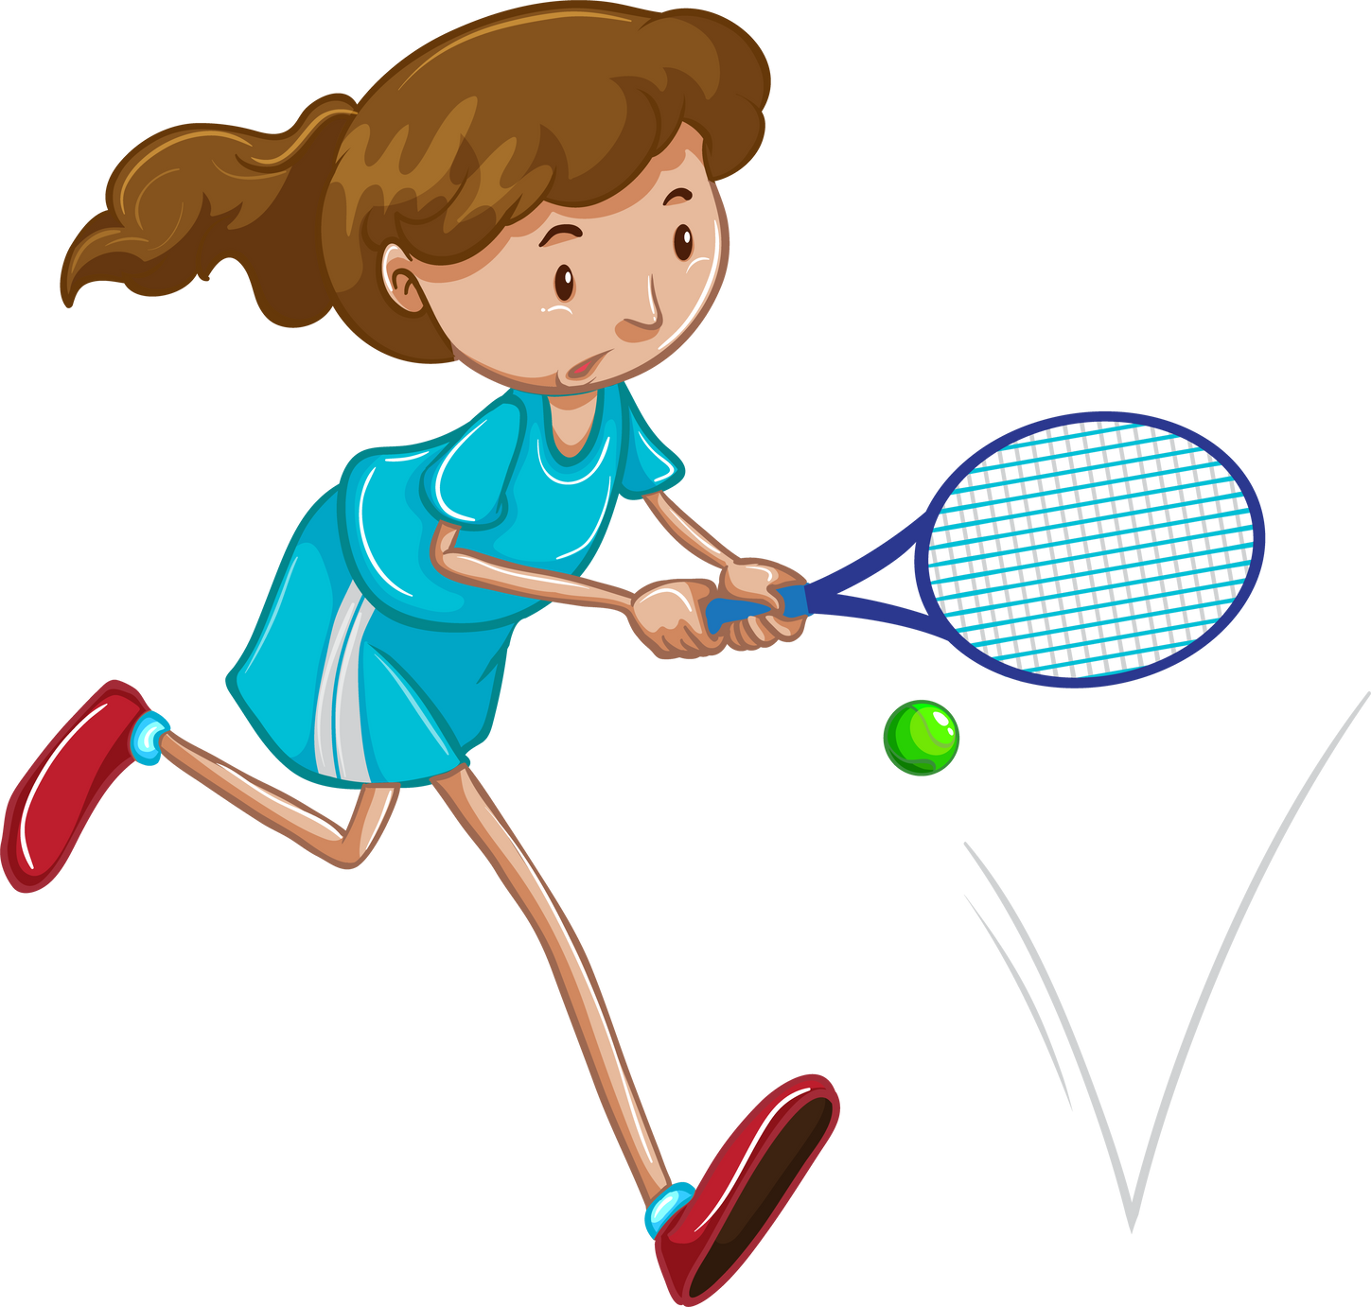

1
8
2
1. She likes playing badminton.
2. She doesn’t like fishing.
7
3
3. She likes running.
4. She doesn’t like playing volleyball.
6
4
5. She likes playing basketball.
5
6. She doesn’t like playing badminton.
7. She likes reading comics.
8. She doesn’t like playing soccer.

Slide 12
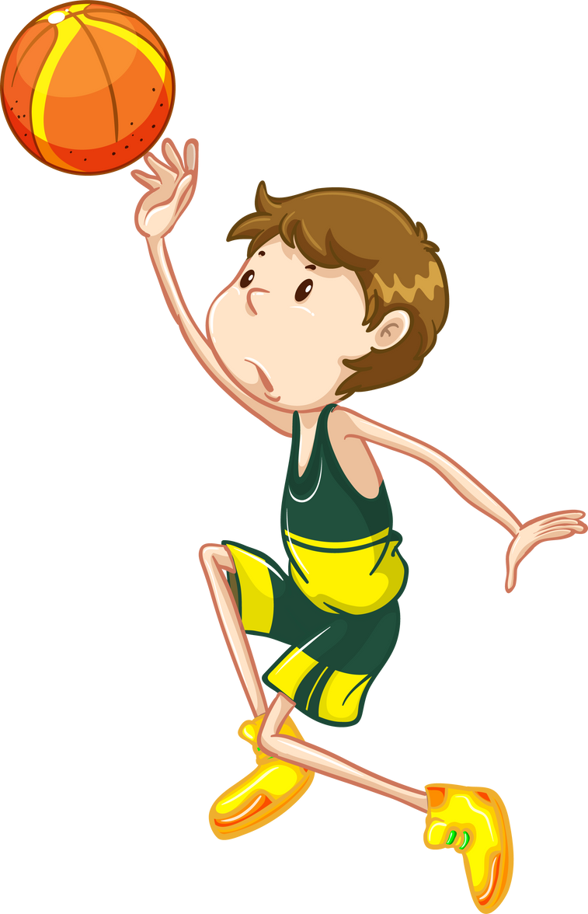
1
8
2
1. He likes playing basketball.
2. He doesn’t like playing badminton.
7
3
3. He doesn’t like playing basketball.
4. He likes playing badminton.
6
4
5. He doesn’t like reading comics.
5
6. He likes fishing.
7. He doesn’t like playing chess.
8. He likes playing chess.

Slide 13
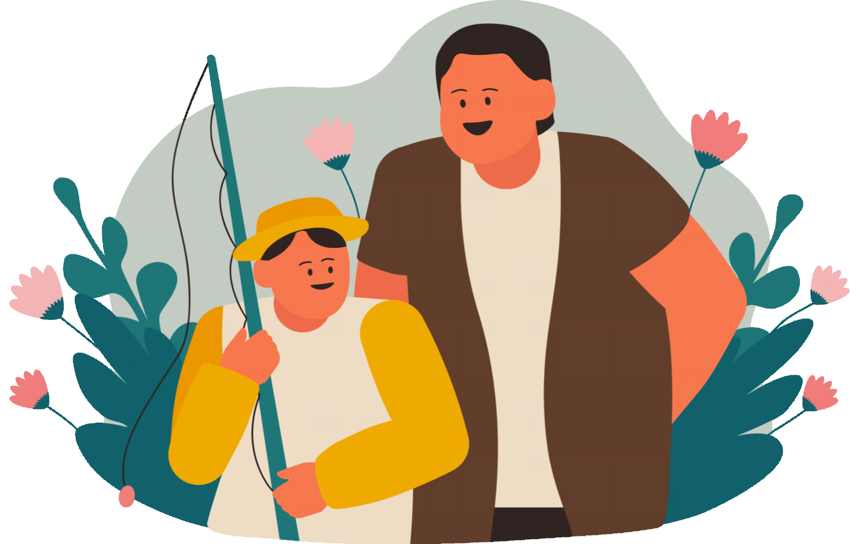
1
8
2
1. They like reading comics.
2. They don’t like reading comics.
7
3
3. They don’t like fishing.
4. They like fishing.
6
4
5. They like talking.
5
6. They don’t like talking.
7. They like swimming.
8. They don’t like swimming.

Slide 14
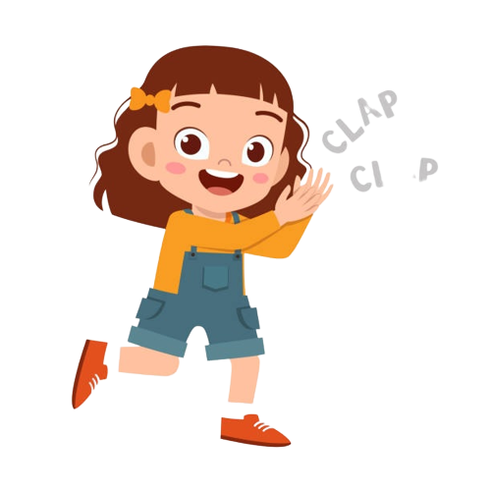
Good job!

Slide 15
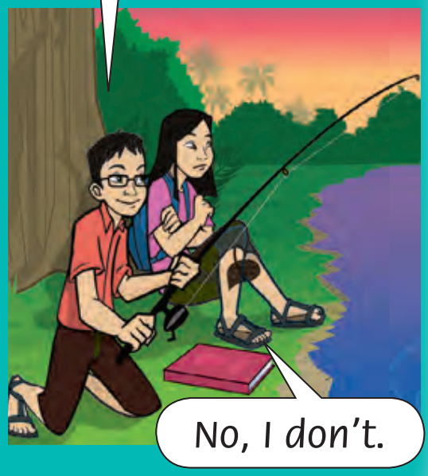

I like fishing. Do you like fishing?
Look and Say
No, I don’t.
Notes:
* Lead-in:
Hold up a picture to encourage ideas.

Slide 16
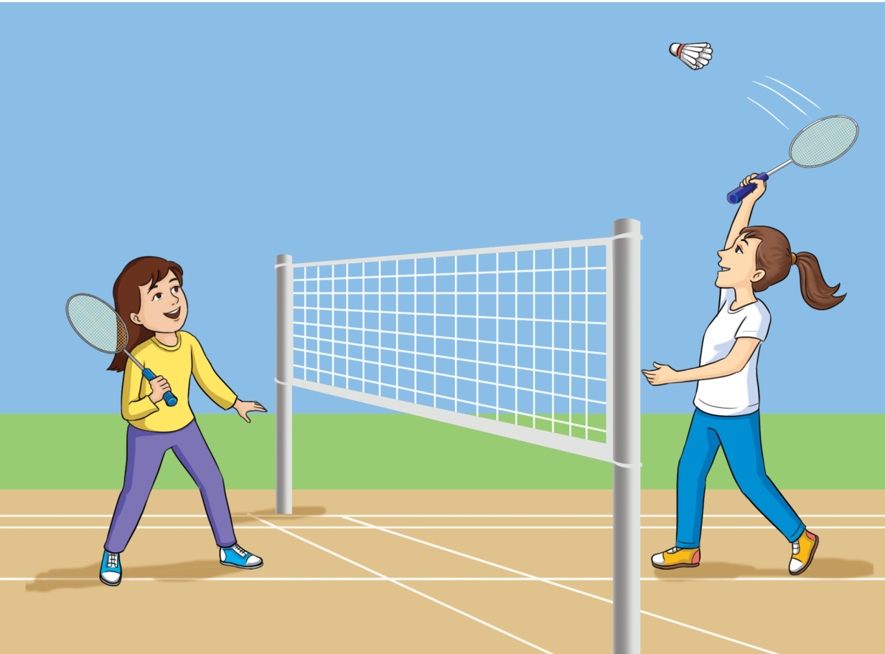
Look and Say
Do they like playing badminton?
Yes, they do.
Notes:
* Lead-in:
Hold up a picture to encourage ideas.

Slide 17
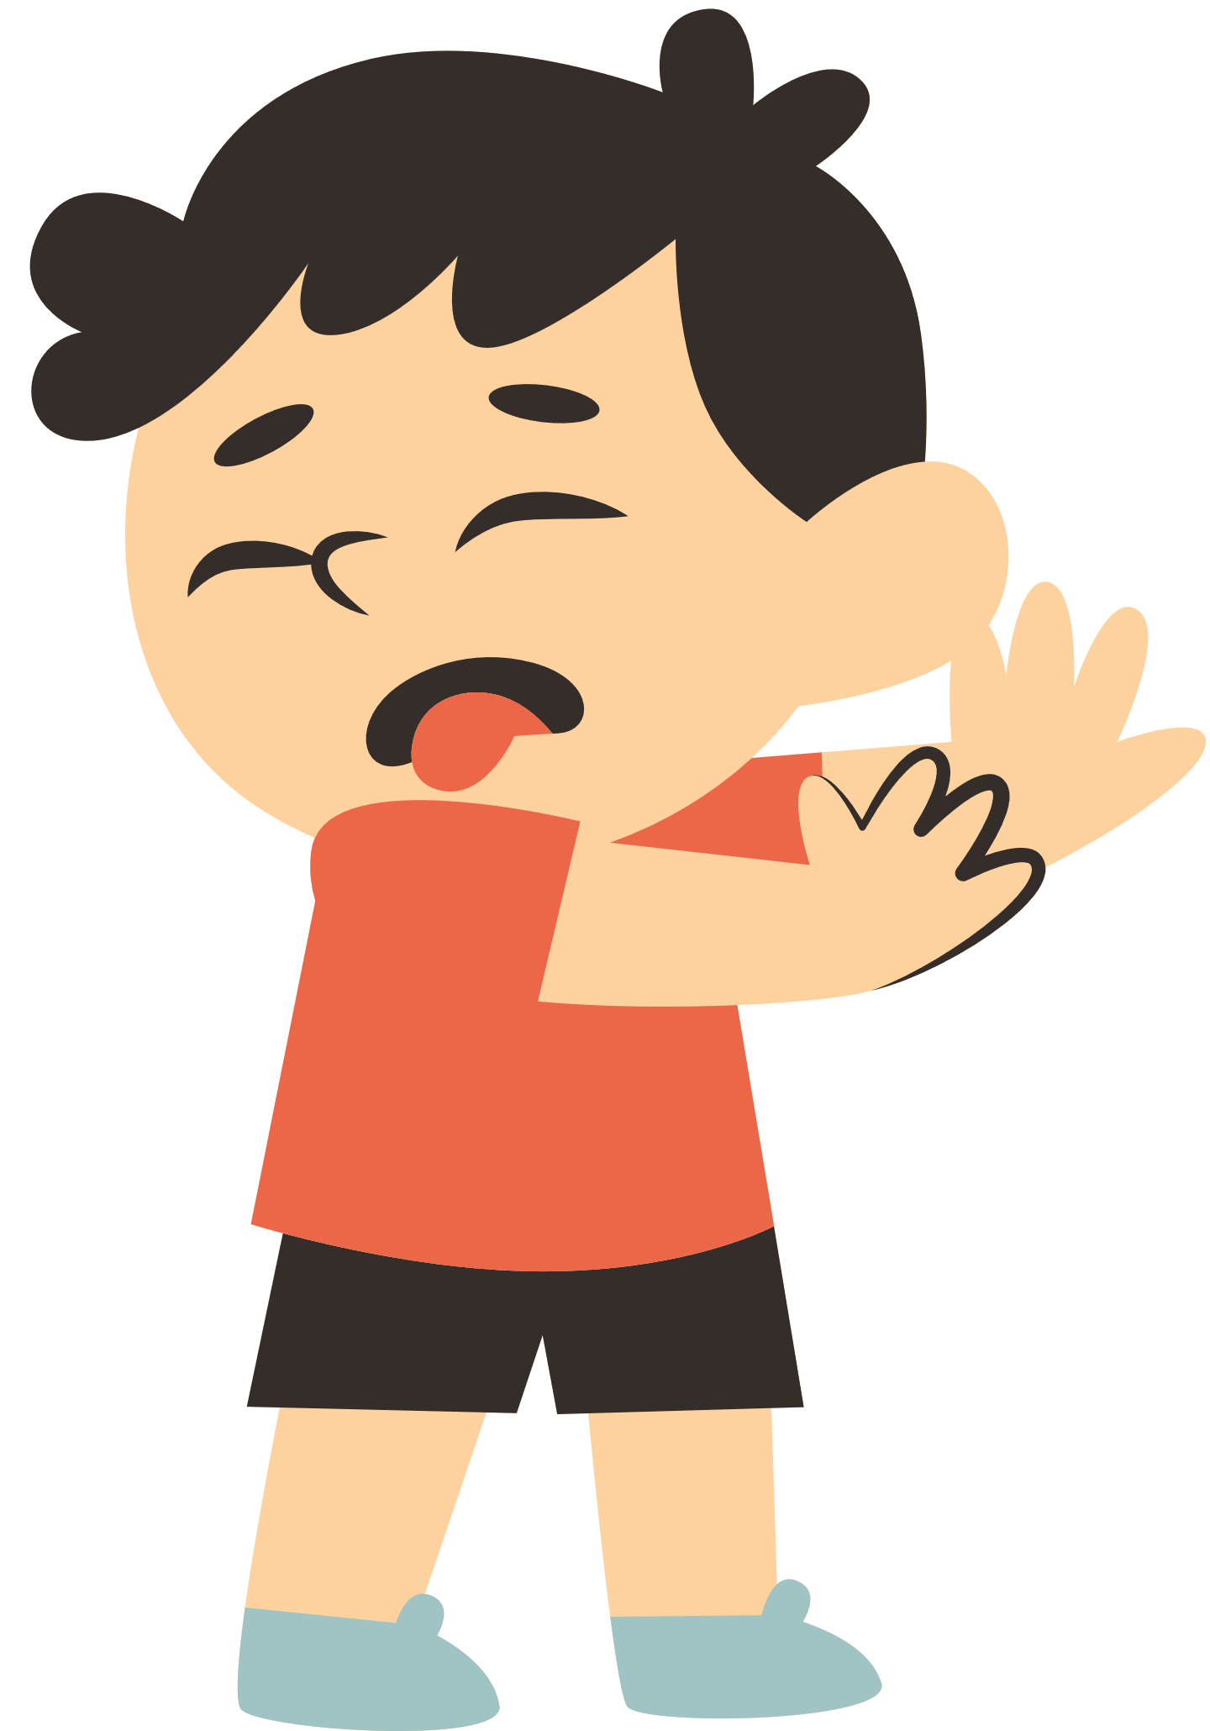
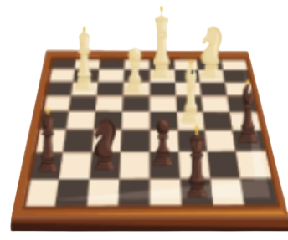
Look and Say
Does he like playing chess?
No, he doesn’t.
Notes:
* Lead-in:
Hold up a picture to encourage ideas.

Slide 18
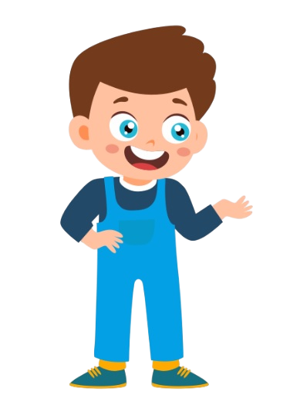
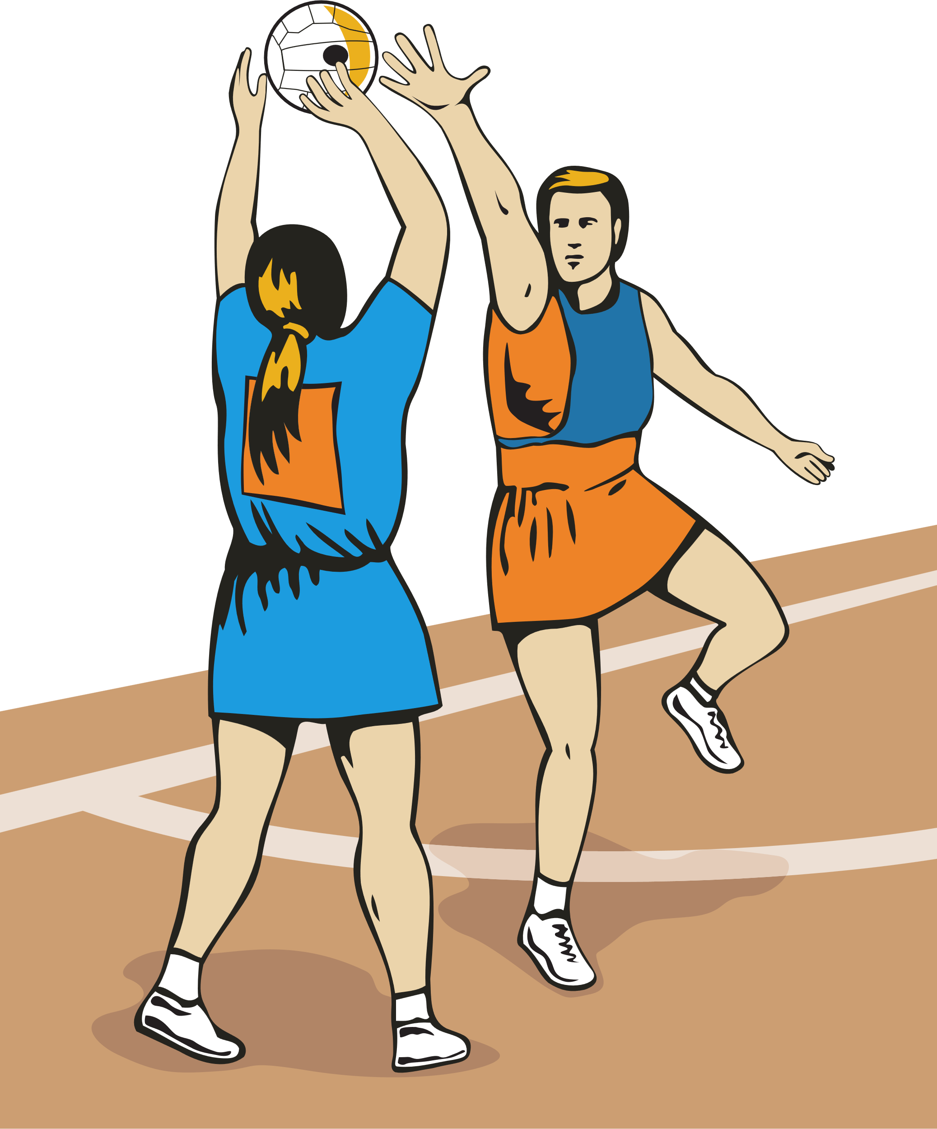
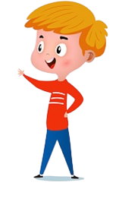


Look and Say
We like playing chess, but we don’t like
playing volleyball.
Notes:
* Lead-in:
Hold up a picture to encourage ideas.

Slide 19
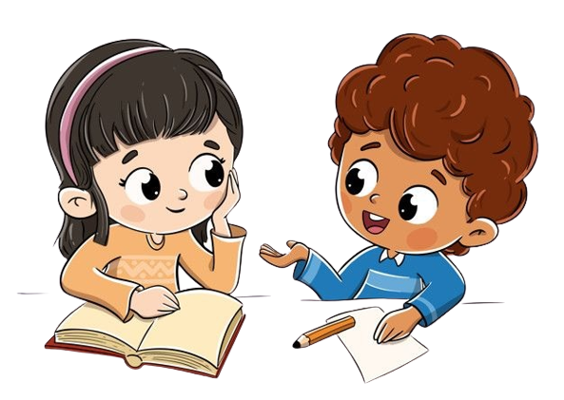
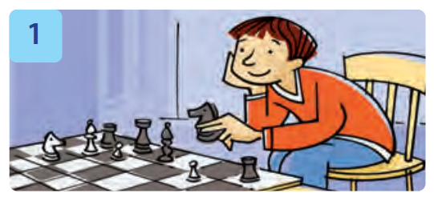
Work in Pairs
Ask and Answer the questions.
Notes:
Children work in pairs to ask and answer the questions.

Slide 20
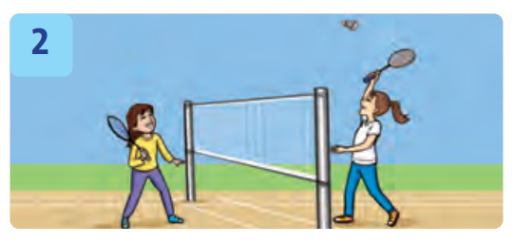
Work in Pairs
Ask and Answer the questions.
Notes:
Children work in pairs to ask and answer the questions.

Slide 21
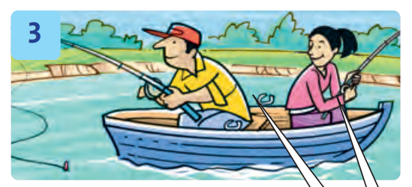
Work in Pairs
Ask and Answer the questions.
Notes:
Children work in pairs to ask and answer the questions.

Slide 22
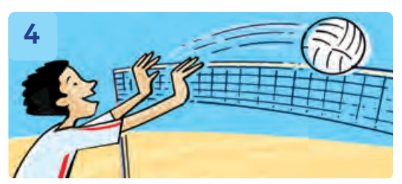
Work in Pairs
Ask and Answer the questions.
Notes:
Children work in pairs to ask and answer the questions.

Slide 23

Let’s write!
Does he like playing chess?
Yes, he does.
______________
Notes:
* Write.
Show the example.

Slide 24
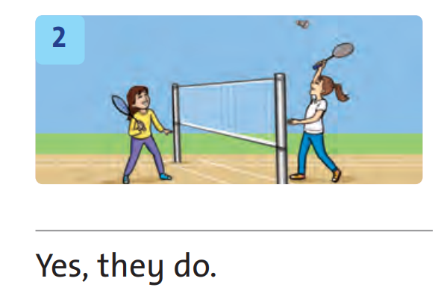
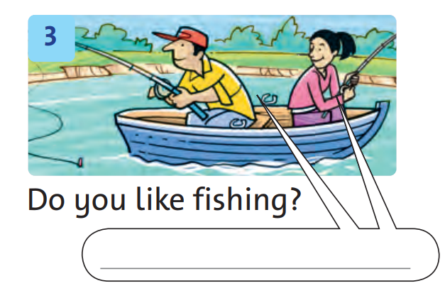
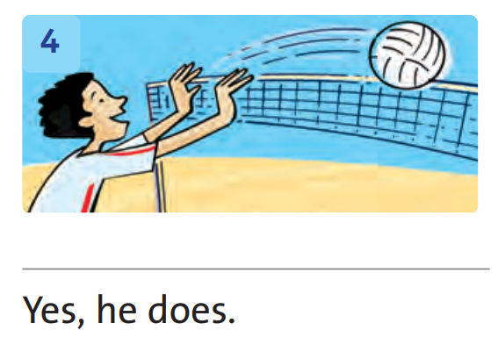
Let’s write!
77
Notes:
Children look at the pictures and write the complete questions and answers in their notebooks.

Slide 25
Work in Pairs
77
Notes:
Ask the children to work in pairs for peer-checking their answers.

Slide 26
Let’s check!
Do they like playing badminton?
___________________________________
Yes, they do.
Notes:
Answers
1 Yes, he does.
2 Do they like playing badminton?
3 Yes, we do.
4 Does he like playing volleyball?

Slide 27
Let’s check!
Do you like fishing?
Yes, we do.
___________
Notes:
Answers
1 Yes, he does.
2 Do they like playing badminton?
3 Yes, we do.
4 Does he like playing volleyball?

Slide 28
Let’s check!
Does he like playing volleyball?
___________________________________
Yes, he does.
Notes:
Answers
1 Yes, he does.
2 Do they like playing badminton?
3 Yes, we do.
4 Does he like playing volleyball?

Slide 29
Good job!

Slide 30

Goin’
Fishin’
Notes:
* Guessing game
Ask children to look at the people and the actions. Ask Does she like …? Elicit the answer Yes, she does.
In pairs, children do the actions, ask, and answer similar questions, using other vocabulary words on the page.

Slide 31
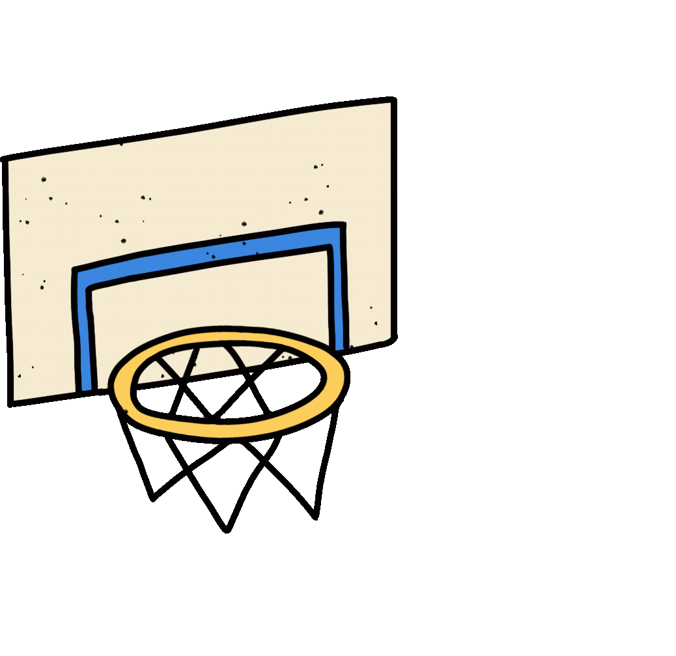
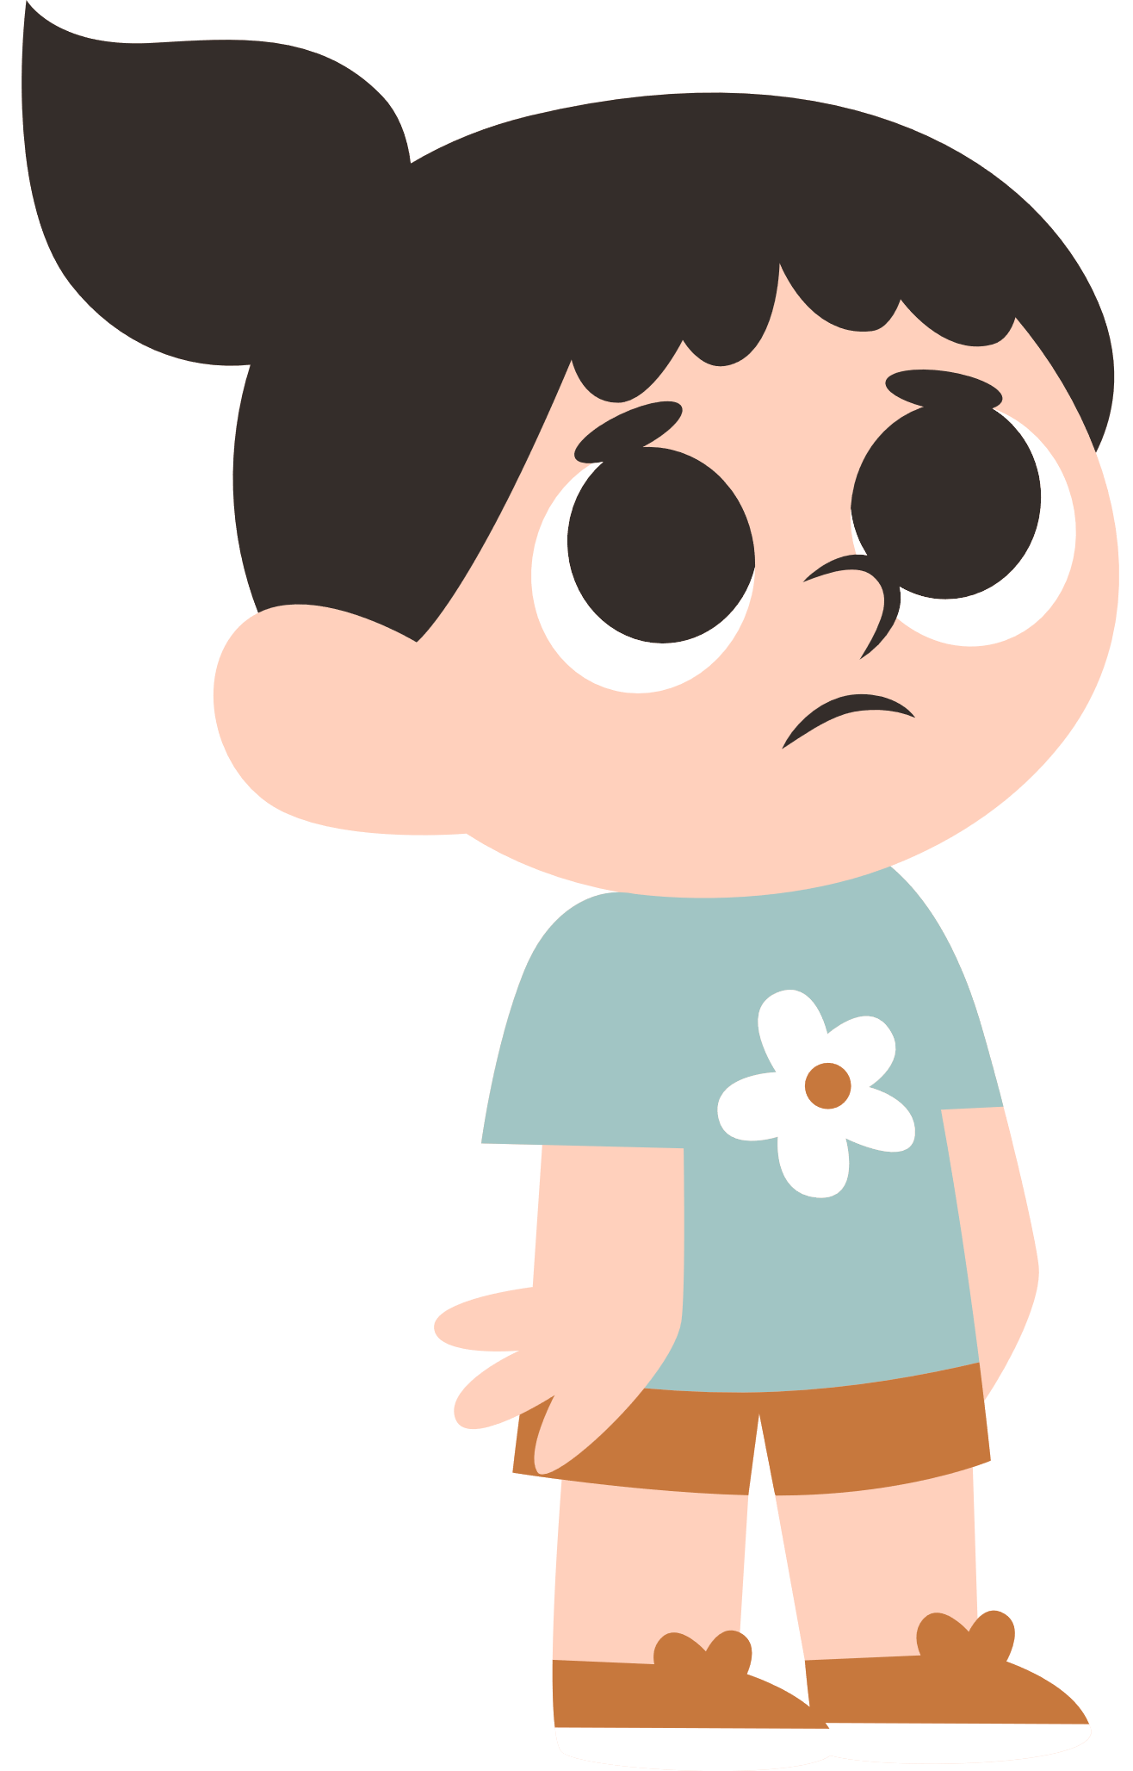
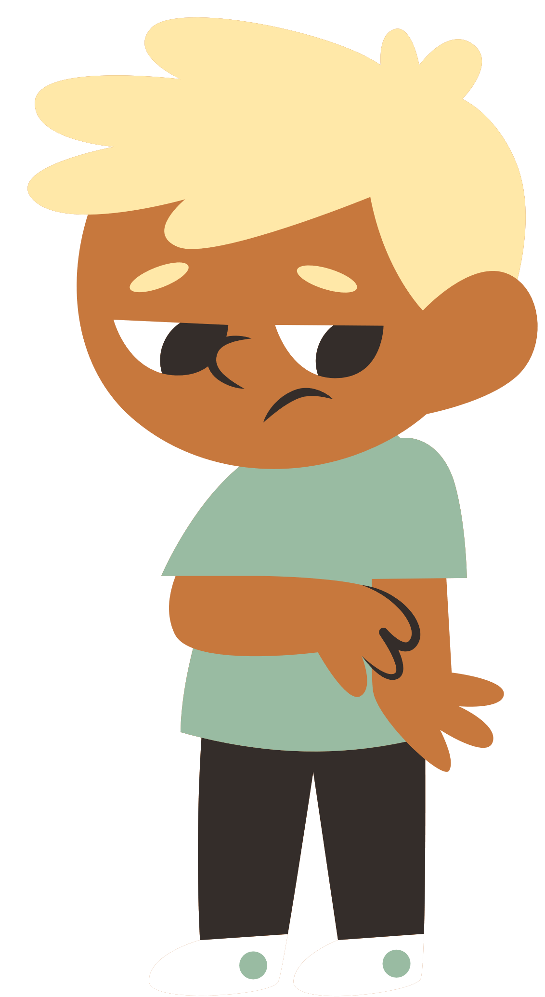
Do they like playing basketball?
A. Yes, they do.
B. No, they don’t.
Notes:
* Guessing game
Ask children to look at the people and the actions. Ask Does she like …? Elicit the answer Yes, she does.
In pairs, children do the actions, ask, and answer similar questions, using other vocabulary words on the page.

Slide 32


Scoring

Slide 33
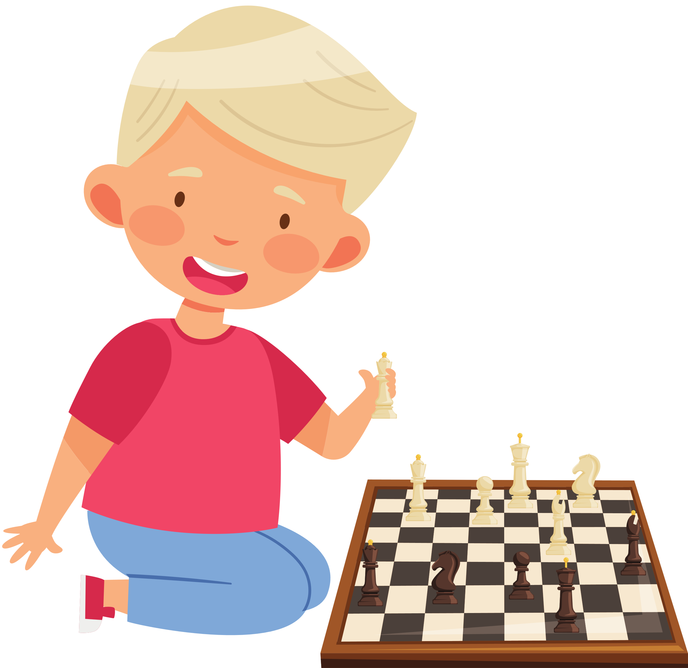
Does he like playing chess?
A. No, he doesn’t.
B. Yes, he does.

Slide 34
Scoring

Slide 35
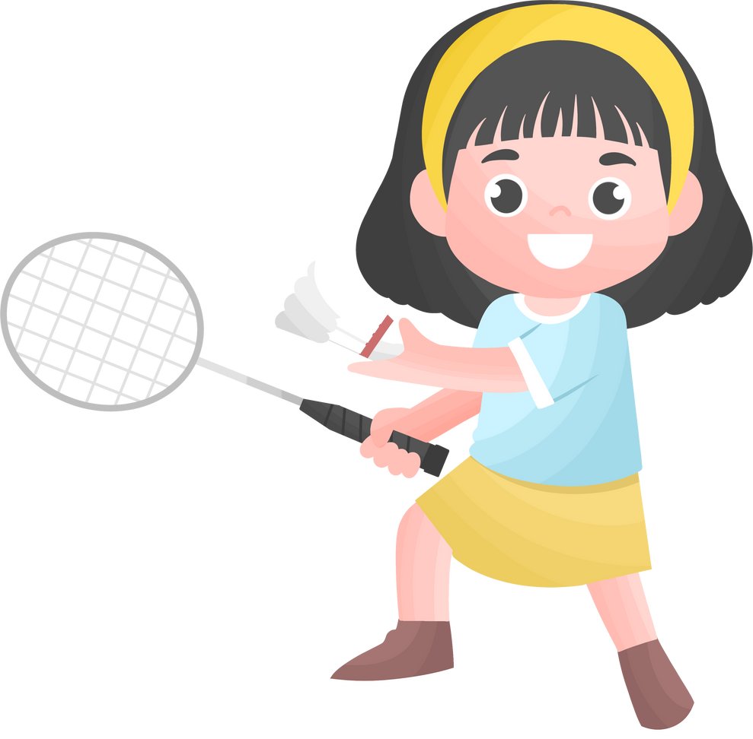
Does she like playing badminton?
A. Yes, she does.
B. No, she doesn’t.

Slide 36

Scoring

Slide 37
Do they like playing volleyball?
A. No, they don’t.
B. Yes, they do.

Slide 38
Scoring

Slide 39
Congratulations!

Slide 40


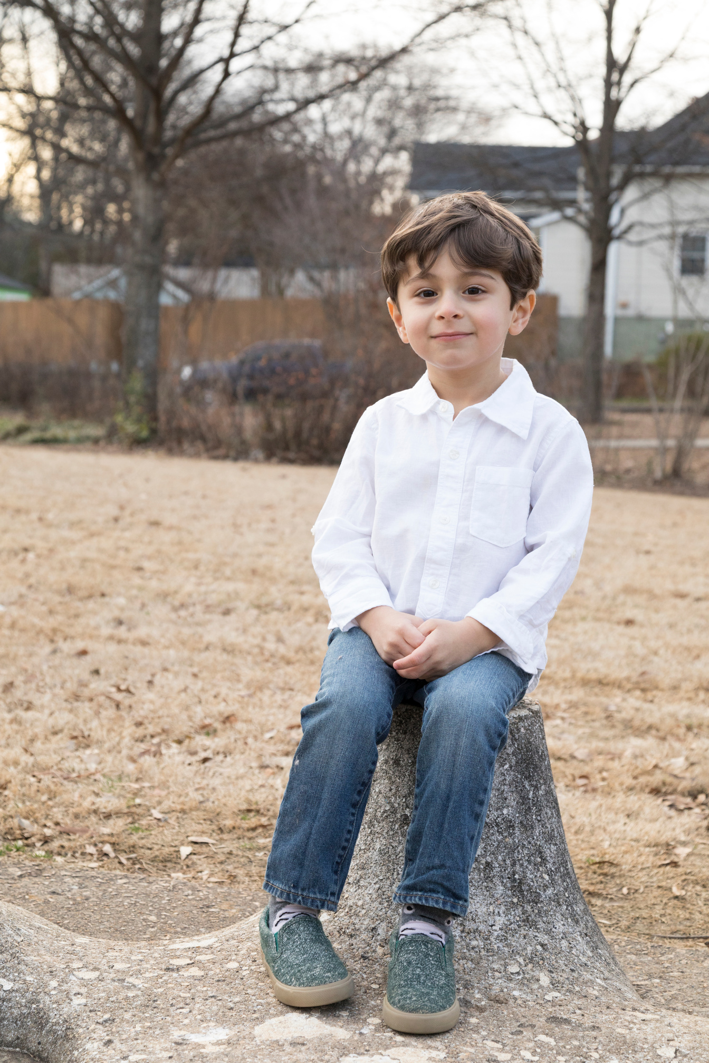
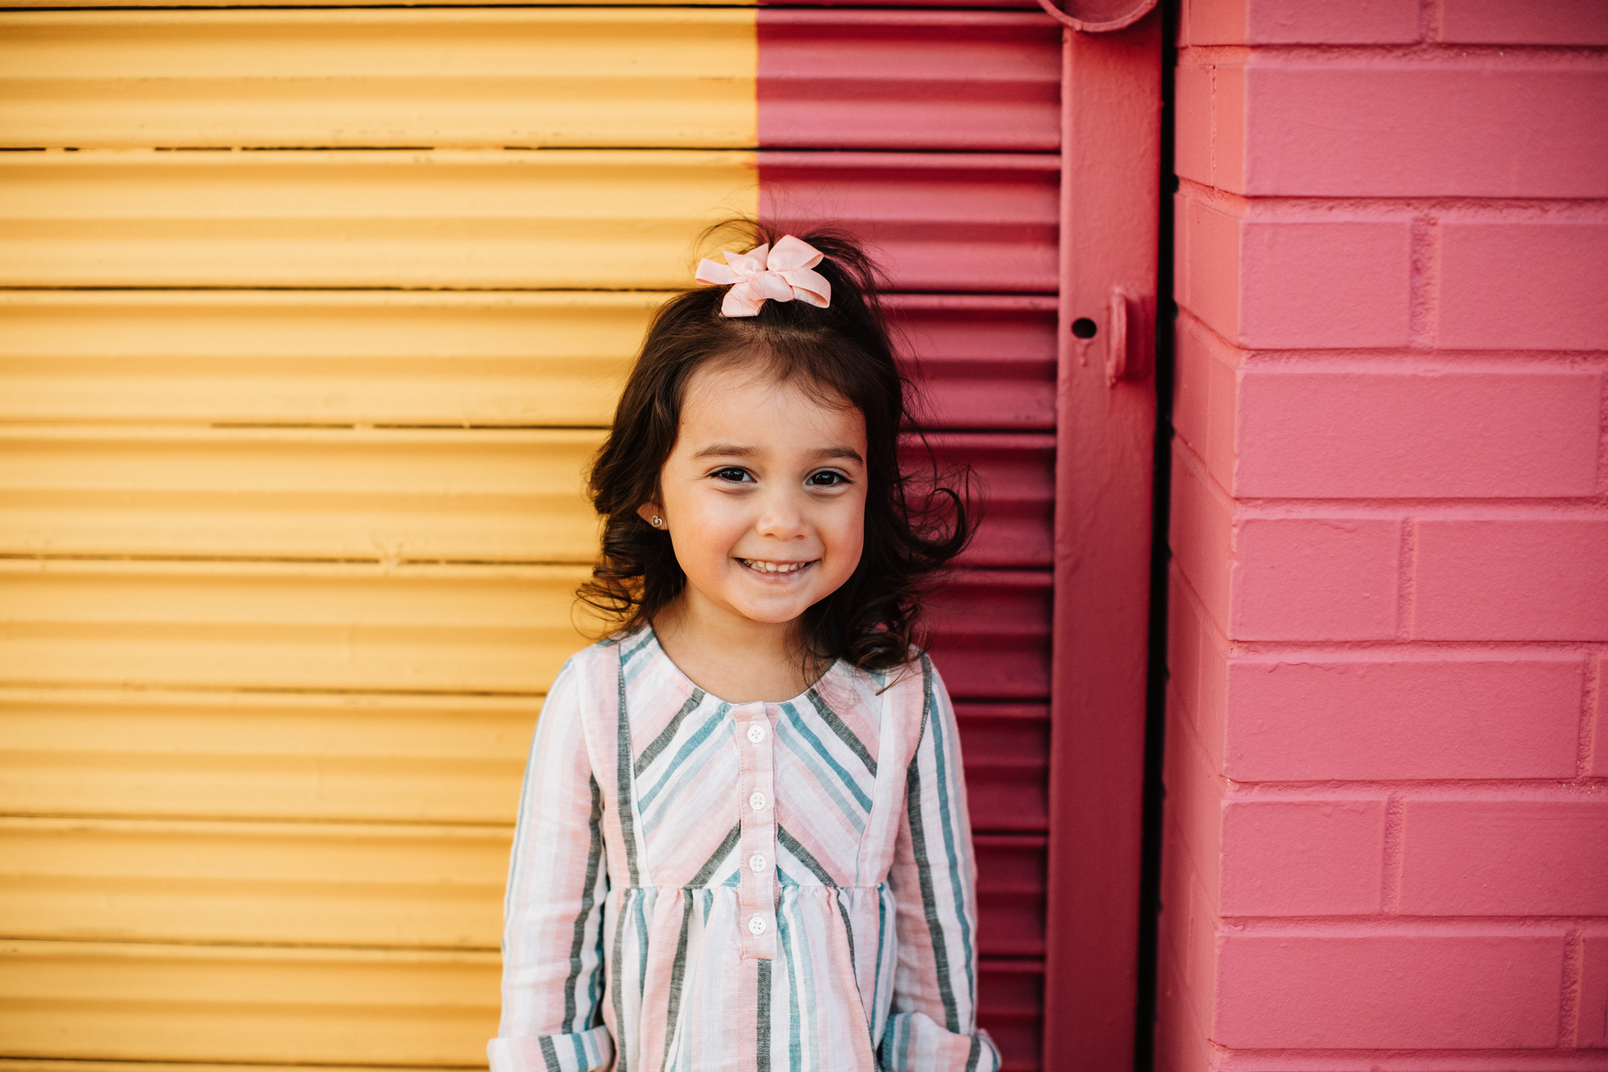
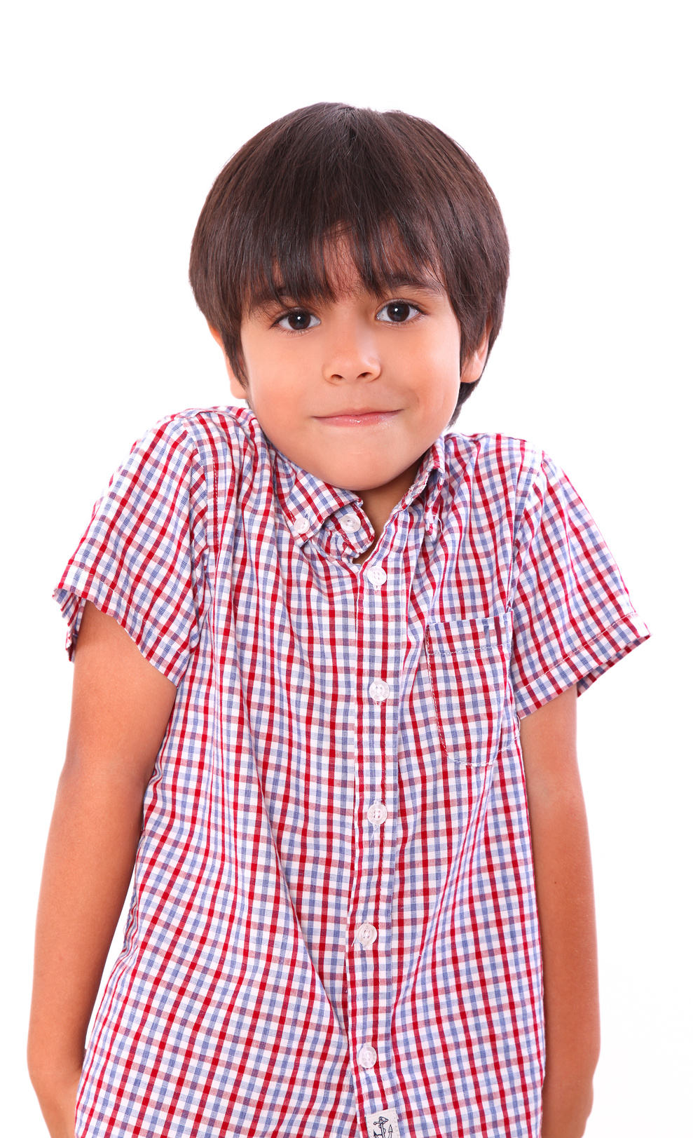
Our Winners!
Peter
Eric
Julie
Notes:
Replace photos and names with your students’ information.

Slide 41


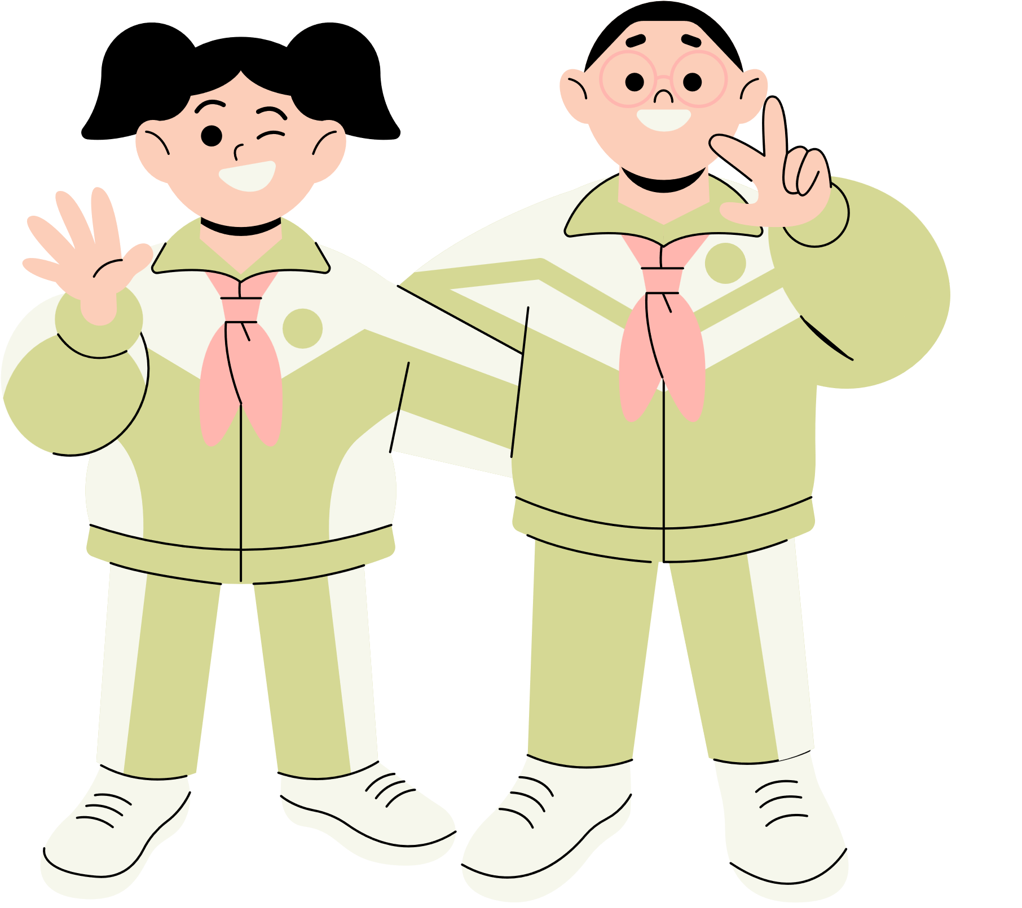





Thank You!
See You Next Time!
Notes:
https://www.youtube.com/watch?v=SRyFiVeNjWs

