Slide 1
Unit 10
May I
take a photo?
Lesson 5 – Skills Time!

Slide 2
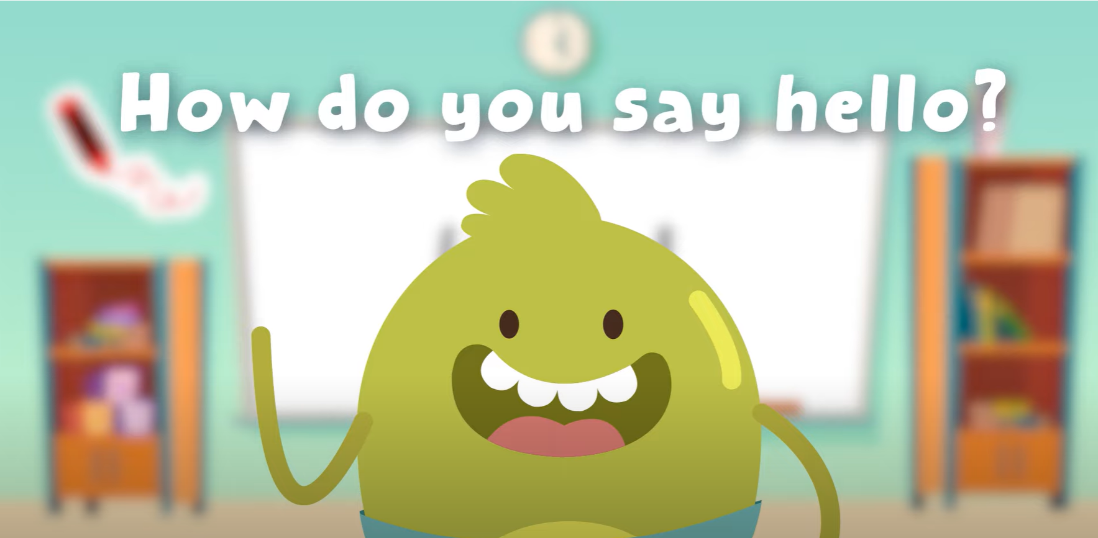
Hello song!

Slide 3
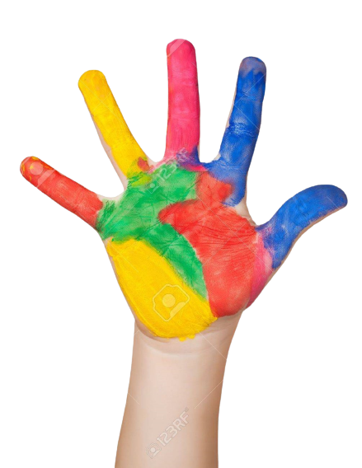
Give me Five

Slide 4
Watch and Sing

Slide 5
Watch and Answer

Slide 6
Good job!

Slide 7
Look and Say
80

Slide 8
Listen and Point
80

Slide 9
Listen and Repeat
80

Slide 10
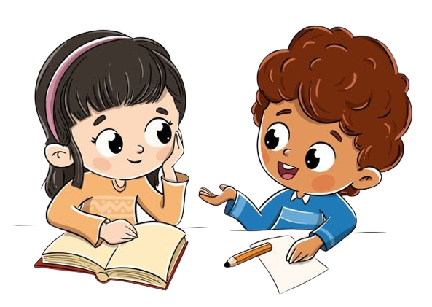
Work in Pairs.
Practice reading.
Notes:
Practice reading skills

Slide 11
Good job!

Slide 12
Read and Write
1. Where is the museum?
a. Hanoi
b. Ho Chi Minh City

Slide 13
Read and Write
2. The gift shop is in the museum.
a. Yes
b. No

Slide 14
Read and Write
3. The museum is open at 9 a.m.
a. Yes
b. No
It’s open at 8 a.m – 12 p.m, 13 p.m – 5 p.m.

Slide 15
Read and Write
4. The elephant is ……………….
a. new
b. old

Slide 16
Read and Write
5. The museum is great.
a. Yes
b. No

Slide 17
Good job!

Slide 18
Let’s talk!
What’s your favourite museum?

Slide 19
Good job!

Slide 20
Game
RUNNING DICTATION

Slide 21
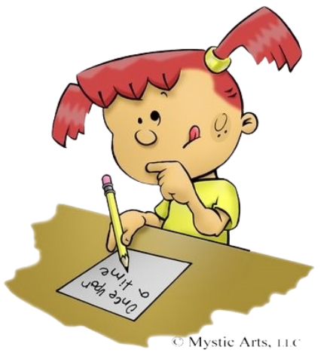
Game
RUNNING DICTATION
The Viet Nam National Museum of history is in Ha Noi. AT the museum, you learn about the history of Viet Nam. I like paintings. The gift shop is great, too!
Notes:
- Divide the class into four groups.
- Teacher sticks the posters of the passages around the class.
- Have one student of each group write the passage and the others run and read the passage.
- The group finishing first wins the game.

Slide 22
Good job!

Slide 23
Thank You

