Slide 1
Unit 10
May I
take a photo?
Lesson 1 - Words

Slide 2
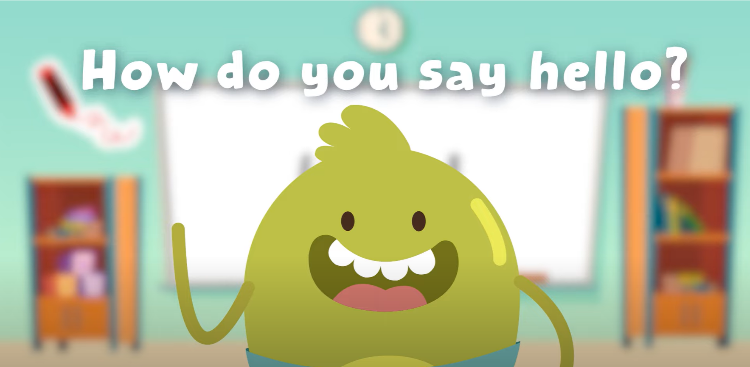
Hello song!

Slide 3
Give me Five

Slide 4
Sing and do actions

Slide 5
Watch and Think
Who can you see?
2. Where are they?
3. What can they do in this place?

Slide 6
Watch and Think

Slide 7
Good job!

Slide 8
Listen and REPEAT

Slide 9
Listen and REPEAT

Slide 10
Listen and REPEAT

Slide 11
Listen and REPEAT

Slide 12
Listen and POINT
Notes:
Listen and chant

Slide 13
Listen and REPEAT
Notes:
Listen and chant

Slide 14
Listen and chant
Notes:
Listen and chant

Slide 15
Who’s this?
Who’s this?
Rosy
Tim
Rosy
Tim

Slide 16
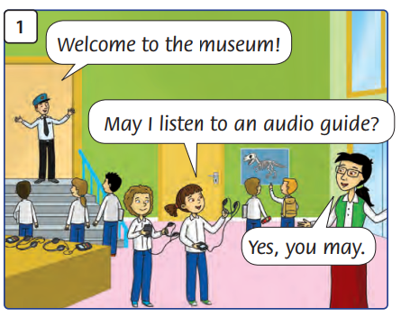
What’s happening?

Slide 17
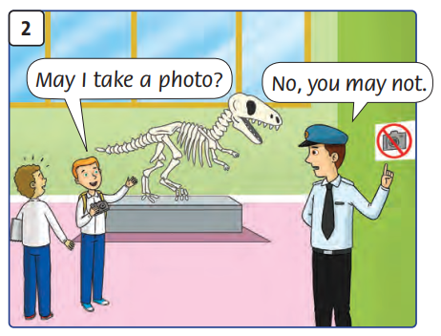
What’s happening?

Slide 18
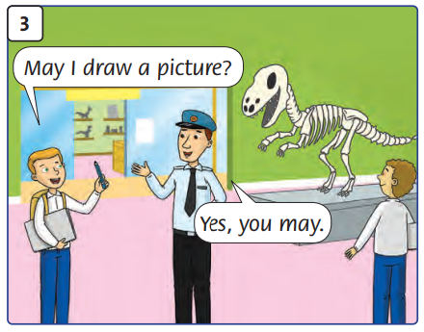
What’s happening?

Slide 19
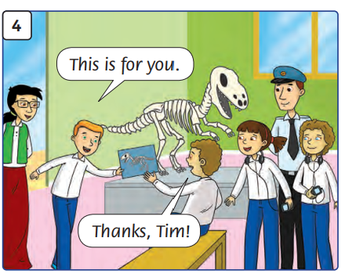
What’s happening?

Slide 20
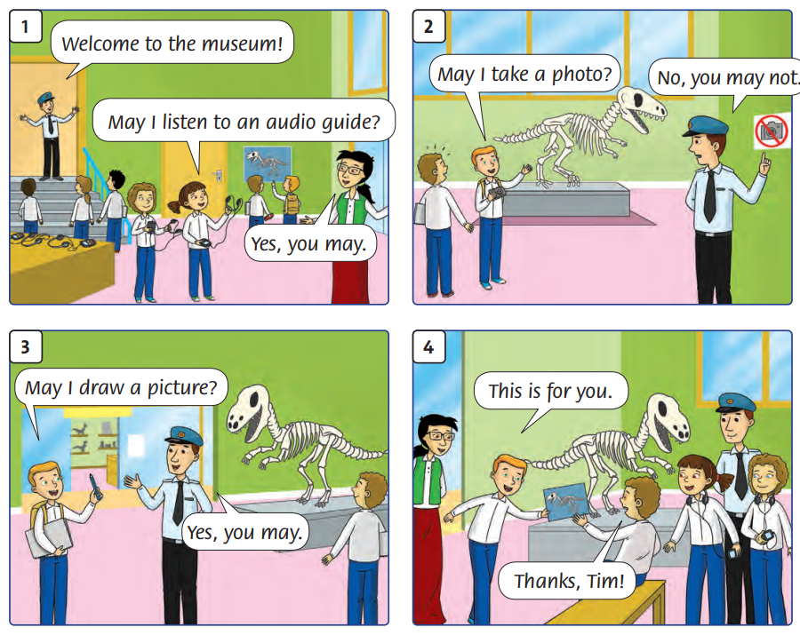
Listen and Point
76

Slide 21
Listen and Repeat
76

Slide 22
Work in groups
Role-Play

Slide 23
Good job!

Slide 24
Game
WHAT’S MISSING?

Slide 25
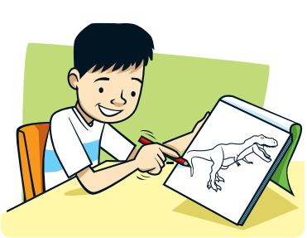
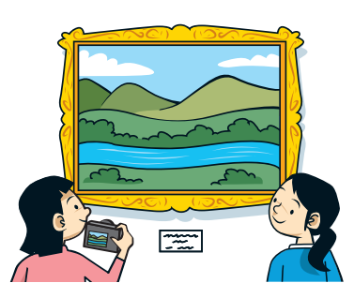
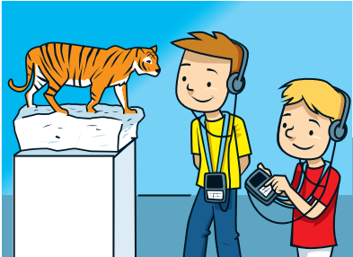
WHAT’S MISSING?
visit the gift shop

Slide 26
WHAT’S MISSING?
take
a photo

Slide 27
WHAT’S MISSING?
listen to
an audio guide

Slide 28
WHAT’S MISSING?
draw
a picture

Slide 29
Good job!

Slide 30
Thank You

