Slide 1
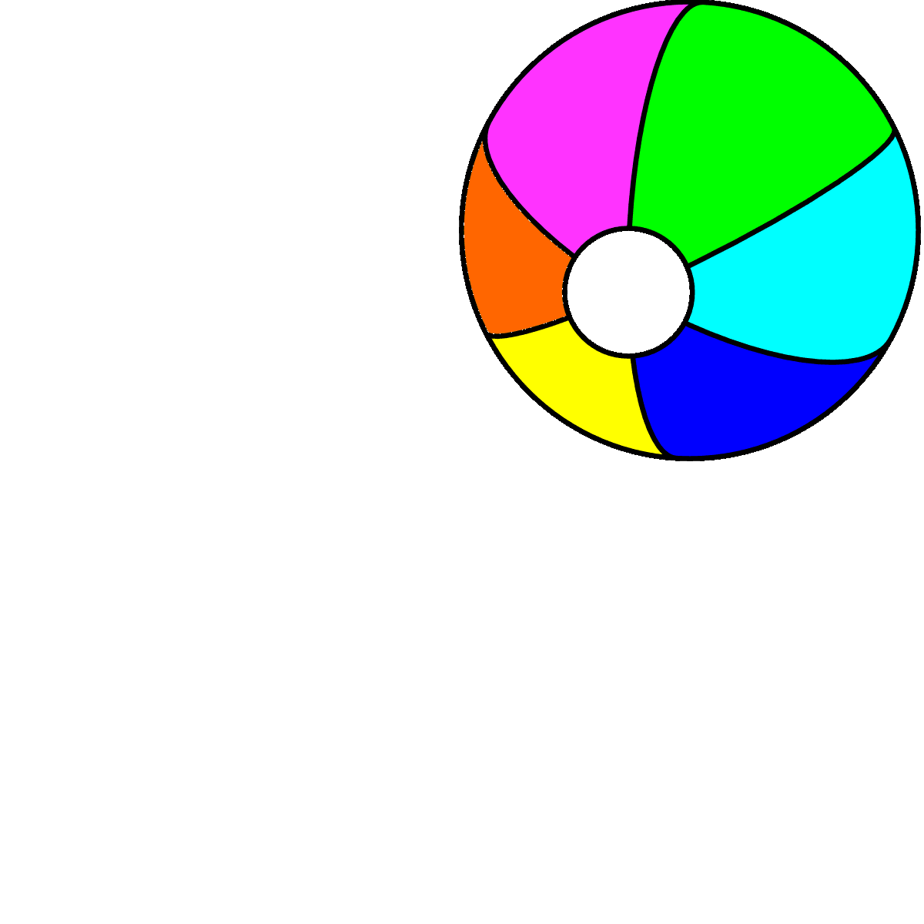
Where’s the ball?
Unit 5
Lesson 1

Slide 4
What can you see at the park?

Slide 5
Listen and point

Slide 7
Listen and repeat

Slide 9
Work in pairs

Slide 10
Listen and point

Slide 12
Listen and chant

Slide 14
Point and say!

Slide 16
Let’s stick!

Slide 17
Frisbee

Slide 18
It’s play time!

Slide 19
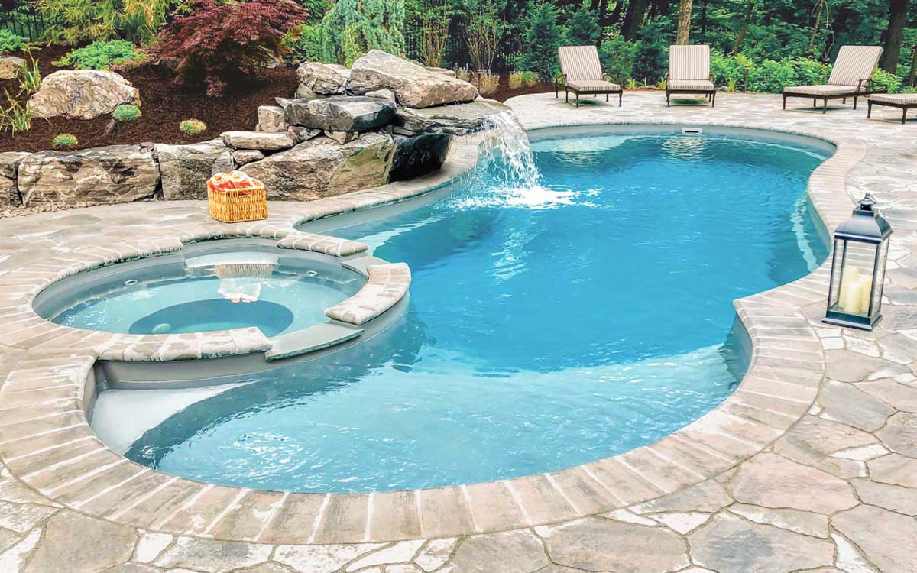
POOL

Slide 20
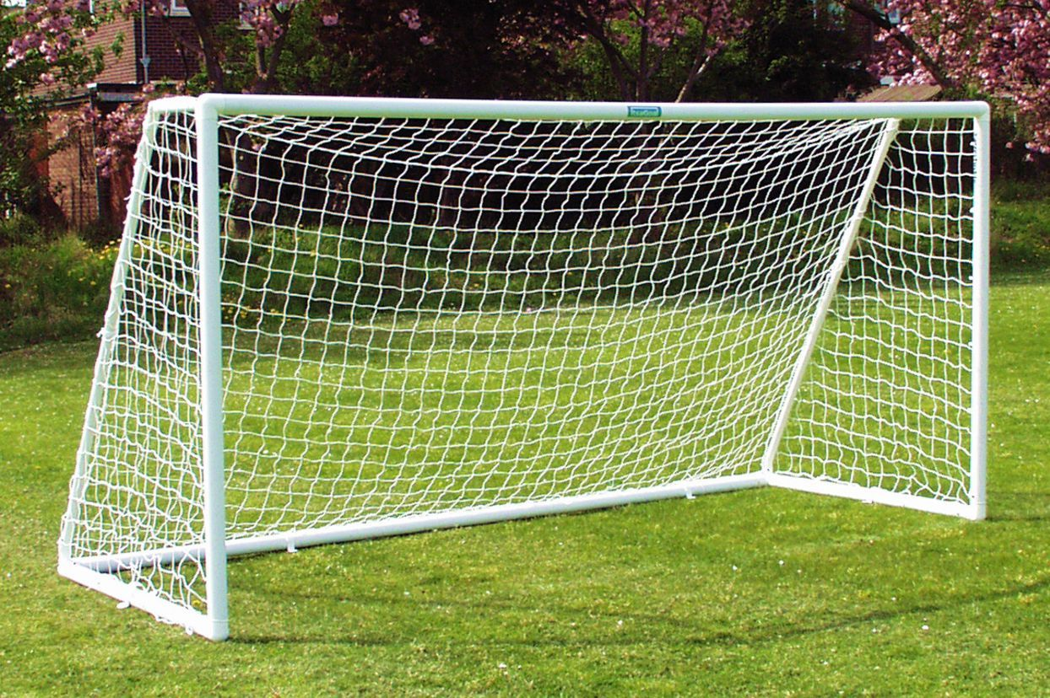
GOAL

Slide 21
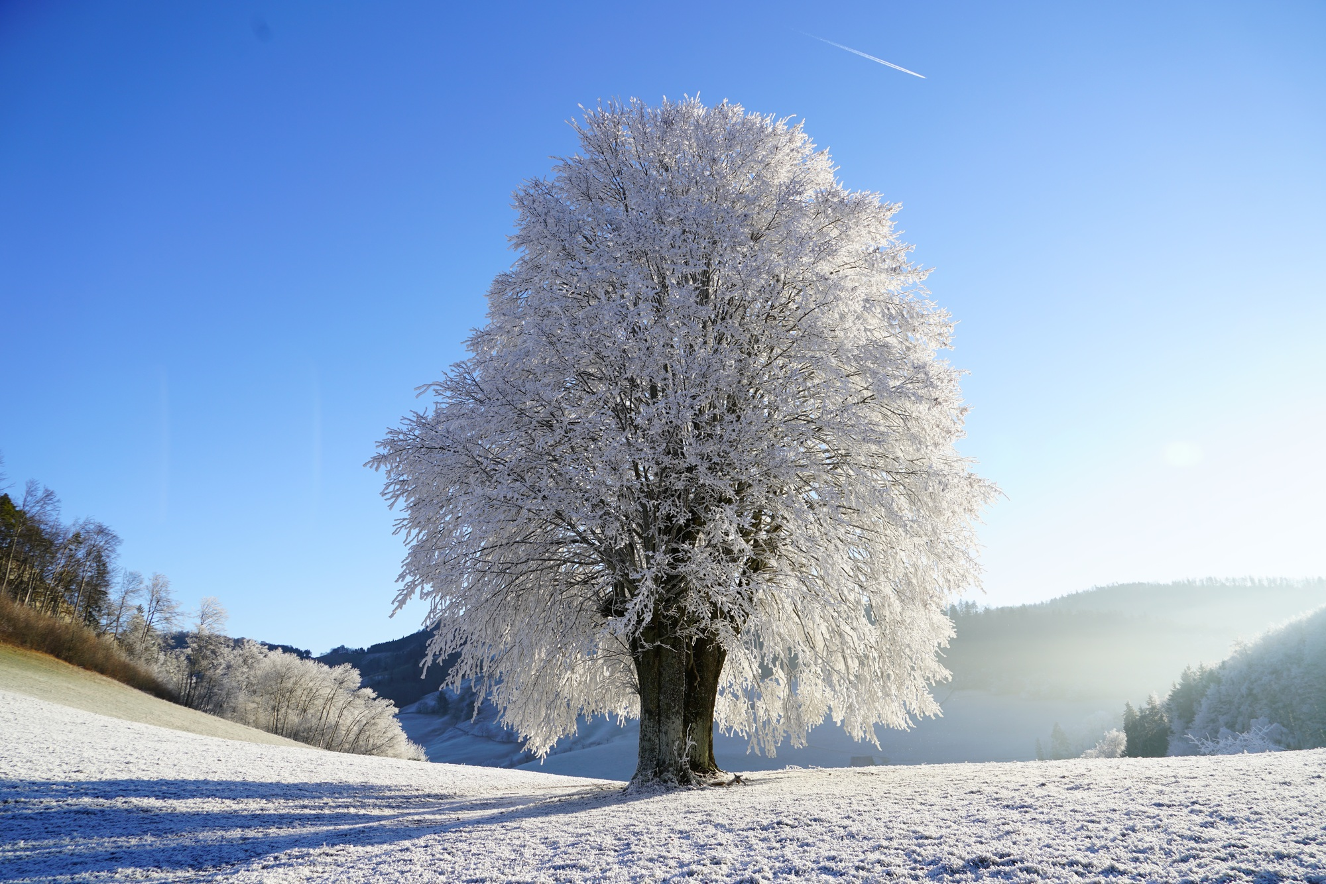
TREE

Slide 22
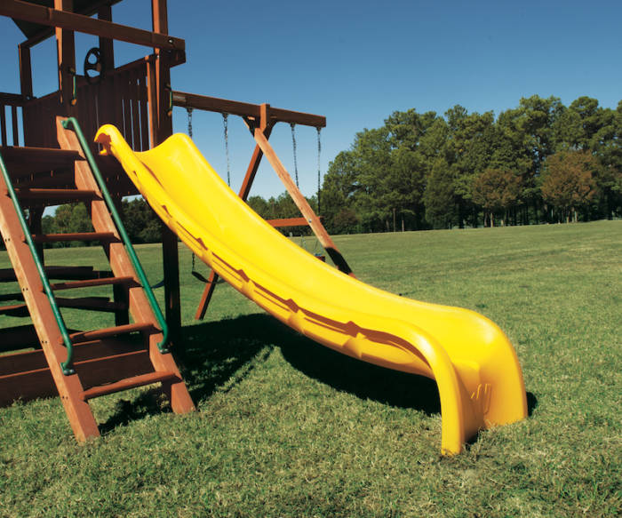
SLIDE

Slide 23
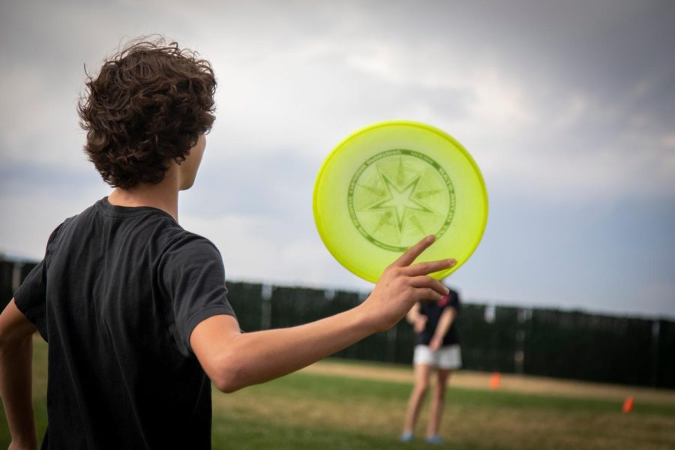
FRISBEE

Slide 24
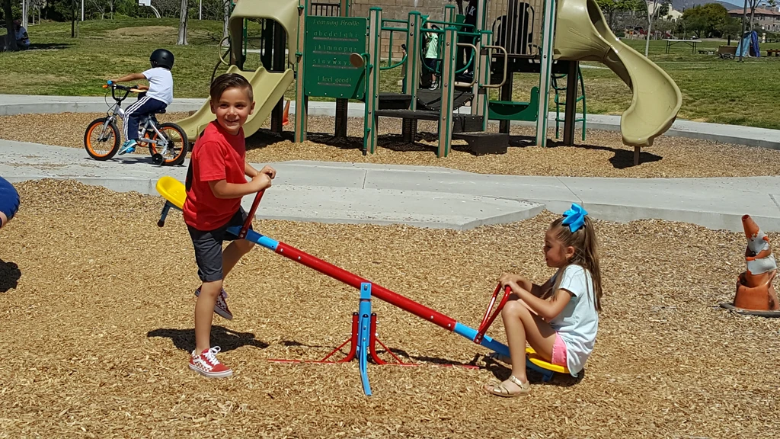
SEESAW

Slide 25
Workbook time!!!

Slide 27
Draw and write

Slide 28
Your favorite thing at the park
This is a……………

