Slide 1
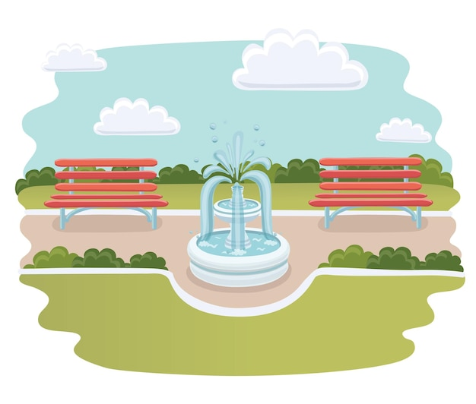
Unit 9: IN THE PARK
Lesson 2: GRAMMAR

Slide 2
Play game: Who is faster?

Slide 3
Order the words
PLAY

Slide 4
How to play
Read the words.
Say the correct sentence as fast as you can.
START

Slide 5
slowly / Walk / path./ on / the /
Walk slowly on the path
NEXT

Slide 6
You/ pick/ mustn’t/ flowers./ the/
You mustn’t pick the flowers.
NEXT

Slide 7
walk/ Don’t/ the/ grass./ on/
Don’t walk on the grass.
NEXT

Slide 8
You / climb / the / mustn’t / tree./
You mustn’t climb the tree.
NEXT

Slide 11
I walk slowly.
slow
slowly

Slide 12
Let’s match
slow
slowly
loud
loudly
politely
well
hard
polite
neatly
fast
good
hard
quiet
neat
quietly
quick
quickly
fast

Slide 13
Let’s check
slow
slowly
quick
quickly
loud
loudly
polite
politely
good
well
neat
neatly
hard
hard
quiet
quietly
fast
fast

Slide 14
loudly
Don’t shout ........

Slide 15
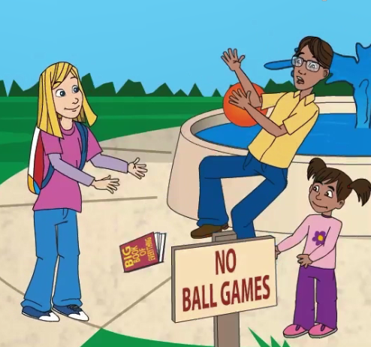
well
Max can’t catch........

Slide 16
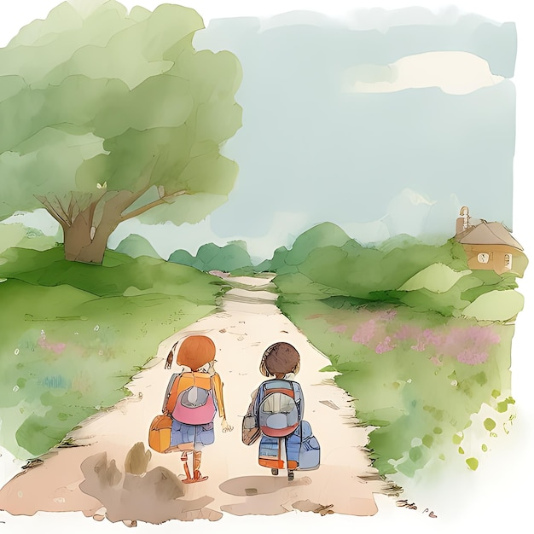
slowly
Walk......... on the path

Slide 17
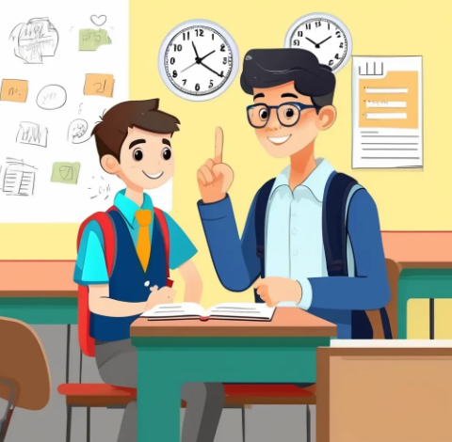
politely
You must speak.........

Slide 18
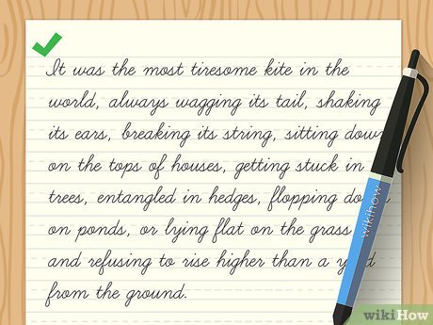
neatly
Write.........in the notebook

Slide 20
fast
fast
neat
neatly
polite
politely
loud
loudly
hard
hard
good
well

Slide 21
well
1.She always does her homework ……………

Slide 22
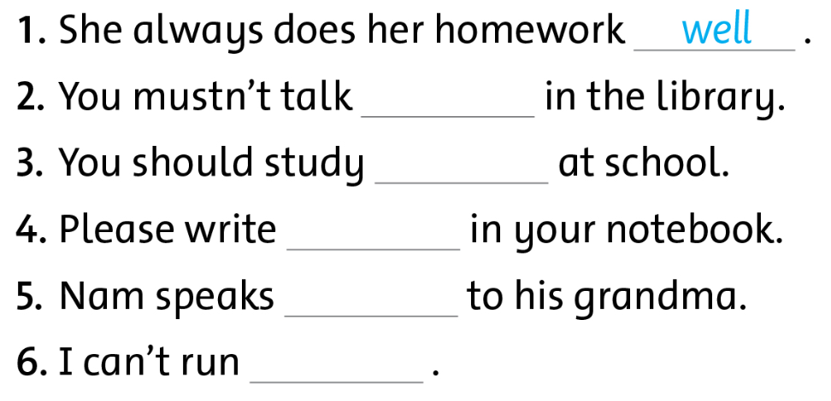

Slide 23
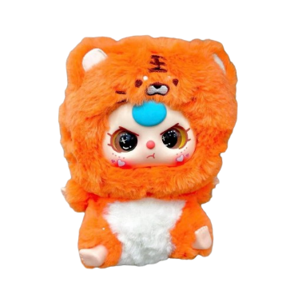
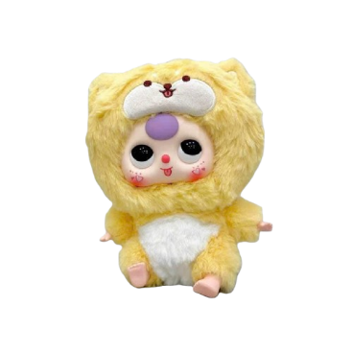
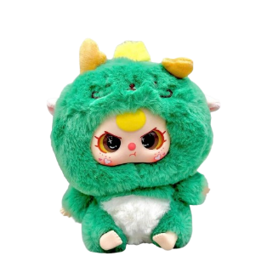
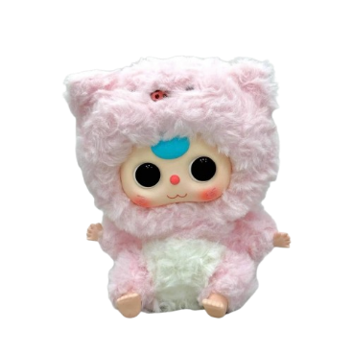
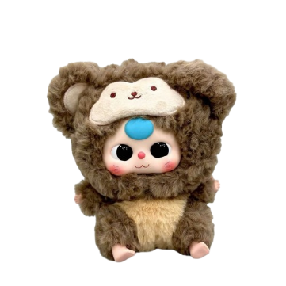
BABY THREE

Slide 24
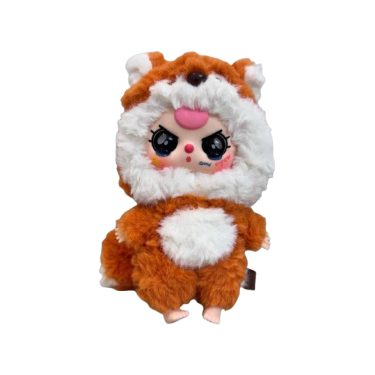
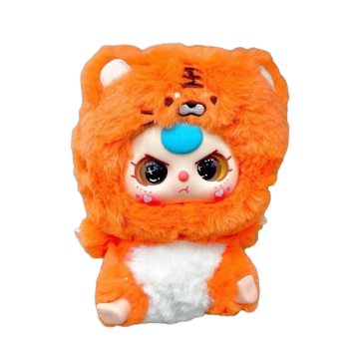
2
3
1
5
4

Slide 25
You mustn’t talk………..in the library.
loudly

Slide 26
You should study…………..at school.
hard

Slide 27
neatly
Please write……………in your notebook

Slide 28
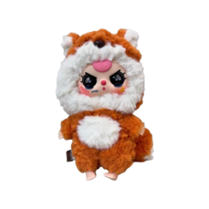
politely
Nam speaks ……………..to his grandma.

Slide 29
I can’t run…………….
fast

Slide 30
loudly
hard
neatly
politely
fast

Slide 33
Workbook time!

