Slide 2
Unit 8
Let’s buy presents!
Lesson 4 – Phonics

Slide 3
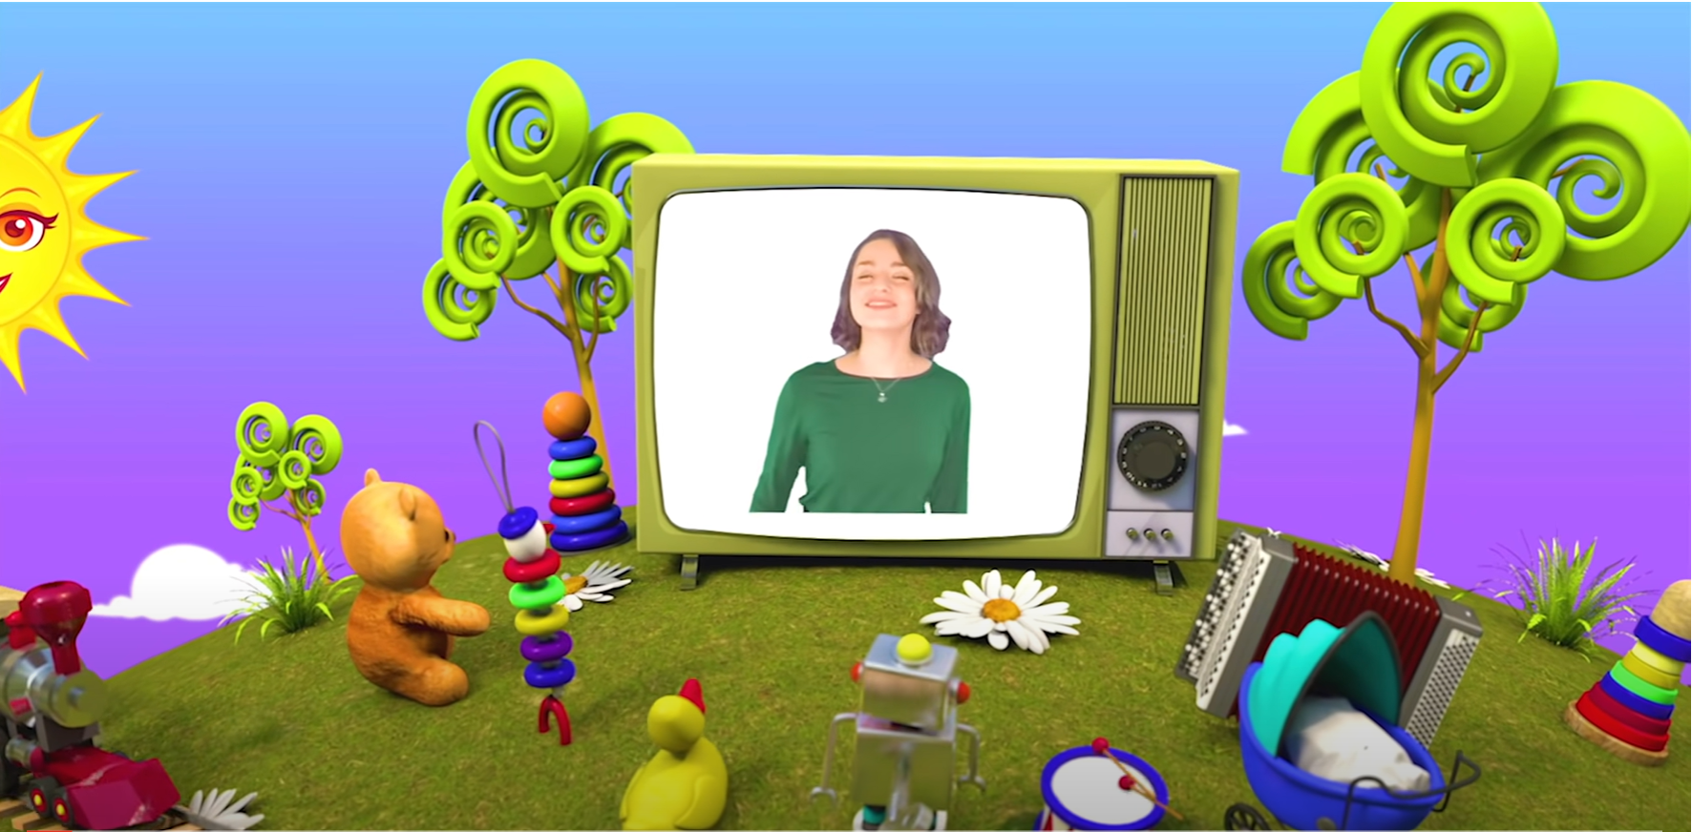
HELLO SONG
Notes:
https://www.youtube.com/watch?v=pqDEwPi7vxg

Slide 4
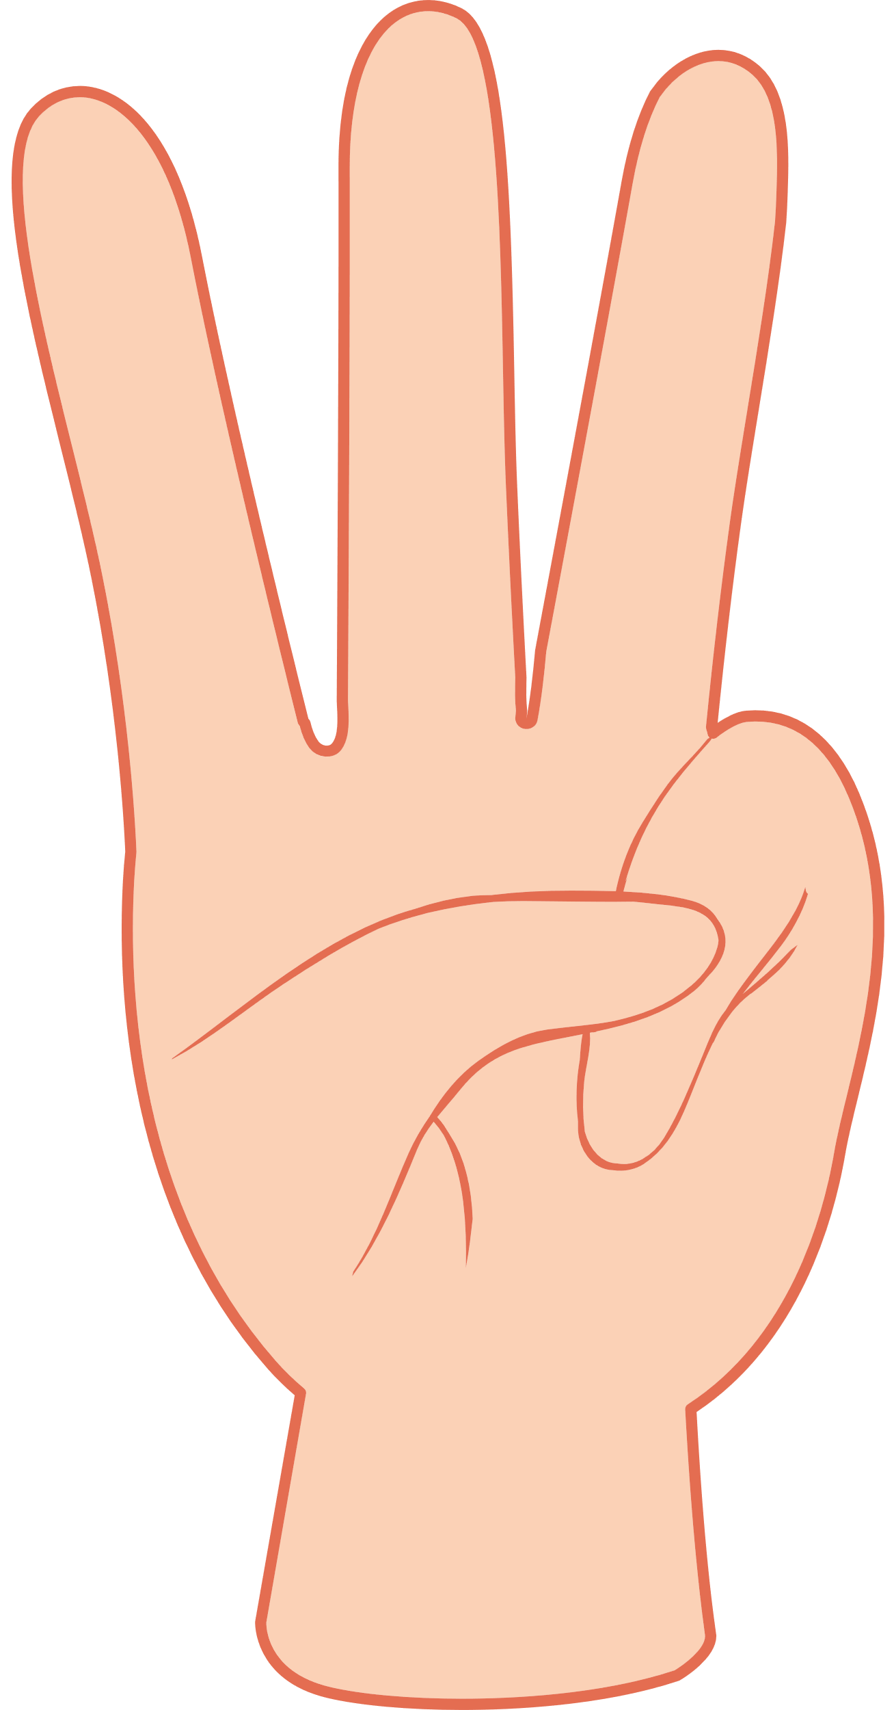

Slide 5
Let’s chant and do the actions!
57
Notes:
* Warmer
Ask children which sounds they looked at in their last phonics lesson (/ŋ/ and /ʒ/).
Do the chant from page 57 to review the sounds.

Slide 6
Good job!

Slide 7
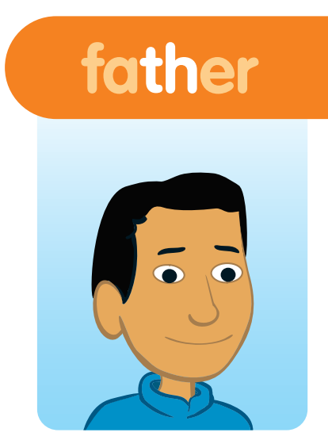
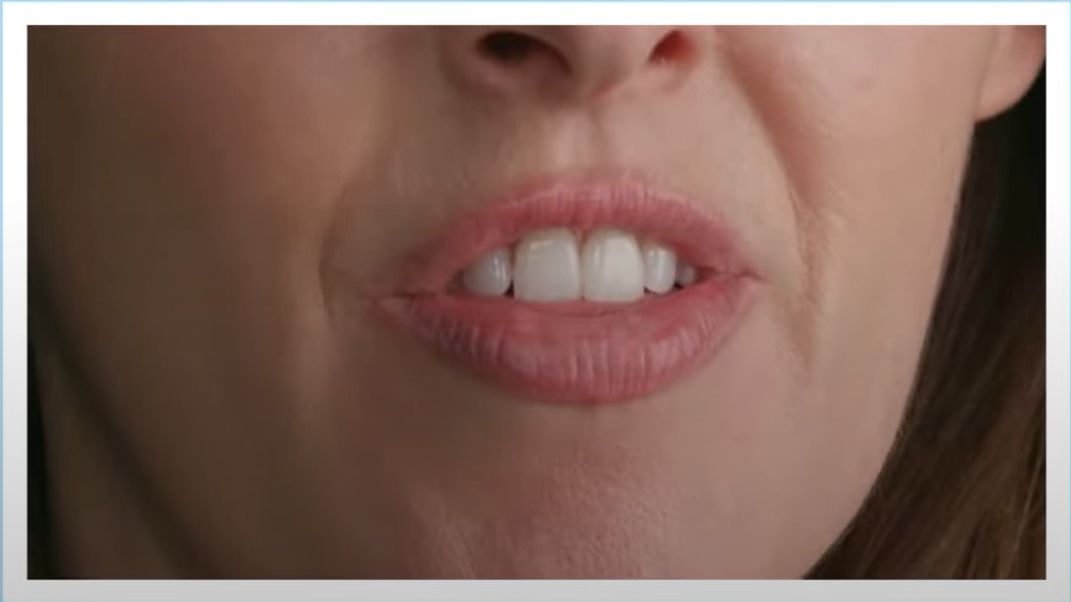
Listen and Repeat.
Notes:
* Lead-in:
Teach the sounds and letters for this lesson using phonics cards.
Hold up the father phonics card. Practice the sound /ð/ several times together. Then say the word father for the children to repeat.

Slide 8
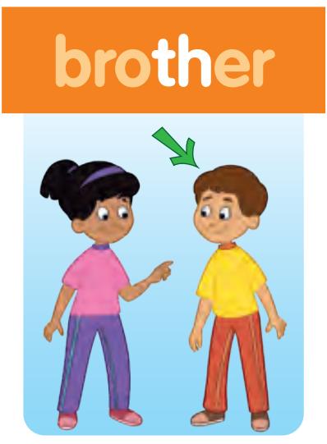
Listen and Repeat.
Notes:
Do the same with the other phonics card. Practice the sound /ð/ several times together. Then say the words for the children to repeat.

Slide 9
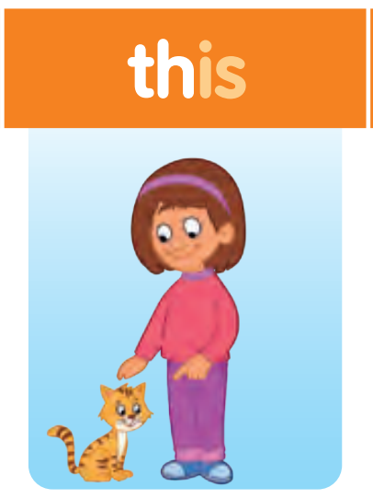
Listen and Repeat.
Notes:
Do the same with the other phonics card. Practice the sound /ð/ several times together. Then say the words for the children to repeat.

Slide 10
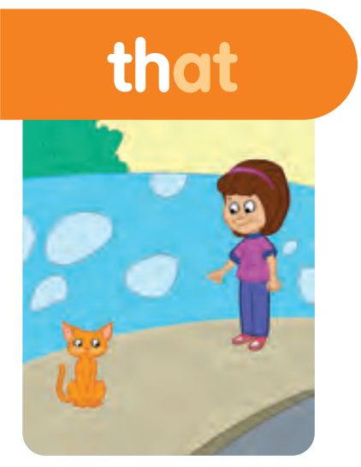
Listen and Repeat.
Notes:
Do the same with the other phonics card. Practice the sound /ð/ several times together. Then say the words for the children to repeat.

Slide 11
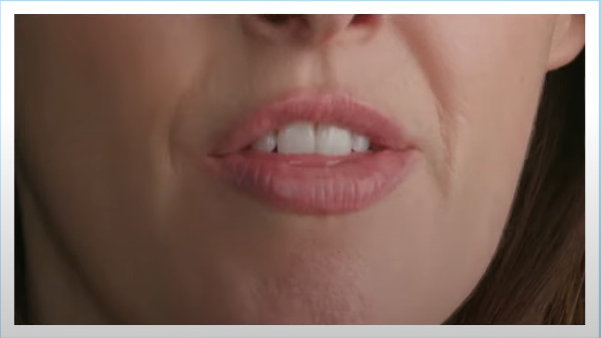
Listen and Repeat.
Notes:
Do the same with the three phonics card. Practice the sound /θ/ several times together. Then say the word three for the children to repeat.
Contrast the two sounds. Point out that the tongue is placed between the teeth to make the /ð/ sound and behind the teeth for the /θ/ sound. You can also explain that /ð/ is voiced, whereas /θ/ is unvoiced.

Slide 12
Listen and Repeat.
Notes:
Do the same with the three phonics card. Practice the sound /θ/ several times together. Then say the word three for the children to repeat.
Contrast the two sounds. Point out that the tongue is placed between the teeth to make the /ð/ sound and behind the teeth for the /θ/ sound. You can also explain that /ð/ is voiced, whereas /θ/ is unvoiced.

Slide 13
Listen and Point.
63
Notes:
Play the first part of Track 101. The children listen and point to the pictures

Slide 14
Listen and Repeat.
63
Notes:
Play the second part of the recording for children to repeat the sound and the words.

Slide 15
Listen and Repeat.
63
Notes:
Play the whole recording. The children point and repeat.

Slide 16
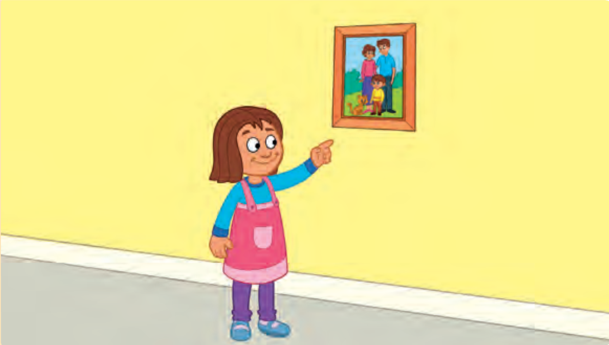
Look and Answer.
What can you see?
Notes:
* Listen and chant. Track 102
Ask children to look at the pictures. Ask What can you see?

Slide 17
Listen and Point.
63
Notes:
Play Track 102 for children to listen to the chant and point to the words in their books.

Slide 18
Listen and Repeat.
There are three people in this picture.
Who is this and who is that?
He’s my father, she’s my mother.
He’s my brother, that’s a cat.
Notes:
Ask children to listen and repeat line by line.
Put the phonics cards around the room.
Play the recording for children to point to the cards.

Slide 19
Listen and Chant.
63
Notes:
Play the recording again and ask children to chant along with actions in groups and in the front.

Slide 20
Read and Say the words with th. Write.
There are three people
in this picture.
Notes:
* Read the chant again. Say the words with th. Write.
Write the first line of the chant on the board.
Ask a child to come and find an example of a word with the sound /ð/. They find and circle there.

Slide 21
Read and Say the words with th. Write.
There are three people
in this picture.
Notes:
* Read the chant again. Say the words with th. Write.
Ask another child to find an example of a word with the sound /θ/. They find and circle three.

Slide 22
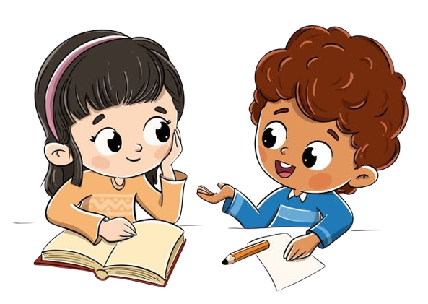
Work in Pairs
Notes:
Children read the chant silently and only say the words with th out loud.
Children write the th words in their notebooks.

Slide 23
Let’s check!
Who is this and
who is that?
Notes:
Check the answers with the whole class.
Answers
there three this that father mother brother that’s the

Slide 24
Let’s check!
He’s my father,
she’s my mother.
Notes:
Check the answers with the whole class.
Answers
there three this that father mother brother that’s the

Slide 25
Let’s check!
He’s my brother,
that’s the cat.
Notes:
Check the answers with the whole class.
Answers
there three this that father mother brother that’s the

Slide 26
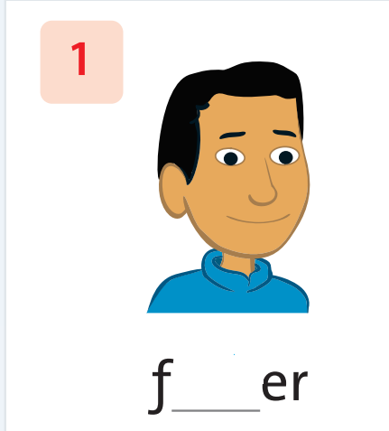
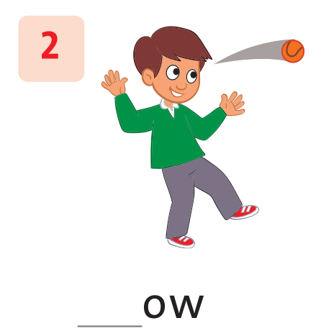
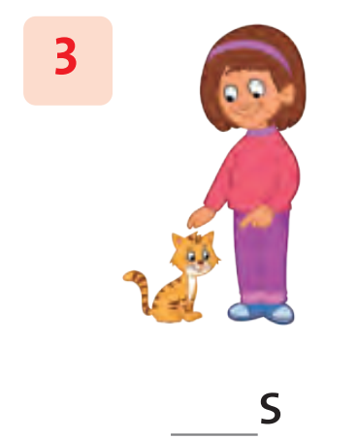
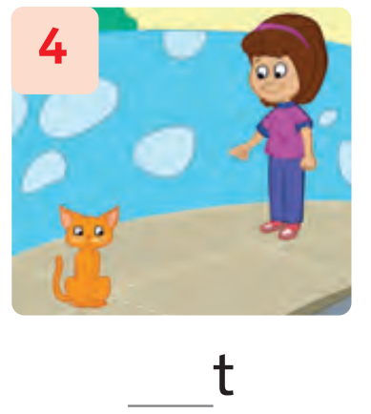
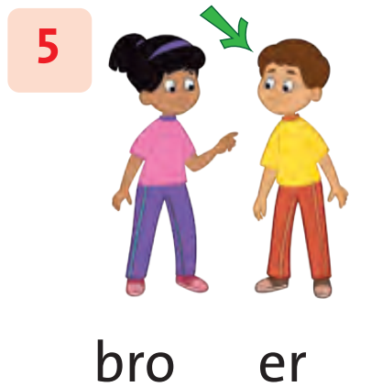
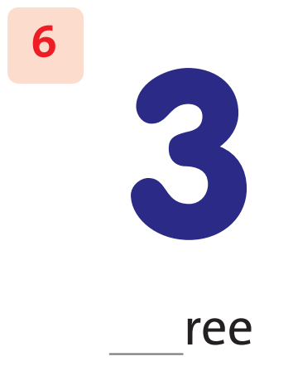
Look, Write and Say.
Notes:
* Write the missing letters. Then say the word.
Ask children to look at the pictures and say what they see.
Show them the words in the box and ask them to write the missing letters with their pencils.
Ask children to pronounce the words.

Slide 27
Look and Write the missing letters.
ath
thi
th
th
tha
thr
f____er
ath
Notes:
* Listen and complete the words. Track 92
Ask children to look at the picture 1 and the beginning of the word. Show the example.

Slide 28
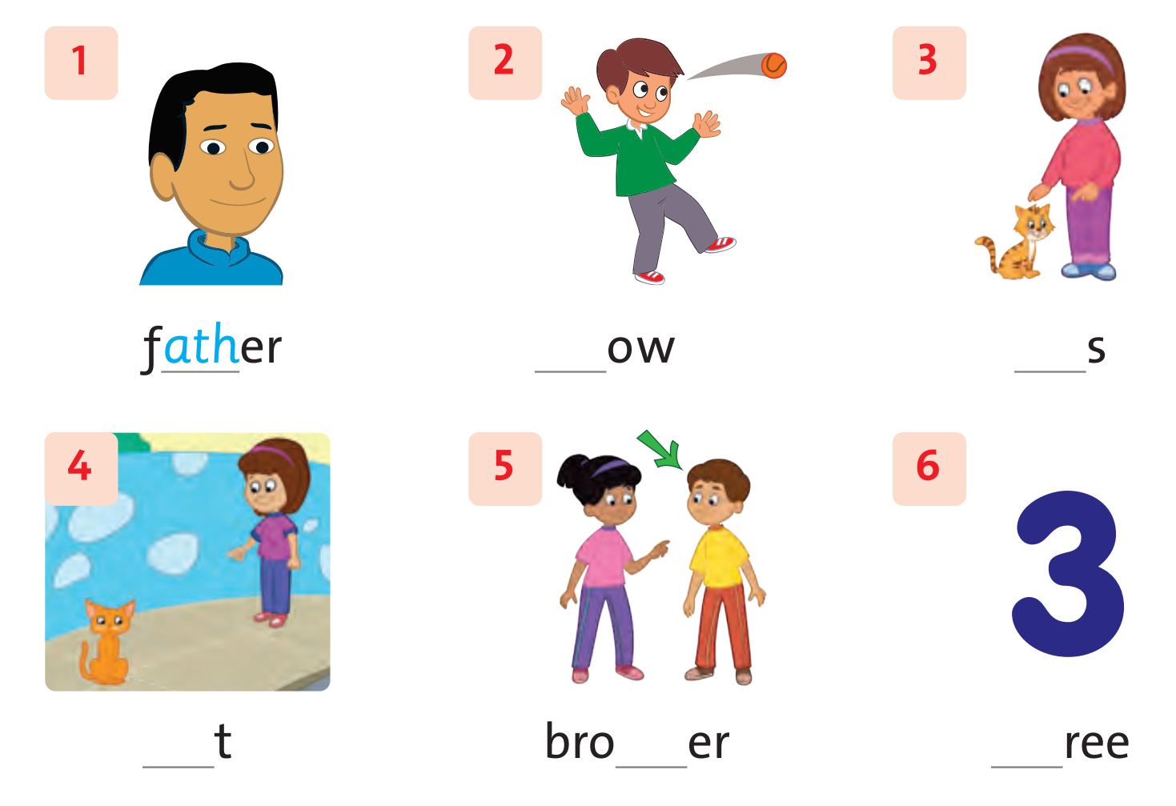
Write the missing letters. Then say.
ath
thi
th
th
tha
thr
63
Notes:
Ask the children to complete the words with their pencils.

Slide 29
Work in Pairs
Notes:
Then work in pairs to peer-check their answers.

Slide 30
Let’s check!
ath
thi
th
th
tha
thr
____ow
thr
Notes:
Answers
1 ath 2 thr 3 thi 4 tha 5 th 6 th

Slide 31
Let’s check!
ath
thi
th
th
tha
thr
___s
thi
Notes:
Answers
1 ath 2 thr 3 thi 4 tha 5 th 6 th

Slide 32
Let’s check!
ath
thi
th
th
tha
thr
___t
tha
Notes:
Answers
1 ath 2 thr 3 thi 4 tha 5 th 6 th

Slide 33
Let’s check!
ath
thi
th
th
tha
thr
bro__er
th
Notes:
Answers
1 ath 2 thr 3 thi 4 tha 5 th 6 th

Slide 34
Let’s check!
ath
thi
th
th
tha
thr
__ree
th
Notes:
Answers
1 ath 2 thr 3 thi 4 tha 5 th 6 th

Slide 35
Sentence
Building

Slide 36
Choose
a number, say and write.

Slide 37
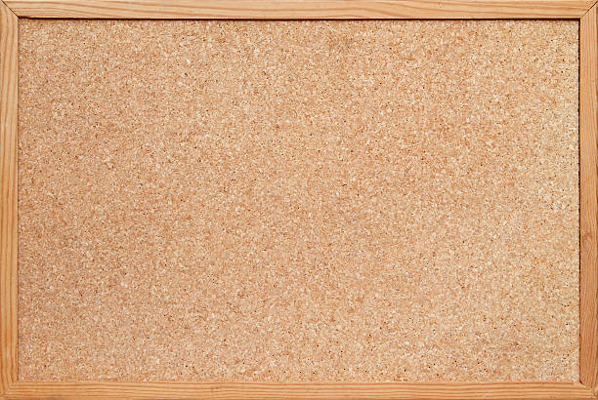
1
6
7
2
3
8
4
9
5
10

Slide 38
father

Slide 39
brother

Slide 40
1/7
this

Slide 41
1/7
that

Slide 42
1/7
mouth

Slide 43
1/7
throw

Slide 44
1/7
weather

Slide 45
1/7
thank

Slide 46
1/7
birthday

Slide 47
1/7
bathroom

Slide 49
Our Winners!
Peter
Eric
Julie
Notes:
Replace photos and names with your students’ information.

Slide 50
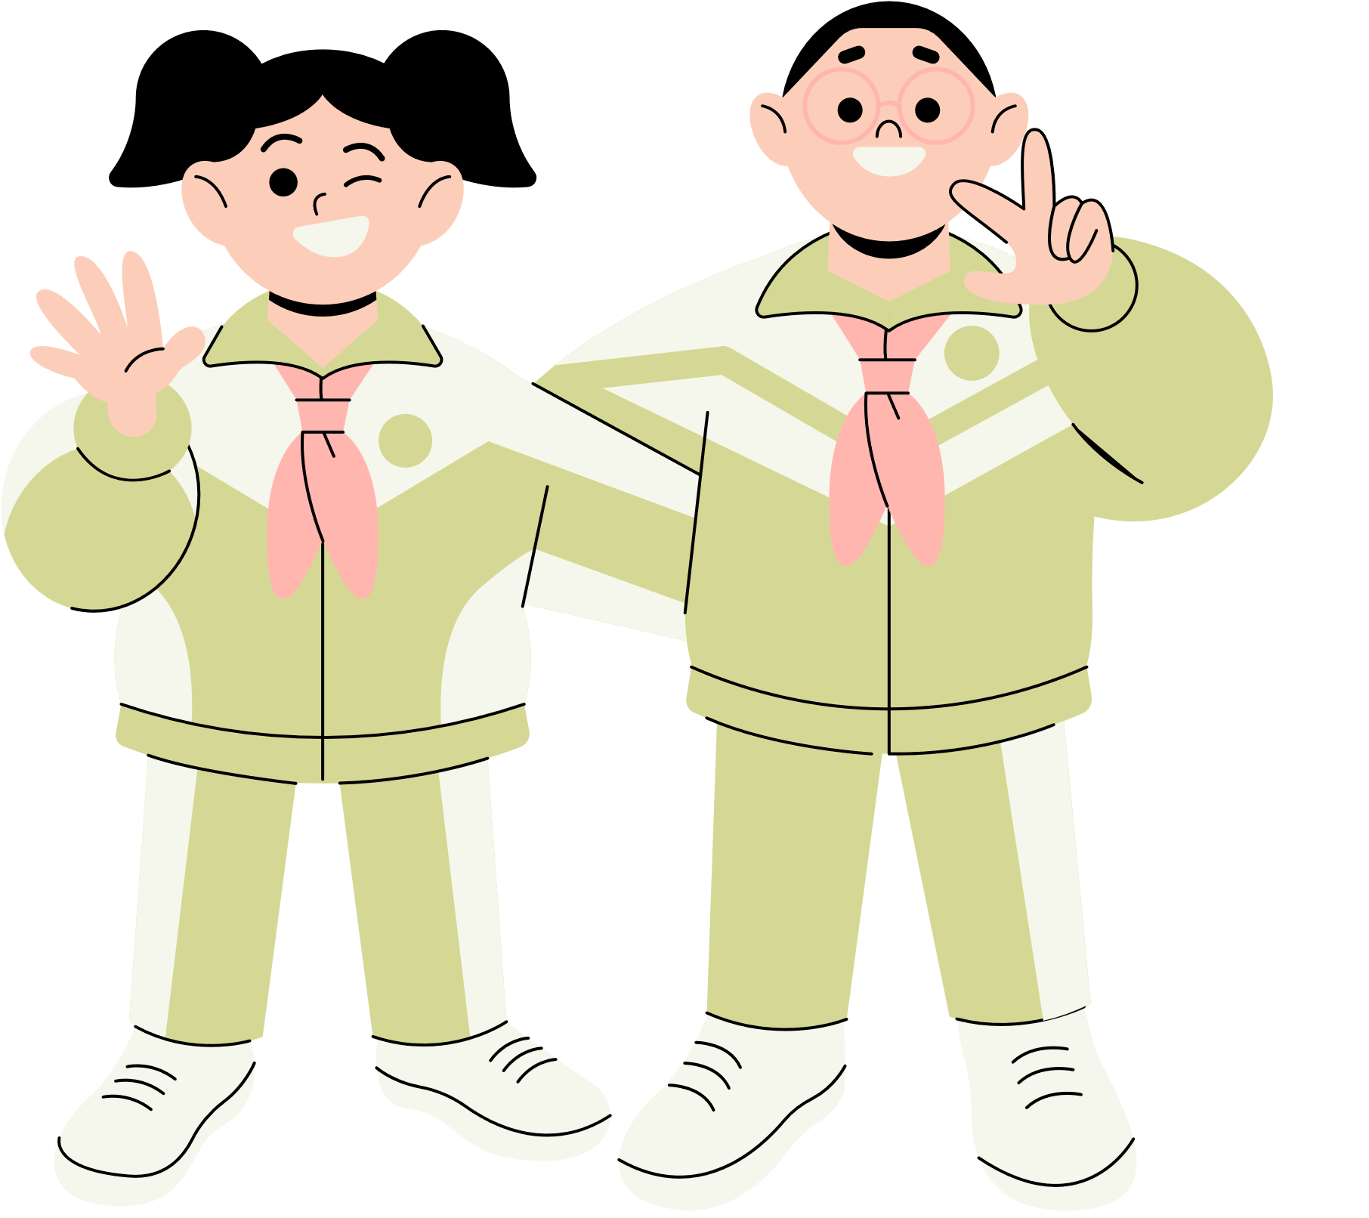
Thank You!
See You Next Time!
Notes:
https://www.youtube.com/watch?v=SRyFiVeNjWs

