Slide 2
Unit 8
Let’s buy presents!
Lesson 1 - Words

Slide 3
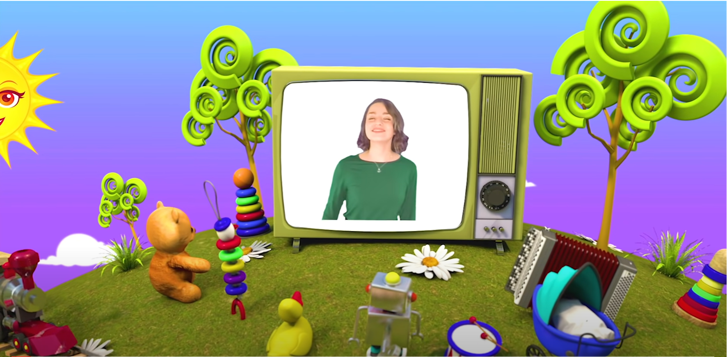
HELLO SONG
Notes:
https://www.youtube.com/watch?v=pqDEwPi7vxg

Slide 5
Sing and do.
Notes:
* Warmer: Track 89
Sing What the weather like today? song from page 56 to energize the class.

Slide 6
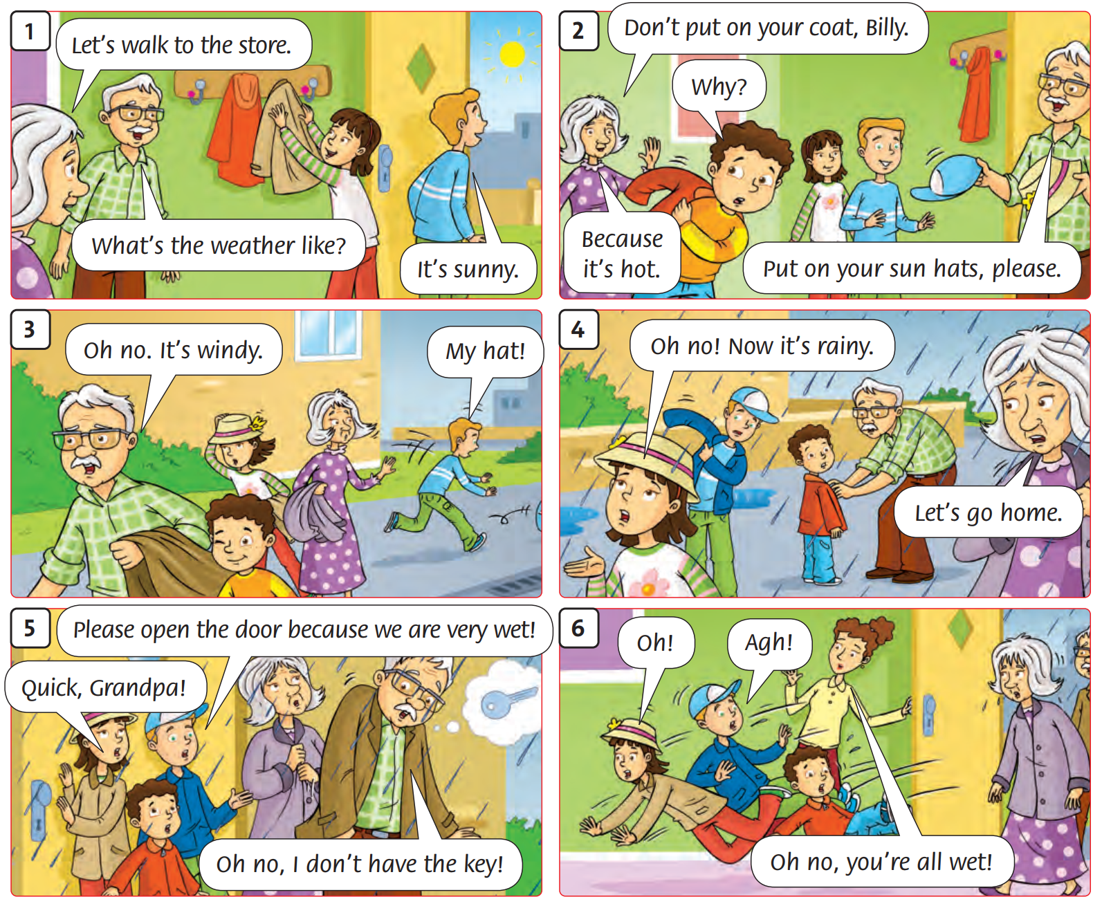
Listen
to the story.
60
Notes:
Hold up your book – Unit 7 - to retell the story from the previous unit with the class. Ask What’s the weather like at first? What’s it like later?

Slide 7
Look and Answer.
Birthday,
Tet,
Teachers’ Day,
…
Notes:
*Lead-in:
Draw a picture of a big box with a ribbon on the board.
Ask What is it? (a present). When do we give presents? (birthday, Tet, Teachers’ Day, etc.).

Slide 8
Look and Answer.
candy
present
Birthday,
Tet,
Teachers’ Day,
…
candle
balloon
Notes:
Ask What other things do we have at parties? Write the ideas on the board around the present.
Use the flashcards to elicit the vocabulary for this lesson (or use real objects if you have them). Hold them up one at a time for children to say the words. Model any unknown words.
Hold the flashcards up in a different order and repeat.

Slide 9
Look
and
Say.
Notes:
Use the flashcards to elicit the vocabulary for this lesson (or use real objects if you have them). Hold them up one at a time for children to say the words. Model any unknown words.
Hold the flashcards up in a different order and repeat.

Slide 10
Look and Listen.
candy
Notes:
Hold the flashcards up in a different order and repeat.

Slide 11
Look and Listen.
balloon
Notes:
Hold the flashcards up in a different order and repeat.

Slide 12
Look and Listen.
present
Notes:
Hold the flashcards up in a different order and repeat.

Slide 13
Look and Listen.
candle
Notes:
Hold the flashcards up in a different order and repeat.

Slide 14
Listen and Point.
60
Notes:
Students open their books to page 60.
Listen and point.

Slide 15
Listen, Point and Repeat.
60
Notes:
Students open their books to page 60.
Listen, point and repeat.

Slide 16
Game: WHAT’S MISSING?
Notes:
Put the flashcards on the board in a sequence, e.g. balloon, candle, present, candy for the children to say the words in order.

Slide 17
Game: WHAT’S MISSING?
Notes:
Remove one flashcard. The class repeats the sequence, including the missing word. Remove one more flashcard each time, until children are saying the whole sequence from memory.

Slide 18
Game: WHAT’S MISSING?
Notes:
Remove one flashcard. The class repeats the sequence, including the missing word. Remove one more flashcard each time, until children are saying the whole sequence from memory.

Slide 19
Game: WHAT’S MISSING?
Notes:
Remove one flashcard. The class repeats the sequence, including the missing word. Remove one more flashcard each time, until children are saying the whole sequence from memory.

Slide 20
Game: WHAT’S MISSING?
Notes:
Remove one flashcard. The class repeats the sequence, including the missing word. Remove one more flashcard each time, until children are saying the whole sequence from memory.

Slide 21
Game: WHAT’S MISSING?
Notes:
Remove one flashcard. The class repeats the sequence, including the missing word. Remove one more flashcard each time, until children are saying the whole sequence from memory.

Slide 22
Game: WHAT’S MISSING?
Notes:
Remove one flashcard. The class repeats the sequence, including the missing word. Remove one more flashcard each time, until children are saying the whole sequence from memory.

Slide 23
Good job!

Slide 24
Listen and Chant.
60
Notes:
Students open their books to page 54.
Listen and chant.

Slide 25
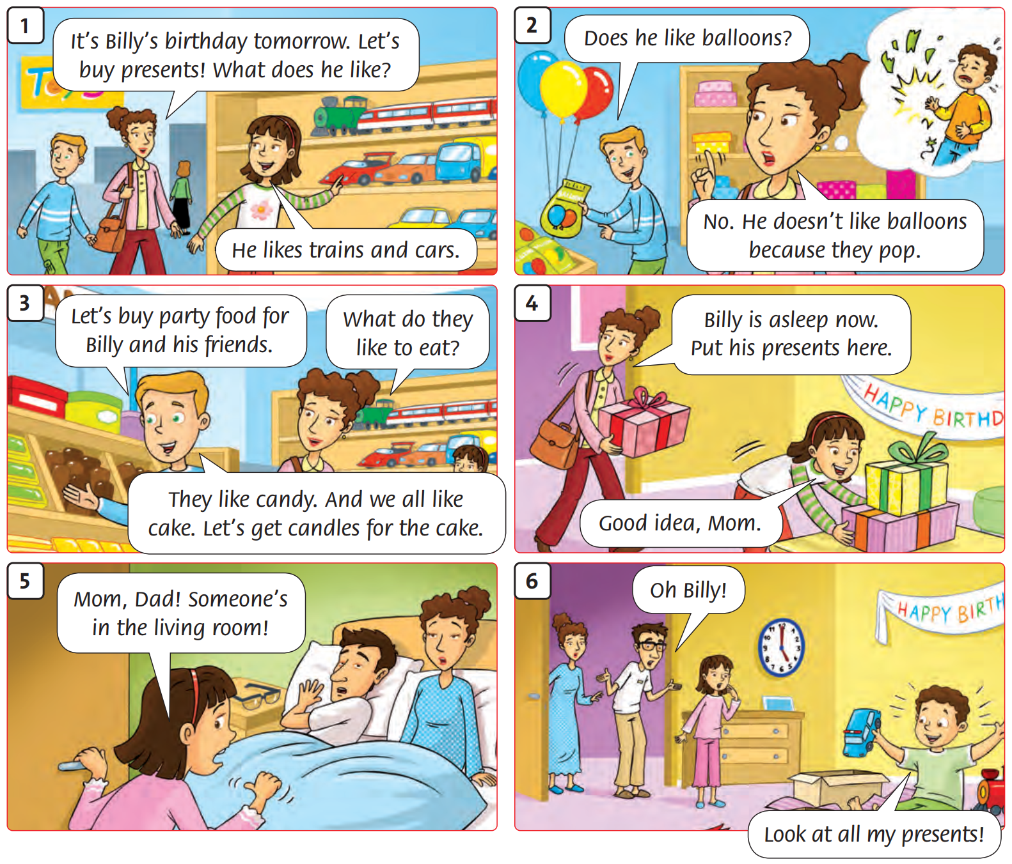
Let’s talk about the story pictures.
Notes:
Draw attention to the story pictures.

Slide 26
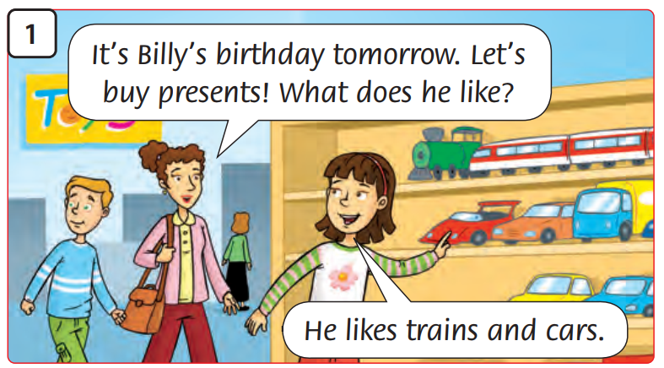
Look and
Say.
Notes:
Talk about each frame with the class. Encourage predictions.

Slide 27
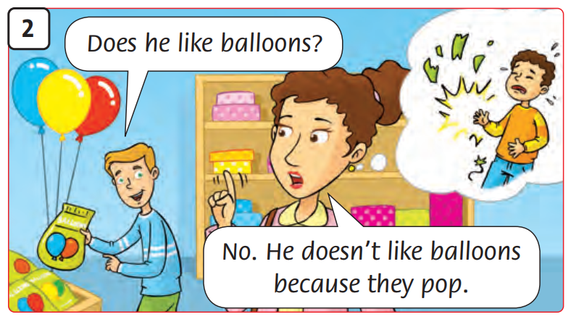
Look and
Say.
Notes:
Talk about each frame with the class. Encourage predictions.

Slide 28
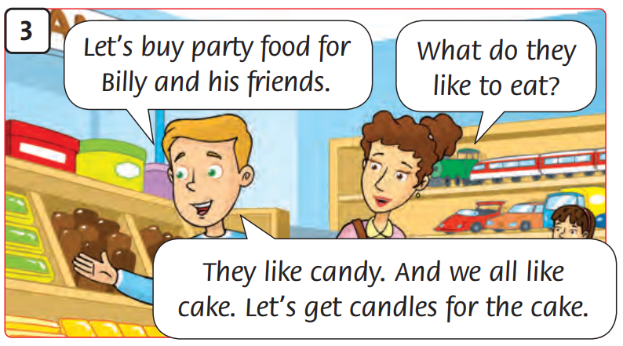
Look and
Say.
Notes:
Talk about each frame with the class. Encourage predictions.

Slide 29
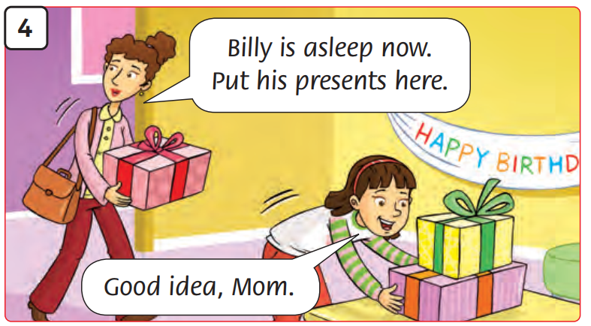
Look and
Say.
Notes:
Talk about each frame with the class. Encourage predictions.

Slide 30
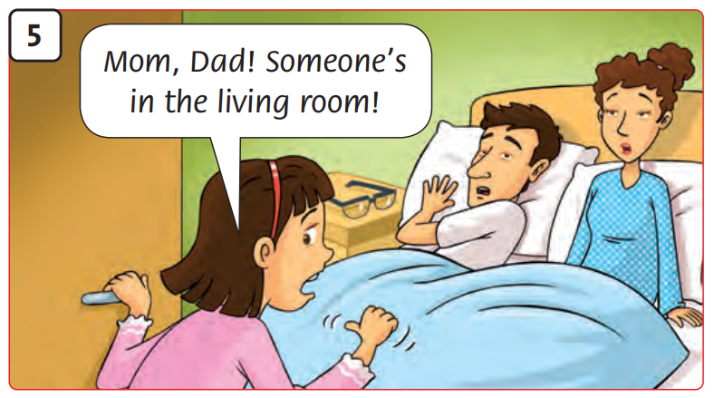
Look and
Say.
Notes:
Talk about each frame with the class. Encourage predictions.

Slide 31
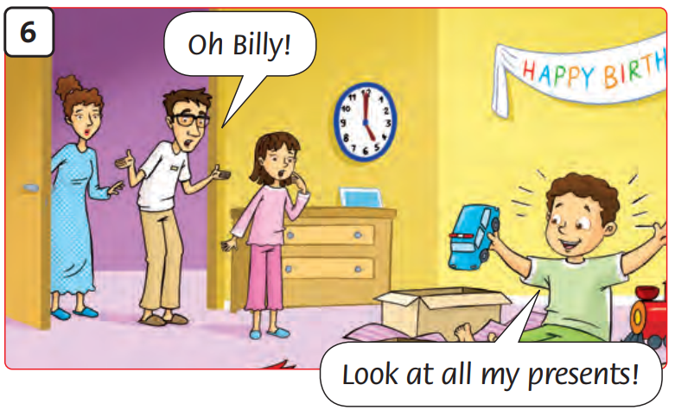
Look and
Say.
Notes:
Talk about each frame with the class. Encourage predictions.

Slide 32
Watch the video.
Notes:
Ask children to look at the story in their books. Play the video or the recording for them to watch or listen and point to the different speech bubbles as they hear the words.

Slide 33
Read and Answer.
60
1. Whose birthday is it?
2. What does Billy like?
3. Who is in the living room?
Notes:
- Ask comprehension questions, e.g. Whose birthday is it? What does Billy like? Who is in the living room?
- Students open their books, read the story and answer the questions. They can work in pairs to talk about the answers.
- Do a click to play music for children talking to each other.

Slide 34
Listen and
Point.
60
Notes:
Ask students to open their books. Listen and point to the pictures. .

Slide 35
Listen and
Repeat.
60
Notes:
Ask students to open their books. Listen and repeat.

Slide 36
Let’s read and
choose a, b, c or d!

Slide 37
You can see it in the party.
It’s colorful.
You cannot eat it.
You play with it.
a) candy
c) present
b) balloon
d) candle

Slide 38
You can see it in the party.
It’s colorful.
It’s sweet.
You can eat it.
a) candy
c) present
b) balloon
d) candle

Slide 39
You can see it in the party.
It’s colorful.
You can see it on the birthday cake.
You cannot eat it.
a) candy
c) present
b) balloon
d) candle

Slide 40
You can see it in the party.
It’s colorful.
You open it
and then you will be surprised.
a) candy
c) present
b) balloon
d) candle

Slide 41
Good job!
Notes:
Point and Say

Slide 42
Homework
Learn new words by heart.
Do the exercises in Workbook page 60.
Prepare for the next lesson
(Unit 8- Lesson 2/ Part 1).

Slide 43
Our Winners!
Peter
Eric
Julie
Notes:
Replace photos and names with your students’ information.

Slide 44
Thank You!
See You Next Time!
Notes:
https://www.youtube.com/watch?v=SRyFiVeNjWs

