Slide 1


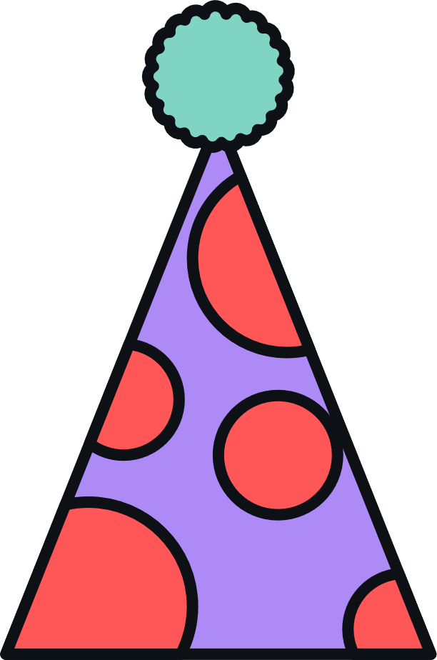



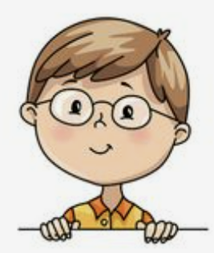
I’m dancing with dad.
Unit 8
Lesson 6: Skills Time

Slide 2


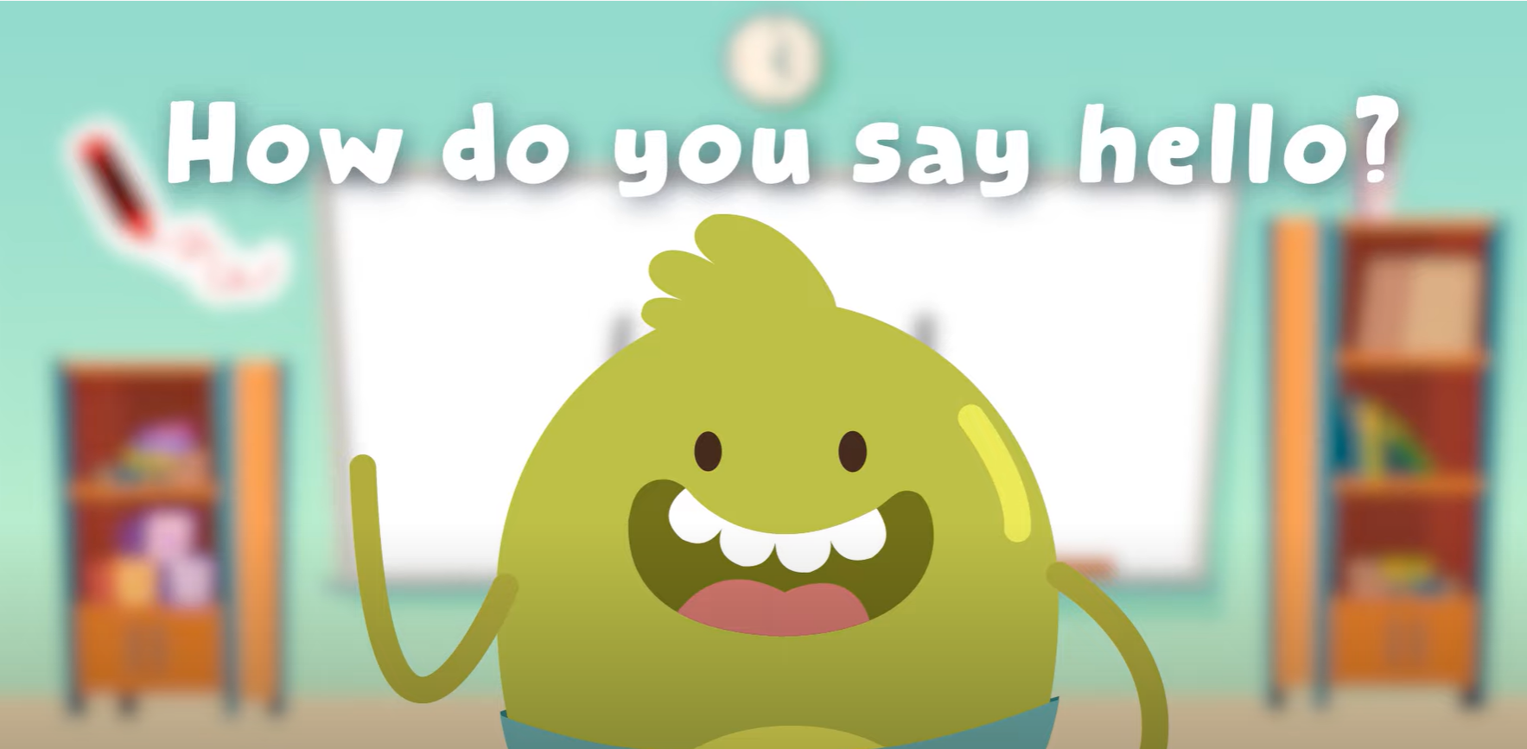
HELLO SONG

Slide 3



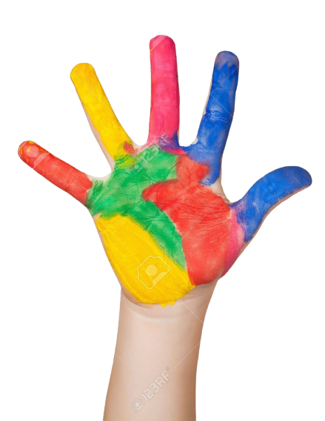



Give me Five

Slide 4
Game
MIND THE WORD
sing
1
eat
2
brush
3
talk
4
dance
5
watch
6
wash
7
take photo
8
Notes:
Choose a number to mind the word.

Slide 5
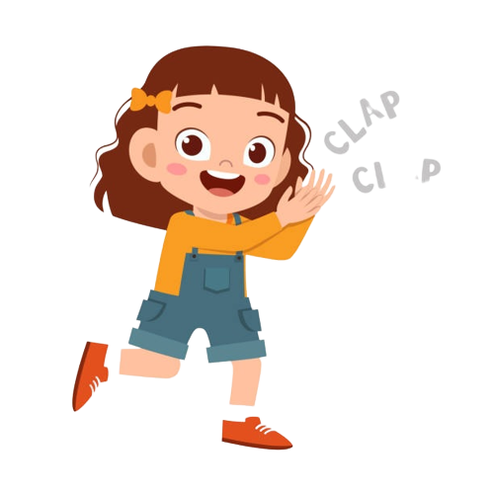
Good job!

Slide 6

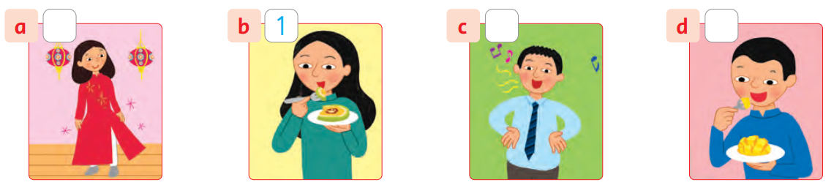
Listen and Number

Slide 7
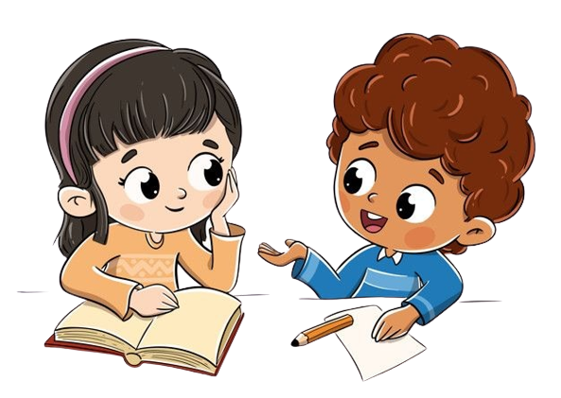
Work in Pairs
Notes:
Students work in pairs to peer-check their answers.

Slide 8
Listen and Number
3
2
4
Notes:
Answers:
1. b 2. c 3. a 4. d

Slide 9
Good job!

Slide 10
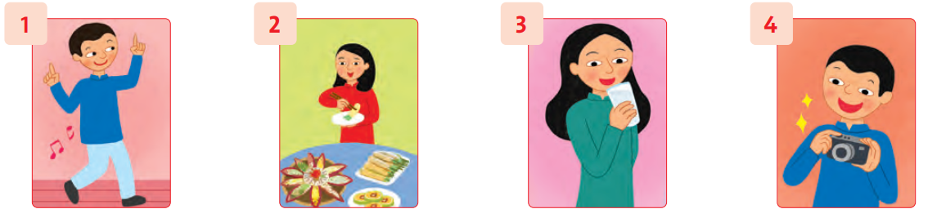
Rock-Scissors-Paper
Notes:
Ask and answer
What’s he doing?
He’s dancing.

Slide 11
Good job!

Slide 12
Read and Write
Write ing
ing
I’m eat__________ some cake.
ing
She’s drink__________ water.
ing
He’s talk______ with his family at the party.

Slide 13
Read and Write
Write about your family at Tet.
It’s Tet holiday. My dad is ______________________. My mom is _______________.
I’m ___________________. We’re happy.
cleaning our house
cooking
helping my mom

Slide 14
Work in Pairs
Notes:
Read their writing texts to each other.

Slide 15
Good job!

Slide 16
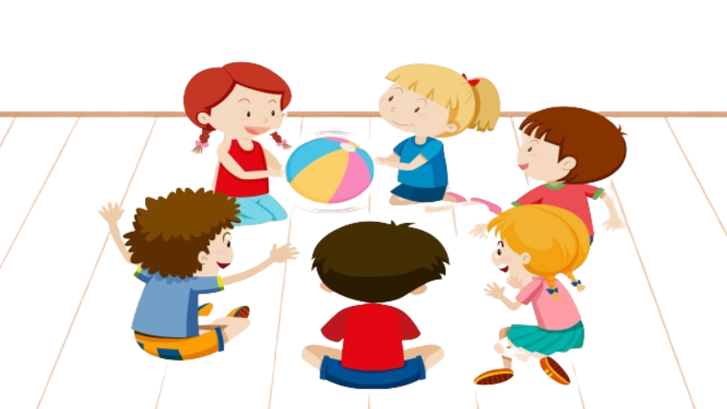
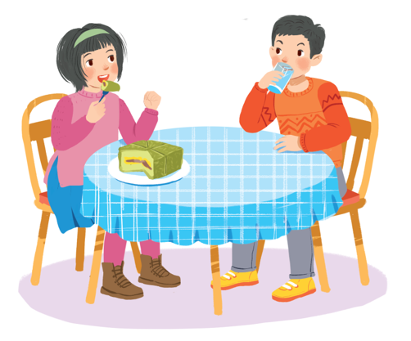
Game
PASSING BALL
She’s eating banh chung.
What’s she doing?
Notes:
Choose a photo of your Tet holiday and say what you’re doing.
I’m eating and drinking.

Slide 17

Game
PASSING BALL
He’s singing.
What’s he doing?
Notes:
Choose a photo of your Tet holiday and say what you’re doing.
I’m eating and drinking.

Slide 18
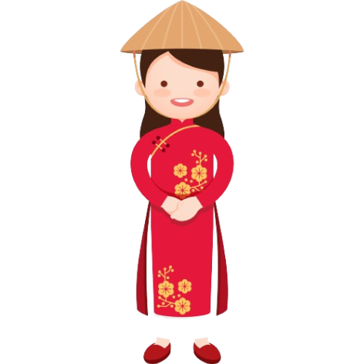
Game
PASSING BALL
She’s wearing new Ao dai.
What’s she doing?
Notes:
Choose a photo of your Tet holiday and say what you’re doing.
I’m eating and drinking.

Slide 19
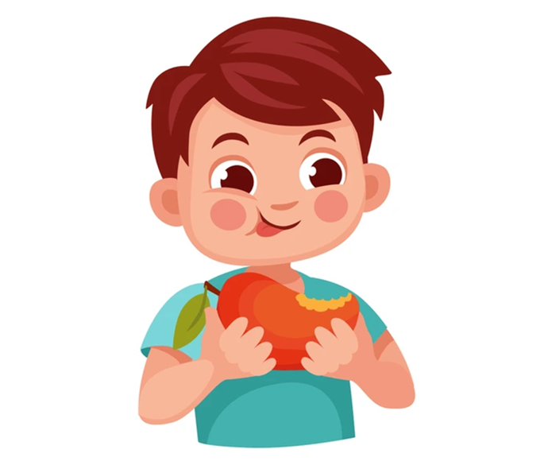
Game
PASSING BALL
He’s eating mango.
What’s he doing?
Notes:
Choose a photo of your Tet holiday and say what you’re doing.
I’m eating and drinking.

Slide 20
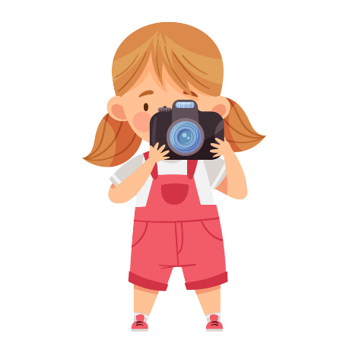
Game
PASSING BALL
She’s taking photos.
What’s she doing?
Notes:
Choose a photo of your Tet holiday and say what you’re doing.
I’m eating and drinking.

Slide 21
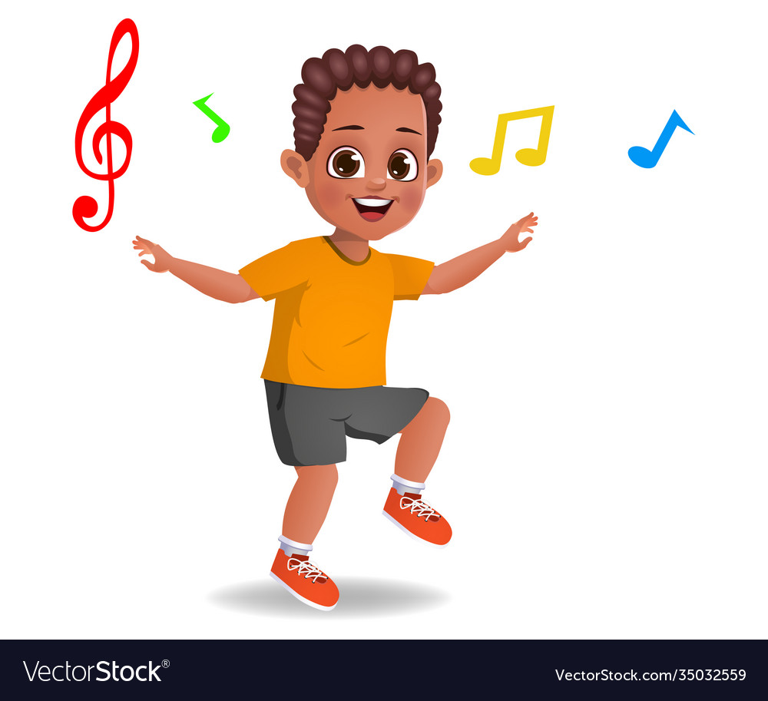
Game
PASSING BALL
He’s dancing.
What’s he doing?
Notes:
Choose a photo of your Tet holiday and say what you’re doing.
I’m eating and drinking.

Slide 22
Thank you for playing!

Slide 23


See you later!

