Slide 1






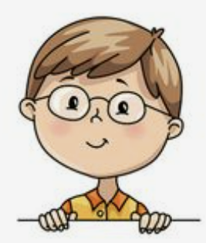
I’m dancing with dad.
Unit 8
Lesson 5: Skills Time

Slide 2


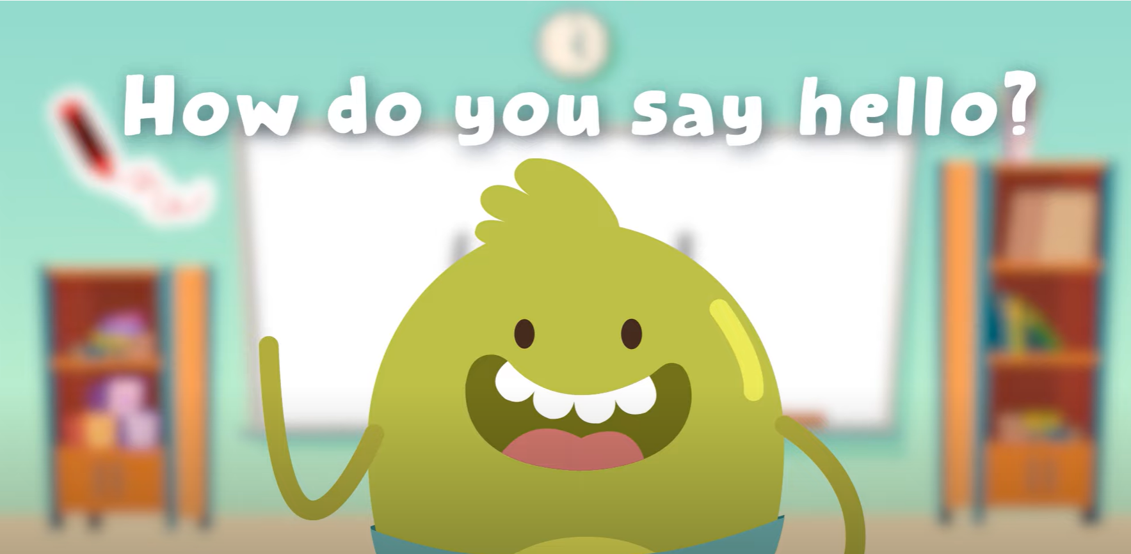
HELLO SONG

Slide 3



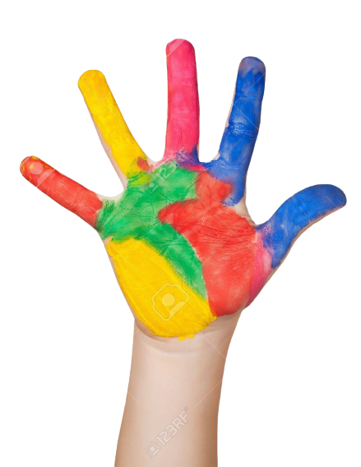



Give me Five

Slide 4
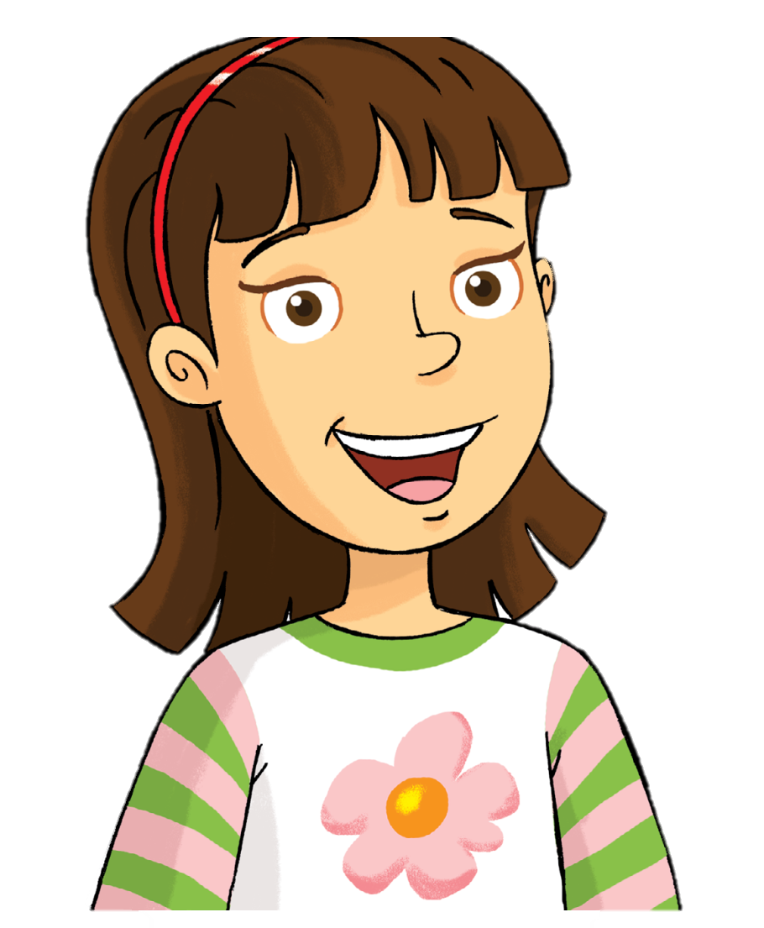
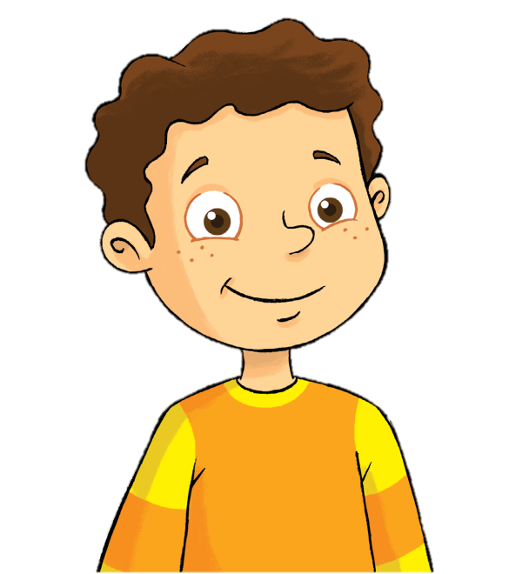


Look and Say
Rosy
Billy
mom
dad

Slide 5

Watch and Answer

Slide 6
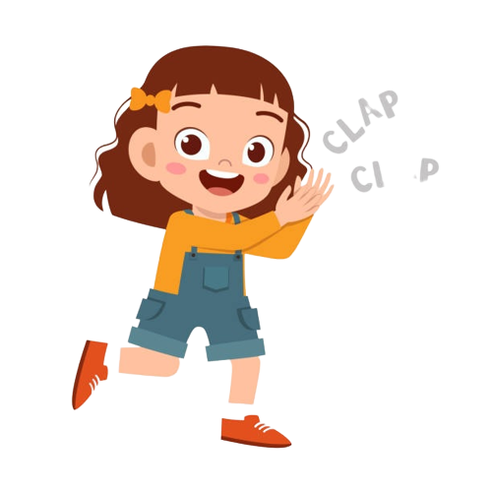
Good job!

Slide 7
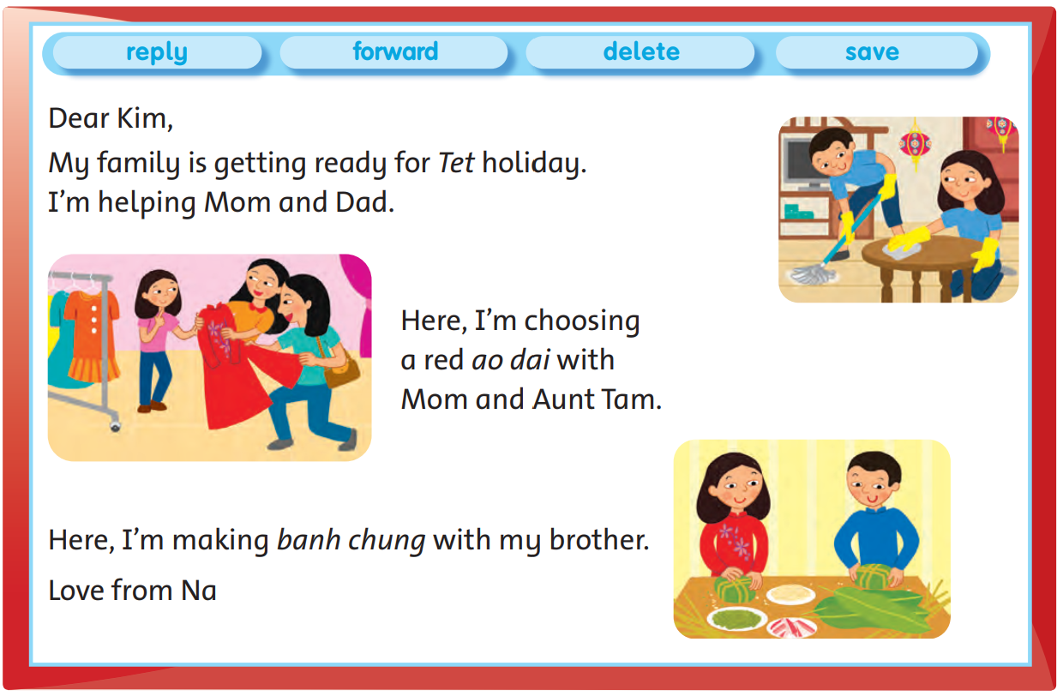
Look and Say

Slide 8

Listen and Point
64

Slide 9
Listen and Repeat
64

Slide 10
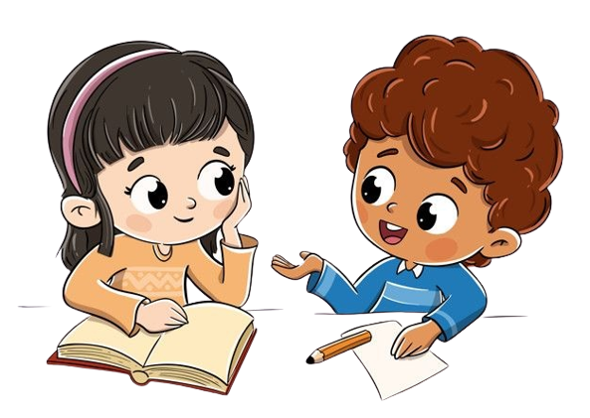
Work in Pairs
Notes:
Practice reading skills

Slide 11
Good job!

Slide 12
Read and Write
holiday

Slide 13
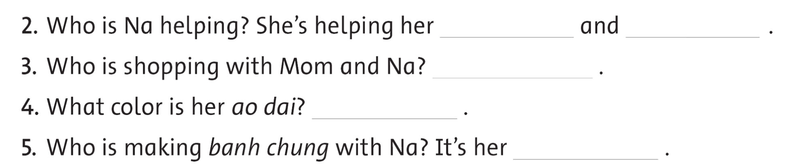
Read and Write

Slide 14
Work in Pairs
Notes:
Peer-checking students’ answers.

Slide 15

Let’s check!
Mom
Dad

Slide 16

Let’s check!
Aunt Tam

Slide 17

Let’s check!
red

Slide 18
Let’s check!
her brother

Slide 19
Good job!

Slide 20
Let’s talk!
How do you celebrate Tet?

Slide 21
Good job!

Slide 22

The Dice Game

Slide 23

The Dice Game
Notes:
- Divide the email into three parts.
- Let each student of each group take turns throwing the dice to choose a student and read each part of the email.
- Give stickers if students read the email well.

Slide 24
Thank you for playing!

Slide 25


THANK YOU!

