Slide 1




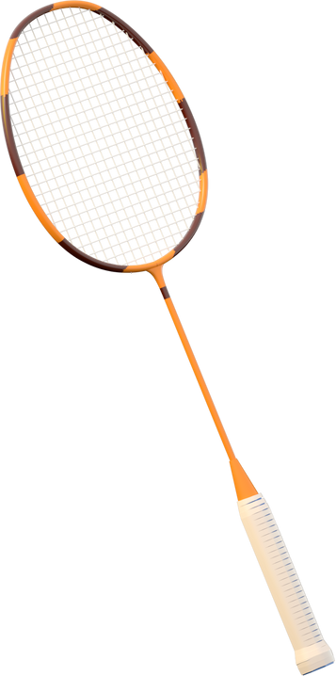
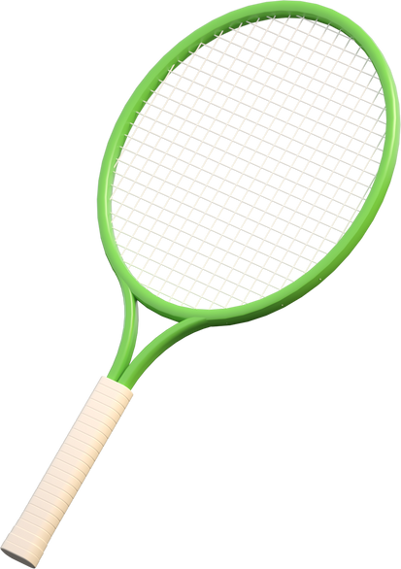




Unit 9
He can run.
Lesson 2

Slide 2



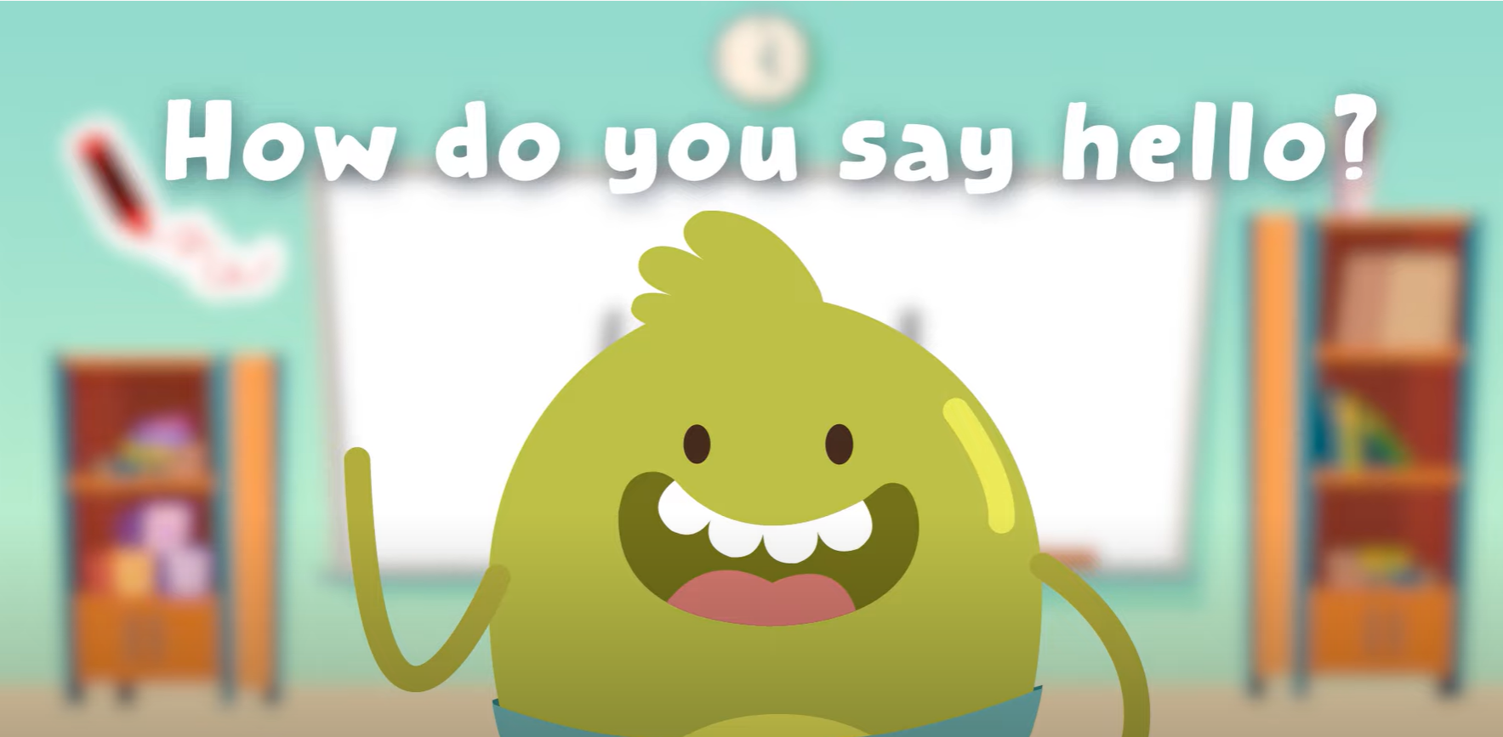




Hello song

Slide 3


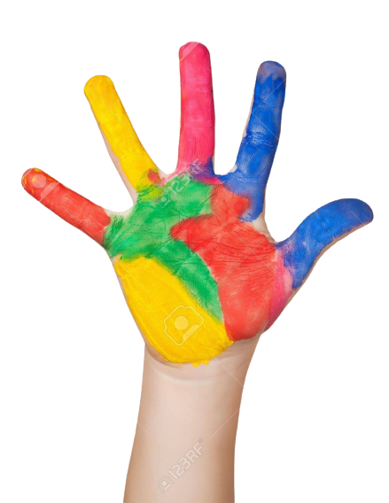



Give me Five

Slide 4


Game
MIMING ACTIONS

Slide 5

Game
MIMING ACTIONS
ride a bike
Notes:
Have one student stand in front of the class.
Show a picture for him or her.
Have student mime the action.
The other students guess and raise their hand to give the answer.

Slide 6
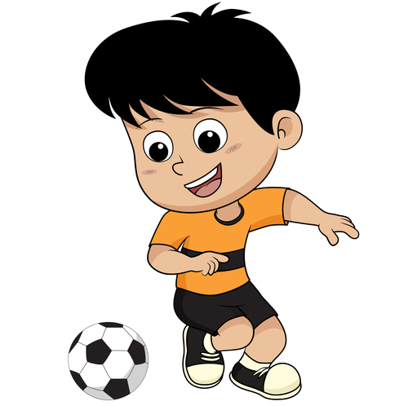
Game
MIMING ACTIONS
play soccer

Slide 7

Game
MIMING ACTIONS
fly

Slide 8

Game
MIMING ACTIONS
run

Slide 9
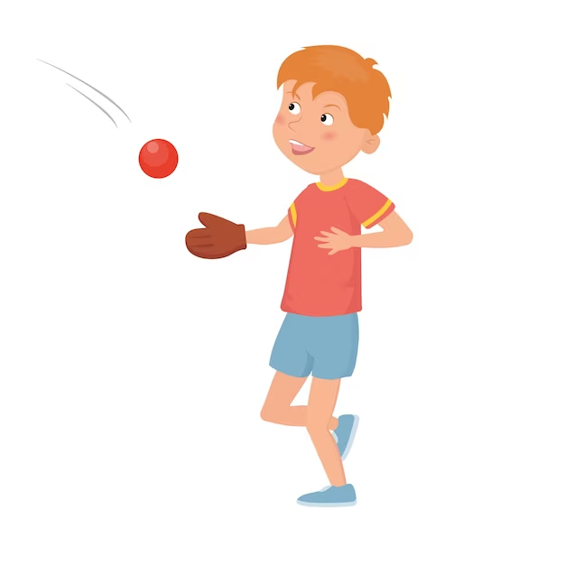
Game
MIMING ACTIONS
catch

Slide 10
Thank you for playing!

Slide 11
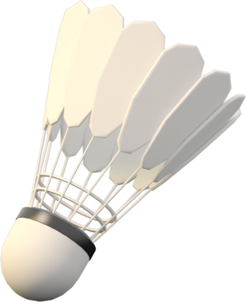
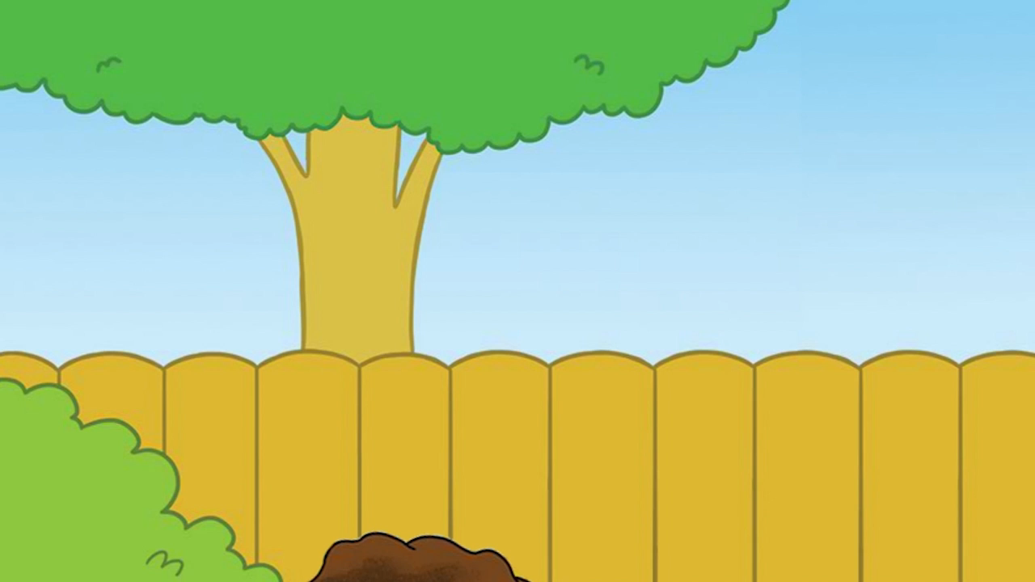
Watch and Say

Slide 12
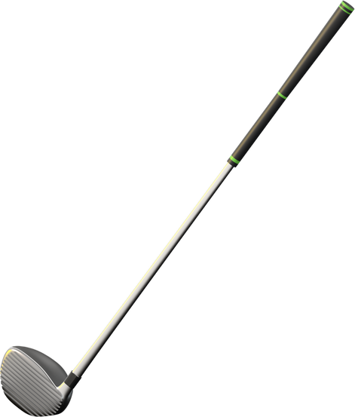



Listen and chant
Notes:
Listen and chant

Slide 13
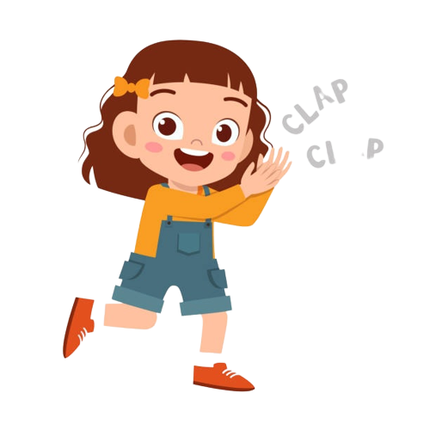
Good job!

Slide 14

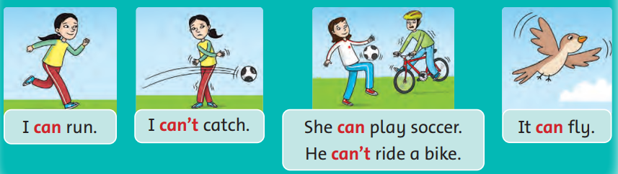

Listen and Point

Slide 15
Listen and Point

Slide 16
Listen and Point

Slide 17
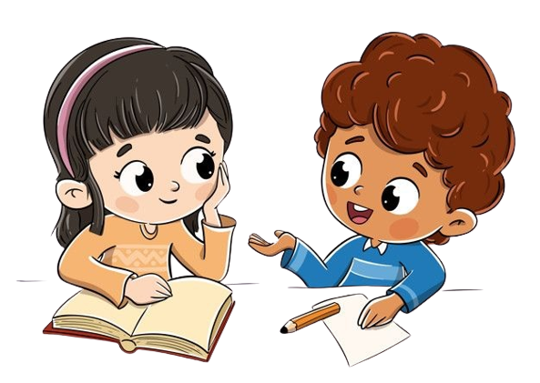
Work in Pairs
Point and Say

Slide 18
Good job!

Slide 19

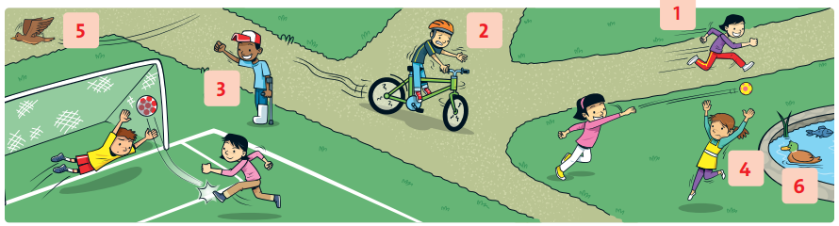
Listen and say Yes or No.
Notes:
Click while listening to the recording.

Slide 20
Work in Pairs
Point and Say

Slide 21
Good job!

Slide 22
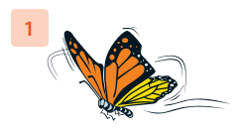
Look and Say
It can fly.

Slide 23
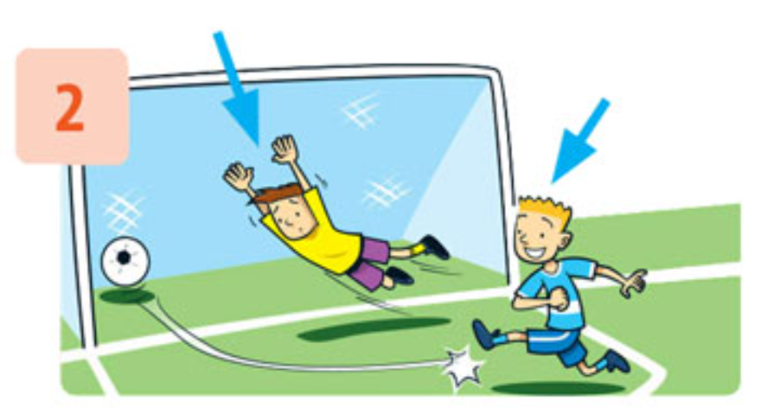
Look and Say
He can’t catch the ball.
He can play soccer.

Slide 24
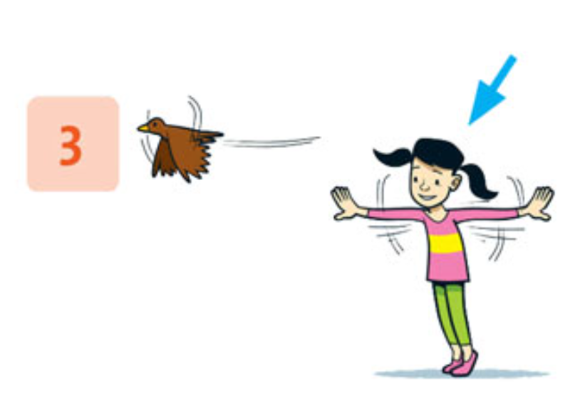
Look and Say
It can fly.
She can’t fly.

Slide 25
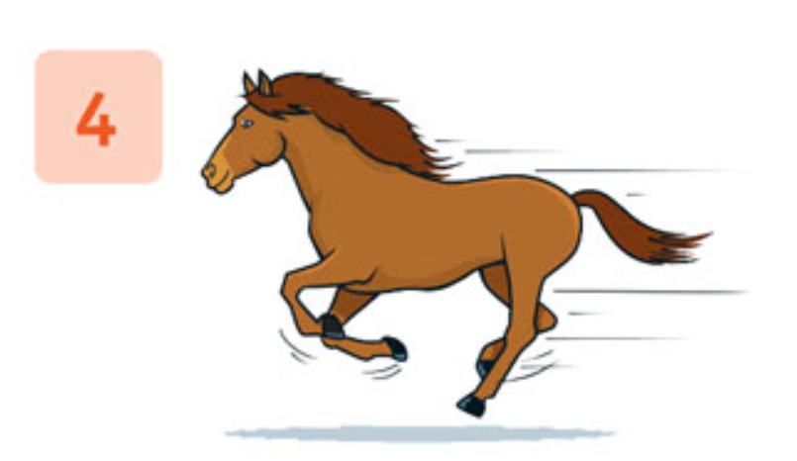
Look and Say
It can fly.

Slide 26
Good job!

Slide 27






Game
LUCKY WINDOWS
NEXT
Notes:
- Click a window to choose.

Slide 28
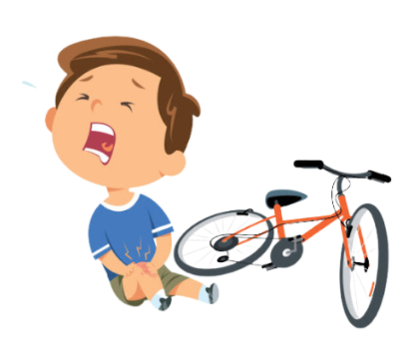
Look and choose
He ________ ride a bike.
can’t
can
can’t
BACK
Notes:
- Click a window to choose.

Slide 29
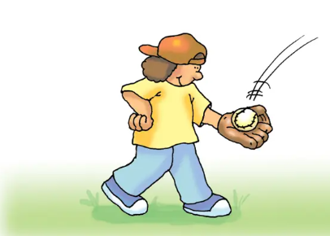
Look and choose
He ________ catch.
can
can
can’t
BACK
Notes:
- Click a window to choose.

Slide 30
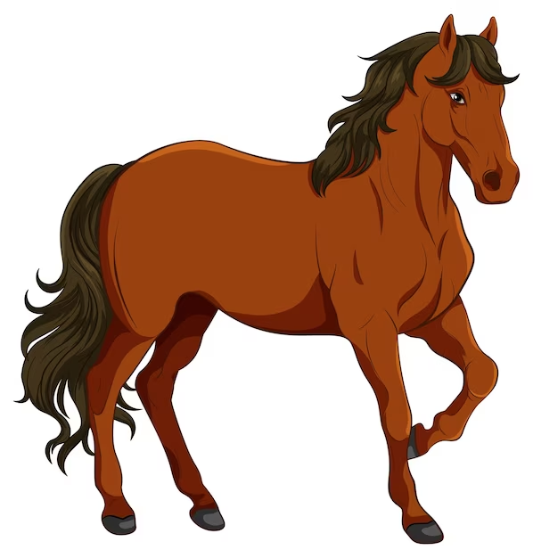
Look and choose
He ________ fly.
can’t
can
can’t
BACK
Notes:
- Click a window to choose.

Slide 31

Look and choose
He ________ run.
can
can
can’t
BACK
Notes:
- Click a window to choose.

Slide 32


BACK
Notes:
- Click a window to choose.

Slide 33
BACK
Notes:
- Click a window to choose.

Slide 34
Thank you for playing!

Slide 35




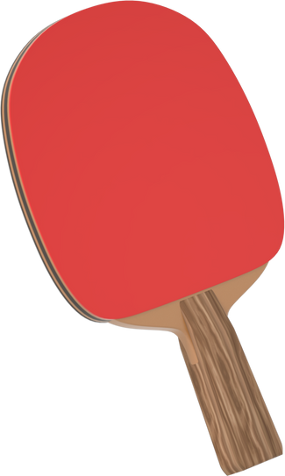
SEE YOU AGAIN!

