Slide 2














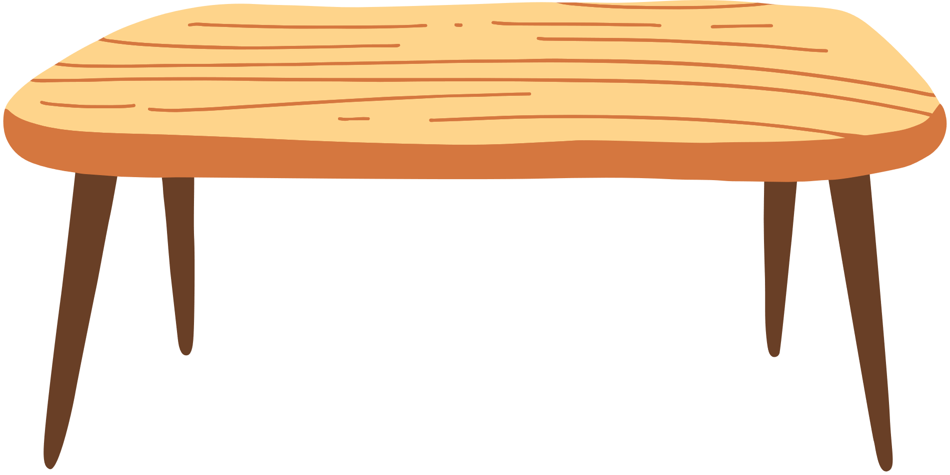
Unit 9
What time is it?
Lesson 2 – Grammar – Period 2

Slide 3
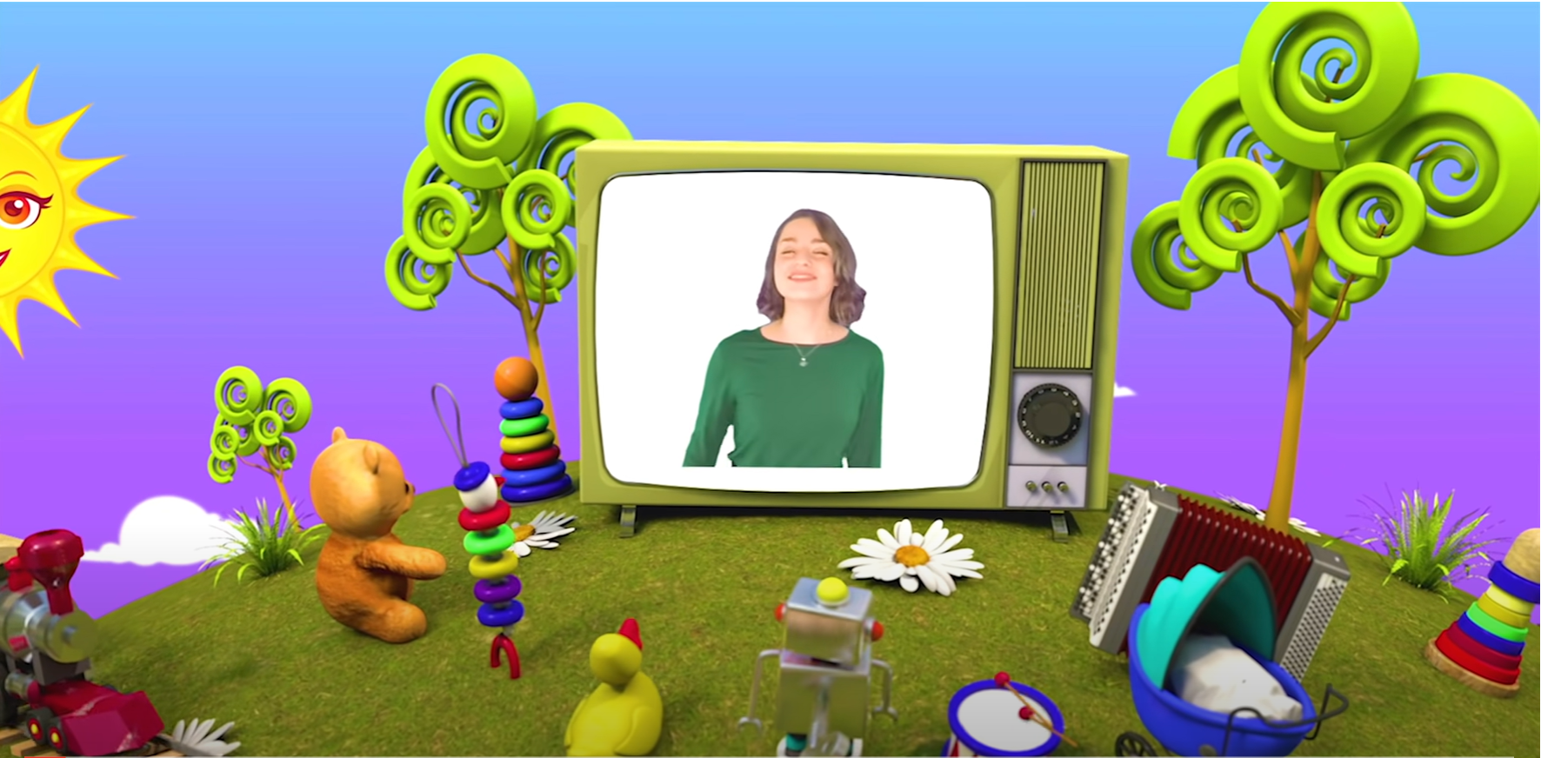

HELLO SONG
Notes:
https://www.youtube.com/watch?v=pqDEwPi7vxg

Slide 4







Slide 5





Game: WHAT TIME IS IT?
12
11
1
10
2
What time is it?
a. It’s eight o’clock.
9
3
b. It’s eleven o’clock.
8
4
c. It’s nine o’clock.
7
5
6
Notes:
Children choose the correct answers.

Slide 6

Game: WHAT TIME IS IT?
12
11
1
The answer is:
10
2
9
3
b. It’s eleven o’clock.
8
4
7
5
6
Notes:
Children choose the correct answers.

Slide 7
Game: WHAT TIME IS IT?
12
11
1
10
2
What time is it?
a. It’s one o’clock.
9
3
b. It’s four o’clock.
c. It’s eight o’clock.
4
8
7
5
6
Notes:
Replace the daily activity phrases in each question and sentence with flashcards to elicit sentences with the same pattern, e.g. What time is it? It’s seven o’clock.

Slide 8
Game: WHAT TIME IS IT?
12
11
1
The answer is:
10
2
9
3
a. It’s one o’clock.
8
4
7
5
6
Notes:
Replace the daily activity phrases in each question and sentence with flashcards to elicit sentences with the same pattern, e.g. What time is it? It’s seven o’clock.

Slide 9

Game: WHAT TIME IS IT?
12
11
1
10
2
What time is it?
a. It’s twleve o’clock.
9
3
b. It’s three o’clock.
c. It’s five o’clock.
4
8
7
5
6
Notes:
Replace the daily activity phrases in each question and sentence with flashcards to elicit sentences with the same pattern, e.g. What time is it? It’s seven o’clock.

Slide 10
Game: WHAT TIME IS IT?
12
11
1
The answer is:
10
2
9
3
c. It’s five o’clock.
8
4
7
5
6
Notes:
Replace the daily activity phrases in each question and sentence with flashcards to elicit sentences with the same pattern, e.g. What time is it? It’s seven o’clock.

Slide 11
Game: WHAT TIME IS IT?
12
11
1
What time is it?
10
2
a. It’s ten o’clock.
9
3
b. It’s eleven o’clock.
c. It’s nine o’clock.
8
4
7
5
6
Notes:
Replace the daily activity phrases in each question and sentence with flashcards to elicit sentences with the same pattern, e.g. What time is it? It’s seven o’clock.

Slide 12
Game: WHAT TIME IS IT?
12
11
1
The answer is:
10
2
a. It’s ten o’clock.
9
3
8
4
7
5
6
Notes:
Replace the daily activity phrases in each question and sentence with flashcards to elicit sentences with the same pattern, e.g. What time is it? It’s seven o’clock.

Slide 13
Game: WHAT TIME IS IT?
12
11
1
10
2
What time is it?
a. It’s six o’clock.
9
3
b. It’s four o’clock.
c. It’s three o’clock.
8
4
7
5
6
Notes:
Replace the daily activity phrases in each question and sentence with flashcards to elicit sentences with the same pattern, e.g. What time is it? It’s seven o’clock.

Slide 14
Game: WHAT TIME IS IT?
12
11
1
The answer is:
10
2
9
3
c. It’s three o’clock.
8
4
7
5
6
Notes:
Replace the daily activity phrases in each question and sentence with flashcards to elicit sentences with the same pattern, e.g. What time is it? It’s seven o’clock.

Slide 15
Game: WHAT TIME IS IT?
12
11
1
10
2
What time is it?
a. It’s eight o’clock.
9
3
b. It’s eleven o’clock.
c. It’s nine o’clock.
8
4
7
5
6
Notes:
Replace the daily activity phrases in each question and sentence with flashcards to elicit sentences with the same pattern, e.g. What time is it? It’s seven o’clock.

Slide 16
Game: WHAT TIME IS IT?
12
11
1
The answer is:
10
2
9
3
a. It’s eight o’clock.
8
4
7
5
6
Notes:
Replace the daily activity phrases in each question and sentence with flashcards to elicit sentences with the same pattern, e.g. What time is it? It’s seven o’clock.

Slide 17

Game: MINGLE!
Notes:
* Mingle
Ask children to draw a clock face on their mini board with the big hand to 12 and the little hand to any number on the clock.
Play music, children move around to ask and answer about the time and what they do at these times of the day.

Slide 18

Good job!

Slide 19

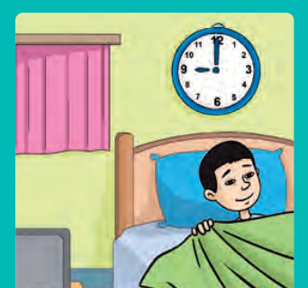

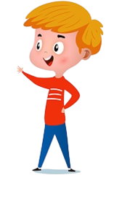
Look and Say.
What time does he go to bed?
He goes to bed at nine o’clock in the evening.
Notes:
* Listen and say. Track 108
Focus on Let’s learn! box. Ask What can you see?
Play the recording, pausing after each question and sentence for children to point to the picture and repeat.
Write the questions and sentences on the board. Play the recording again, miming the actions in the pictures.

Slide 20
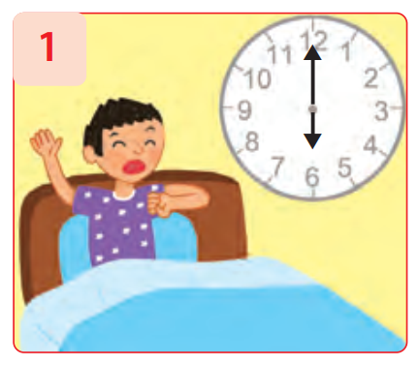
Ask and Answer.
What time does he get up?
He gets up at six o’clock in the morning.
Notes:
Replace the daily activity phrases in each question and sentence with flashcards to elicit sentences with the same pattern, e.g. What time does he get up? He gets up at six o’clock.

Slide 21
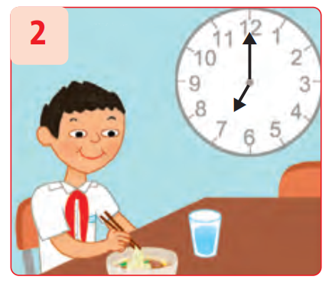
Ask and Answer.
What time does he have breakfast?
He has breakfast at seven o’clock in the morning.
Notes:
Replace the daily activity phrases in each question and sentence with flashcards to elicit sentences with the same pattern, e.g. What time does he get up? He gets up at six o’clock.

Slide 22
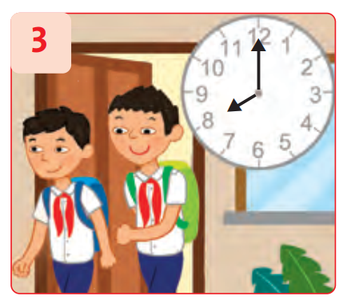
Ask and Answer.
What time do they go to school?
They go to school at eight o’clock in the morning.
Notes:
Replace the daily activity phrases in each question and sentence with flashcards to elicit sentences with the same pattern, e.g. What time does he get up? He gets up at six o’clock.

Slide 23
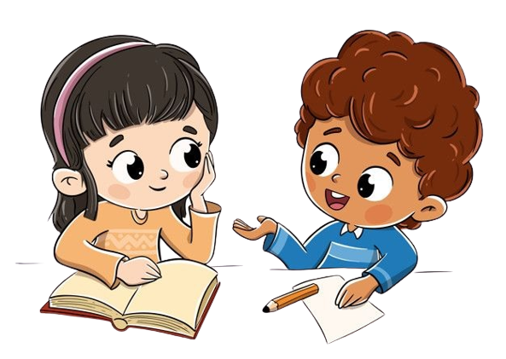
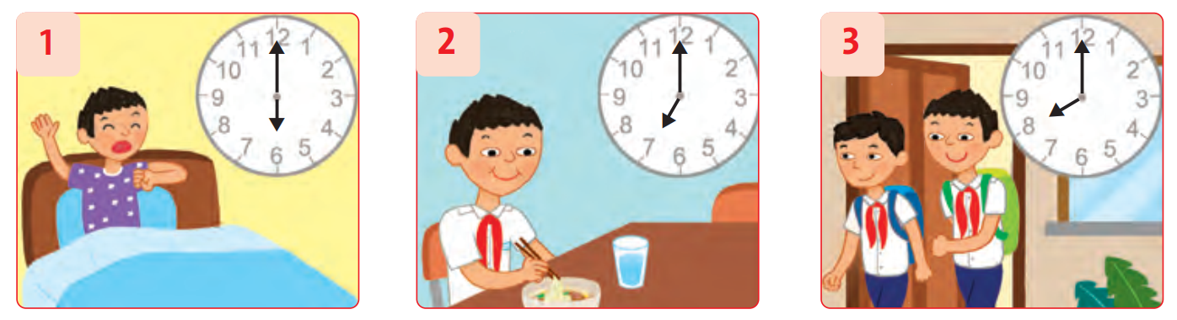
Work in Pairs
Ask and Answer the questions.
Notes:
Children work in pairs to ask and answer the questions.

Slide 24

Let’s write!
gets up
He ________ at six o’clock in the morning.
Notes:
* Write.
Ask children to identify the everyday activities and times.
Allow time for children to write the complete sentences in their notebooks.

Slide 25
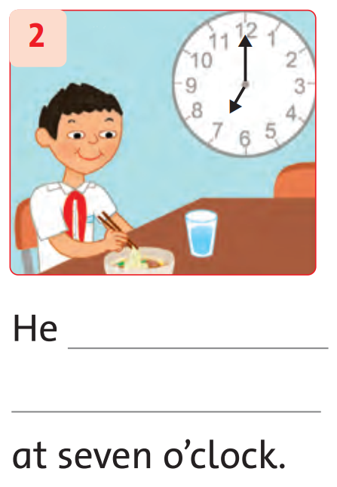
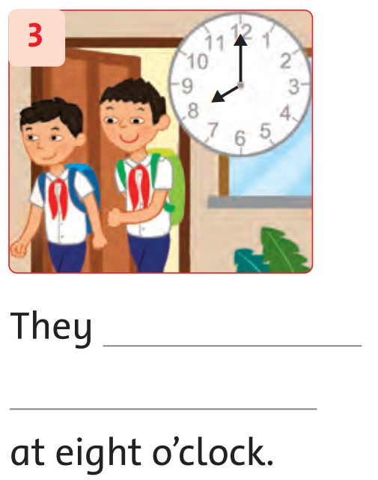
Let’s write!
Notes:
* Write.
Ask children to identify the everyday activities and times.
Allow time for children to write the complete sentences in their notebooks.

Slide 26
Let’s check!
He ______________ at seven o’clock.
has breakfast
Notes:
* Write.
Ask children to identify the everyday activities and times.
Allow time for children to write the complete sentences in their notebooks.

Slide 27
Let’s check!
They ______________ at eight o’clock.
go to school
Notes:
* Write.
Ask children to identify the everyday activities and times.
Allow time for children to write the complete sentences in their notebooks.

Slide 28
Good job!

Slide 29


DAILY ROUTINES
Time Quiz

Slide 30

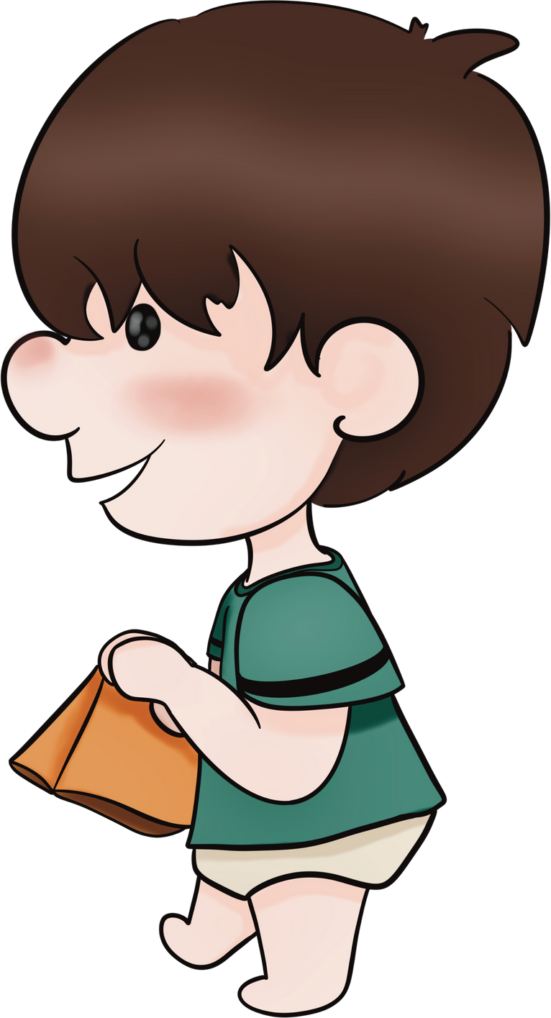
INSTRUCTIONS
Pupils answer questions about the time of John's daily activities.
The student with the most correct answers wins the game!

Slide 31
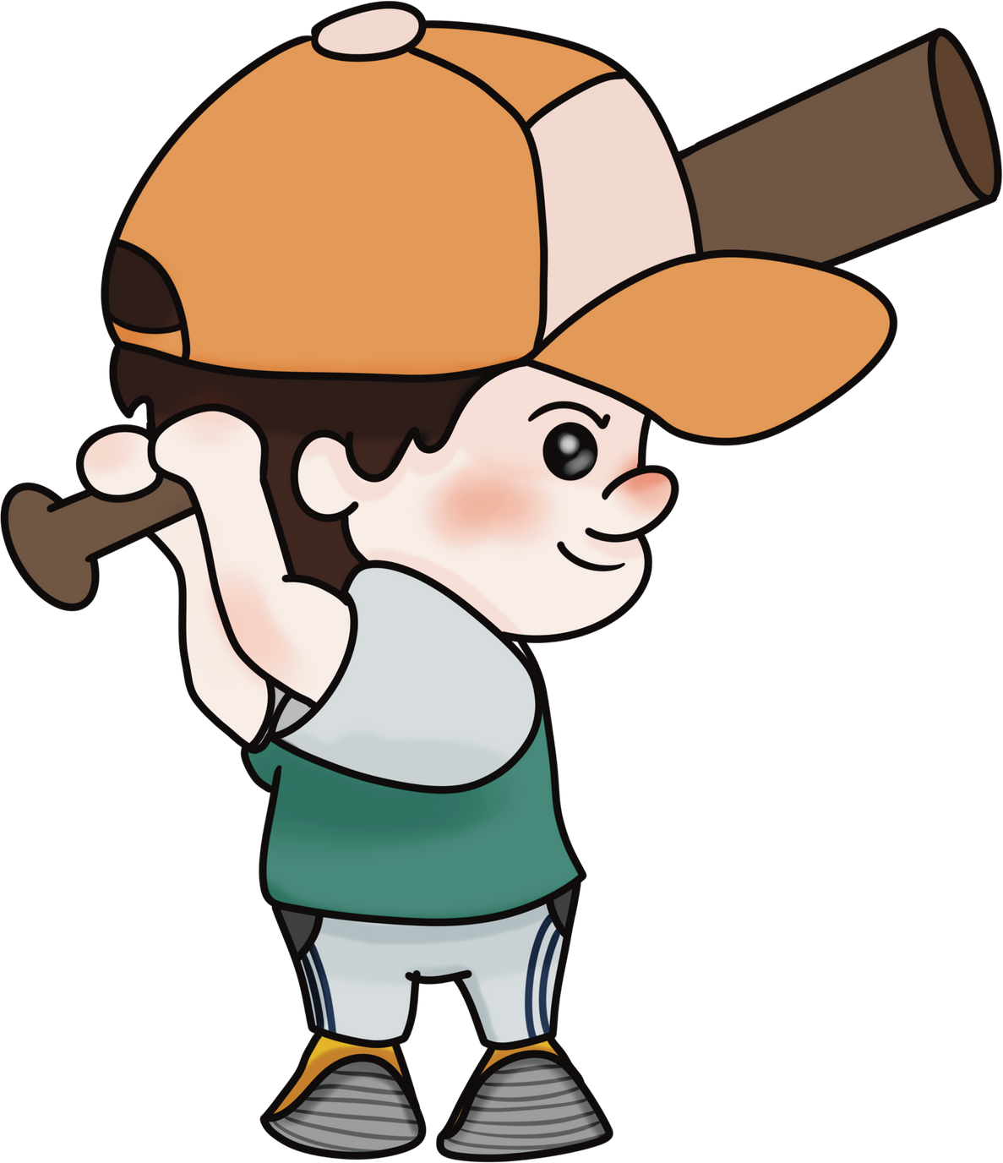
ARE YOU READY?

Slide 32


QUESTION 1
What time does he
brush his teeth?
at 8 o'clock
at 7 o'clock
at 9 o'clock

Slide 33

ANSWER
He brushes his teeth ...
at 8 o'clock
at 7 o'clock
7:00
at 9 o'clock

Slide 34


QUESTION 2
What time does he
have lunch?
at 1 o'clock
at 2 o'clock
at 4 o'clock

Slide 35
ANSWER
He has lunch ...
at 1 o'clock
at 2 o'clock
1:00
at 4 o'clock

Slide 36

QUESTION 3
Does he play baseball
at 4 o'clock?
True
False

Slide 37
ANSWER
He plays baseball
at 3 o'clock.
True
3:00
False

Slide 38
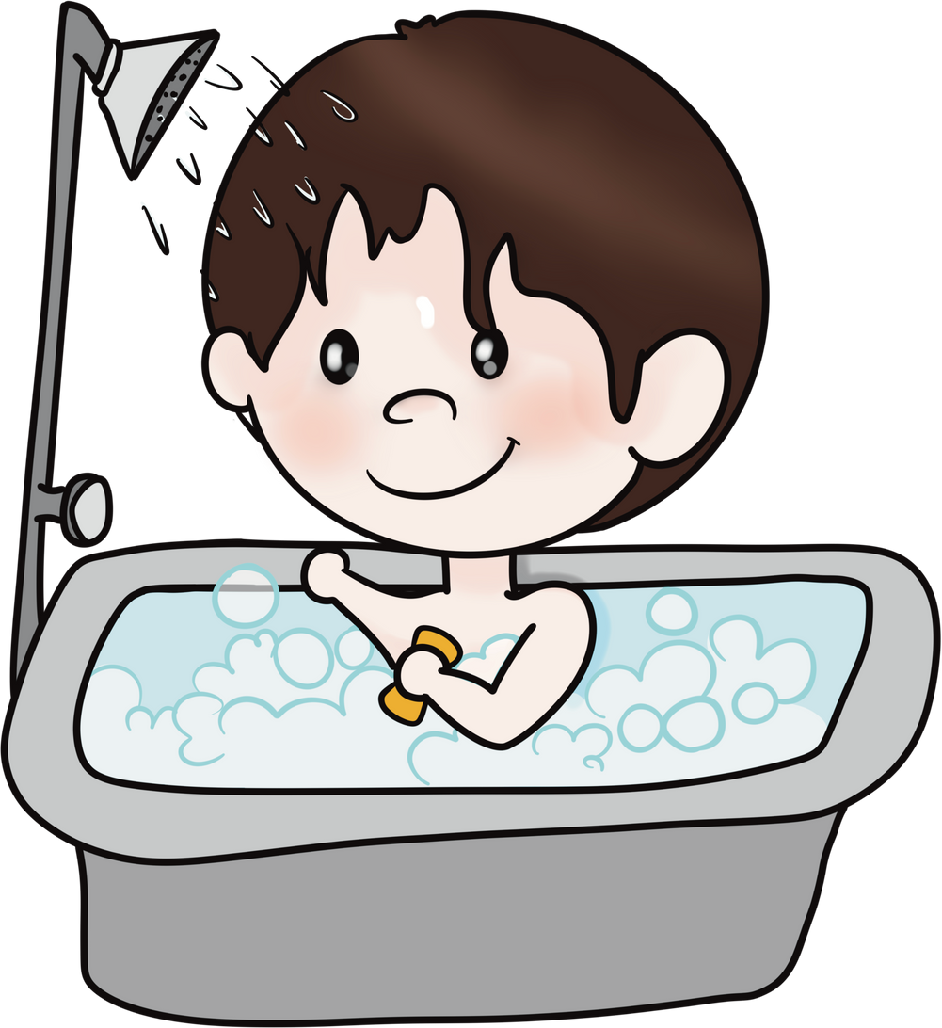

QUESTION 4
What time does he
take a bath?
at 8 o'clock
at 7 o'clock

Slide 39
ANSWER
8:00
He takes a bath ...
at 8 o'clock
at 7 o'clock

Slide 40
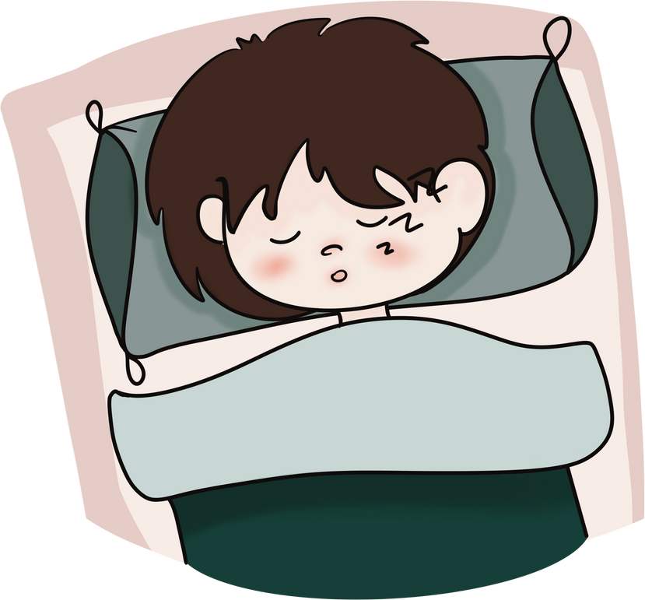

QUESTION 5
What time does he
go to bed?
at 10 o'clock
at 9 o'clock

Slide 41
ANSWER
9:00
He goes to bed...
at 10 o'clock
at 9 o'clock

Slide 42

GREAT JOB!

Slide 43


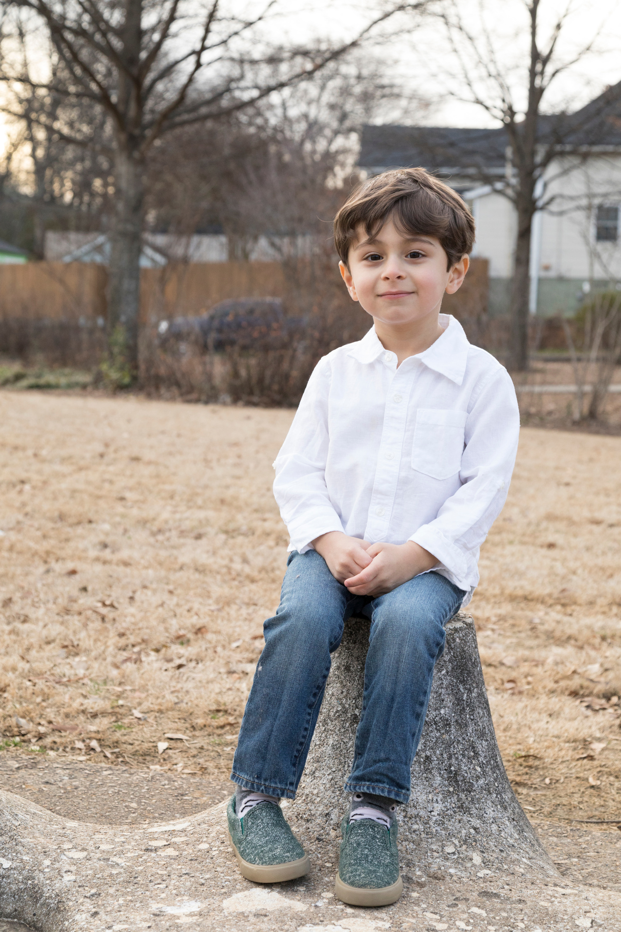
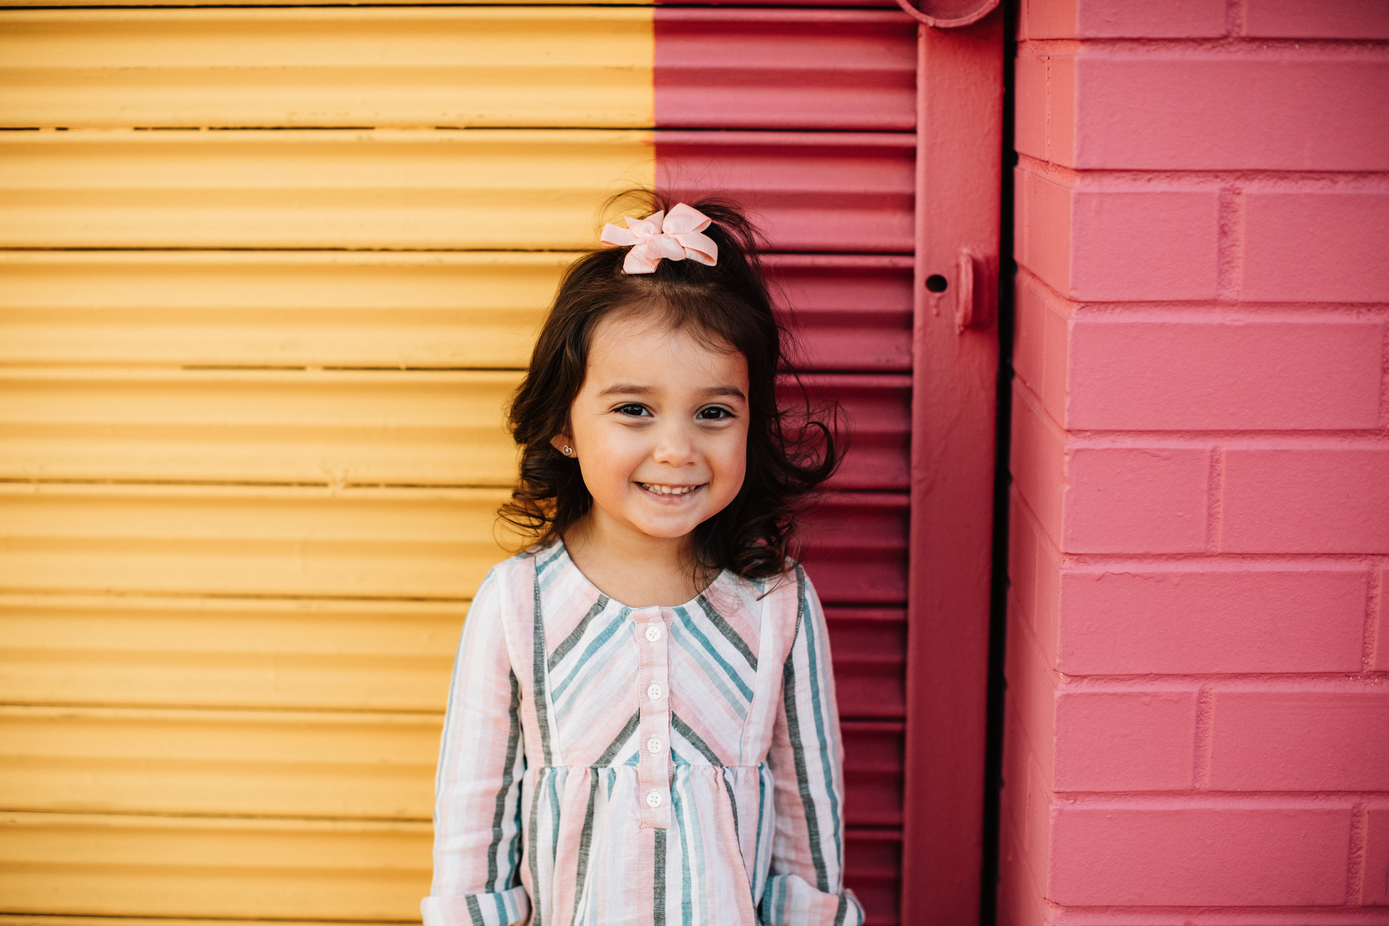

Our Winners!
Peter
Eric
Julie
Notes:
Replace photos and names with your students’ information.

Slide 44


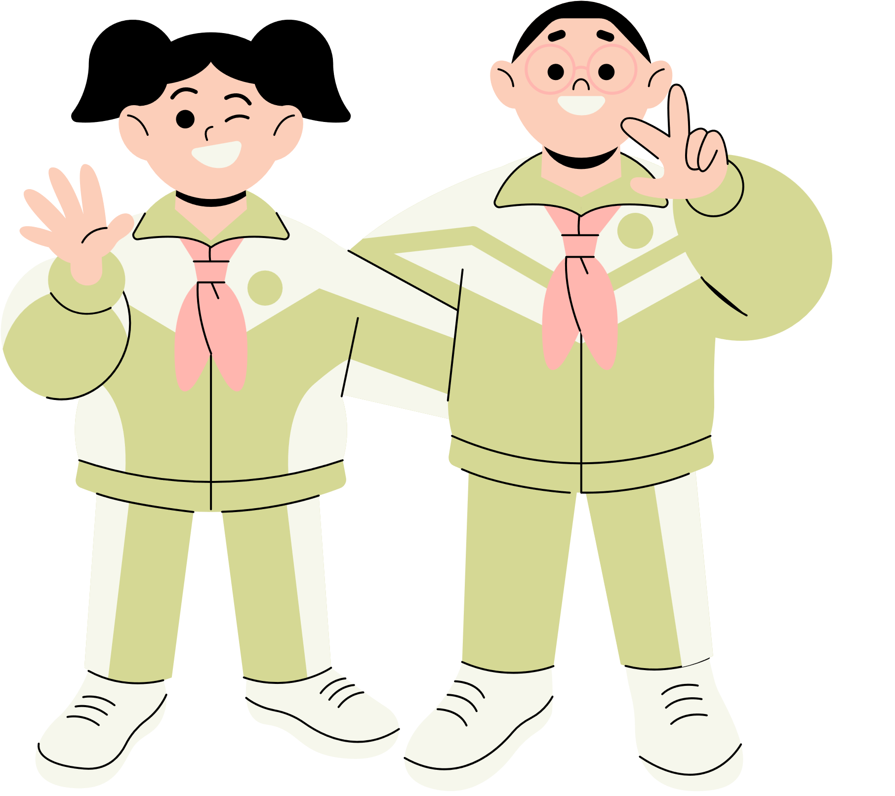





Thank You!
See You Next Time!
Notes:
https://www.youtube.com/watch?v=SRyFiVeNjWs

